Slide 1
사내교육용

Slide 3
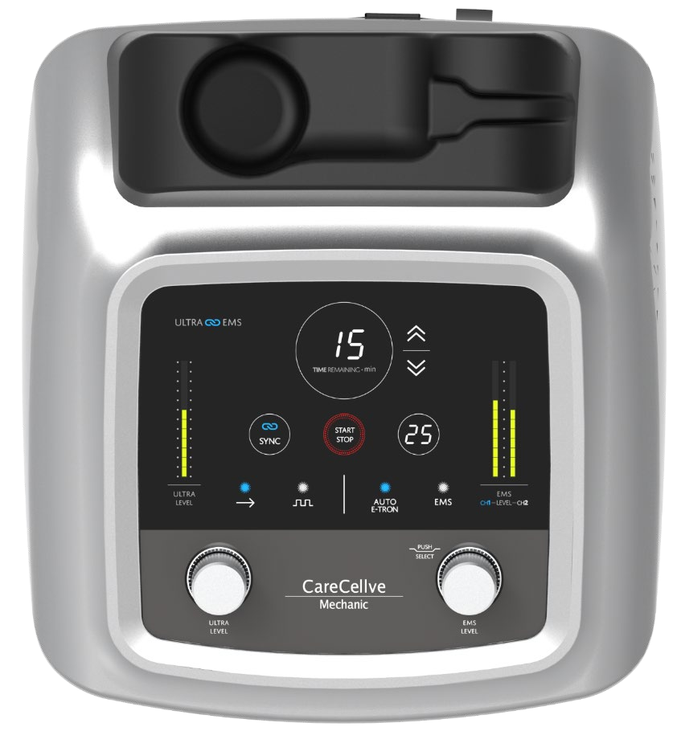
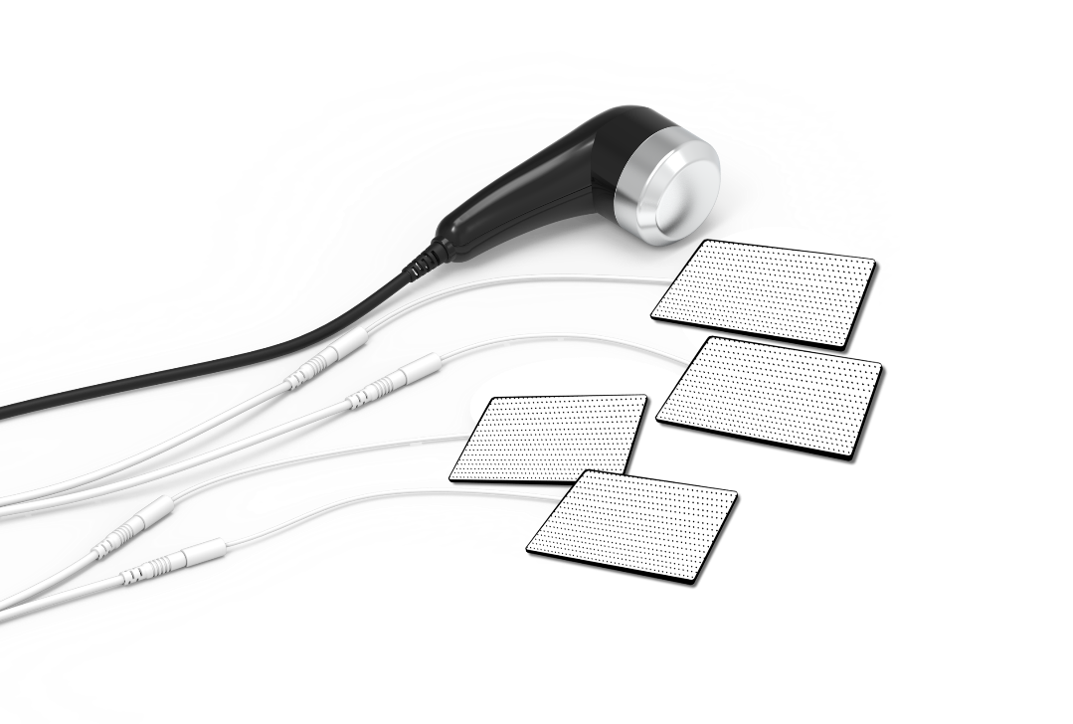
01. Point
Seven Main Points
Point 1
Dual-functional device: Ultrasonic and low frequency.
Point 2
Three care options: Skin care, body shape management, and pain care.
Point 3
Three different low-frequency functions.
TENS (Pain relief)
EMS (Muscle rehabilitation)
E-Tron (Patented technological system used to relieve pain such as
chronic pain or sports injury.)
Point 4
The 1.2MHz and 11W high-power ultrasonic waves help take
care of the skin and pain
Point 5
The application of Smart Sensing technology secures the manufacture
of extracorporeal shock wave therapy devices.
Point 6
Equipped with a sync function.
Simultaneous output of ultrasonic waves and low frequency (TENS) from the ultrasonic handle upon activating the sync function.
Point 7
One-touch start and overcurrent blocking.

Slide 4
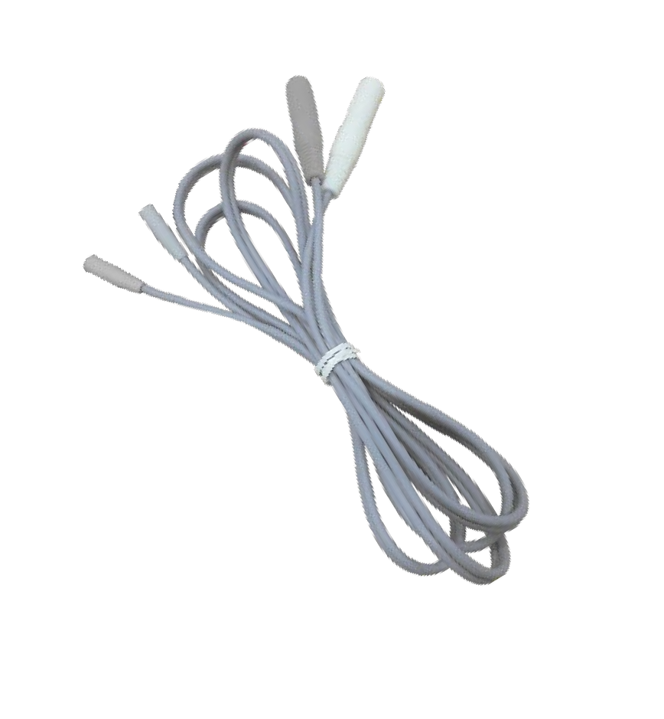
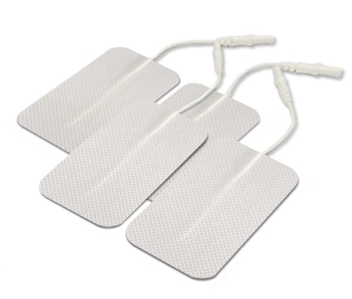
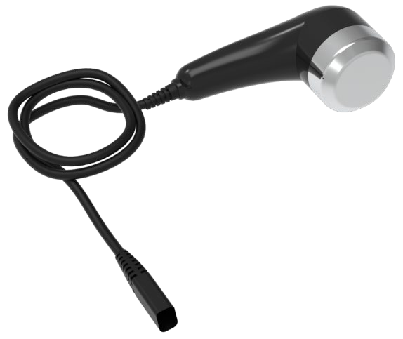
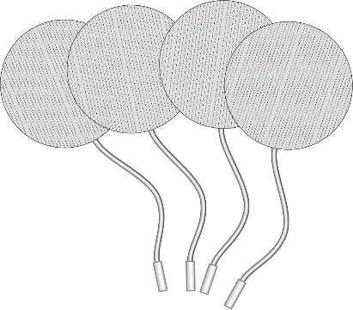
02. Product Introduction
Product Specifications
Products
Product Name: CareCellve Mechanic
Ultrasound Frequency: 1.2MHz
Electric Voltage/Rated Frequency: AC 220V / 60Hz
Power Consumption: 80W
Basic Output Waveform: Pulse Waves
E-Tron Frequency Range: Low (1,000-1,255 Hz), High (1,000-1,480 Hz)
EMS Frequency Range: 3-50Hz
Auto Frequency Range: 1-89Hz, 2-100Hz, 11-100Hz
Dimensions: 293mm (W) x 325mm (D) x 146mm (H) / 2.6kg [11.54 in. (W) x 12.80 in. (D) x 5.75 in. (H) / 5.73 lbs.]

Slide 5
03. . Product Features
Ultrasonic Skin Care
Ultrasonic Skin Care
Pain Management (TENS/EMS/E-TRON)
+
+
Simultaneous Use of All Three Functions

Slide 6
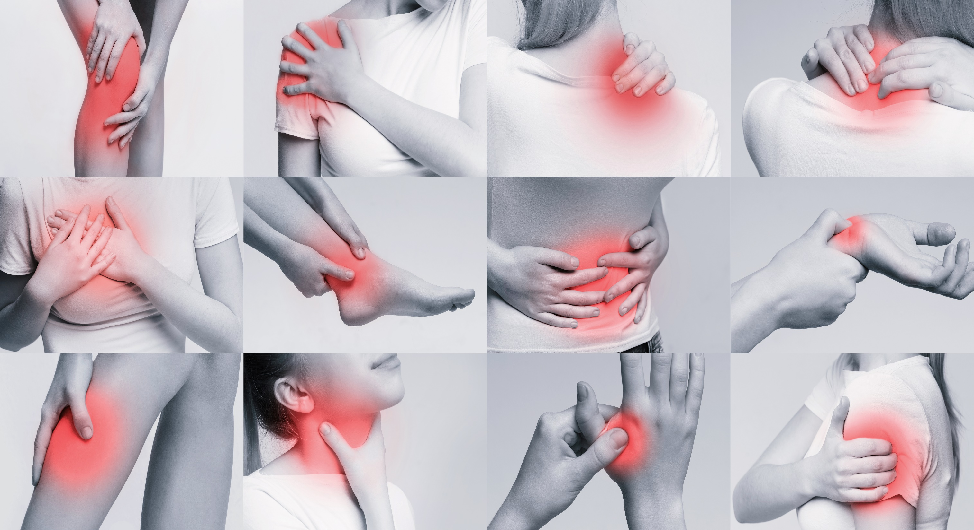
Comfortably take care of your pain!

Slide 7






















03. Product Features
Market Size
Number of Patients with Musculoskeletal and Connective Tissue Diseases
(Source: Health Insurance Review and Assessment Service) (Unit: People)
Elderly Population Age 65 and Older
(Source: Statistics Korea) (Unit: 10,000 People)
(단위 : 만명)
(단위 : 명)
(단위 : 만명)
(단위 : 명)
738
775
820
1000
1900
14,344,792
15,121,173
15,869,748
16,831,638
17,761,043
2018 2019 2020 2024 2049
2011 2013 2015 2017 2019
The number of patients suffering from pain will increase as the age of the population continues to rise.
---------------------------------------------------------------
.
The number of patients with musculoskeletal pain treated in orthopedics, rehabilitation medicine, and anesthesiology is increasing by roughly 420,000 every year, which has led to an increase in pain clinics..
(Source : http://www.medicaltimes.com/Users/News/NewsView.html?ID=1144536)

Slide 8
03. Product Features
Pain Treatment Therapy
Ultrasound Stimulator
Deep Thermal Stimulator, M/W, High Frequency, Magnetic Field
Pain Management
Painless Signal Therapy Devices
Orthopedic Traction Devices
Hot Cold pack / IR
Heat and Cold Therapy
TENS / ICT
Low Frequency, Interference Wave Stimulator
Laser Light Irradiator
(Low Power/High Intensity Laser)
Typical
Conservative
Therapy
(Physical Therapy)

Slide 9

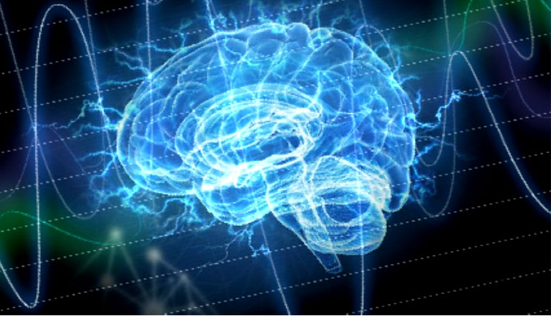
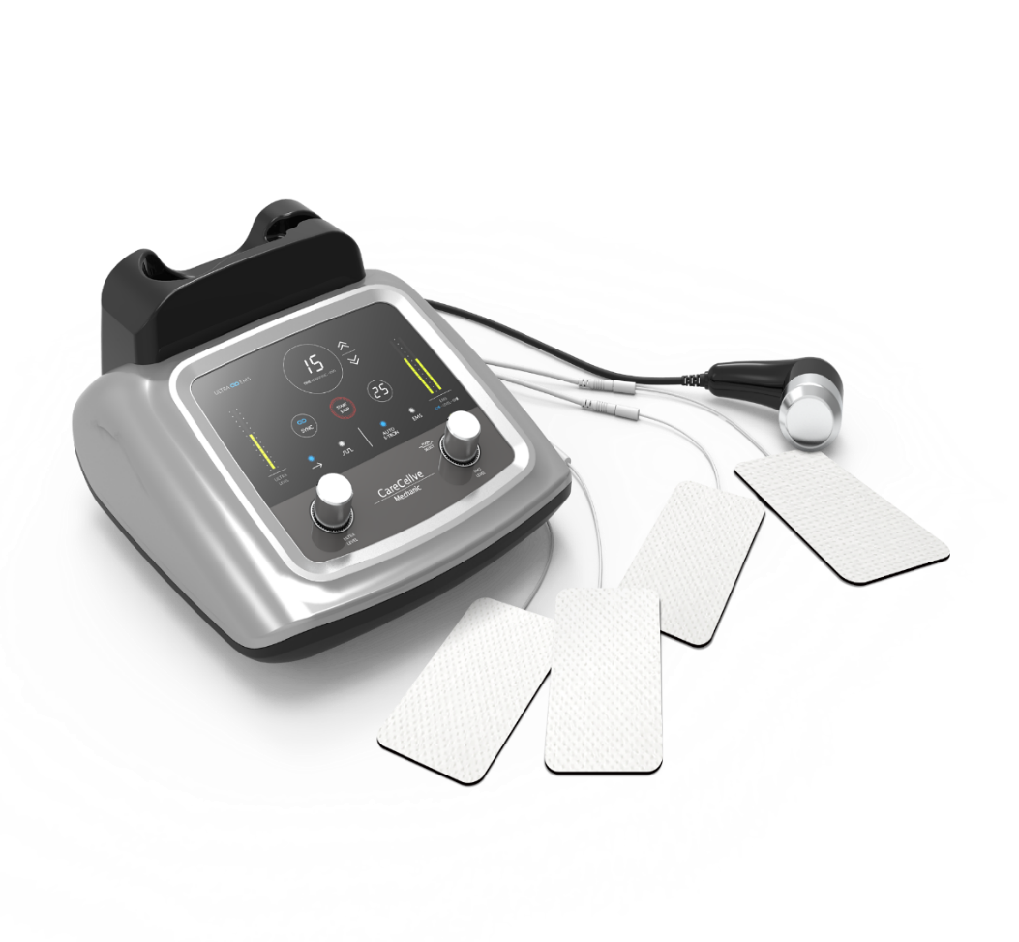
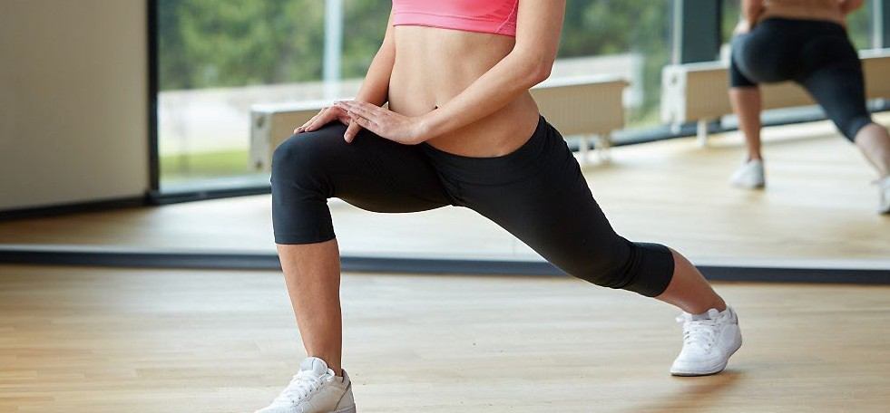
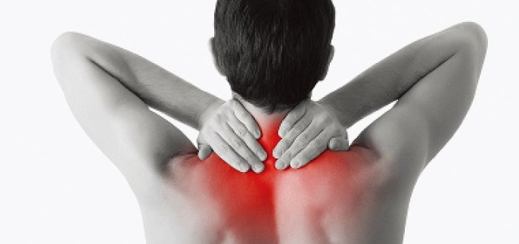
03.Product Features
Pain Management
The generation of E-tron waves actively stimulates the lesions of acute and chronic pain in a more stable manner.
The E-tron electrode mode attached to the usage area helps transmit the electrical pain disturbance signal to a wider range as painless nerve information helps relieve pain.
ULTRASOUND
It helps relieve pain such as acute and chronic inflammation caused by musculoskeletal disorders. It promotes sterile joint healing and tissue relaxation from myofascial pain syndrome.
LF
Transcutaneous nerve stimulation helps the muscles in the impacted area relax to help relieve pain.

Slide 10
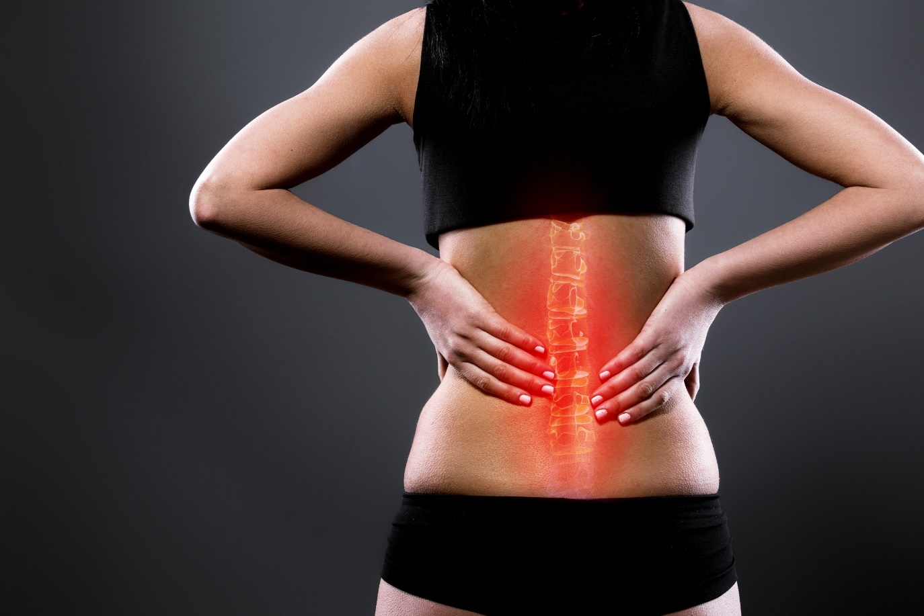
03. Product Features
Pain Management
Pain
An irritating or unpleasant sensation indicating possible or actual damage.
Types of Pain
Chronic/acute pain, neuropathic pain, complex regional pain syndrome, nociceptive pain, etc.

Slide 11
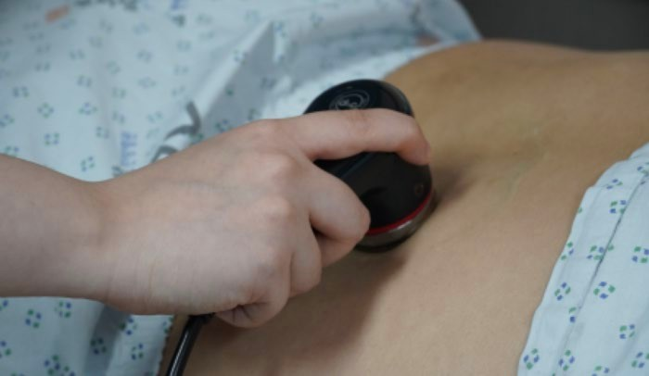
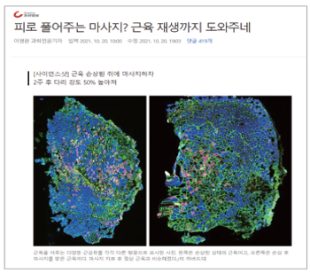
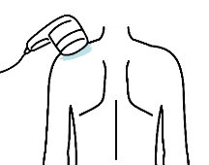

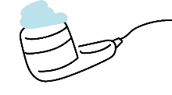
03.Product Features
Pain Management
01
Pain Care System: Ultrasound
Ultrasound Stimulator
A representative form of deep heat stimulation therapy. Basic 0.8-1MHz ultrasonic electrical energy is converted into physical energy to generate deep heat and vibrations. The heat raises the temperature of human tissue to help circulate blood and metabolism, thereby relieving pain.
It is used in various ways depending on the purpose such as relieving pain and/or inflammation for those suffering from musculoskeletal disorders.
How To Use
Key Point
#Frictional movement of affected cells relaxes muscles.
# Thermal and non-thermal effects help increase blood and lymph circulation and expel toxins.
# Increases body temperature.
# Intensive administration to the impacted area relieves pain.
# Regenerates cartilage and activates cells.
# Relieves inflammation.
# Breaks down fat.
Apply the gel.
Attach the device to the area of use, then turn it on.
Roll the device around the impacted area.

Slide 12
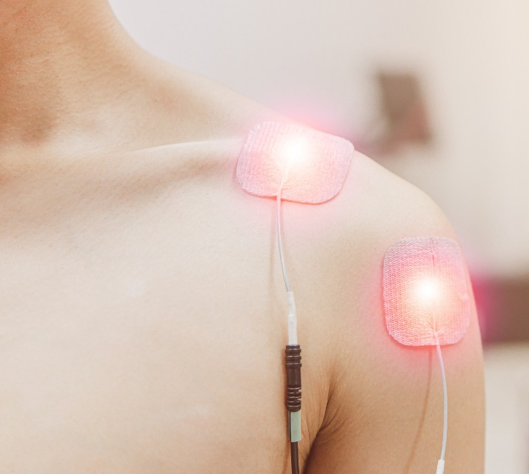
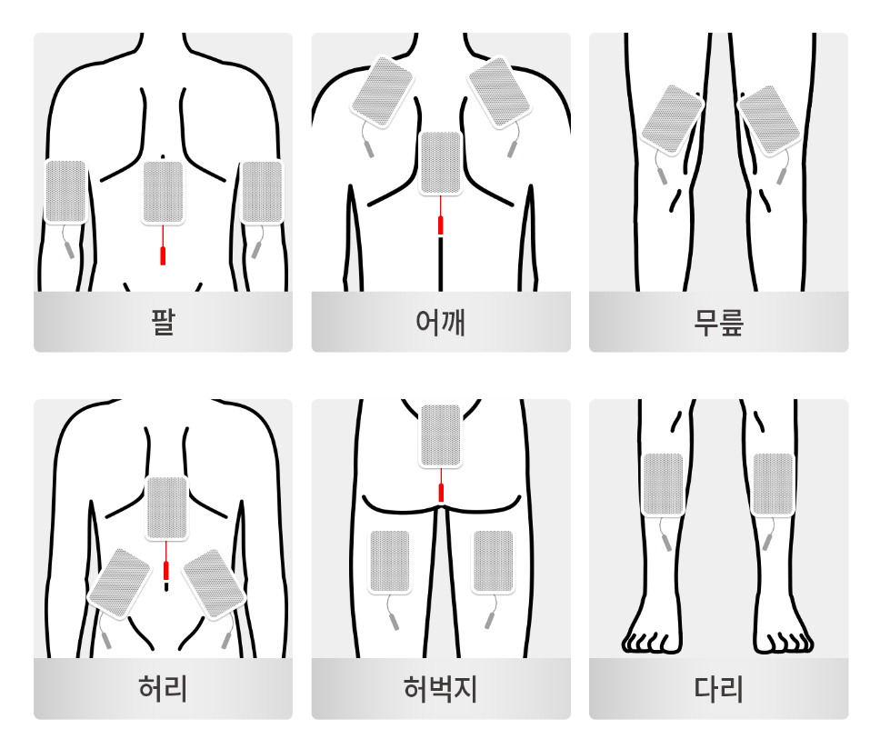
03. Product Features
Pain Management
02
Pain Care System: Low Frequency
Low Frequency Stimulator_ TENS
( Transcutaneous electirical nerve stimulation)
Transcutaneous Electrical Nerve Stimulation (TENS) is a representative form of basic physical therapy.
“Low frequency” refers to waves that have a frequency of 10 kHz or less. Low-frequency signals stimulate the nerves in the impacted area while various mechanisms such as gate control theory work together to help relieve pain. It can be used for minor pain relief, relaxing tight muscles, and limb rehabilitation management.
Effects
Increases cell growth and movement.
Decomposes faT
Relieves swelling.
Stimulates bundled or damaged nerves and muscles
around the impacted area.
Electric stimulation muscle exercise helps strengthen muscles.
Recovers nerve and muscle functions
As effective as working out.
How To Use
Arms Shoulders Knees Waist Thighs Legs

Slide 13
03. Product Features
Ultrasound/Low Frequency Comparison
Effects | 초음파(Ultrasound) | 저주파(low)
Relieves Pain
Activates the Regeneration of Cartilage in Cells
Relieves Inflammation
Increases Lymphatic Circulation, Expels Toxins
Increases Blood Circulation, Improves Metabolism
Stimulates Nerves
Relaxes and Strengthens Muscles (*Excluded.) | *근력 강화 제외
Lipolysis

Slide 14
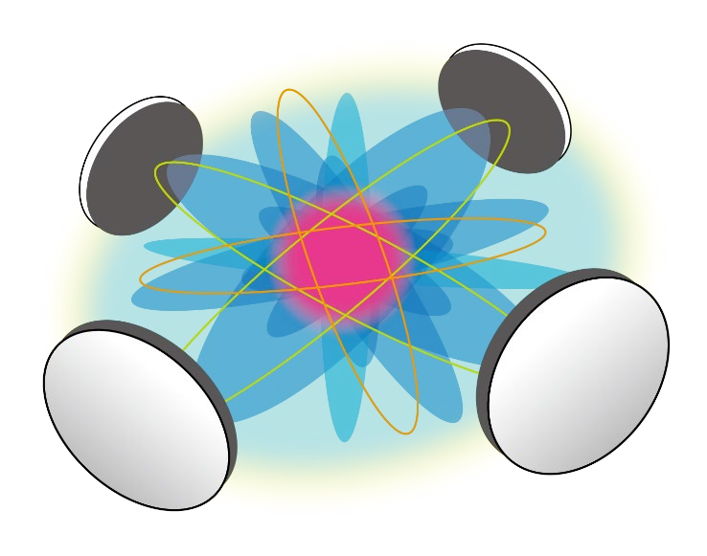
03. Product Features
Pain Management
03
Pain Care System: E-TroneTRON
E TRON
A new form of pain management that helps relieve pain by using painless signal therapy to disturb signals in the impacted area through various forms of electrical stimuli of E-tron waveforms
It helps relieve acute or chronic inflammation caused by musculoskeletal disorders, sports injury, or postoperative pain.

Slide 15

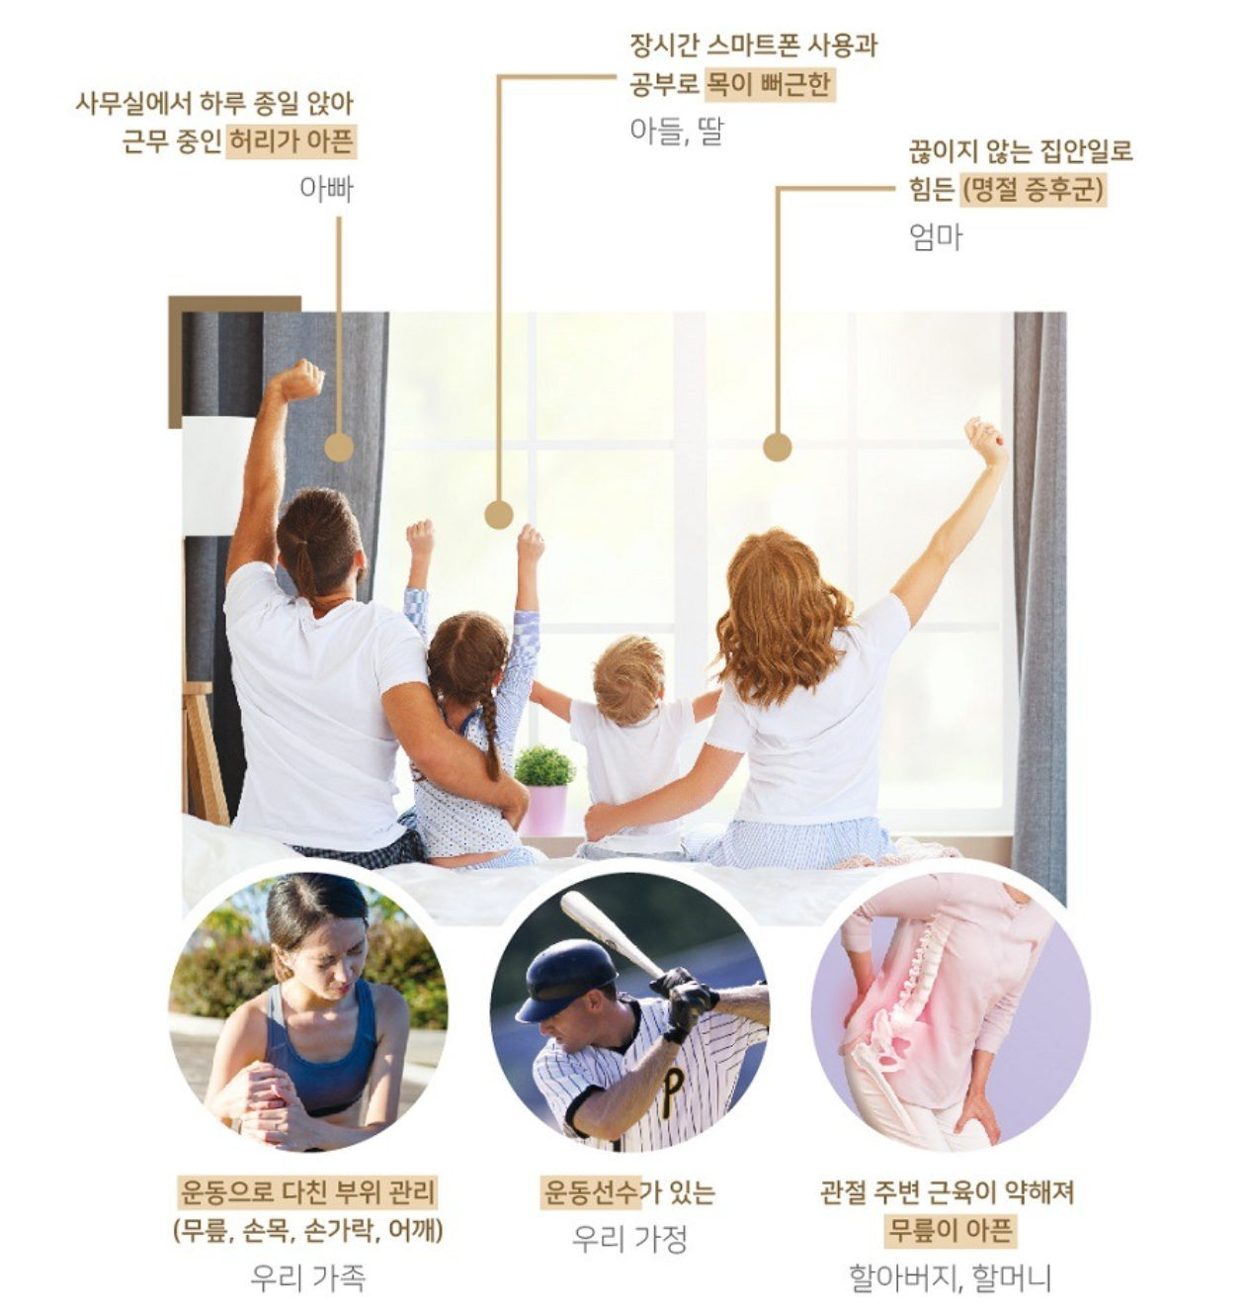

03. Product Features
Recommended For
Sons and daughters with stiff necks from studying and using smartphones for long periods of time.
Fathers who have sore backs from sitting at the office all day.
Mothers who struggle with constant housework.
We recommend the device for the following people!
Those who are suffering from pain.
Those who need medical devices that
are not as painful to use.
Those looking for a gift for their parents.
Those who need easy pain management
anytime, anywhere. (Limited to places
with a power supply.).
Those who need care after intense sports
or leisure activities such as golf, mountain
climbing, or cycling.
Those who have pain in various parts of
the body even with less activity than usual
(knees, shoulders, etc.).
Those who want to manage their pain.
Those looking for a device that can provide care for different injuries for the entire family (knee, wrist, finger, shoulder).
Those who have athletes in the family.
Grandfathers and grandmothers who suffer from knee pain due to weakened muscles around the joints.
Those who have been advised by a doctor
to find a form of at-home pain management.

Slide 16
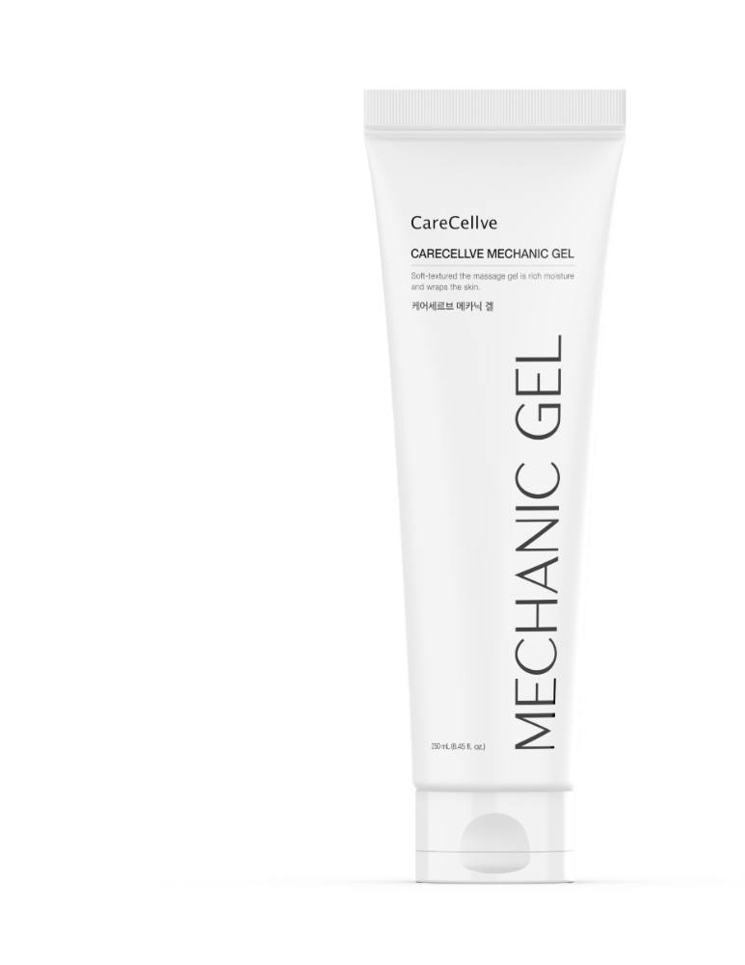
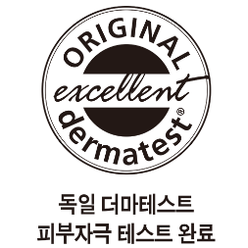
03. Product Features
Function Description
What is Sensing Technology?
Sensing Technology is CareCellve Mechanic’s proprietary technology that prevents overheating and burns by stopping the device when the gel does not reach the ultrasonic vibrator.

Slide 17
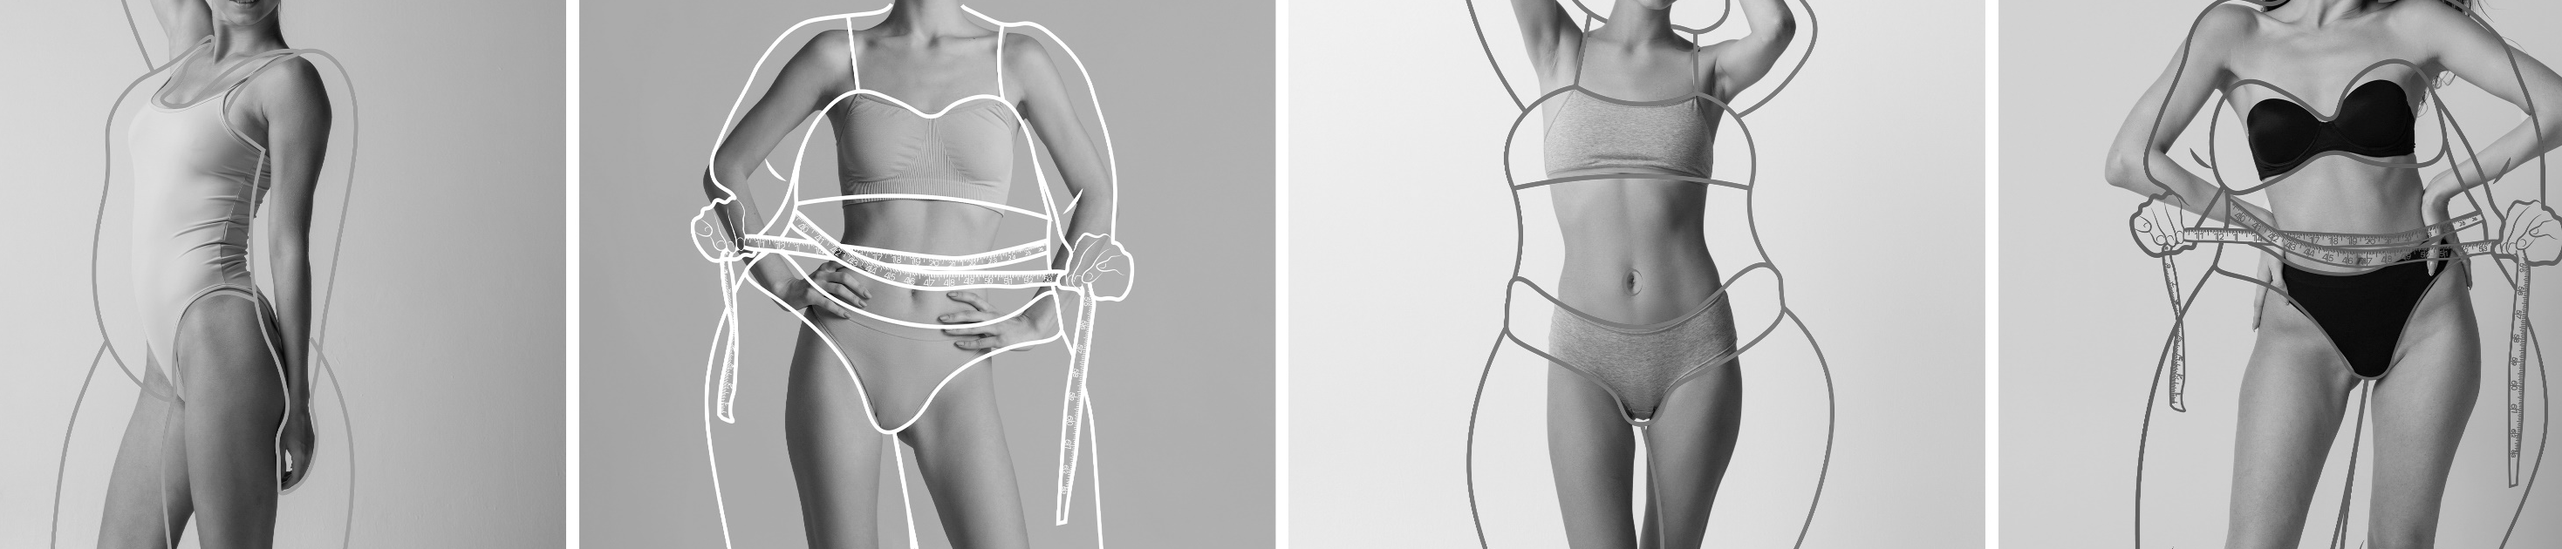

Body shape management helps slim the body!

Slide 18
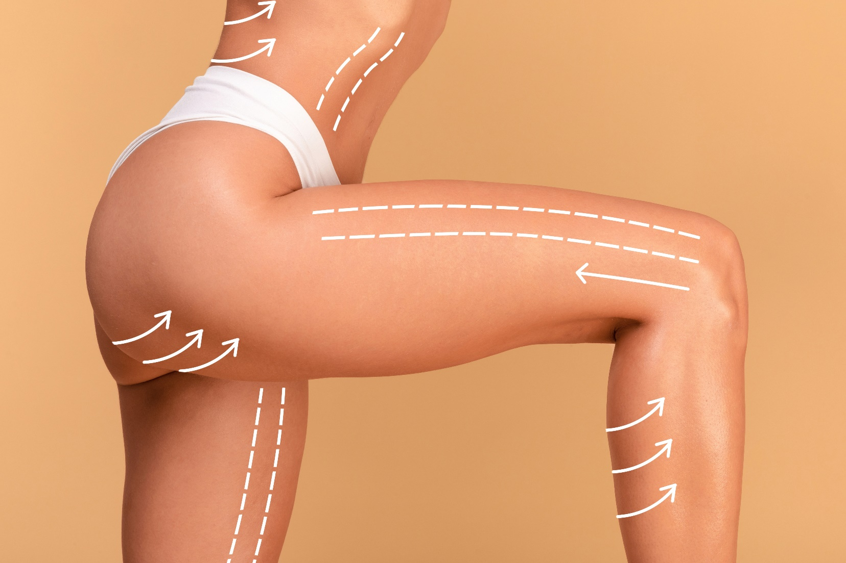

03. Product Features
Body Shape Care
No Words Necessary!
Flanks
Take care of your body
anywhere you want!
The device helps relieve edema to slim the body!
A dual-functional device that is small in size and light in weight!
Abdomen
Dual stimulation method of fat (ultrasound/low frequency).
Slim your body anywhere you want!
Buttocks
Lower Body and Arms
Area of Use

Slide 19
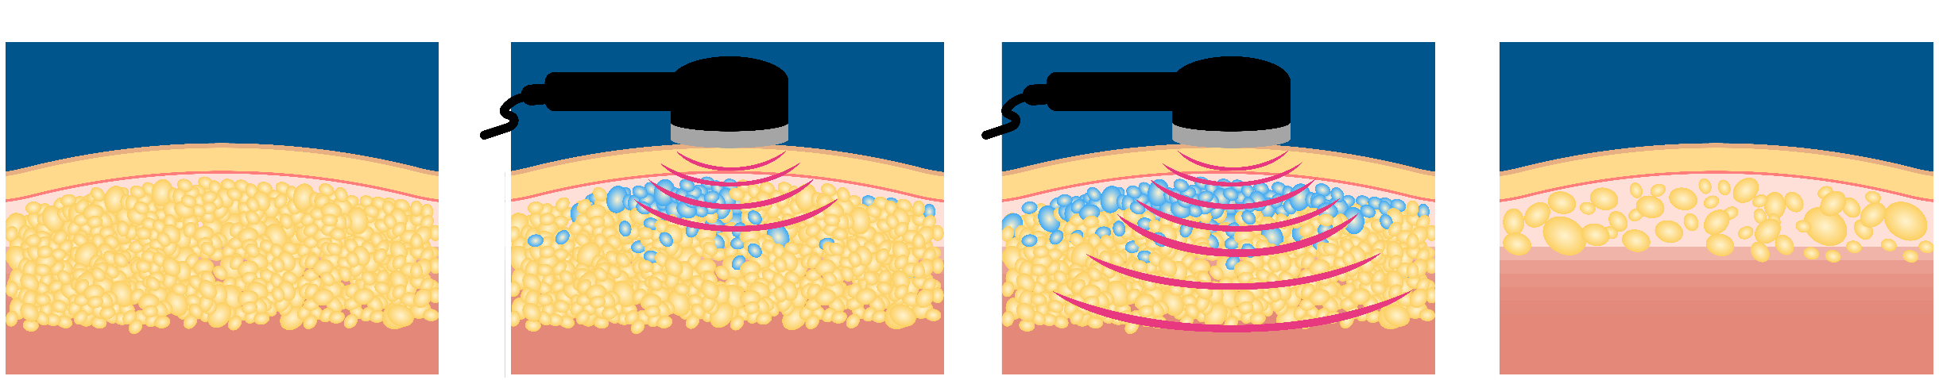
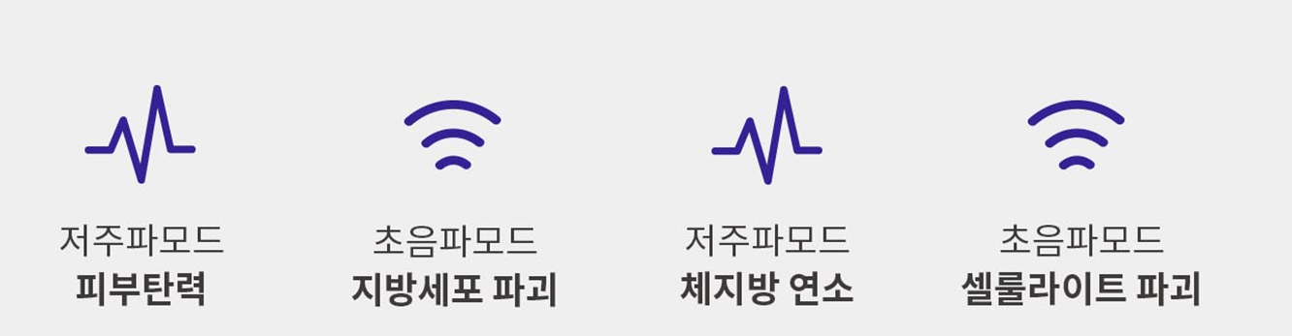
03. Product Features
Body Shape Care
Changes Due to Ultrasonic Effect
The perfect way to manage any kind of body type without surgery or side effects!
Before
After
지방
CareCellve Mechanic takes care of stubborn body fat.
The mechanical ultrasonic stimulation (contraction, expansion) stimulates fat cells to make them easier to remove.
Now you can get professional body shape management in the comfort of your own home!
Low Frequency Mode
Increases Elasticity
Ultrasound Mode
Destruction of Fat Cells
Low Frequency Mode
Burns Body Fat
Ultrasound
Mode
Destroys Cellulite

Slide 20
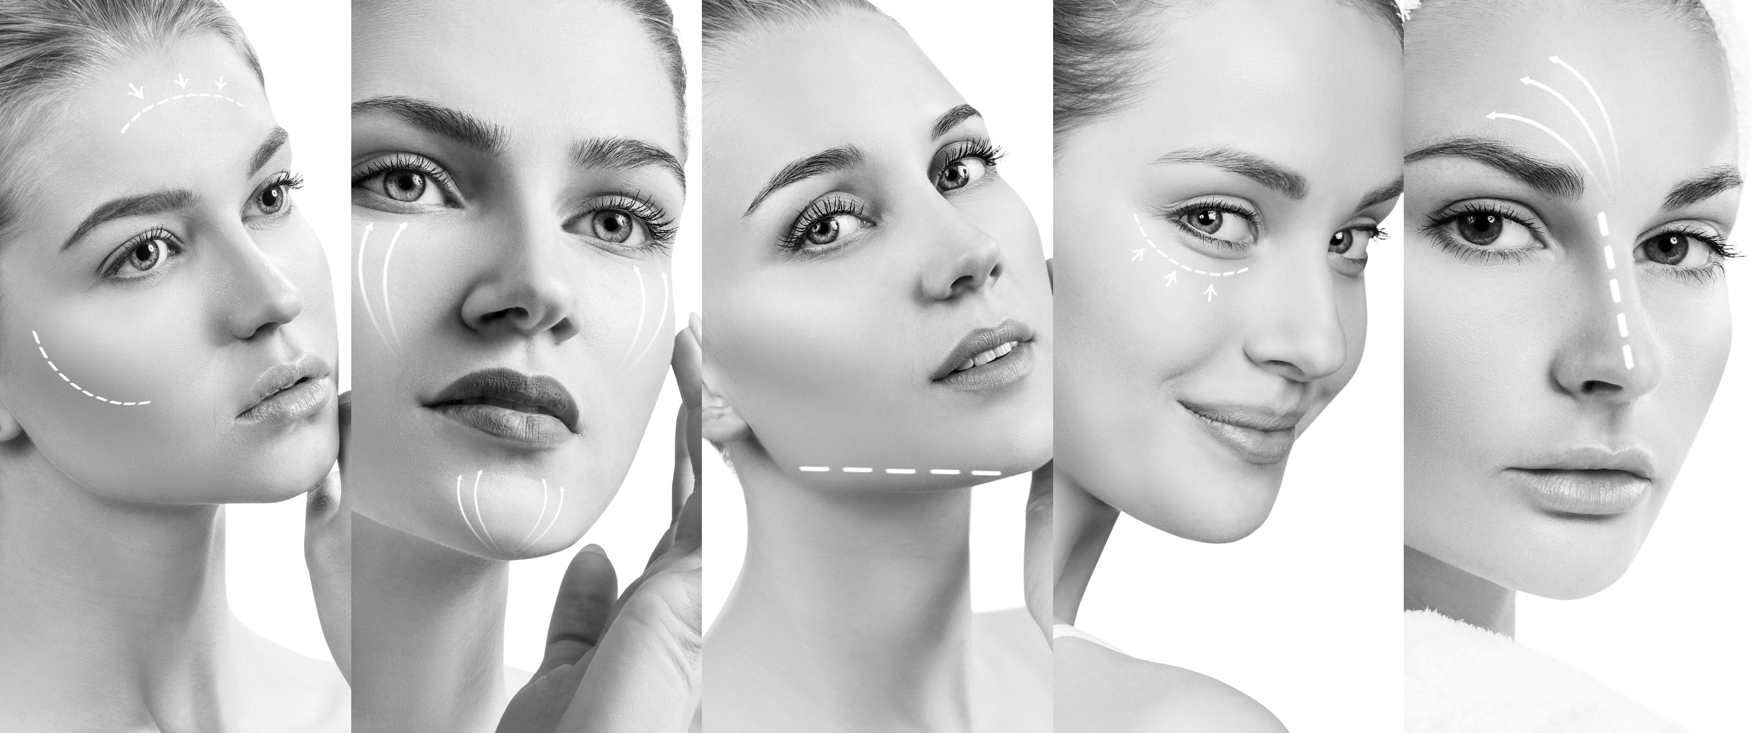
Make your skin look even more beautiful!

Slide 21
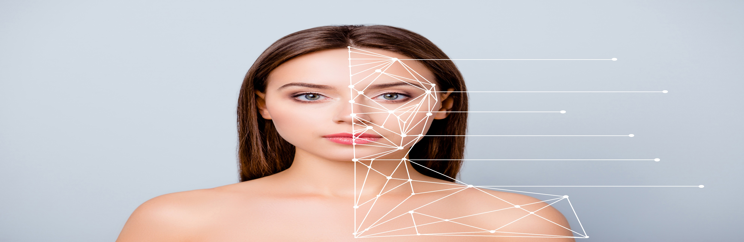
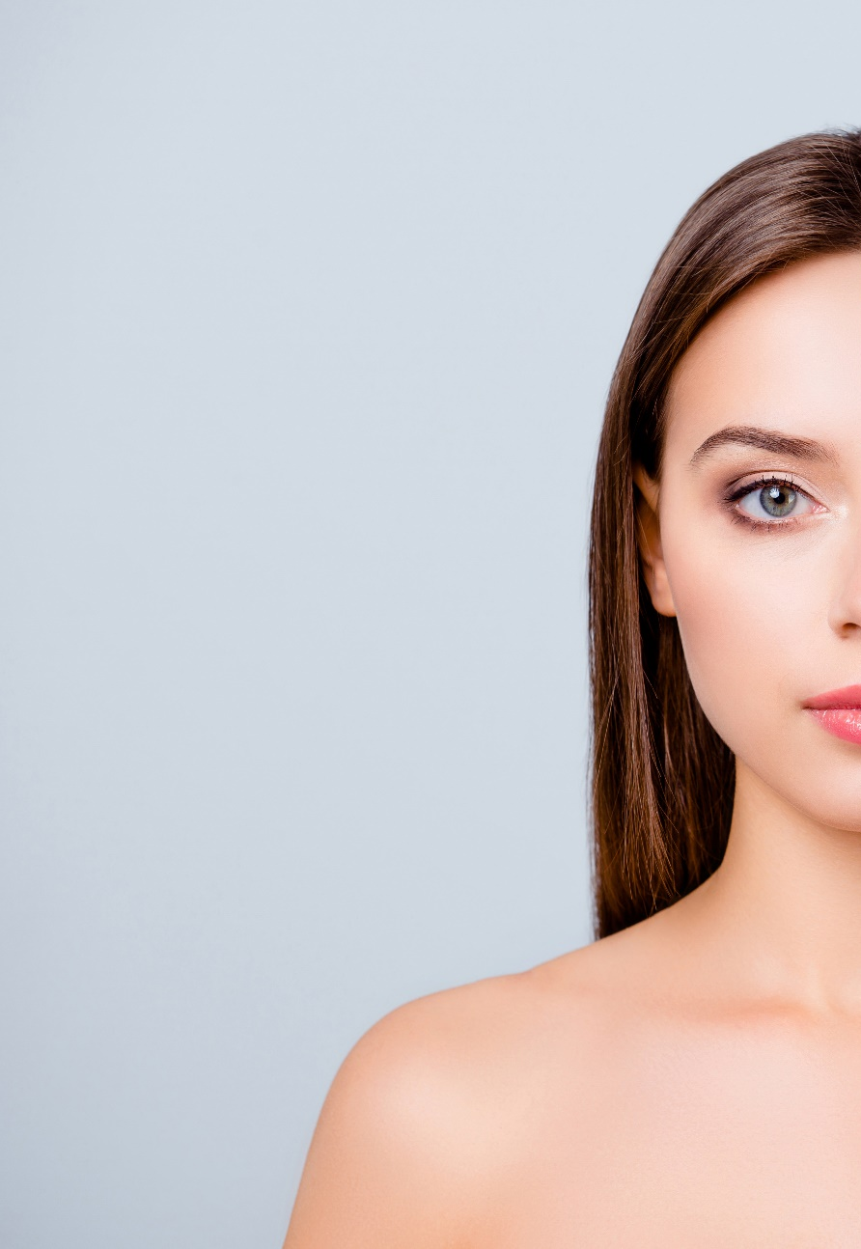
03. Product Features
Skin Care
  1
  2
Effects of Ultrasonic Skin Care
Moisturizing Care
Skin Tone Care
Ultrasonic skin care uses the frictional force generated by the momentary powerful vibrations to transmit harmless sound waves to the deep subcutaneous layer.
The ultrasonic waves stimulate and activate the cells to adjust the balance of the skin and help it regenerate.
Effectively moisturizes the skin by tapping it to help it better absorb nutrients.
Improves blood circulation.
Increases elasticity and brightens the skin.
  3
  4
Healing Care
Massage Effect
Healing care that helps regenerate skin that has become tired from stress.
Gently tap the skin as if massaging.

Slide 22
03. Product Features
Skin Care
Dual-Functional Device (Ultrasound / Low Frequency)
The Effects of Dual-Functional Skin Regeneration
The device uses 1.2 MHz (high-density ultrasound) waves to induce the activation of natural cells without pain, swelling, or redness. It helps the skin regenerate to treat problematic skin in a healthy way
Balancing the production and decomposition of ECM (extracellular matrix) naturally moisturizes and brightens the skin to purify the complexion. It reduces wrinkles, shrinks pores, and increases elasticity to make aging skin appear younger and healthier.
※ ECM (extracellular matrix) is a substance that fills the space between cells to provide them with support.
Check 1
Check 2

Slide 23
Development Background

Slide 24
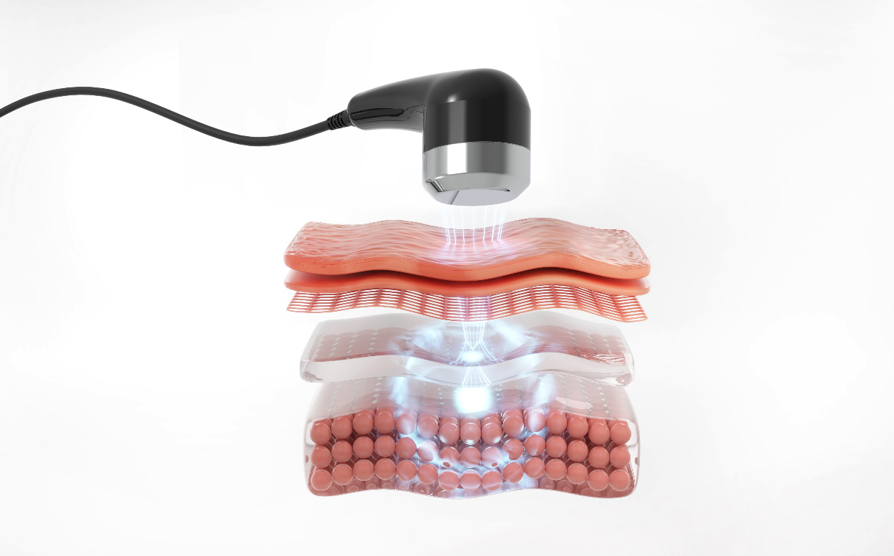
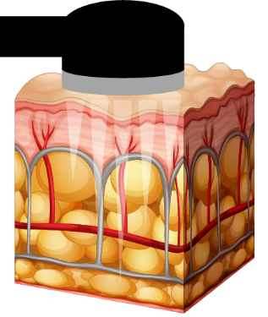
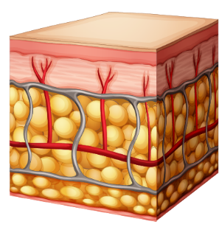
03. Product Features
Development Background
Upper Layer of Dermis
Dermis Layer
SMAS Layer
Before
After
The CareCellve Mechanical Device transmits ultrasonic heat energy generated by 1.2 million vibrations per second from the superficial musculoaponeurotic system (SMAS) to the dermis and epidermis layers.

Slide 25
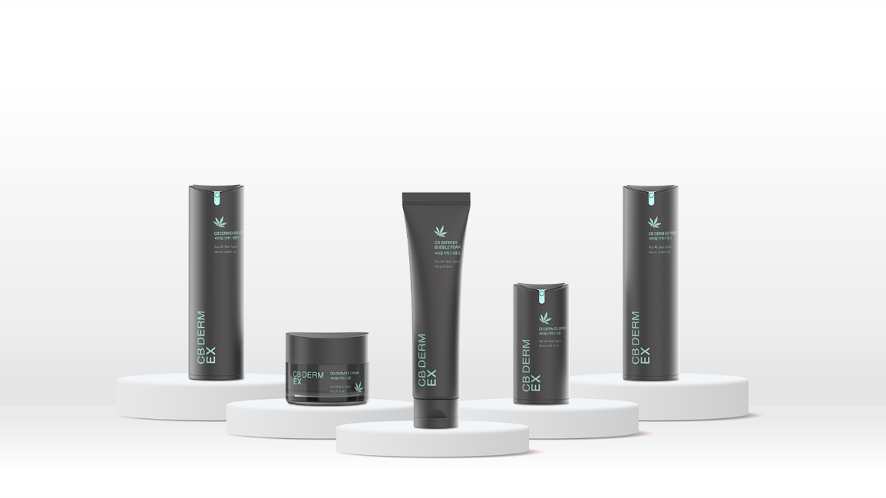
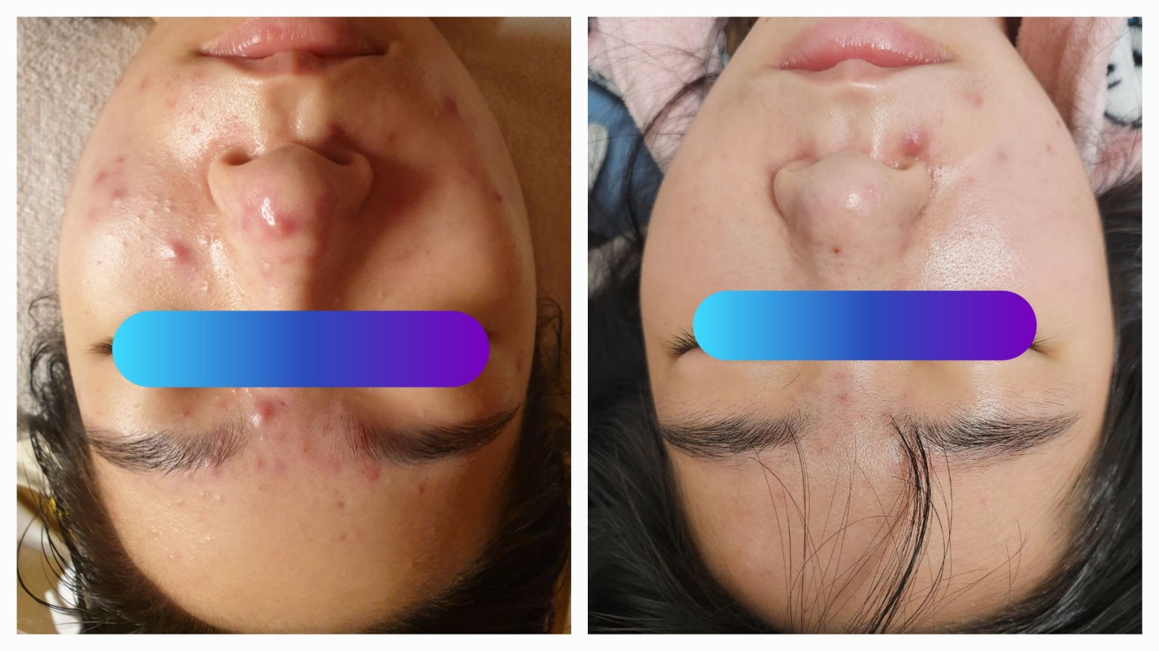
03. Product Features
CareCellve X CB DERM
CM DERM EX products supply the skin with nutrients to ensure the skin does not lose any while using the ultrasonic device.
The device delivers the nutrients of the CB DERM EX products deep into the skin.
[Ultrasound + CB DERM EX]
Using CB DERM EX products together increases the speed of skin regeneration to reduce wrinkles, increase elasticity, and lift and brighten the skin.
Before
After

Slide 26
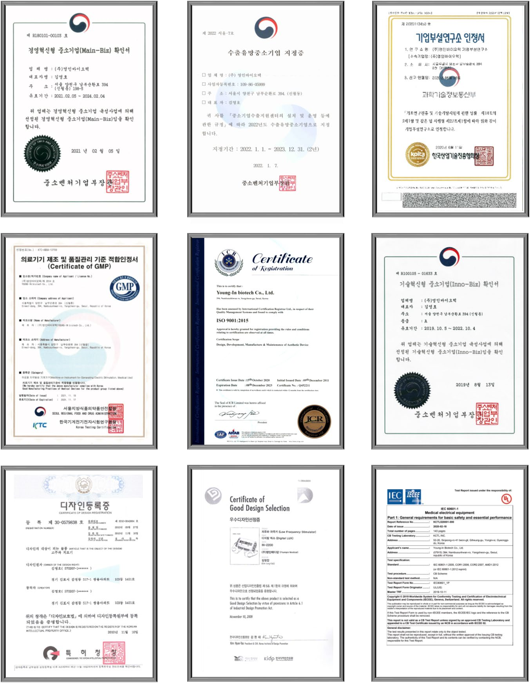
04. Certification Data
Patent and Certification

Slide 27
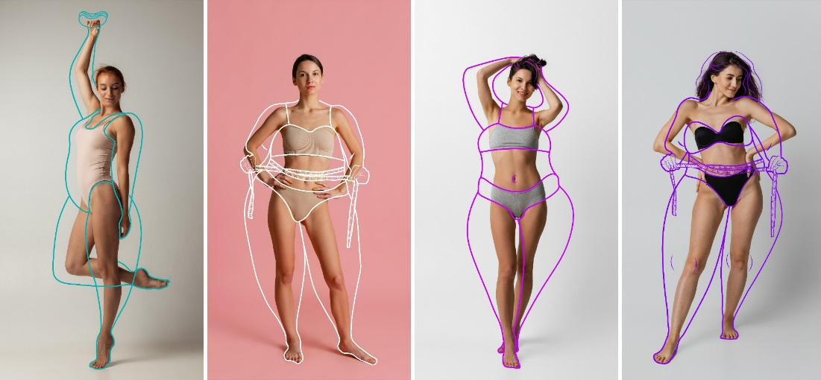
05. Recommended For
Target
The Perfect Device for the Following .
The beauty device is similar to ones used at skincare clinics, which means it is able to perfectly manage the skin of all body types.
Provide care based on specific areas of the body.
Helps people maintain their body shape without surgery, bruises, or scars.
Virtually no yo-yo or side effects even after treatment, which means people can resume their daily activities.
Harmless ultrasonic waves make it safe and simple to use.

Slide 28
Reference Materials

Slide 29
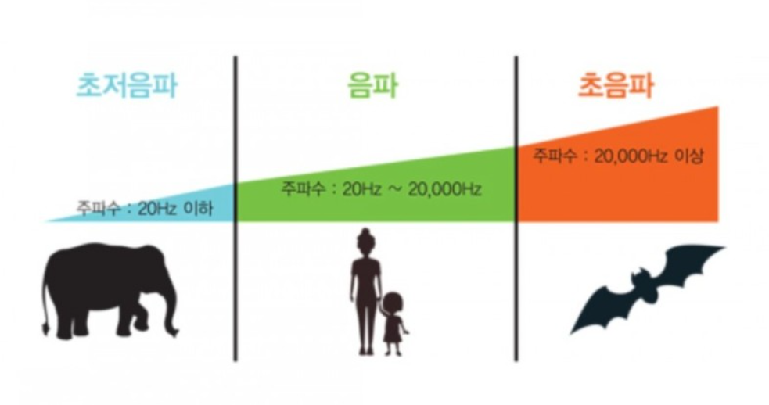
06. Reference Materials
Definition of Ultrasound
What is an Ultrasound?
The name “ultrasound” can be broken down to mean “to exceed sound.”
The range of sound that the human ear can hear is 20Hz to 20kHz. This range is referred to as audible frequency.
It refers to sound waves that exceed the audible frequency of 20 Khz, which is a range that cannot be heard by the human ear.
Infrasound Sound Waves Ultrasonic Waves
이미지 출처 : 네이버

Slide 30
06. 참고 자료
초음파의 뷰티케어 개선 원리
Improvements | Principles | 15 Minutes Per Session
Acne | Removes sebum and waste in pores; sterilizes and regenerates the skin. | 3~4회 Three to Four Times
Blemishes, Spots, Freckles | Reduces pigmentation and melanin; shortens the skin cell circulation cycle; activates the 28-day cellular turnover in skin in people in their twenties after three months of use; eradicates germs inside skin cells; removes waste. | 4~12주 Four to Twelve Weeks
Abdominal Care | Activates intestinal function; removes stool; excretes toxins. | 2~3회 Two to Three Times
Reduction of Fine Wrinkles | Promotes metabolism; makes the skin appear more youthful and transparent. | 4~12주 Four to Twelve Weeks
Anti-Aging | Creates collagen and elastin fibers; normalizes and restores skin elasticity. | 3~4회 Three to Four Times
Pore Cleansing | Delicate micro-massage effect that removes impurities in pores. | 2~3회 Two to Three Times
Pore Shrinkage | Shrinks pores, produces collagen, and restores elasticity. | 1~2주 One to Two Weeks
Balance Care | Normalizes skin cell function for both oily and dry skin. | 1~2주 One to Two Weeks
Exfoliation | Removes dead cells and foreign matter from the stratum corneum of the epidermis. | 1~2주 One to Two Weeks
Lifting | Recovers elasticity and lifts the skin by shrinking it to decompose fat. | 4~5회 Four to Five Times
Deep Cleansing | Utilizes vibrations to exfoliate the skin and remove impurities that have accumulated deep in the pores. | 4~5회 Four to Five Times
Brightening | Utilizes vibrations to prevent pigmentation and normalize skin cell functions. | 3~4주 Three to Four Weeks
Moisturizing | Converted to water due to catabolism and the breakdown of saturated fat; keeps the skin hydrated. | 2~3회 Two to Three Times
Slimming | Dissolves and removes fat to adjust the balance of the face and body. | 2~3회 Two to Three Times
Makeup | Improves the secretion of the epidermis; keeps the skin hydrated; uses phonophoresis to help functional natural cosmetic products better adhere to the skin. | 3~5회 Three to Five Times

Slide 31
06. Reference Materials
Ultrasound: Health Improvements
Improvements | Principles | Principles and Functions
Tumors (Cancer) | Use a repetitive reciprocating motion and pause method in 2-3cm sections. | Toxicity temperature [keep above 44℃ (111.2°F)].
Removal of Inflammation | Use a repetitive reciprocating motion and pause method in 2-3cm sections. | Sterilizes lymphs; enhances leukocyte activity.
Pain Relief | Use a repetitive reciprocating motion and pause method in 2-3cm sections. | Dissolves crystallized uric acid.
Blood Circulation | Entire body care (hand, plantar lymph/conception vessel, governor vessel) | Accelerates metabolism; removes waste from the body.
Cartilage Regeneration | Use a repetitive reciprocating motion and pause method in 2-3cm (0.79-1.18 in.) sections. | Increases protein synthesis and the elongation of collagen; promotes collagen (cartilage) production.
Eyes (Cataracts / Glaucoma) | Use while moving without stopping above and below the eyelid and around the edges of the eyes for five minutes. (Make sure to avoid the center of the pupil.) | Accelerates metabolism; removes waste.
Headaches, Dementia, and Memory Enhancement | Eye massage + Left temple Entire head / Neck, clavicle lymph nodes / Cervical spine | Strengthens the function of the hippocampus (temporary memory) to reinforce data transfer activity to the cerebral cortex (permanent memory

Slide 32
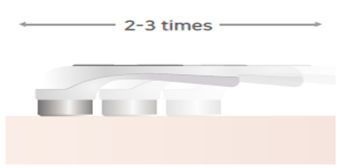
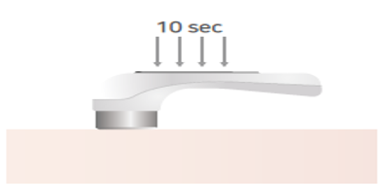
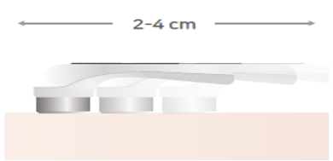
06. . Reference Materials
How to Correctly Use the CareCellve Mechanic Device
01
02
03
Exploration Care
Quickly pass the device two to three times over the area as if searching.
Intensive Care
Apply the ultrasonic head closely to the area of use and rub it gently for at least ten seconds
Slow-Moving Care
Apply the ultrasonic head closely to the area of use and move it at a slow pace 2-4 cm (0.79-1.58 in.) per second.
*Choose from three types of care.

Slide 33
06. Reference Materials
How to Correctly Use the Ultrasonic Device
01
Daily Care for
Palms and Soles
Acupuncture effect.
02
Rapidly discharges waste and removes swelling from the body.
Provides care for the following: neck lymph nodes, supraclavicular lymph nodes, axillary lymph nodes, inguinal lymph nodes, popliteal lymph nodes, and achilles tendon lymph nodes.
Manage Lymphs
The most fundamental healing method is to correct the spine, return the blood circulation to its original state, and release accumulated blood.
Abnormalities can occur when the body is out of balance. It's important to create an environment that allows the body to maintain this balance in order to stay healthy with proper blood circulation.
Provides care for the following: first cervical vertebrae to the sacrum, the erector spinae muscles centered on the spine.
03
Artery Care

Slide 34
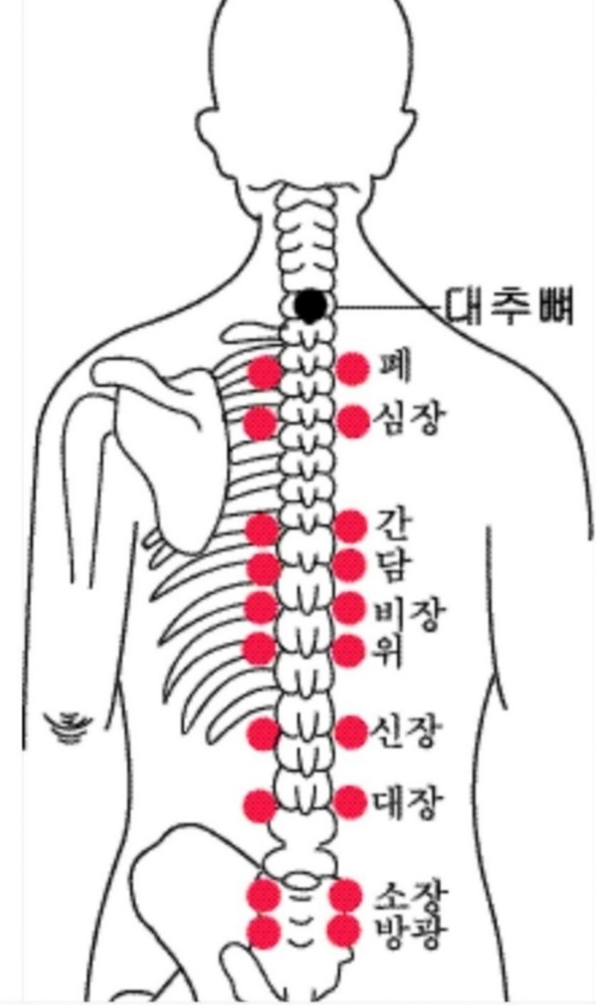
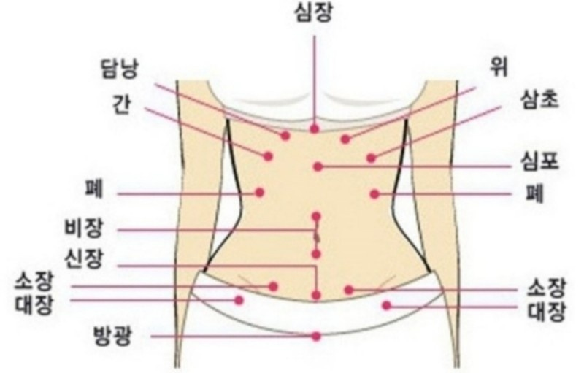
06. Reference Materials
Back Acupoint Management
Acupoint Management
Heart
Gallbladder
Stomach
Spine
Liver
San Jiao
Lungs
Heart
Cardiac
Lungs
Liver
Lungs
Gallbladder
Spleen
Spleen
Kidney
Stomach
Small Intestine
Small Intestine
Kidney
Large Intestine
Large Intestine
Large Intestine
Bladder
Small Intestine
Bladder

Slide 35
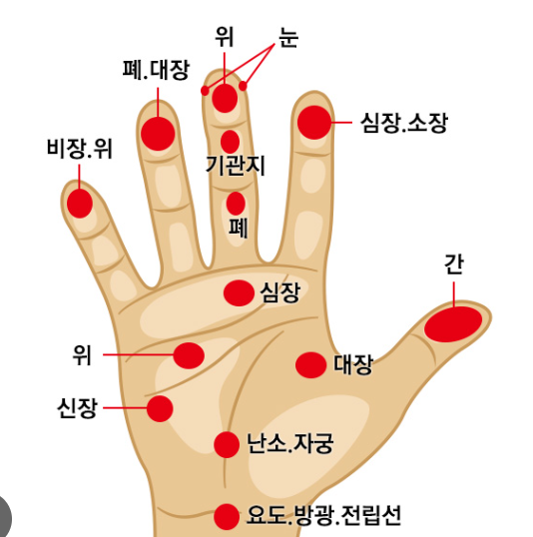
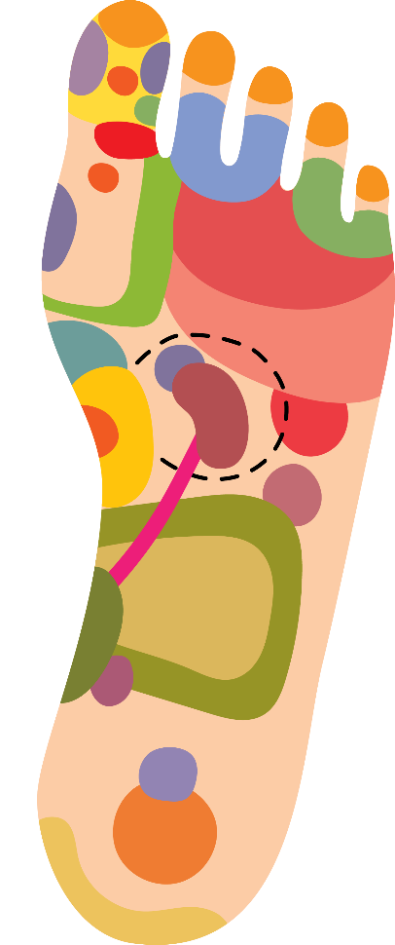
06. Reference Materials
Hand/Foot Acupoint Management
Acupoint Management
Nose
Sinusitis, Hay Fever
Eyes
Bloodshot Eyes, Glaucoma, Cataracts
Stomach
Eyes
Ears
Tinnitus, Hearing Loss
Lungs and Large Intestine
Neck
Stiff Shoulders, Cervical Discs
Heart and Small Intestine
Osteoporosis, Allergies
Shoulders
Frozen Shoulder, Numb Hands
Spleen and Stomach
Bronchi
Asthma, Cough
Lungs
Thyroid
Obesity, Emaciation, Arrhythmia
Kidneys
Heart
Arrhythmia, Angina
Heart
Stomach
Gastric Ulcers, Gastroptosis
Transverse Colon
Abdominal Pain, Diarrhea
Stomach
Intestines
Digestion (Absorption), Diarrhea, Abdominal Pain
Large Intestine
Kidneys
Arteriosclerosis, Edema
Liver
Ovaries and Uterus
Rectum Constipation
Bladder
Cystitis, Poor Urination
Urethra, Bladder, and Prostate
Gonads,
Menstrual Cramps, Irregularities, Disorders

Slide 36
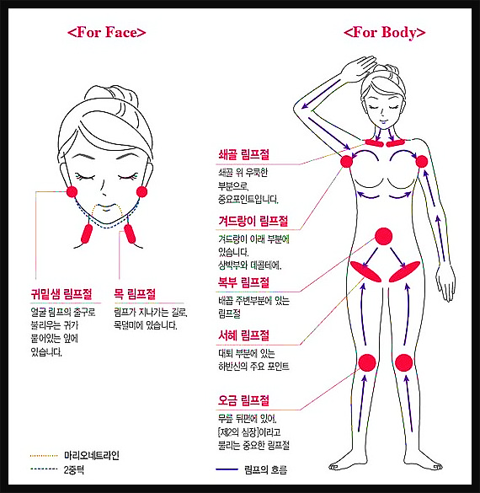
06. Reference Materials
Lymph Circulation Management
For Face
For Body
Subclavian Lymph Nodes
Important lymph nodes found in the concave part above the collarbone.
Axillary Lymph Nodes
Located in the area under the armpit.
Abdominal Lymph Nodes
Lymph nodes found in the area around the navel.
Inguinal Lymph Nodes
Located next to the ears; known as the facial lymph outlet
An important part of the lower body located in the thigh.
Parotid Lymph Nodes
Cervical Lymph Nodes
Located at the nape of the neck; serve as a path through which lymph flows.
Popliteal Lymph Nodes
Important lymph nodes that are referred to as the second heart as they are located on the back of the knee.
Lymphatic Flow

Slide 37
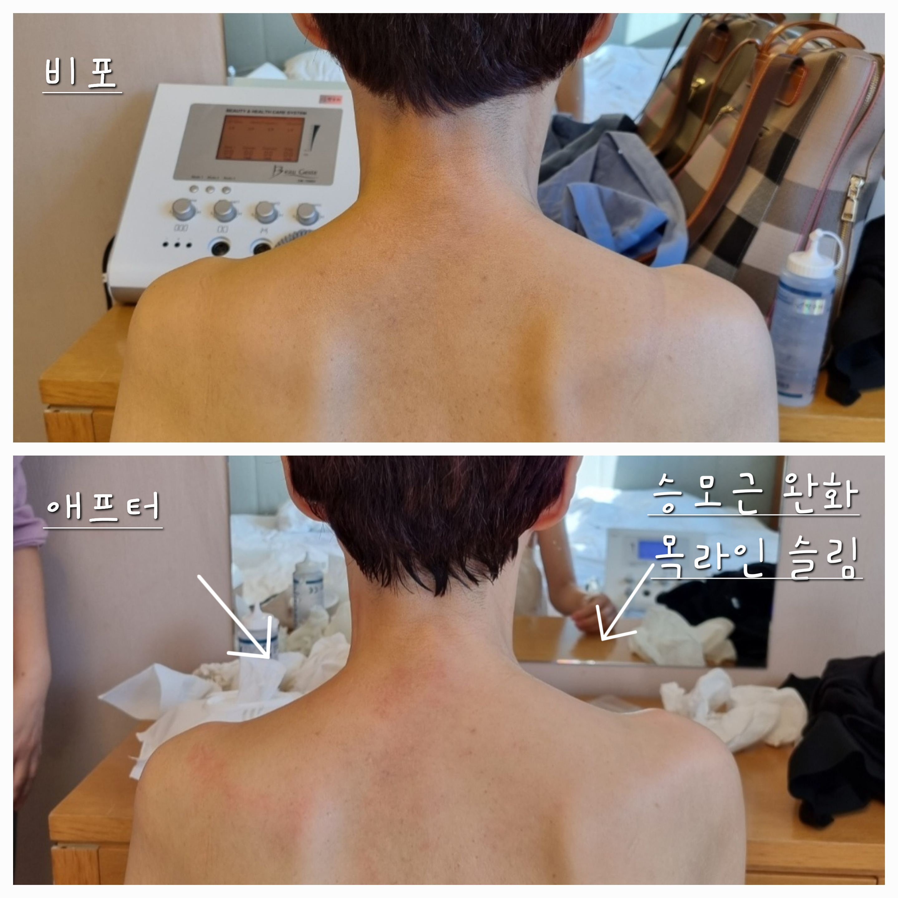
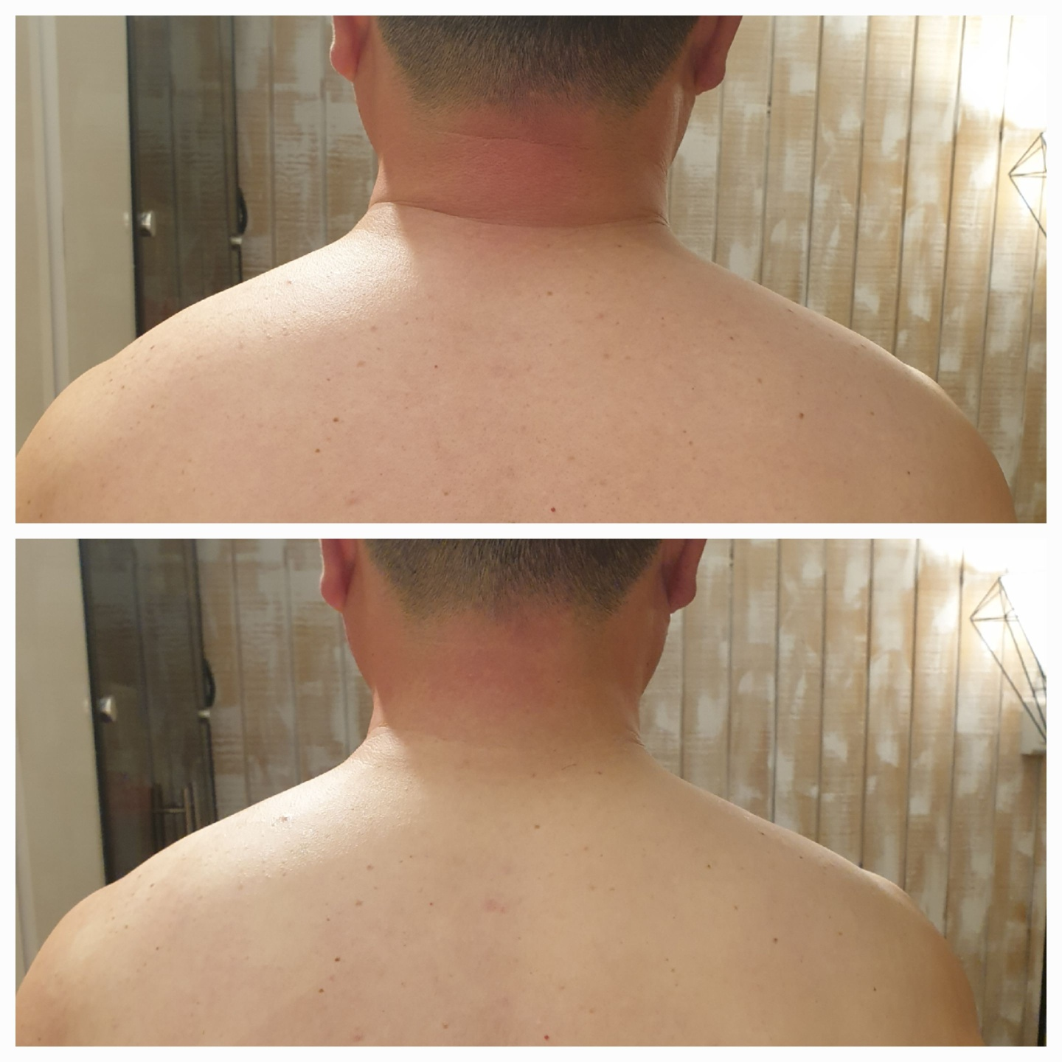
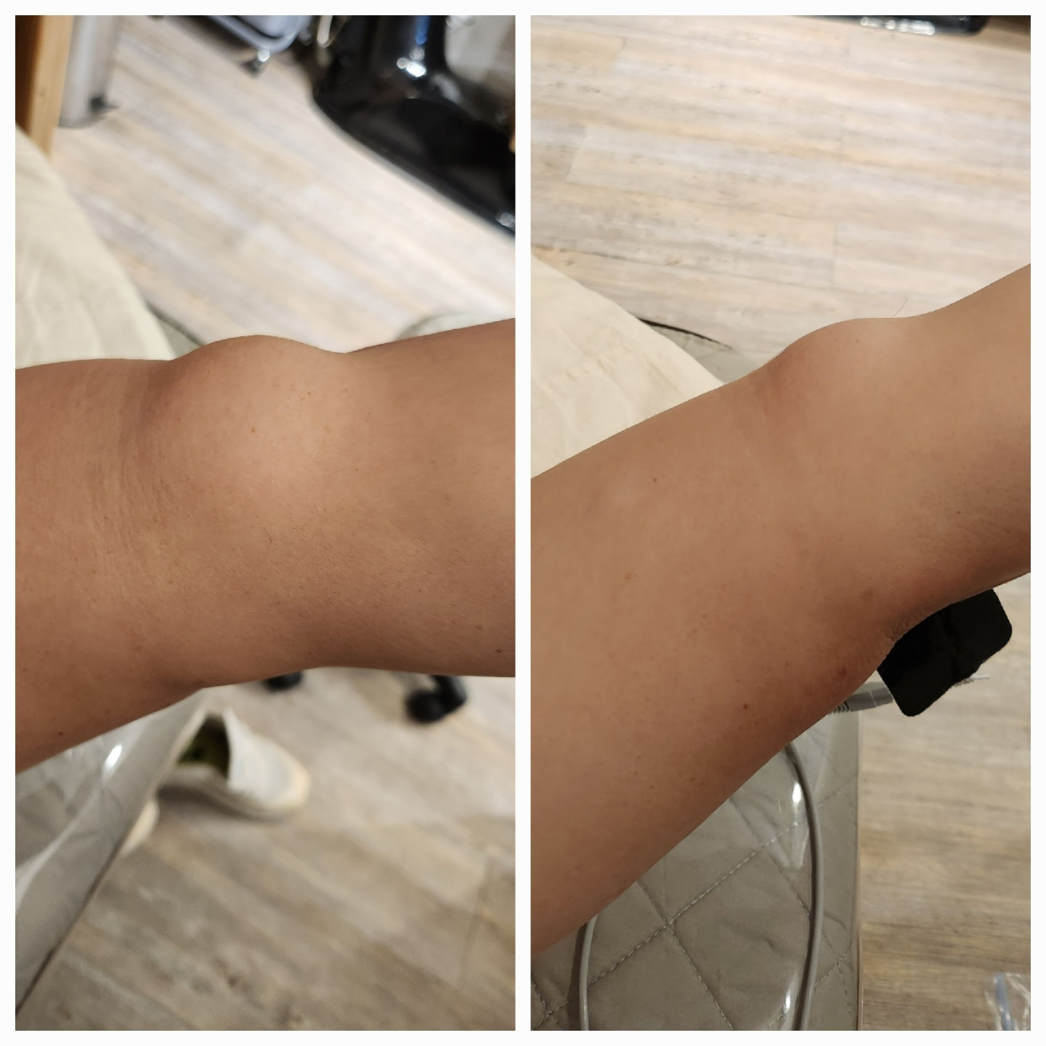
06. Reference Materials
Ultrasound Experiences

Slide 38
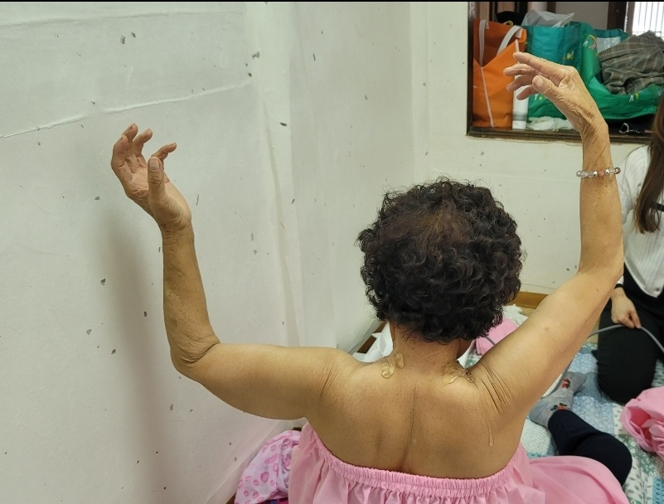
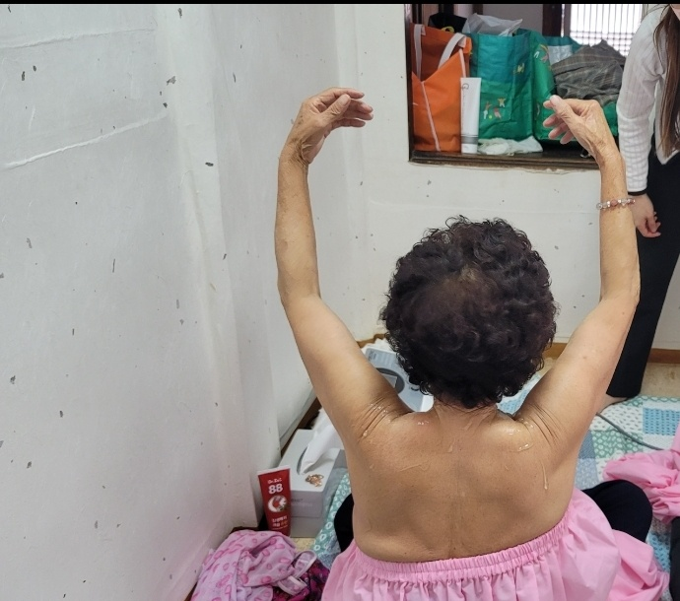



06. Reference Materials
Ultrasound Experiences

Slide 39



06. Reference Materials
Before Treatment
Up

Slide 40


06. Reference Materials
Before Treatment

Slide 41
06. Reference Materials
Q&A
Q: How often do you need to go through treatment to see results?
A: Those with acne, sensitive, dry, and/or flushed skin as well as those looking to increase elasticity will begin to see results after receiving treatment once to twice a week
for six to eight weeks. It is more effective when combined with other kinds of aging procedures.
Q: How long does the ultrasound treatment last?
A: You can see improvements when you receive three or more treatment sessions. You will see even more improvements after 10 treatment sessions that will maintain
results for six months to one year. (It’s easier to maintain results after 10 treatment sessions if you continue to receive one
to two treatments a month.)
Q: Can I still receive treatment if I have sensitive/red/problematic skin?
A: Those with skin problems will experience more visible results than those with healthy skin. The device is a suitable form of treatment for people with problematic skin as it
keeps the environment of the inner skin healthy without causing irritation.
Q: Can I receive treatment if I am pregnant or planning on becoming pregnant?
A: Absolutely! Pregnant women can also undergo face and neck procedures.
Q: What makes this anti-aging care?
A: The device decomposes aged collagen that has reached the end of its lifespan to create space for new collagen to be created. It maximizes the skin's own immunity and
regenerative power by restoring balance.
Q: How long does each treatment session last?
A: Each session takes between 10 and 20 minutes depending on the client’s skin condition and area of use. It can take 50 minutes to one hour if combined with other
treatments.
Q: When will I start to see results?
A: You will begin to see results after your first treatment session. Results will become more noticeable the more treatment sessions you undergo.
Q: Is there anything I need to look out for after receiving treatment?
A: There is almost no pain or irritation during treatment, only a warm sensation. You will not experience any redness or swelling after treatment, so just continue to apply
your regular moisturizer and sunscreen.

Slide 42
Thank you

