Slide 1
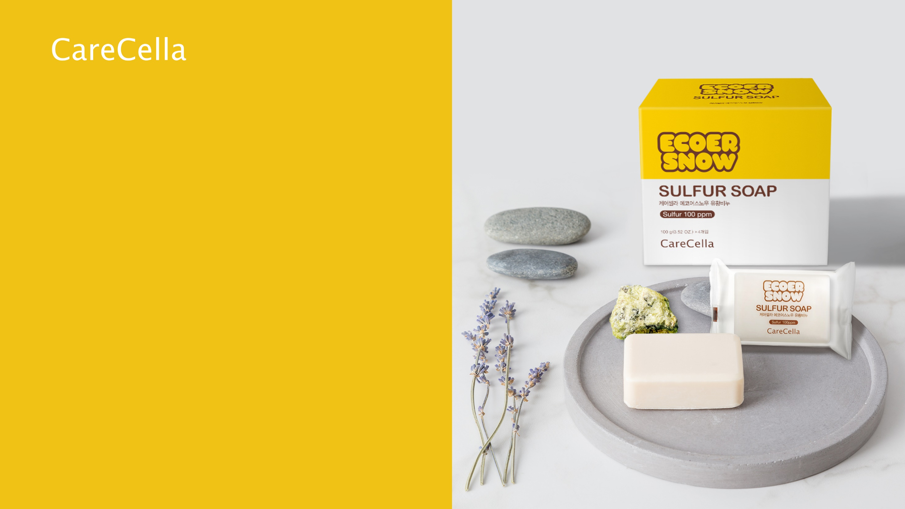

SULFUR SOAP
* This document is meant only for internal training and shall be kept confidential. It is prohibited to disclose or post any information included in this document

Slide 2
1
Product Details
+ Product Name : ECOER SNOW Natural Sulfur Soap
+ Contents : Sulfur Soap 110g (when dry 100g X 10ea)
+ Ingredients : Coconut Oil, Sulfur Salt, Wax, Glycerin, Yogurt

Slide 3

2
Features
+ Comparable to a Natural Sulfur Hot Spring
You can enjoy a hot spring bath at home that is comparable to a natural hot spring
+ Fermented in Lower Temperatures for 4 Weeks
The soap is fermented for 4 weeks and produces a gentle mild lather. The Sulfur Salt helps to make the soap particles soft.
+No Additives
This product does not contain any preservatives, coloring, scents, and SLS/SLES

Slide 4
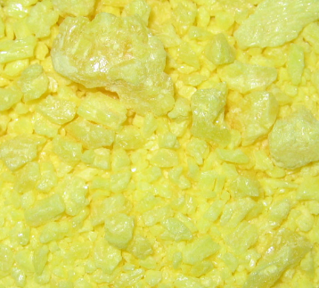
3
+ Sulfur
Indonesia is located on the Pacific Rim and there are more than 50 active volcanoes scattered over Java Island. We use 100% natural sulfur sourced from the island.
+ Effects
From ancient times sulfur has been known as an ingredient to alleviate skin disease and many people would visit hot springs to heal their skin.
In ancient Chinese medical texts, a paste was made from sulfur and other ingredients to heal dry skin.
Sulfur has sterilization properties and when applied to the skin the sulfur reacts with the organic matter to create Pentatitanic Acid (HO-SO2-S3-OH) which helps to exfoliate and disinfect skin.
Main Ingredients
+ Only related to the characteristic as raw materials

Slide 5








+ Production Process
4
Production
PREPERATION
PRODUCTION
1. Raw Material Testing
2. Sterilization of tools
3. Raw Materials Measured
4. Product Testing
FINISHING
8. Packaging and Testing
7. Fermentation
6. Soap Trimming
5. Soap Cutting

Slide 6
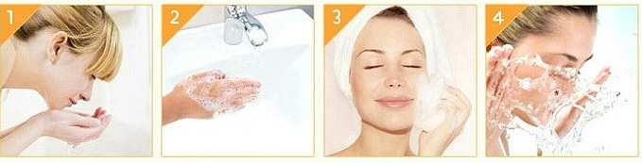
5
Directions
1. Wash hands before use and rinse face with water.
2. Create a rich lather with the soap and apply to the face in a massaging motion to cleanse the skin.
* Can be used on face, neck and body.
3. Rinse thoroughly with water.
* Caution: Avoid product in the eyes or on open wounds.

Slide 7
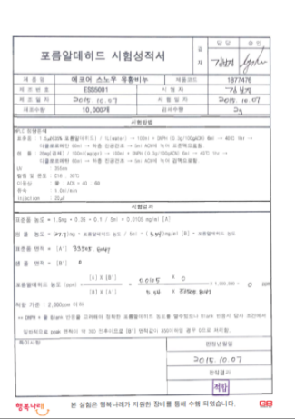
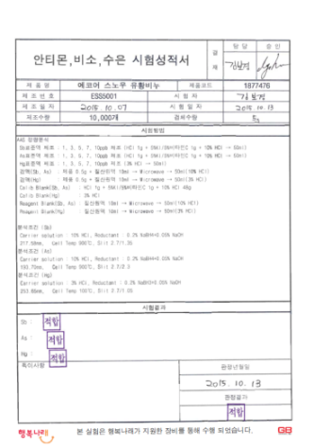
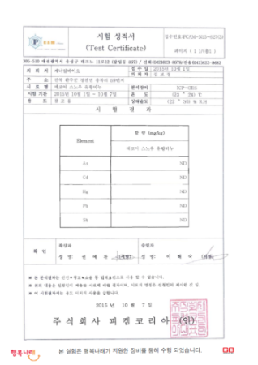
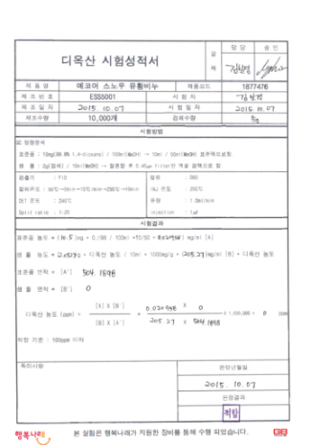
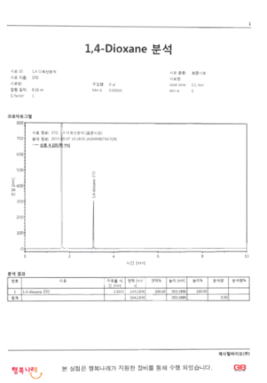
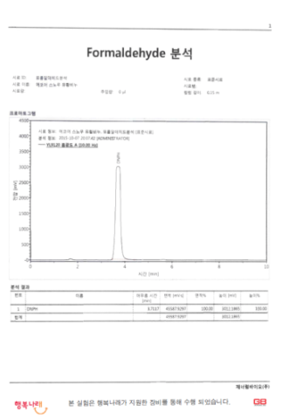
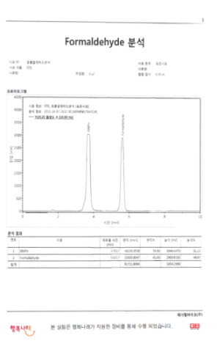
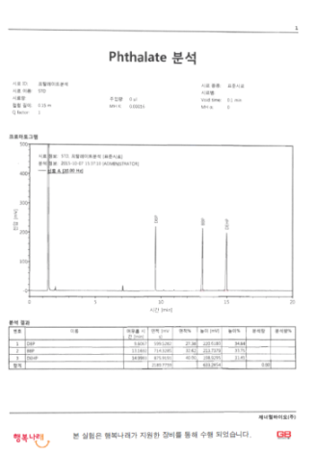
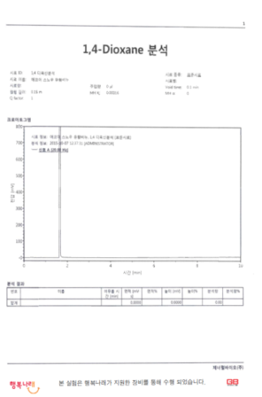
6
Quality Testing Results
Formaldehyde: Not Found
Antimony, Arsenic, Mercury : Not Found
Moisture and Volatile Organic Compounds
Dioxane
1,4Dioxane : Not Found
Formaldehyde : Not Found
Phthalate : Not Found
Phthalate : Not Found
1,4Dioxane : Not Found

Slide 8
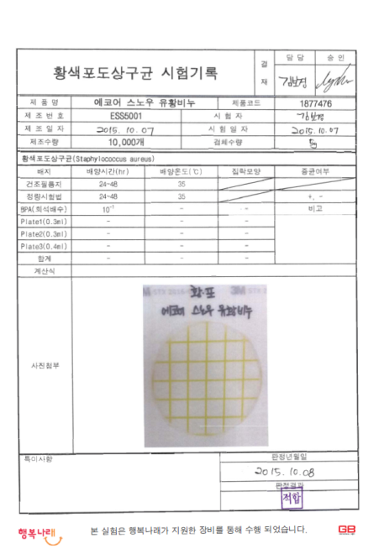
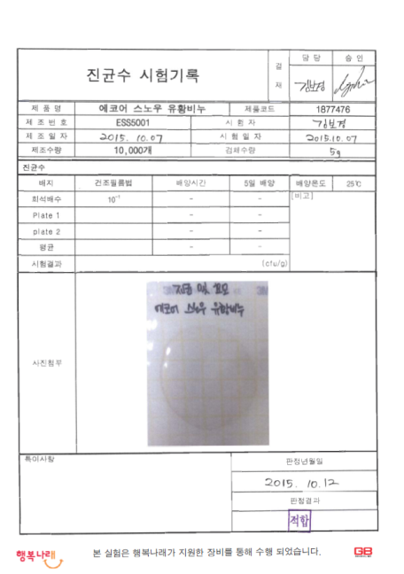
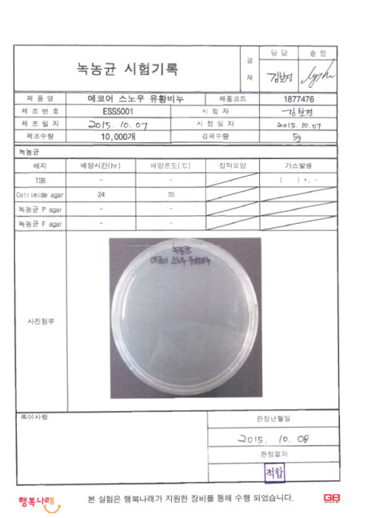
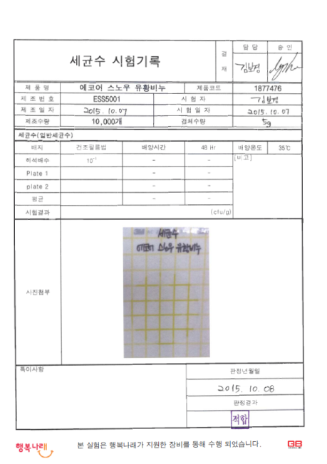
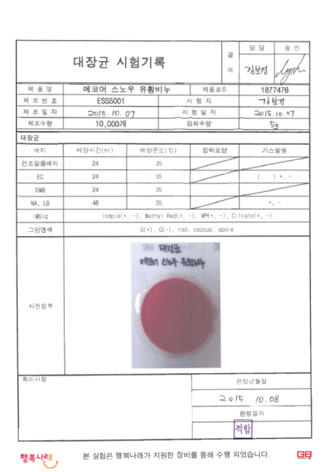
6
Quality Testing Results
Staphylococcus Aureus : Not Found
Fungus Count : Not Found
Pseudomonas Aeruginosa : Not Found
Bacteria Count : Not Found
E.Coli : Not Found

Slide 9
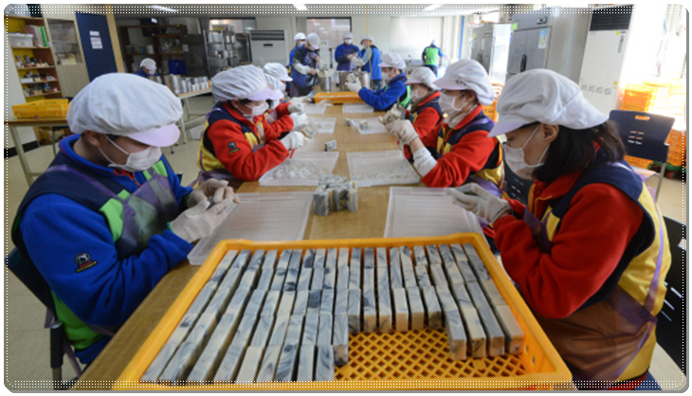
+ ECOER SNOW Handmade Sulfur Soap Creating a Social Difference
Creating Opportunity in Society
Our Handmade Sulfur Soaps are produced by the disabled who need jobs and opportunity. By doing so we are able to share and grow with all members of our community.

