Slide 1
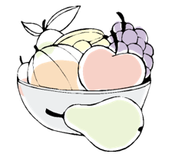

DISH
LIQUID
Concentrated Type

Slide 2
DISH
LIQUID
Concentrated Type
1
2
3
4
5
6
Product Overview
Product Features
How to Use
Precautions
Ingredients
Synthetic vs Plant Derived Surfactants
* This document is meant for internal training purposes only. Unauthorized use is strictly prohibited. (Please be advised that this document is in compliance with the standards of the Food and Drug Administration of South Korea. Please note that the standards in each country may be different and the use of this document must be in accordance with the standards of each country.)

Slide 3
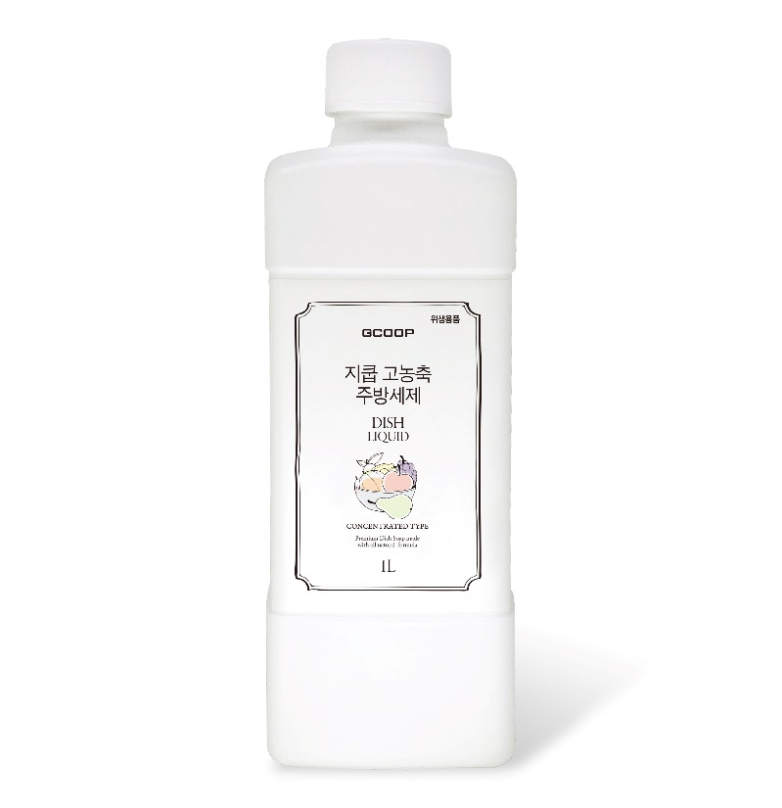
1
Product Details
+ 제품명 : GCOOP Dish Liquid
+ Contents : 1L
+ Ingredients : Surfactant from plants (24.3%), Glycerin, Aloe Vera gel Powder, Apricot extract,
Citron extract, Rice bran extract, Spearmint Oil, lavender Oil
+ Recommended Usage : Use .75ml per liter of water
+ Uses : To clean cookware, dinnerware, flatware, and fruits and vegetables
※ This product is concentrated. To use, dilute with 1 liter of water per liter of dish liquid.

Slide 4


All Natural Plant Derived Formula
+ Helps to protect the environment because it is made with all natural plant derived surfactants
+ May be used to clean baby bottles and utensils
Tested for Quality Assurance and Safety by Dermatests
(Test results showed that the formula is non irritating)
+ NO ADDITIVES
NO preservatives(14types), heavy metals, allergens (24 kinds), phthalates (6 kinds), fluorescent whitening agent, nophosphate, dodioxane, methylmethyl alcohol, glutaraldehyde, petroleum-free surfactant, artificial fragrances, animal raw materials, pigments
+ All Natural Formula With Ultra Cleaning Power
Concentrated formula is tough on grease and rinses clean without leaving any residue
2
Product Features
dermatest® RESEARCH INSTITUTE FOR RELIABLE RESULTS
Ministry of Health and Welfare 1Type Dish Liquid

Slide 5
How to Use
[To Wash Produce]
Dilute the product with water as recommended and soak vegetables to clean.
Do not soak for longer than 5 minutes.
After soaking, rinse with water that is suitable for drinking. When rinsing under running water, rinse for at least 30 seconds, and when rinsing using a bowl or sink filled with water, rinse at least twice.
[To clean cookware, flatware, dinnerware]
Apply as needed to the sponge and create a lather to wash dishes.
Rinse with water that is suitable for drinking. When rinsing under running water, rinse for at least 30 seconds, and when rinsing using a bowl or sink filled with water, rinse at least twice.
3
Storage and Handling Instructions

Slide 6
Precautions
Do not use for other purposes than recommended.
Keep out of reach of children
This product may cause irritations f you have sensitive skin or use this product for a prolonged time. To prevent this, wear rubber gloves when using this product and wash your hands thoroughly with water after use.
Please be cautious as this product may stain clothing or fabric.
Store in a cool dry place, away from excessive heat or freezing temperatures. (Due to the nature of the product, deposits may form. However this is normal and the quality of the product remains the same.)
When using this product dilute as needed for every use. Do not dilute and use for a prolonged amount of time as this may cause the product to turn.
Please be cautious as product may leak if not standing properly.
4
Precautions
※Warning※ If swallowed or ingested, contact your local poison control center or medical professional. If product gets into eyes, flush with water and contact your local poison control center or medical professional.

Slide 7
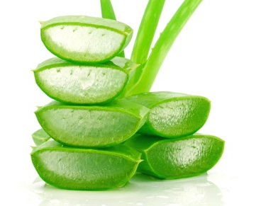
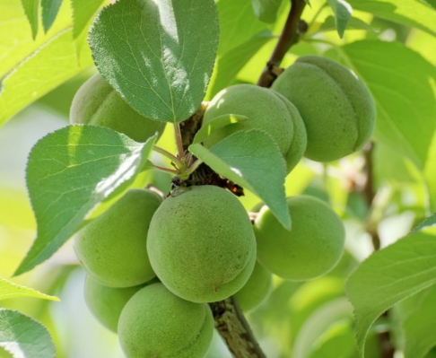
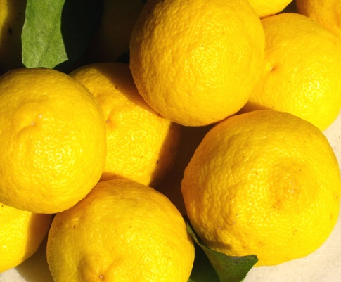
5
Ingredients
Aloe Vera gel Powder
Apricot extract
Citron extract
Helps to soften and moisturize skin
Helps to prevent dryness and hydrates skin
Contains Vitamins C and B and helps to revitalize skin.
* Pertains to the characteristics of the raw materials

Slide 8
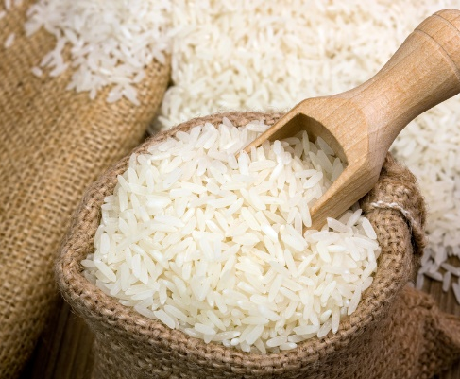
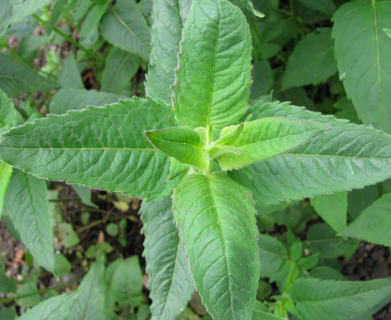
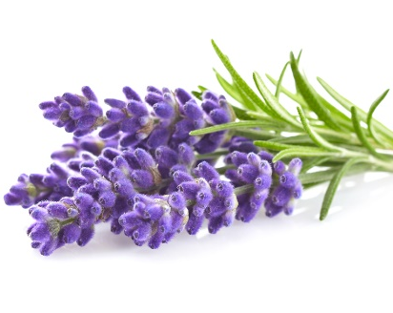
5
Ingredients
Rice bran extract
Spearmint Oil
lavender Oil
Extracted from rice and helps to soften skin
Provides a fresh and clean scent
Provides a calming scent
* Pertains to the characteristics of the raw materials

Slide 9
Synthetic Surfactants
Plant Derived Surfactants
6
Extracts
Chemical substances such as sulfuric acid, nitric acid and hydrochloric acid.
Wheat germ oil and sugar cane extracts and vegetable glycerin
Synthetic vs Plant Derived Surfactants
Effects
May cause skin irritations. Pollutes the environments.
Non Irritating Formula
Cleaning Power
Requires heavy rinsing
Effective cleaning power and eco-friendly
Main Types
SLS(Sodium Lauryl Sulfate), SLES(Sodium Laureth Sulfate)
Main component to create rich lather. May cause skin irritations
ALES/ALS (Ammonium Lauryl Sulfate))
Sodium Cortis Sulfate
Cleaning ingredient derived from coconut oil
(Alkyl Polyglucoside)
Plant derived surfactant extracted from sugarcane.

