Slide 1

■ Product Specifics
■ Product Characteristics
■ Antibacterial Test Results

Slide 2
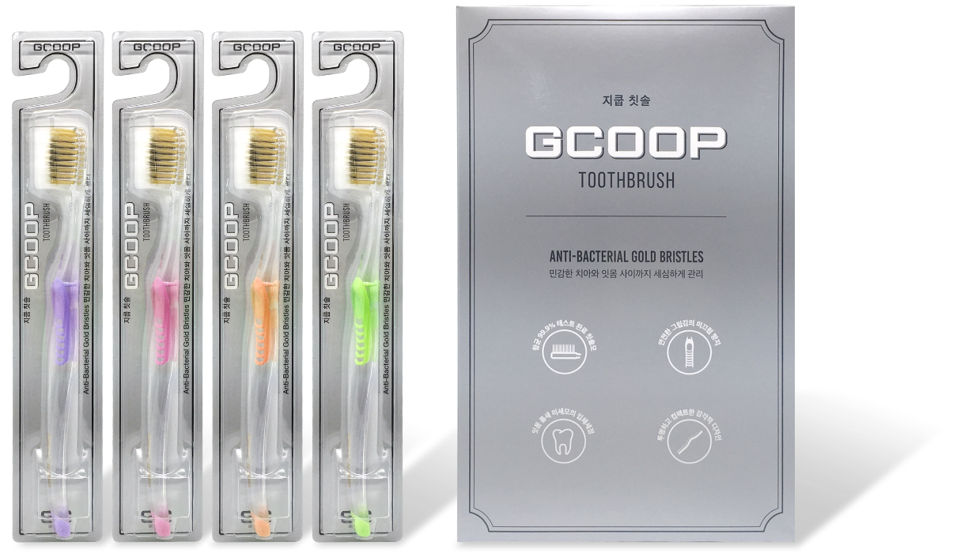
Product Name: Gcoop Toothbrush
Component: 1 Set (4 ea.)
Handgrip Material: PET & Natural Rubber
Bristle Material: Synthetic Resin
Type of Bristle: Soft
Heat Resistance Limit: 60℃
Caution
1. Only use for brushing teeth
2. Do not boil the product. Heat will cause the brush to bend and the bristles to fall out.
3. Be sure to brush gently in order to prevent damage to gums.
4. Do not grip the product too tightly to prevent damage.

Slide 3




GCOOP TOOTHBRUSH
Anti-bacterial bristles kill 99.9% of germs
Our product removes plaque from between teeth and offers an antibacterial effect with processed gold and charcoal bristles.
Slip-proof handgrip made of rubber
Our product protects your teeth and gums from accidental damage with its slip-proof rubber handgrip.
Thin bristles capable of cleaning crevices between teeth
The double bristles on this brush can remove plaque that forms deep between teeth.
Transparent wave-shaped handle
The transparent wave-shaped handle helps you evaluate the hygienic condition of your brush at a glance and offers a comfortable grip with an ergonomic design.

Slide 4
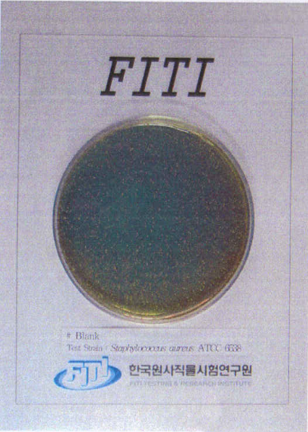
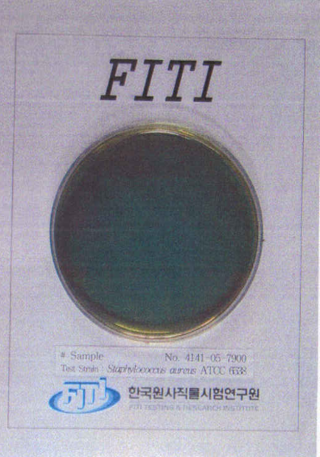
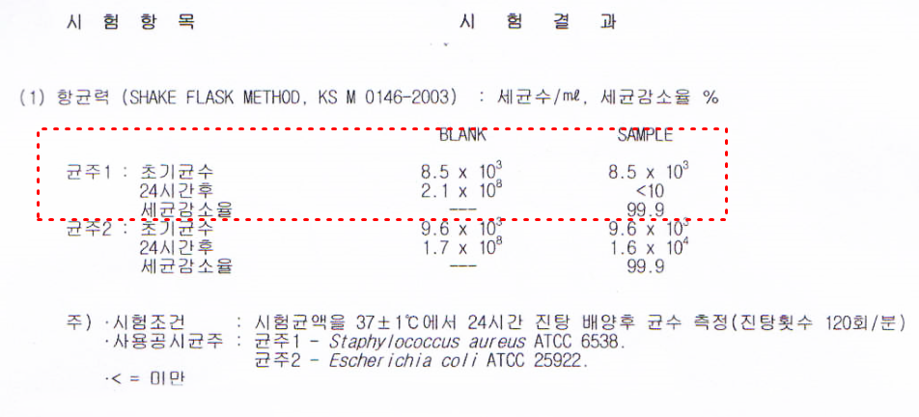
Gcoop Toothbrush Antibacterial Activity Test
Test Item
Test Result
(1) Antibiotic Serial Number (SHAKE FLASK METHOD, KS M 0146-2003): The number of germs/ml, a reduction ratio of germs
Flora 1: Initial Germs
24 Hours Later
Reduction Ratio of Germs
Flora 2: Initial Germs
24 Hours Later
Reduction Ratio of Germs
Notes:
Test Conditions: The number of germs was measured after twenty-four hours of shaking the culture subject liquid at a temperature of 37 degrees Celsius with an error tolerance of 1 degree Celsius (shaking 120 times per minute)
Type of Germ Used: Flora 1 - Staphylococcus aureus ATCC 6538
Flora 2 - Escherichia coli ATCC 25922
<= : Less Than

Slide 5
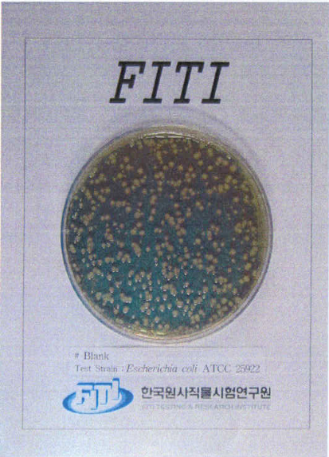
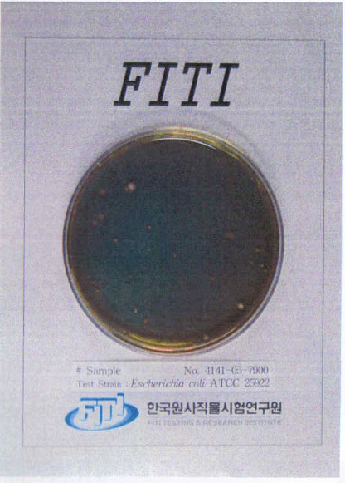
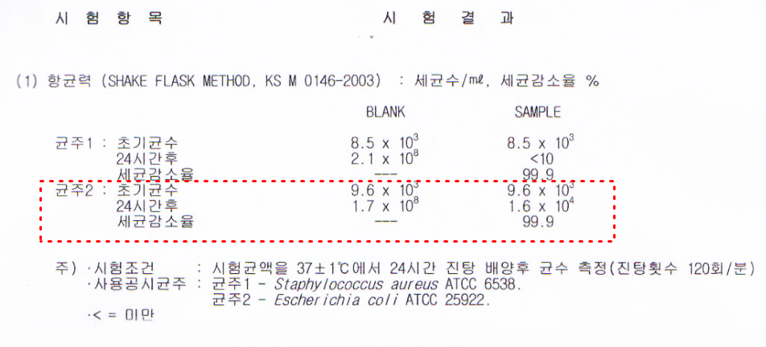
Gcoop Toothbrush Antibacterial Activity Test
Test Item
Test Result
(1) Antibiotic Serial Number (SHAKE FLASK METHOD, KS M 0146-2003): The number of germs/ml, a reduction ratio of germs
Flora 1: Initial Germs
24 Hours Later
Reduction Ratio of Germs
Flora 2: Initial Germs
24 Hours Later
Reduction Ratio of Germs
Notes:
Test Conditions: The number of germs was measured after twenty-four hours of shaking the culture subject liquid at a temperature of 37 degrees Celsius with an error tolerance of 1 degree Celsius (shaking 120 times per minute)
Type of Germ Used: Flora 1 - Staphylococcus aureus ATCC 6538
Flora 2 - Escherichia coli ATCC 25922
<= : Less Than

Slide 6
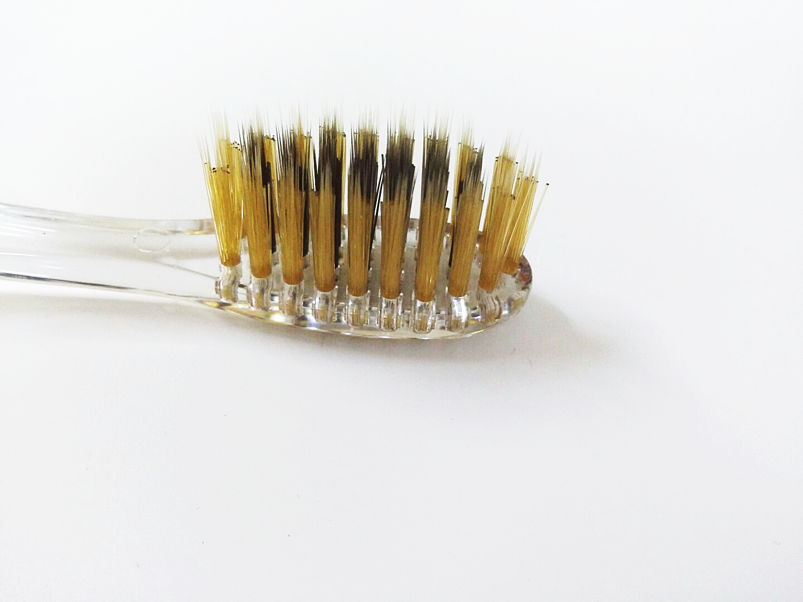
CARE INSTRUCTIONS
Do not use hard bristle toothbrushes
Hard bristle toothbrushes will damage your gums and cause wear on teeth. Use soft bristles to protect your oral health.
Do not use the same toothbrush for too long
You should change your toothbrush every three months. Using the same toothbrush for too long causes the bristles to wear out and reduces the brush's capacity to clean your teeth.
Wash your toothbrush properly with water after using it
Do not forget to remove food and toothpaste residue from your toothbrush after use since these can cause bacterial multiplication.
Store your toothbrush individually
In order to prevent bacterial multiplication, store your toothbrush upright and individually.
Dry your toothbrush after use
Humidity accelerates the multiplication of bacteria, so keep your toothbrush dry.

