Slide 1
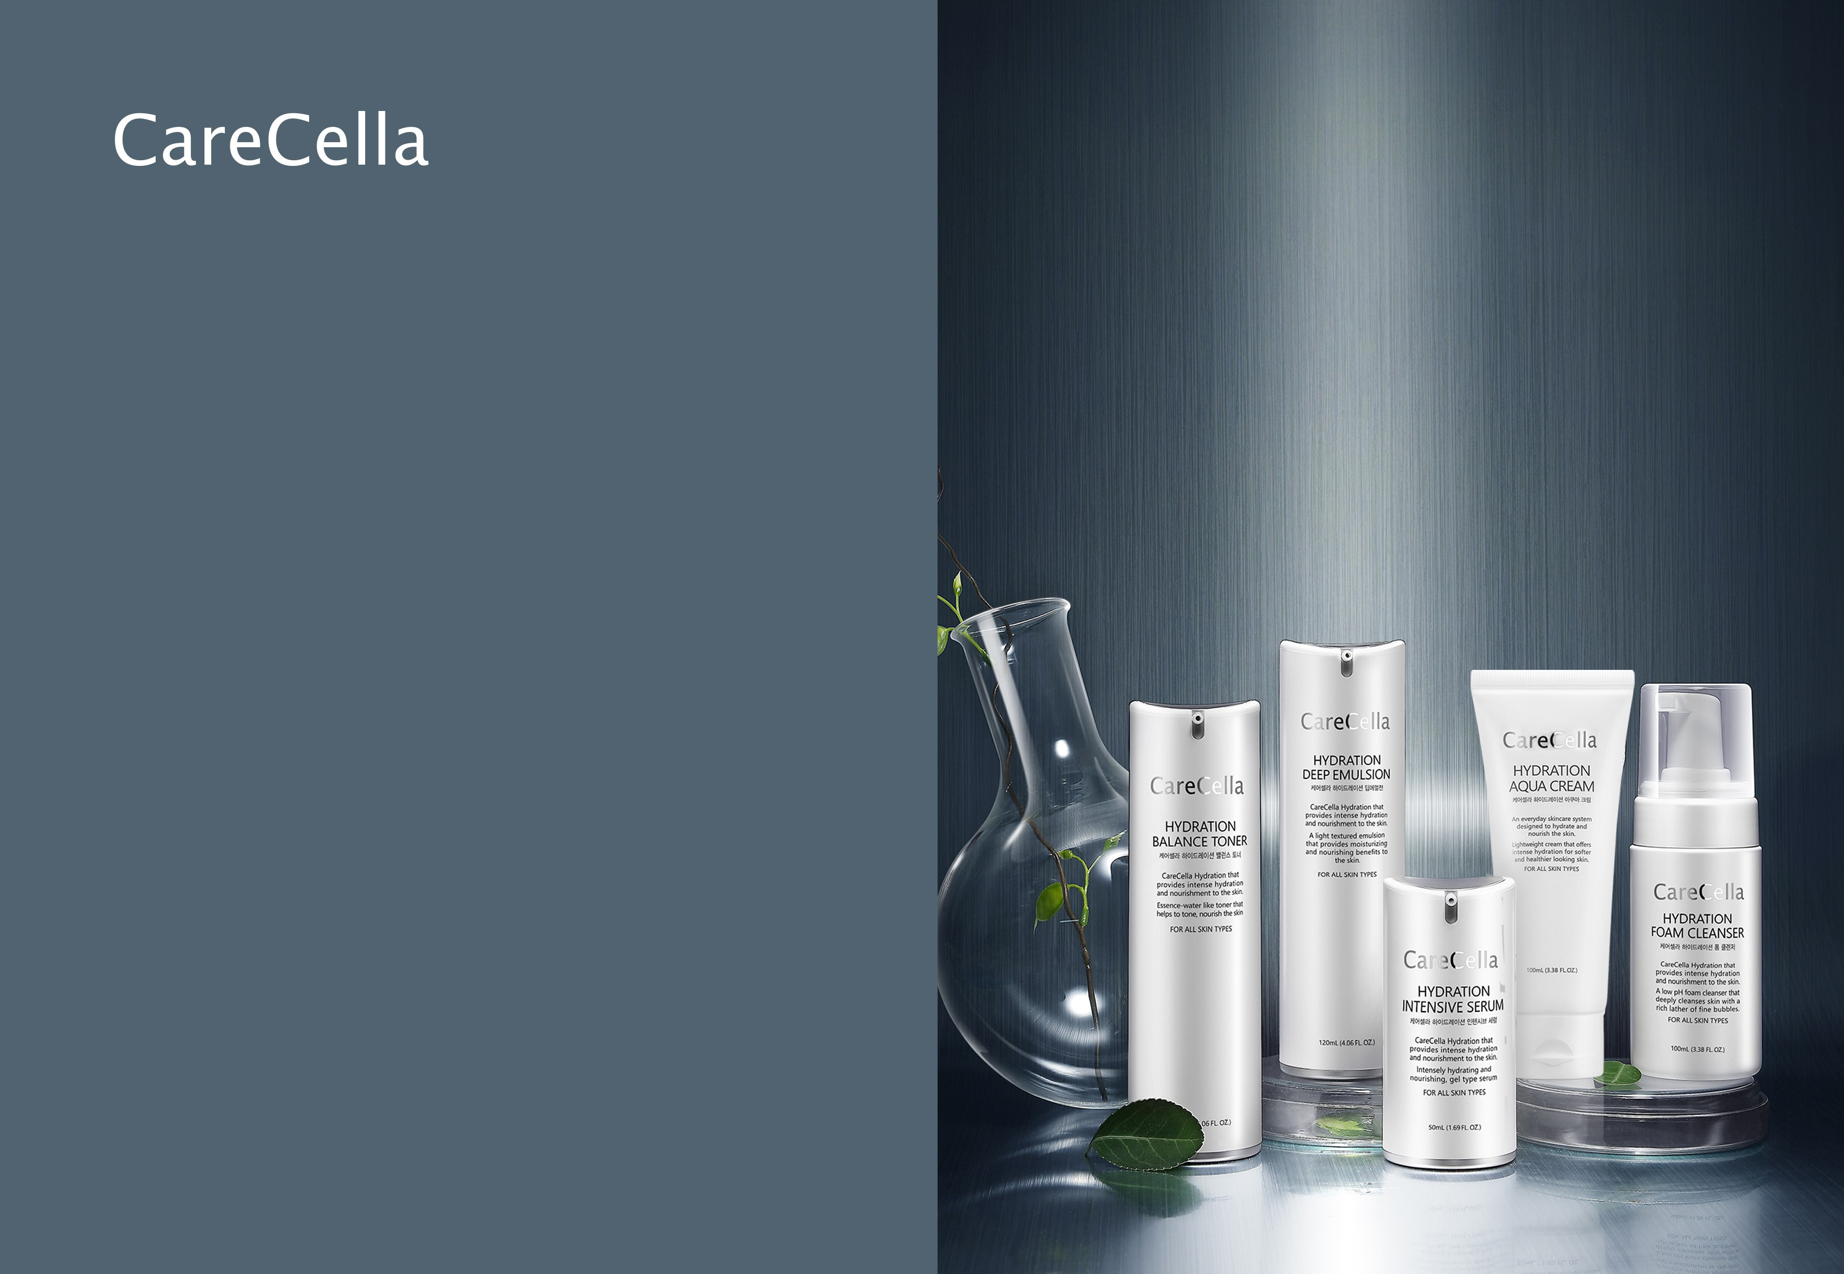
케어셀라
하이드레이션
베이직 세트
CareCella Hydration Basic Set
* This document is based on the laws and standards of the Korea Ministry of Food and Drug Safety (MFDS). Please note that food and drug standards and laws differ in every country.
* This document is meant strictly for internal training purposes. Unauthorized use of this document is strictly prohibited.

Slide 2

Advertising Laws Regarding Cosmetics
GCOOP strives to ensure that members are not mislead through unlawful or deceptive advertising methods.
We ask for your cooperation in this matter. Please refer to the guidance below to avoid unlawful or deceptive advertising methods.
1. Deceptive or misleading statements regarding the products name, effects and or uses that may cause consumers to believe the product is a drug must not be made.
2. Labels and advertising statements that compare products with competing products on the market must be clearly marked and based on factual evidence. Labels and advertising must not use expressions such as ”best” exclusively.
3. False or deceptive statements, or partially factual statements that mislead and deceive consumers regarding the overall product, must not be used.
4. Statements regarding the quality or effectivity of the product that cannot be objectively confirmed based on factual evidence, or markings/advertising that is outside of the scope of cosmetics as stated in Section 2 Article 1, must not be made.
5. Advertising must not contain degrading expressions, graphics, visuals or photographic content.
6. Advertising must not state or imply that the product contains internationally endangered processed goods.
7. Statements that are slanderous or may be construed as slanderous without any factual evidence, regarding other products must not be made.
Enforced Regulations of the Cosmetics Act Article 22 (Scope of Labeling Advertising etc.) [Enforcement April 19, 2018] [Appendix 5] <Revision2017.1.12.> Scope and Compliance of Cosmetics Labeling and Advertising

Slide 3
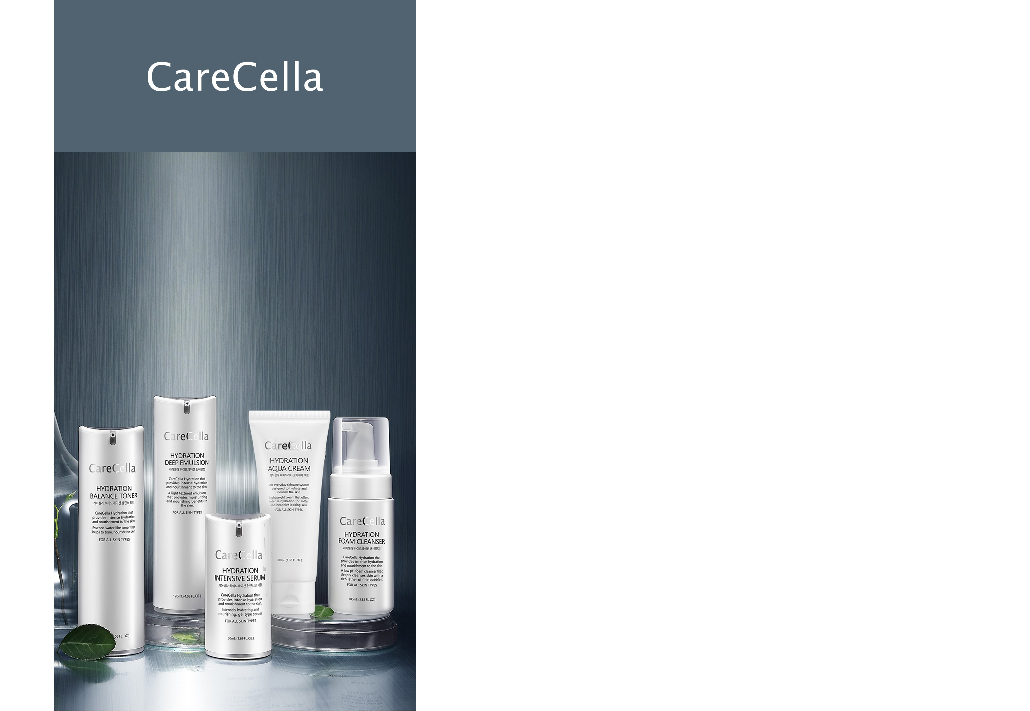
Hydration Basic Set
케어셀라 하이드레이션 베이직 세트
1. Product Set Details
2. Individual Product Details
3. Product Features
4. Order of Use
5. Featured Ingredients
* This document is meant strictly for internal training purposes. Unauthorized use of this document is strictly prohibited.

Slide 4
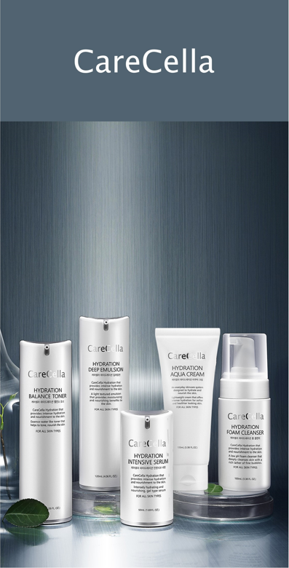

Product Set Details
+ CareCella Hydration Foam Cleanser
- 100mL e 3.38 fl. Oz. / Tested for Safety and Quality Assurance by Dermatest (Germany) and in South Korea
+ CareCella Hydration Balance Toner
- 120mL e 4.05 fl. Oz. / Tested for Safety and Quality Assurance by Dermatest (Germany) and in South Korea
/ Brightens and helps to reduce the appearance of wrinkles
+ CareCella Hydration Intensive Serum
- 50mL e 1.69 fl. Oz. / Tested for Safety and Quality Assurance by Dermatest (Germany) and in South Korea
/ Brightens and helps to reduce the appearance of wrinkles
+ CareCella Hydration Deep Emulsion
- 120mL e 4.05 fl. Oz. / Tested for Safety and Quality Assurance by Dermatest (Germany) and in South Korea
/ Brightens and helps to reduce the appearance of wrinkles
+ CareCella Hydration Aqua Cream
- 100mL e 3.38 fl. Oz. / Tested for Safety and Quality Assurance by Dermatest (Germany) and in South Korea
/ Brightens and helps to reduce the appearance of wrinkles

Slide 5
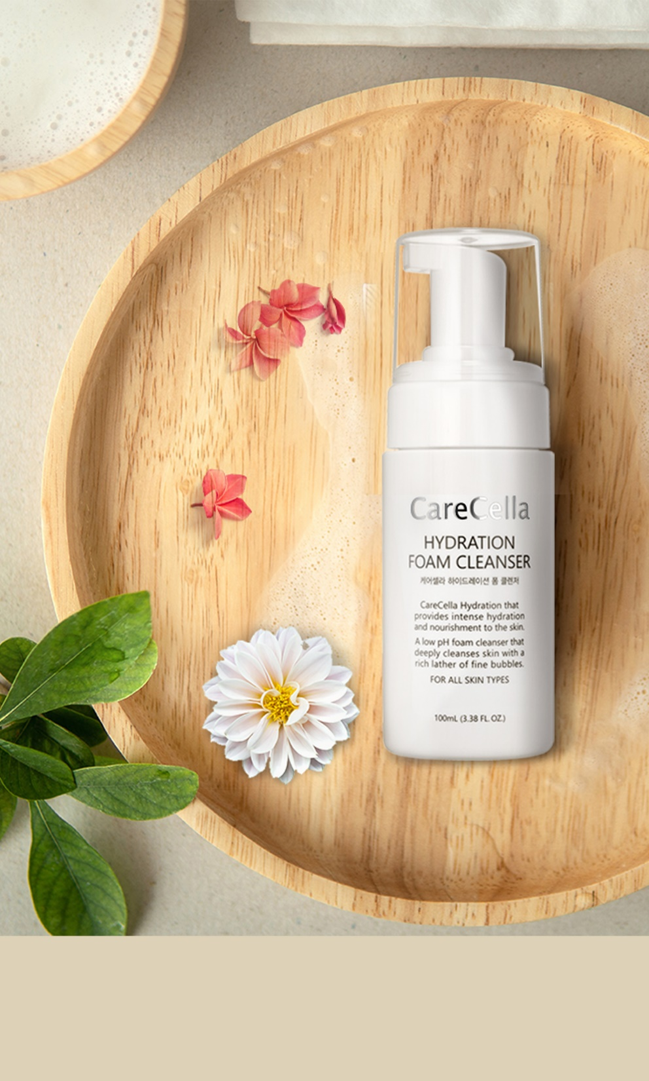
Individual Product Details
+ CareCella Hydration Foam Cleanser
+ Net Wt. 100mL
+ Featured Ingredients
Soybean Phyto-placenta, Ginsenoside, Argan
Kernel Oil, Aloe Vera Leaf Extract, Centella
Asiatica Extract, Green Tea Extract,
Copper Tripeptide-1, etc.,
+ How to use
1. Every morning and evening during cleansing,
apply the CareCella Hydration Foam Cleanser
to the hands.
2. Gently massage the foamy lather onto the skin
to cleanse.
3. Rinse thoroughly with lukewarm water and
finish with a final cold rinse.

Slide 6
Product Features
+ Start With Hydration! Gentle and Hydrating Foam Cleanser
Low pH cleanser with a foamy rich lather that gently
cleanses and refreshes the skin
+ Safe, Plant-Based Surfactants
Formulated with gentle plant-based surfactants to
minimize irritations.
+ Silky Smooth Texture
Removes excess oils and flaking skin without stripping
away moisture from the skin.

Slide 7
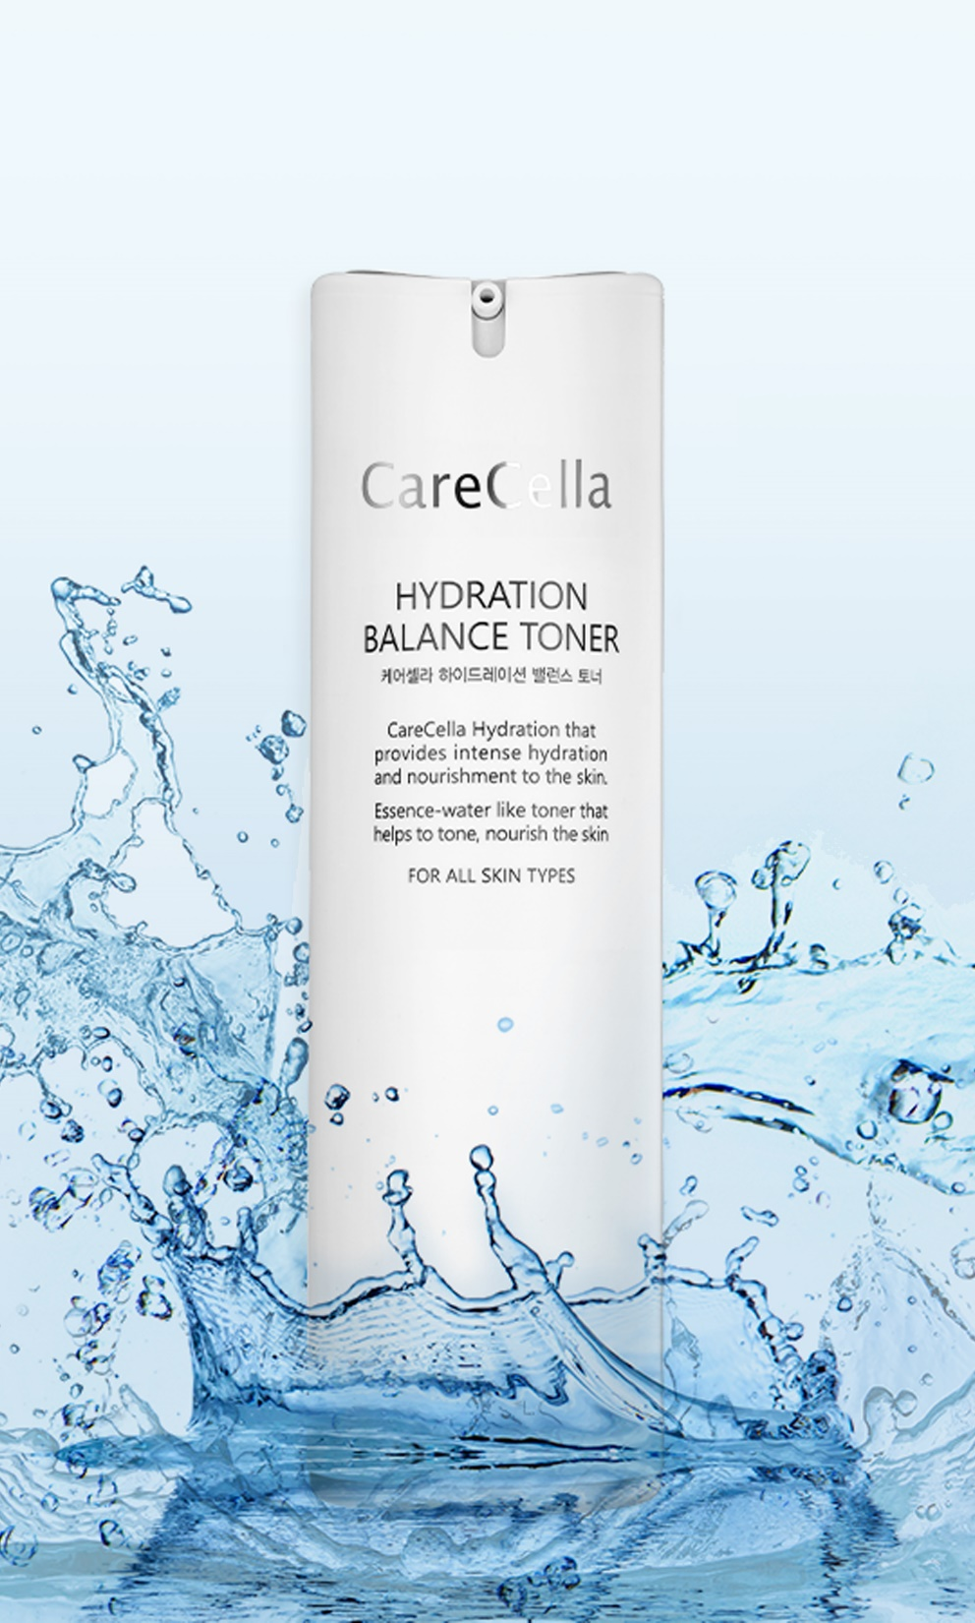
Individual Product Details
+ CareCella Hydration Balance Toner
+ Net Wt. 120mL e 4.05 fl. Oz.
+ Cosmetic - Brightens skin tone and reduces the appearance of wrinkles.
+ Featured Ingredients
Niacinamide, Adenosine, Soybean Phyto-placenta,
Ginsenoside, Argan Kernel Oil, Hydrolyzed Collagen,
Hyaluronic Acid (Sodium Hyaluronate), Sorbitol, etc.,
+ How to Use
1. Every morning and evening after cleansing, apply
the CareCella Hydration Balance Toner to the palms
of your hands and gently pat into the skin.
2. For super smooth skin, apply the toner to a cotton
pad and apply it to the skin using a gentle wiping
motion.

Slide 8
Product Features
+ Ultra-Lightweight Hydrating Essence Water
Ultra-lightweight essence water quickly absorbs and
quenches the skin with a refreshing burst of hydration.
+ Tones the Skin
Every drop helps to tone and prep the skin for skincare.
+ Provides Lasting Hydration
Provides hydration that lasts and helps to make skin feel soft and smooth.

Slide 9
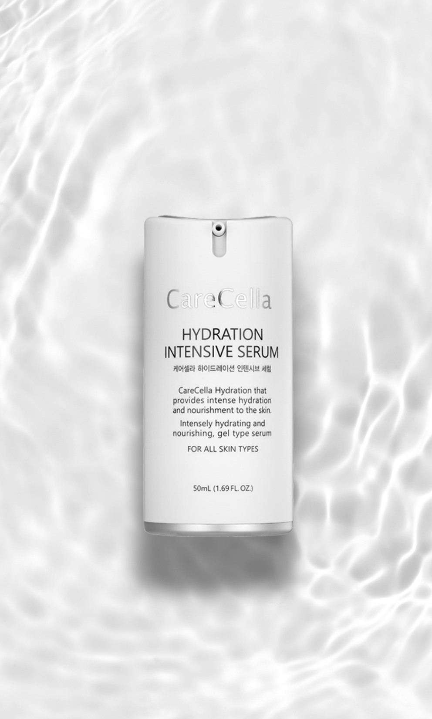
Individual Product Details
+ CareCella Hydration Intensive Serum
+ Net Wt. 50mL e 1.69 fl. Oz.
+ Cosmetic - Brightens skin tone and reduces the appearance of wrinkles.
+ Featured Ingredients
Niacinamide, Adenosine, Soybean Phyto-placenta,
Ginsenoside, Argan kernel Oil, Panthenol, Hydrolyzed
Collagen, Hyaluronic Acid(Sodium Hyaluronate), Aloe
Vera Leaf Extract, Allantoin, etc.,
+ How to Use
1. Every morning and evening after applying toner, use
the CareCella Hydration Intensive Serum.
2. Dot the product onto the cheeks, forehead, and chin. Massage the product from the center of the face to the outside of the face to absorb.

Slide 10
Product Features
+ Concentrated Gel Serum for Intense Hydration and Nourishment
Replenishes moisture and nourishes the skin with
Hyaluronic Acid, and Peptide complex containing
Soybean Phyto-placenta, Ginsenosides, and Hydrolyzed
Collagen.
+ Soothing Gel Formula
Contains Aloe Vera Leaf Extract, Panthenol, and Allantoin
to soothe the skin while providing hydration.

Slide 11
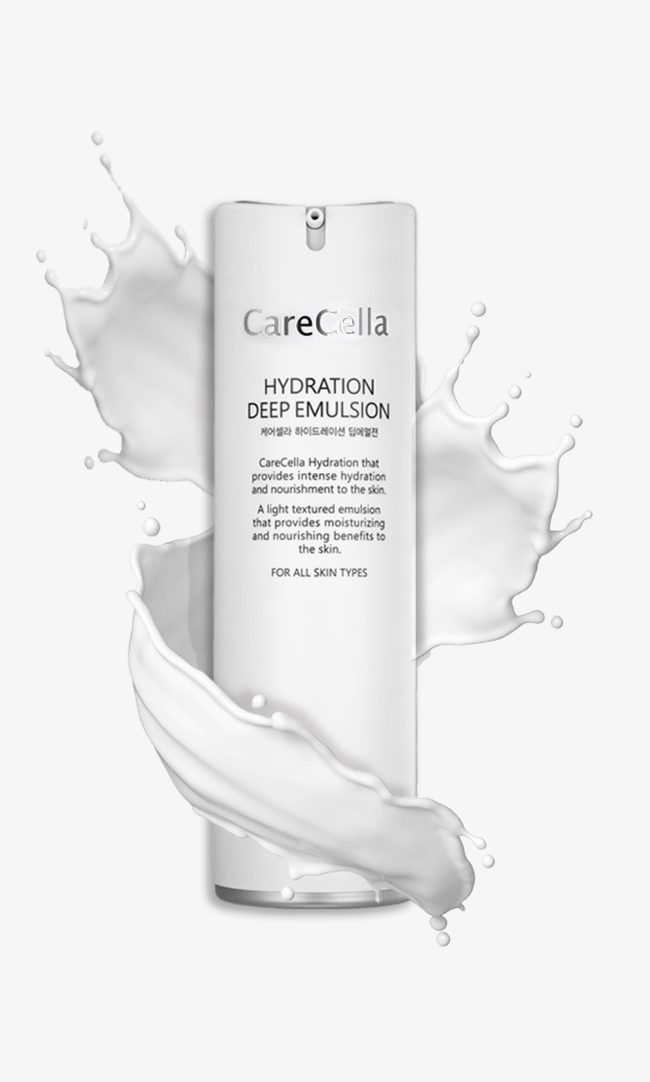
Individual Product Details
+ CareCella Hydration Deep Emulsion
+ Net Wt. 120mL 4.05 fl. Oz.
+ Cosmetic - Brightens skin tone and reduces the appearance of wrinkles.
+ Featured Ingredients
Niacinamide, Adenosine, Soybean Phyto-placenta,
Ginsenoside, Argan Kernel Oil, Shea Butter,
Hydrolyzed Collagen, Hyaluronic Acid (Sodium
Hyaluronate), etc.,
+ How to Use
1. Every morning and evening after applying serum, apply the CareCella Hydration Deep Emulsion. Dot the product onto the cheeks, forehead, and chin and massage into the skin using a circular motion.

Slide 12
Product Features
+ Hydration and Nourishment
Lightweight silky emulsion glides onto the skin to provide
hydration and nourishment.
+ Creates a Moisture Barrier for Glowing Skin
Contains Hyaluronic Acid and Peptide Complex (Soybean Phyto-placenta, Ginsenoside, Hydrolyzed Collagen) and Shea Butter to create a moisture barrier that will keep skin optimally hydrated while also providing a hydrated glow.

Slide 13
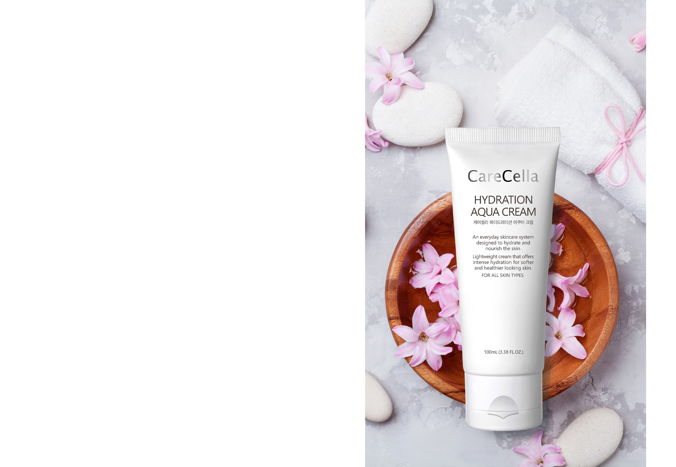
Individual Product Details
+ CareCella Hydration Aqua Cream
+ Net Wt. : 100mL e 3.38 fl. Oz.
+ Uses : Hydrates, brightens, and reduces the appearance of wrinkles.
+ Cosmetic - Brightens skin tone and reduces the appearance of wrinkles.
+ Tested for Safety and Quality Assurance by Dermatest
+ Featured Ingredients
Hydrolyzed Ginseng Saponin, Ginsenoside, Niacinamide, Adenosine, Hydrolyzed Collagen, Sodium Hyaluronate, Panthenol, Trehalose, Sea Salt, Allantoin
+ How to Use: After applying toner and serum, apply the CareCella Hydration Aqua Cream to the face and neck.

Slide 14
Product Features
+ Double the Hydration
Hydrolyzed Collagen and Sodium Hyaluronate are combined for powerful moisturizing benefits.
+ Optimal Formulation of Dead Sea Salt, Panthenol, Allantoin, and Trehalose
Contains hydrating ingredients that condition the skin and help to relieve and prevent itchiness due to dryness.
Dead Sea Salt, an ingredient rich in unique minerals, as well as Panthenol, Allantoin and Trehalose are optimally formulated to condition the skin.

Slide 15
Product Features
+ 3 Types of Hyaluronic Acid Particles
3 types of Hyaluronic Acid particles creates three
layers of hydration to maintain hydrated skin.
+ Peptide Complex to Awaken Dull, Dry Skin
Tripeptide-29, Acetyl Hexapeptide-8, Hexapeptide-9, and Nicotinoyl Tripeptide-1 helps to awaken and refresh dull, dry skin.
+ Nourishes the Skin
Ginsenoside and Hydrolyzed Ginseng Saponin nourish the skin and help to strengthen skin barrier.
+ Brightens Skin Tone and Reduces the Appearance of Wrinkles
Contains Niacinamide and Adenosine to brighten the skin and reduce the appearance of wrinkles.

Slide 16
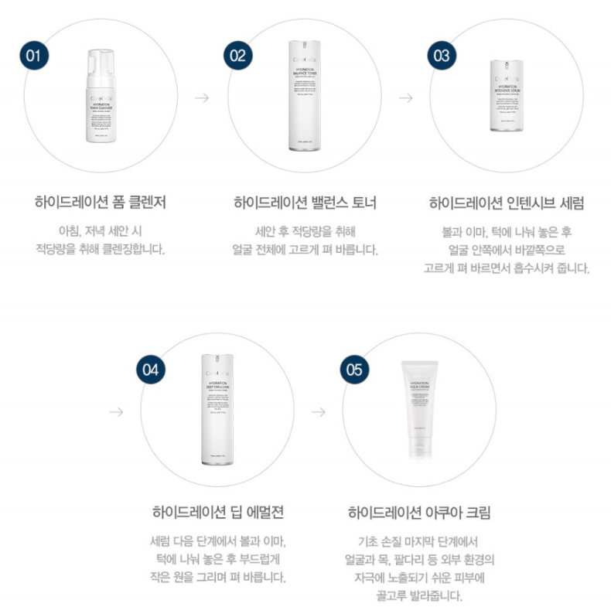
Order of Use
Hydration Foam Cleanser
Hydration Balance Toner
Hydration Intensive Serum
Cleanse every morning
and evening.
After cleansing,
apply toner.
Dot the product onto the
cheeks, forehead and chin.
Massage the product from
the center of the face to the
outside of the face to absorb.
Hydration Deep Emulsion
Hydration Aqua Cream
After serum, dot the product onto the cheeks, forehead and chin.
Massage the product into the
skin using a circular motion.
After basic skincare apply the product
to the face and neck and other
parts of the body that may be
exposed to external irritants.

Slide 17

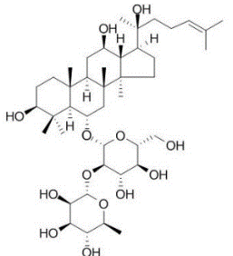
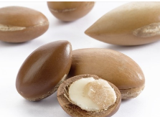
Featured Ingredients – Characteristics of the Raw Materials
Soybean Phyto-placenta
Rich in nutrients that are beneficial to the skin.
Ginsenoside
Nourishing ginseng extract.
Argan Kernel Oil
Rich in vitamins.
* Pertains to the characteristics of the raw materials.

Slide 18
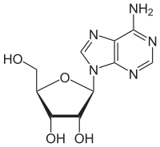
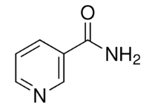
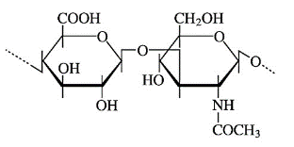
Featured Ingredients – Characteristics of the Raw Materials
Adenosine
- Reduces the appearance of wrinkles.
Niacinamide
- Brightens skin tone.
Hyaluronic Acid (Sodium Hyaluronate)
Provides lasting hydration.
* Pertains to the characteristics of the raw materials.

Slide 19
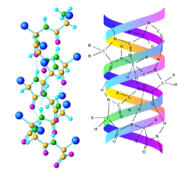

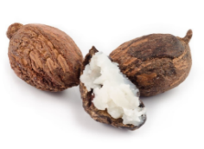
Featured Ingredients – Characteristics of the Raw Materials
Hydrolyzed Collagen
Also called ‘marine collagen’ and helps to provide lasting hydration.
Sorbitol
Helps to provide lasting hydration
Shea Butter
Naturally hydrating ingredient extracted from the fruit of Shea trees.
* Pertains to the characteristics of the raw materials.

