Slide 1
All In one Bio Mist
* This document is based on the laws and standards of the Korea Ministry of Food and Drug Safety (MSDS).
Please not that food and drug standards and laws differ in every country.

Slide 2

Advertising Laws Regarding Cosmetics
GCOOP strives to ensure that members are not mislead through unlawful or deceptive advertising methods.
We ask for your cooperation in this matter. Please refer to the guidance below to avoid unlawful or deceptive advertising methods.
1. Deceptive or misleading statements regarding the products name, effects and or uses that may cause consumers to believe the product is a drug
must not be made.
2. Labels and advertising statements that compare products with competing products on the market must be clearly marked and based on factual
evidence. Labels and advertising must not use expressions such as ”best” exclusively.
3. False or deceptive statements, or partially factual statements that mislead and deceive consumers regarding the overall product, must not be used.
4. Statements regarding the quality or effectivity of the product that cannot be objectively confirmed based on factual evidence, or
markings/advertising that is outside of the scope of cosmetics as stated in Section 2 Article 1, must not be made.
5. Advertising must not contain degrading expressions, graphics, visuals or photographic content.
6. Advertising must not state or imply that the product contains internationally endangered processed goods.
7. Statements that are slanderous or may be construed as slanderous without any factual evidence, regarding other products must not be made.
Enforced Regulations of the Cosmetics Act Article 22 (Scope of Labeling Advertising etc.) [Enforcement April 19, 2018]
[Appendix 5] <Revision2017.1.12.> Scope and Compliance of Cosmetics Labeling and Advertising

Slide 3
All In one Bio Mist
1
2
3
4
Product Overview
How to Use
Product Features
Featured nNgredients
*This document is strictly meant for internal training purposes. Unauthorized use of this document is strictly prohibited.

Slide 4
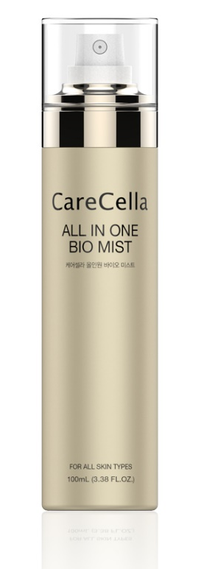


1
Product Overview
+ Effects: Hydrates, brightens skin tone, reduces the appearance of wrinkles.
+ Uses: Brightening, Wrinkle Care Cosmetics
+ Tested for Safety and Quality Assurance by Dermatest
+ Featured Ingredients: Adenosine, Niacinamide, Ginseng Callus Culture Extract, Soybean
Phyto Placenta, Hydrolyzed Ginseng Saponin, Sodium Hyaluronate, Green Tea Extract,
Centella Asiatica Extract, Aloe Vera Leaf Extract
+ Net Quantity : 100mL
+ How to Use: Close eyes and hold 8-10 inches away from face. Mist evenly over skin.

Slide 5
2
① Cleanse the skin.
② Close eyes and hold 8-10 inches away from face. Mist evenly over face and neck.
③ After the mist is absorbed into the skin, follow with Hydration Intensive Serum
and Hydration Deep Emulsion.
Apply sunscreen prior to sun exposure.
④ Apply mist as needed.
How to Use
+ All in One Bio Mist is a concentrated mist that contains Hyaluronic Acid.
It is deeply hydrating, and 2-3 uses are enough to keep skin feeling moisturized
all day long.

Slide 6
+ 5 Peptides that help to make the skin appear firmer and refines skin texture.
Coppertripeptide-1, Peptide Complex (Acetyl Hexapeptide-8
Nicotinoyl Tripeptide,-1, Hexapeptide-9 , Tripeptide-29)
+ GF(Growth Factor) Complex+ Ginseng Callus Culture Extract + Soybean Phyto-placenta
Extract – Triple Strength Formula
Triple strength formula protects and nourishes the skin. Soothes skin sensitized by external
factors.
+ Premium mist that nourishes dry, parched skin.
Brightens and reduces the appearance of wrinkles and contains nourishing ingredients for
beautiful looking skin.
+ Portable and Convenient Size
Portable and Convenient Size so that you can bring it with you anywhere and use it
anytime.
+ Fine Mist Particle
Ultra light fine mist particles are evenly dispersed onto the skin from a PANACHE Valve
Pump (Produced by Albea, a French company)
3
Product Features

Slide 7
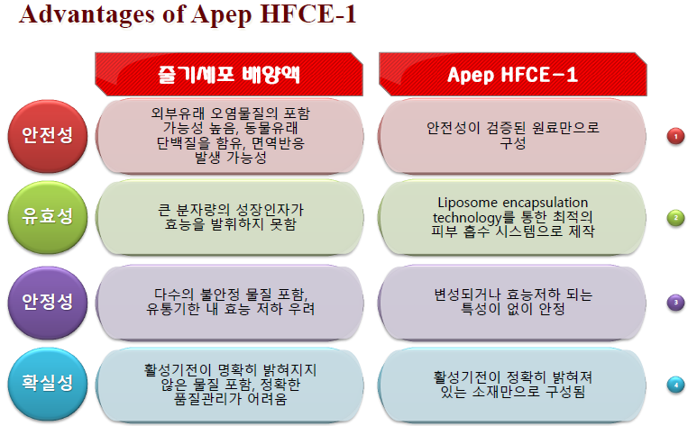
+ Previous Ingredients VS New Ingredients
3
Product Features
- Ingredient Comparison
High possibility that it may contain external pollutants and animal protein. May cause immune system reaction.
Formulated only with ingredients
that are proven to be safe.
Safety
Particle size too large
to be effective.
Particles produced using liposome encapsulation technology to ensure optimal absorption
Effectivity
Contains various unstable substances
with concern for loss of effectivity prior to expiration date.
Stabilized ingredients that will continue to remain effective until expiration date.
Safety
Quality Assurance
Contains substances with active mechanisms that have not been clearly identified and clear quality assessment is difficult.
Contains substances with active mechanisms that are clearly identified.
* GF(Growth Factor)Complex= Apep HFCE-1
* Pertains to the characteristics of the raw materials.

Slide 8
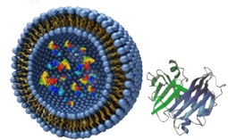
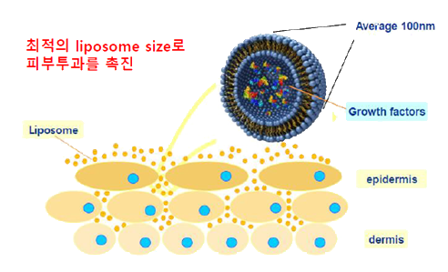
1
4
SH-oligopeptide-1 | EGF
SH- polypeptide-1 | bFGF
SH-oligopeptide-2 | IGF-1
SH-polypeptide-9 | VEGF
SH- polypeptide-22 | TGF-ß1
Featured Ingredients
GF(Growth Factor) Complex
Liposome encapsulation technology for optimal absorption
+ Pertains to the characteristics of the raw materials.

Slide 9


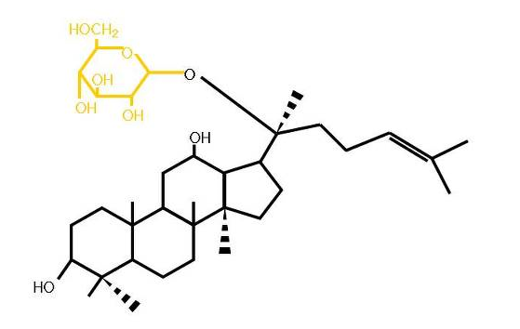
Hydrolyzed Ginseng Saponin
2
3
4
4
Featured Ingredients
Ginseng Callus Culture Extract
Soybean Phyto-Placenta
Hydrolyzed Ginseng Saponin
Rich in nutrients and helps to protect the skin.
Rich in nutrients and helps to strengthen skin barrier.
Rich in nutrients and helps to strengthen skin barrier.
+ Pertains to the characteristics of the raw materials.

Slide 10
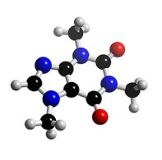
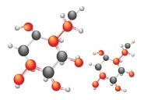
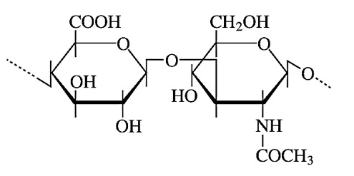
5
6
7
4
Featured Ingredients
Peptide Complex
Sodium Hyaluronate
Adenosine
Contains 5 peptides including Acetyl Hexapeptide-8,
Coppertripeptide-1
to help protect and strengthen the skin.
Keeps skin optimally hydrated.
Helps to reduce the appearance of wrinkles.
+ Pertains to the characteristics of the raw materials.

Slide 11
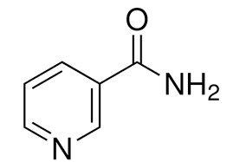
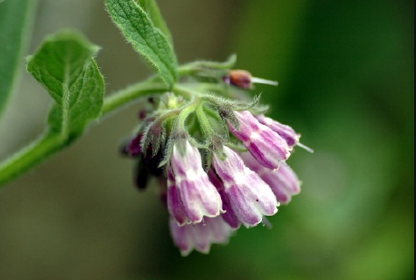
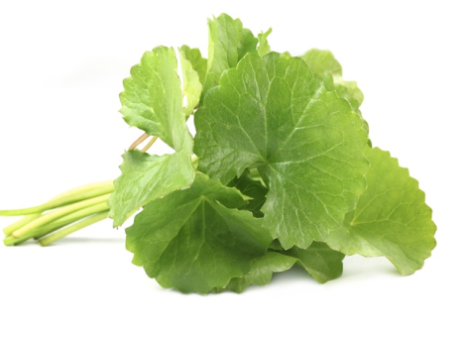
8
9
10
4
-1
Featured Ingredients
Niacinamide
Allantoin
Centella Asiatica
Brightens and clarifies skin tone.
Hydrates and calms
the skin.
Originated from Madagascar and helps to calm the skin.
+ Pertains to the characteristics of the raw materials.

