Slide 1
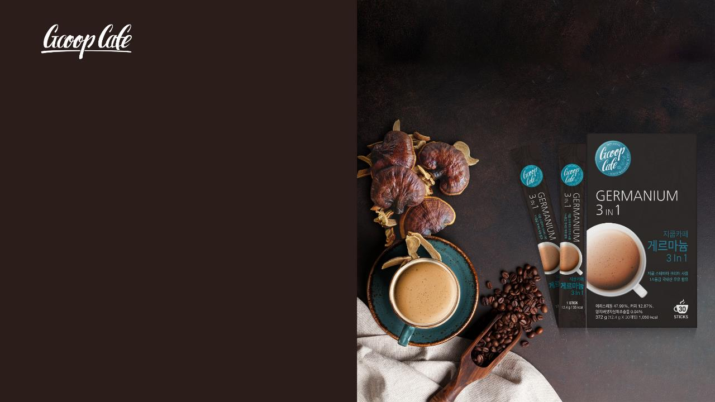
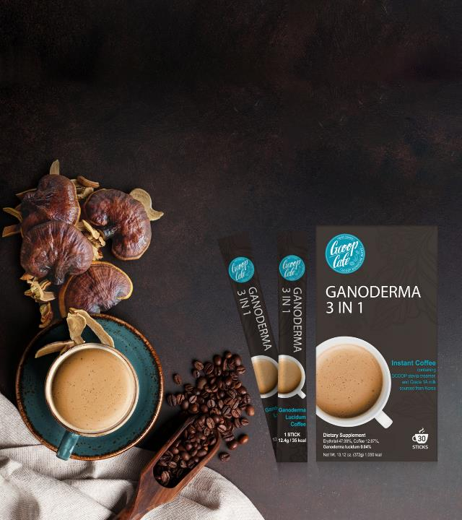
GCOOP CAFE GANODERMA
3-in-1 COFFEE
This data is based on the standards of the Korean Ministry of Food and Drug Safety.
Please note that the MFDS standards and legal standards for each country are different.
* This material is for internal educational purposes only. Please do not distribute it externally.

Slide 2

Regulations Regarding Advertising Claims for Dietary Supplements
GCOOP strives to promote a healthy and transparent advertising culture to comply with regulatory advertising standards and to ensure that members and consumers are not misled or deceived. We ask that you please refer to the guideline below to help
prevent the use of false or inaccurate advertising claims.
1. Do not use expressions or claims that may mislead consumers to believe a product can prevent · treat disease.
2. Do not use expressions or claims that may mislead consumers to believe a food or supplement is a drug.
3. Do not make false or exaggerated claims that may mislead consumers to think/believe a product that is not a dietary
supplement to be a dietary supplement.
4. Do not make false or exaggerated claims.
5. Do not make misleading or deceptive claims.
6. Do not make claims that defame/slander or may be suspected of defaming/slandering another product or company.
7. Claims that compare products with others on the market, must be objective and the standard of comparison and exactly
which products are being compared must be made clear.
8. Expressions or claims that promote speculative feelings or significantly infringe public morals or social ethics by using obscene expressions.
9. Expressions or advertising claims in violation of business operator's compliance (manufacturing facilities, expiration date, and promotion of corruption and speculative practices).
This document is intended for internal training purposes only.
Unauthorized use of this document is strictly prohibited.

Slide 3
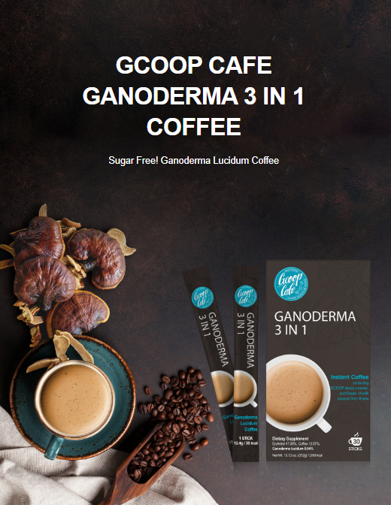
GCOOP Café Ganoderma 3-in-1 Coffee
Key Points of Ganoderma 3-in-1 Coffee
Introduction
Product Characteristics
Recommended Drinking Practices
Recommended For
Related Products (Good to Take Together)
Q & A
References

Slide 4
Key Points of Ganoderma 3-in-1 Coffee
1
Dietary Supplement Instant Coffee with Reishi (Ganoderma) Mushroom Extract
2
5mg of Ganoderma Extract (5mg) 730ug(ppm) of Beta Glucan, and 150mg of Polyphenols in one cup of coffee.
3
Sugar Free, Cholesterol Free, Sodium Caseinate, Low Calorie
4
Brazilian Coffee Beans, Stevia, Ganoderma Lucidum, Grade 1A Milk Sourced from South Korea, Milk Calcium
5
Additive Free

Slide 5
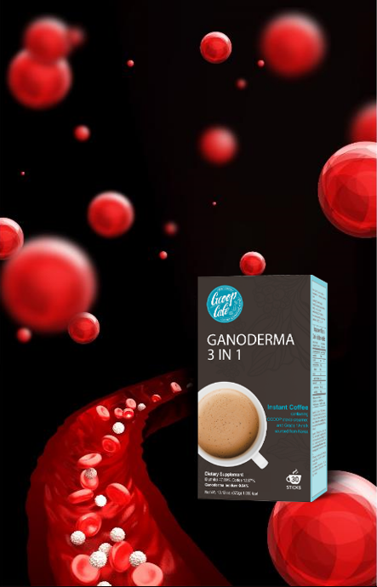
Product Introduction
  Product Name: GCOOP CAFÉ GANODERMA 3-in-1 Coffee
  Type: Ganoderma Lucidum Instant Coffee
  Content: 12.4g x 30 sachets (372g)
  Ingredients: GCOOP Stevia Creamer (Erythritol, Vegetable Cream, enzymatically modified stevia), Grade 1 milk, puredex, skimmed milk powder, 100% Brazilian coffee, Ganoderma (Reishi mushroom) extract
  Dosage/Method of Intake: Mix 1 packet with 1/3~1/2 cup (2.70~3.38 fl.oz.) hot water and stir.
Precautions:
Excessive consumption may cause diarrhea.
Allergies: May cause hypersensitivity reactions depending on the individual.
If you have a specific allergies, please check the ingredients before consuming.
Check serving size and suggestions prior to consumption.
Be careful when opening or ingesting the product, as it may be damaged by the packaging material.
Nitrogen flush packaging.

Slide 6
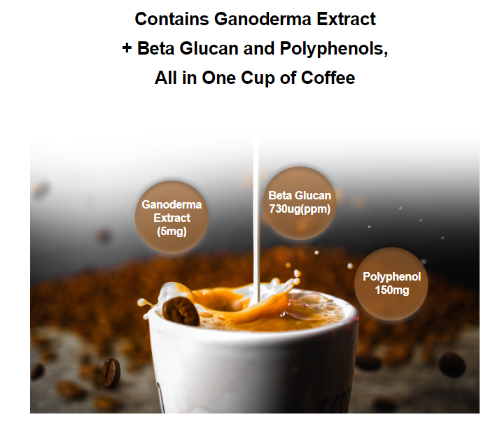
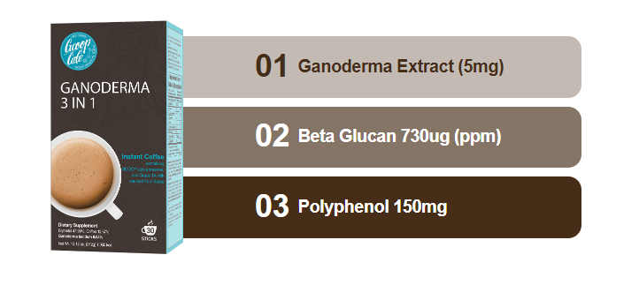
PRODUCT FEATURES
A. Dietary Supplement Instant Coffee →Contains the Highest Content of 3 Functional Ingredients
“Contains Reishi mushrooms, beta-glucan, polyphenols”

Slide 7
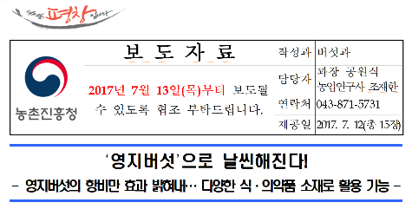
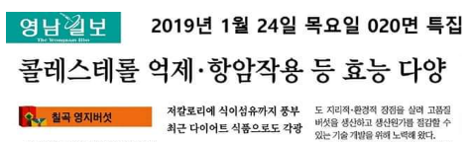
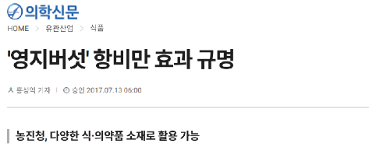
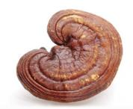
B. Health →Contains Reishi Mushroom Extract
Since ancient times, reishi mushrooms have been very rare, have no side effects, and have the best medicinal effect for health recovery, so they are called "fresh herb, bulbophyllum herb" in China, and "reishi or bulbocho" in Korea, and contain rich nutrients such as beta-glucan, polyphenols, and unsaturated fatty acids.※
Fat Loss
Weight Loss
Anti-Cancer
Immune Activity
Detox
Antiviral
Beta Glucan
Helps Blood Circulation
Immune Action
Anti-Cancer Increase
Cholesterol Suppression
Polyphenols
Antioxidant
Neutralize Free Radicals
Cell Protection
Suppression of Heart Disease
Above information is based on outsourced studies and may not be directly
related to the products of our company.
Anti-Obesity
Reduces Fatty Liver
※ Above statement has not been evaluated by the FDA. This product is not intended to diagnose, treat, cure, or prevent any disease.
Also, above info is based on outsourced sturdies and may not be directly related to the products of our company.

Slide 8
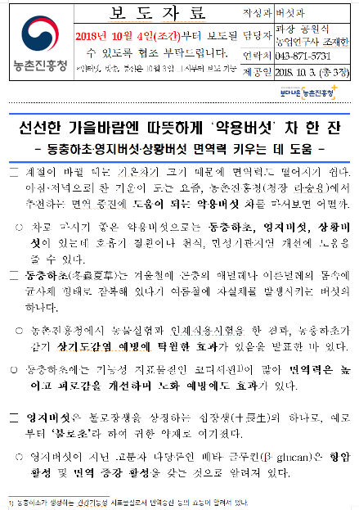
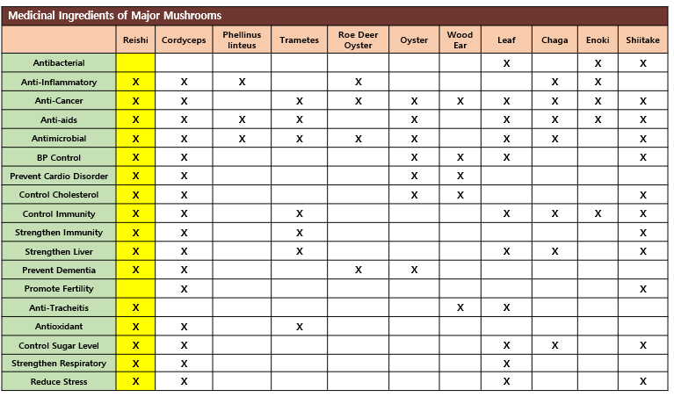
B-1. Reishi Mushrooms with Beta-Glucan
According to the Korea Rural Development Administration, beta-glucan, a polymer polysaccharide in reishi mushrooms, is known to have anti-cancer activity and immune-enhancing activity. ※
※ Above statement has not been evaluated by the FDA. This product is not intended to diagnose, treat, cure, or prevent any disease.
Source: Rural Development Administration
Above information above is based on outsourced studies and may not be directly related to the products of our company.

Slide 9
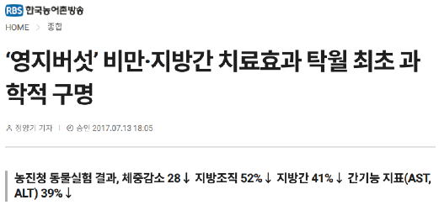
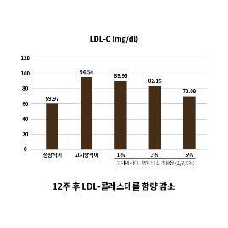
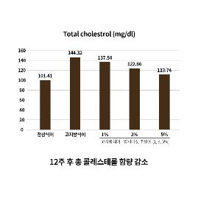
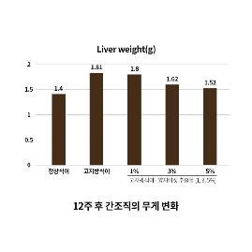
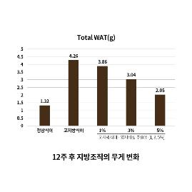
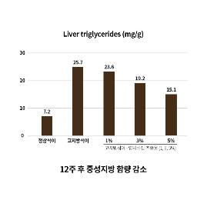
B-2. Reishi Mushroom – Weight Loss Effect
As a result of animal experiments on reishi mushrooms by the Korea Rural Development Agency, it was found that the weight loss effect of Reishi mushroom extract was reduced by 28%, the weight of adipose tissue was reduced by 52%, and fatty liver was reduced by 41%, and serum (AST, ALT), an indicator of liver function, was reduced by 39%. ※
”Reishi Mushroom” First Scientific Life Saver as
Excellent Treatment for Obesity and Fatty Liver
After 12 weeks: LDL cholesterol reduction
After 12 weeks: Total cholesterol reduction
After 12 weeks: Changes in liver weight
After 12 weeks: Changes in fat cells
After 12 weeks: Reduction in triglycerides
※ Above statement has not been evaluated by the FDA. This product is not intended to diagnose, treat, cure, or prevent any disease.
Source - Korea Rural Development Administration
Above information above is based on outsourced studies and may not be directly related to the products of our company.

Slide 10
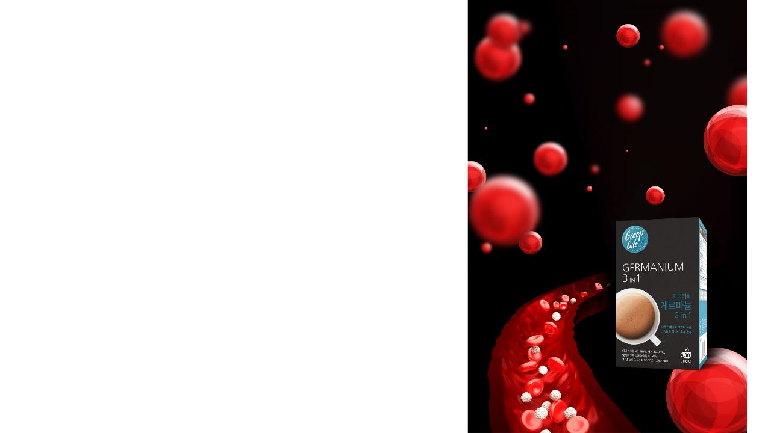
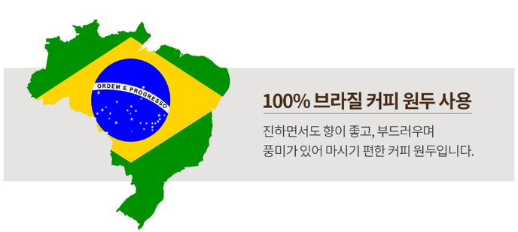
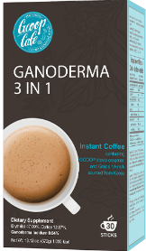
C. 100% Brazilian Coffee Beans
Used 100% Brazilian Coffee Beans
Dark with Great Aroma
Smooth & Zesty Balanced
Easy-to-Drink Coffee
본 자료는 회원 교육용 학술 자료이며 관련 제품의 홍보나 광고 목적으로 사용할수 없습니다 .

Slide 11
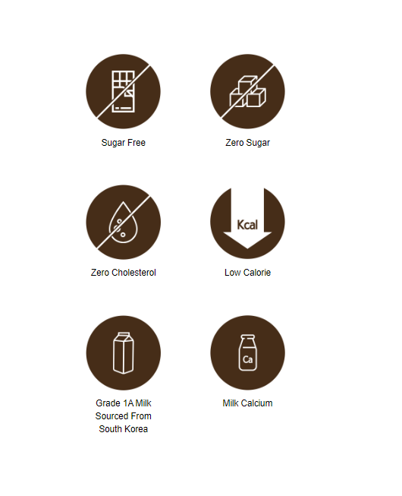
GCOOP Stevia Creamer Features
Formulated with GCOOP’s Stevia Creamer instead of
sugar so no worries about sugar or cholesterol!
D. GCOOP Stevia Creamer
Finally, “healthy” coffee has been made.
Formulated with GCOOP’s very own uniquely mixed Stevia Creamer instead of sugar.
Don’t worry about cholesterol and, best of all, cut calories by half!
For smoother texture of coffee, Grade 1A milk sourced from South Korea has been added.

Slide 12
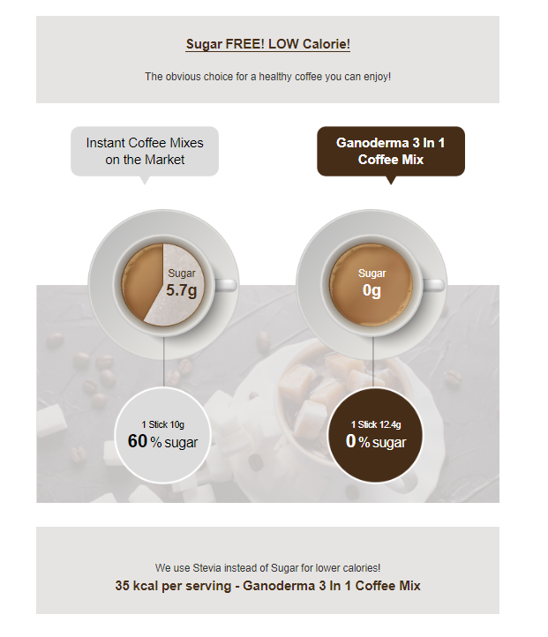
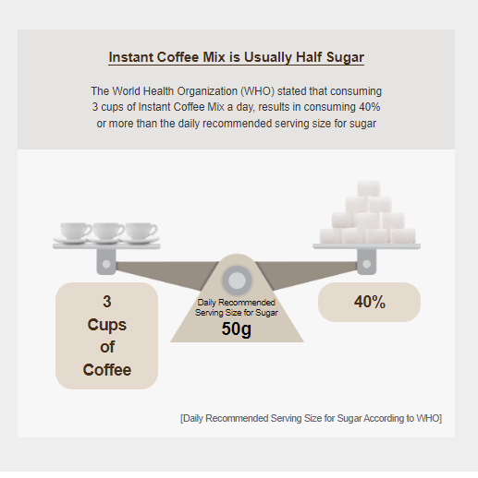
E. Sugar FREE Coffee
No Sugar! Feel Free to Drink it

Slide 13
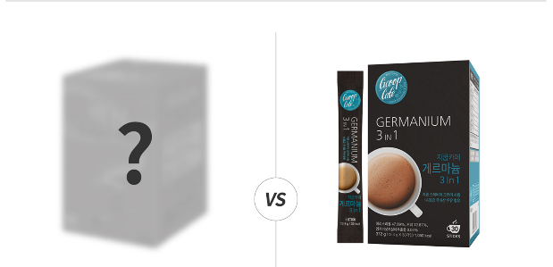


F. LOW CALORIE
Stevia instead of Sugar to Lower Calories!
35Kcal Reishi Coffee Mix
1 packet of regular coffee mix
60Kcal
1 packet of Ganoderma 3-in-1 Coffee Mix
35Kcal per serving

Slide 14
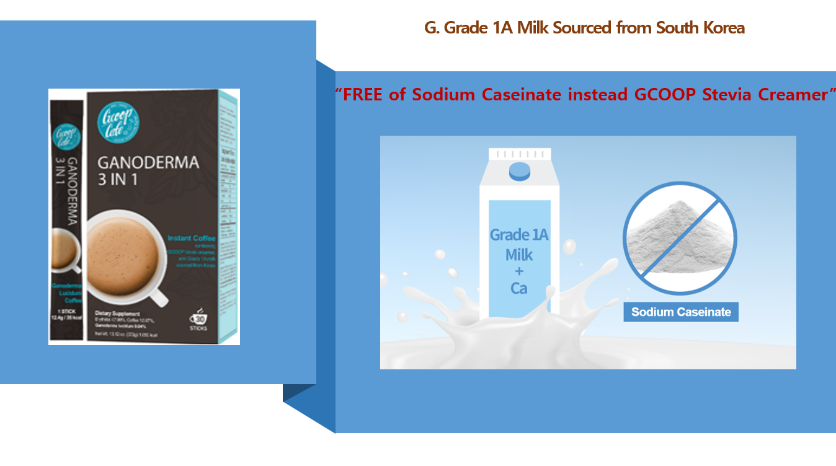

Slide 15
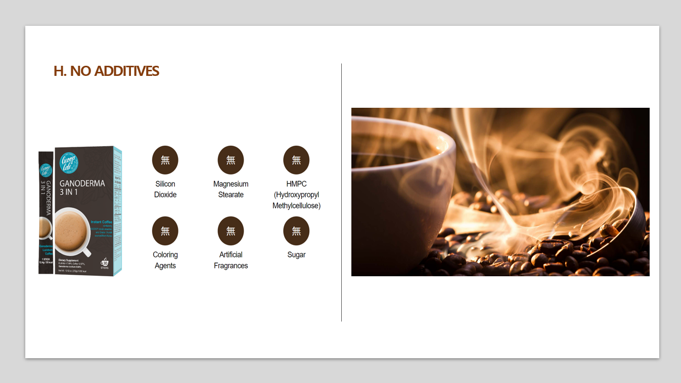

Slide 16
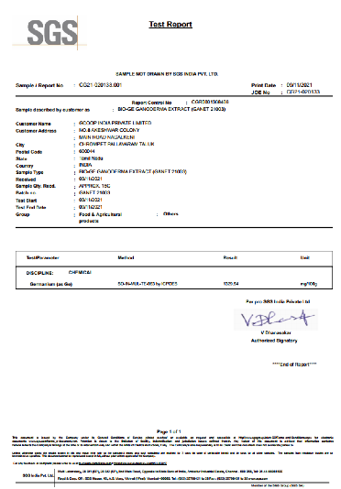
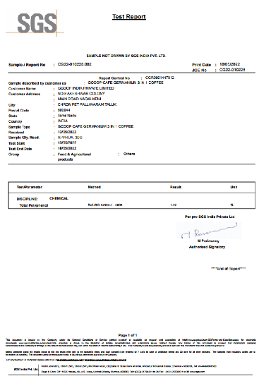
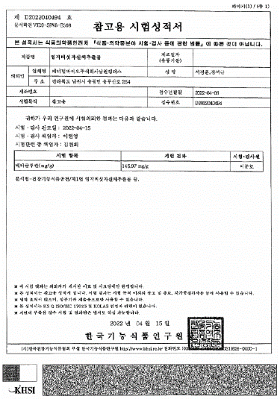
H-1. Raw Material Ingredient Certificate

Slide 17
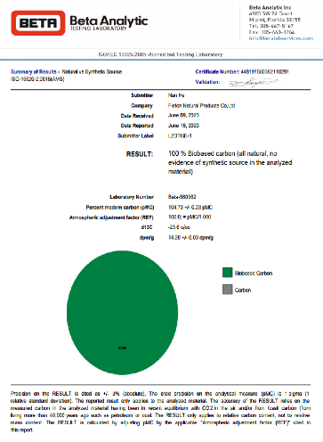
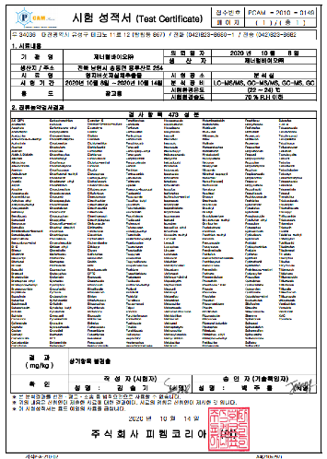
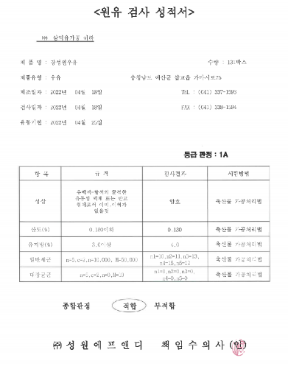
H-2. Certification and Pesticide Residue Test Report

Slide 18
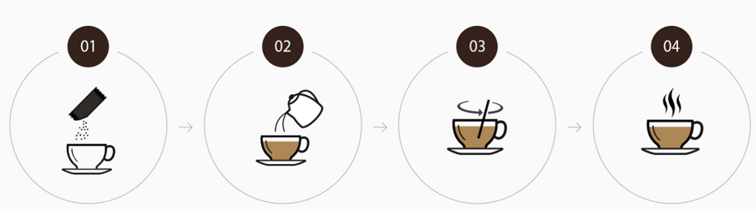
Best Way to ENJOY
GCOOP Café
Put 1 Ganoderma
3-in-1 Coffee packet
into a coffee cup
Slowly Pour 1/3~1/2
cup of Hot Water
(Water level can be adjusted
according to preference)
Stir Well
Enjoy the fresh aroma
of rich coffee taste

Slide 19
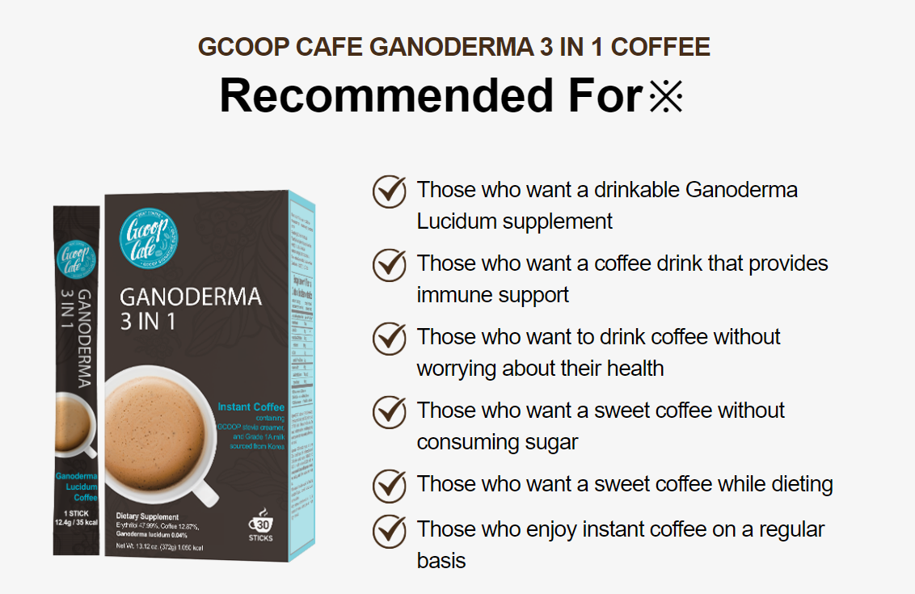

Slide 20
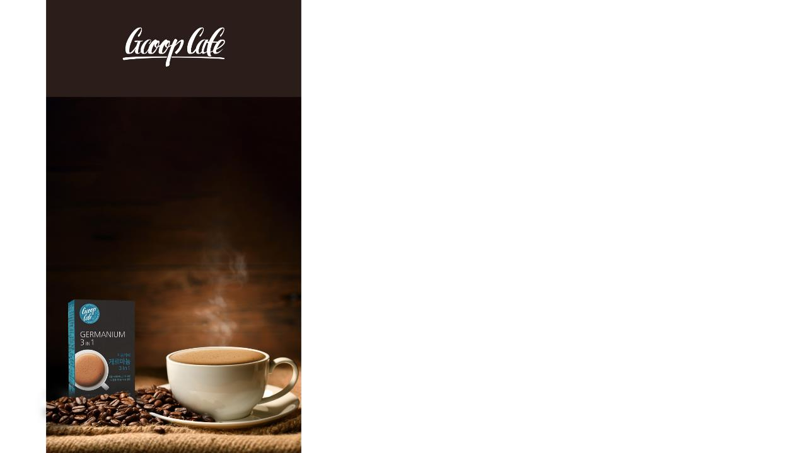
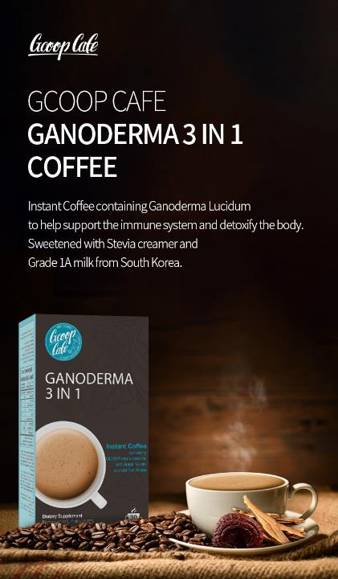
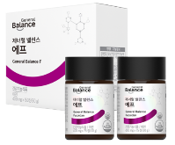
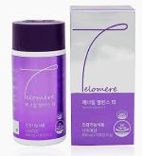
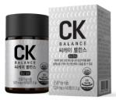
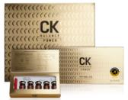
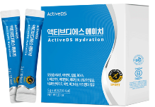
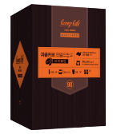
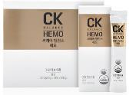
Suggested Good Products to Take Together
General Balance F
General Balance T (Telomere)
ActiveDS H
GCOOP Café Wild Mango
Decaffeinated Coffee
CK Balance Series

Slide 21
Q&A
1. What kind of Coffee is GCOOP Café Ganoderma 3-in-1?
GCOOP Café Ganoderma 3-in-1 Coffee contains Reishi mushroom extract, which provides oxygen to the body, detoxification, blood pressure regulation, and anti-cancer effects and coffee that can help improve immunity.
※ It contains a lot of beta-glucan and polyphenols, so it is recommended for those who want healthy coffee.
2. What about the amount of GCOOP Café Ganoderma Coffee?
GCOOP Café Ganoderma 3-in-1 Coffee is a sugar-free product that can be consumed by those who are burdened with sugar or those who are sick. It contains caffeine so we suggest to adjust the amount if you are sensitive.
3. Why are there calories?
GCOOP Stevia Creamer contains Grade 1 milk to make healthy coffee, so it has calories.
It does not contain sugar or cholesterol, so it is recommended for those who are on a diet.※
지쿱 스테비아 크리머에는 건강한 커피를 만들기 위해 1등급 국내산 우유가 들어 있어 칼로리가 있습니다. 또한, 당 및 콜레스테롤이 들어 있지 않아 다이어트를 하시는 분들에게 권해 드립니다.
4. Does it contain calcium?
It contains Grade 1 milk, so it contains milk calcium (whey calcium).
1등급 국내산 우유에는 우유칼슘 (유청칼슘)이 포함되어 있습니다.
5. Can pregnant or nursing women take it?
If you are pregnant or nursing, please refrain from consuming coffee for the sake of your baby as it contains caffeine.
6. What is the best way to take it?
Depending on your preference, pour 1/3 or 1/2 of hot water in a cup and stir well or you can add ice to have it as ice-coffee.
※ This statement has not been evaluated by the FDA. This product is not intended to diagnose, treat, cure, or prevent any disease.

Slide 22

REFERENCES
This information is an external source extracted to help you understand the product and may not be directly related to our product.
We do not guarantee this information presented and are not responsible for any direct or indirect damages arising therefrom.

Slide 23
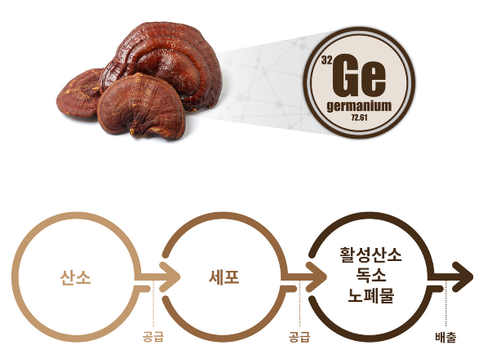
REFERENCES…
Organic Germanium (Bio Germanium)
"The miraculous element of germanium"
“Oxygen Helper” Organic Germanium (Bio Germanium) Extracted from Reishi
Germanium consists of 3-4 oxygen according to its structure, and it replenishes oxygen to cells along red blood cells, helps to supply oxygen to the body, regulate blood pressure, have anticancer effects, and improve immunity, and excretes active oxygen, carcinogens, toxins and wastes (heavy metals, environmental hormones, abnormal cells) out of the body together to normalize the function of cells and various organs.
Active
Oxygen
Toxins
Wastes
Oxygen
Cell
Replenishes
Replenishes
Excretes
This information is based on outsourced studies and may not be directly related to the products of our company.

Slide 24
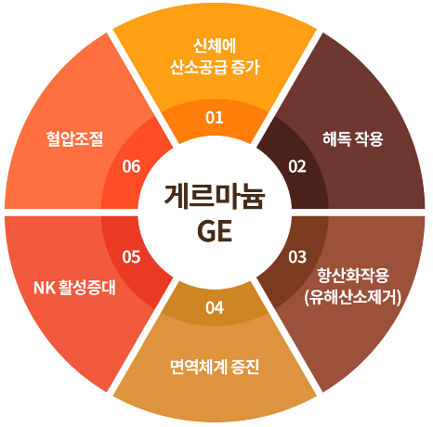
Organic Germanium (Bio-Germanium)
Increase
Oxygen Supply
Germanium includes inorganic germanium and organic germanium, which are mainly used as necklaces and bracelets, etc.
Edible organic germanium is a very small amount of wild ginseng and Reishi mushrooms and is known to have the effect of strengthening immunity, anti-cancer effects, and excreting unnecessary toxins, pathogens, and foreign substances from the body into the feces or skin, thereby is known to provide energetic metabolism and increase vitality.
The effects of germanium were first confirmed when "the Lourdes spring in France around 1940 was said to have therapeutic effects on a number of incurable diseases," and many scientists analyzed the composition of the Lourdes spring and found that "the high content of germanium proves that it can be treated medically for incurable diseases."
Regulate
Blood Pressure
Detoxification
Germanium
Increase
NK Activity
Antioxidant
(Eliminate
Free Radicals)
Boost
Immune Function
This information is based on outsourced studies and may not be directly related to the products of our company.

Slide 25
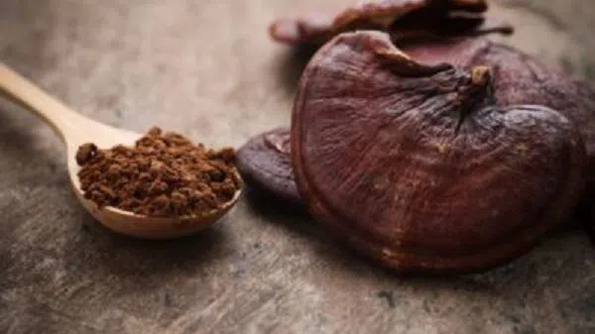
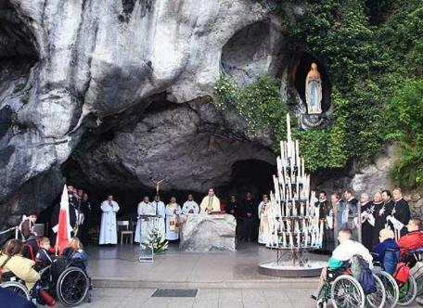
Lourdes Springs is Known For…
Reishi Mushroom Extract
One of World’s Four Miracle Waters
Annually 5 million people visits
Years of spring water analysis and research have confirmed that it contains a large amount of germanium when compared to other spring waters.
Active research on the therapeutic function of germanium
Contains 5mg of Reishi mushroom extract in 1 sachet
Reishi mushrooms contain approximately 50ug
(per certificate of ingredient)
1 packet
Contains 500L of Spring Water
Inclusion content: 0.1ug/L
This information is based on outsourced studies and may not be directly related to the products of our company.

Slide 26
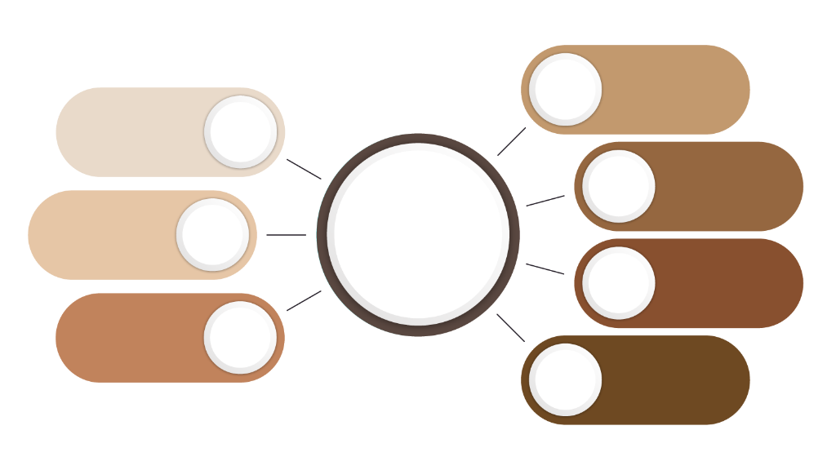
Effects of Water-Soluble Organic Germanium (Bio-Germanium)
“Inhibition of cancer cells and increase of NK cells through detox"
Blood purification
Lipid degradation
Hormonal regulation
Oxygen
Supply
Stress , Aging,
Fatigue,
Environmental
Pollution
Social
Symptoms
Cancer cell inhibition
Reduction of adult diseases, dementia
& cholesterol
Natural
Organic
Germanium
Disease
Produce free radicals
Acid diathesis
Metabolic disorders
Dysfunction
Antiviral
Anti-inflammatory Inflammation relief
Heavy metal detox
Detox
Cancer, Adult diseases, Atopy, Immune system collapse
Disease
Antioxidant
Activate immunity
Interferon secretion
Immunity
Above statement has not been evaluated by the FDA. This product is not intended to diagnose, treat, cure, or prevent any disease.
This information is based on outsourced studies and may not be directly related to the products of our company.

Slide 27
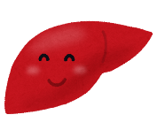









Effects of Water-Soluble Organic Germanium (Bio-Germanium)
“Old red blood cells into young red blood cells“
“Prevents lipid peroxide through free radical supply“
※ Above statement has not been evaluated by the FDA. This product is not intended to diagnose, treat, cure, or prevent any disease.
This information is based on outsourced studies and may not be directly related to the products of our company.

Slide 28




Effects (SCI Paper) Water-Soluble Organic Germanium (Bio-Germanium)
“Anti-cancer effect of germanium on colorectal cancer”
“Effects of Germanium on Multiple Myeloma Cancer Patients”
"Cancer-inhibitory effect of germanium on liver cancer, lung cancer, thyroid cancer, bladder cancer, etc."
"Study of the possibility of germanium anti-cancer drugs and
Biological analysis"
Above statement has not been evaluated by FDA. This product is not intended to diagnose, treat, cure or prevent any disease.
This information is based on outsourced studies and may not be directly related to the products of our company.
Resource: “Germanium Research” Experiments and Clinical Trials

Slide 29




Effects (SCI Paper) Water-Soluble Organic Germanium (Bio-Germanium)
"Organic germanium analgesic effect"
"Inhibition of cancer metastasis through NK cell and macrophage activity"
"Pain relief and amicable relief for terminally ill cancer patients,
Effects of Germanium on the End-of-Life Disease"
"Recovery and improvement effect of decreased immune function after surgery"
Above statement has not been evaluated by FDA. This product is not intended to diagnose, treat, cure or prevent any disease.
This information is based on outsourced studies and may not be directly related to the products of our company.
Resource: “Germanium Research” Experiments and Clinical Trials

Slide 30




Effects (SCI Paper) Water-Soluble Organic Germanium (Bio-Germanium)
"Antioxidant activity against
oxidative stress"
"Inhibition of macrophage penetration of germanium reduces atherosclerosis"
"Organic germanium in immuno-compromised patients has an immunomodulatory effect and white blood cell function modulation"
“Effects on influenza virus
antiviral enzyme activity"
Above statement has not been evaluated by FDA. This product is not intended to diagnose, treat, cure or prevent any disease.
This information is based on outsourced studies and may not be directly related to the products of our company.
Resource: “Germanium Research” Experiments and Clinical Trials

Slide 31


