Slide 1

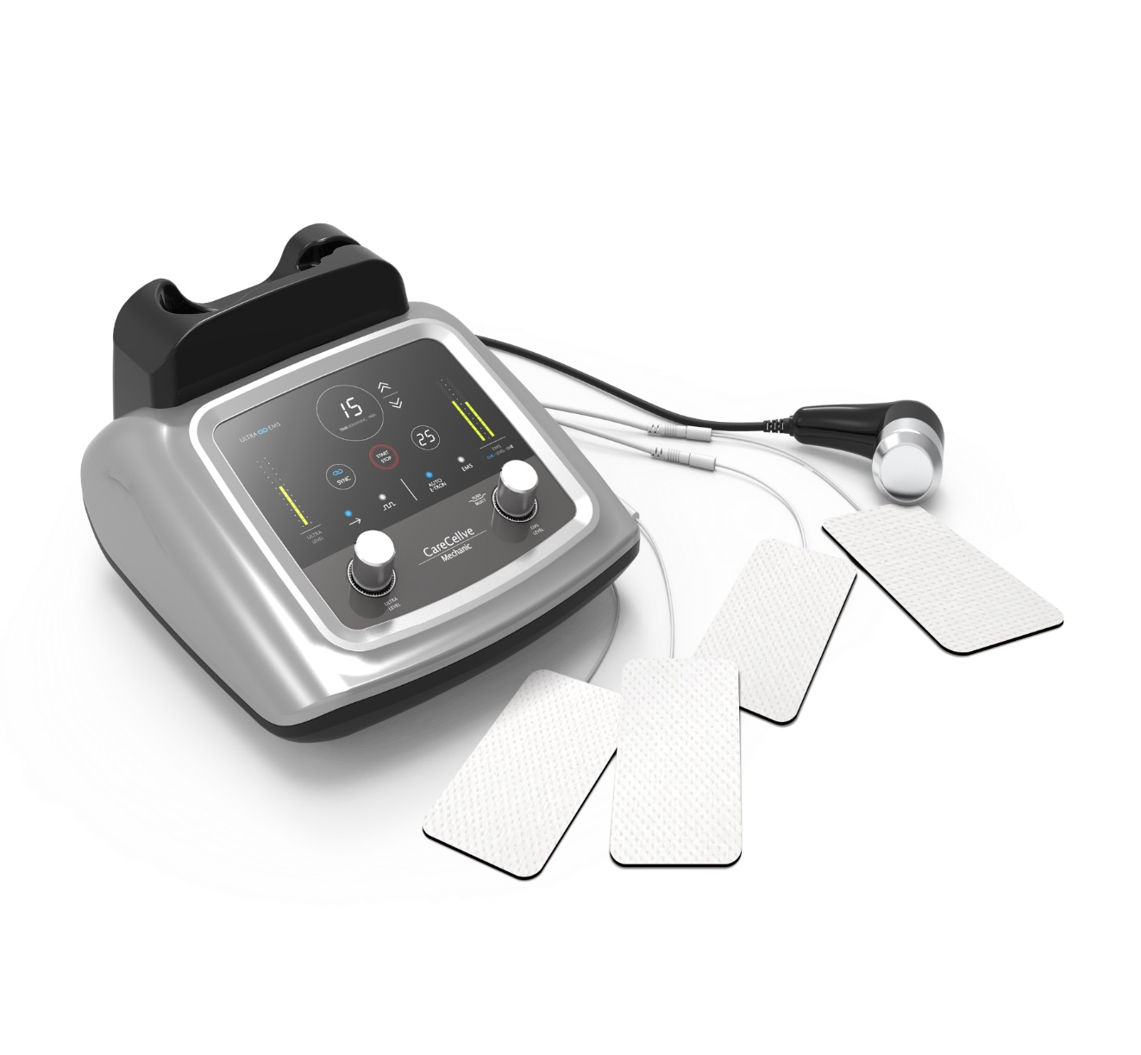


Slide 2

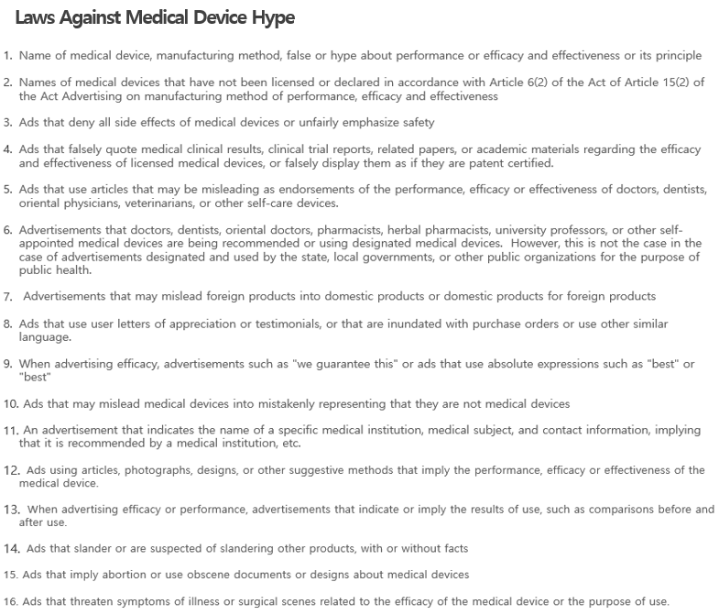
G-Coop Co., Ltd. strives for a healthy advertising culture so that all members are not harmed by hype. Please refer to the relevant laws below and cooperate so as not to lead to false hype.
This material is for internal training purposes and cannot be exported or posted separately.
Important Notice

Slide 3
CareCellve Mechanic
Contents
7 Key Points
Product Specification
Product Features
Certifications
Recommended For
References

Slide 4

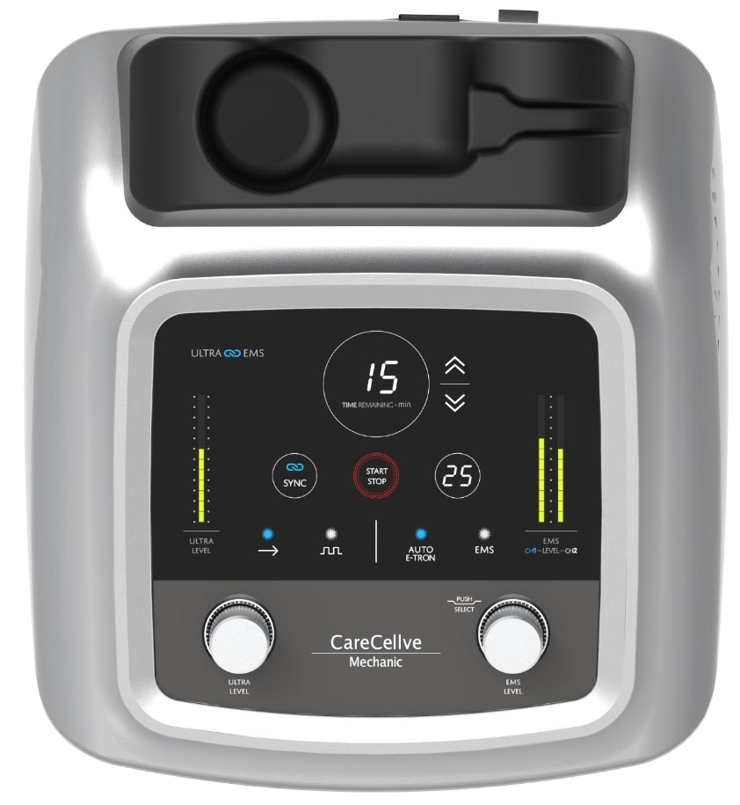
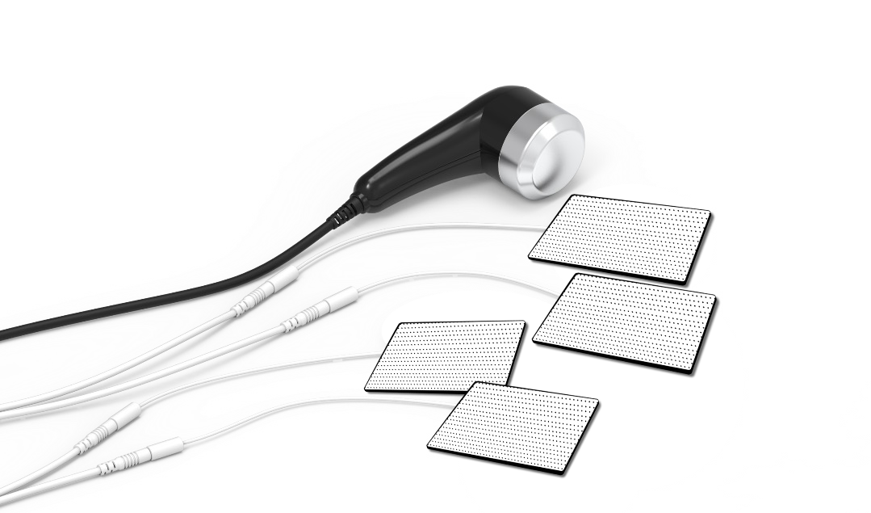
7 Key Points
Point 1
Dual function of ultrasonic wave + low frequency
Point 2
3 types of care at once (skin care, body shape care & pain care)
3 Low-Frequency Functions Implemented
TENS (pain relief)
EMS (muscle rehabilitation)
E-Tron (patented technology system to relieve chronic pain, sports trauma and other pain)
Point 3
Implementation of 3 low-frequency functions
TENS (Pain relief)
EMS (Muscle rehabilitation)
E-Tron (Patented technology system to relieve chronic pain, sports trauma and other pain)
Point 4
Skin care to pain care through 1.2 MHz ultrasonic wave, output 11W high-frequency ultrasonic wave
Point 5
Application of Smart Sensing technology secured from the manufacture of extracorporeal shock wave therapy devices
Point 6
Equipped with SYNC function
When SYNC function is activated, simultaneous 'Ultrasonic Wave + Low Frequency Wave (TENS)' output from the ultrasonic handle
Point 7
One-touch zero-start and overcurrent cut-off

Slide 5
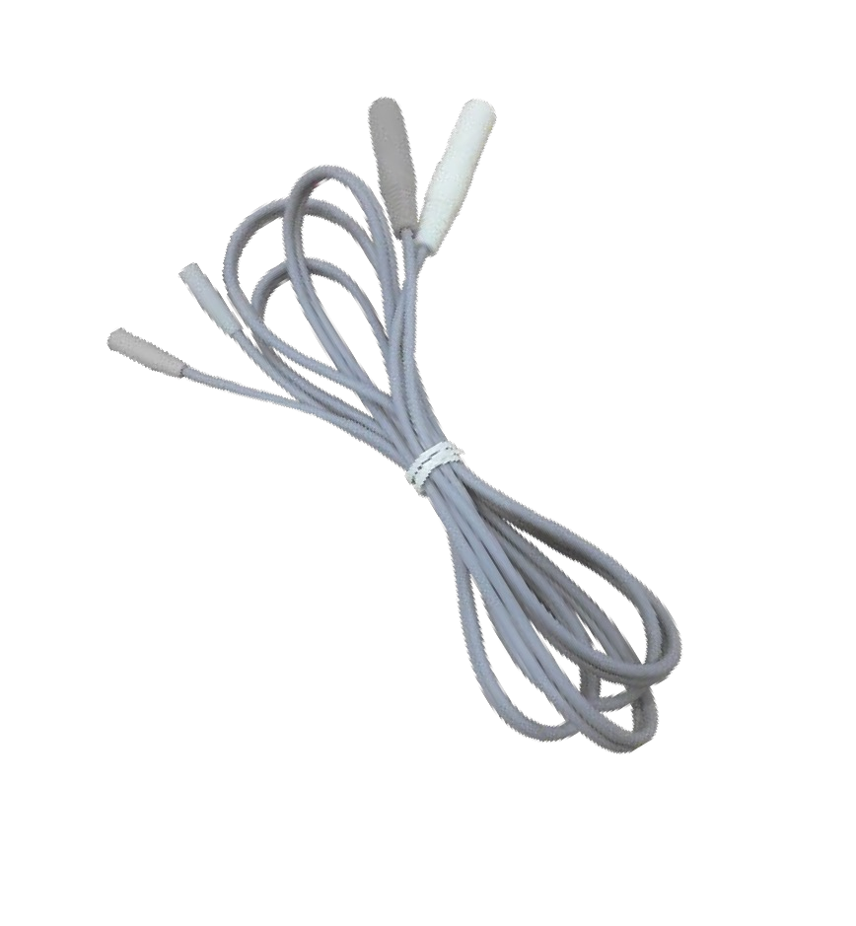
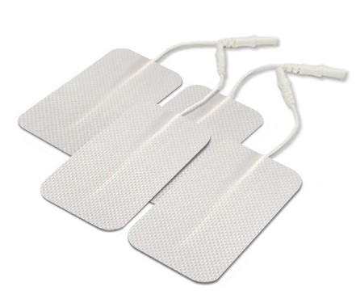
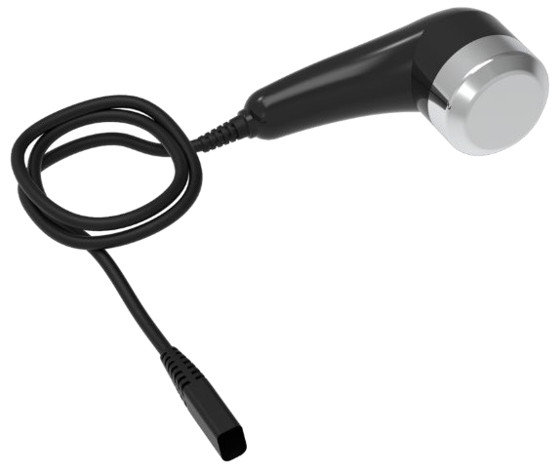
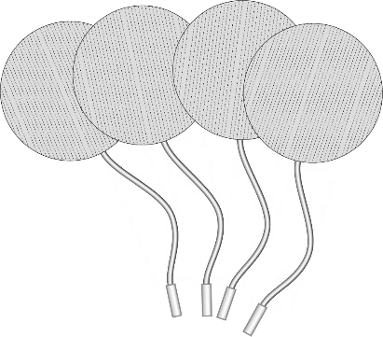
Product Specification
Product Name: CareCellve Mechanic
Ultrasonic frequency: 1.2MHz
Lightning voltage/rated frequency: AC 200V / 60Hz
Power Consumption: 80W
Output Fundamental Waveform: Pulse Wave
E-tron Frequency Range: Low (1,000~1,255Hz)
High (1,000~1,480Hz)
EMS Frequency Range: 3~50Hz
Auto Frequency Range: 1-89Hz, 2-100Hz, 11-100Hz
Measurement: 293(W) x 325(D) x 146(H)mm / 5.7Lbs (2.6kg)

Slide 6
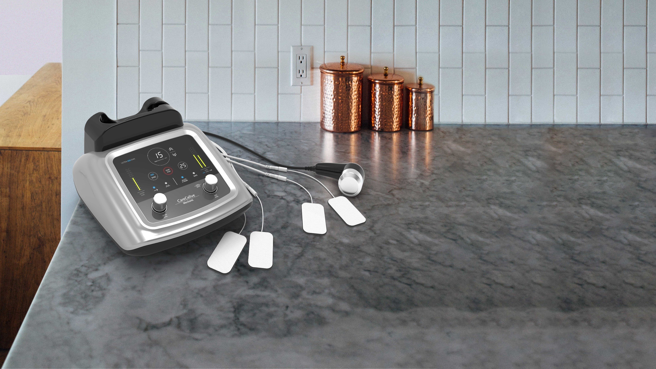



Product Features
Ultrasonic Wave
Skincare
Ultrasonic Wave
Body Shape
Management
Pain Management
TENS/EMS/E-TRON
+
+
3 Functions At Once

Slide 7
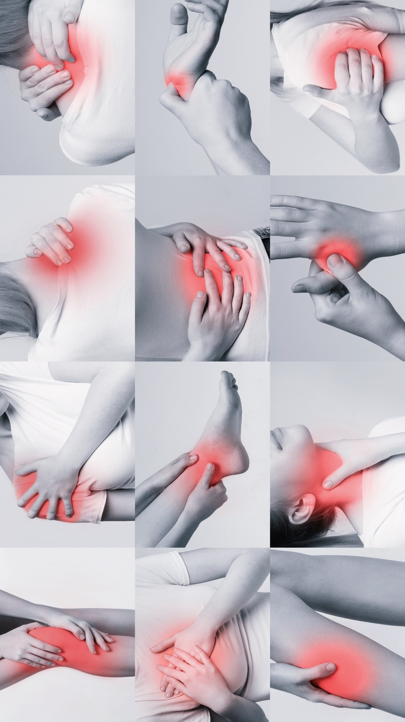
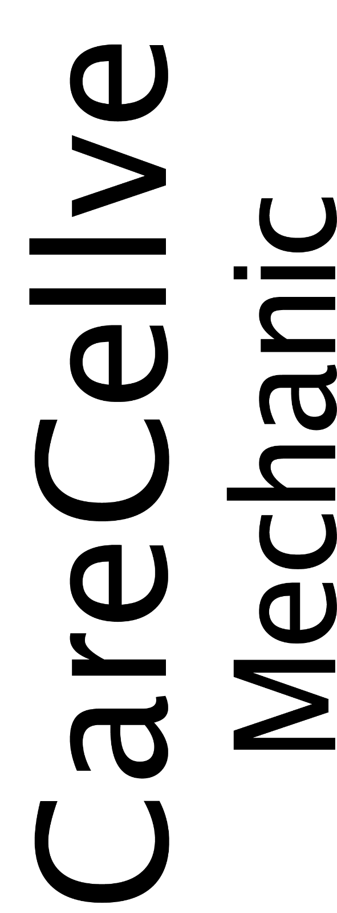
RELIEVE PAIN!

Slide 8






















Market Size
Elderly Population over 65 years old (Source: National Statistics Office)
Number of Patients with Musculoskeletal and Connective Tissue Diseases
(Source: Health Insurance Review and Evaluation Service)
(Unit: Ten Thousand)
(Unit: Ten Thousand)
(Unit: Ten Thousand)
(Unit: Ten Thousand)
1900
16,831,638
17,761,043
15,869,748
14,344,792
15,121,173
1000
738
775
820
2018 2019 2020 2024 2049
2011 2013 2015 2017 2019
As the elderly population increases, the number of patients suffering from pain diseases will also intensify.
The number of musculoskeletal pain patients treated by the Department of Orthopedics, Rehabilitation Medicine, and Anesthesiology & Pain Medicine is increasing by about 420,000 every year. The opening trend is also a trend of pain clinics.
[Source: http://www.medicaltimes.com/Users/New/NewsView.html?ID=1144536]

Slide 9


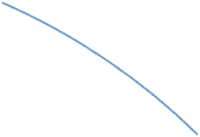










Pain Treatment Regimen
Ultrasonic Stimulator
Deep heat stimulator, M/W, high frequency, magnetic field
TENS / ICT
저주파.간섭파자극기
TENS / ICT
Low frequency
Interferometer stimulator
LASER Photo Irradiator
(Low power high
intensity laser)
Typical Conservative Therapies
(Physiotherapy)
Hot Cold Pack / IR
Hyperthermia
Cold therapy
Pain Management Machines
Pain-free signal
therapy device
Orthopedic Traction Device

Slide 10


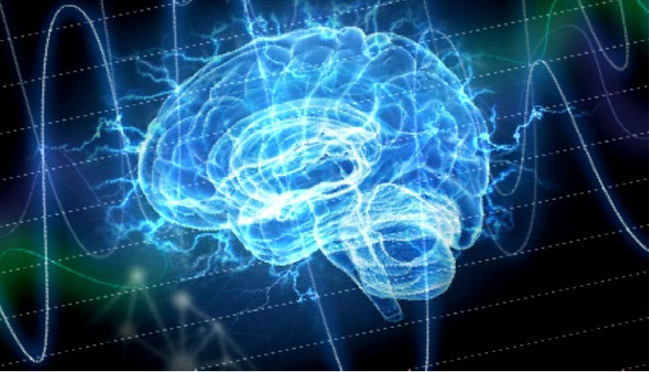
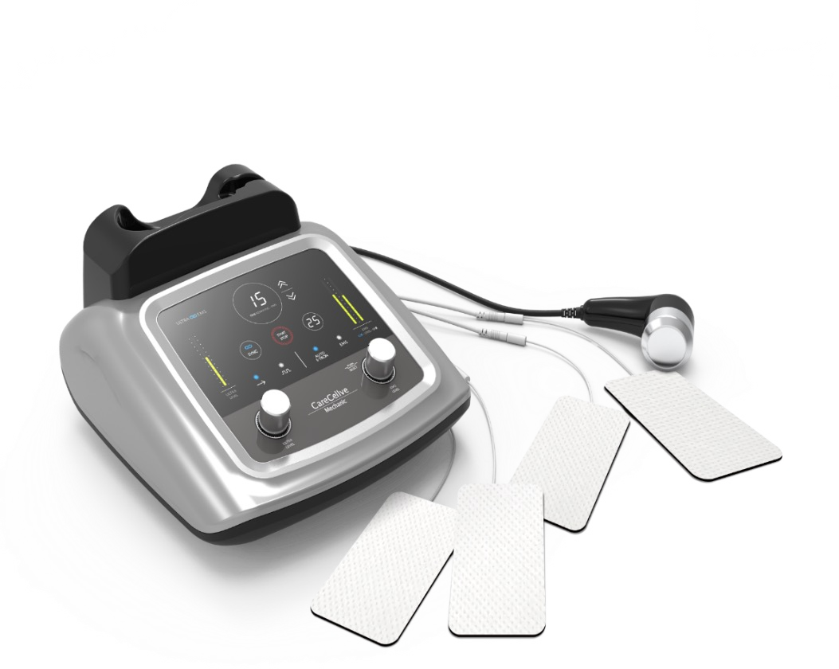

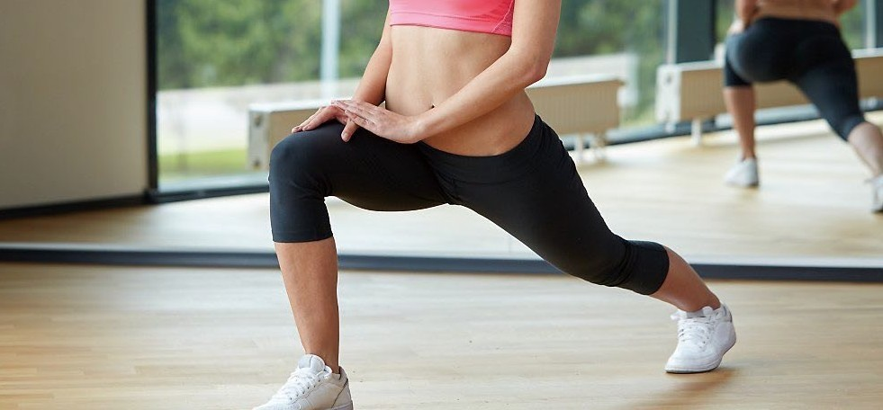

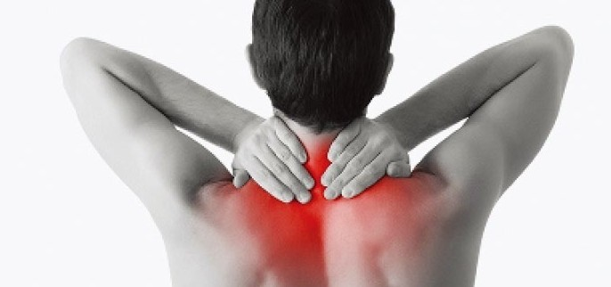
Pain Management
E-TRON WAVE is generated to actively stimulate acute and chronic pain lesions in a more stable way. Through the E-TRON electrode attached to the site of use, electrical pain disturbance signals are converted into pain-free nerve information and is delivered over a wide range and helps relieve pain.
ULTRASONIC
Relieves pain in acute chronic inflammatory diseases of the musculoskeletal system, such as pain relief, sterilization, joint healing, inflammation relief of myofascial pain syndrome, and tissue relaxation.
LF (Low Frequency)
Supplied to painful areas or muscle disorders through percutaneous nerve stimulation to help relieve pain by contracting and relaxing muscles.

Slide 11
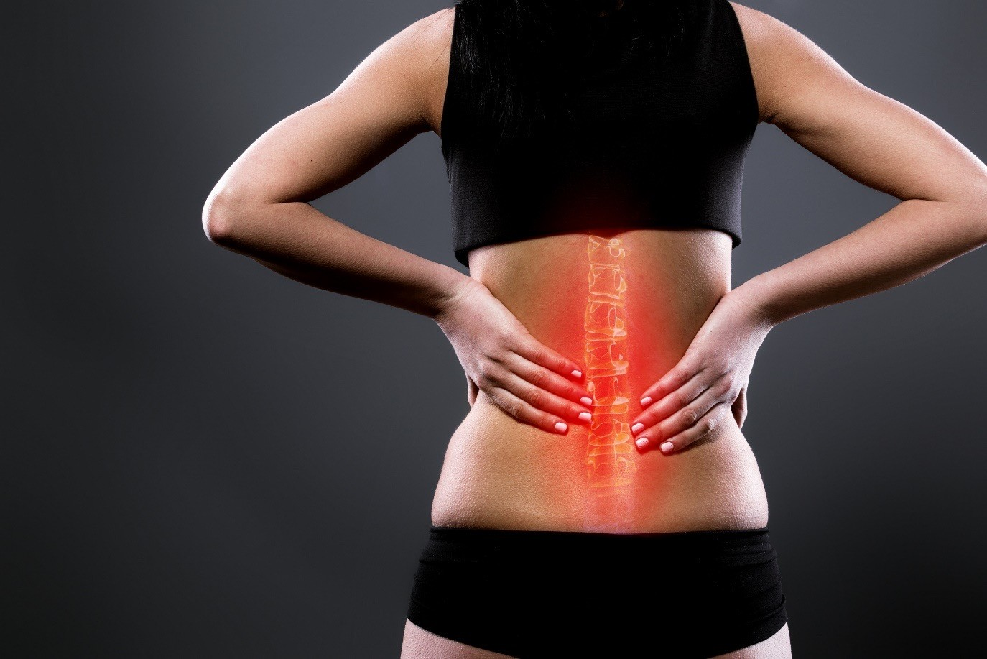
PAIN
Actual damage or unpleasant
sensations indicating possible damage
[Types]: Chronic/acute pain, neuropathic pain, complex regional pain syndrome, nociceptive pain, etc.

Slide 12
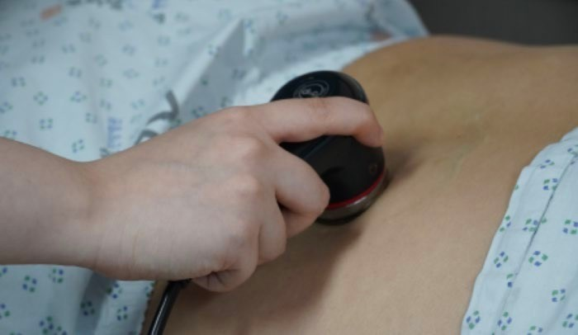
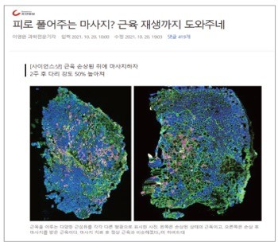
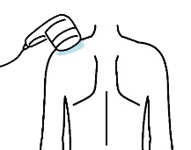
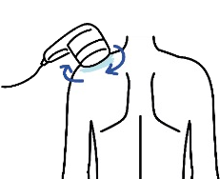
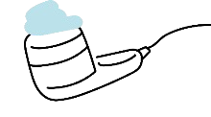
Pain Management
01
Pain Care System: Ultrasonic
Ultrasonic Stimulator
Basic 0.8~1MHz ultrasonic electrical energy is converted into physical energy, resulting in deep heat and vibration, which raises the temperature of human tissues to help blood circulation metabolism and relieve pain. It is the representative physical therapy of deep heat stimulation therapy.
It is used in various ways depending on the use such as pain relief and inflammation relief in musculoskeletal disorders.
Key Point
Instructions
Key Points
#Frictional movement of affected cells relaxes muscle contraction
#Thermal and non-thermal effects, blood and lymph circulation, excretion of toxins
#Occurrence of deep fever
#Intensive administration of painful areas
#Cartilage regeneration, cell activation
#Relieves inflammation
#Lipolysis (fat breakdown)
Gel Application
Start after close contact to the painful area
Roll around the painful area

Slide 13
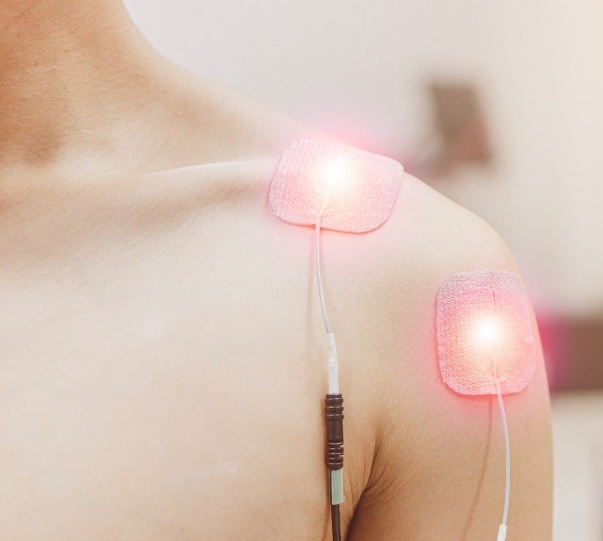

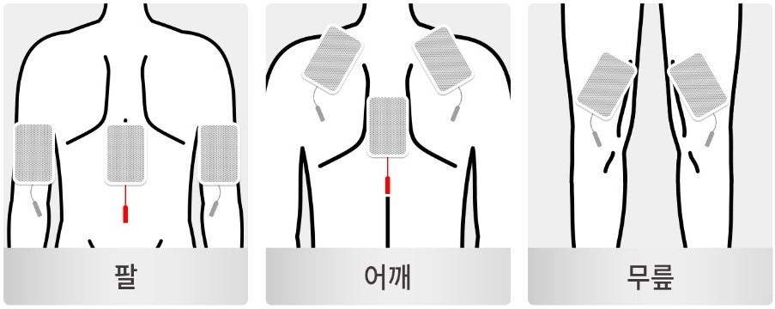
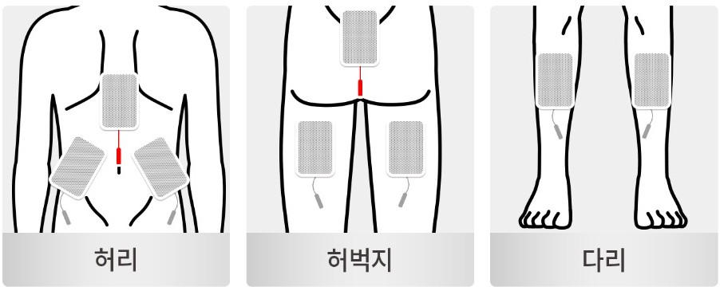
Pain Management
02
Care System: Low Frequency
Low Frequency Stimulator_ TENS Transcutaneous electrical nerve stimulation
Transcutaneous nerve stimulator (TENS) is a typical basic physiotherapy regimen. A low frequency is a wave with frequency of 10 kHz or less called “low frequency.” Low-frequency signals reduce pain by stimulating nerves in the painful area, and various mechanisms such as gate control theory work together to help relieve pain. It is applied to relieve minor pain, relax tight muscles, and rehabilitate hands and feet.
효과
Irritates pinched or damaged nerves & muscles in and around the painful area
Strengthens muscles with electrically stimulated muscle exercises
Restores nerve and muscle function
Exercise effect
Effects on cell growth & movement
Lipolysis(Breakdown of fat)
Relieves swelling
Instructions
Arms
Shoulders
Knees
Waist
Thighs
Legs

Slide 14

Ultrasonic/Low Frequency Comparison
Effect | Ultrasonic | Low Frequency
Pain relief
Activate cartilage regenerating cells
Relieves inflammation
Lymphatic circulation, excretion of toxins
Increased blood flow, metabolism
Nerve impulses
Muscle contraction relaxation, muscle strength enhancement | *Excludes strength training
Lipolysis (Fat breakdown)

Slide 15
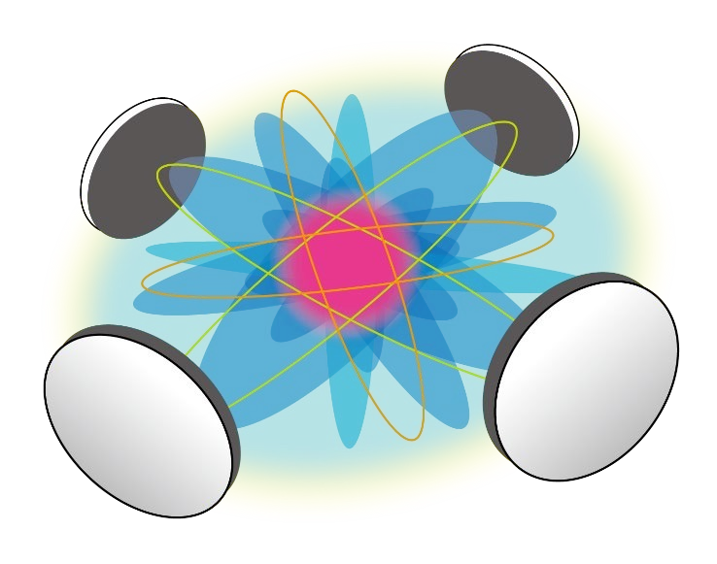
Pain Management
03
Pain Care System: E-TRON
E-TRON
Based on pain-free signal therapy, it is a new concept of pain management that helps relieve pain by disturbing pain signals in the painful area through various electrical stimulation of E-TRON waveforms.
It is used to help relieve pain for acute diseases of musculoskeletal system such as chronic pain, sports trauma, and postoperative pain.

Slide 16

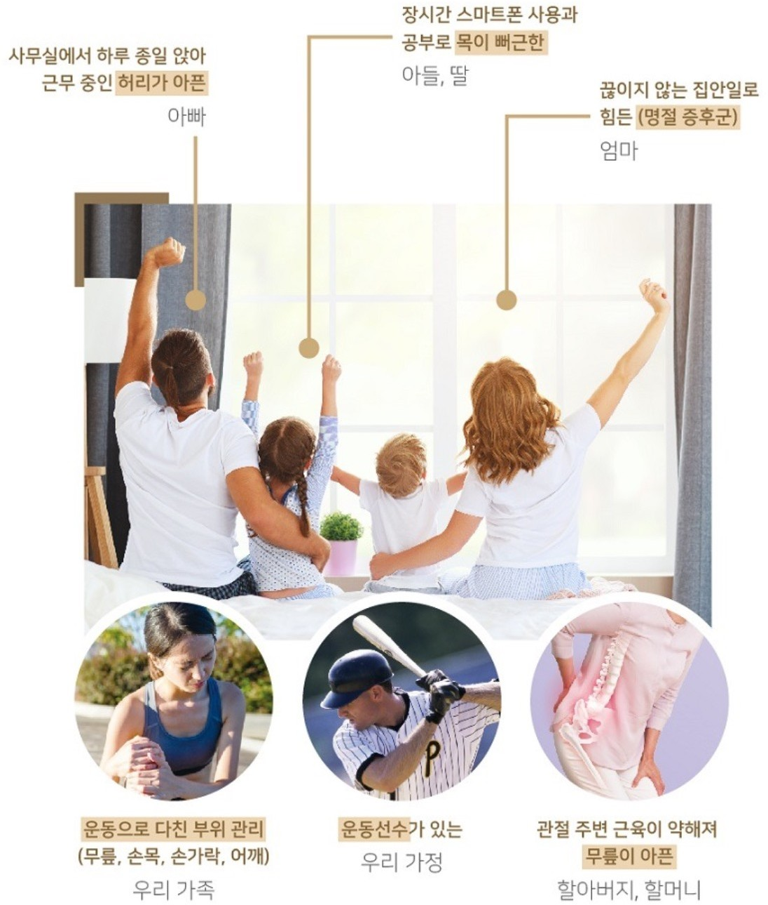


Recommended For…
Neck pain from using long hours of computer/cellphone
Back pain from sitting long hours in the office
Endless housework 24/7
(no holiday syndrome)
For those who ….
Suffering from pain
Need medical device
Easy pain management anytime, anywhere (where there is a power outlet)
Need post-leisure management after golf, hiking, cycling and other powerful sports
Have various pain even in normal activities. (Knees, shoulders, etc.)
Those who are looking for gifts for their parents
Those who are aware of pain and want to manage it
properly
Have received a doctor's opinion that you need pain management at home.
Pain from sports activities / exercise
Weak joints/ degenerative arthritis for the elderly
Injured parts of body from outdoor activities
(knees, wrist, fingers, shoulder, etc.)

Slide 17
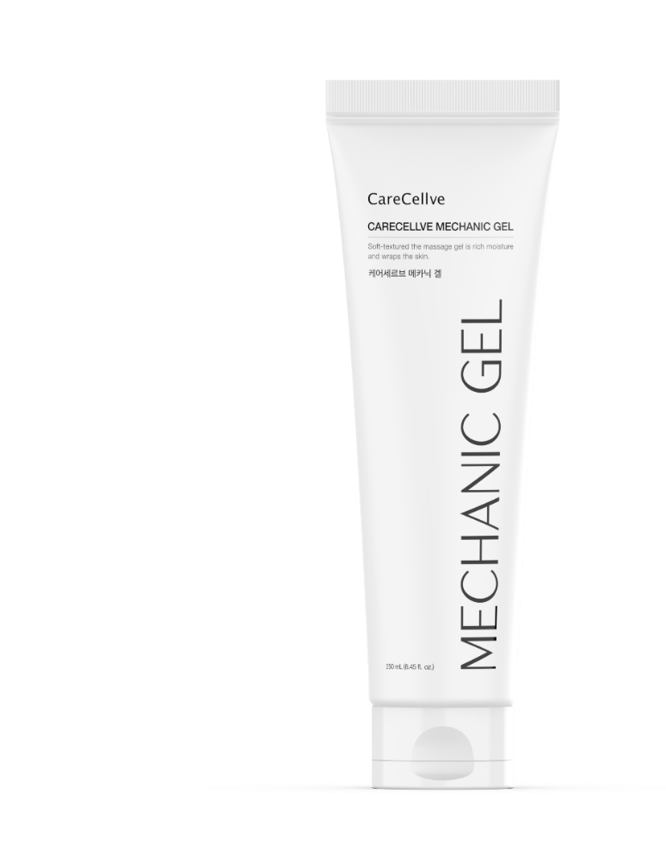

Description of Function
What is Sensing Technology?
If the gel that has been produced for ultrasonic vibrator does not come into contact with the device, it will stop its operation. It is the unique technology of CareCellve mechanism that prevents overheating and burns.

Slide 18
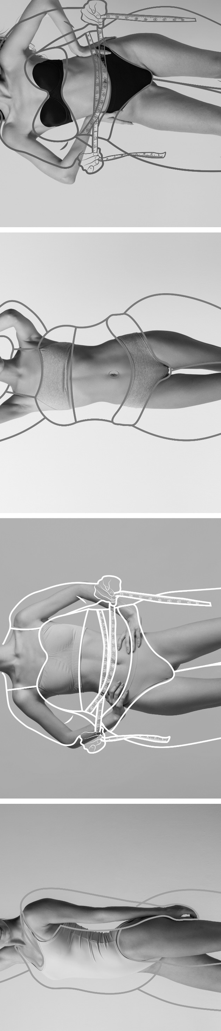
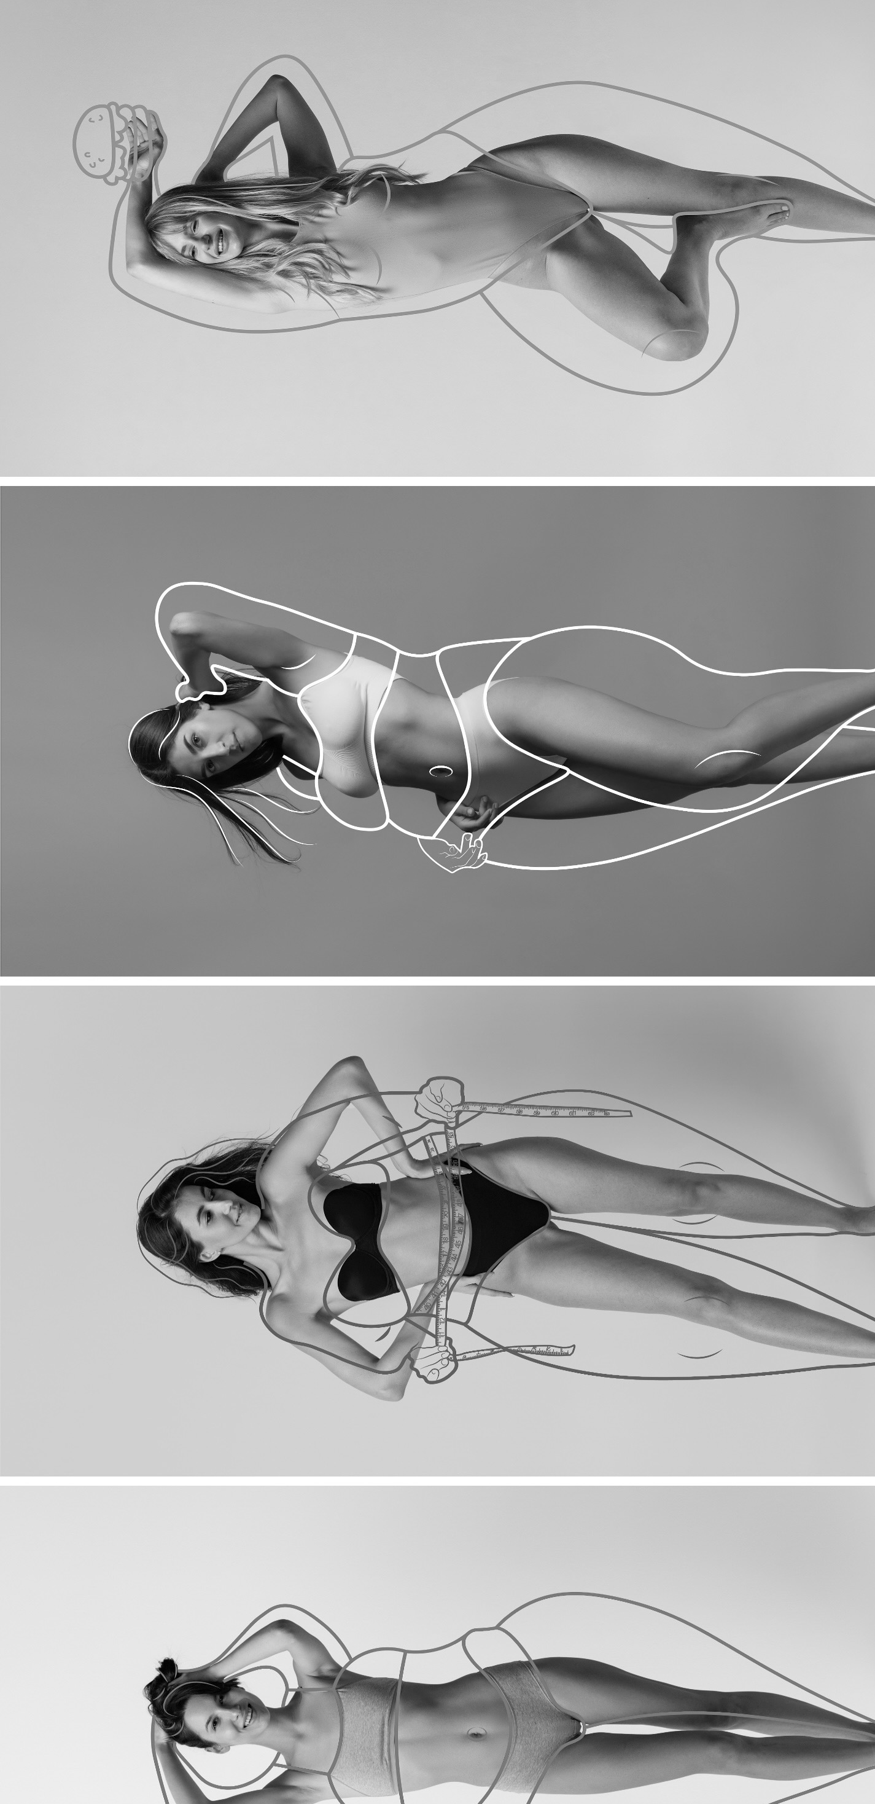
Body Shape Management! Slimmer!

Slide 19
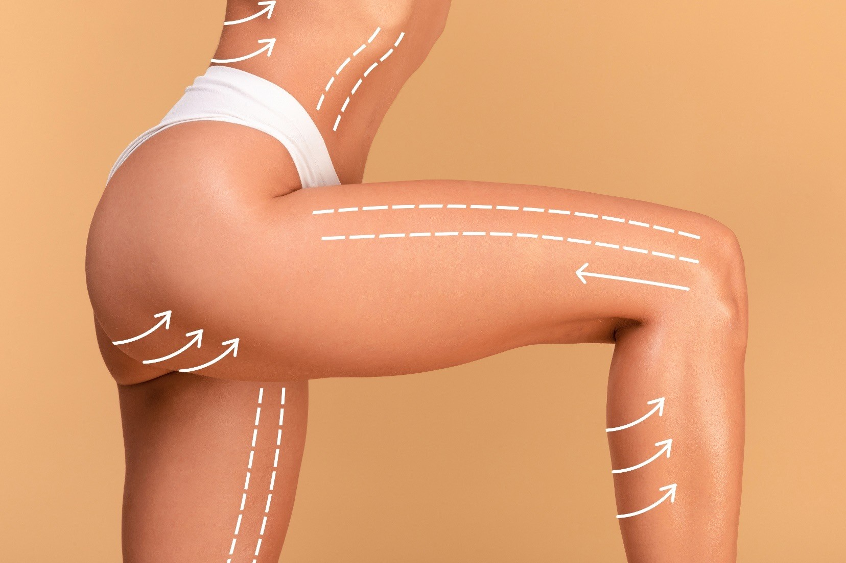
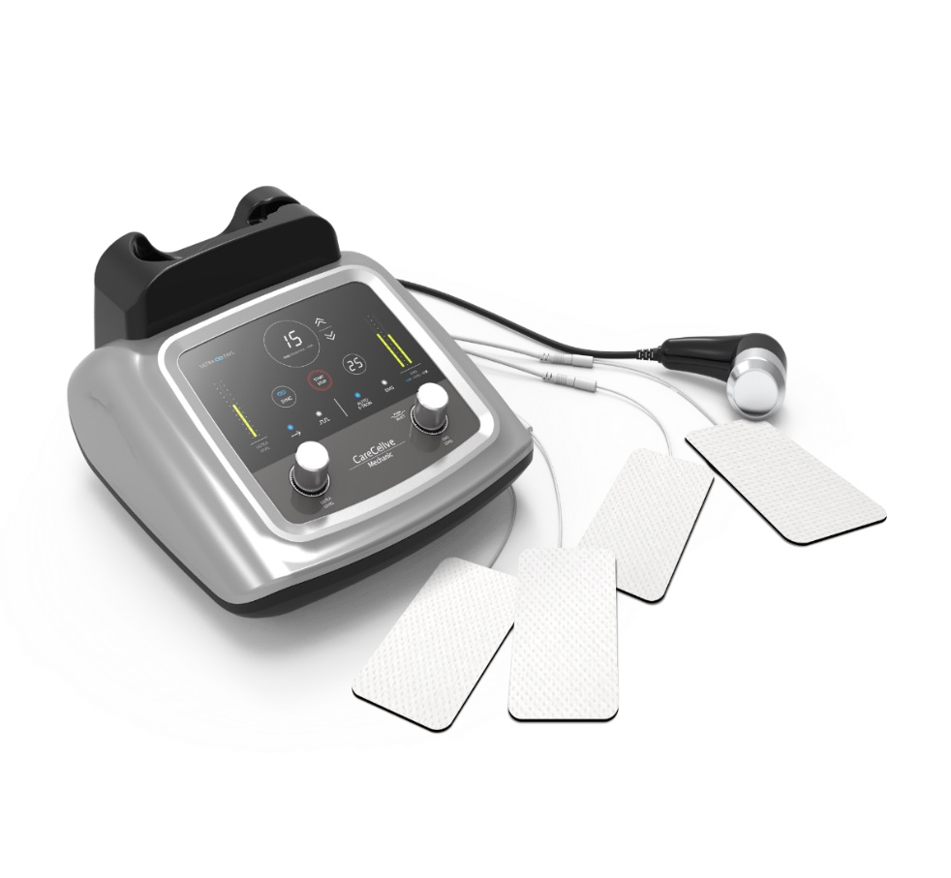
Body Shape Management
No Words Needed!
Whichever Area You Want!
Ultrasonic / Low Frequency Fat Layer Dual Stimulation System Slim wherever you want!
“Love Handles”
Body shape management, slimming management, swelling management! Anyone can use it whether from big to smaller size, heavy to light weight …
a double up effect!
Abdominal care
Lift Up Hip
Lower Body Care or Leg Care
Areas of Use

Slide 20
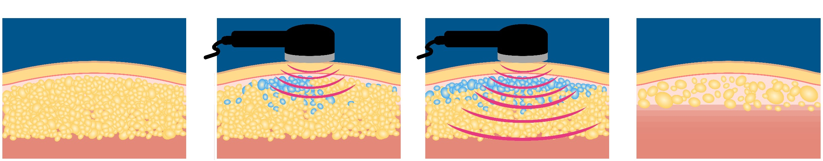
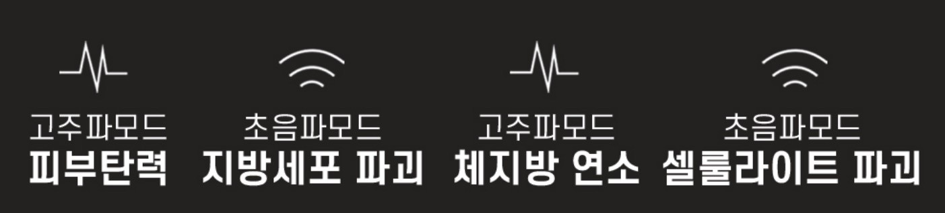
Body Shape Management
Changes with the Ultrasonic Effect
Take care of all body types perfectly, without surgery, without side effects!
Flabby skin that does not go away, CareCellve Mechanic will solve it. Fat that is difficult to dissolve easily, CareCellve Mechanic provides ultrasonic stimulation (contrast/expand) to stimulate fat cells. Now you can have professional body shape care right from the comfort of your own home!
High Frequency Mode Ultrasonic Mode High Frequency Mode Ultrasonic Mode
Skin Elasticity Destroy Fat Cells Burn Body Fat Destroy Cellulites

Slide 21
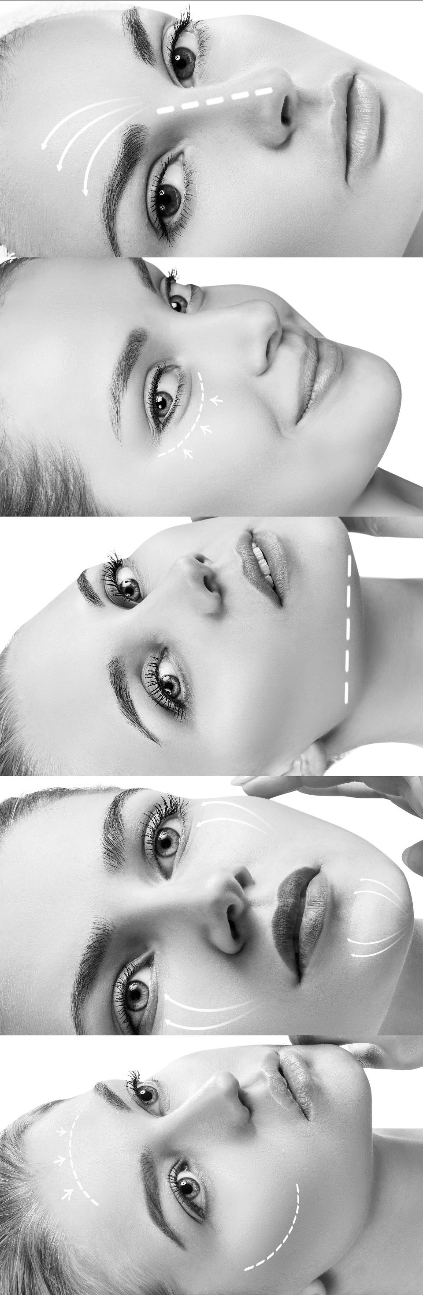
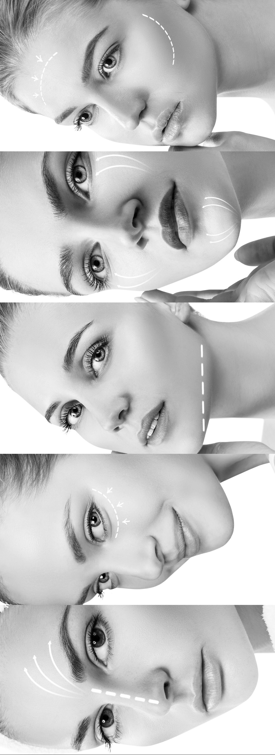
Skin Care!
More Beautiful!

Slide 22












Skin Care
1
Moisturizing Care
2
Skin Tone Care
Effects of Ultrasonic
Skin Care
Ultrasonic management uses the frictional force generated by instantaneous powerful vibrations to deliver harmless ultrasound waves deep into the subcutaneous body.
The ultrasound delivered in this way stimulates each cell and activates the cell itself.
It regulates the balance of the skin and helps with the skin regeneration effect.
Pats deep into skin for effective moisturizing
Improves blood circulation Improves skin elasticity & whitening
3
Healing Care
4
Massage Effect
Healing care to help regenerate stress-tired skin
Massage effect with fine tapping

Slide 23
Skin Care
Dual function (ultrasonic/low frequency)
Dual Function Skin Regeneration Effect
Check 1
Using 1.2 MHz (high-density ultrasound) it induces natural cell activity without pain, swelling, and redness, helping skin regeneration to treat problem skin healthily.
Check 2
Balancing the production and degradation of ECM (extracellular matrix) it naturally moisturizes skin, brightening (complexion cleansing), wrinkle improvement, pore narrowing, etc. It improves elasticity and makes aging skin fundamentally young and healthy.
※ What is ECM?
It is a substance that fills the space between cells and supports the cell.
Check 1
Check 2

Slide 24
Development Background

Slide 25
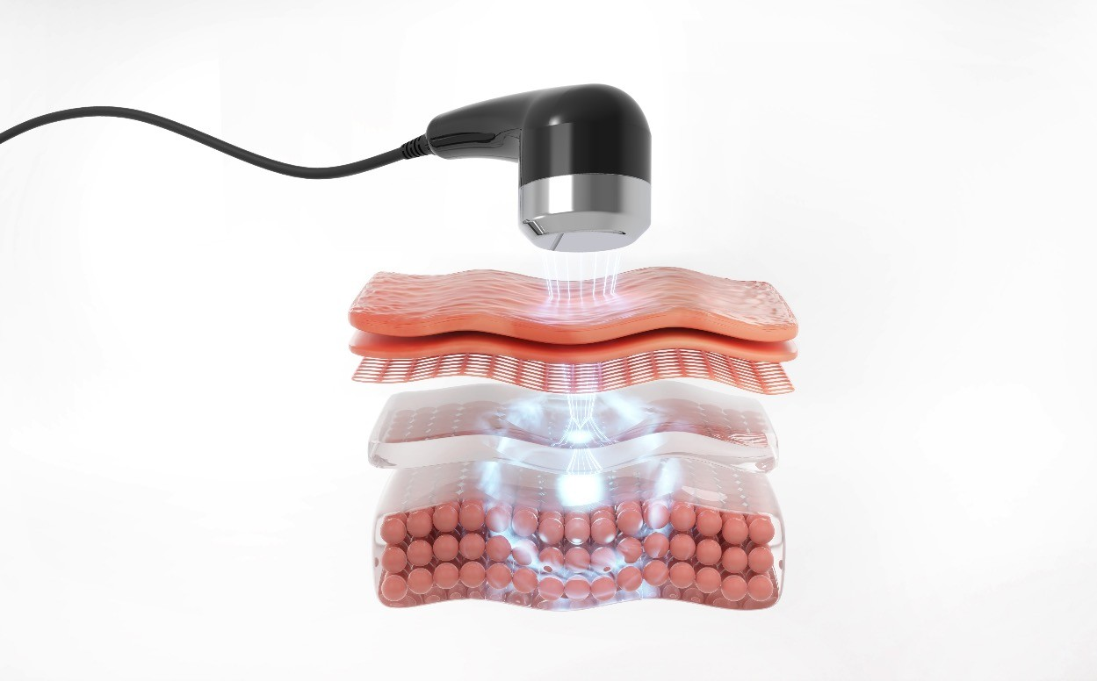
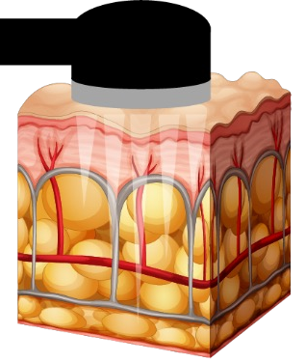
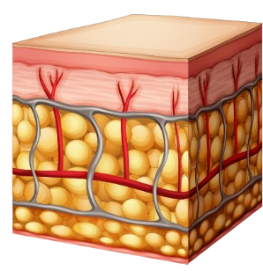
Development Background
Before
After
CareCellve Mechanic device delivers ultrasonic heat energy from the SMAS layer, which is the deep layer of the skin, to the dermis layer, and the epidermis layer with 1.2 million vibrations per second where you can see the main causes of skin aging: enlarged pores, deepened wrinkles, skin elasticity improvement, whitening and lifting effects.

Slide 26
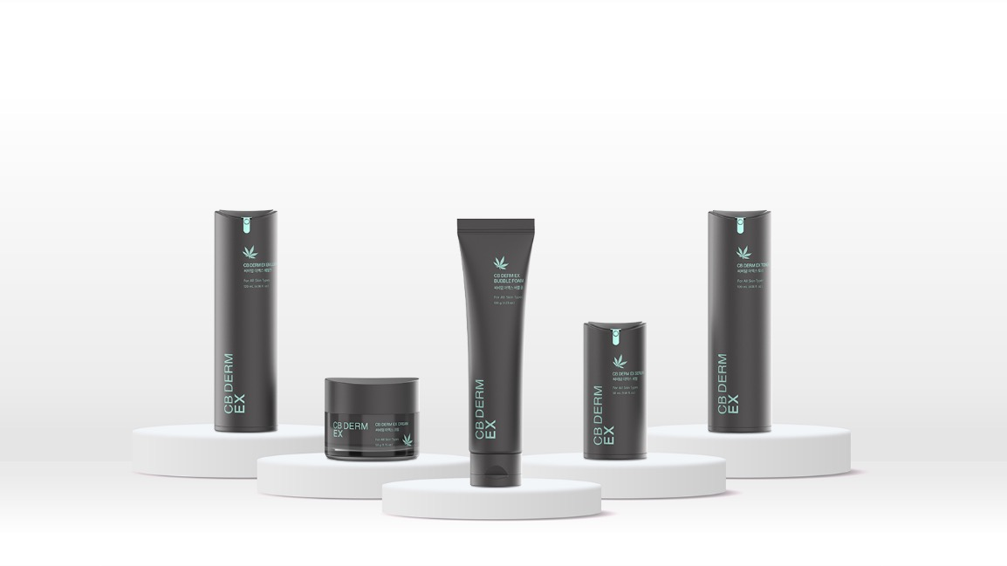


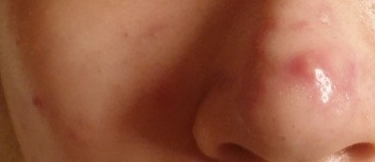
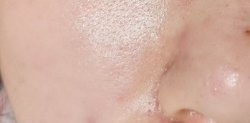
CareCellve CB DERM EX
Let Ultrasonic Device Supply and Preserve Nutrients with
CB Derm EX
Delivers Nutrients of CB DERM EX Penetrating Deep into the Skin.
[Ultrasound + CB DERM EX]
When used together, it has a skin regenerating effect that helps improve wrinkles, skin elasticity, whitening and lifting care quickly.
Before
After

Slide 27
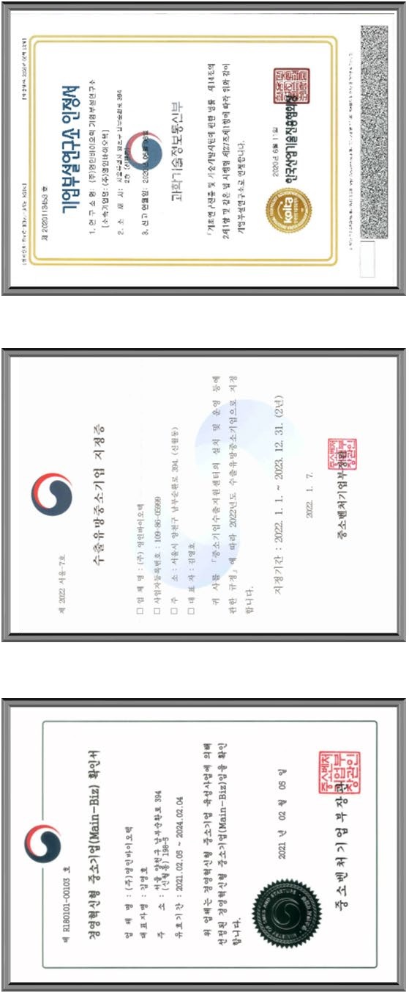
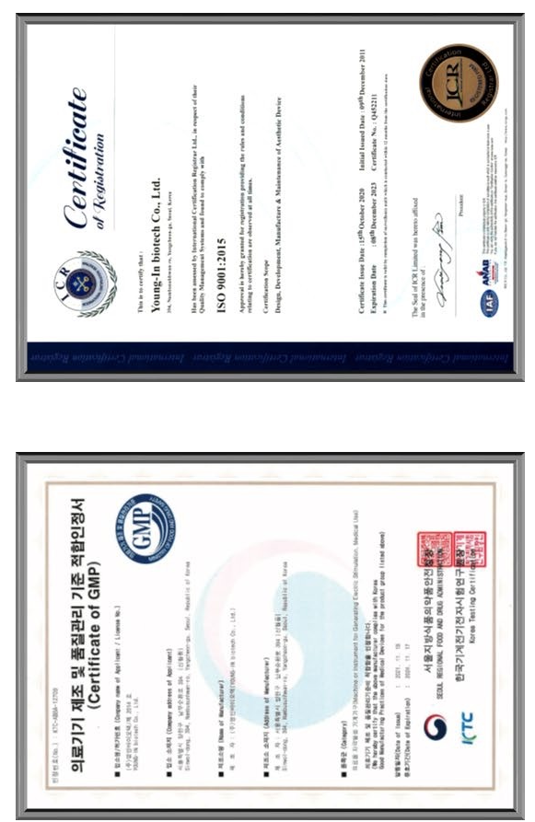
Patents & Certifications

Slide 28
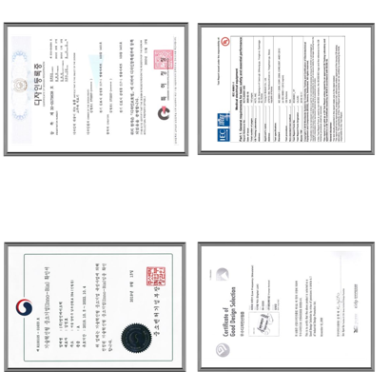
Patents & Certifications

Slide 29
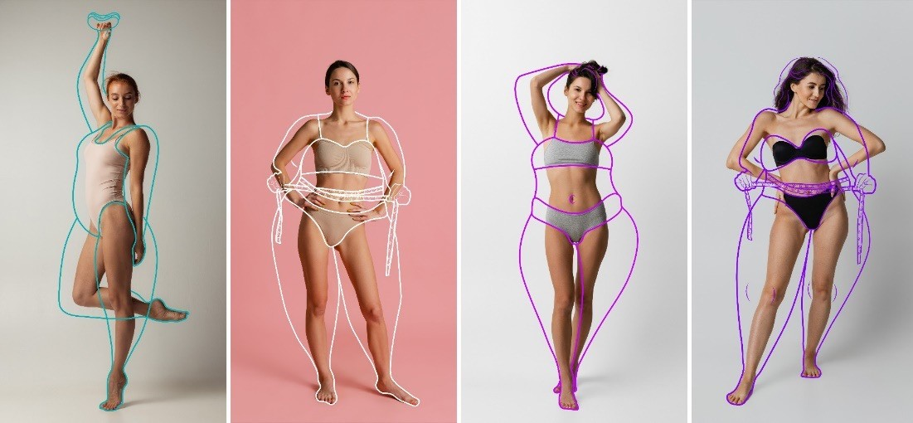
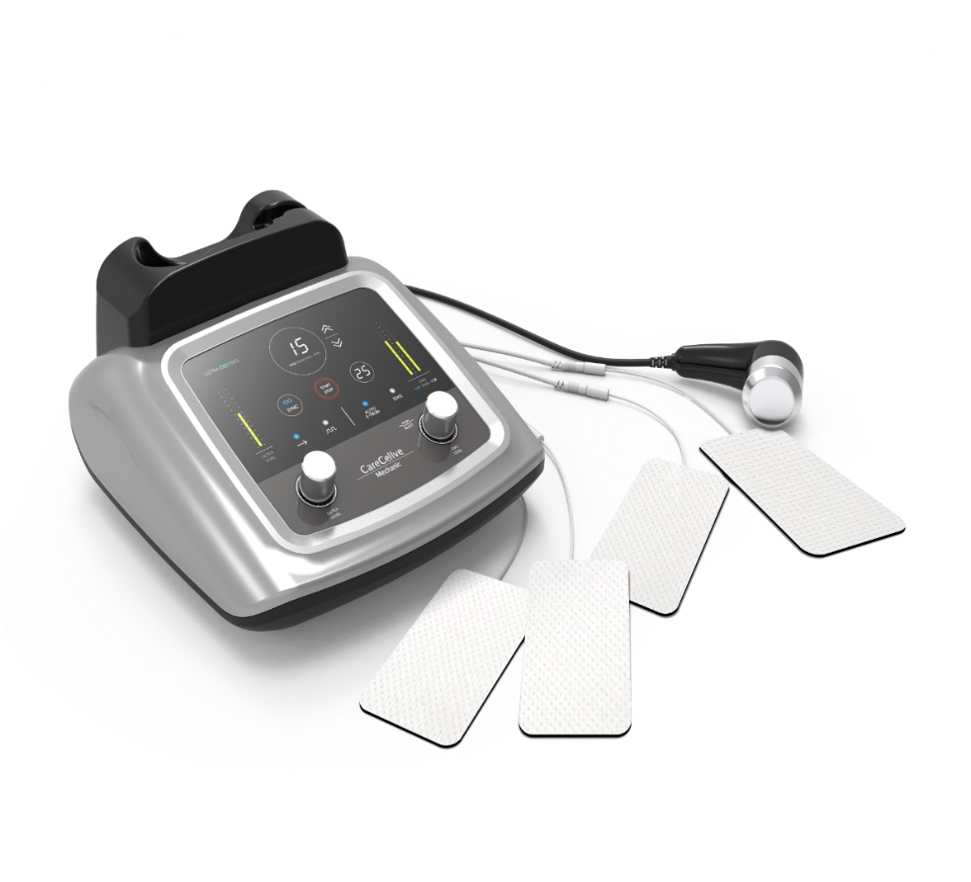
Those Who Need It
are the following …
Same beauty device effect that is often used in medical clinics
Perfect care for your skin and all body shapes
Possible to selectively manage parts by parts. when managing body shape
Body shape management is possible without surgery, bruising or scarring.
Even after administering, there are almost no yo-yos or side effects, and daily life is possible.
Harmless ultrasound is safe and simple to use to the human body

Slide 30
References

Slide 31
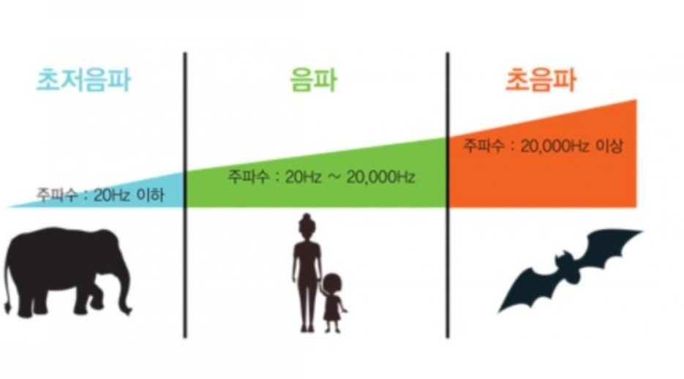
What is Ultrasonic Wave?
Ultrasonic waves are sound waves with frequencies above the upper limit of a human’s audible range. Ultra means “beyond” and “sonic” means the audible range or sound humans can hear. Our human ear can hear sounds from 20Hz to 20kHz. The range between them is called the audible frequency.
Ultrasonic frequencies refers to sound waves exceeding 20 kHz with an audible frequency, and it is a range in which the human ear cannot hear sound.
Infrasound
Audible Frequency
Ultrasonic
Over 20kHz
Below 20Hz
20Hz ~ 20kHz
Image Source: Naver

Slide 32
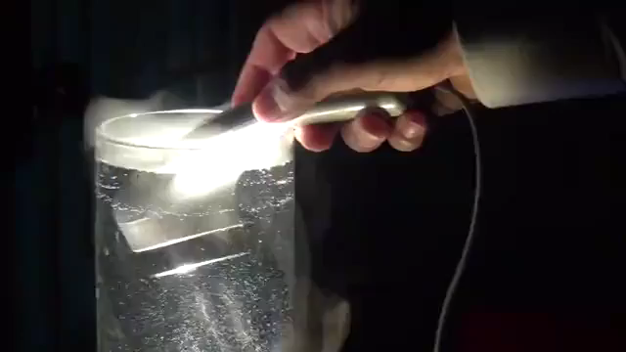
Catabolism Effect →1.2 Million Waves in 1 Second!

Slide 33
Ultrasonic Principles in Beauty Care Improvement
Improvements | Principle | 1st Time / 15 Min.
Pimple | Removal and sterilization of pus due to sebum and waste residues in pores; regeneration | 3~4 times
Blemishes, Dark Spots & Freckles | Deposition, melanin pigment reduction / 20s activated in 28 cycles when used for 3 months | 4~12 weeks
Abdominal Care | Activation of bowel function / elimination of bowel movement / excretion of toxins | 2~3 times
Fine Lines | Boosts metabolism to rejuvenate and improve skin transparency | 4~12 weeks
Anti-aging | Collagen and elastin fiber production / function normalization & skin elasticity restoration | 3~4 times
Pore Cleansing | Delicate micro-massage effect removes impurities from pores | 2~3 times
Shrink Pores | Collagen production restores elasticity and shrinks pores | 1~2 weeks
Balance Management | Normalization of skin cell function for both oily & dry (neutralize) | 1~2 weeks
Exfoliation | Removal of dead cells and foreign bodies in the stratum corneum of the epidermis | 1~2 weeks
Lifting | Decomposition / restores elasticity & lifting as the skin shrinks as much as the fat is removed | 4~5 times
Deep Cleansing | Vibrating & peeling action cleanses impurities deep into pores | 4~5 times
Whitening | Decomposes pigmentation by vibration / prevents pigmentation by normalizing skin | 3~4 weeks
Moisturizing | Catabolism & saturation fat breakdown convert into moisture / keep skin moisturized | 2~3 times
Slimming | Fat breakdown & removal by area to balance face and body shape | 2~3 times
Makeup
Improves epidermal secretion & moisturizing when using functional natural cosmetics;
Transmitted to the dermis layer by sonic persuasion
3~5 times

Slide 34
Ultrasonic Principles in Healthcare Improvement
Improvements | Principle | Principles / Tips
Tumor (Cancer) | 2~3cm straight reciprocating movement / stop-repeat | Toxic temperature (above 44 C)
Removal of Inflammation | 2~3cm straight reciprocating movement / stop-repeat | Sterile lymph, enhances white blood cell activity
Pain Relief | 2~3cm straight reciprocating movement / stop-repeat | Crystallized uric acid dissolution
Blood Circulation | Hand, plantar lymphatic whole/limb, venom systemic care | Promotes metabolism / removes body wastes
Cartilage Regeneration | 2~3cm straight reciprocating movement / stop-repeat | Protein synthesis, increase extensibility of collagen; promotes collagen (cartilage) production
Eyes (Cataract/Glaucoma) | Use while moving non-stop above & below and around the corners of both eyes | Boosts metabolism and removes waste
Headache, Dementia & Memory Enhancement | Eye massage + left temple of the entire head / neck, clavicle lymph / cervical spine | Strengthening the function of the Hippo campus (temporary memory) to enhance data transmission activities to the cerebral cortex (permanent memory)

Slide 35
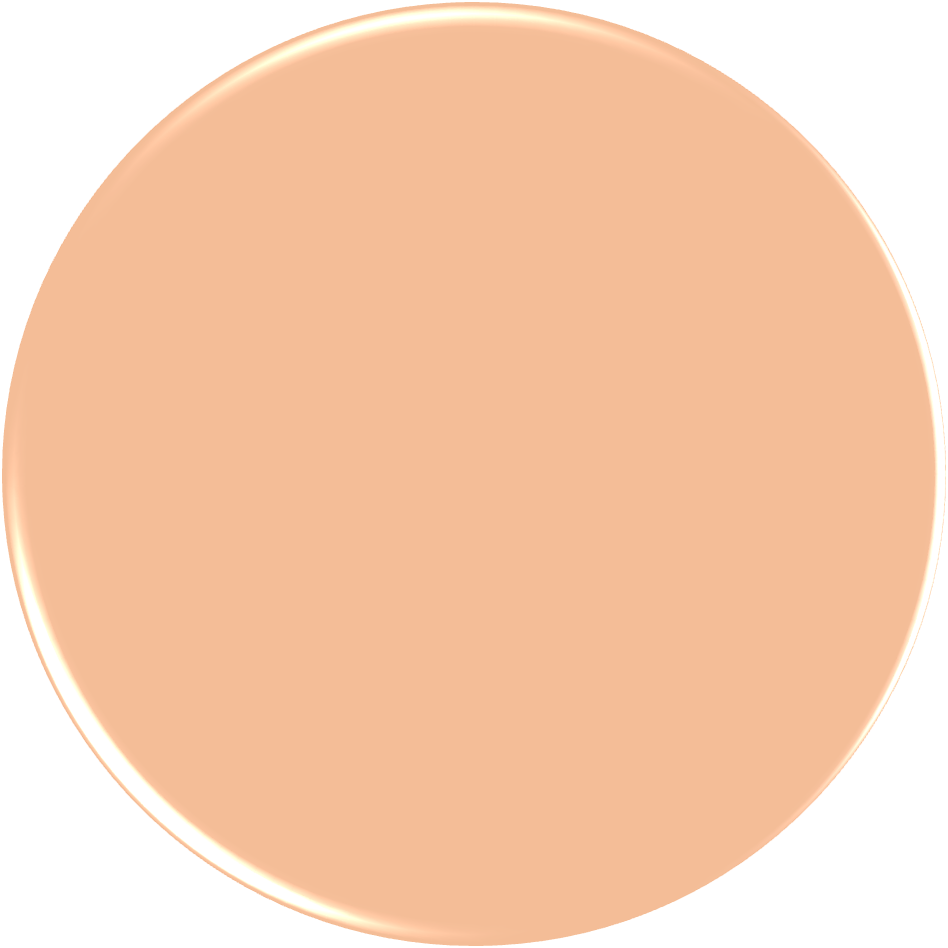





How to Use CareCellve Mechanic Correctly
01
02
Intensive Care
Place the ultrasonic head on the focused area and treat it for at least 10 seconds.
03
Slow Care
Adhere the ultrasonic head to the focused area and slowly move 20~40mm for 1 second.
*Choose from 3 types of care
Exploratory Care
Quickly pass 2~3 times as if searching for the area of use.

Slide 36
Effective Methods to Use Ultrasonic Wave
01
Daily Care of Palms and Soles
Hand acupuncture therapy effect
Neck lymph nodes / clavicle lymphatic terminal / axillary lymph nodes / Inguinal lymph nodes / popliteal lymph nodes / ankle Achilles lymph management to expel wastes from the body quickly and effects to remove body swelling
02
03
Care for Lymph Nodes
Erector spine muscle from cervical vertebra 1 of the glandular bone, the most fundamental healing method is to correct the spine, return the blood circulation to its original state, and release the accumulated blood clot. Because the harmony of the body is already broken, there may be abnormalities in all the organs.
The body will be healthy by creating an environment for harmony of the body through smooth blood circulation.
Care for Arteries

Slide 37



Slide 38


Acupressure Care Points on Back
Acupuncture Points
Gallbladder
Stomach
Liver
Liver
Lungs
“Shinpo” (major body point)
Heart
Lungs
Lungs
Liver
Gallbladder
Spleen
Spleen
Stomach
Kidneys
Kidneys
S. Intestine
S. Intestine
L. Intestine
L. Intestine
L. Intestine
Bladder
S. Intestine Bladder

Slide 39


Spinal Nerve Diagram
Total of 26 Bones
Cervical spine (7)
Thoracic spine (12)
Lumbar spine (5)
Sacrum (5)
Coccyx (3)

Slide 40


Acupressure Care Points for Hand/Feet
Acupuncture Points
Sinusitis, hay fever
Nose
Eyes Bloodshot eyes, glaucoma, cataracts
Stomach
Eyes
Ear
Ringing in the ears, hearing loss
Lungs. Large Intestine
Stiff shoulders
Neck
Heart. Small Intestine
Shoulder
Osteoporosis, allergies
Frozen shoulders, numbness in the hands
Bronchi
Thyroid
Obesity, thinness, arrhythmia
Asthma, cough
Heart Arrhythmia, angina pectoris
Transverse colon
Abdominal pain, diarrhea
Small Intestine
Digestion and absorption, diarrhea, abdominal pain
Lungs
Liver
Stomach
Stomach ulcer, gastric and hypogastric fluid
Heart
Stomach
Large Intestine
Kidney
Arteriosclerosis, edema
Kidney
Rectal
Ovary.Uterus
Bladder
Cystitis, poor urination
constipation
Hemorrhoids, constipation
Urethra.Bladder.Prostate
Sciatica
Reproductive Organs
Menstrual cramps, menstrual irregularities,

Slide 41





5 Major Acupuncture Points
Acupoint Dealing with Lymphatic System
Acupoint Dealing with Diseases of the Head
Vigor and Physical Improvement, Waist Muscles,
Abdominal Pain, Edema Enteritis, Diarrhea & Difficulty Urinating
Headache, Dizziness, Blurred Vision, Tinnitus and Stroke, & Nasal Congestion
Acupoint Dealing with Digestion and Gastrointestinal Tracts
Acupoint Dealing with Restoring Energy, Physical Strength
Pressing when Indigestion occurs, Nasogastric Control & Systemic Management of the Five Intestines
Acupoint to Stimulate Adrenal Glands, Lower Abdominal Ailments
Re-enforces Acupressure Points, Fatigue Recovery, Growth Development & Blood Circulation
Back Pain and Kidney Disease

Slide 42


Acupuncture Points of the Ear
Acupoint for Reproductive Organs
Suspect disorder of menstrual irregularities, prostate and
reproductive organs
Acupoint for Spine
Suspect disorder of disc and spine related symptoms
Acupoint for Digestion
Acupoint for DIET
Suspect digestive diseases, nausea,
and bloating
Acupoint for Head
Suspect disorder of central nervous system diseases (headache, stress, etc.)
Acupoint for Eyes
Suspect disorder of ophthalmology such as
eye fatigue and cataract

Slide 43


Lymphatic Circulation Management
Face
Body
Clavicle lymph nodes
An important point as it is a concave area above the collarbone.
Armpital lymph nodes
Located in the lower part of the armpit.
Abdominal lymph nodes
In the area around the navel
lymph node
Inguinal nodes
Parotid Lymph Nodes
Located next to which the ear is attached, called the exit of the facial lymph.
Neck Lymph Nodes
Located in the nape of the neck as a way through which the lymph passes.
Located in the groin in the femoral triangle region
Popliteal nodes
Located on the back of
the knee
An important lymph node called the [second heart]

Slide 44

Lymph Flow
Toxins from the upper body are cleansed under the ears, armpits, abdomen, neck, etc. However, toxins created from the lower body circulates from the tips of the feet to the knees, thighs and cleanses only from the Y-Zone lymph nodes
Cervical Lymph Nodes
Armpit
Lymph Nodes
Elbow Lymph Nodes
Inguinal Lymph Nodes
RED DOTS
Lymphatic of the Lower Limbs
Lymph Nodes

Slide 45

Muscle Pain = Myofascial Pain Syndrome
More than 70% of Human Diseases are Related to Muscles
Causes
Poor posture and bad habits that have formed in the muscles after injury, stress, anxiety or overuse. These sensitive areas are called “trigger points” and can cause strain and pain throughout the muscle.
Symptoms
Loss of function and pain occurs as inflammation develops between the muscle and fascia.
Pain persists or worsens due to lack of blood circulation caused by muscle buildup and inflammatory substances not being removed properly.
Muscle is torn if elasticity is not achieved due to degeneration (chronic muscle pain).
A tender knot in a muscle and hurts when pressed.
Trigger Point Complex
Normal Fibers
Taut Band
(Stress Muscle)
Nodule
Contraction Knot

Slide 46
Q & A
Q : How long does the procedure take to be effective?
A : It is effective to receive 1-2 times a week for 6-8 weeks for acne, sensitivity, dryness, and redness skin, and 6-8 weeks once a week for skin aging & elasticity improvement and is more effective if combined with various aging treatments such as ultrasonic lifting or thread lifting rather than the procedure alone.
Q: How long is the ultrasonic wave maintained?
A : If you have more than 3 treatments, you can feel the improvement of one or more skin problems, and if you receive more than 10 treatments, it will be maintained for 6 months to a year. (After 10 treatments, you can maintain it for a longer time if you treat it steadily with 1-2 treatments per month)
Q : Can I receive treatment if I have sensitive/redness/trouble skin problem?
A : You can! Feel the improvement of your skin during sensitive skin treatment rather than healthy skin. It is more suitable because it makes the inner environment of the skin healthy without irritation.
Q : As I am planning to become pregnant or am pregnant, can I still receive treatment?
A: Absolutely. Pregnant women can also perform facial and neck treatments.
Q : Why anti-aging effect?
A : This is because it breaks down aging collagen at the end of its lifespan to create space for new collagen to be produced, maximizes the skin's own immunity and regeneration power, and restores the normal balance of the skin.
Q : How long does the procedure take?
A : Depending on your skin condition and area, it takes at least 10-20 minutes. If you combine it with other treatments depending on your skin problem, it takes about 50 minutes to 1 hour.
Q : When will the treatment effect appear?
A : The effect can be felt immediately during the first treatment, and the visible effect is confirmed as you repeat the treatment.
Q : Are there any precautions after the procedure?
A : There is almost no pain during the procedure, there is no irritation only with a warm feeling of heat, and there is no erythema or swelling after the procedure, so you only need to apply moisturizer and sunscreen well as usual.

Slide 47
Function Description - Low Frequency
Deeper Breakthrough Stimulation
Adjustable Pad
E-TRON
Viscera
Dual Adjustable
Method
Wide Frequency Range
Safe Stimulating Environment
Broad
Frequency
Range
Output
Display
Simple
Touch Method
Y-PAD
Electrotrod
Delicate and Relaxing Stimulation
Convenient Design

Slide 48



Ultrasonic Wave Case Studies
Before
After
Notice neck /shoulder line

Slide 49


Before Treatment
After Treatment: Changes in Neckline/Skin Tone

Slide 50


Health Care

Slide 51


Health Care

Slide 52


Health Care

Slide 53

Health Care

Slide 54

Health Care

Slide 55




Health Care

Slide 56

Health Care
after

Slide 57


Health Care
Treatment after 30 Min.

Slide 58


Health Care

Slide 59


Health Care
After 30 Min.
Knee Treatment

Slide 60



Health Care
Bunion Corrected!
Using #3 on the Ultrasonic Device!
Awesome

Slide 61


Whitening Care
1st Treatment of Ultrasonic Care
10th Treatment of Ultrasonic Care

Slide 62



Ultrasonic Wave Case Studies

Slide 63



Ultrasonic Wave Case Studies

Slide 64


Ultrasonic Wave Case Studies
(Facial)

Slide 65


Ultrasonic Wave Case Studies
(Belly Fat Management)

Slide 66


Health Care
Before
After

Slide 67




Slide 68

CareCellve Mechanic Gel

Slide 69
IMPORTANT NOTICE
All members are committed to a healthy advertising culture so that they are not harmed by hype.
Please refer to the Act on the Hype of Health Functional Foods and cooperate so as not to lead to false hype.
This material is for internal training purposes and cannot be exported or posted separately.
Cosmetics Hype Act
Do not advertise the contents that may be mistakenly recognized as medicines, the name of the product, and the efficacy effect.
Display advertisements comparing with competing products must clearly state the objects and criteria for comparison and display only those matters that can be objectively confirmed. Do not advertise with absolute expressions such as "best" or “the best" that are exclusive.
Do not advertise display advertisements that are untrue or partially true that can likely be misunderstood by consumers in their entirety, or display advertisements that deceive consumers or may be deceived by consumers.
Do not advertise quality efficacy, etc., even though they cannot or have not been objectively verified or advertise labels that are outside the scope of cosmetics in accordance with Article 2(1) of the Act.
Do not advertise displays that use vulgar or hateful graphic photographs, etc.
Do not advertise labels that express or imply that cosmetics contain processed products of internationally endangered species.
Do not advertise labels that slander or suspect of slandering other products, whether or not they are true.
Article 22 of the Enforcement Regulations of the Cosmetics Act (Scope of Labeling Advertisements, etc.) [Enforcement 2018. 4. 19.] [Prime Minister Decree No. 1454, 2018. 4. 11., Amendments to Other Laws] [Schedule 5] < Amendment 2017. 1. 12.> Scope and compliance of cosmetic labeling advertisements

Slide 70
Difference of Ultrasonic Gel
Other company’s Gel →Use of adhesive agents obtained by dissolving Dimethyl X (harmful substances) in the gel-manufacturing process along with catalyzing sulfuric acid and nitric acid.
Prohibited cosmetic raw materials due to the occurrence of side effects such as abdominal pain, headache, nausea, etc.
Medical device products are not obliged to release all ingredients. It is only listed in the patent data, so consumers are left clueless.
Unlawful ingredients cannot be used in cosmetics, so CareCellve Mechanic Gel has launched, the safest and cleanest gel.
Added Kava Kava extract and various soothing ingredients to help relieve pain.

Slide 71

CareCellve MECHANIC GEL
CONTENTS
Product Features (Selling Point)
Product Specifications
Product Features
Introduction of Key Raw Materials
Recommended For
How to Use
Related Products
FAQ

Slide 72

MECHANIC GEL
Product Features (Selling Point)
EWG GREEN rated skin-friendly water-soluble gel
Colorant-free for all skin types · Unscented · Skin hypoallergenic cosmetics
Helps improve the transmission of energy generated by ultrasonic devices to the human body
Soft rubbing maintains texture viscosity for a long time
Contains Kava Kava extract, traditionally used as a pain-relieving sedative
Contains ingredients that help soothe the skin
With a non-sticky finish

Slide 73

MECHANIC GEL
Product Specification
Efficacy : Ultrasonic energy transfer, soothing, moisturizing
German Dermatest®/ Skin Irritation Test Completed
Main ingredients : Kava Kava extract, Centella Asiatica extract,
Green Tea extract, Allantoin
Contents: 250 mL (8.45 fl. oz.)
Where to Use: Face and Body
How to Use:
Apply to the ultrasonic massage area before use.
Wipe off with a wet towel (wipes) after use.
*For face and body only. If the contact area is dry or insufficient, the conductivity decreases and the effect decreases, so apply ample amount of gel.

Slide 74

MECHANIC GEL
Product Features
Delivers High Energy to the Skin
By improving the degree of energy transmission to the human body generated by ultrasonic devices, it achieves effective results in various beauty/medical devices such as ultrasonic massage, body care device, low-frequency device, and various beauty devices.

Slide 75

MECHANIC GEL
Product Features
Composed of Pure Water and
EWG Green Grade Ingredients
CareCellve Mechanic Gel is based on pure water and made with skin-friendly ingredients.
Tested with the Dermatest,
Germany’s Dermatology Institute for skin irritation, the hypoallergenic gel can be used safely on all skin types.

Slide 76

MECHANIC GEL
Product Features
Full of Moisture
Maintains Long Viscosity that Does Not
Dry Out Easily!
Mechanic Gel has been developed as a formulation that maintains a stable gel state so that the viscosity does not change severely depending on the temperature.
Gel can be conveniently used as a medium for Ultrasonic
Device transmission for maintaining smooth glide

Slide 77


MECHANIC GEL
Key Raw Materials
Kava Kava Extract for Skin Soothing
and Relaxing Effect
The root extract of Kava Kava has been used as an odorless beverage to induce physiological and psychological relaxation in traditional religious and cultural ceremonies, medicinal purposes, and social gatherings, and in detail, it is also known to be used for local anesthesia (pain relief) and treatment.
Kavalactones (Kavapyrones)
Kava Kava root (rhizome) is a predominantly present lactone-based ingredient that is an active ingredient with anxiolytic and soothing properties. It has also been reported to be used as an anxiolytic, sleep aid, anti-depressant, diuretic, anti-inflammatory, antibacterial, sedative, analgesic, antispasmodic, antifungal effects, etc.

Slide 78






MECHANIC GEL
Key Raw Materials
Contains 3 Soothing Ingredients
to help relieve functional reaction from
the external environment
Contains ingredients such as Centella Asiatica extract, Green Tea extract, and Allantoin that help soothe the skin.
Safe to use on weak and sensitive skin
Centella Asiatica Extract
*Limited to raw material characteristics.
Allantoin
Green Tea Extract

Slide 79

MECHANIC GEL
Recommended For …
Those who want to check the effect of ultrasonic devices more accurately
Those who are looking for a mild gel to use with devices without irritation
Those who do not like stickiness after use but want a fresh feeling
After use, those who need a moisturizing effect

Slide 80


MECHANIC GEL
How to Use
1
2
Apply sparingly to the ultrasonic massage area before use.
Wipe off with a wet towel (wipes) after use.
*For face and body only. If the contact area is dry or insufficient, the conductivity decreases and the effect decreases, so apply ample amount of gel.

Slide 81












MECHANIC GEL
Related Products
Elasticity Total Care
Produce new collagen and even fat burning
Lifting effect by shrinking fascial tissue
Intensive care by reversing elasticity of age
Lipolysis (destruction of fat cells) thru heat energy
01
02
Professional Esthetic Care
Manage sebum & dead skin cells in the pores & waste
Cleaning with 1 million vibrations per second
Whitening effect through blood circulation
CareCellve
Pain Home Care
Mechanic
Thru increased blood circulation it promotes damaged tissue and functional recovery
Gently relaxes various inflammation or adhesions
Micro-vibration effect leads to inflammatory decomposition and edema absorption
03

Slide 82
Q.
A.
MECHANIC GEL
FAQ
What is CareCellve Mechanic Gel?
It is a pigment-free, fragrance-free, water-soluble ultrasonic massage gel with skin-friendly ingredients as the main ingredient.
Q.
A.
What is its purpose?
It is to improve the degree of energy transfer to the human body generated by medical and cosmetic devices.
Q.
A.
What is the pH of CareCellve Mechanic Gel?
It is pH : 6.00 ± 1.00.
Q.
A.
Can I use it in high-frequency devices?
It cannot be used on high-frequency devices. Since high-frequency devices require continuous rubbing to penetrate heat conduction, cream-type products should be used.
Q.
A.
I am curious about the scope of use of CareCellve Mechanic Gel.
Use it on your face and body.
It can also be used to care for a double chin and jawline and can also be applied to areas high in muscle and fat (cellulite) all over the body.

Slide 83



Use Reliable U.S.-made Gels!!
Reliable Domestic (Korean) made!!
Extracorporeal Medical Electrodes
CM-7000Q 3D TENS
MFDS Certification
Medical Device
Class 1 Product
Gel, an important part that touches the skin is made in USA
Reliable quality & reliability with domestic manufacturing
Products for CM-7000Q 3D TENS
Care functions for various parts of body
Content consist of 3 sets (1set=4)
This product is a medical device. Please carefully read the precautions and instructions before using the device.

Slide 84


Precautions
3D TENS Attachment Location by Use Part
Do not use device above neck area. Due to airway blockage, it can cause side effects like muscle spasms, difficulty breathing, high blood pressure or heartbeat irregularity.
Do not use on chest area. The current velocity can be irregular and can have fatal consequences.
Do not use in the proximity or near any of cancer lesion.
Arms
Shoulders
Knees
Too small a wave rate or improper use may result in discomfort or burns.
Do not share usage with others. It can cause side effects such as exchange of infection.
Irritation may occur at the contact site with the electrode.
Others
Waist
Thighs
Legs
Do not use electrodes when showering, bathing or swimming.
Replace the electrode when the adhesion is poor, the surface may become hard, or the stimulation may weaken when the electrode is separated.
* This content is to protect the safety of users and prevent damage to property.
Please read the precautions carefully and use them correctly.
Attach the red CM-7000Q 3D TENS as shown above.
In case of knees & legs, place the red TENS patch as same as the thigh area.

Slide 85

CareCellve
Thank You

