Slide 4
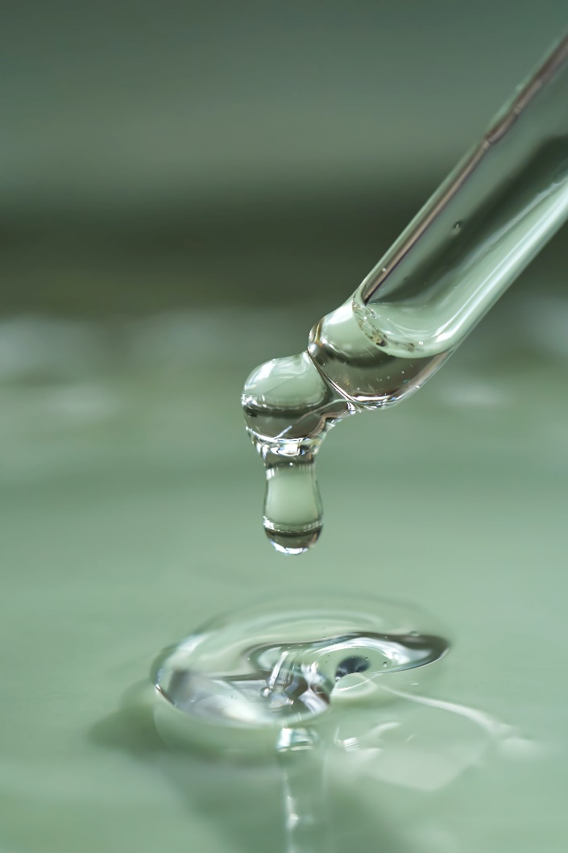
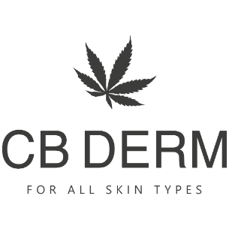
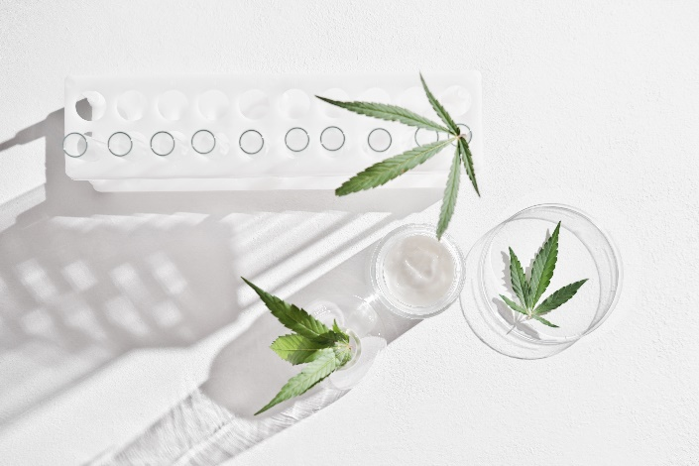
01. Brand Introduction
CB DERM
CB DERM products are made from the core raw materials found in hemp that represent the ingredient’s natural super anti-aging properties.
CB DERM is a specialized hemp cosmetics brand that creates safe, high-quality products that pursue the natural beauty of the skin. We use our own derma technology to ensure our products are safe and offer unmatched efficacy.

Slide 5
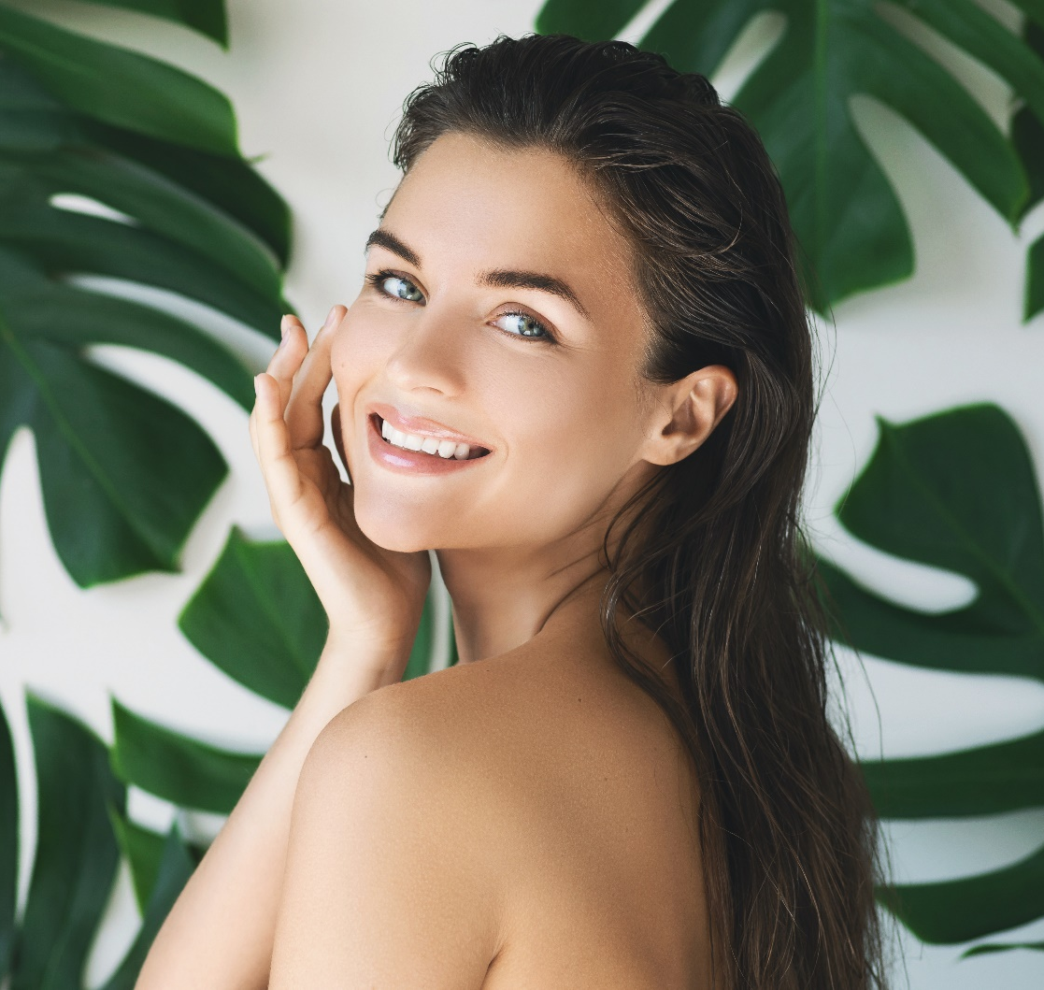
01. Brand Introduction
CB DERM
Who is the brand for?
Checksumers* who meticulously search all ingredients and user reviews. (*Short for “check” and “consumer,” it refers to people who carefully research products to evaluate their safety.)
Consumers who prioritize the health of their skin.
CB DERM is consistently conducting research to challenge ourselves to create beauty products that can be used
by the entire family as well as all people.
We only use truly natural ingredients.
-CB DERM

Slide 6
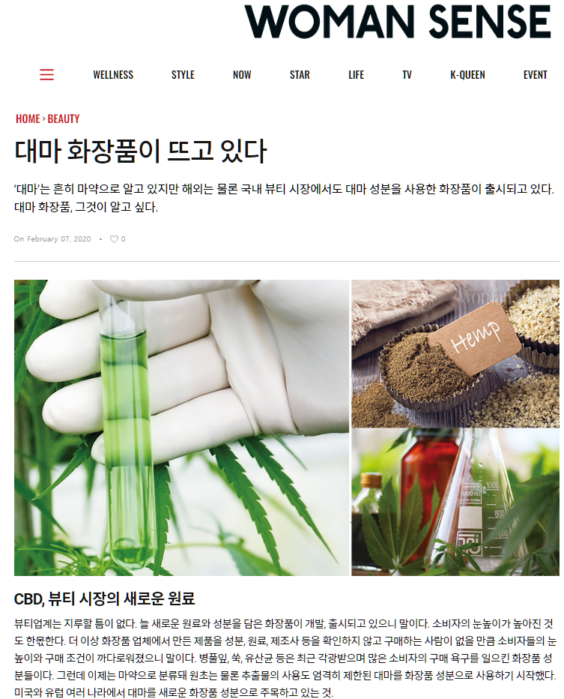
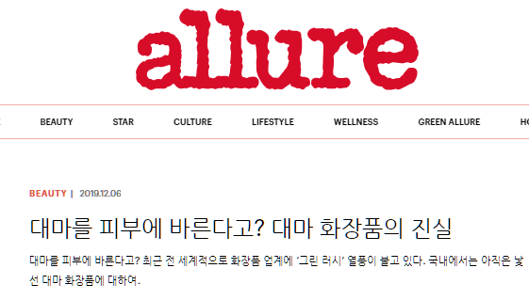
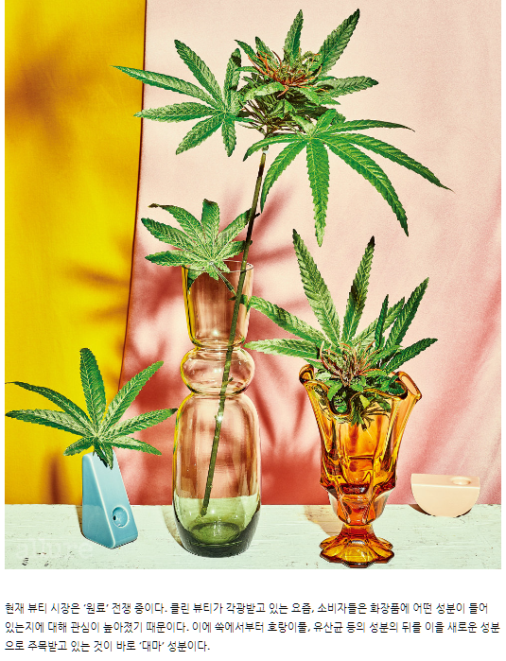
02. Product
Development Story
Product (CB DERM EX) Development Story
Trend
“Hemp Cosmetics are on the Rise”
“Putting Hemp on Your Skin? The Truth About Hemp Cosmetics”
“
“Hemp Cosmetics are on the Rise”
“
“The Beauty Market is in the Middle of a Raw Materials War”
[Source] https://www.smlounge.co.kr/woman/article/44039
[Source] https://www.allurekorea.com/2019/12/06/대마를-피부에-바른다고-대마-화장품의-진실/

Slide 7
02. Product
Development Story
Product (CB DERM EX) Development Story
Contains All of the Core Raw Materials Found in Hemp
Hemp Seed Oil
Hemp Stem/Root
Exosomes
Hemp Root
Ferment Filtrate
Hemp Stem
Extract
Hemp Root Extract

Slide 8
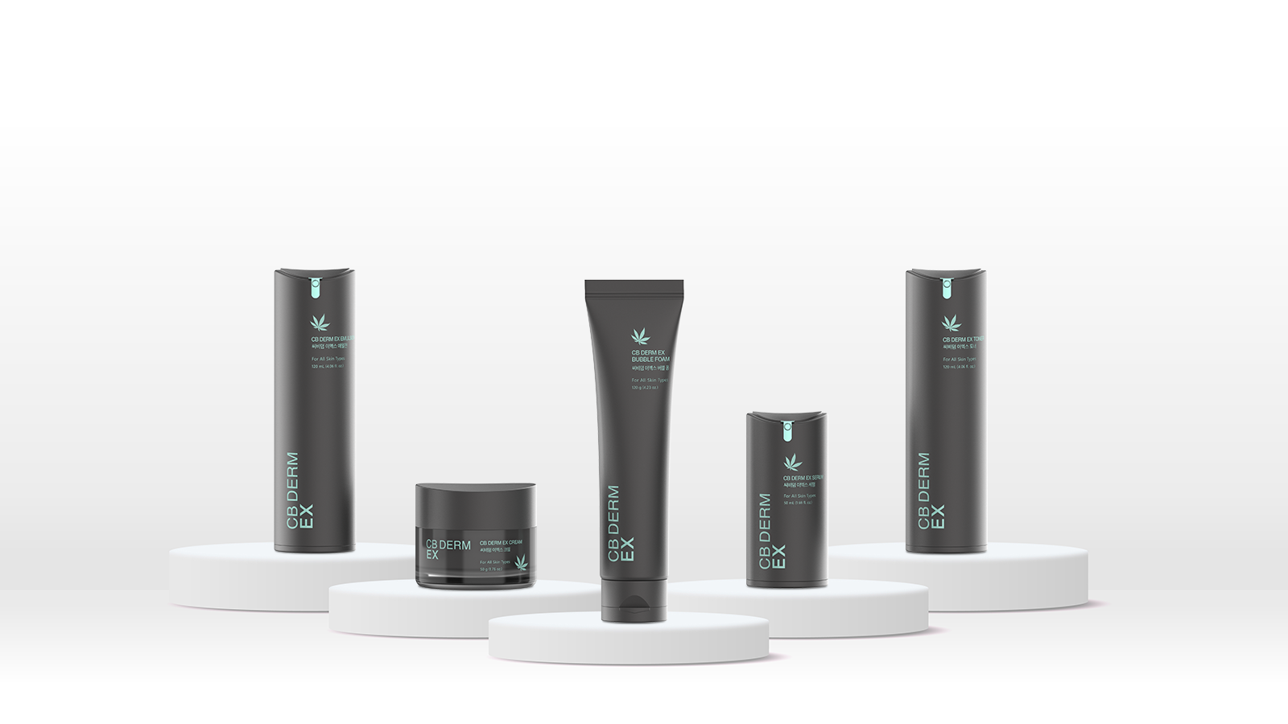

Slide 9

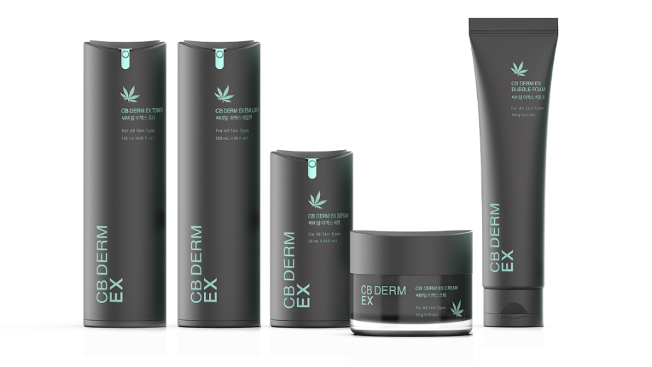
03. Product Introduction
Product (CB DERM EX) Introduction
CB DERM EX products are the first in the world to contain all of the core raw materials found in hemp. We used our own exosome and liposome technology to create safe products that provide optimal results. CB DERM pursues super anti-aging care to fundamentally solve skin problems.
We have created five effective hemp-based products based on skin science that present the optimal absorption solution through the perfect blend of excellent ingredients and the best technology

Slide 10
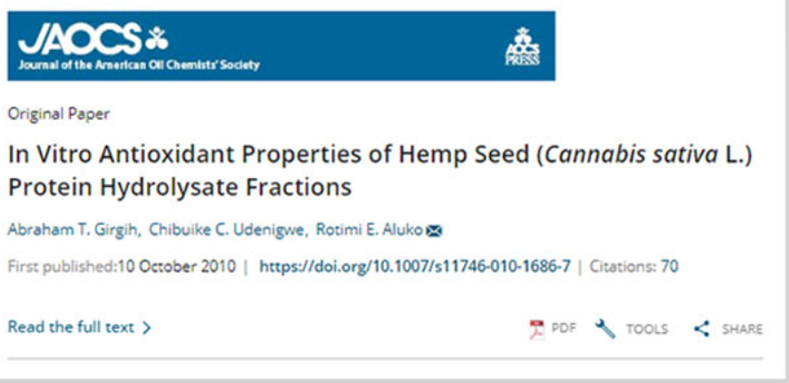
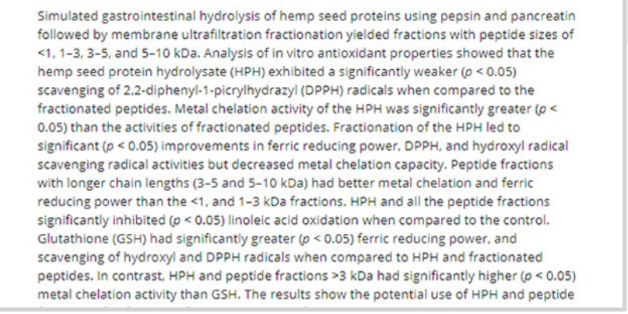
03. Product Introduction
Product (CB DERM EX) Introduction
Do hemp seeds really work?
Hemp seed ingredients used in cosmetics and medicines are non-toxic and harmless to the human body, so it can be considered a good ingredient. Overseas, they are already used in a variety of ways because of their effectiveness, and cosmetic hemp seed ingredients are known to be very effective for dry and sensitive skin.
The Most Powerful Food Ingredient on the Planet
Cannabis Sativa (Hemp Seed)
Hemp seeds are anti-stress and contain omega-3 and 6, which help prevent dry skin without clogging pores, as well as act as antioxidants to soothe skin irritation.
It also has a soothing effect on sensitive skin.

Slide 11

03. Product Introduction
Product Features and Benefits
01
02
03
04
We applied the core raw materials found in hemp to all of our products (hemp seed oil, hemp stem extract, hemp root extract, and hemp root ferment filtrate).
All of our products contain hemp stem and hemp root exosomes.
All of our products contain centella asiatica exosomes.
Our products have the dual effect of exosomes and liposomes.
05
06
07
All of our products contain selaginella rossii extract, an exclusive ingredient developed by GB.
All of our products contain collagen extract instead of purified water.
We used EWG Green Grade ingredients.

Slide 12
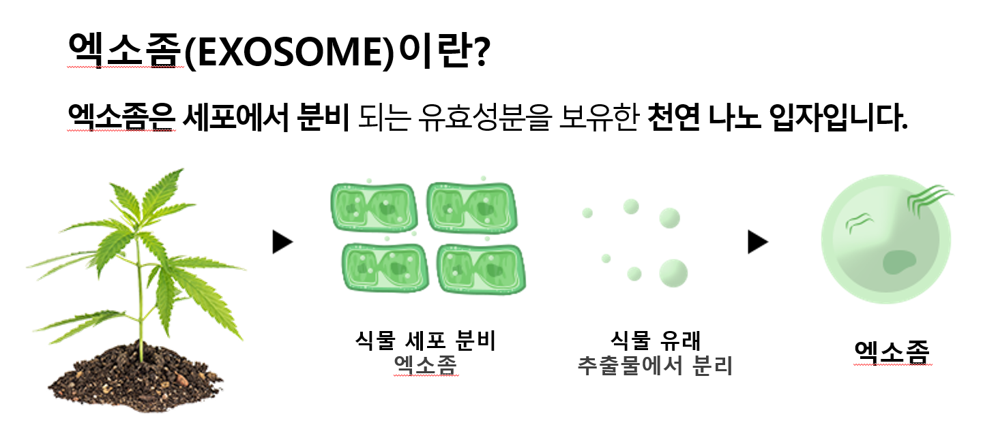
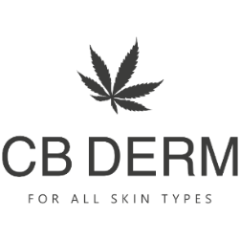
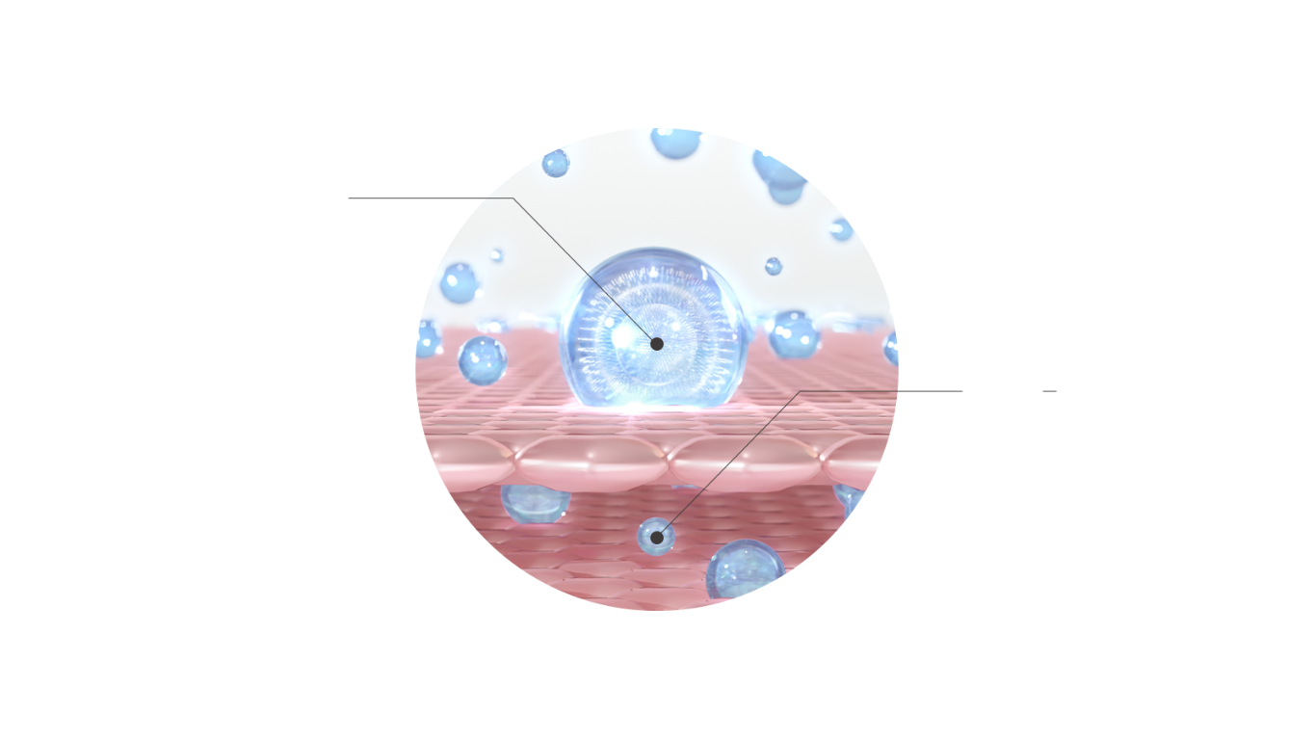
03. Product Introduction
Product Features and Benefits
Exosome Technology
Exosome
Technology
What are Exosomes?
Exosomes are natural nanoparticles that contain active ingredients secreted by cells.
What are Exosomes?
Exosomes are nano-sized endoplasmic reticulum
secreted by cells that aid in the exchange of information.
They contain signaling substances (RNA, protein, etc.)
and are natural nanoparticles that help with movement
and absorption between cells.
Exosomes Secreted
by Plant Cells
Isolated From Plant-Derived Extracts
Exosome
Characteristics of Exosomes
STEP 01
Exosomes are able to maintain the characteristics
of the original cell through transmission
(maintain tissue homeostasis).
2. They contain genetic material such as mRNA and protein,
components that contribute to skin cell activation and
regeneration.
3. The nanoparticles have a high cell absorption rate and
stably deliver active ingredients to skin cells.
Exosomes adhere to the skin membrane and are absorbed.
STEP 02
Active ingredients inside the exosomes are absorbed by the skin membrane.

Slide 13
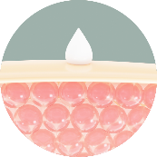

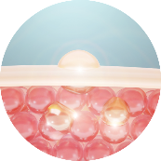

03. Product Introduction
Product Features and Benefits
Liposome Technology
ㆍ Liposomes are nanoparticles that help the skin effectively absorb major ingredients.
ㆍ Formulation: Nano-processing (60-300nm).
Characteristics of Liposomes
01. Most liposomes are spherical or oval.
They are roughly 60-300nm in diameter and
have an average thickness of roughly 130nm.
They deliver the active ingredients inside them to the skin.
02. Liposomes are rapidly absorbed between
intercellular phospholipids. This means that their outer membrane
melts at skin temperature, which allows them to be better absorbed
by the skin.
03. The active ingredients inside liposomes are
quickly absorbed by the skin.
04. Liposomes contain active ingredients that fill the skin with
nutrients to help improve the overall appearance of aging.
STEP 01
STEP 02
STEP 03
STEP 04

Slide 14
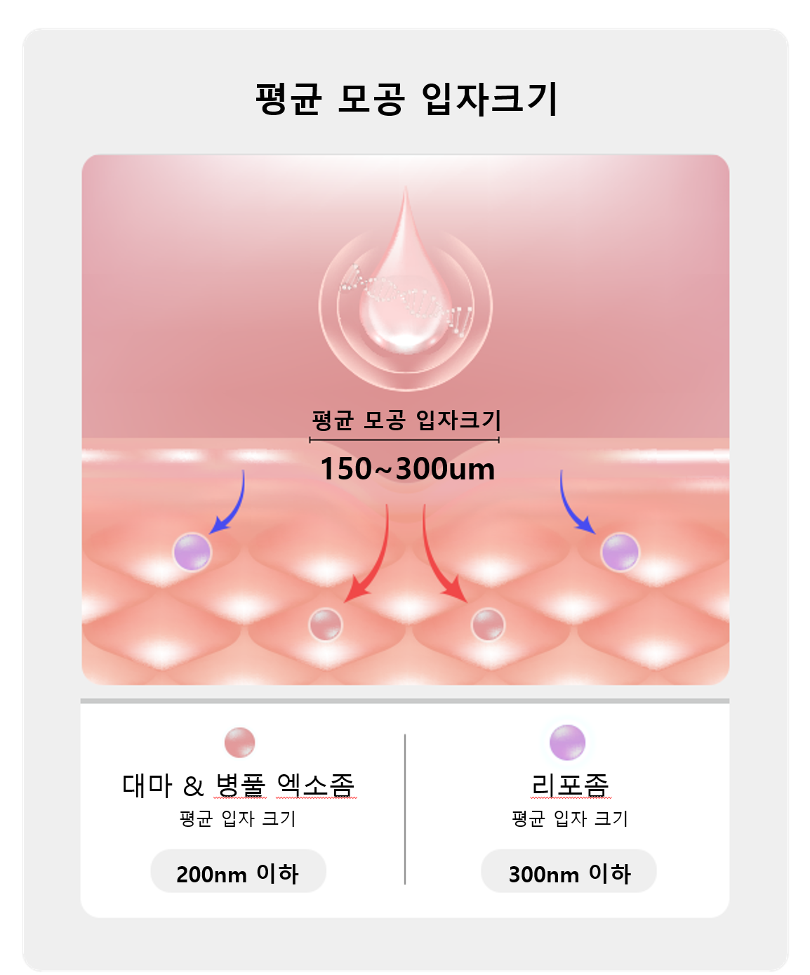

03. Product Introduction
Product Features and Benefits
Dual Effect Technology of Exosomes and Liposomes
Average Pore Particle Size
Exosomes Extracted From Natural Sources
+
Core Raw Materials and Liposomes
=
Deep Absorption by the
Average Particle Size
 | Exosomes | Liposomes
SIZE | 200nm or less | 300nm or less
Manufacturing Method Characteristics | Extracted from the raw materials themselves | Liposome, a core raw material.
 | Liposomes extract the natural active ingredients of the plant and facilitate the absorption by the skin. (Activates ingredients / collects natural nutrients). | The nanonization of the cosmetics formulation facilitates the absorption of active ingredients (increases the absorption rate of the actual formulation / creates an excellent feeling of use).
Hemp and Centella Asiatica Exosomes
Liposomes
Average Particle Size
200nm or less
300nm or less

Slide 15
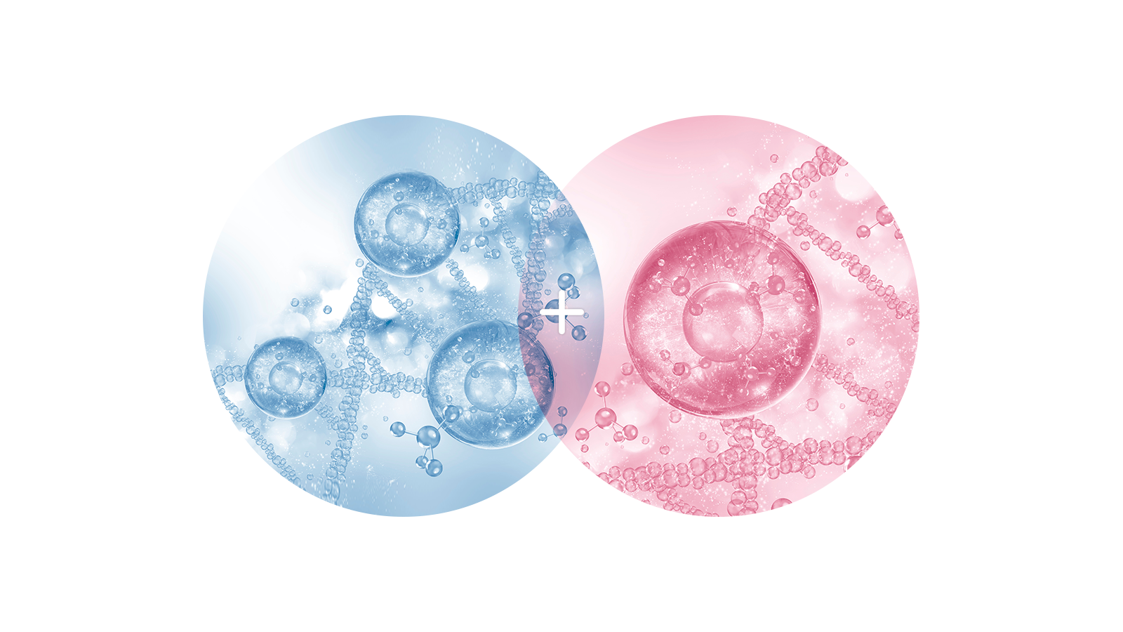
03. Product Introduction
Product Features and Benefits
Dual Effect Technology of Exosomes and Liposomes
Our products contain exosomes from
hemp stem/root that have a high absorption rate,
a complex made from hemp raw materials,
and exosomes from centella asiatica.
We applied our exosome and liposome technology
to create a dual effect that would properly deliver active
ingredients to the skin to fill it with nutrients from the inside.
Exosomes
Liposomes

Slide 16
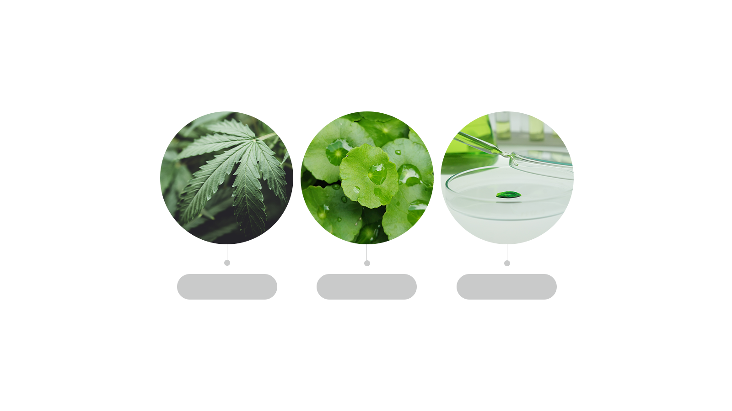
03. Product Introduction
Product Features and Benefits
Hemp & Cica Centella Asiatica + Exosomes
Double Effect of Exotraction (Exosome Extraction and Purification Method)
HEMP(대마)
CICA(병풀)
Exosome
Supplies the skin with nutrients
Protects the skin.
Strengthens the skin barrier.
Increases skin elasticity.
Soothes the skin. Protects the skin.
Strengthens the skin barrier.
Improves itchiness caused by dry skin.
Reduces wrinkles
Absorb nanoparticles.
Absorb core raw materials.
Softly absorb nutrients.
Optimal rate of absorption.

Slide 17
03. Product Introduction
Product Features and Benefits
Protect your skin every day with a mild, mildly acidic CB DERM that promotes healthy skin.
4 5 6
1 2 3 4
7 8 9 10
pH5
Irritated / Oily skin
Dry / Sensitive skin
Healthy skin has a f of 4.5 to 6, which is slightly acidic.
Oily, sebaceous skin is more acidic, while dry, dehydrated skin is more alkaline.
To achieve a balance for healthy skin, we have developed formulas that are slightly acidic.

Slide 18


03. Product Introduction
Product Features and Benefits
Recommended skin types
Dehydrated Skin
Easily Sensitized Skin
Rough skin
Oily skin
Keratin skin
SENSITIVITY
ROUGHNESS
STIMULATION
KERATIN
MOISTUTRE

Slide 19
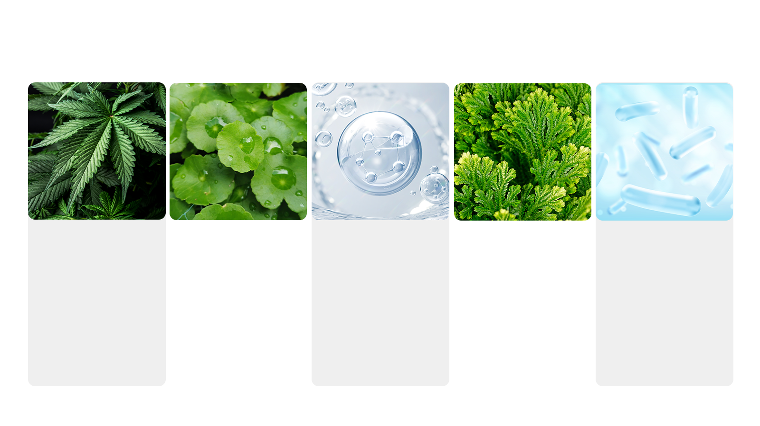
03. Product Introduction
Introduction of Main Ingredients
Hemp Extract
(Root, Stem, Seed)
Centella Asiatica Extract
Collagen
Selaginella Rossii Extract
Lactobacillus Fermented Extract
Hemp extract reduces oxidative stress, inhibits the skin aging process, helps increase skin hydration, and suppresses the expression of inflammatory factors that cause acne and dry skin.
People began referring to centella asiatica as “tiger grass” after watching a wounded tiger roll around in the grass to relieve its pain. It promotes collagen synthesis in wounds to help the skin regenerate. It also has anti-aging properties that relieve inflammation and reduce wrinkles.
A form of hydrolyzed collagen (from fish and animals) that has anti-aging properties that strengthen the skin barrier, increase elasticity, moisturize the skin, and reduce wrinkles.
Selaginella rossii extract has been proven to prevent skin aging and reduce wrinkles by activating collagen synthesis genes.
Lactobacillus fermented extract is one of the three main fermented extracts along with bifida and galactomyces.
It helps inhibit melanin production.

Slide 20
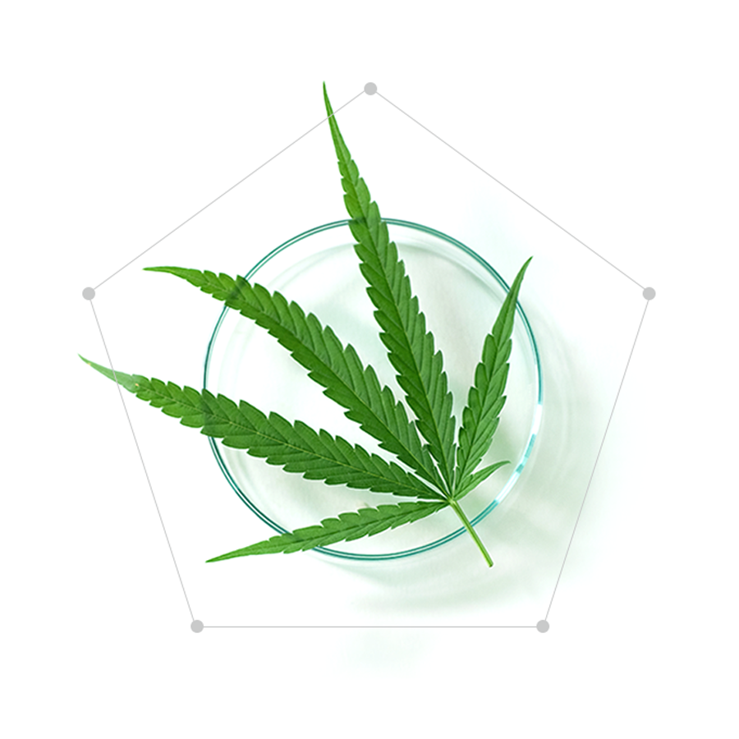
03. Product Introduction
Introduction of Main Ingredients
Hemp Complex Extract
Hemp Seed Oil
01
Introduction of Main Ingredients
The complex contains hemp stem extract, hemp root extract, hemp root ferment filtrate, and hemp seed oil.
It soothes and increases elasticity in sagging skin.
Hemp seed oil helps strengthen the skin barrier to make the skin healthy.
Contains exosomes from hemp stem/root.
Contains a high content of hemp-related extracts.
Hemp Stem
Extract
Hemp Root
Extract
02
03
04
05
Hemp Root
Ferment Filtrate
Hemp Stem/Root
Exosomes

Slide 21
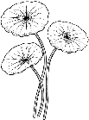
03. Product Introduction
Introduction of Main Ingredients
Components of Exosomes
From Centella Asiatica
Centella Asiatica Exosome Process
① People began referring to centella asiatica as “tiger grass”
after watching a wounded tiger roll around
in the grass to relieve its pain.
② Main Components: Madecassoside, madecassic acid,
asiaticoside, and cica exosomes.
③ The components promote collagen synthesis in wounds
to help the skin regenerate. They also help relieve
inflammation and possess anti-aging properties
that reduce wrinkles.
④ The components are stabilized by isolating/purifying
nano-sized (less than 200nm) exosomes from
centella asiatica.
⑤ The results of the transcriptome analysis showed
that the components can be used on various skin types.
Exotraction
Exo CICIA
Exosomes From Centella Asiatica
*Classification by type.
Centella Asiatica
*Cell of origin.
Pretreatment/Extraction
Exosome
Isolation/Purification
Exosome Stabilization
Centella Asiatica Extract
UPCYCLING*

Slide 22
03. Product Introduction
Introduction of Main Ingredients
What is Exotraction?
First Generation
Plant + Extraction
Plant + Extraction(various) + Liposome
Plant + Extraction + Exosome = Exotraction → Application of Differentiated New Trend Technology to Familiar Materials
Second Generation
Third Generation
Exosome Extraction and Purification Method = Exotraction
Introduction of Optimized Extraction/Separation/
Purification Method Among Exosome Separation Methods
High Pressure Treatment
Particles/Ml or Higher Concentration of Exosome Raw Materials
Source
Selection
Concentrated Exosomes
1.0x10⁷
Relevant Patents Held:
A method for purifying centella asiatica-derived exosomes with excellent dispersibility and stability and a cosmetic composition containing the same. (Registration No. 10-2265811)
2. A method for stabilizing human stem cell-derived extracellular vesicles and a composition for topical skin application containing the stabilized extracellular vesicles. (Application No. 10-0026748)
3. A purification method of purslane-derived exosomes with excellent dispersibility and stability and a cosmetic composition containing the same. (Application No. 10-2021-0086801)
Pressure
Created an Aqueous Two-Phase System

Slide 23
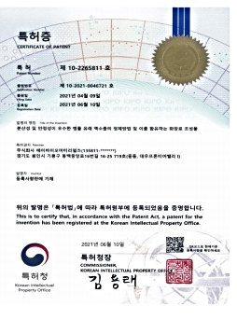
03. Product Introduction
Introduction of Main Ingredients
Applied patented exosomes from centella asiatica
(No. 102265811).
Help soothe and strengthen the elasticity of the skin
Replenish the skin with nutrients from the inside.

Slide 24
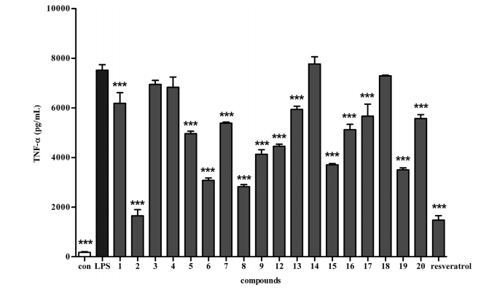
03. Product Introduction
Introduction of Main Ingredients
Anti-Neuritis Activity Effect | Hemp Seed
Dissertation data
Twenty compounds with anti-neuritis activity were isolated from hemp seeds. The anti-neuroinflammatory activity (inhibition of TNF-α production) of the isolated compound was then measured. The results showed a significant inhibitory effect on the TNF-α production of BV2 microglia induced by LPS.
This confirmed that the compound extracted from hemp seeds has an anti-neuritis activity and that hemp seeds are a potential raw material for preventing neurodegenerative diseases.
Improvement Effect of TNF-α
The compound glucoside number two showed the same cytoprotective effect from inflammatory stimuli
as the positive control level
[[Source: 2018 Chemical Constituents of Hemp Seed with Potential Anti-Neuroinflammatory Activity]

Slide 25
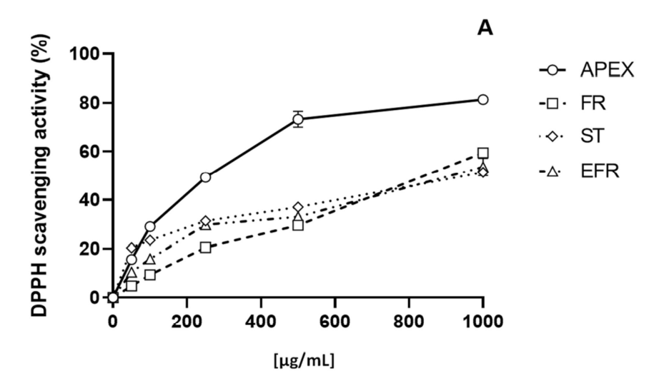
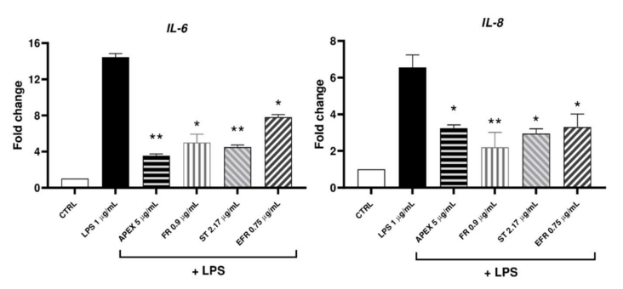
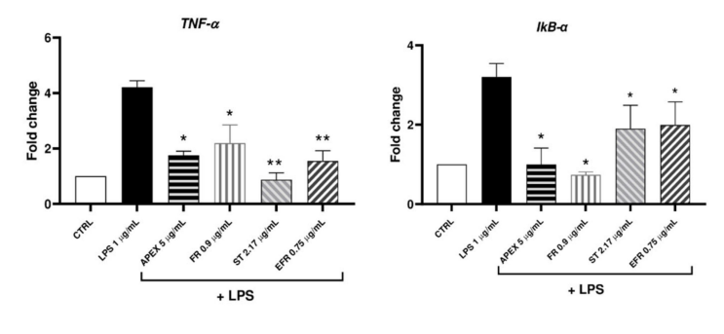
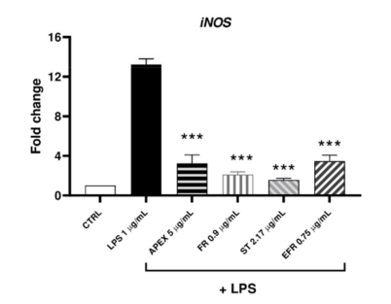
03. Product Introduction
Introduction of Main Ingredients
Anti-Inflammatory and Antioxidant Activity | Hemp Root Extract
The results of an evaluation on the biological activity of hemp root extract found the extract to have excellent anti-inflammatory and antioxidant properties.
The evaluation confirmed that the DPPH activity of hemp root extract increased in a concentration-dependent manner.
Pre-treatment of hemp root extract significantly reduced the overexpression of LPS-induced factors.
Antioxidant Activity Effect
Dissertation Data
Modulating the Expression Level of Anti-Inflammatory Related Markers
[Source: Antioxidants 2022, 11, 860. Characterization of the Biological Activity of the Ethanolic Extract From the Roots of Hemp Grown in Aeroponics]

Slide 26



03. Product Introduction
Introduction of Main Ingredients
Exclusive Raw Material: Selaginella Rossii Extract
Patented New Material
Selaginella rossii extract was created for the localization of cosmetic materials.
① Selaginella Rossii Extract
② Known for its anti-cancer properties,
it is also effective for liver cirrhosis, epilepsy,
hemostasis, melasma, bruises, and burns.
③ Completed research with GB and KRIBB
(Korea Research Institute of Bioscience and Biotechnology).
④ Registered for a technology patent.
⑤ Selected as a GB national project
⑥ Registered for GB ICID.
The patented new cosmetic material adds bio technology to natural plant material! (Patent No. 2335262)
&
1
2
Listed as the world’s first cosmetics ingredient that
contains selaginella rossii extract.
Registered
selaginella rossii extract as a cosmetics ingredient for the first time in the Republic of Korea.
Technological cooperation between General Bio Co., Ltd. (GB) and the Korea Research Institute of Bioscience and Biotechnology.

Slide 27
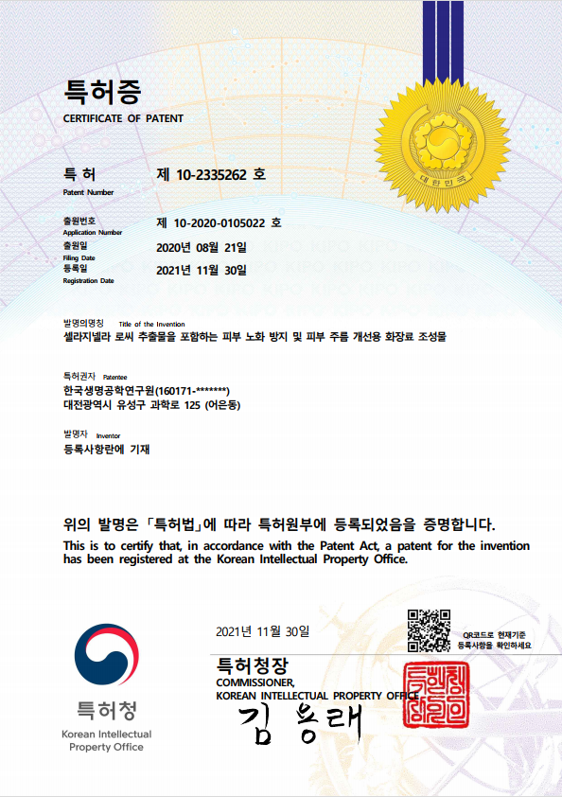
03. Product Introduction
Introduction of Main Ingredients
Patent Certificate for Selaginella Rossii Extract
Received technology transfer from the Korea Research Institute of Bioscience and Biotechnology.

Slide 28
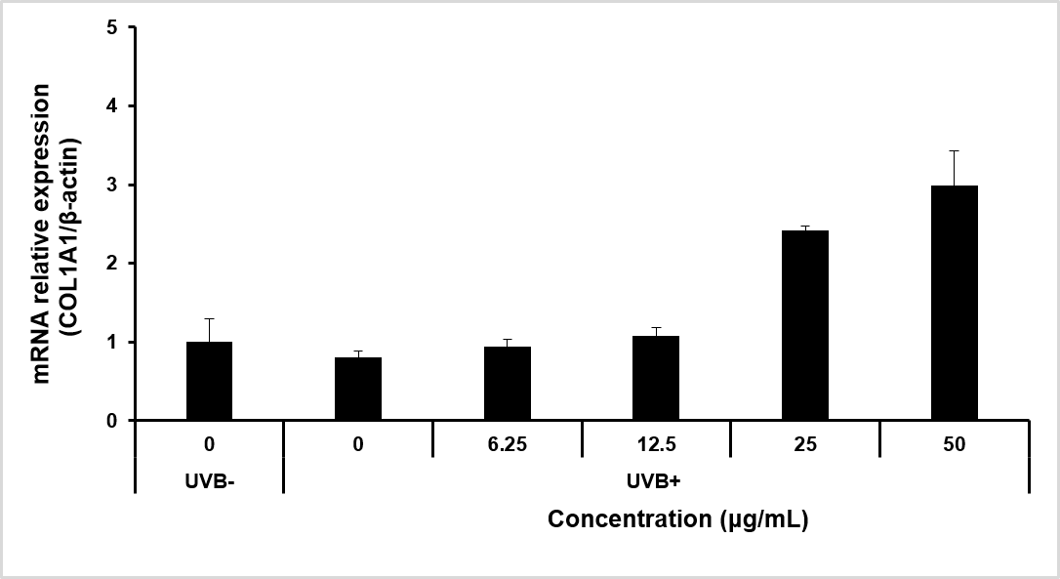
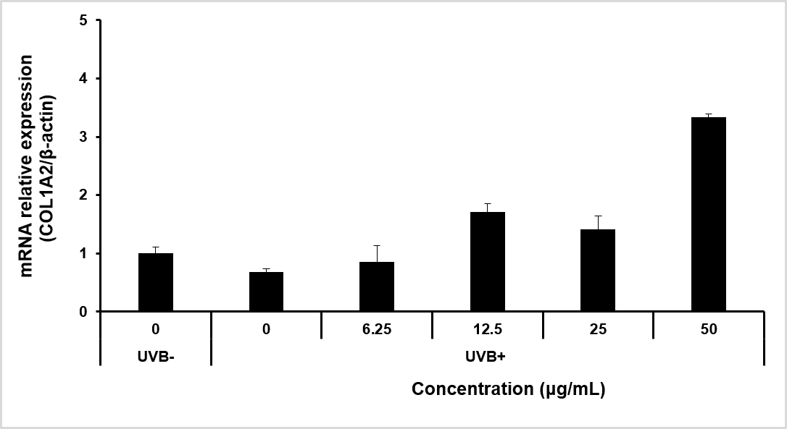
03. Product Introduction
Introduction of Main Ingredients
Collagen Synthesis Activity Test of Selaginella Rossii Extract
* Control 1: UVB- cells (cells not treated with UVB).
* Control 2: UVB+ cells (cells treated with UVB).
* Experimental Group: UVB+ cells treated with a concentration of selaginella rossii extract.
COL1A1 mRNA Expression Level
COL1A2 mRNA Expression Level
Results
The results showed that the expression of COL1A1 and COL1A2 decreased in UVB+ cells while the expression
level increased according to the concentration of selaginella rossii extract.
COL1A1 and COL1A2 mRNA increased the most at 50μg/mL at a higher expression level than UVB- cells.
The results confirmed that selaginella rossii extract has anti-aging and anti-wrinkle properties thanks to the activation of the collagen synthesis gene.

Slide 29
03. Product Introduction
Introduction of Main Ingredients
Stability Evaluation of Selaginella Rossii Extract
*Changes in the content of the indicator component amentoflavone based on period.
Results
The content of the indicator component amentoflavone found in selaginella rossii extract was able to maintain stability over a period of time.
The results proved the efficacy of the long-term retention of selaginella rossii extract.

Slide 30
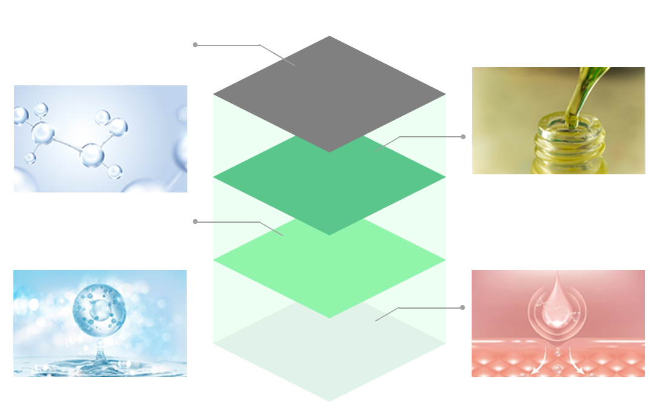
03. Product Introduction
Introduction of Supplementary Ingredients
Combination of the Best Ingredients
Contains six peptides and 13
amino acids that reverse the
effects of aging.
Moisturizes the skin, increases elasticity, and strengthens
the skin barrier.
A complex made from fermented extracts and
skin-friendly vegetable oils.
Moisturizes the skin.
Peptide Complex
Vegetable Oil Complex
Formulation contains the brightening functional ingredient niacinamide.
It also contains adenosine, an ingredient known to reduce wrinkles.
Dual-functional cosmetic product.
Contains collagen extract (not purified water) and three kinds of hyaluronic acid.
Increases skin elasticity.
Brightens
the Skin and Reduces Wrinkles
Collagen Extract

Slide 31
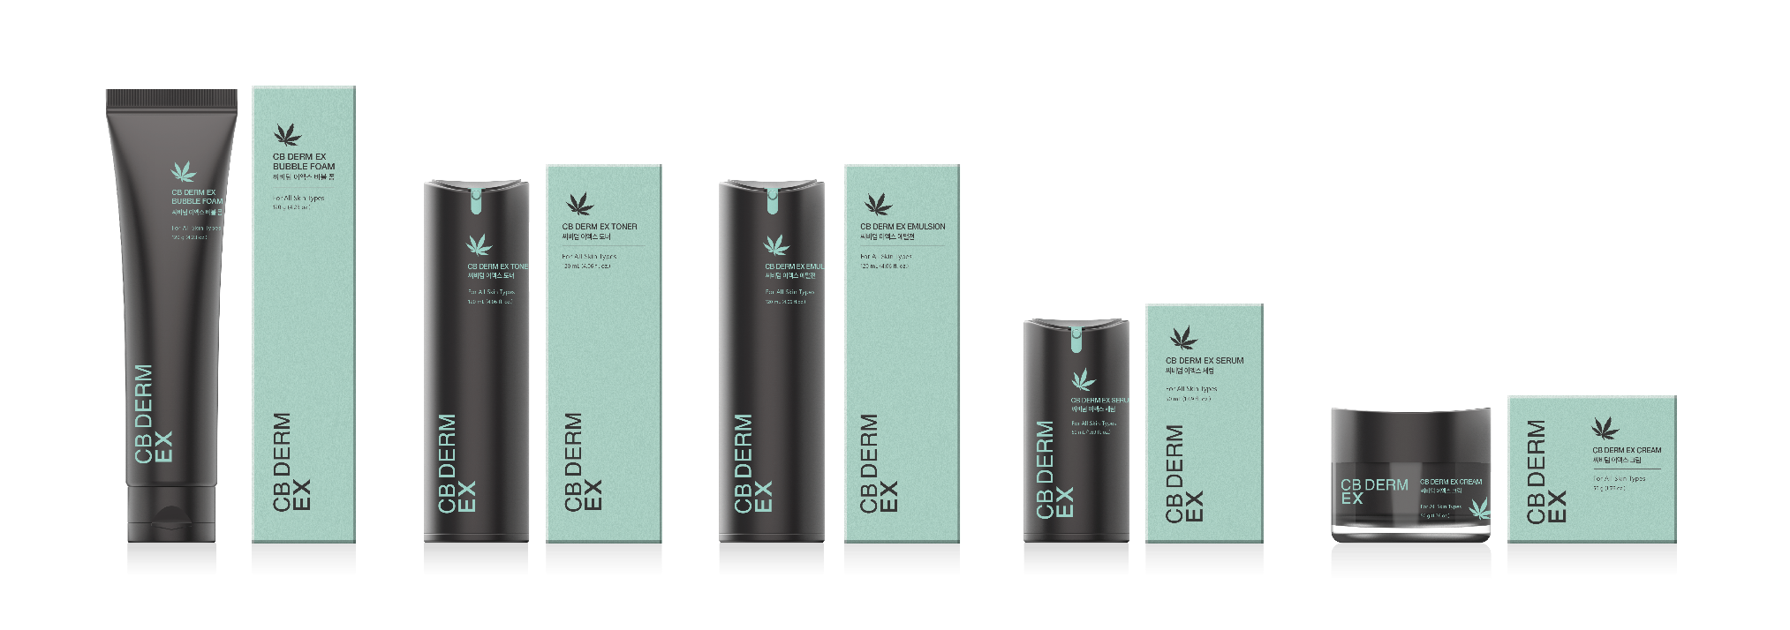
03. Product Introduction
Product Composition
ㆍAll CB DERM EX Productsㆍ
CB DERM EX
Bubble Foam
120g
CB DERM EX Toner
120ml
CB DERM EX Emulsion
120ml
CB DERM EX Serum
50ml
CB DERM EX Cream
50g
Total Hemp Content
18,000ppm or more
96,000ppm or more
114,000ppm or more
47,000ppm or more
52,000ppm
or more

Slide 32
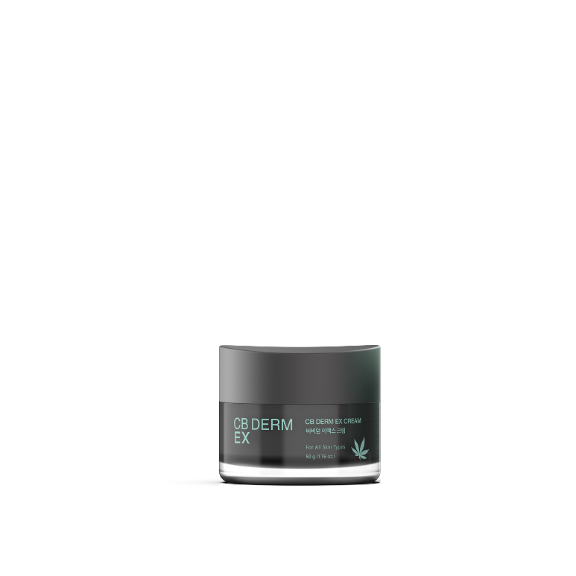
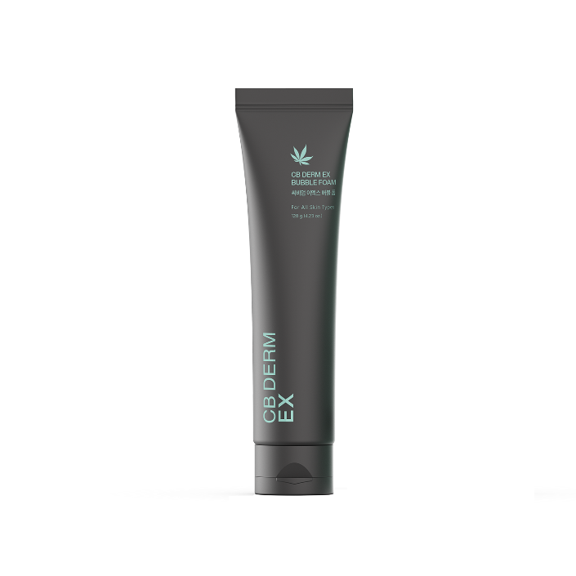
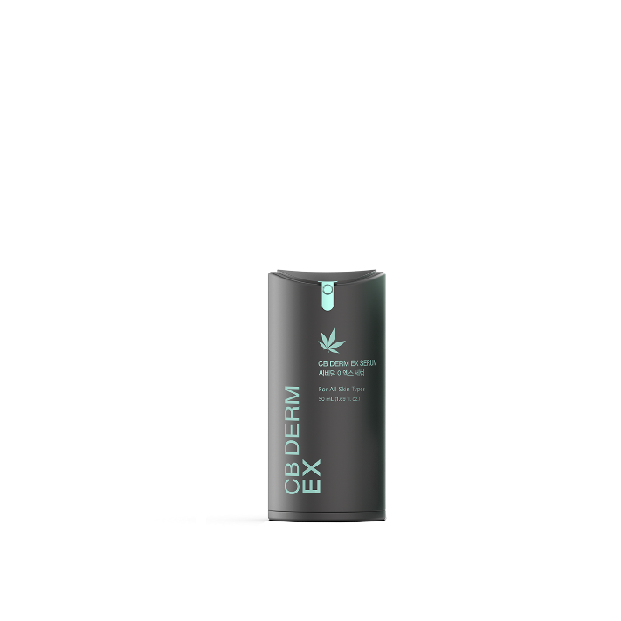
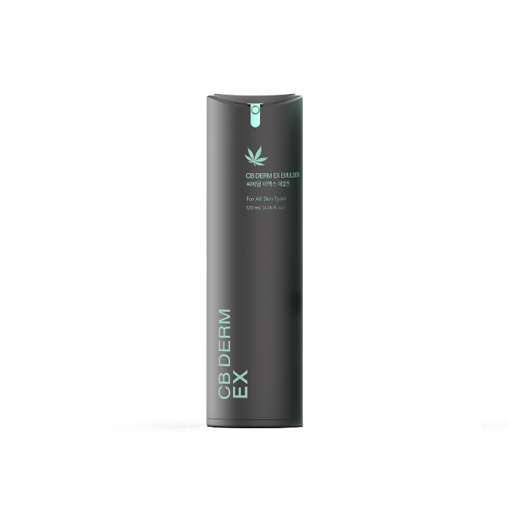
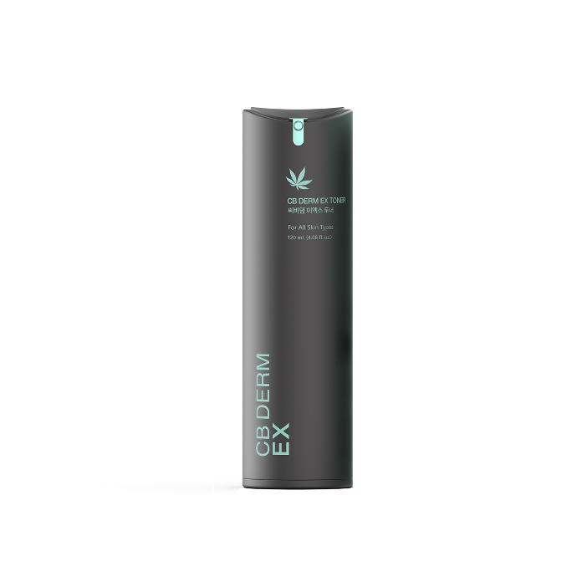
03. Product Introduction
Order of Use for Products
ㆍOrder of Use for All CB DERM EX Productsㆍ
CB DERM EX
Bubble Foam
CB DERM EX
Toner
CB DERM EX
Emulsion
CB DERM EX
Serum
CB DERM EX
Cream

Slide 33
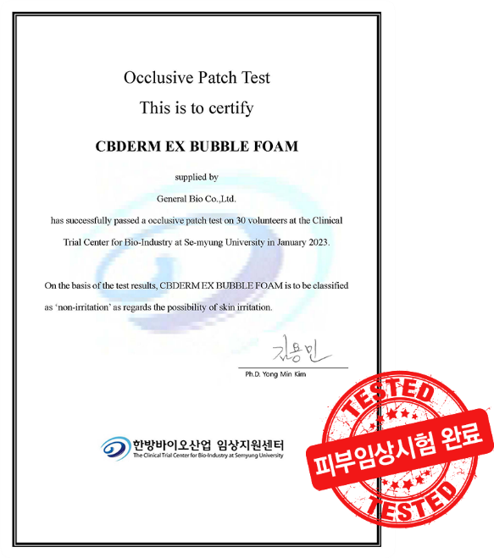
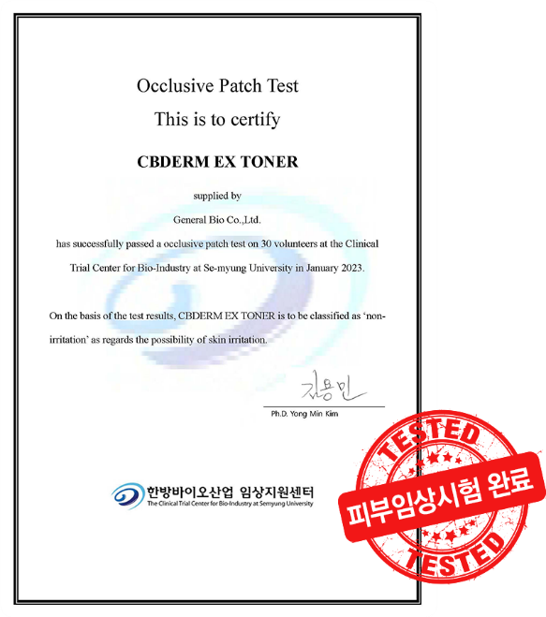

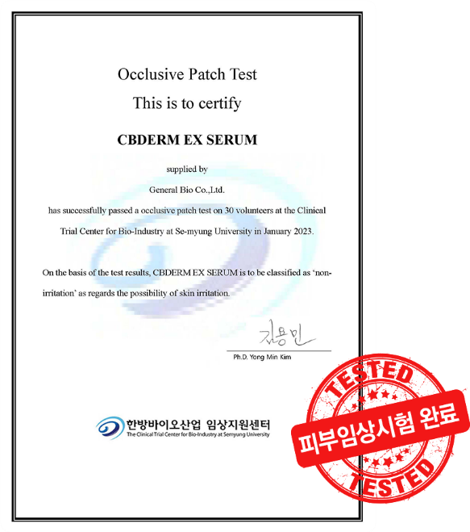

03. Product Introduction
Clinical Test
Completed Skin Clinical Test

Slide 34
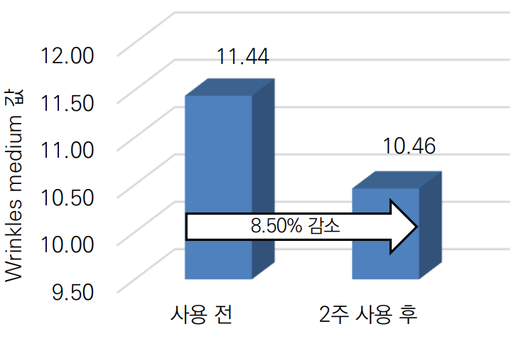
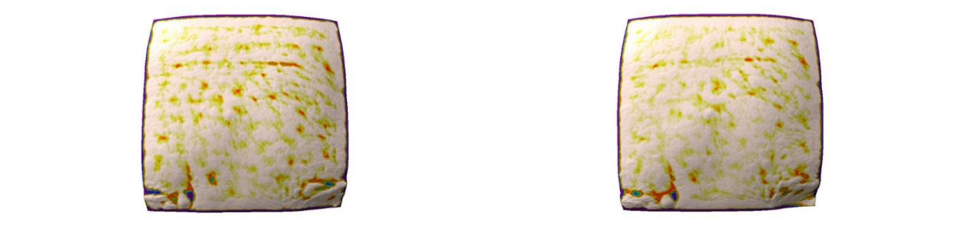
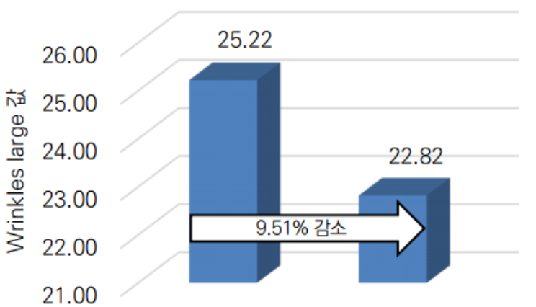
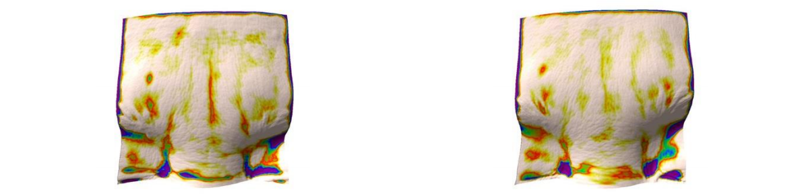

03. Product Introduction
Human clinical trials
Human clinical trials of EX Cream on Forehead wrinkles & Glabellar lines(wrinkles)
Decrease
Before use
After 2 weeks
of use
Before use
After 2 weeks of use
Wrinkles Improvement Rate(%)
Decrease
Before use
After 2 weeks
of use
Before use
After 2 weeks of use
Wrinkles Improvement Rate(%)
Source: Human clinical trial of EX Cream on Forehead wrinkles, Glabellar lines, Eye area wrinkles, Nasolabial folds, Skin melanin reduction, Improve the amount of skin moisture lost, Skin Moisturizing

Slide 35
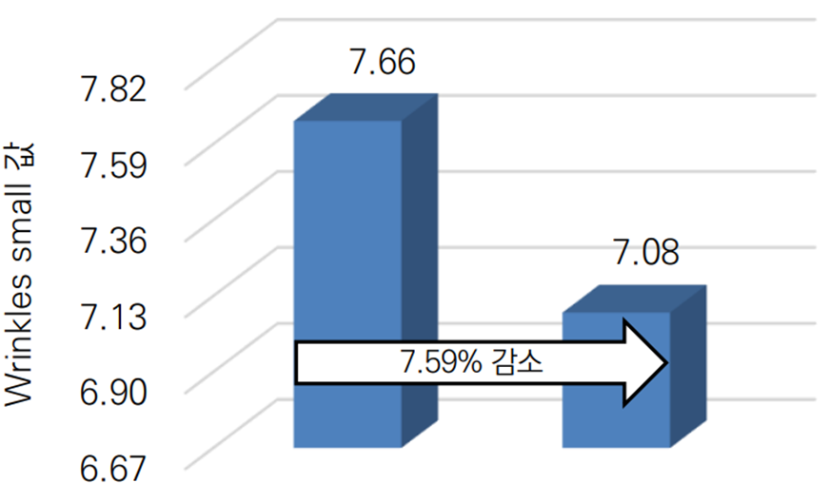
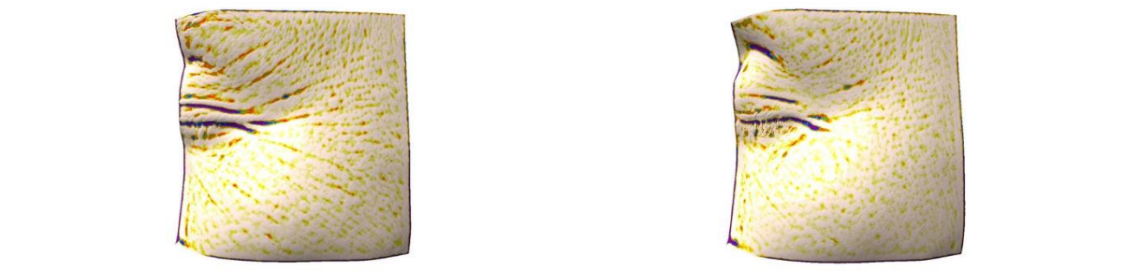
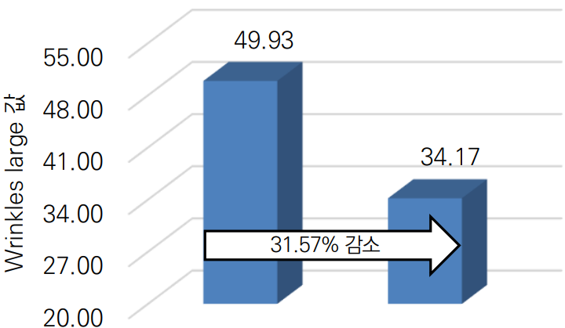
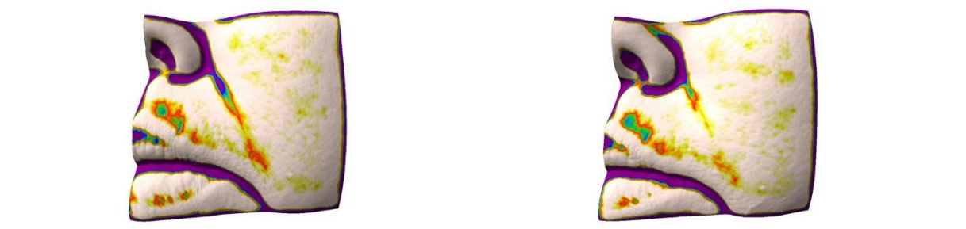
03. Product Introduction
Human clinical trials
Human clinical trials of EX Cream on Eye area wrinkles & Nasolabial folds(wrinkles)
Decrease
Before use
After 2 weeks
of use
Before use
After 2 weeks of use
Wrinkles Improvement Rate(%)
Decrease
Before use
After 2 weeks
of use
Before use
After 2 weeks of use
Wrinkles Improvement Rate(%)
Source: Human clinical trial of EX Cream on Forehead wrinkles, Glabellar lines, Eye area wrinkles, Nasolabial folds, Skin melanin reduction, Improve the amount of skin moisture lost, Skin Moisturizing

Slide 36
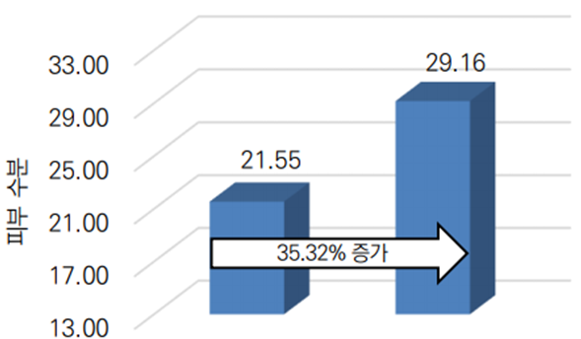



03. Product Introduction
Human clinical trials
Human clinical trials of EX Cream on Skin Moisturizing Inner line / Out line
Improve
Before use
After 2 weeks
of use
Skin Moisturizing Improvement Rate(%)
Before use
After 2 weeks of use
Improve
Before use
After 2 weeks
of use
Before use
After 2 weeks of use
Skin Moisturizing Improvement Rate(%)
Source: Human clinical trial of EX Cream on Forehead wrinkles, Glabellar lines, Eye area wrinkles, Nasolabial folds, Skin melanin reduction, Improve the amount of skin moisture lost, Skin Moisturizing

Slide 37



03. Product Introduction
Human clinical trials
Human clinical trials of EX Cream on Skin melanin reduction
& Improve the amount of skin moisture lost
Decrease
Before use
After 2 weeks
of use
Abnormal melanin Improvement Rate(%)
Before use
After 2 weeks of use
Decrease
Before use
After 2 weeks
of use
Amount of skin moisture lost Improvement Rate(%)
Source: Human clinical trial of EX Cream on Forehead wrinkles, Glabellar lines, Eye area wrinkles, Nasolabial folds, Skin melanin reduction, Improve the amount of skin moisture lost, Skin Moisturizing

Slide 38

03. Product Introduction
Recommended For
Recommended For
Check 1.
Check 2.
Check 3.
Check 4.
Check 5.
Check 6.
Check 7.
Those who want strong anti-aging care.
Those who want a product that fills the skin with elasticity from the inside.
Those who are worried about wrinkles and sagging due to aging.
Those who are born with a thin skin barrier and suffer from weak skin.
Those who need skin cell turnover management due to poor skin regeneration.
Those with sensitive skin who need soothing and nourishing care.
Those who are worried about dry skin.

Slide 39

04. Reference
Nutrition Analysis and Efficacy of Hemp
Nutrition Analysis and Efficacy of Hemp
Hemp Stems ▶
Hemp
Hemp Seed Oil ▶
Plant-Based Omega-3
Relieves Symptoms
of Epilepsy
Anti-Aging,
Anti-Inflammatory, Antioxidant Properties

Slide 40

04. Reference
Hempseed Nutritional Features
Hempseed can be consumed as such (whole, hulled seed) or dehulled(hempseed kernel), as well as its processing products, including oil, flour ,and protein powder.
It typically contains 25-35% lipids with a unique and perfectly balanced fatty acids composition; 20-25% proteins easy to digest and rich in essential amino acids; 20-30% carbohydrates, a great part of which are constituted in dietary fiber mainly insoluble; as well as vitamins, and minerals
Hempseed nutritional composition
[출처:2020_The Seed of Industrial Hemp (Cannabis sativa L.): Nutritional Quality and Potential Functionality for Human Health and Nutrition]

Slide 41

04. Reference
Hempseed Nutritional Features | Fatty acid
Essential fatty acids(EFA) cannot be synthesized by mammals and, therefore, must be acquired by diet because they are necessary to maintain healthy human life.
EFAs are necessary for many physiological processes, including maintenance of cell membrane structure, cardiovascular health,
regulating inflammation, and brain health.
The levels of LA (Linoleic Acid) and ALA ( α-Linolenic Acid) found in the fat component of hempseeds make them a food matrix with the ideal.
Hempseed fatty acid composition
[출처:2020_The Seed of Industrial Hemp (Cannabis sativa L.): Nutritional Quality and Potential Functionality for Human Health and Nutrition]

Slide 42

04. Reference
Ameliorative effects of hypercholesterolemia | Hempseed
Livers of control and HS (hempseed) fed animals demonstrated normal morphology, and deep red coloration with no visible fat deposition.
On the contrary, livers of rats in the HFD (high-fat diet) group appeared much enlarged, and pale in appearance compared to HFD+HS, HFD/HS and control groups.
Hempseed ameliorates sings of hypercholesterolemia
Normal morphology, deep red coloration with no visible fat deposition
Much enlarged, and pale in appearance
Liver of control
Livers of rats HFD fed
Livers of rats HFD/HS fed
[출처 : 2019_Ameliorative effects of hempseed (Cannabis sativa) against hypercholesterolemia associated cardiovascular changes]

Slide 43

04. Reference
Ameliorative effects of hypertriglyceridemia | Hempseed
HS, HFD+HS and HFD/HS fed group, demonstrated an appreciable decrease in the levels of cholesterol, LDL, and triglycerides and a concomitant increase in HDL compared to the HFD group signifying the ameliorative effect of hypercholesterolemia on the hypertriglyceridemia.
Decrease of cholesterol
Decrease of triglycerides
Decrease of LDL
increase of HDL

Slide 44
04. Reference
Wrinkle improvement | Hempseed extract
Hemp seeds are currently evaluated as beneficial due to their rich nutritional value and ideal unsaturated fatty acid content, and a lot of attention and various studies are being conducted as a superfood.
The main effects of hemp seeds are reported to be skin care, antioxidant, and immunity enhancement.
This study investigated the anti-wrinkle effect of hemp seed extract and aims to suggest various application possibilities through the verification of wrinkle-reducing functional efficacy.
Using human dermal fibroblasts (Hs68), 50% cell death was induced through cytotoxicity and UV treatment according to extract treatment, and then the expression rate of MMPs were measured.
Results
MMP-1, 3, and 9 all showed statistically significant differences and showed a tendency to decrease in a concentration-dependent
The expression levelof MMP-1, MMP-3, and MMP-9 at 100 ug/mL of the extract, decreased by 43%, 82%, and 77%, respectively, compared to the UV treated group.
In particular, the expression level of MMPs was decreased by 28% compared to the group treated with retinol (0.3 ug/mL), which is a positive control group.
[출처: 피부 섬유 아세포에서 대마 씨 추출물의 주름 개선 기능성 검증]

Slide 45



04. Reference
Antioxidative and Anti-inflammatory effects | Hempseed extract
To confirm the antioxidant effect of skin cells, the antioxidant efficacy of the extract was evaluated, and the antibacterial effect against the Propionibacterium acnes strain was confirmed.
DPPH radical-scavenging activity:
HSSE45_35.52 ± 0.76%, HSSE60_30.85 ± 0.21%, and HSSE30_11.18 ± 0.64% at 20 mg/mL
ABTS⁺ radical-scavenging activity:
HSSE45_42.97 ± 0.29%, HSSE60_41.05 ± 1.20%, HSSE30_38.28 ± 0.83% scavenging activity at the highest concentration
As a result, the scavenging ability increased in a concentration-dependent manner, and the antioxidant activity tended to increase in the order of HSSE45>HSSE60>HSSE30
Clear zones appear in Propionibacterium acnes strains
Antioxidative effect
Antibacterial activity effect
Hemp Seed Supercritical Extract (HSSE)
- HSSE30: Hemp seed supercritical fluid 30℃ extracts / HSSE45: Hemp seed supercritical fluid 45℃ extracts / HSSE60: Hemp seed supercritical fluid 60℃ extracts
[출처: JCCT Vol. 7, No. 4, pp.683-691, November 30, 2021. Cosmetic Efficacy of Supercritical Cannabis sativa Seed Extracts and Enhancement of Skin Permeation]

Slide 46

04. Reference
Anti-skin Aging , Reduction of oxidative stress,
Skin hydration | Hempseed extract
Reduction of oxidative stress
Experimental results, Hemp extract reduces oxidative stress, inhibits skin aging process, and hydrogel based on hemp extract has been shown to have a positive effect on skin hydration.
Reduction of oxidative stress
▶In the case of fibroblasts, a statistically significant decrease
in ROS production was observed at concentrations of 1 and
100 μg/mL, and in the case of keratinocytes, it was observed
at concentrations of 1-250 μg/mL.
▶The extract showed a protective effect on the cells tested at
low concentrations, indicating that it reduces oxidative
stress inside the cells.
[출처: Molecules 2021, 26, 802. Positive Effect of Cannabis sativa L. Herb Extracts on Skin Cells and Assessment of Cannabinoid-Based Hydrogels Properties]

Slide 47


04. Reference
Anti-skin Aging , Reduction of oxidative stress,
Skin hydration | Hempseed extract
Inhibition of elastase and collagenase activity
of hemp extract
Elastin and collagen are the major skin-forming proteins, and play an important role in wound healing and skin regeneration as well as in the skin aging process.
Elastase and collagenase enzymes are responsible for degrading the structure of elastin and collagen in the skin.
Anti-skin Aging
▶ Hemp extract increases the inhibition of elastase and
collagenase activity in a concentration-dependent manner
▶ At an extraction concentration of 1000 μg/mL, the ability
to inhibit elastase activity was significantly increased by 30%.
▶ In the case of UAE extract, the collagenase inhibitory activity
was significantly high at about 80%.
- MAE: Magnetic stirrer assisted extraction
- UAE: Ultrasound assisted extraction
[출처: Molecules 2021, 26, 802. Positive Effect of Cannabis sativa L. Herb Extracts on Skin Cells and Assessment of Cannabinoid-Based Hydrogels Properties]

Slide 48


04. Reference
Anti-skin Aging , Reduction of oxidative stress,
Skin hydration | Hempseed extract
In the case of many dermatological problems such as atopy, skin disease, and psoriasis, the wound heals maintaining an appropriate level of skin moisture during the process is very important.
The effect of cannabis extract on skin moisture and transepidermal water loss (TEWL) was evaluated after application of a hydrogel containing cannabis extract to 15 participants.
Effects of increasing skin moisture and reducing transepidermal water loss
▶ The sample containing 1.0% of the extract had stronger skin moisturizing
potential, and in the case of the UAE extract, the durability and
moisturizing properties were far superior to that of the MAE extract.
▶ After 5 hours (relative to the control group), the increase in skin moisture
increased by about 10% for the UAE_1.0 sample and about 5% for
the MAE_1.0 hydrogel.
▶ The protective effect against water loss in the epidermis
was approximately 20-30% lower than that of SLS-treated skin
Effect of increasing skin moisture and transepidermal water loss reduction effect
- MAE: Magnetic stirrer assisted extraction
- UAE: Ultrasound assisted extraction
[출처: Molecules 2021, 26, 802. Positive Effect of Cannabis sativa L. Herb Extracts on Skin Cells and Assessment of Cannabinoid-Based Hydrogels Properties]

Slide 49





04. Reference
“
“Global Superfood (Hemp Seed )”
Proven Guaranteed Effect of Six Global Superfood Seeds”
“Hemp seeds are rich in protein, which makes them an excellent nutritional source for replacing animal protein.”
Why is the beauty industry going crazy for hemp seeds?
Hemp is one of the world's first cultivated crops.
What makes it special?
Skin, hair, and even nails can benefit from hempseed cosmetics.
”
Reason to Believe
Source: TIME (USA) (2014))
[Source] https://www.sommeliertimes.com/news/articleView.html?idxno=16686
[Source] https://time.com/2946028/seeds-chia-hemp-flax-sesame-pumpkin-nigella/

Slide 50







04. Reference
일반 화장품
추출물
정제수
90% Naturally Derived Ingredients
70-80% Hemp Seed Extract and Key Ingredients
Hemp seed effective content 18,000 ppm to 114,000 ppm
90% naturally derived ingredients
Complete active ingredients to maximize active ingredient absorption
(Hemp Seed, Guggenheimia, CICA, Hyaluronic Acid, Collagen, Peptide Complex)
Formulated using Exosome & liposome technology
Mostly purified water
40-50% natural ingredients
Uses 1-2 active ingredients
Reduced absorption due to conventional formulation
Reduced active ingredient functionality
COPYRIGHT © 2022 GCOOP All Rights Reserved.

Slide 51
04. Reference
“Hemp Seed Key Points”
Hempseed protects skin from oxidation and aging.
Hempseed oil is 100% suitable for all skin types.
Hemp seed oil contains gamma-linolenic acid (GLA) and omega-9 fatty acids, which have anti-inflammatory properties.
Studies have shown that hempseed oil can make skin stronger, It can also be used to treat eczema and acne.
This means it attracts moisture to the skin.
It helps water reach between cells, strengthening the cell-matrix.
Hemp seeds have the highest concentration of some of the essential fatty acids that make them the best moisturizers.
Hemp seeds are
anti-inflammatory and very healthy
for the skin.
Hemp seed oil contains linolenic and oleic acids, which prevent wrinkles and fine lines. The anti-aging benefits of hemp are not only preventative,
but also regenerative.
The amino acids present in hempseed
oil make the skin look plump, and by regenerating the skin's natural protective barrier, it can actually turn back the hands of time with regular use.
Hempseed oil moisturizes the skin. It is perfect to combat dry skin.
This means that normal or combination skin types, even sensitive skin can benefit from
this great oil.

Slide 52
04. Reference
“Hemp Seed Key Points” Source.
https://www.cosmeticsdesign-europe.com/Headlines/Promotional-Features/Hemp-Seed-Oil-Trendy-sustainable-with-proven-efficacy-for-skin
https://www.healthline.com/health/hemp-oil-for-skin#benefits-for-your-skin
https://www.thehindu.com/life-and-style/hemp-on-a-high-why-beauty-products-are-turning-to-hemp/article25709457.ece
https://www.stephensonpersonalcare.com/blog/2019-05-13-ingredient-spotlight-hemp-oil-in-the-personal-care-industry
https://cosmeticsbusiness.com/news/article_page/What_can_hemp_do_for_beauty/122380
https://www.byrdie.com/hemp-oil-for-skin
https://thehempmag.com/2020/05/7-reasons-to-incorporate-hempseed-oil-into-your-beauty-routine/
https://www.healthline.com/health/hemp-oil-for-skin
https://www.ellabache.com.au/blogs/ella-bache/4-reasons-to-include-hemp-oil-in-your-skin-care-routine

Slide 53
05. Compare
Competitor Comparison Analysis
Competitor Comparison Analysis (Hemp Cosmetics)
Division | CB DERM EX | Third Party Products
Composition | Bubble Foam, Toner, Emulsion, Serum, Cream | Bubble Foam, Toner, Emulsion, Serum,
Ingredients | All Products: Hemp seed oil, hemp stem extract, hemp root extract, and hemp root ferment filtrate. | Featured Ingredients: Fermented hemp stem/root.
Hemp Component | High Dose Application (All Ingredients are Different) 80,000ppm or more (per 100g) | Concept Application (All Ingredients Below) Less than 400ppm (per 100g)
Application of Exosomes | Hemp stem, Hemp root, Centella asiatica. | Hemp stem, hemp root, centella asiatica.
Application of Liposomes | All Core Raw Materials | Not Applicable
Mixture Ratio | Accurate | Inaccurate
Proprietary Ingredients | Selaginella Rossii Extract (GB ICID Listed Raw Material) | Not Applicable
Formulation | Application of Liposome Method | Not Applicable

Slide 54

Thank you.

