Slide 1

Hello,
GCOOPERS

Slide 2
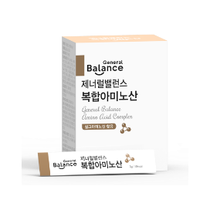
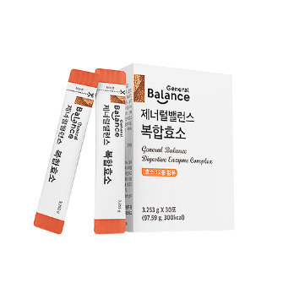
“The Spark
of Life”
Enzymes
Amino Acids

Slide 3
모모 가 Who Knew Enzymes Even Did All This?
Enzymes
Fertilization occurs when the sperm penetrates the cell membrane of the egg cell with **.
From the beginning of life **has a role.
NK cells, which are immune cells penetrate cancer cell membranes with an ** called Perforin,
and destroys cancer cells by secreting a protein** called granzyme.
**are necessary to move muscles.
**in red blood cells bind oxygen and hemoglobin and deliver it to other cells to help sustain life.
Without the ** Acetylcholinesterase, Acetylcholine, a neurotransmitter, cannot be produced and muscle stiffness, and paralysis of respiratory systems can also occur.
Nutrients that are digested and absorbed are converted into glucose to create energy(ATP) in the mitochondria.
In order for this to occur **are necessary.

Slide 4


Enzymes…
The size of an enzyme is approximately 1billionth of a millimeter. Enzymes, which are extremely small particles, exist everywhere within the body and there are over 2000 types. Some even say there are over 3000 types.
Enzymes such as Amylase, which breaks down starch and “antioxidant” enzymes are more familiar among the many enzymes.
On cuts and wounds, enzymes concentrate in the area to help stop the bleeding and help to heal and regenerate cells.
All phenomena related to life are a chemical reaction of sorts and these chemical reactions cannot occur without enzymes.
Enzymes are involved in all 4 stages of decomposition·absorption·antioxidation·conversion and are essential to life.
Enzymes are mixed in our blood or inside the cells in our organs.
Basically they are everywhere in our body. If a person is living, they have enzymes present.
If anything, enzymes are still active for a period of time even after life has ended.
Source: http://health.chosun.com/site/data/html_dir/2012/07/13/2012071302025.html / 헬스조선 / 2017.07.13

Slide 5
Lifespan depends on the amount of enzymes present.

Slide 6

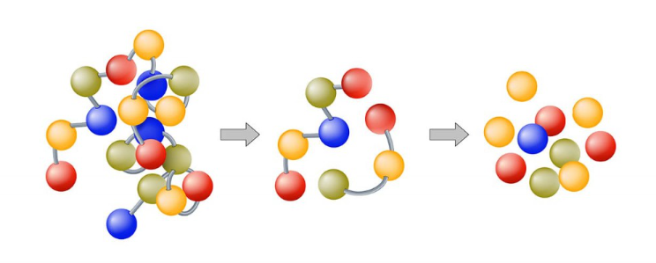
Can you believe it?
There’s a set amount of enzymes produced in the body during one’s lifetime?
There is a set amount of enzymes produced in the body during one’s lifetime
And there is a set amount of enzymes produced in a day
Our bodies use the daily amount of enzymes for digestion and metabolism
The important thing is,
The rate of enzymes used for digestion
should be lower in order to be healthy
3:7
https://m.blog.naver.com/uandi2014/221283105843 /

Slide 7
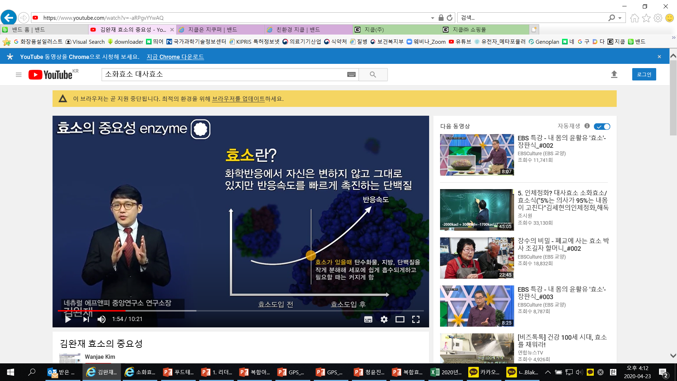
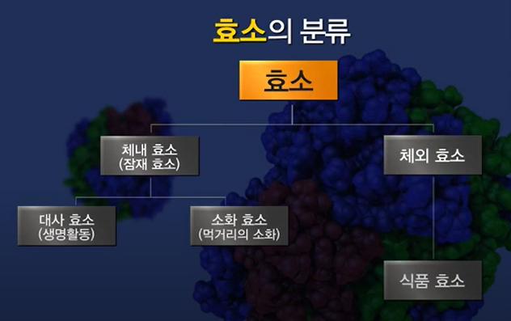


Studying Enzymes
What are Enzymes?
Types of Enzymes
Proteins that do not undergo change themselves during a
chemical reaction but acts as a catalyst to a chemical reaction.
Enzymes
Reaction Rate
Enzymes within the body
(latent)
Enzymes outside
of the body
Enzymes break down carbohydrates, fats,
and protein into small particles that can be absorbed by cells when necessary make
them larger c
Metabolic
enzymes
Digestive Enzymes
Enzymes in Food
Before Enzymes are Involved
After Enzymes are Involved
Types of Enzymes
Types of Enzymes
Enzymes within the body
- Digestive enzymes: breaks down food that is consumed
Enzymes within the body
- Metabolic enzymes: maintains balance of nutrients absorbed
Amylase
Starch → Glucose
Increase in metabolism
Strengthens natural healing abilities
Cleans the blood
Metabolic
Enzymes
Removes harmful substances
Lipase
Fat→ Fatty Acids
Digestive Enzymes
Protease
Protein → Amino Acids
Breaks down
fats
Boosts immune system
출처 : https://www.youtube.com/watch?v=-aRPgvYYwAQ

Slide 8

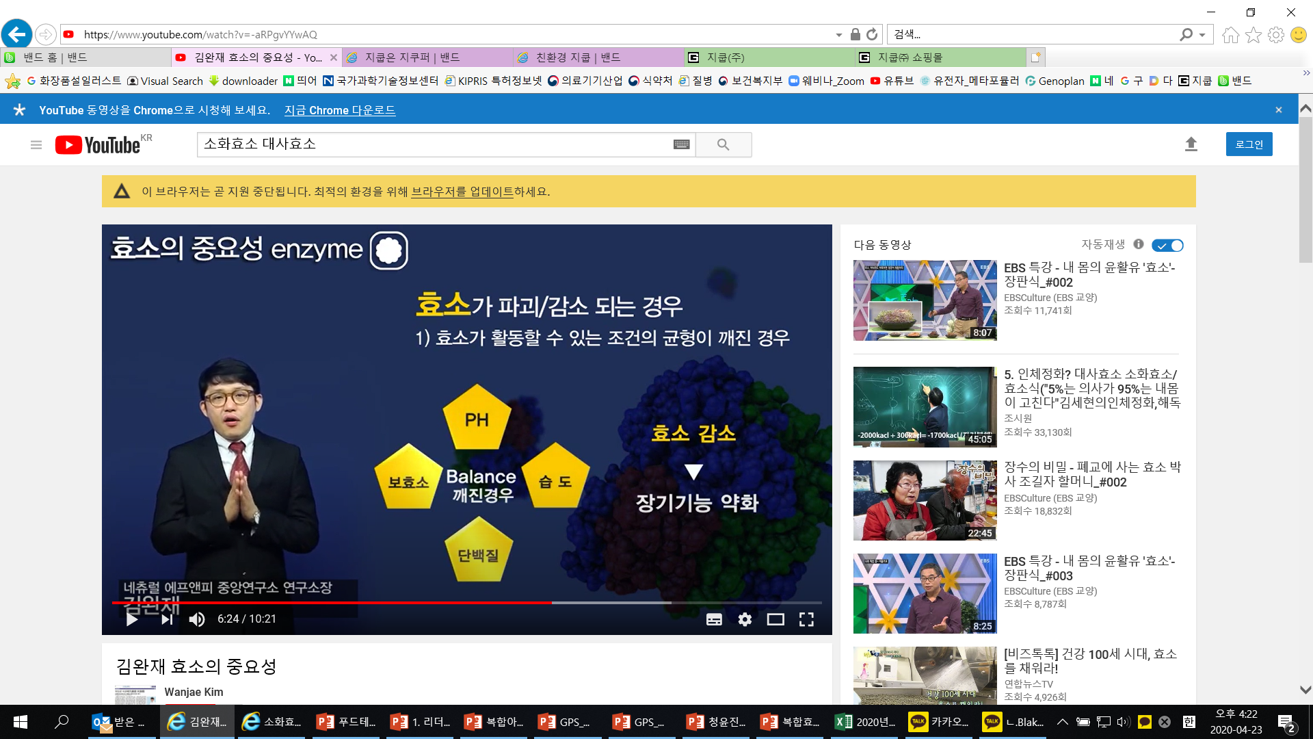
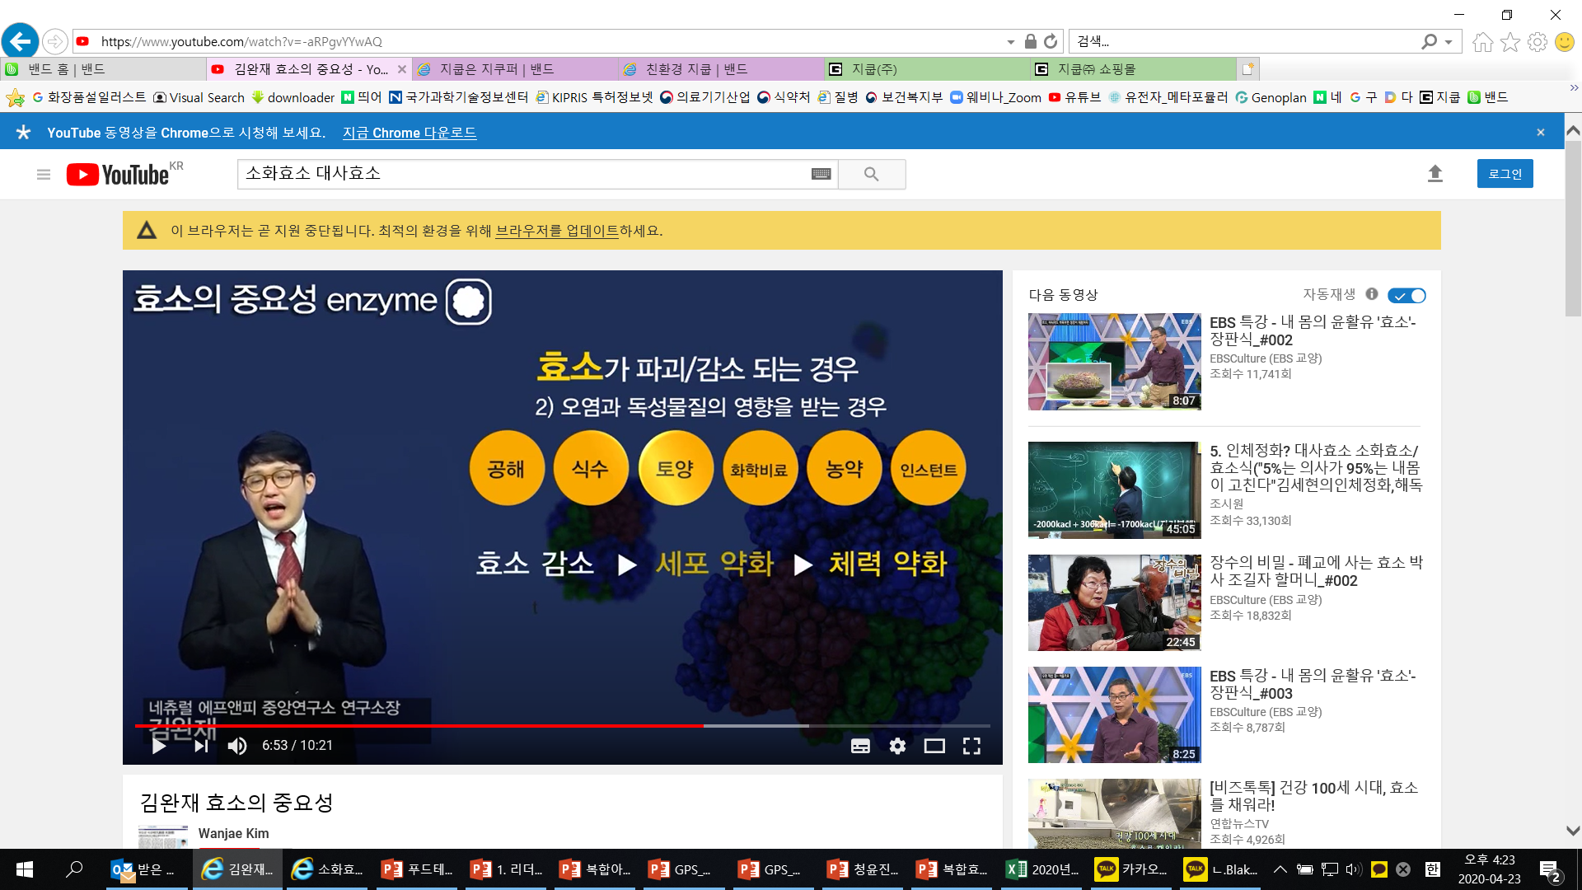
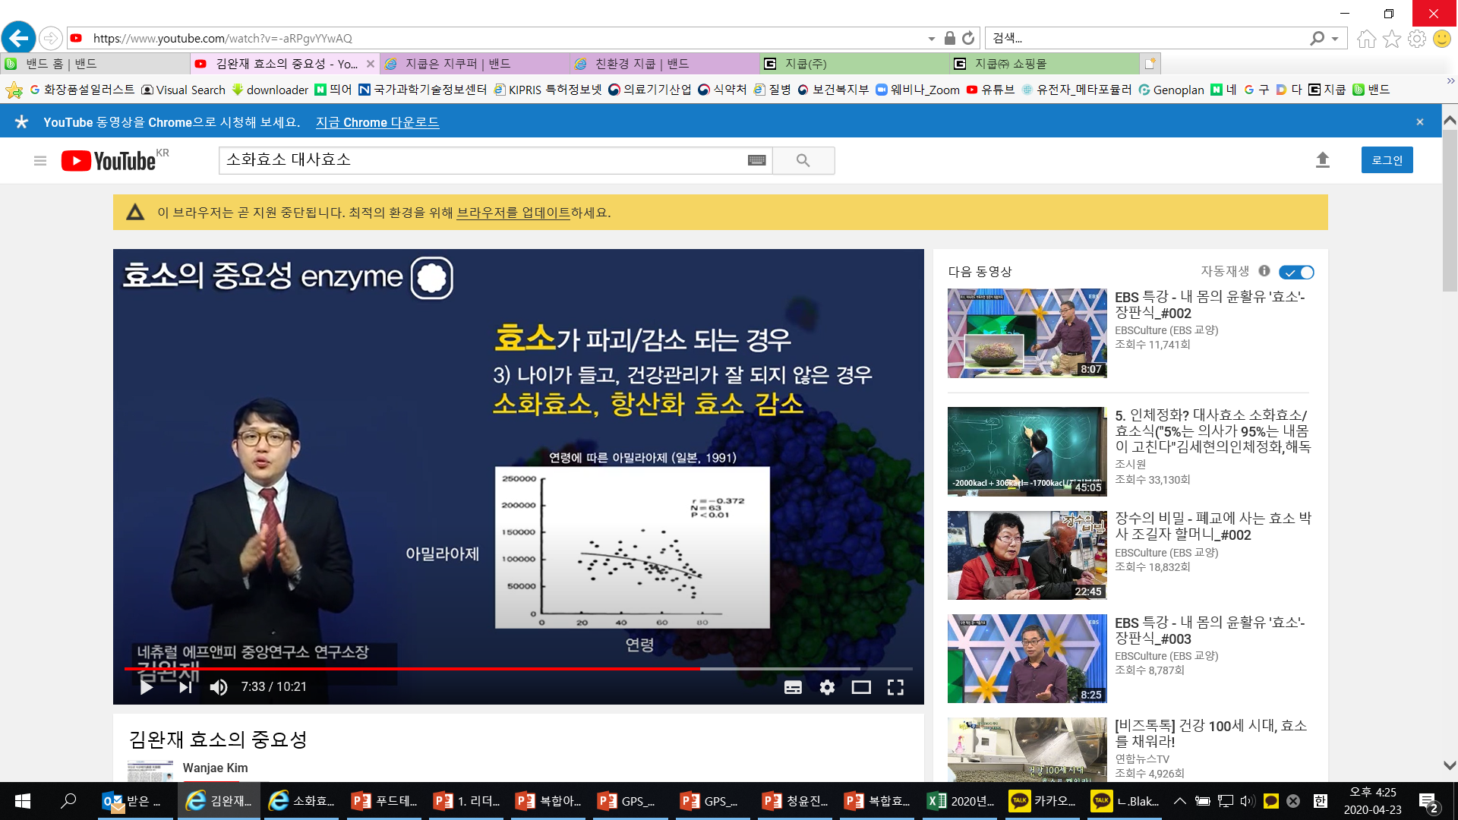
Studying Enzymes
Types of Enzymes
What causes Enzymes to be destroyed?
Enzymes outside of the body
Enzymes in foods: enzymes provided through food
Found in raw foods and in fermented enzymes
If the conditions that are required for enzyme activity are unbalanced.
PH
Decrease of Enzymes
Coenzyme
Unbalanced
Humidity
Weakened Organ
Function
Protein
What causes Enzymes to be destroyed?
What causes Enzymes to be destroyed?
3) Aging and poor health management
Decrease in digestive and metabolic enzymes
2) If affected by toxic or harmful substances
Amylase content by Age (Japan 1991)
Drinking
Water
Checmical
Fertilizers
Instant
Foods
Protein
Soil
Chemical
Fertilizers
Pesticides
Instant
Foods
Pollution
Soil
Pesticides
Amylase
Weakened
Cells
Decreased
Strength and
Endurance
Decrease of
Enzymes
Age
출처 : https://www.youtube.com/watch?v=-aRPgvYYwAQ

Slide 9
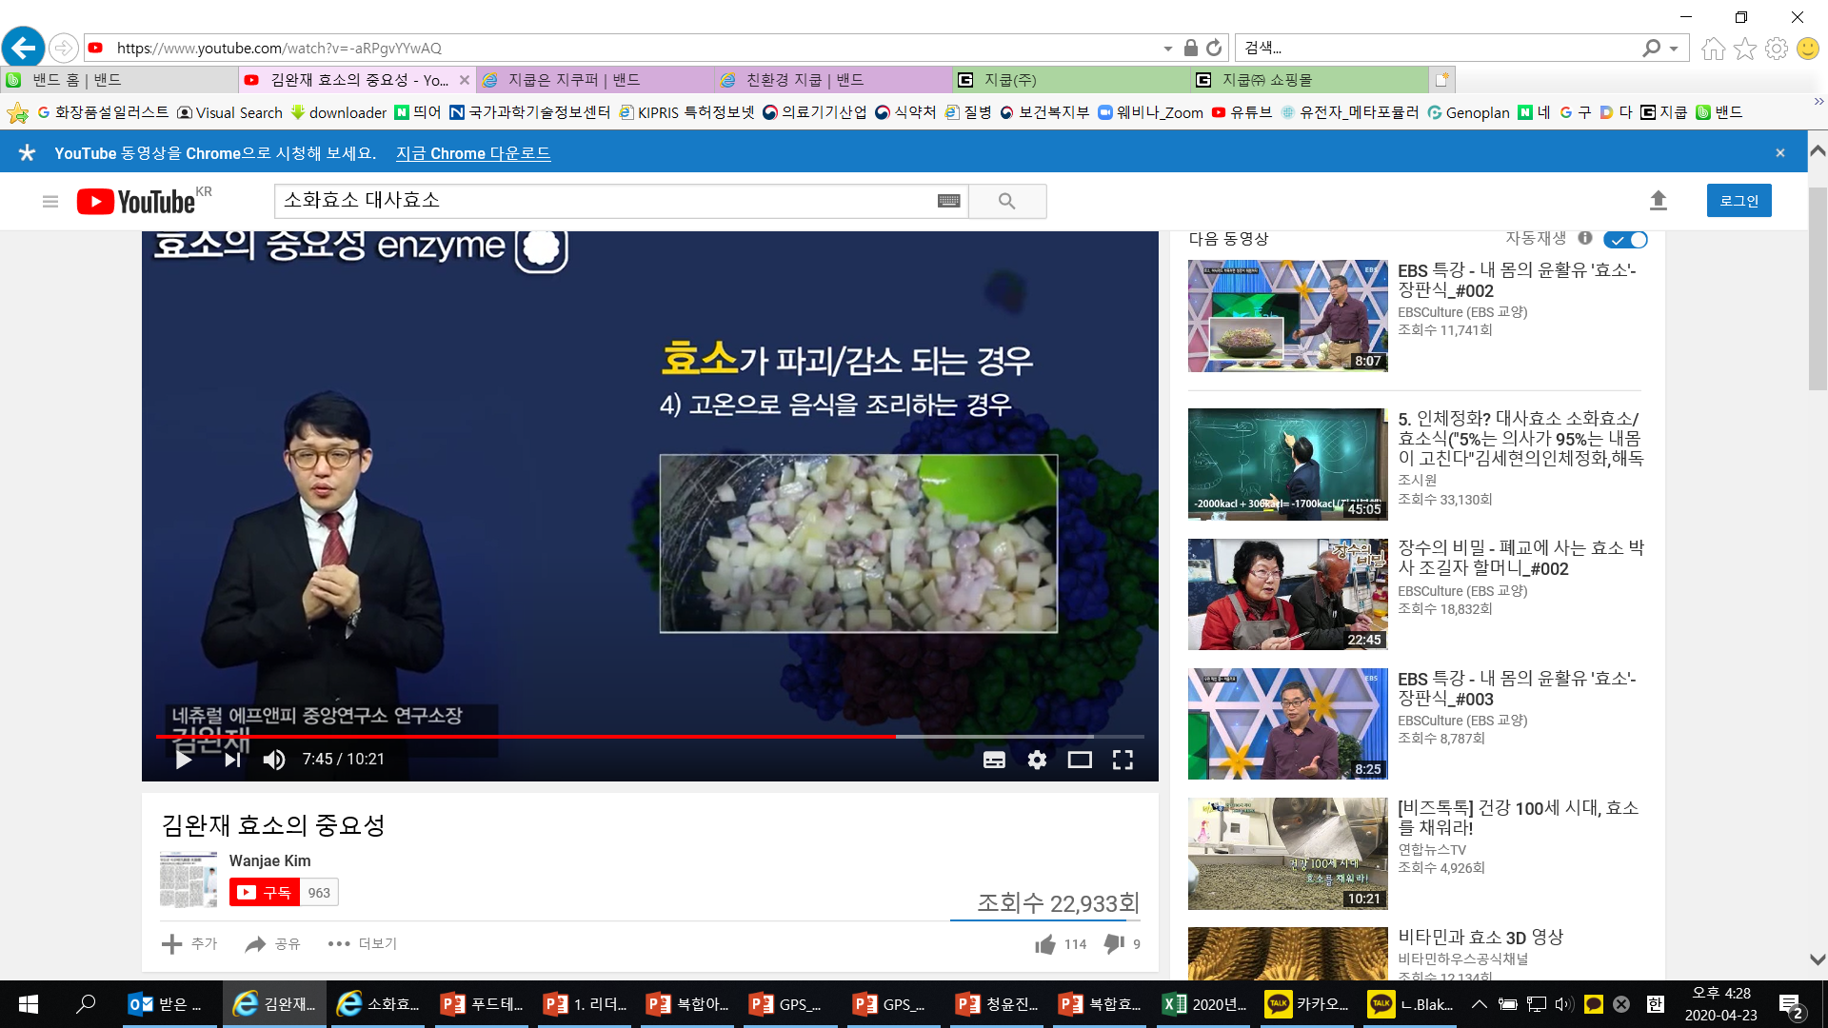
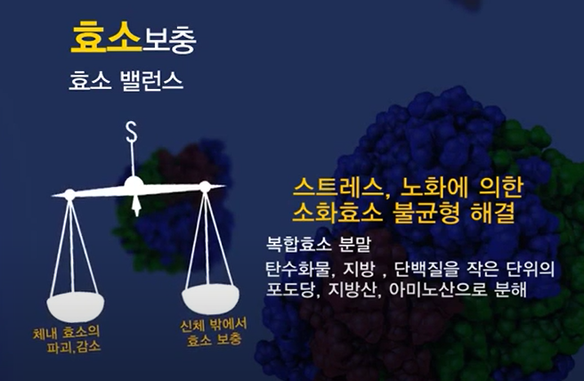
Studying Enzymes
What causes Enzymes to be destroyed?
Enzyme Supplementation
4) Foods cooked at high temperatures
Enzyme Balance
Solution for unbalanced Digestive Enzymes due to stress and aging
Enzyme Complex Powder
Breaks down carbohydrates,
fats, and protein into smaller
units of glucose, fatty acids,
amino acids.
Enzymes destroyed/decreased in the
body
Supplemented with enzymes outside the
body
Even if all the metabolic enzymes are utilized for digestion, proper digestion still cannot occur. As this continues to occur day after day the eliminated waste floats around the blood stream.
﻿
In order to aid our bodies in the purification process we must need to utilize metabolic enzymes. What are Metabolic Enzymes?
They help to support self healing, waste elimination, cell regeneration and blood purification.
[출처] 효소의 쓰임: 건강인- 대사작용 70%>소화작용 30%|
출처 : https://www.youtube.com/watch?v=-aRPgvYYwAQ
Digestion-> Absorption->Decomposition->Excretion
Called ‘Metabolic Process’

Slide 10
The reason we don’t have enough enzymes
What are our dietary habits?

Slide 11

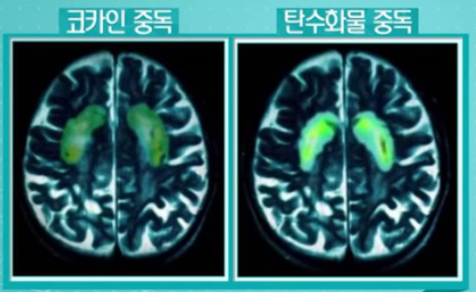
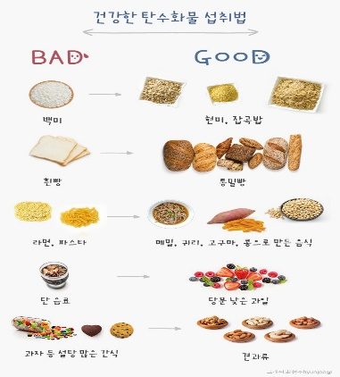

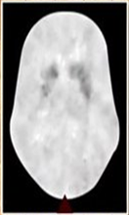
Carb
Addicts
Addiction is high
(same active parts)
1) Cheap and easily
accessible
2) Not filling for a
long period of time
3) Makes you feel
happy
Brain of Drug Addict
Brain of carb addict

Slide 12
There are many beneficial things, but you can’t live without enzymes
Carbohydrates
Vitamins
Minerals
Enzymes
Protein
Fats
Dietary Fibers
“Amylase” Essential for dieting and digesting carbs
“Protease” Helps to break down proteins, which contribute to a healthy diet, and helps to absorb and break it down into amino acids
“Lipase” Essential for dieting and breaking down fats and monoglycerides

Slide 13
The First Flame of Life

Slide 14
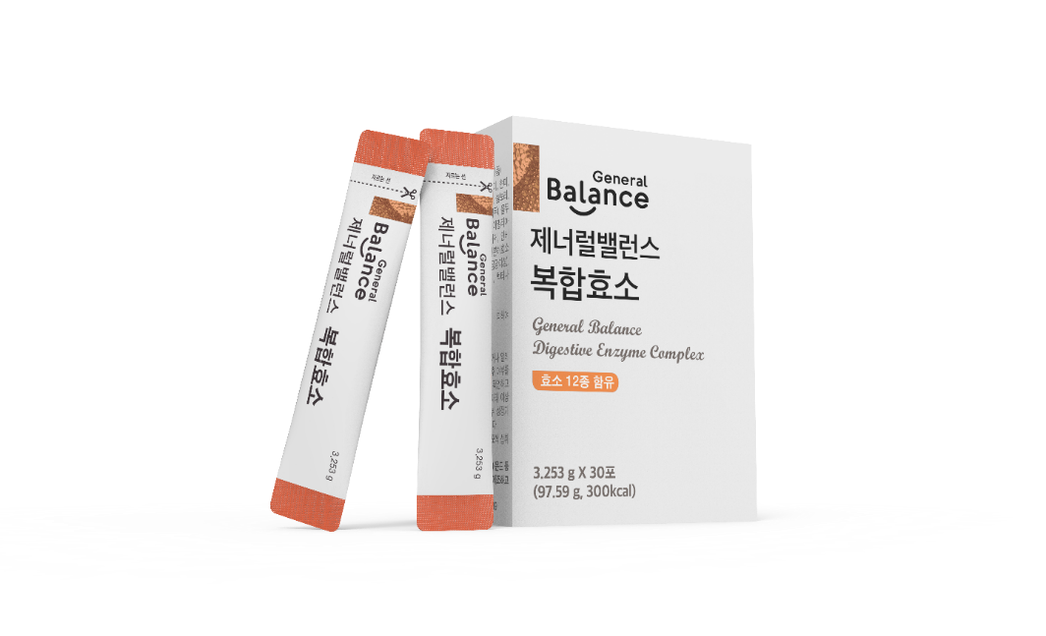
General Balance Digestive Enzyme Complex
Product Type: Dietary Supplement (Enzyme Supplement)
Net Wt.: 97.59g(3,253mg / 30 sticks /1 month
Key Ingredients: Amino Acid Complex (18 Grain Enzymes, 12 Enzyme Mixed Powder)
Serving Size and Directions
- Serving Size: Take 1 stick once a day with water.
- Take with water. (Take with food)
- 우유나 요거트, 시리얼 또는 각종 샐러드와 함께 드셔도 좋습니다.
Optimal Temperature 35∼40℃ for Reaction Rate
Temperatures above 40℃ affect the structure of the enzyme due to the heat and reaction rate is considerably lowered.
*Precautions:
- Take with food or immediately after a meal.
Those pregnant, nursing, children and those with chronic illness must consult with a doctor prior to using this product.
If any adverse reactions occur, stop using immediately and seek medical attention.
If you have any allergies check all ingredients prior to using this product.

Slide 15
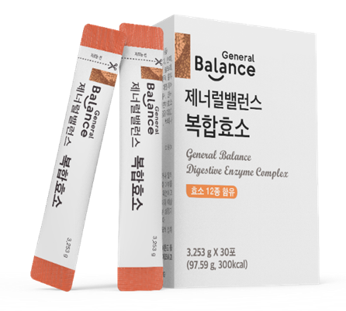

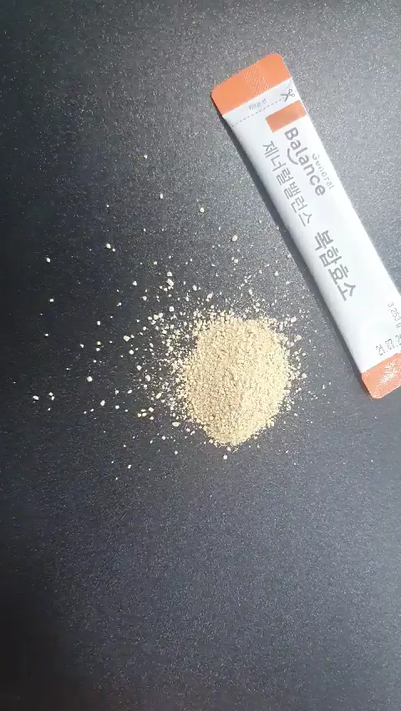
Start Taking It As Soon As You Can
For those that consume all meals throughout the day but are still unable to absorb nutrients, Digestive Enzyme Complex contains 18 grain enzymes and 12 complex enzymes to help support nutrient absorption.
2. “No matter how great the food is, if it can’t be absorbed it’s good for nothing” Fermented enzymes helps to supplement nutrients.
3. In order to maintain healthy intestines, there must be a healthy balance of flora in the intestines.
Fermented enzymes help to support a healthy balance of flora.
(Flora = microorganisms in the intestines)
4. The 18 grain enzymes were produced using grains sourced 100% in South Korea and were fermented as is, without using additives, preservatives or flavorings.
5. The 12 complex enzymes, which includes lipase, were produced using a powder blend of 12 enzymes and may help to reduce appetite.
6. Enzymes help to support the digestion-> absorption-> decomposition -> excretion processes.

Slide 16

18 Grain Enzymes
+ Grain Enzymes
Carefully selected ingredients
Glutinous Rice
Brown
Rice
Sorghum
Adlay
Oats
Rice
Black
Rice
Barley
Glutinous Millet
Wheat
Non-Glutinous Rice
Glutinous
Brown Rice
White
Soybean
Black
Soybean
Red
Beans
Corn
Green
Gram
Embryo
Bud of Rice

Slide 17
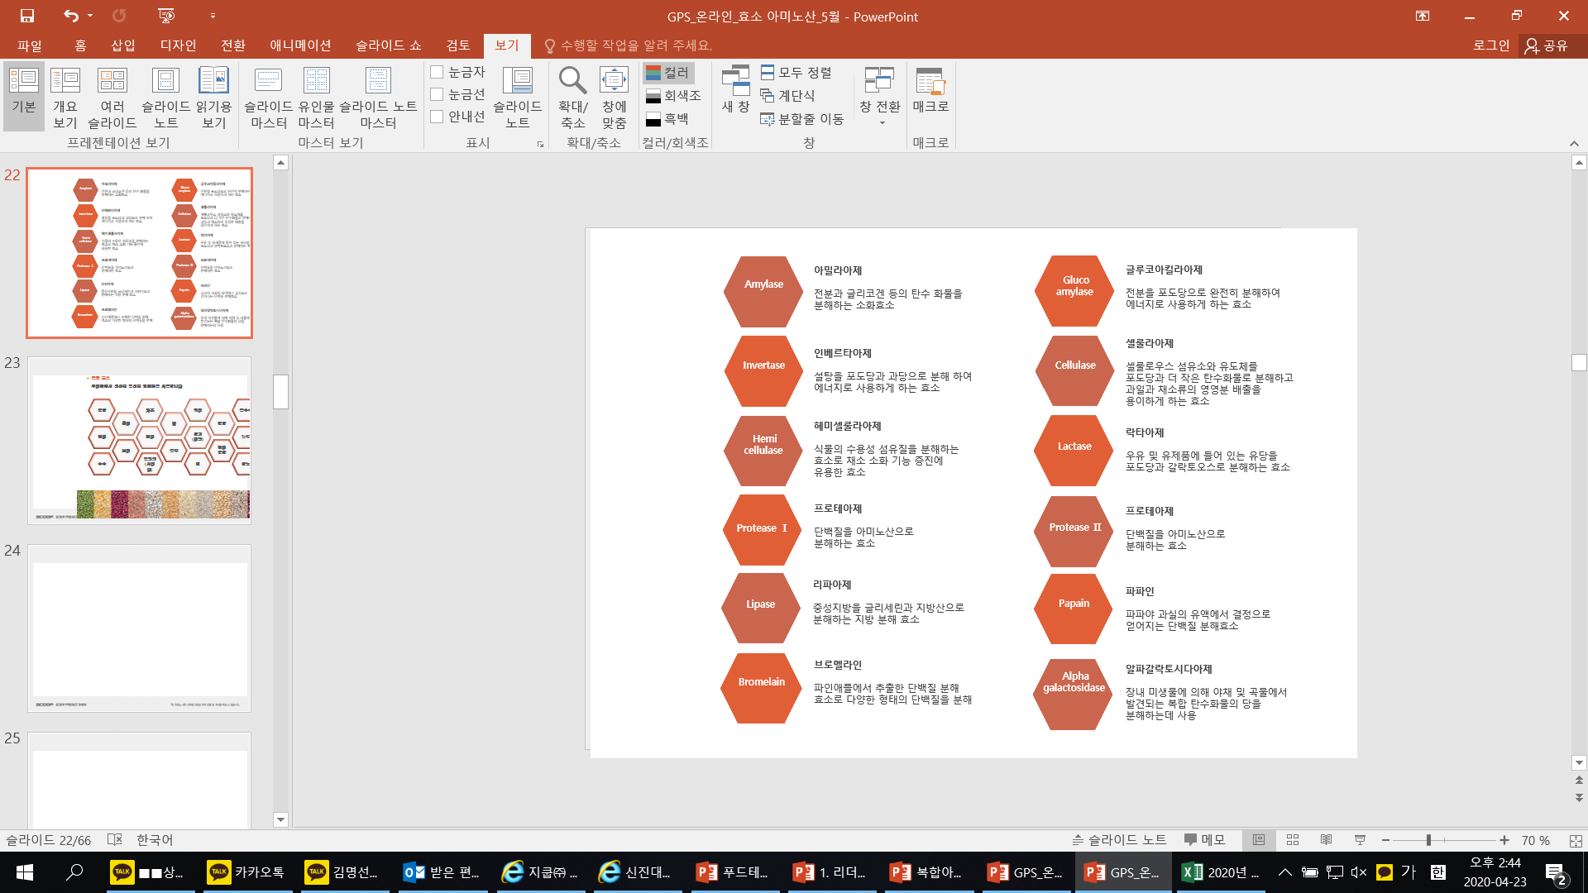
12 Enzyme Mixed Powder
다이어트에 필수, 탄수화물을 분해하는 “아밀라아제”
다이어트에 도움되는 단백질을 분해를 도와주며 소화, 흡수되어 아미노산으로 분해 하는 “프로테아제”
다이어트에 필수, 지방을 분해하여 지방산과 모노글리세리드를 분해하는 “라파아제”
탄력
“Amylase” Essential for dieting and digesting carbs
“Protease” Helps to break down proteins, which contribute to a healthy diet, and helps to absorb and break it down into amino acids
“Lipase” Essential for dieting and breaking down fats and monoglycerides

Slide 18
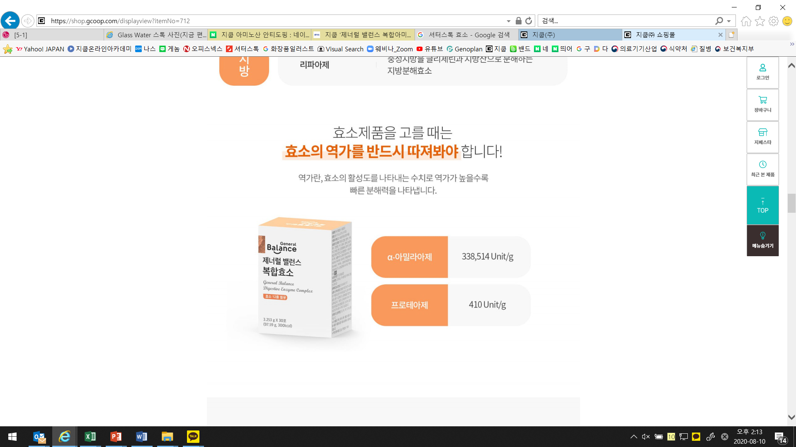
Wait, Lets Look at Enzyme Activity!
When choosing enzyme supplements,
always remember to check Enzyme Activity!
The higher the level of enzyme activity, the faster the enzyme can break down nutrients.
α-Amylase
Protease

Slide 19
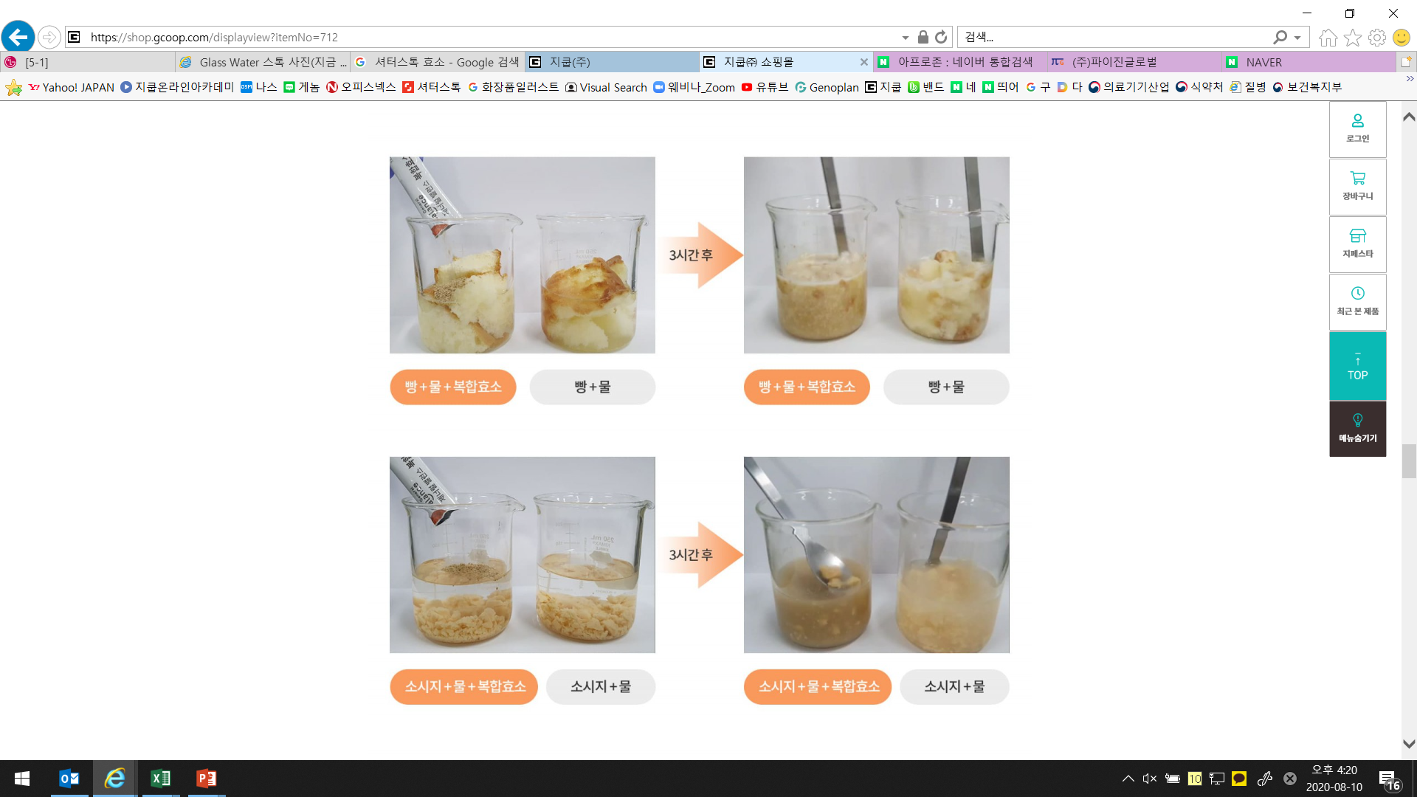
Wait, Lets Look at Enzyme Activity!
Breaking Down
3 hours later
Bread + Water + Digestive
Enzyme Complex
Bread + Water
Bread + Water + Digestive
Enzyme Complex
Bread + Water
3 hours later
Sausage + Water + Digestive
Enzyme Complex
Sausage + Water
Sausage + Water + Digestive
Enzyme Complex
Sausage + Water

Slide 20

Start Taking it ASAP
+ Helps to support digestion and optimal nutrient absorption
+ For those who feel heavy and sluggish
+ For those who exercise but are struggling to lose weight
+ For those who have difficulty absorbing nutrients
+ For those who often consume instant foods, high carb or fatty foods
+ For seniors that want to care for their health in
+ For infants that are consuming formula or soft foods
+ For those who feel sleepy or heavy after eating
If it’s hard to break poor dietary habits, try General Balance Digestive Enzyme Complex

Slide 21

Lack of Enzymes Also Effect Amino Acids
If metabolic enzymes are lacking, the body has difficulty synthesizing Amino Acids to generate new cells.
If metabolic enzymes are lacking free radicals are not effectively removed and waste removal functions decline
Metabolic enzymes synthesize Amino Acids that were broken down from protein,
to generate cells of various parts of the body
Protein cannot be absorbed directly and are therefore broken down into amino acids by enzymes in the intestines and absorbed. They are then moved to various parts of the body where they are needed.
Source : http://hyoso1.com/article/%ED%9A%A8%EC%86%8C%EC%99%80-%EA%B1%B4%EA%B0%95/7/56/?page=

Slide 22
The Second Flame of Life

Slide 23
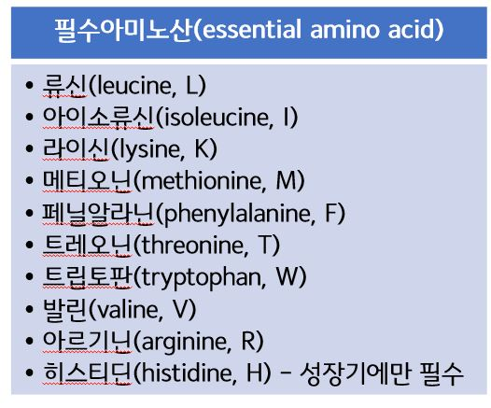

Amino Acids
Amino Acids are protein substances present in the intestines and muscles.
Protein makes up 20% of our body weight.
Amino Acids produce energy and help to maintain our health and are therefore essential.
Amino Acids help to increase strength and endurance and help to increase physical ability.
They help to prevent the decomposition of muscles, provides prolonged amounts of energy
and helps to relieve muscle soreness.
Amino Acids are also necessary for producing nerve cells and neurotransmitters.
If concentration and or memory function decreases, and the brain is over exhausted,
amino acids must be supplemented. Amino Acids are also a main substance that produces
collagen which helps to support skin elasticity. Pork rinds which are said to be good for
The skin is also because they are rich in amino acids.
Amino Acids vary in type and molecular structure and essential amino acids and
non-essential amino acids are also categorized by molecular structure.
Of the 22 amino acids, 9 are not produced within the body and must be
supplemented through food. These are called essential amino acids.
Essential amino acids are not produced in the body and therefore must be consumed through food.
Source : https://m.blog.naver.com/PostView.nhn?blogId=staroot99&logNo=220684171634&proxyReferer=https:%2F%2Fwww.google.com%2F

Slide 24
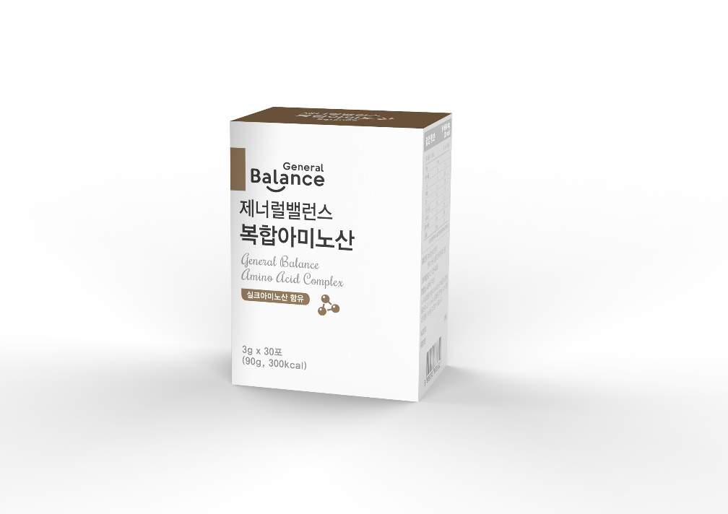
General Balance Amino Acid Complex
+ Product Type: Dietary Supplement
+ Net Wt.: General Balance Amino Acid Complex (90g total /3g x 30sticks/300Kcal)
+ Ingredients: 18 Silk Amino Acids (Contains 9 essential amino acids) Amino Acids 40% + Amino Acid mixed powder 20% + Probiotics 15% + Xylitol + Vitamin C
+ Directions:
- Take 1 packet once a day
- The powder can be taken directly.
- If the powder cannot be taken directly, it can be dissolved into a glass of water or milk (1 packet 180mL of milk/water)
(For better absorption, milk is recommended.)
- May also be added to food, raw foods, shakes, rice, porridge etc.
* Precautions
If you have a chronic illness or allergies, consult a physician prior to using this product.
Use as directed.
If you experience any adverse reactions or stop using immediately.
Those pregnant, nursing and or adolescent young woman must use this product with caution.

Slide 25

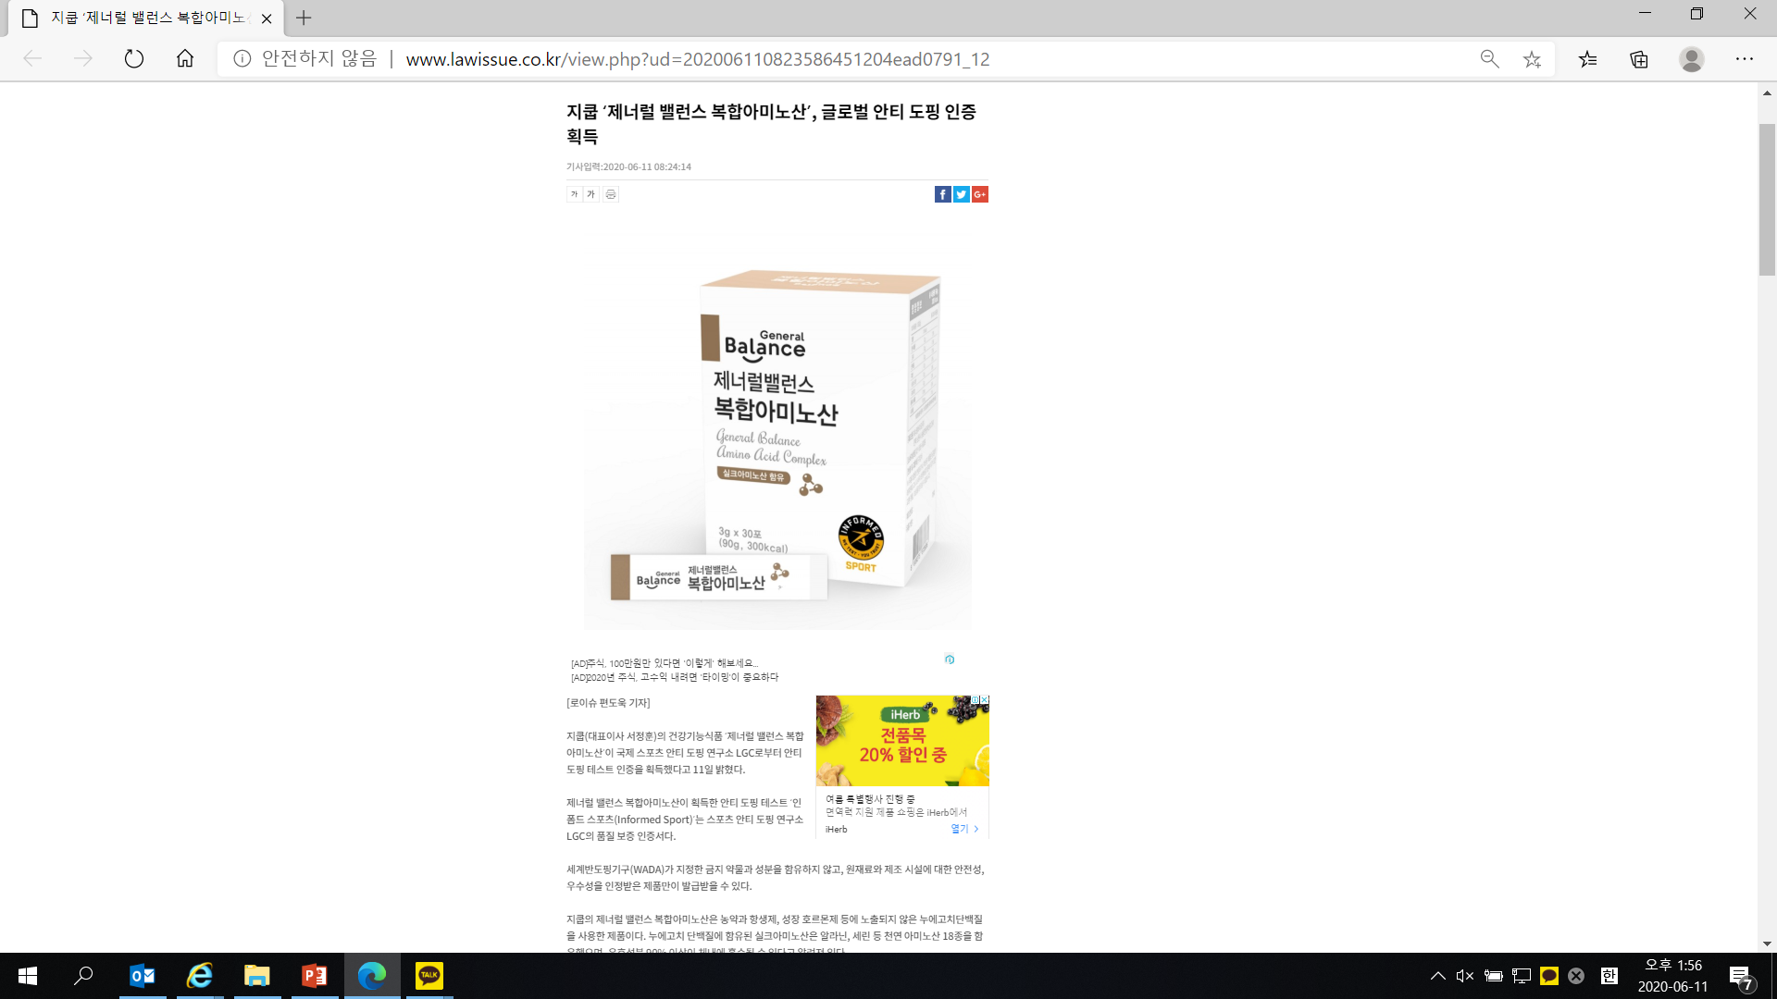
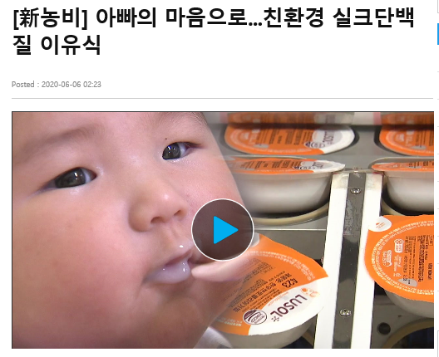
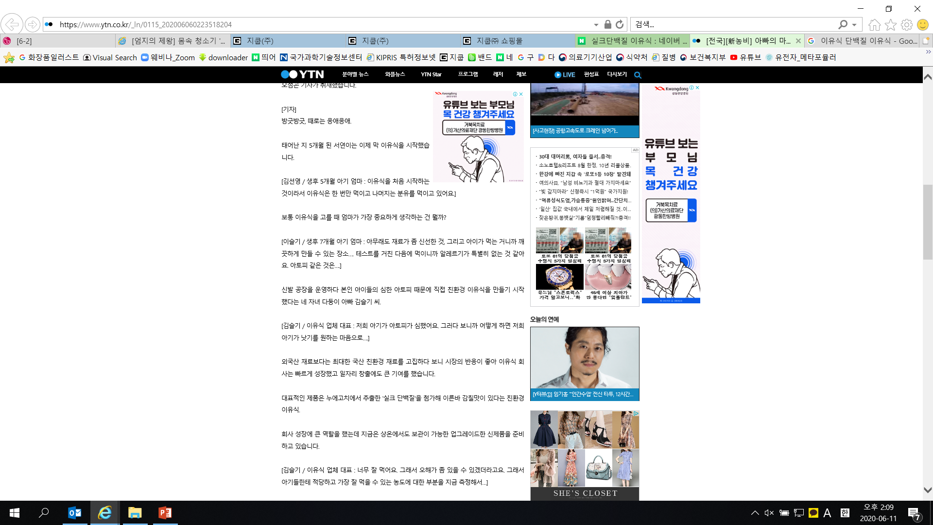
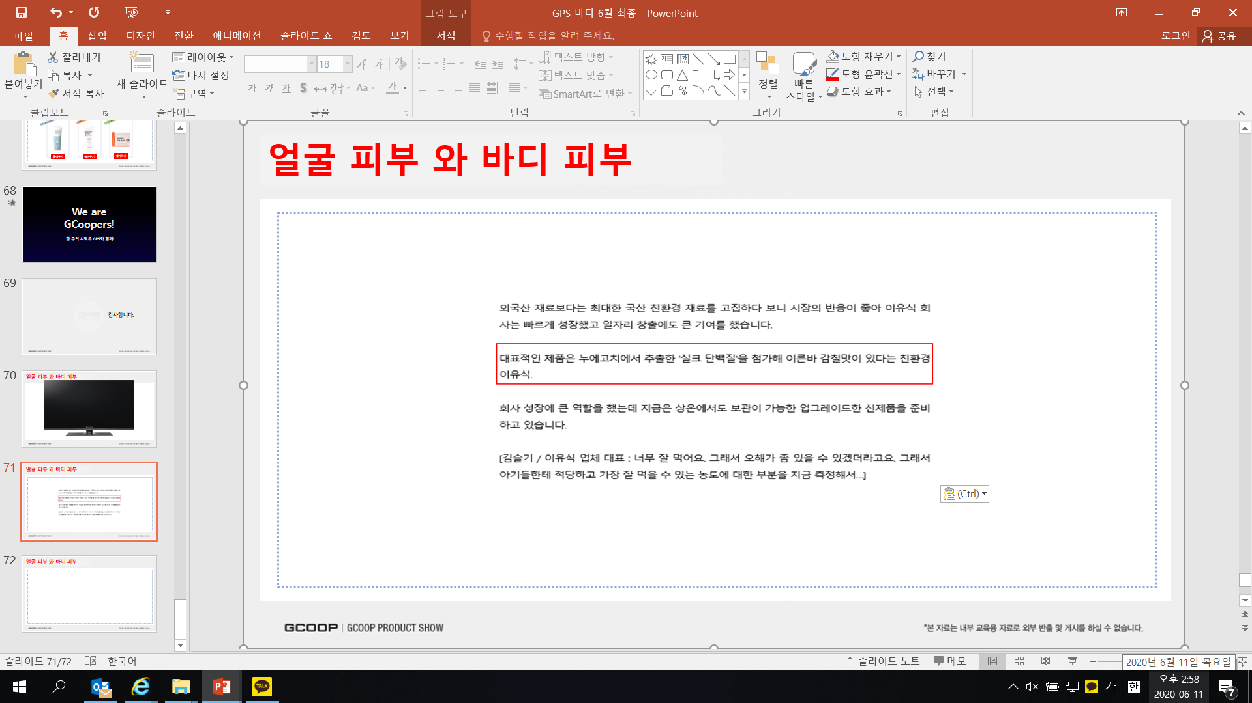

Check Out these Articles
탄력
GCOOP ‘General Balance Amino Acid Complex‘ , Global Anti-Doping Certification
From a Father’s Heart… Eco-friendly Silk Amino Acid Baby Food
Posted : 2020-06-06 02:23
발췌:https://ccnews.lawissue.co.kr/view.php?ud=202006110823586451204ead0791_12
발췌: https://www.ytn.co.kr/_ln/0115_202006060223518204

Slide 26
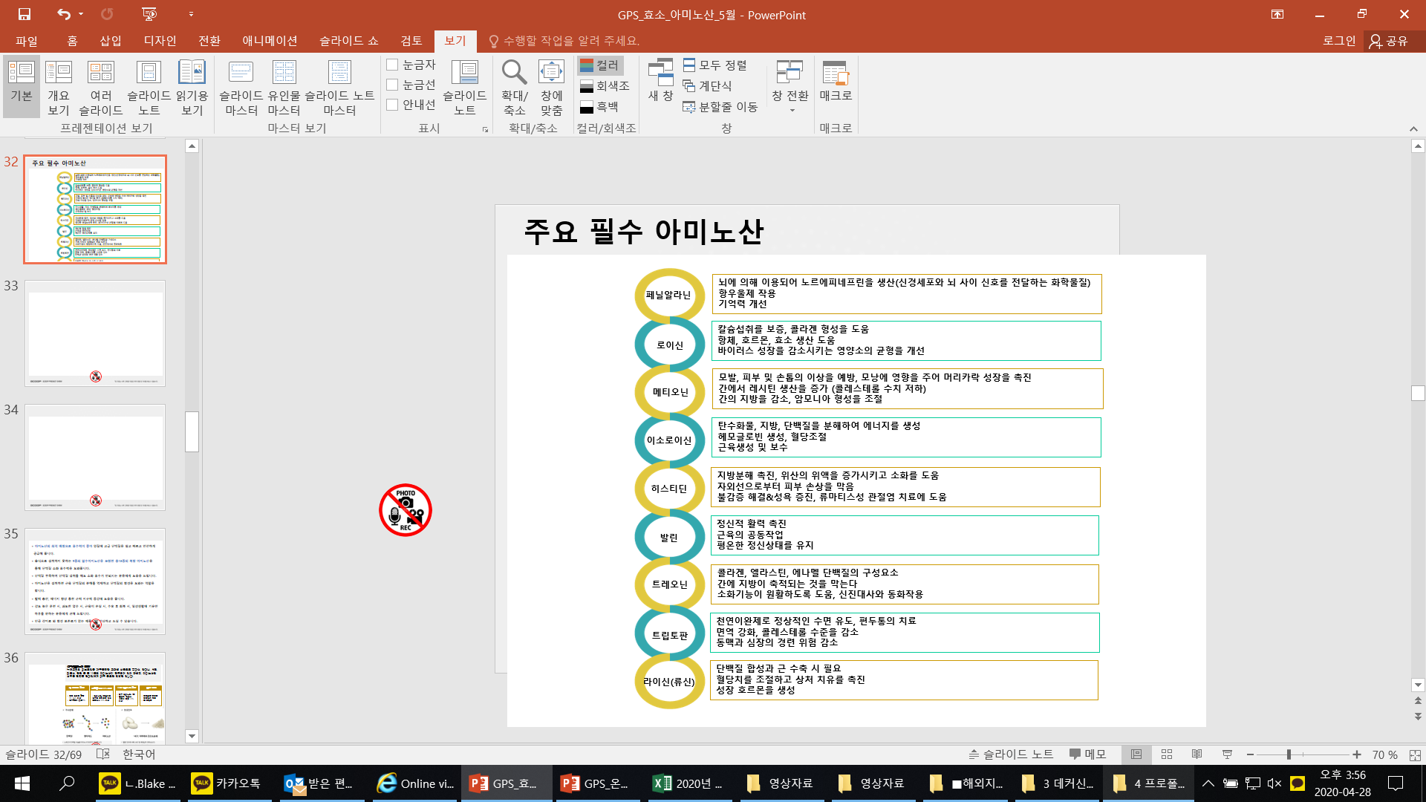
9 Essential Amino Acids
Phenylalanine
Used by the brain to produce norepinephrine (a neurotransmitter)
Anti-depressant function
Supports memory
Guarantees calcium intake, and helps to form collagen
Helps to produce, antibodies, hormones and enzymes
Decreases virus growth and improves nutrient balance
Leucine
Prevents abnormalities in hair skin and nails, affects hair follicles and accelerates hair growth
Increases lecithin production in the liver (lowers cholesterol levels)
Decreases fat in the liver and controls ammonia production
Methionine
Irosoicin
Breaks down carbohydrates, fats, protein to produce energy
Produces hemoglobin and controls insulin levels
Produces and maintains muscles
Accelerates decomposition of fats and increases stomach acid to help support digestion
Helps to protect the skin from UVA/UVB rays
Histidine
Valine
Accelerates mental activity
Maintains mental stability
Threonine
Component of collagen, elastin, enamel proteins
Prevents fat from accumulating in the liver
Helps to support digestion
Natural relaxant, helps to support sleep and relieve headaches
Strengthens immune system, lowers cholesterol
Supports heart health
Tryptophan
Natural relaxant, helps to support sleep and relieve headaches
Strengthens immune system, lowers cholesterol
Supports heart health
Lysine
Necessary for muscle synthesis
Maintains blood insulin levels and accelerates healing of wounds
Produces growth hormones

Slide 27
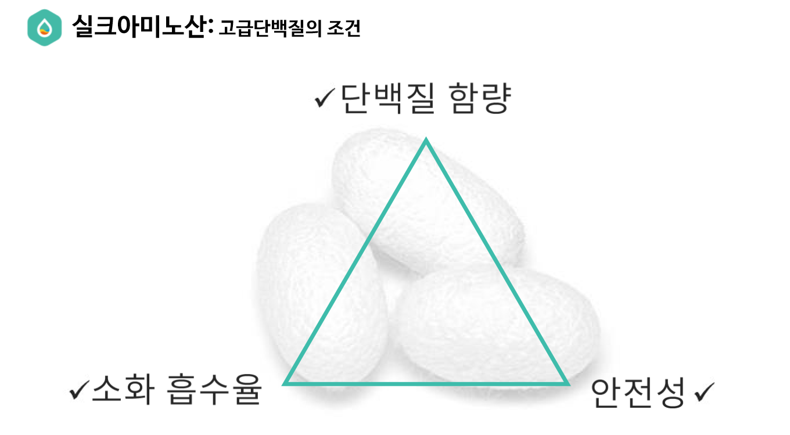
Silk Amino Acids
Silk Amino Acids: A condition for premium protein
Protein Content
Digestion and Absorption Rate
Safety

Slide 28

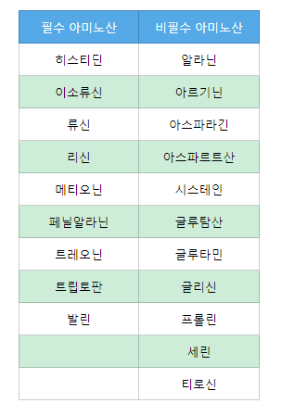
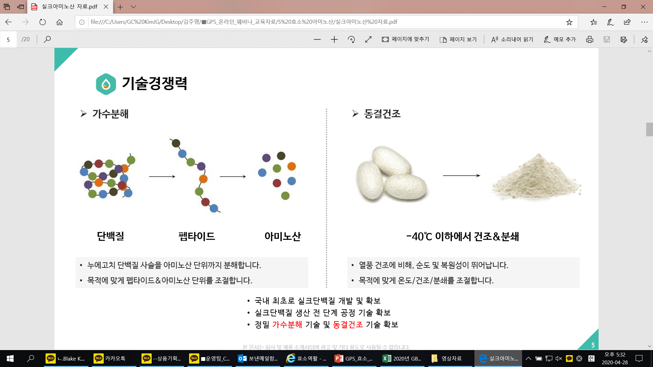
Silk Amino Acids
What are Silk Amino Acids?
Silk Amino Acids are hydrolyzed cocoon fibroins, which are a high protein food containing 18 enzymes including, glycine, alanine, serine, tyrosine, valine. It’s an important nutrient for consumers wanting to supplement proteins and amino acids through food.
High in Protein
Digestion Absorption Rate 90%
Contains 18 Amino Acids
High Purity
고 단백질 함량
소화흡수율 90%이상
18종 아미노산 함유
+ Natural protein content above 90-95%
+ 0% Carbs or Fats
+ More than 90% is broken down into amino acids and peptides in the Small Intestines
+ 8 essential amino acids
+ Over 70% Glycine, Alanine, Serine
+ Freeze-dried extraction method
+ Free of additives

Slide 29
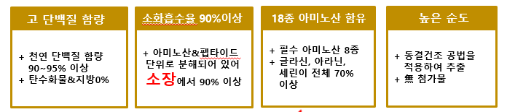
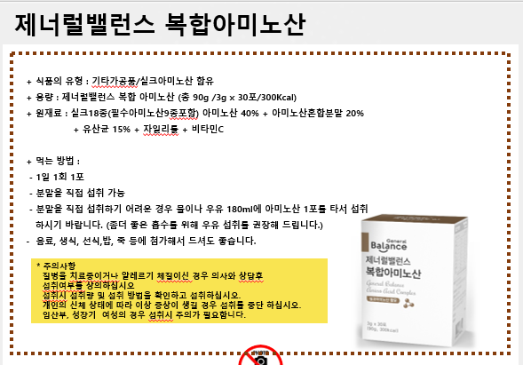
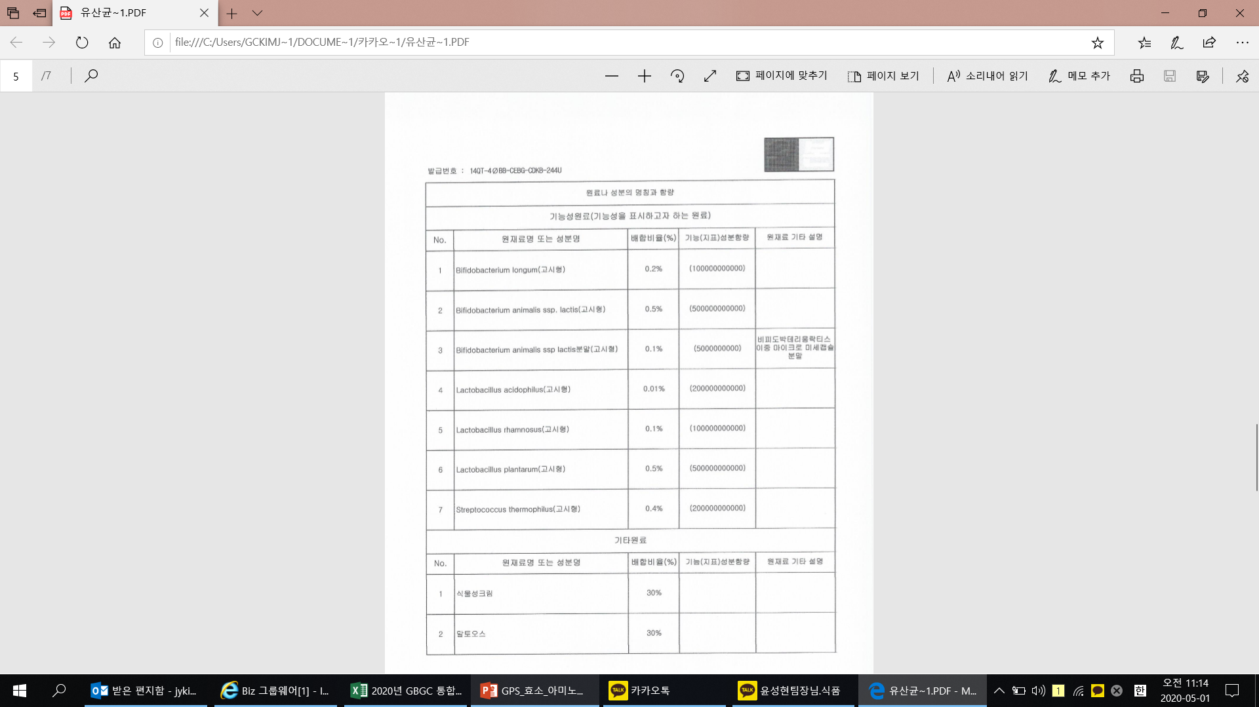
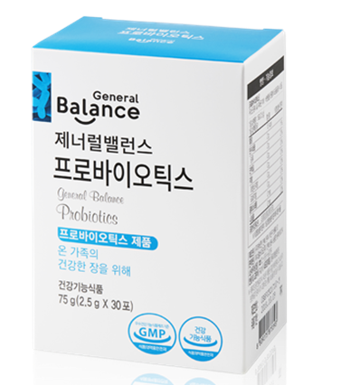
High Absorption Rate
High in Protein
Digestion Absorption Rate 90%
Contains 18 Amino Acids
High Purity
+ Natural protein content above 90-95%
+ 0% Carbs or Fats
+ More than 90% is broken down into amino acids and peptides in the Small Intestines
+ 8 essential amino acids
+ Over 70% Glycine, Alanine, Serine
+ Freeze-dried extraction method
+ Free of additives
Bifidobacterium longum CBG - C11
Bifidobacterium lactis CBG - C10
Bifidobacterium lactis Double Micro-encapsulation
Lactobacillus acidophilus CBG - C13
Lactobacillus rhamnosus CBG - C14
Lactobacillus plantarum JBMI5
Streptococcus thermophiles CBG - C19

Slide 30
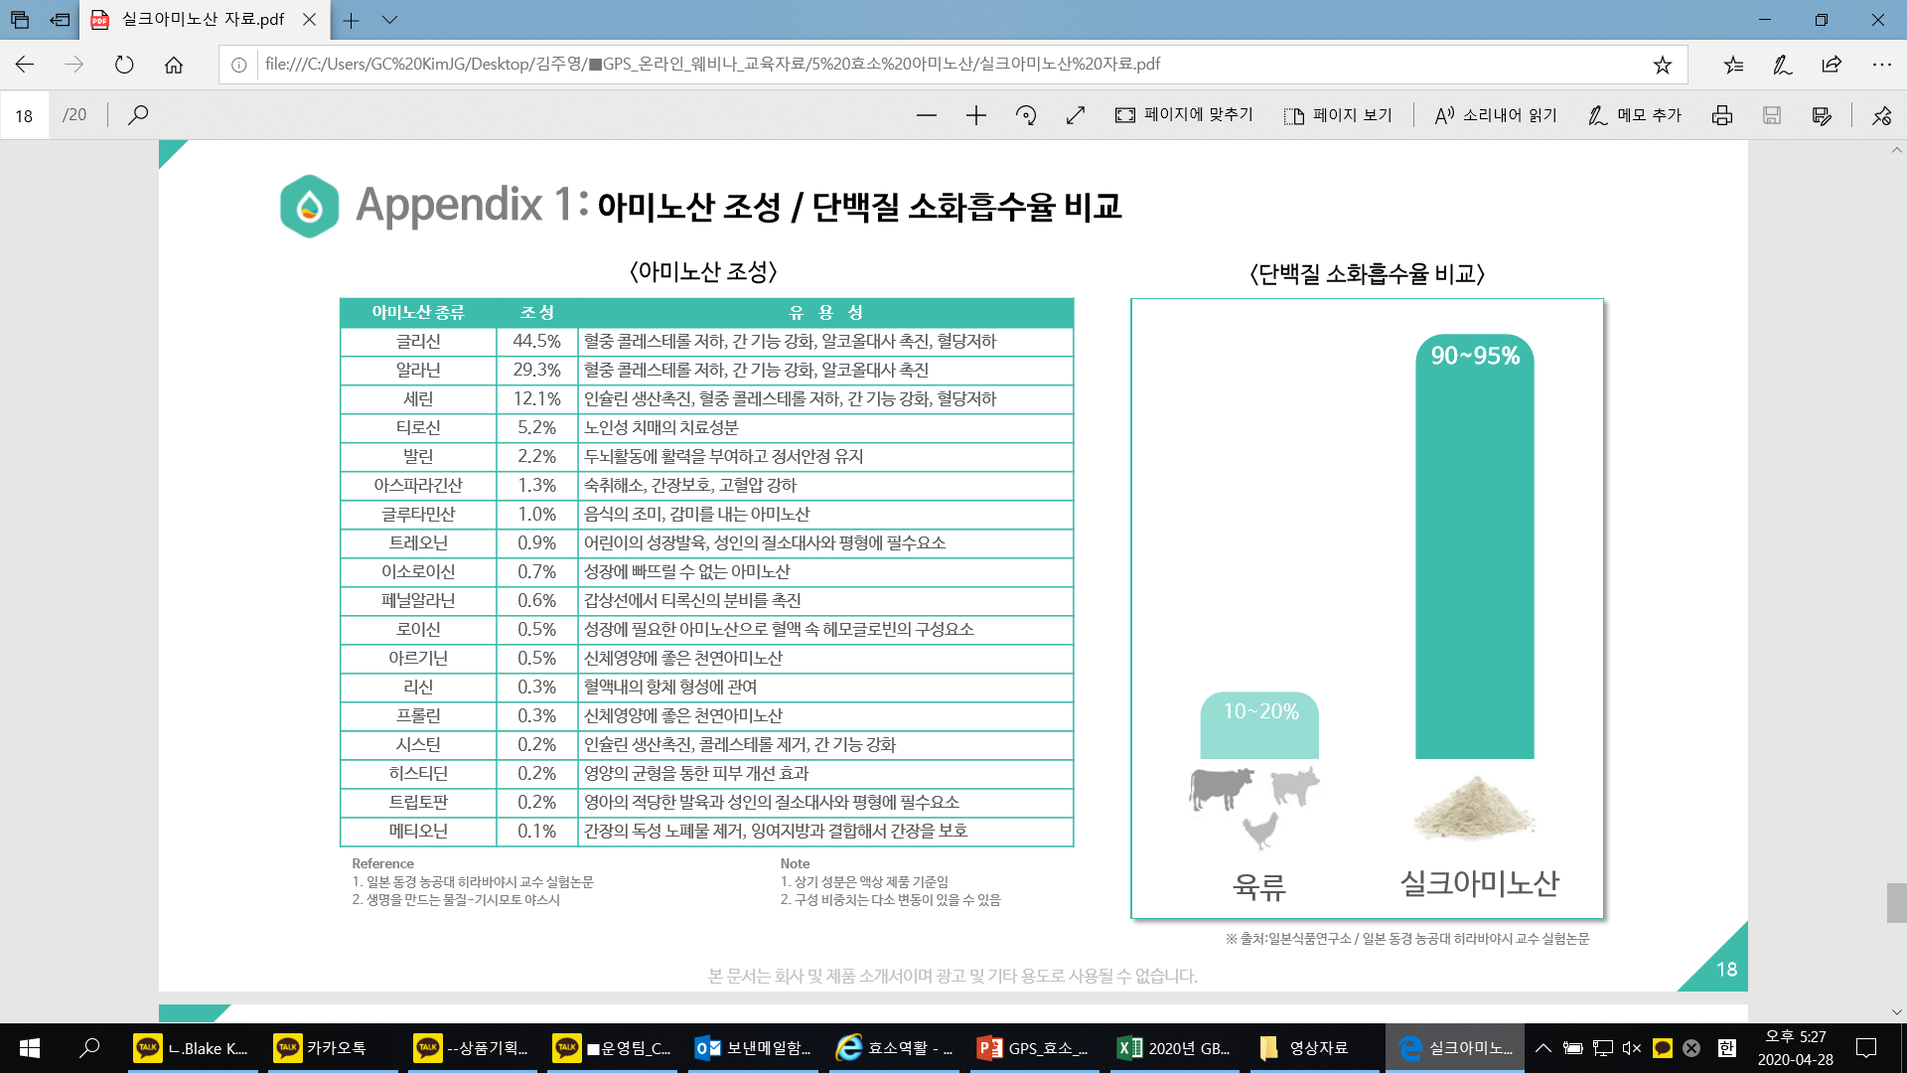
18 Amino Acids in Silk Amino Acids

Slide 31


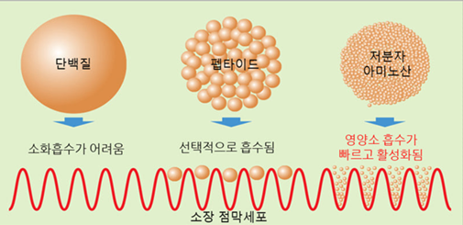
Fast Absorbing
It is beneficial to consume products that are already in amino acid form for better absorption.
3~4 Hours Until Absorbed
Protein
Peptide
Amino Acid
Absorption
Absorbed within 30 minutes
Amino Acid
Absorption
Silk Amino Acids
Essential Amino Acids
Probiotics

Slide 32
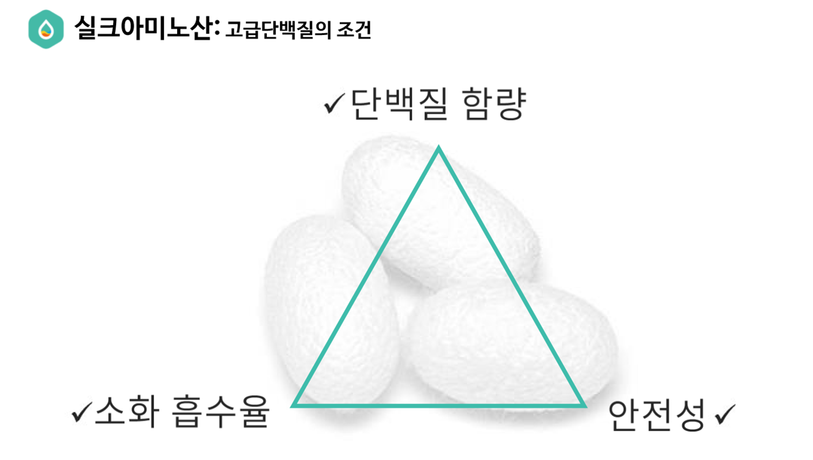
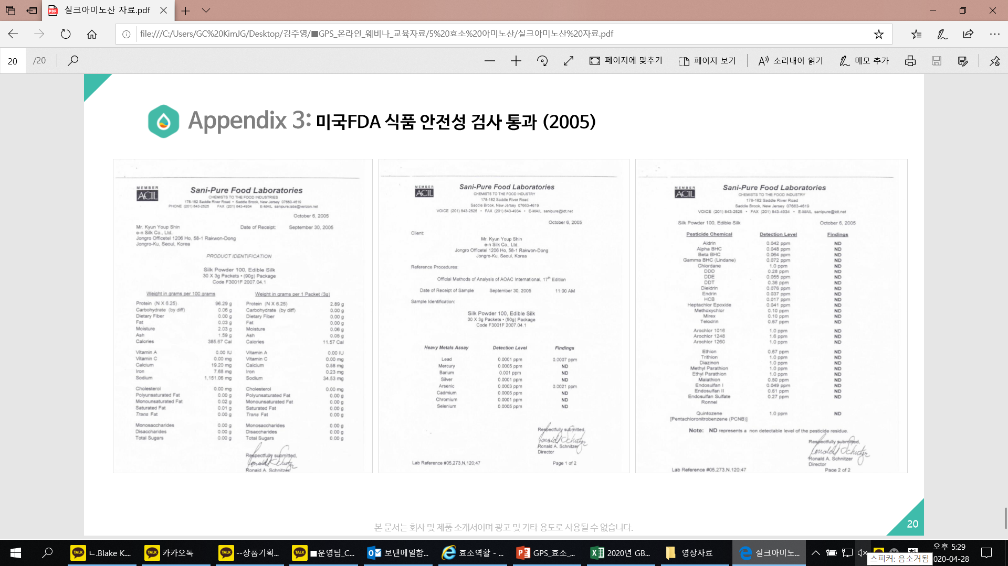
Safe Amino Acids

Slide 33
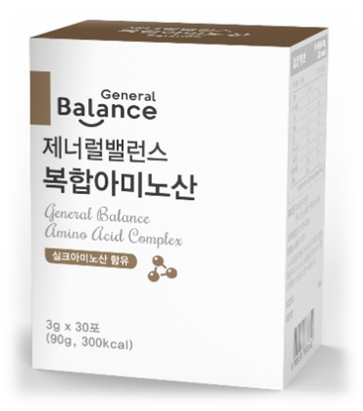
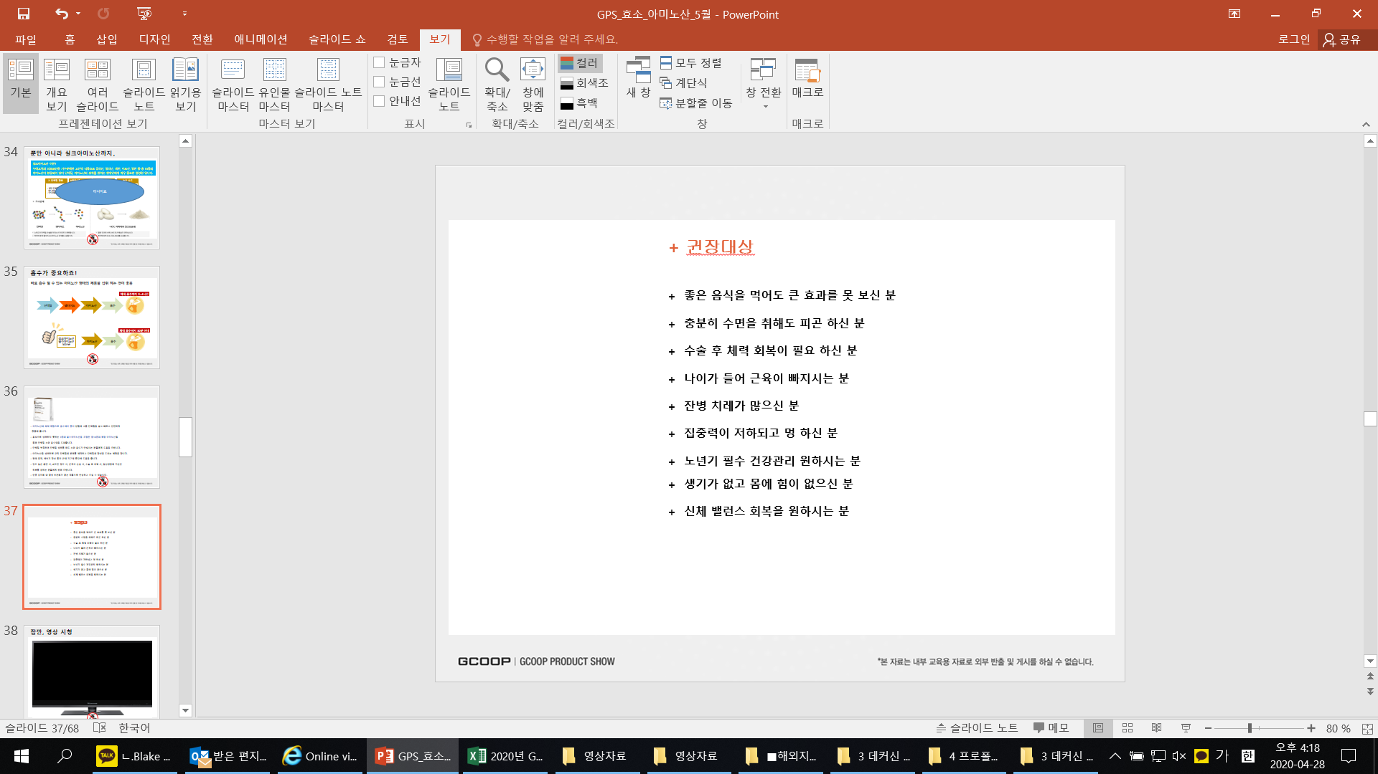


Optimal Blend of General Balance Amino Acid Complex
+ Quality and convenient supplement containing an optimal blend of amino acids with high absorption rate.
+ Contains 18 amino acids that include 9 essential amino acids that must be supplemented through food to
help support digestion and absorption of protein.
+ Helps to supplement protein.
+ Helps to support the strengthening and development of muscles.
+ Helps to support endurance and energy production.
+ Recommended for those undergoing high intensity training, overwork, muscle exhaustion,
recovery from surgery or those who want an energetic daily life.
+ Safe, high quality product that is free of artificial flavors, or chemical preservatives.
+ For those who are unable to see benefits
even though they are consuming a healthy diet.
+ Those who still feel tired after sleeping.
+ Those recovering from surgery.
+Those losing muscle mass due to aging.
+ Those that are often sick or unwell.
+Those that have decreased concentration.
+ Seniors wanting to care for their health.
+ For those with decreased strength
and endurance.
+ For those that want to restore balance.
Ultimate Amino Acid Supplement!

Slide 34


General Balance Amino Acid Complex is Different!
+ Tiredness
If you still feel tired even after enough rest, energy and concentration decrease.
+ Muscle Soreness After Exercise
If soreness lasts after light exercise, strength and endurance are constantly low and muscle soreness occurs.
+ Immune System and Nutrient Balance Concerns
If the immune system is weakened and nutrient balance is off nails may start to split and hair may fall out or become brittle.
+ Feeling Sluggish and Heavy
Improper nutrient balance causes low energy levels and feeling sluggish and or heavy.

Slide 35


Enzyme & Amino Acid Set

Slide 36
We are
GCoopers!

Slide 37

Thank You.

