Slide 1
제너럴 밸런스
데커신
General Balance Decursin

Slide 4
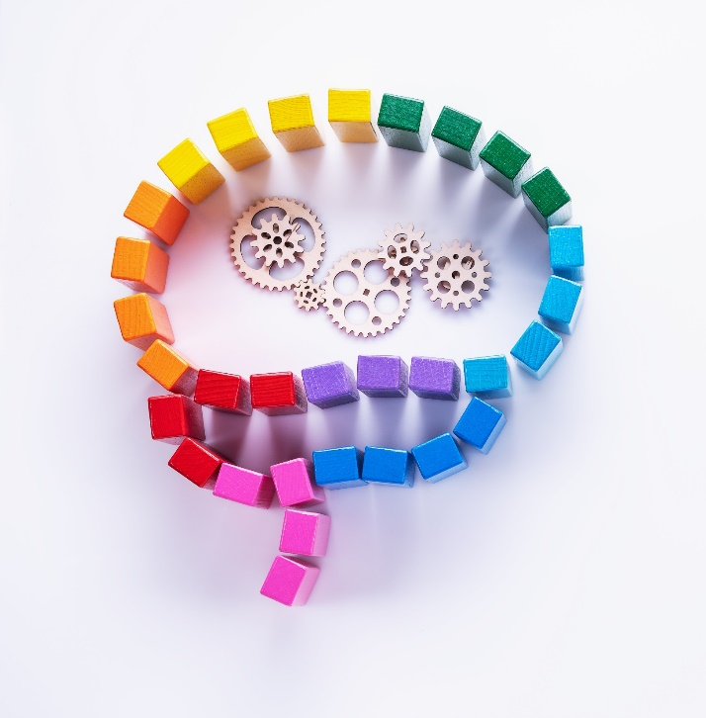
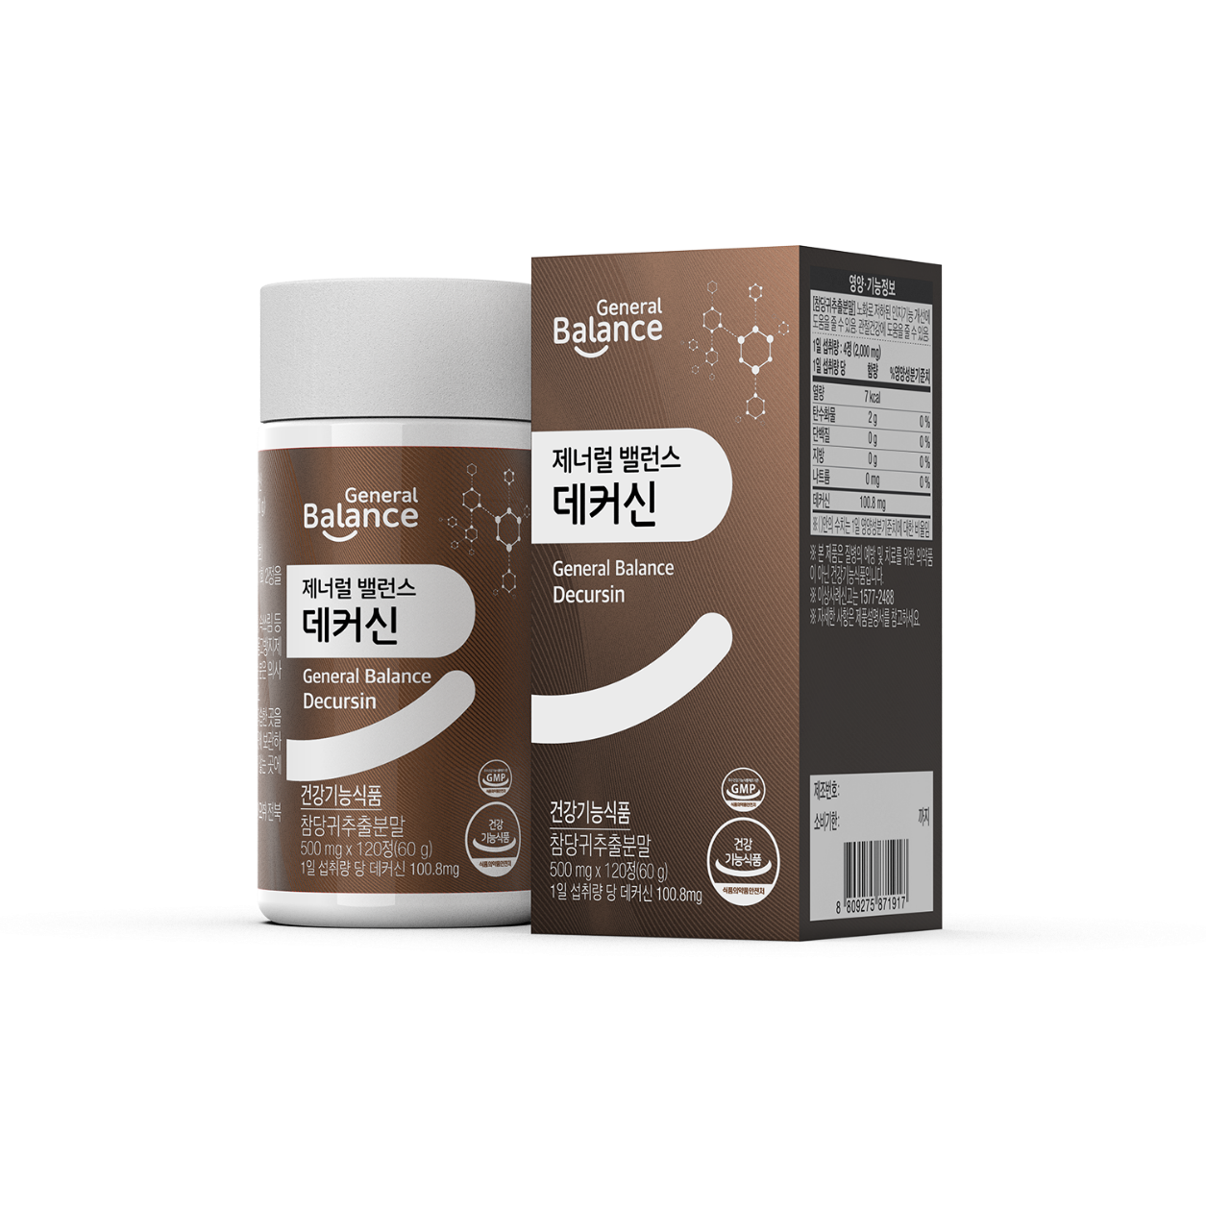
1. Product information
[Product Name] General Balance Decursin
[Product Type] Dietary Supplement
(Angelica root extract powder(Decursin)
[Net Quantity] 500mgX120 tablet (60g / 2.1164 oz )
[Ingredients] Angelica pea extract powder(Decursin), Oat fiber,
seaweed calcium, Maltodextrin, corn starch, Glucose,
Chicory root extract powder, , Corn protein extract
[Directions] Take two, tablet twice a day with water
[Precautions]
- Young Children, pregnant or nursing women must take caution when using this product.
- If you have any allergies be sure to carefully read all ingredients prior to use.
- Ingestion may cause indigestion and heartburn.
- If you are taking anticoagulants or hypoglycemic agents, please consult your doctor before use.
- Stop using immediately if you experience any adverse reactions and seek medical attention.
- Do not use past expiration date.
- If you have any allergies be sure to carefully read all ingredients prior to use.
- Stop using immediately if you experience any adverse reactions and seek medical attention.
- Do not use past expiration date.
- Do not ingest the Silica gel

Slide 5
2. Product Features
01
Double Complex Functionality
(Brain-to-Joint Health Care).
02
Made with ingredients approved by
the Korean Food and Drug Administration.
03
Administration (KFDA) for double
complex function Angelica Gigas
3,700% concentrated.
04
Contains Selected Carefully Supplementary Ingredients.
05
No Additives.

Slide 6
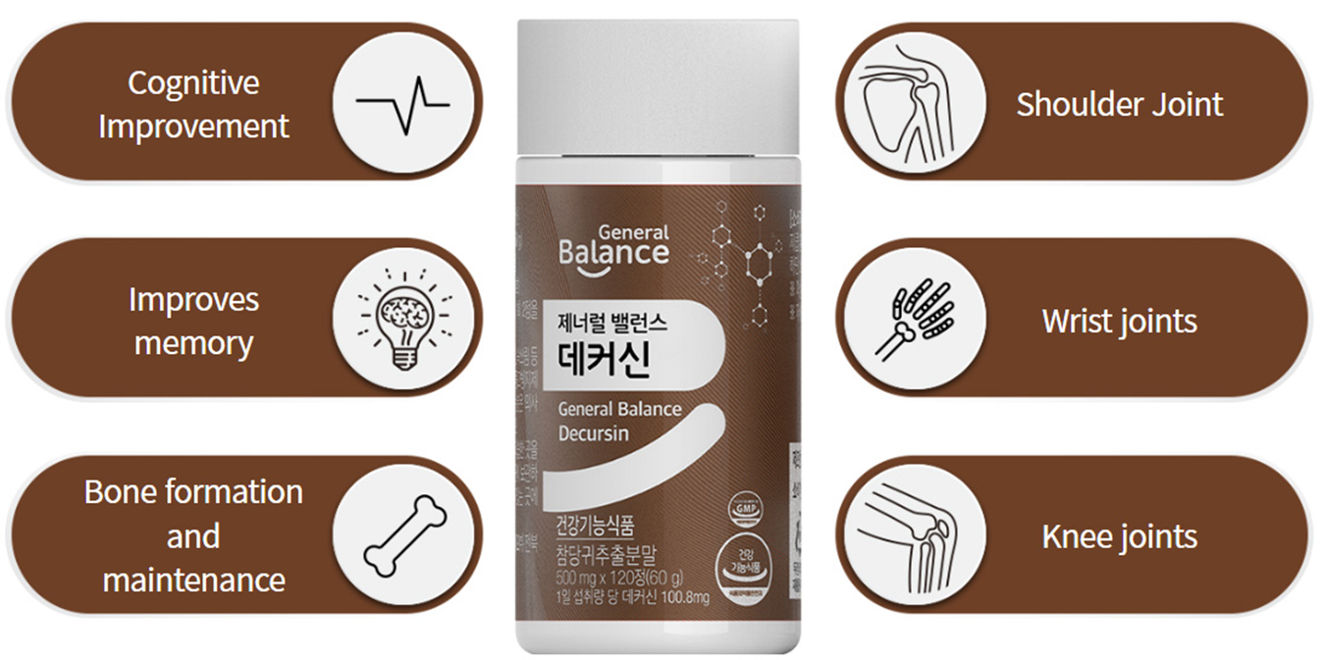
2. Product Features
6 Complex Functionality
Brain to Joint Health Care
Carefully selected ingredients for bone health

Slide 7
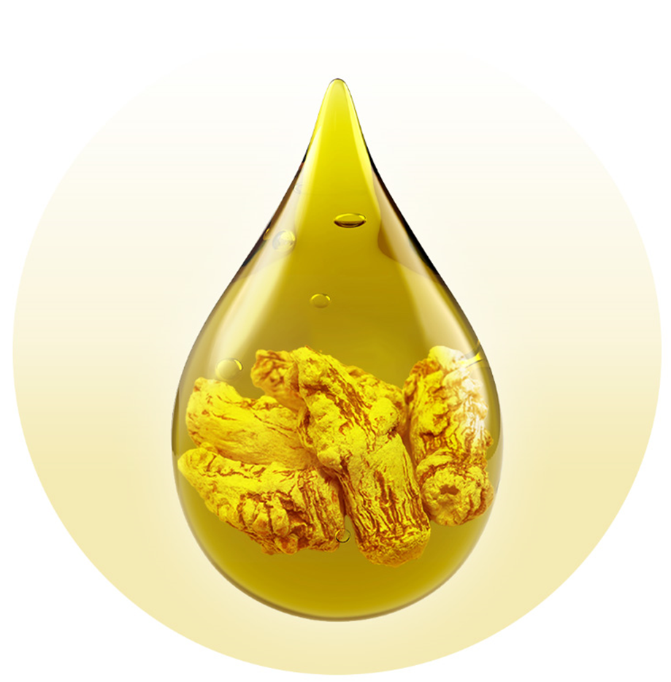

2. Product Features
Multi-Functional General Balance Decursin
Directions : Take 2 tablets twice a day (2,000 mg)
01. Angelica Gigas Extract Powder (Nutragen) is 3,700% concentrated
using a patented extraction process.
02. 100% Korean Angelica Gigas with the highest decursin content
03. Angelica Gigas extract powder, a health functional ingredient
recognized by the approval of safety for 2 types of functions from
Korean Ministry of Food and Drug
Helps improve cognitive function due to aging
Helps support joint health

Slide 8
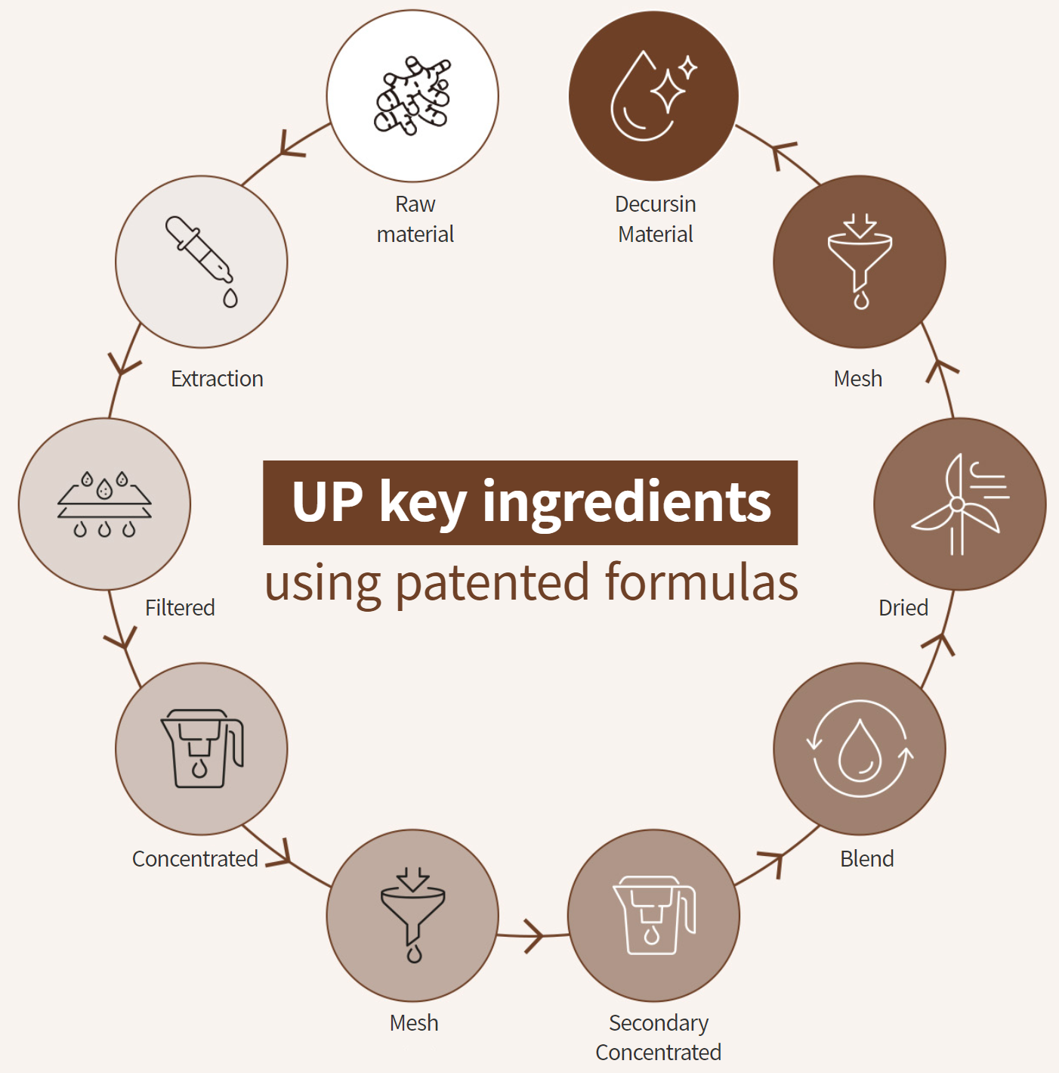
2. Product Features
Major Active Ingredients
of Angelica Gigas
Decursin
3,700%
Concentrated

Slide 9
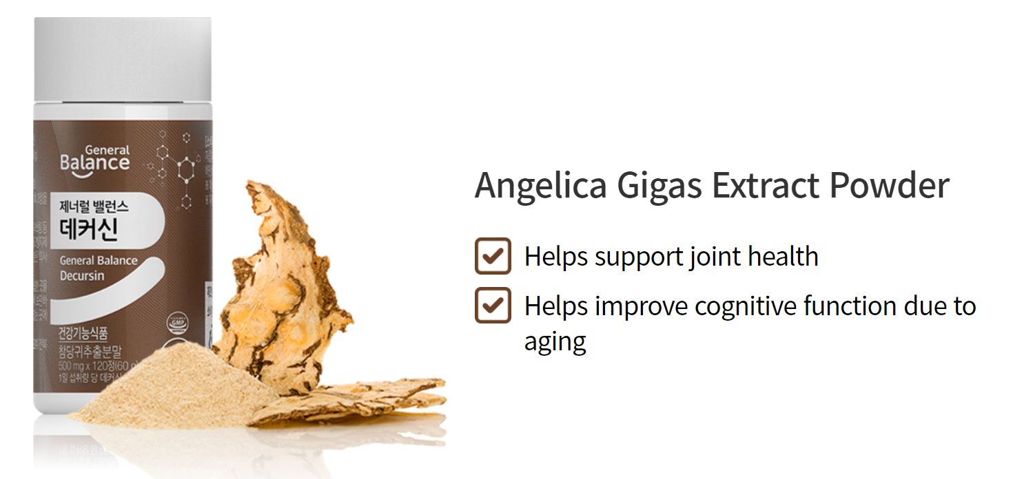
2. Product Features
Dual Functional KFDA Nutraceutical Ingredients
Korea's first dual-functional nutraceutical ingredient

Slide 10
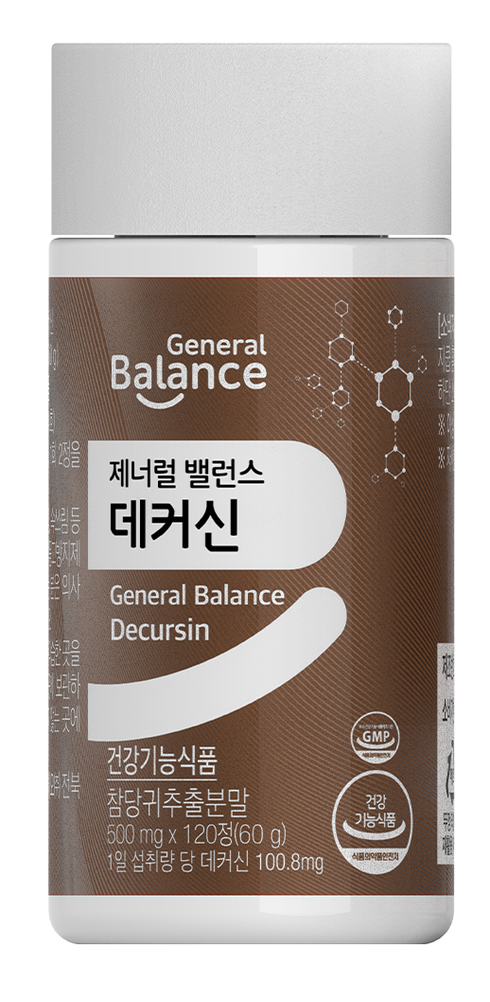
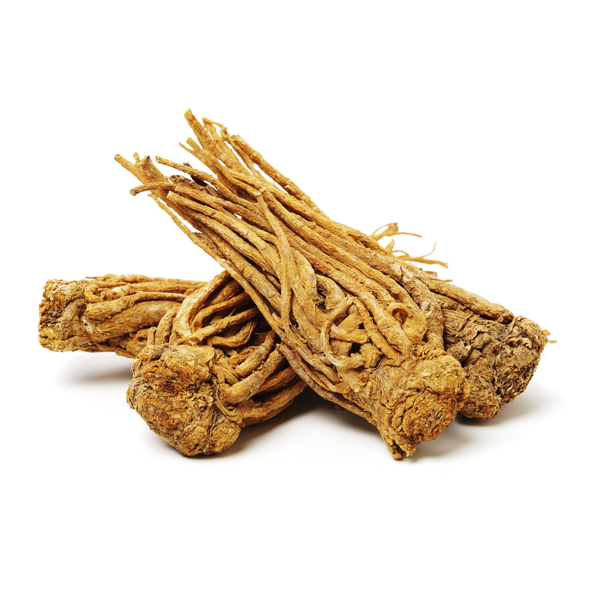
3. Key Ingredients
Dietary Supplement Ingredient
Angelica gigas Extract Powder
Extracted from the roots of the Korean angelica (Angelica gigas Nakai), angelica extract powder is an individually recognized ingredient whose functionality was recognized by the Korean Ministry of
Food and Drug Safety in 2014. Decursin, known as an indicator ingredient, may help improve cognitive function that declines
with age and support joint health.
Angelica Extract Powder (2014-44)
Contains 800 mg daily value

Slide 11
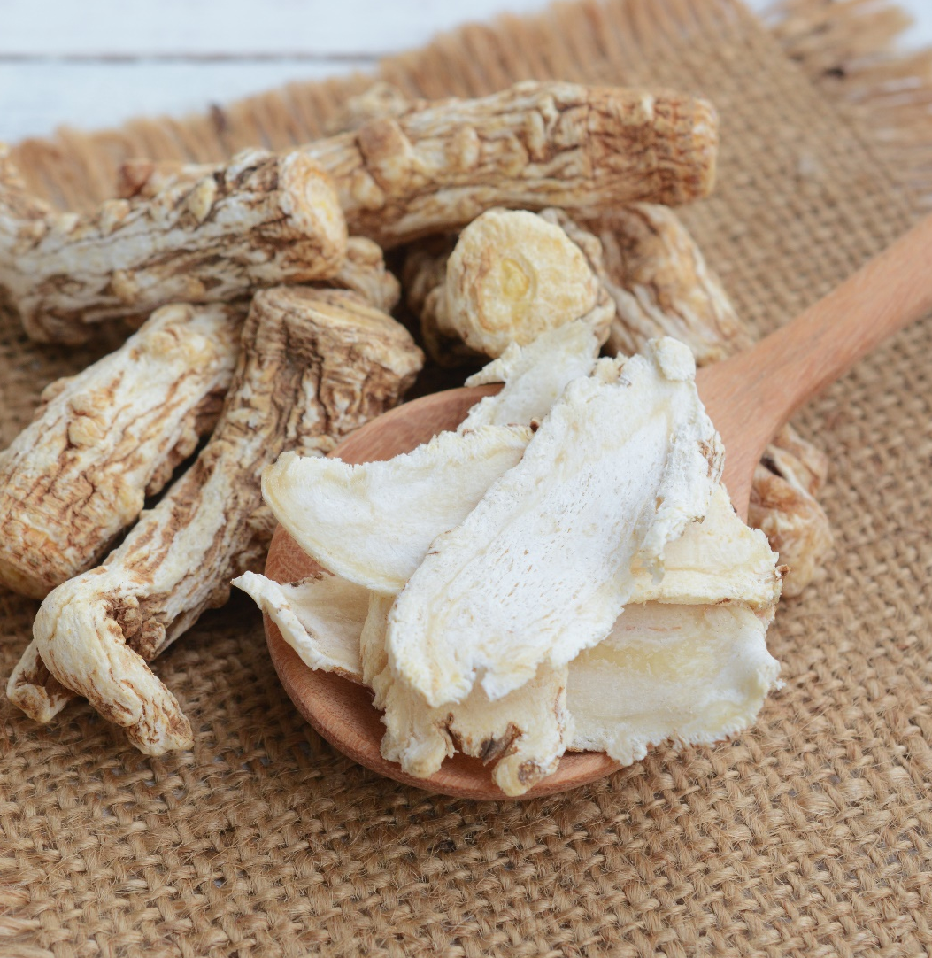
3. Key Ingredients
What's Angelica Gigas?
Angelica Gigasi, also known as Korean Angelica, is a monocarpic biennial(short lived perennial)herb of the Apiaceae family.
There are Chinese and Japanese Angelica plants as well.
Angelica Gigas is known for its yellowish white bark, and the taste is slightly bitter and has a powerful aroma.

Slide 12
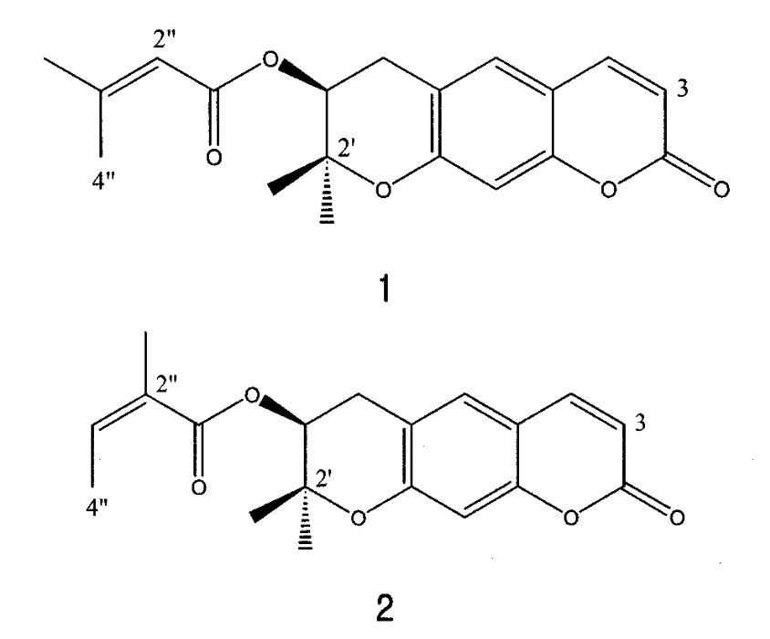
3. Key Ingredients
Angelica Functional Fractions
The most commonly known major active compounds found
in Angelica Gigas ,are Decursin, Decursinol Angelate,
and Nodakenin, all of which are a type of coumarins.
It is reported that the root of the plant contains a high concentration of Decursin.
데커신
데커시놀 안젤레이트
[Source] Decursin: a cytotoxic agent and protein kinase C activator from the root of Angelica gigas (Planta Med. 1996 Feb;62(1):7-9)

Slide 13
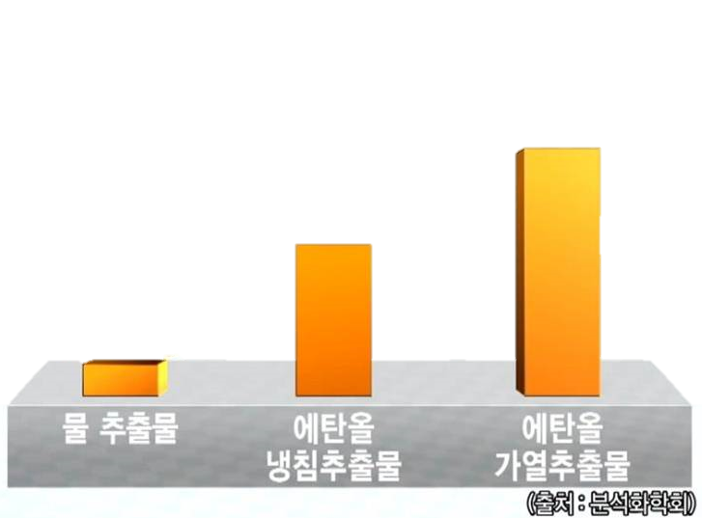
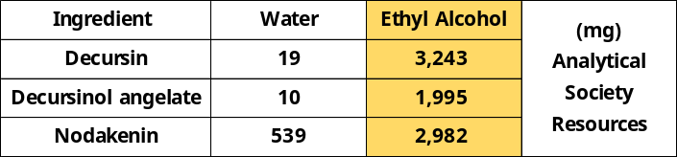
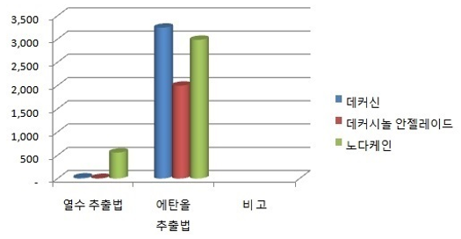
3. Key Ingredients
Angelica Brewing（ethyl alcohol） Method
Decursin
3,243 mg
Angelica is extracted with 95% edible alcohol and contains high content of active ingredients such as Decursin, Decursinol angelate, and nodakenin, and the safety of extraction has been confirmed by a 4-week toxicity test.
1,920 mg
19 mg
RESULT
The extraction efficiency of decursin and decursinol angelate in water and
alcohol was analyzed, and the content of decursin was 0.182% and
decursinol angelate was 0.153% of the dry weight of decursin in deionized water.
Therefore, it was found that very little component content was extracted
in water extraction. On the other hand, 100% ethyl alcohol extraction
yielded 3.341% decursin and 2.778% decursinol angelate, while 50% ethyl
alcohol yielded 3.142% and 2.547%, respectively. Therefore, it is suggested that
the extraction method using organic solvents such as ethyl alcohol is suitable
as an efficient mass extraction process for decursin and decursinol angelate.
Decursin
Decursinol angelate
Nodakenin
Water
Extract
Ethyl Alcohol
Extract
[Source] HPLC Analysis and Extraction Methods of Decursin and Decursinol Angelate in Angelica gigas Roots (Kor. J. Pharmacogn. 2003;34(3):201-205)

Slide 14
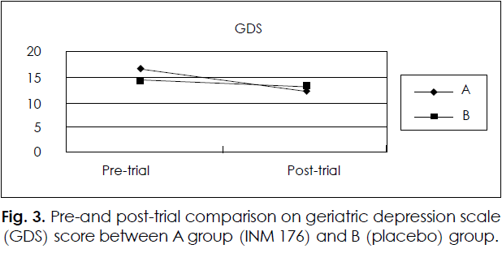
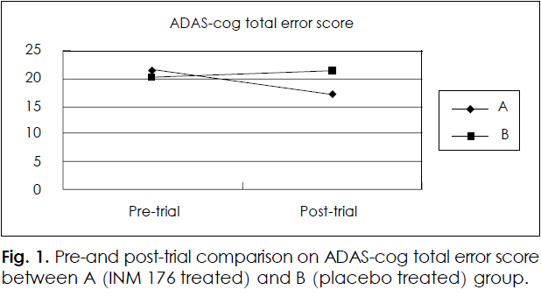
3. Key Ingredients
16.74
13.14
14.28
Human clinical trial results
12.32
Men and women aged 55 years and older
with usual memory impairment were given 800 mg of
angelica extract per day for 12 weeks and found to
improve on measures of cognitive function compared
to a control group.
21.52
21.32
20.21
17.04
[Source] A Three Month Placebo-Controlled Clinical Trial of INM 176 in the Old Aged Subjects
with Memory Impairment (J Korean Neuropsychiatr Assoc 2003:42(2);254-262)

Slide 15
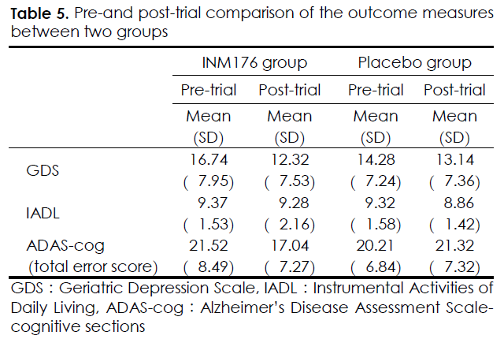
3. Key Ingredients
Target
Older adults of both sexes (n=299) aged 55 years and
older who self-reported memory impairment (n=147), with a score of 25
or less on the Korean Mini-Mental State Examination (K-MMSE) or
who were at high risk for Alzheimer-type dementia based on
a 7-minute screening test, were selected for the study through individual
interviews by a psychiatrist.
Conditions
psych12-week INM 176 double-blind, placebo-controlled trial design,
with the Angelica root extract group receiving 400 mg twice daily
(800 mg total daily) for 3 months, and the placebo group receiving
a digestive ingredient with a similar flavor and color to Angelica root extract.
* ADAS-Cog : Alzheimer's Cognitive Assessment Test
* GDS : Geriatric Depression Scale
Results
GDS: placebo group did not change from pre-test 14.28 to
13.14, while treatment group improved from 16.74 to 12.32
ADAS-Cog: placebo group worsened from 20.21 to 21.32 pre-test,
while treatment group improved from 21.52 to 17.04

Slide 16
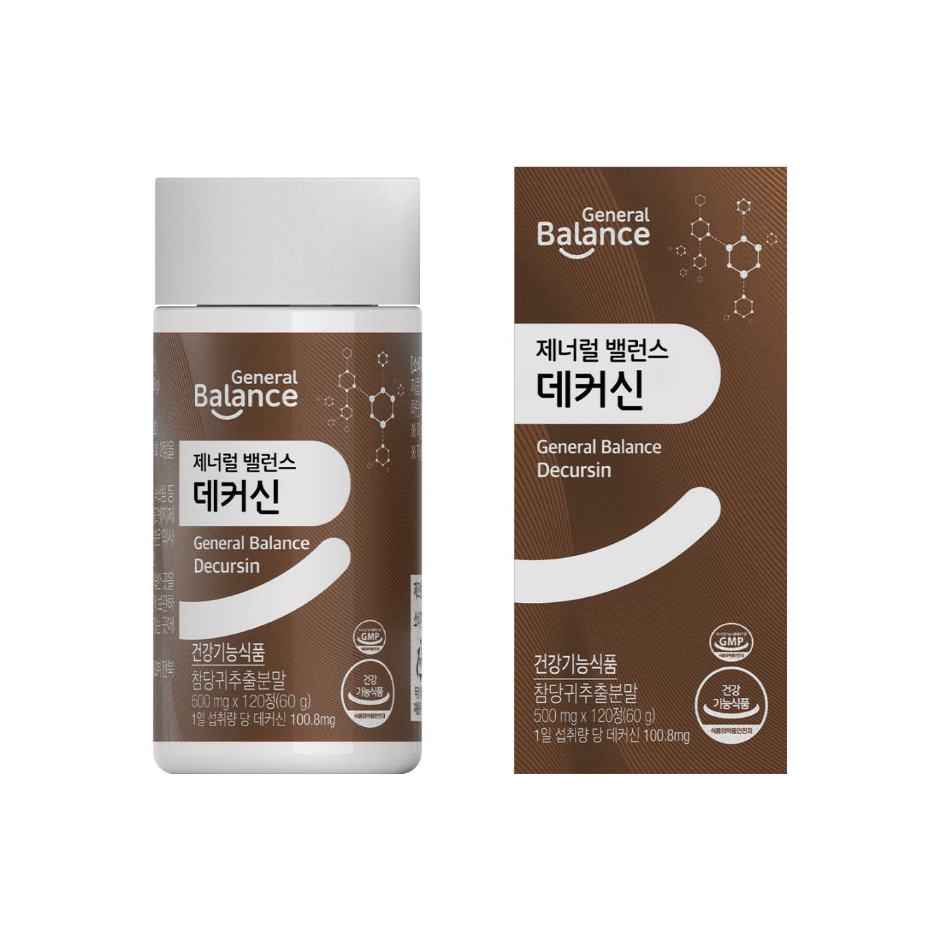
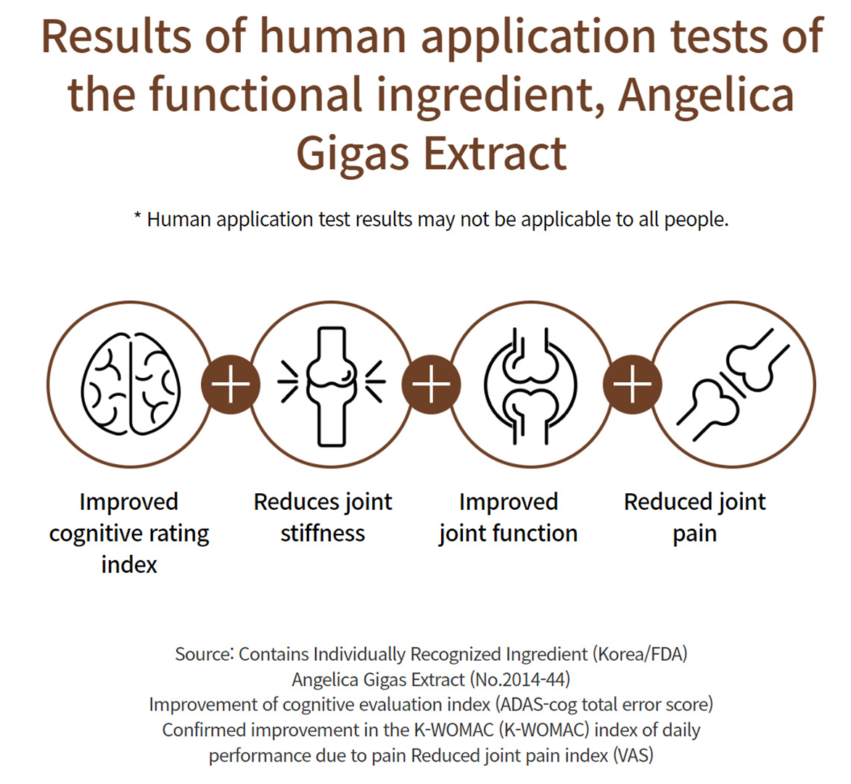
3. Key Ingredients

Slide 17
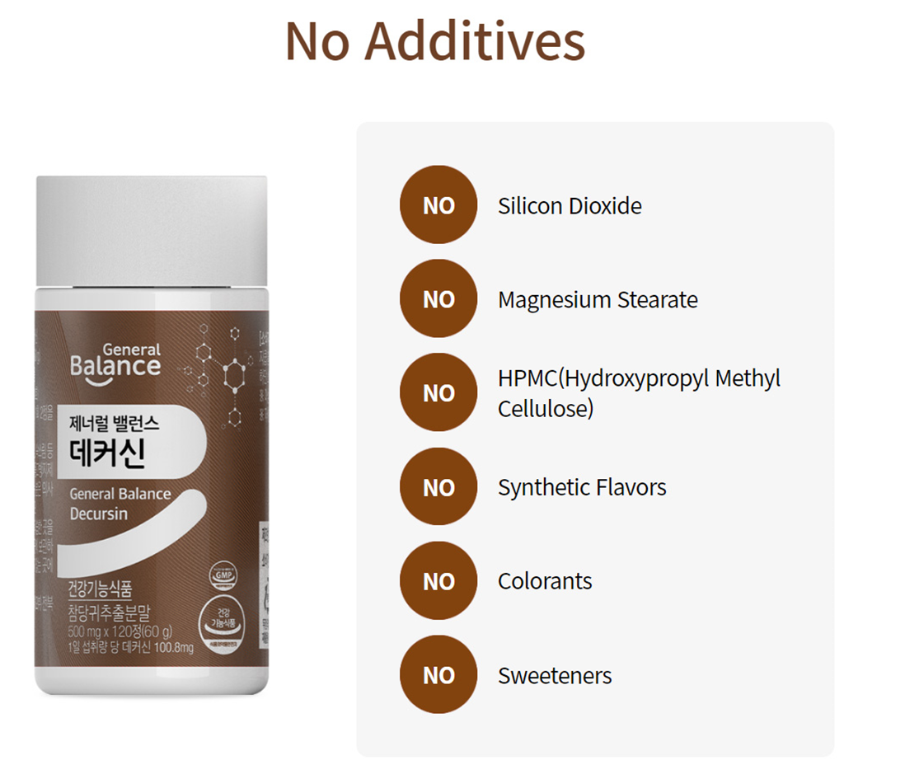
3. Key Ingredients

Slide 18
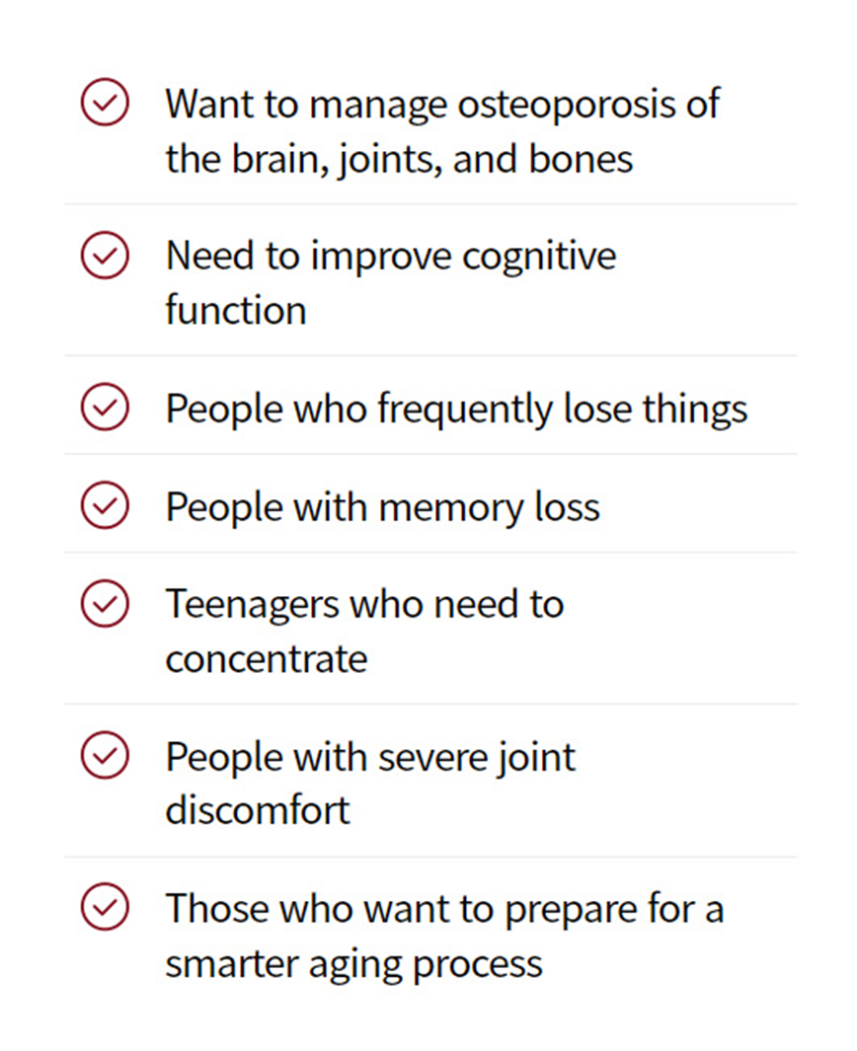

4. Recommended For

Slide 19
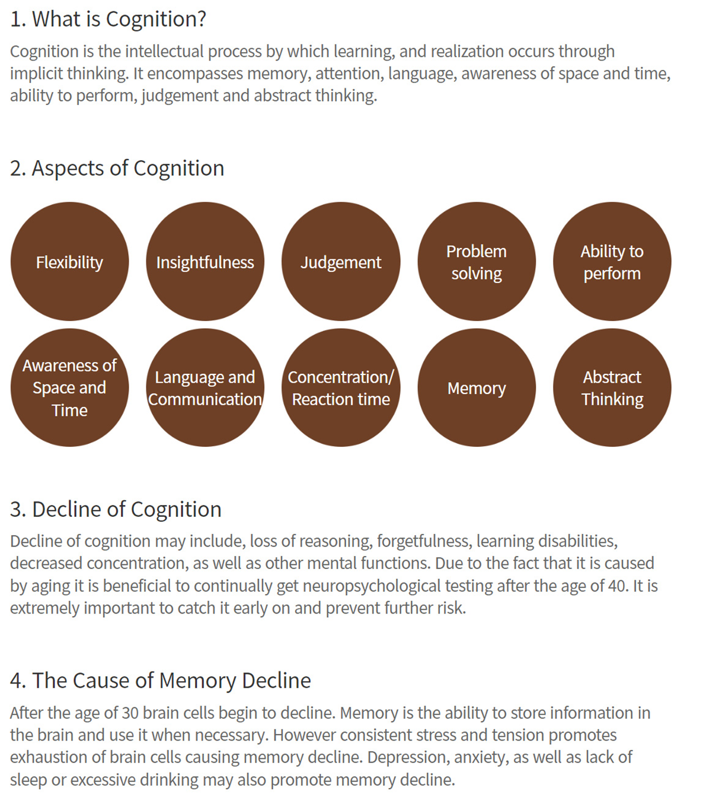
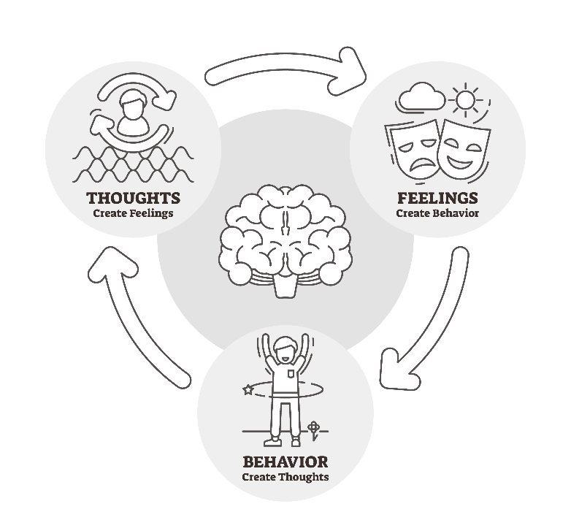
5. Health information
[출처] Development and Standardization Process, and Factor Analysis of the Computerized Cognitive Function Test System for Korea Adults (J Korean Neuropsychiatr Assoc 2002;41(3):551-562)

Slide 20

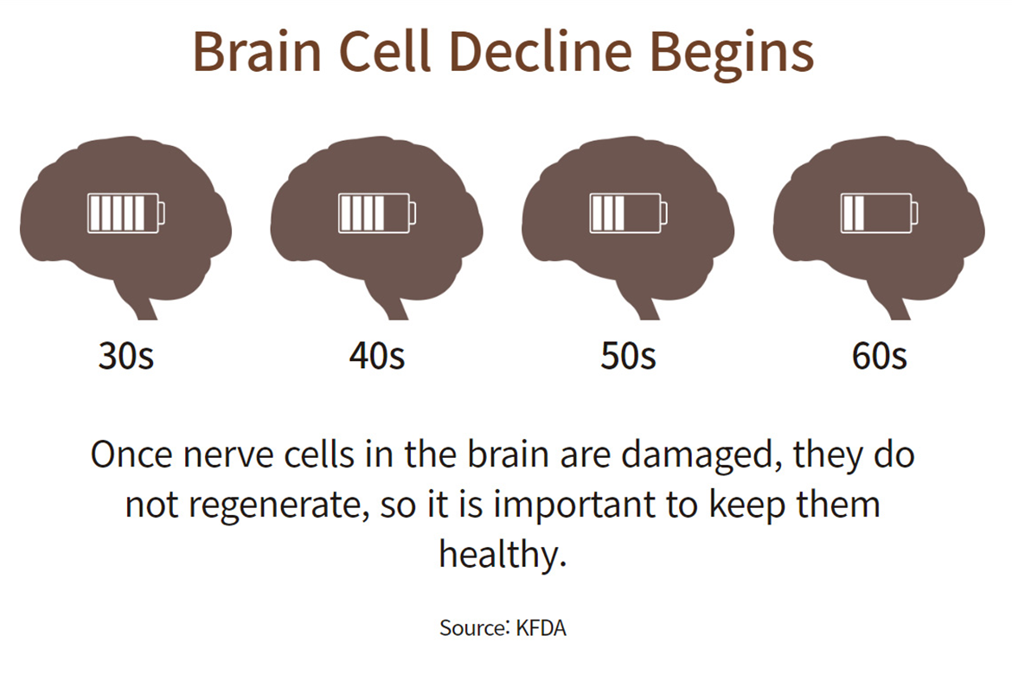
5. Health information
Stress
Medicarions
Alcohol
Sleep
deprivation
Depression

Slide 21
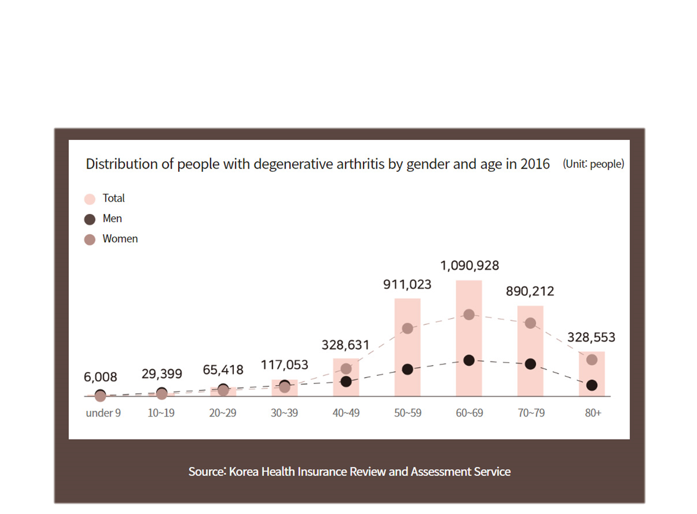
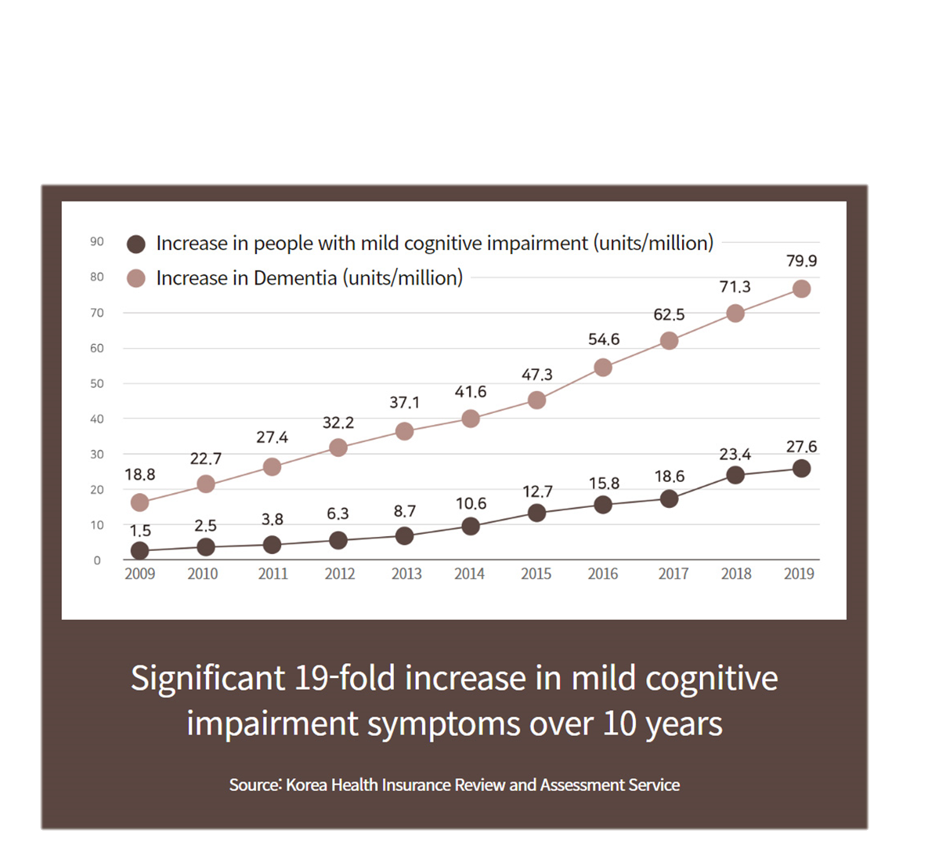
5. Health information
Increase in people with mild cognitige impairment
Degenerative arthritis increases after age 30,
Brain cells begin to decline

Slide 22
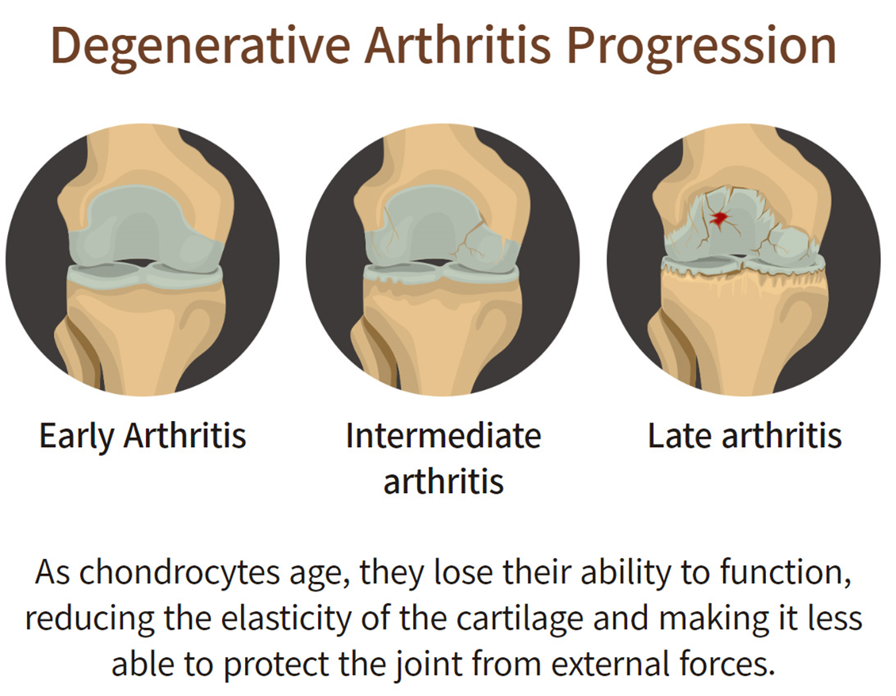
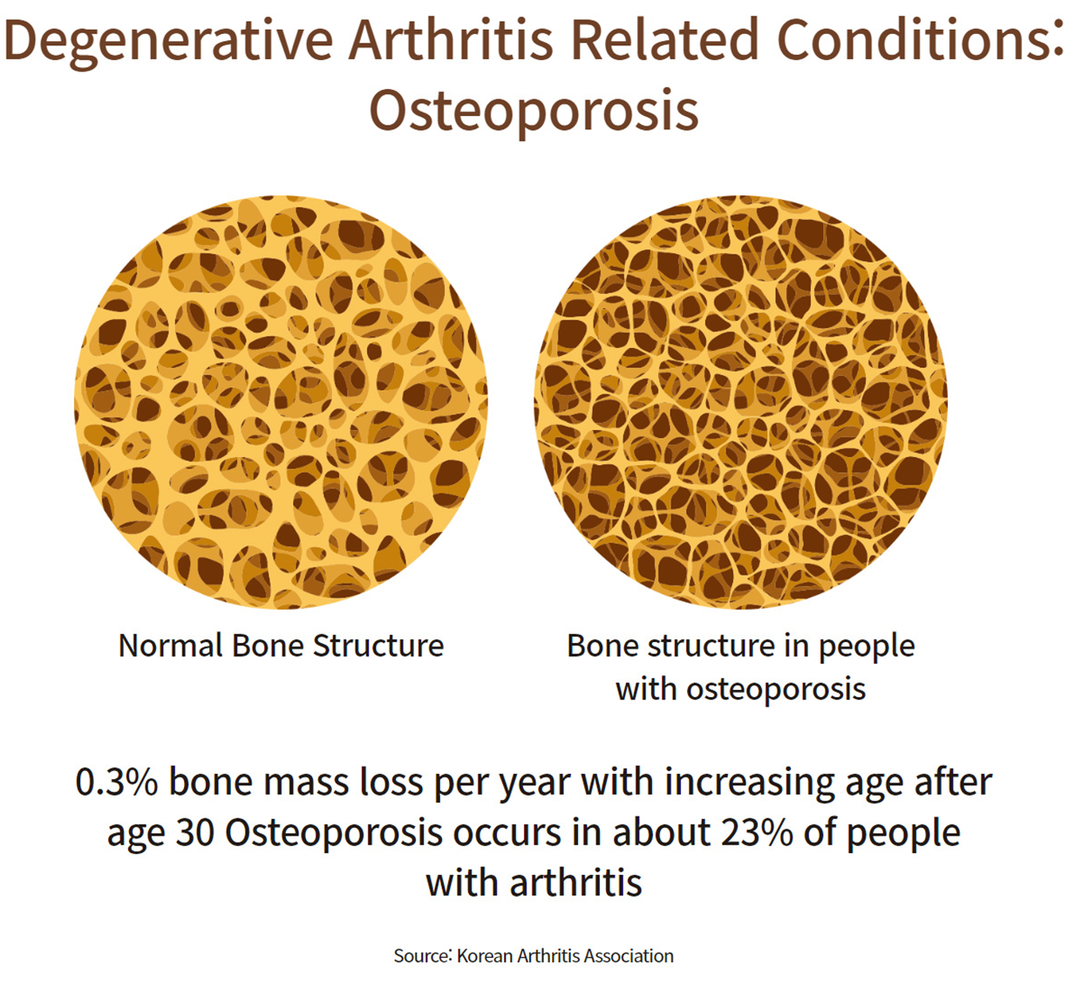
5. Health information

Slide 23
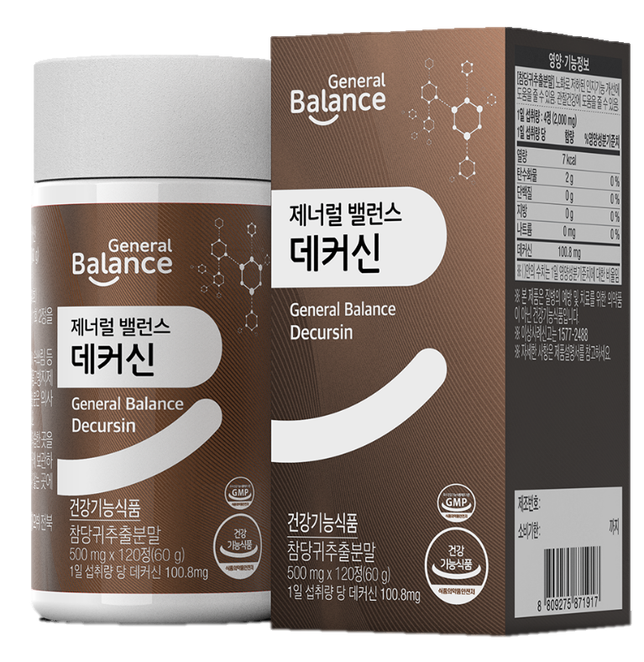
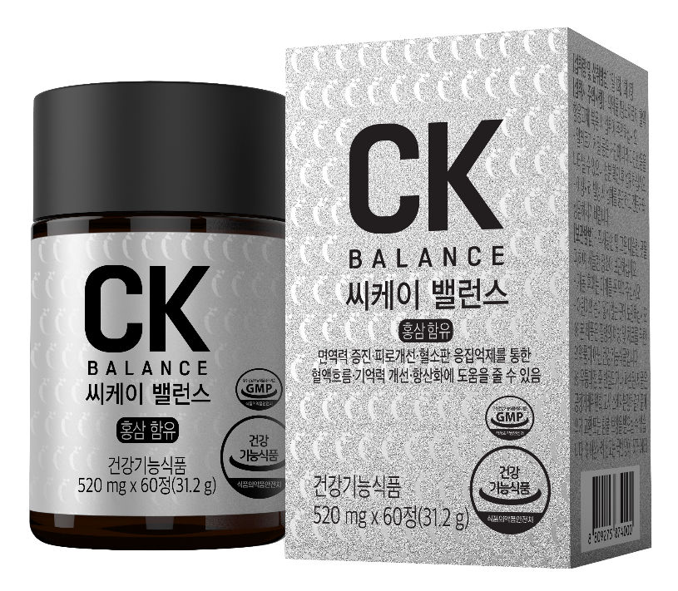
TIP – Related Products
+

Slide 24
Thank you

