Slide 1
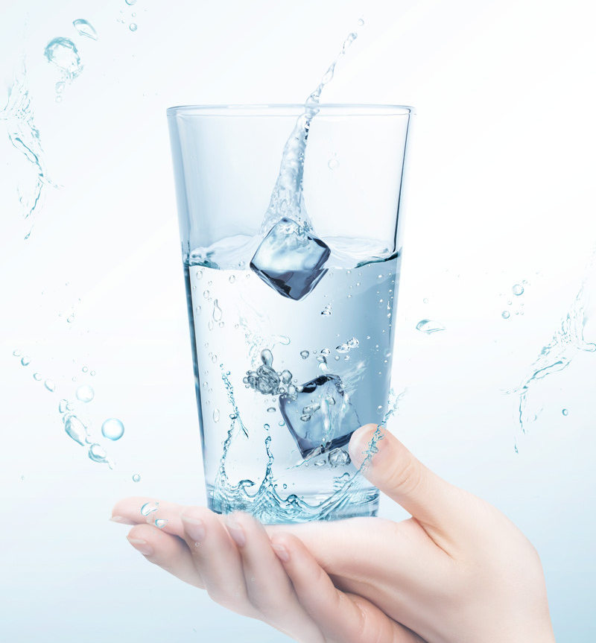

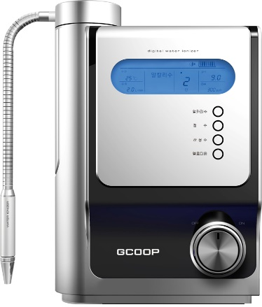
GCOOP Hydrogen Plus
Alkaline Water Ionizer
* This document is intended for internal training purposes only. Unauthorized use of this document is strictly prohibited.
* Please carefully read the Instruction Manual and Warnings prior to using this product.

Slide 2

Regulations Regarding Advertising Claims
GCOOP strives to promote a healthy and transparent advertising culture to comply with regulatory advertising standards and to ensure that members and consumers are not misled or deceived.
We ask that you please refer to the guideline below to help prevent the use of false or inaccurate advertising claims.
1. Do not make false or exaggerated claims related to the product name, manufacturing method, or theories about the products effects or benefits.
2. Do not make advertising claims that deny side effects or exaggerates and emphasizes the safety of the product.
3. Do not falsely quote clinical studies, articles, academic sources, in relation to the effects of the product without evidence. Do not make false claims about patents or certifications about the product.
4. Do not make claims using articles that may mislead consumers to believe that the effects of the product are guaranteed by doctors, dentists, acupuncturists, veterinarians.
5. Do not make advertising claims that suggest doctors, dentists, acupuncturists, pharmacists, university professors, or others sponsors, certifies, recommends, or uses the product themselves. This excludes, advertisements with content created by the state, local governments, or other public organizations for the purpose of public health
7. Do not make advertising claims that may mislead consumers about the Country of Origin of a product.
8. Do not make advertising claims using customer reviews or testimonials, and express sentiments including but not limited to “purchases/orders are overwhelming” or anything that conveys something similar in nature.
9. Do not make claims that suggest that product can be fully guaranteed or absolute expressions such as “best” or “ultimate”
10. Do not make claims or use images/designs that imply medical effects/benefits related to a product.
11. Do not make claims or use before/after images that suggest or imply certain results.
12. Do not make claims that defame/slander or may be suspected of defaming/slandering another product, whether true or not.
13. Do not make inappropriate or obscene advertising claims.
14. Do not make claims that threateningly depict surgeries/procedures, illness, symptoms of disease related to the effects of a product.
Notes:
- 이 제품은 미국에는 일반 공산품으로 수입되므로, 한국의 ‘의료기기‘ 관련 표기는 삭제 하였음

Slide 3


GCOOP HYDROGEN PLUS
ALKALINE WATER IONIZER
Product Overview
Filtration Process
Features of Alkaline Water
Research Studies
Certifications
Product Features
Health Information
Q & A

Slide 4
제품소개
Product Overview
+ Product Name
+ Model Name
+ Product License
(South Korea)
+ Registration Class
(South Korea)
+ Voltage
+ Electrolytic Capacity
+ Filter Capacity
+ Electrode Material
+ Cleaning Functions
+ Electrolysis Stages
+ Intended Purpose
+ Description
GCOOP Hydrogen Plus Alkaline Water Ionizer
GC2020S
License No. 09-279
Class 2 Medical Device
(Ministry of Food and Drug Safety – South Korea)
220V 60Hz 150VA
2.5Liters per minute
Approximately 4,800 Liter (8 Months)
Platinum Titanium Electrode
Patented Self-Cleaning Function (exchange system for outflow in the electrolyzer)
Alkaline Water (4 levels), Filtered Water, Acidic Water (2 levels)
Helps to Support Digestive Health
Chronic Diarrhea, Indigestion, Acid Reflux, Poor Gut Bacteria
Generates Alkaline Ionized Water from pH8.5~10.0
Notes:
* 청색표기: 업데이트/변경 사항

Slide 5

Filtration Process
Filtered Water
“ Generates clean, filtered water (hot/cold) through advanced filtration system“
[Type : Reverse Osmosis (RO) Filter, Membrane (UF) Filter etc., Ministry of Environment-South Korea]
Tap Water
Water Filters (4)
Water Tank
Cold/Hot Water
Alkaline Ionized Water
“Filters water through advanced filtration system and generates alkaline/acidic water through the ion separation process “
(Please note: In South Korea, Alkaline Water is recognized as a functional water, regulated by the South Korean Ministry of Food and Drug Safety)
+
-
Tap Water
Complex Water Filter
Electrolyzer
Alkaline/Filtered/Acidic

Slide 6

Alkaline Ionized Water
After water (drinking water) is purified through a filter
alkaline and acidic water are produced through ion separation.
Alkaline Ionized Water
[- Pole Reaction]
2H₂O + 2e → 2OH⁻ + 2H⁺ + 2e
→ 2OH⁻ + H₂ ↑
H
H₂
Hydrogen Ions
H⁺
OH⁻
+
Hydroxide Ions
OH⁻
Electrolytic Cell
-Platinum Titanium Electrode Plate
H₂O
Water
H₂O
Membrane
Acidic Water
+Ions (Minerals)
+
+Platinum Titanium Electrode Plate
O
O₂
- Ions
-
[+Pole Reaction]
2H₂O - 4e → 2H⁺ + 2OH⁻ - 4e
→ 2H⁺ + 2H⁺ + O₂ ↑
→ 4H⁺ + O₂ ↑
H⁺
-
H₂O

Slide 7


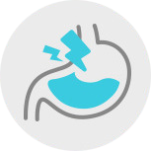

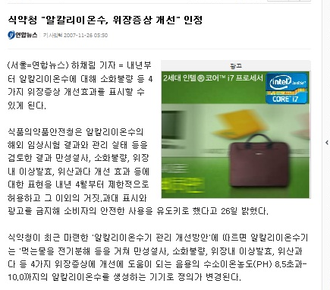
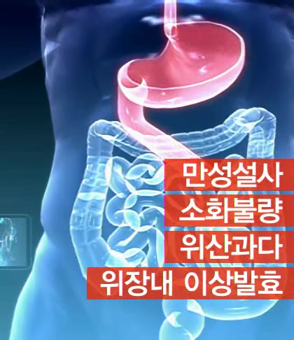

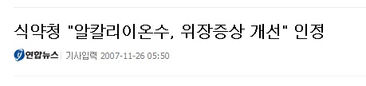

Features of Alkaline Water
※ These statements have not been evaluated by the Food and Drug Administration. This product is not intended to diagnose, treat, prevent, or cure any disease.
GCOOP Hydrogen Plus Alkaline Water
consistently, helps to support digestive health.
Chronic Diarrhea
Indigestion
Acid Reflux
Poor Gut Bacteria
Notes:
※ These statements have not been evaluated by the Food and Drug Administration. This product is not intended to diagnose, treat, prevent, or cure any disease.

Slide 8
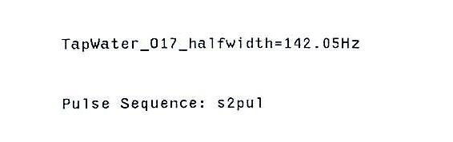
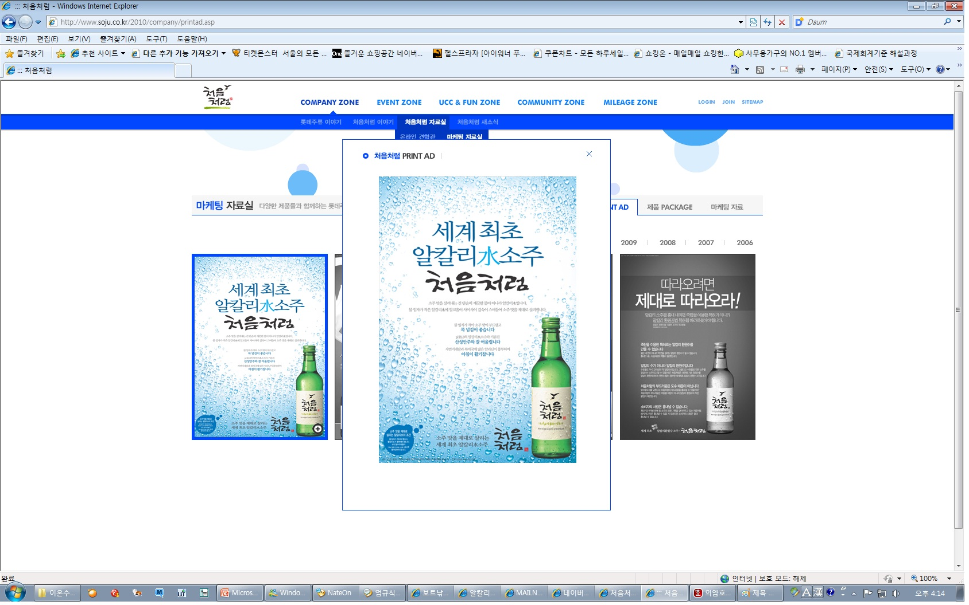
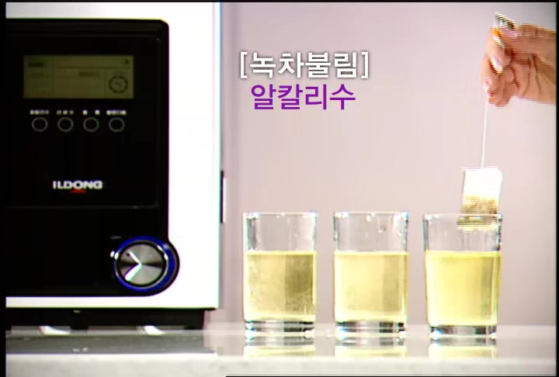
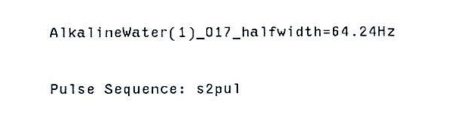
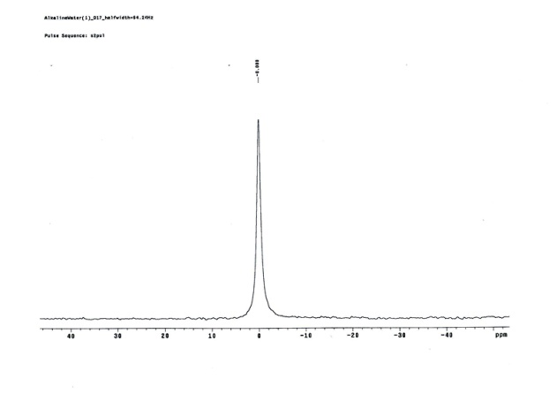
Features of Alkaline Water
※ These statements have not been evaluated by the Food and Drug Administration. This product is not intended to diagnose, treat, prevent, or cure any disease.
GCOOP Hydrogen Plus Alkaline Water
has small clusters, for smooth taste and faster absorption and excretion.
You can easily make 3 glasses of
green tea with cold water!!!
54.8% Decrease
[Water Source]
[Alkaline Water Level 4]
[A major South Korean liquor ad, featuring the clusters in alkaline water]
[Smaller clusters extract more efficiently.]
Category | Tap Water | Mineral Water | Alkaline Water
Cluster Size | 120~150Hz | 80~100Hz | 50~70Hz
[Image-2011 Korea Basic Science Institute NMR 500Mz TEST Report]

Slide 9
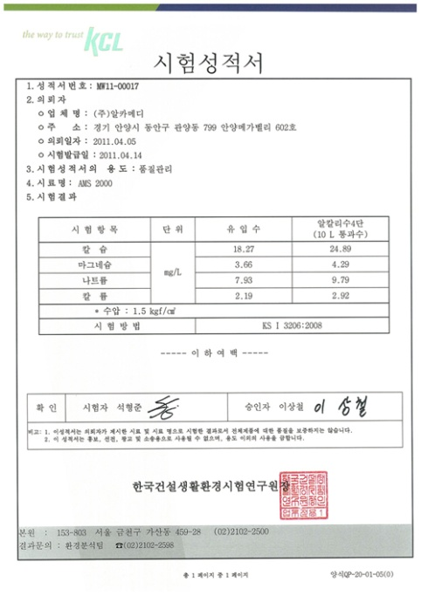
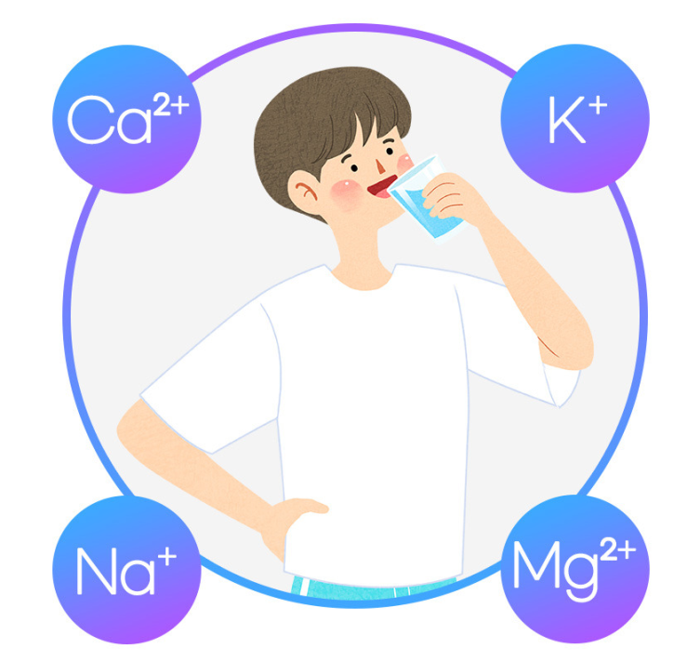
Features of Alkaline Water
※ These statements have not been evaluated by the Food and Drug Administration. This product is not intended to diagnose, treat, prevent, or cure any disease.
GCOOP Hydrogen Plus Alkaline Water
is rich in alkaline minerals in an ionic state.
[Unit of measure: mg/L, Rate of increase compared to water prior to ionization]
Ca²⁺ 26.5% Increase
Ma²⁺ 14.6% Increase
Na⁺ 18.9% Increase
K⁺ 25% Increase
[Image-2011 Korea Conformity Laboratories Report]

Slide 10
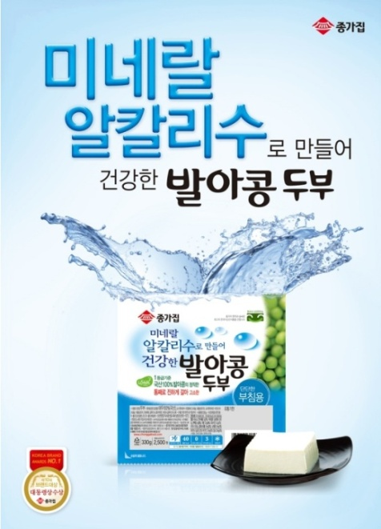
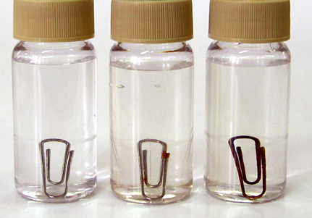
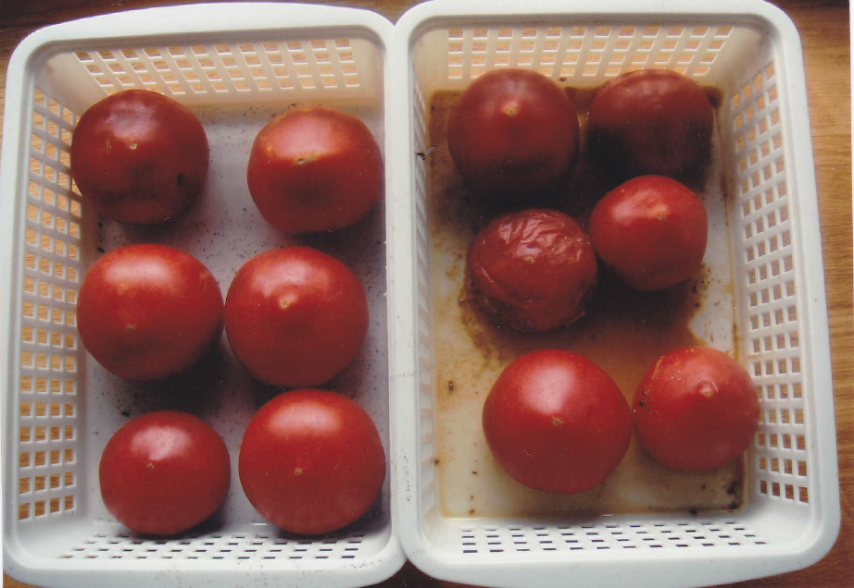
Features of Alkaline Water
※ These statements have not been evaluated by the Food and Drug Administration. This product is not intended to diagnose, treat, prevent, or cure any disease.
GCOOP Hydrogen Plus Alkaline Water
Has Oxidation Reduction Potential.
[ORP]
[OP]
[OP]
Comparison of
Oxidation Potential
-100 ~
-400mV
(Prevents Rust)
+300 ~
+500mV
(Rust Occurs)
+500 ~
+700mV
(Rust Occurs)
Reducing Oxidation Potential in
tofu to keep it fresh longer
[ALKALINE WATER]
[TAP WATER]
[ACIDIC WATER]
ORP(Oxidation Reduction Potential)
A unit (mV) indicating the oxidation/reduction potential
value of a substance. If the value is +, the oxidizing
potential is strong, and if the value is -, the reduction
potential is strong.
[A major South Korean tofu ad, featuring the ORP of alkaline water]
[Fruits and vegetables washing alkaline water stay fresh longer]

Slide 11
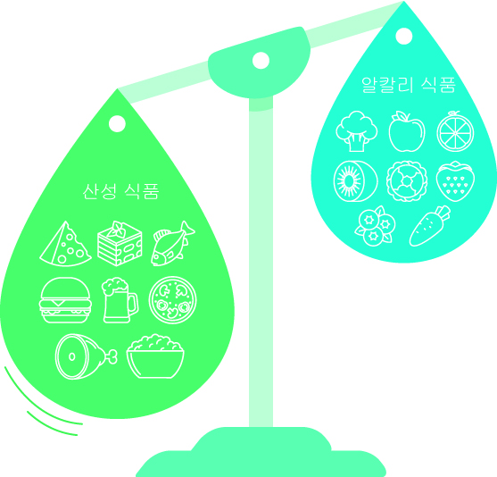
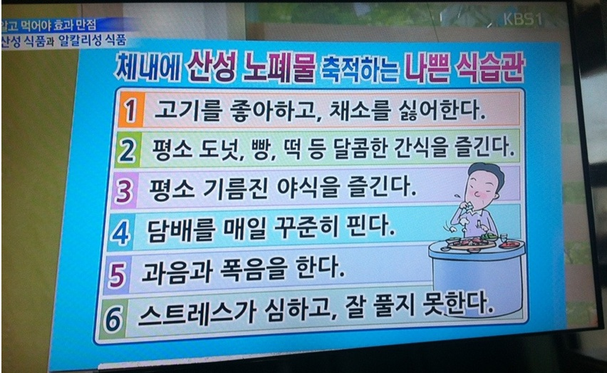
Features of Alkaline Water
※ These statements have not been evaluated by the Food and Drug Administration. This product is not intended to diagnose, treat, prevent, or cure any disease.
GCOOP Hydrogen Plus Alkaline Water
helps to balance the pH in our body.
KBS-Know What You Eat for Maximum Benefit
Imbalance in pH due to high consumption of acidic foods

Slide 12
* This information is based on outsourced studies and may not be directly related to the products of our company.
Features of Alkaline Water
Comparison | Water Ionizer (Alkaline Water) | Hydrogen Generator (Portable) | RO Filter (Filtered Water) | UF Filter (Filtered Water) | Mineral Water (Cold/Hot Water Dispenser)
Removal of Contaminants | O | △ | ◎ | O | O
Minerals | ◎(Increased mineral content compared to water source) | O(same as water source) | X | O(same as water water source) | O(same as water source)
pH | Low Alkalinity | Neutral | Mildly Acidic | Neutral | Neutral
Clusters | 50~70Hz | - | 150Hz | 100~120Hz | 80~100Hz
ORP | ◎ ORP (Oxidation Reduction Potential) | O ORP (Oxidation Reduction Potential) | OP Oxidation Potential | OP Oxidation Potential | OP Oxidation Potential
Hygiene | Generated instantly | - | Generated Instantly | Generated and stored | -
Health Support | Helps to support digestive health (registered as a medical device in South Korea) | X | X | X | X
Hydrogen(DH) Content | ◎ Contains DH | ◎ Contains DH | X | X | X
※ These statements have not been evaluated by the Food and Drug Administration. This product is not intended to diagnose, treat, prevent, or cure any disease.

Slide 13
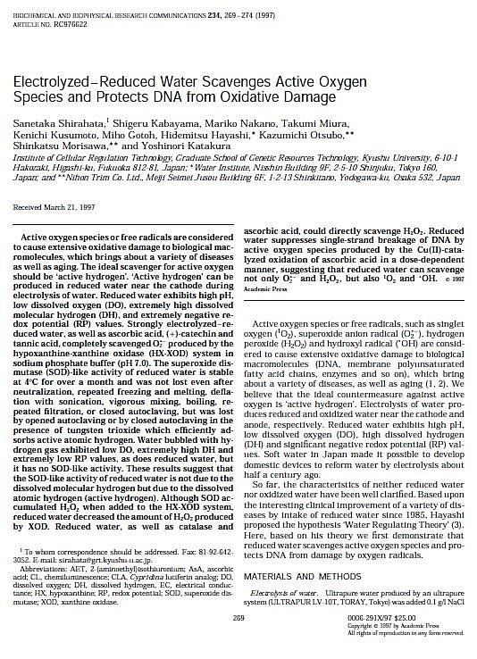
Research Studies
BBRC
(Biochemical and Biophysical Research Communications)
1997, Sanetaka Shirahata
Electrolyzed-Reduced Water
Scavenges Active Oxygen Species and
Protects DNA from Oxidative Damage
* This information is based on outsourced studies and may not be directly related to the products of our company.
* The effects discussed in this study do not guarantee the effectivity of this product.

Slide 14
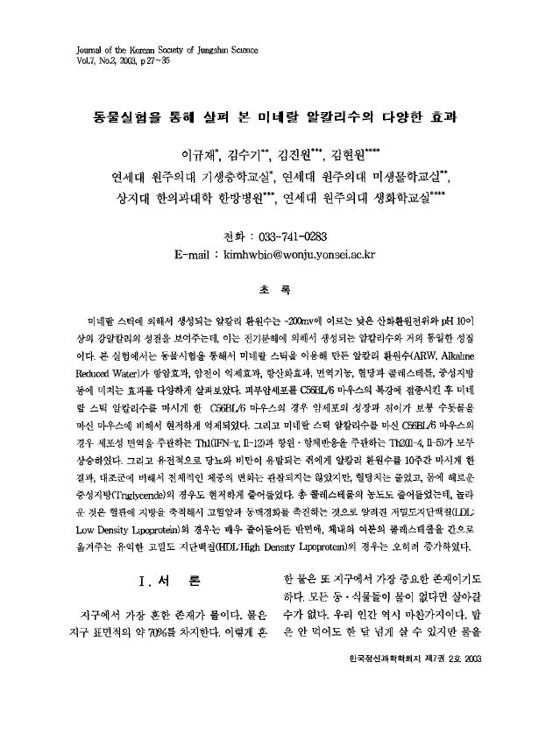
Research Studies
2003, 4 Faculty Professors from
Yonsei University/Sangji University
(Journal of the Korean jungshin science society)
The Various Effects of Mineral Alkaline Water
Observed Through Animal Testing
Improvements observed through animal testing
▶ Anti-cancerous, anti-metastatic
▶ Beneficial for the immune system
▶ Antioxidant properties
▶ Beneficial for diabetes and obesity
Press releases on KBS, MBC(3Part Special), SBS
(Major South Korean Broadcasting networks)
* This information is based on outsourced studies and may not be directly related to the products of our company.
* The effects discussed in this study do not guarantee the effectivity of this product.

Slide 15
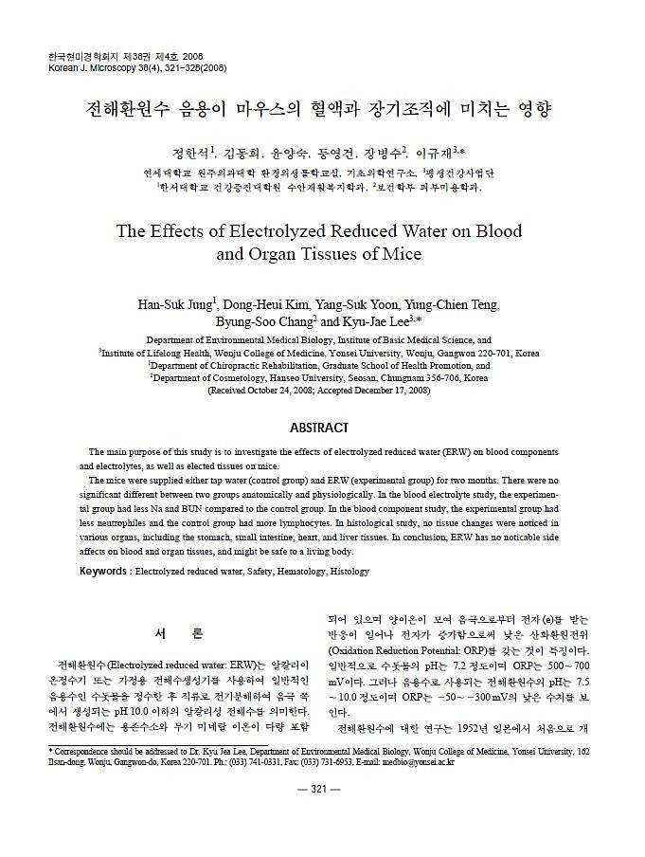
Research Studies
2008, 6 Faculty Professors from
Yonsei/Hanseo University
* Research for the Ministry of Food and Drug Safety from South Korea
* Approx. 18 months of research(2006.6.15~2007.11.30)
The Effects of Electrolyzed Reduced Water
on Blood and Organ Tissues of Mice
- Secured safety of drinking alkaline water
- Recognized as the only medical device for
benefits provided
▶ Chronic Diarrhea
▶ Indigestion
▶ Acid Reflux
▶ Helps to improve gut bacteria
* This information is based on outsourced studies and may not be directly related to the products of our company.
* The effects discussed in this study do not guarantee the effectivity of this product.

Slide 16
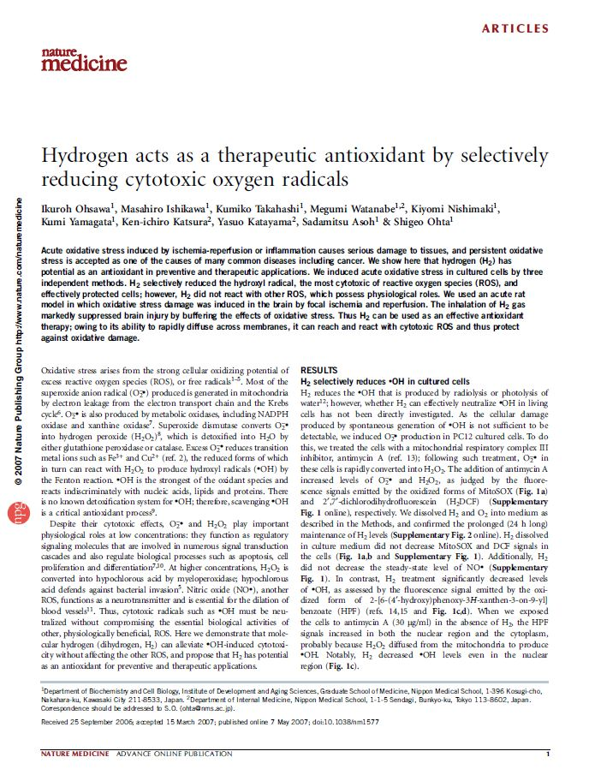
Research Studies
Nature
medicine
2007, Shigeo Ohta
Hydrogen Acts as a Therapeutic Antioxidant Selectively Reducing Cytotoxic Oxygen Radicals
Hydrogen Water was administered to mice with brain infarction,
and it reduced radical oxides by 60%
more than half of the brain cells were revived.
* This information is based on outsourced studies and may not be directly related to the products of our company.
* The effects discussed in this study do not guarantee the effectivity of this product.

Slide 17
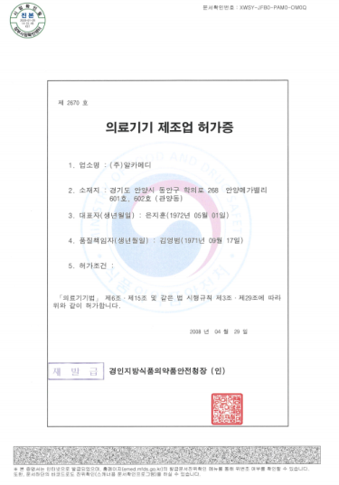
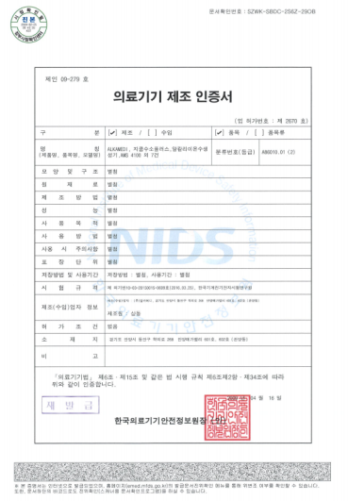
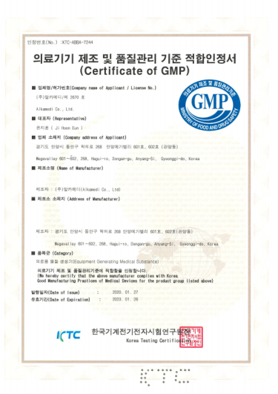
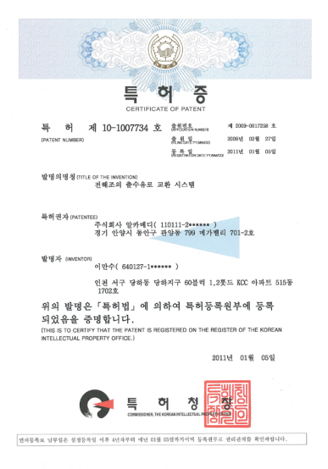
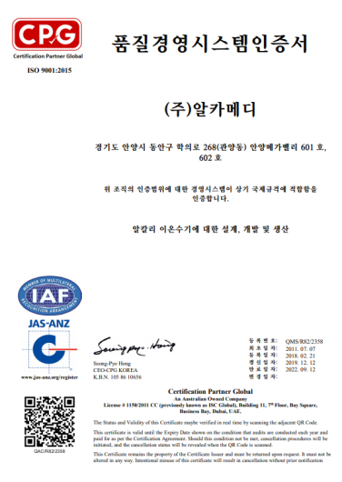
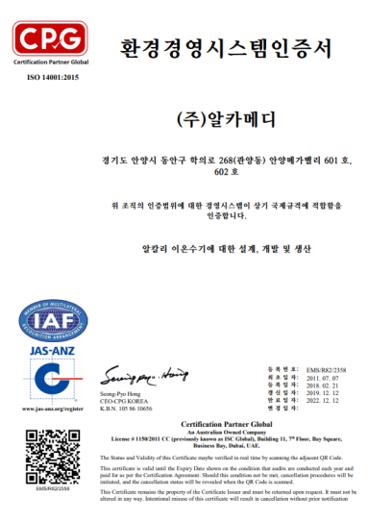
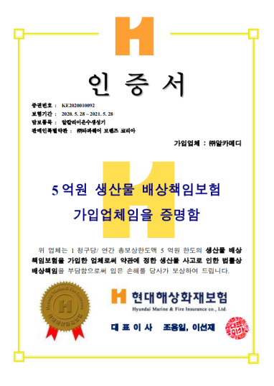
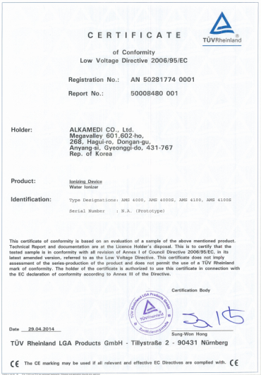
Certifications
Medical Device Manufacturer License – South Korea
Medical Device Certification – South Korea
GMP Certification – South Korea
Patent (Path switch/scale prevention) - South Korea
ISO 9001 Certification
ISO 14001 Certification
PL Insurance (500,000 KRW) – South Korea
CE Certification – South Korea

Slide 18
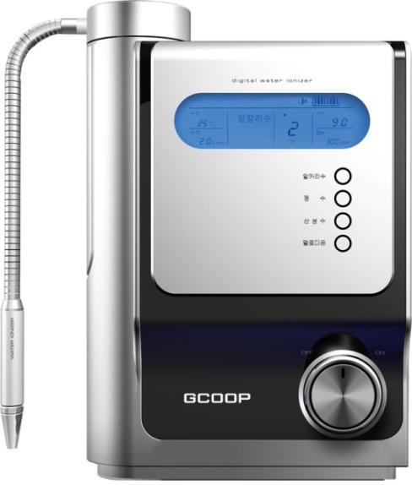
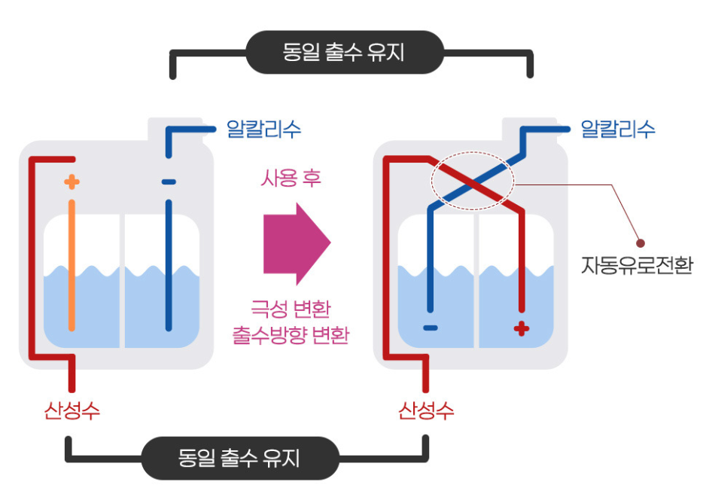
Product Features
The GCOOP Hydrogen Plus Alkaline Water Ionizer
has a (patented) path switching device to prevent scales in the electrolyzer.
Simultaneous Outflow
Alkaline Water
Alkaline Water
After Use
Automatic Path Switch
Polarity Change
Outflow Direction Switched
Acidic Water
Acidic Water
Simultaneous Outflow
By reversing the polarity of alkaline and acidic water with every use, and the patented technology that
automatically removes scales and cleans the electrode plate, you can always enjoy clean alkaline water.

Slide 19
Product Features
Displays Dissolved Hydrogen (DH) Content
Displays the DH content of alkaline water selected 100ppb, 300ppb, 600ppb, 1200ppb
Displays pH level of Alkaline Water
Acidic Water 2(pH6.0), Acidic Water 1(pH5.5)
Neutral Water (pH7.4)
Alkaline Water 1(pH8.5), Alkaline Water 2(pH9.0), Alkaline Water 3(pH9.5), Alkaline Water 4(pH10.0)
* When Alkaline Water Level 1 is dispensed, the acidic water produced in the simultaneous outflow is approx. pH 3
Touch Buttons
Touch the button for desired ionized water, and it will be dispensed through the main spout.
Self-Diagnostics and Voice Guidance
Device detects malfunctions, and alerts when filter replacements are necessary through voice guidance
LCD Color Change System
Depending on the level of alkalinity/acidity selected, the LCD backlight changes according to pH levels

Slide 20
Product Features
Recognized Genuine Filters
The sensor embedded in the filter chamber can recognize genuine filters.
Simple, Easy Filter Replacement
Rotational detachment/attachment is easy for anyone to use.
Compact Size
Slim design looks sleek on any countertop. May be hung on the wall as well.
Product Dimension: 10.11in X 14.76in X 6.25in/257*375*159mm
Flexible Waterspout
Waterspout is flexible and can rotate 360 degrees for hygienic, convenient use.

Slide 21
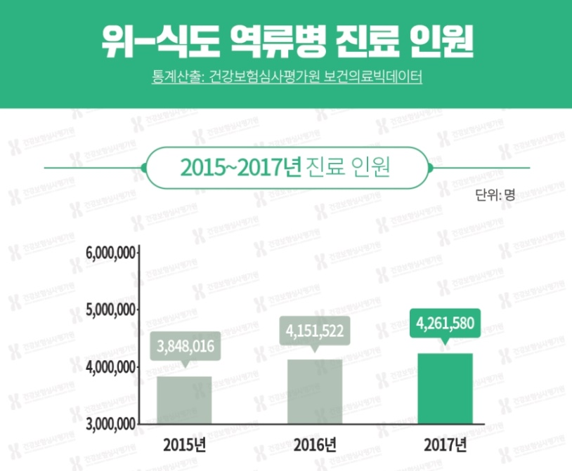
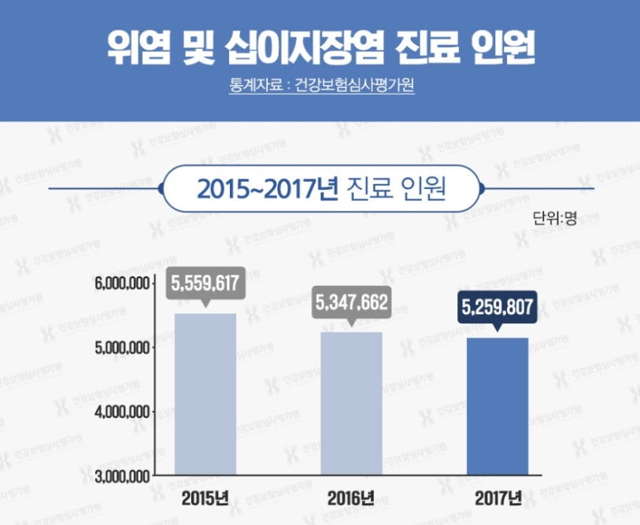
Health Information
* This information is based on outsourced studies and may not be directly related to the products of our company.
Source: Health Insurance Review and Assessment Service-South Korea
Source: Health Insurance Review and Assessment Service-South Korea
Causes of Gastroesophageal Reflux Disease (GERD)
Statistical Analysis: Health Insurance Review and Assessment Service Healthcare Big Data
Gastritis and Duodenitis
Statistical Analysis: Health Insurance Review and Assessment Service
5.25 million
Patients Diagnosed in 2015~2017
Patients Diagnosed in 2015~2017
4.26 million
According to documents from the Health Insurance Review and Assessment Service of South Korea
approximately 9.51 million patients are treated for gastroesophageal reflux disease, gastritis, and
duodenitis annually.

Slide 22
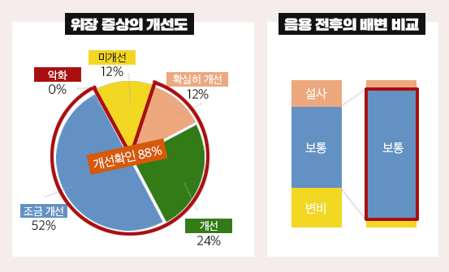
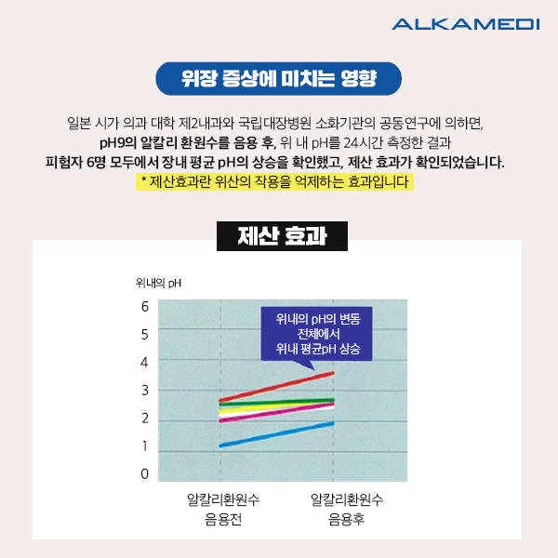
Health Information
* This information is based on outsourced studies and may not be directly related to the products of our company.
Improvement in Gastric Symptoms
Comparison of Bowel Movements
Before and After Drinking
Antacid Effect
No Improvement
Gastric pH
Worsening
Significant Improvement
pH Changes in the
Stomach
Increase in
average pH
Diarrhea
88% Showed Improvement
Normal
Normal
Minor Improvement
Constipation
Improvement
Alkaline Conversion Rate
Before Drinking
Alkaline Conversion Rate
After Drinking
According to a joint study between the Department of Internal Medicine at Shiga University and the National Colorectal Surgery Department of
the National Hospital in Japan, drinking 1 liter of alkaline water with a
pH of 9.5 every day for 2 weeks, resulted in patients with no worsening of symptoms, and 22 (88%) patients showed improvement. Results also
showed bowel movements became normal.
(Source: Japan, Association of alkaline Ionized Water Apparatus)
According to a joint study between the Department of Internal Medicine at Shiga University and the National Colorectal Surgery Department of the National Hospital in Japan, within 24 hours after drinking alkaline water with a pH of 9 all 6 patients showed an increase in intestinal pH levels
and results also showed antacid benefits.
(Source: Japan, Association of alkaline Ionized Water Apparatus)

Slide 23
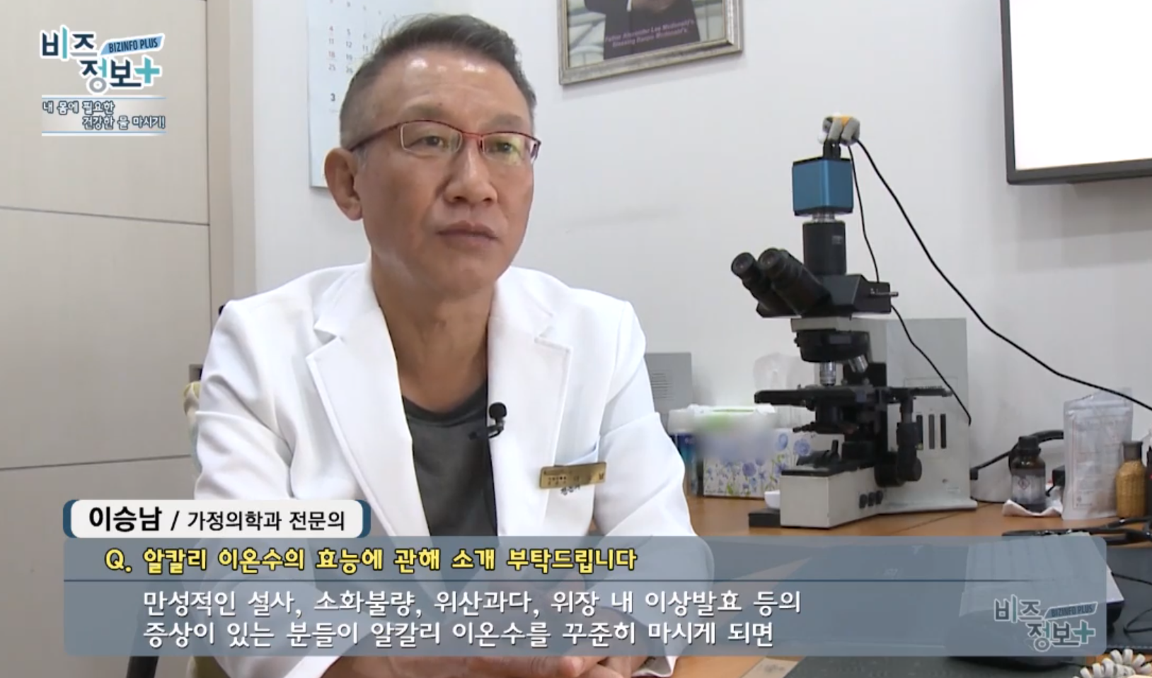
Health Information
* This information is based on outsourced studies and may not be directly related to the products of our company.
* The information below is based on a televised interview and does not guarantee the effectivity of this product.
What Dr. Seung Nam Won of the Gangnam Best Clinic says about the benefits of Alkaline Ionized Water
1) Improvement in Gastric Symptoms, 2) Antioxidants, 3) Fast Absorption and Excretion, 4) Diet/Weight Loss Effects

Slide 24
Q & A
※ These statements have not been evaluated by the Food and Drug Administration. This product is not intended to diagnose, treat, prevent, or cure any disease.
Q1. What Level of Alkaline Water should I drink?
After initial installation, start with level 2. After a week you can raise it to level 3-4.
For those who are in good health drink level 3. Those looking to improve their health should drink level 4.
Children under the age of 2 should consume neutral filtered water or alkaline water level 1. Those above age 2 have no restrictions.
For cooking, washing fruits and vegetables, beverages and tea, use alkaline water level 4.
Q2. How do I store Alkaline Water?
Those looking to improve their health should drink alkaline water that is dispensed directly from the appliance. Store in a sealed jar/container in the refrigerator and consume within 1 day of producing it.
Q3. Doesn’t drinking a lot of Alkaline Water neutralize stomach acids?
The difference in pH between alkaline water and stomach acids is quite small.
In order to neutralize stomach acids by drinking alkaline water, the water must be incredibly alkaline. (Much more alkaline than you could imagine.)
The reason alkaline water improves acid reflux is because of the calcium hydroxide component of alkaline water.
Q4. What is the purpose of filtered water?
Drink alkaline water for your daily drinking needs.
However, drink filtered water when taking prescription medications.
You can drink alkaline water when taking supplements, vitamins, etc.
Q5. Can I boil Alkaline Water?
Boiling alkaline water may result in evaporating the dissolved hydrogen content
Do not boil water water intended for drinking.
Teabags infuse well in room temperature alkaline water.

Slide 25
Q & A
※ These statements have not been evaluated by the Food and Drug Administration. This product is not intended to diagnose, treat, prevent, or cure any disease.
Q6. What is the purpose of Acidic Water?
Acidic Water that you can choose to dispense from the main spout is between pH 5~6.5,
and the simultaneous outflow of acidic water that occurs when dispensing alkaline water from the main spout is between pH 3~5.
You can use acidic water in a spray bottle and apply to the skin after showering, or to cleanse your skin.
You can also replace hair conditioner with acidic water, use it to maintain/car for your pet’s coat, as well as a sterilization solution for rags, cutting boards and other kitchen tools.
Q7. Is drinking Alkaline Water restricted for anyone?
Those with renal deficiencies or calcium metabolism disorders should consult with a doctor prior to drinking alkaline water.
Q8. How efficient is the filtration if there is only 1 filter?
Filtration efficiency is not related to the number of filters. What’s important is the filtration efficiency verified by the testing institute. The carbon block composite filter this product is composed of, is a 6-step filtration system, and can effectively filter up to 4,800 liters. It can be used for about 8 months, and when it is time to replace the filter, you will be notified by the voice guidance function.
Q9. Can this be installed to a groundwater source?
This product must be used with suitable drinking water. If the groundwater in your home is suitable for drinking you can connect the appliance to a groundwater source. However, you may need to connect more pre-filters depending on the quality of the water.
Q10. Can it dispense hot/cold water?
If the alkaline water is stored in a tank within the device, the benefits of the water may be decreased. Therefore, our product dispenses the water directly, during each use. Depending on your needs, you can refrigerate the water or heat it using an electric pot.

Slide 26
Q & A
※ These statements have not been evaluated by the Food and Drug Administration. This product is not intended to diagnose, treat, prevent, or cure any disease.
Q11. How much alkaline water should you drink per day?
For the average adult it is recommended to drink between 500ml~1L per day.
Q12. Why is there a white powdery substance in the container that I use to store Alkaline Water?
Alkaline Water is rich in ionized minerals. When these minerals accumulate, they appear white and powdery.
To remove this, mix vinegar and water (ratio of 1:9 respectively), and use the solution to clean the container.
Q13. Why are there bubbles when alkaline water is dispensed?
Alkaline water produced through ion separation, also produces dissolved hydrogen and this is what cause the bubbles to form.
Q14. I drank acidic water by accident.
The Acidic Water is filtered, and the pH is higher than that of carbonated drinks (pH 2~3)
Q15. Is there no KC water certification mark like water filtration systems?
The KC water certification mark is limited to water filters only. Alkaline Water Ionizers are Class 2 Medical Devices in South Korea and have passed
tests for drinking water.
Products regulated by the Ministry of Food and Drug Safety have acquired Medical Device Registration and therefore, the KC mark is not
applicable.

