Slide 1

Hello,
GCOOPERS

Slide 2
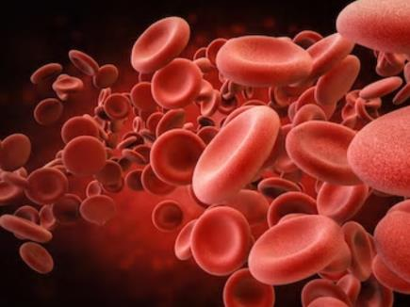
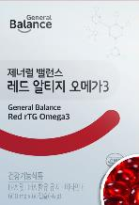
“Red rTG Omega3
To Help Support Heart Health and Vascular Health ”

Slide 3




‘Building Blocks of Life’ Theory
8
Essential Amino Acids
‘Building Blocks of Life Theory’
8 Essential Amino. Acids, 16 Minerals, 20 Vitamins, etc., Total 44 Essential Nutrients
Must be consumed Daily
20
Vitamins
16
Minerals
[Nutrition Against Disease], Roger J Williams
* The information above is based on outsourced studies and may not be directly related to the products of our company.

Slide 4
Essential Nutrients!
What are Essential Nutrients?!
Essential Nutrients are nutrients that help to support growth/development and normal function but are either not synthesized in the body or only synthesized in small amounts.
Therefore, they must be supplemented or consumed through food!
Essential Amino Acids
Leucine / Isoleucine / Lysine / Methionine / phenylalanine / Threonine / Tryptophan /
Valine / Histidine(infants)
Essential Fatty Acids
Linoleic Acid / Linolenic Acid (EPA, DHA)
Essential Vitamins
VitaminB1(Thiamine)/ VitaminB2(Riboflavin)/ VitaminB6(Pyridoxine)/ VitaminB12 Niacin/ Pantothenic Acid/ Folic Acid / Biotin / VitaminC / VitaminA / VitaminD / VitaminE / VitaminK
Essential Minerals
Calcium / Phosphorus / Sodium / Chlorine / Potassium / Magnesium / Iron / Zinc / Copper / Fluorine
Manganese / Iodine / Selenium / Molybdenum / Chromium / Cobalt
Other Nutrients
Carbohydrates / Sugar / Fat / Protein / Dietary Fiber / Hydration
* The information above is based on outsourced studies and may not be directly related to the products of our company.

Slide 5
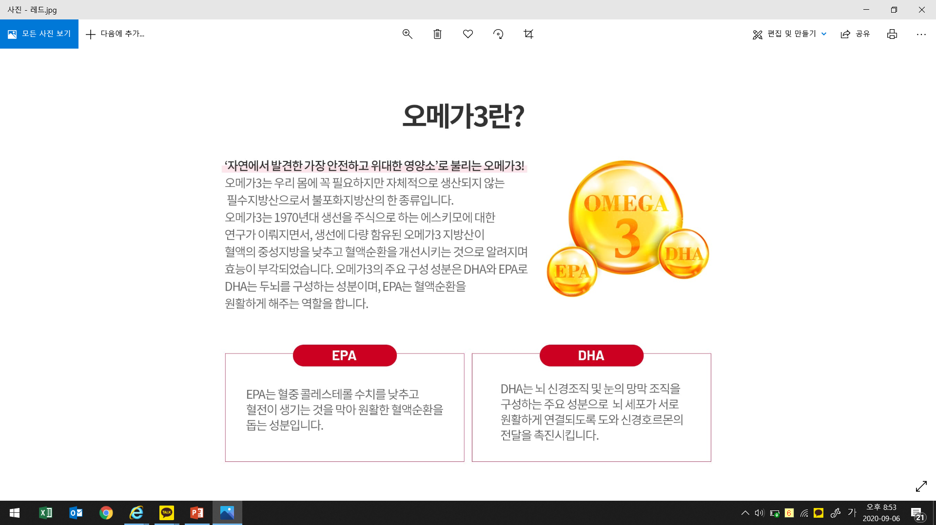

Nutrients Found in Nature
'Omega 3, a Nutrient Found in Nature!’
Omega 3 is an essential unsaturated fatty acid that is not synthesized by the body.
Omega 3 was discovered through research on Eskimo’s that had a diet primarily comprised of fish. The research showed that Omega 3, which is found in fish, can help to support vascular health and heart health. The main components that Omega 3 is comprised of, DHA and EPA, are found in the brain and help to support circulation, respectively.
EPA helps to support vascular health.
DHA is a DHA is a major component of
the brain and eye structures.
Limited to ingredient characteristics.
* The information above is based on outsourced studies and may not be directly related to the products of our company.

Slide 6
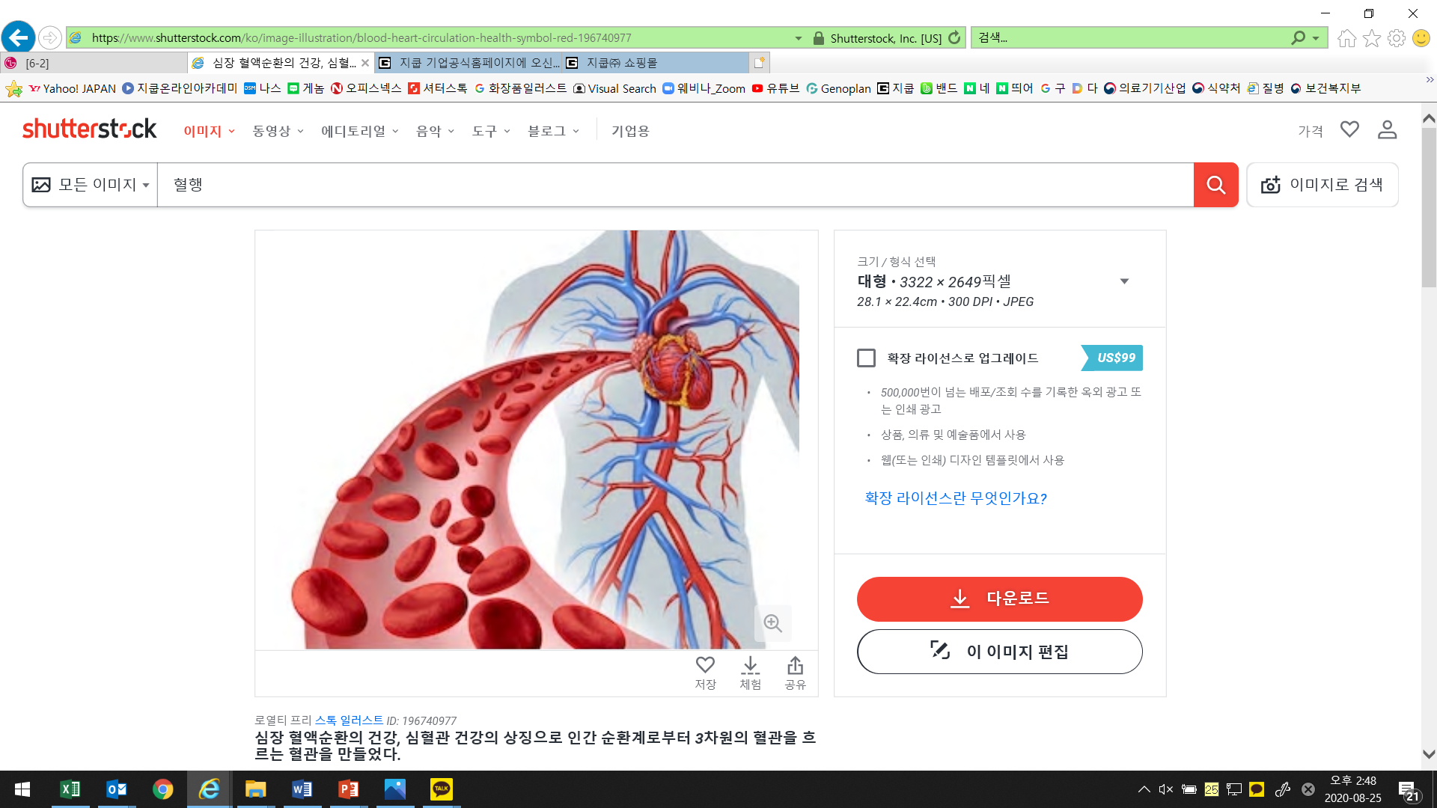
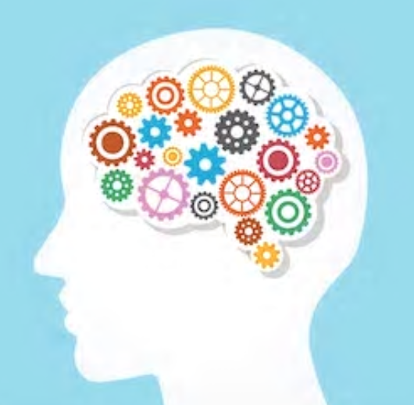
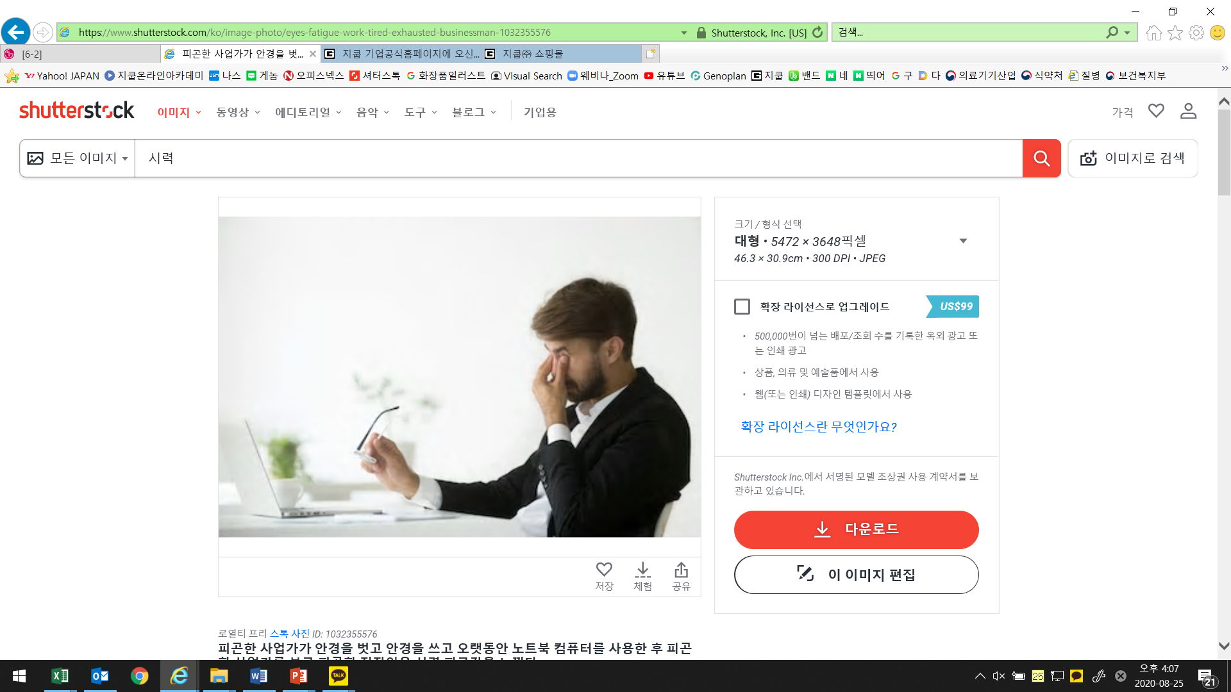
What Are the Health Benefits of Omega3?
Helps to Support Vascular Health
Helps to Support Brain Health
Helps to Support Eye Health
Helps to Support Circulation
Helps to Support Heart Health
May Help to Reduce Risk of Dementia
Helps to Support Brain Function
May Help to Reduce the Risk of Impaired Vision
Helps to Support Eye Function
* The information above is based on outsourced studies and may not be directly related to the products of our company.

Slide 7
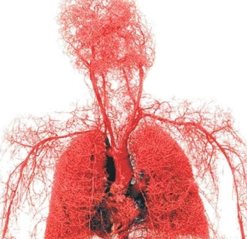
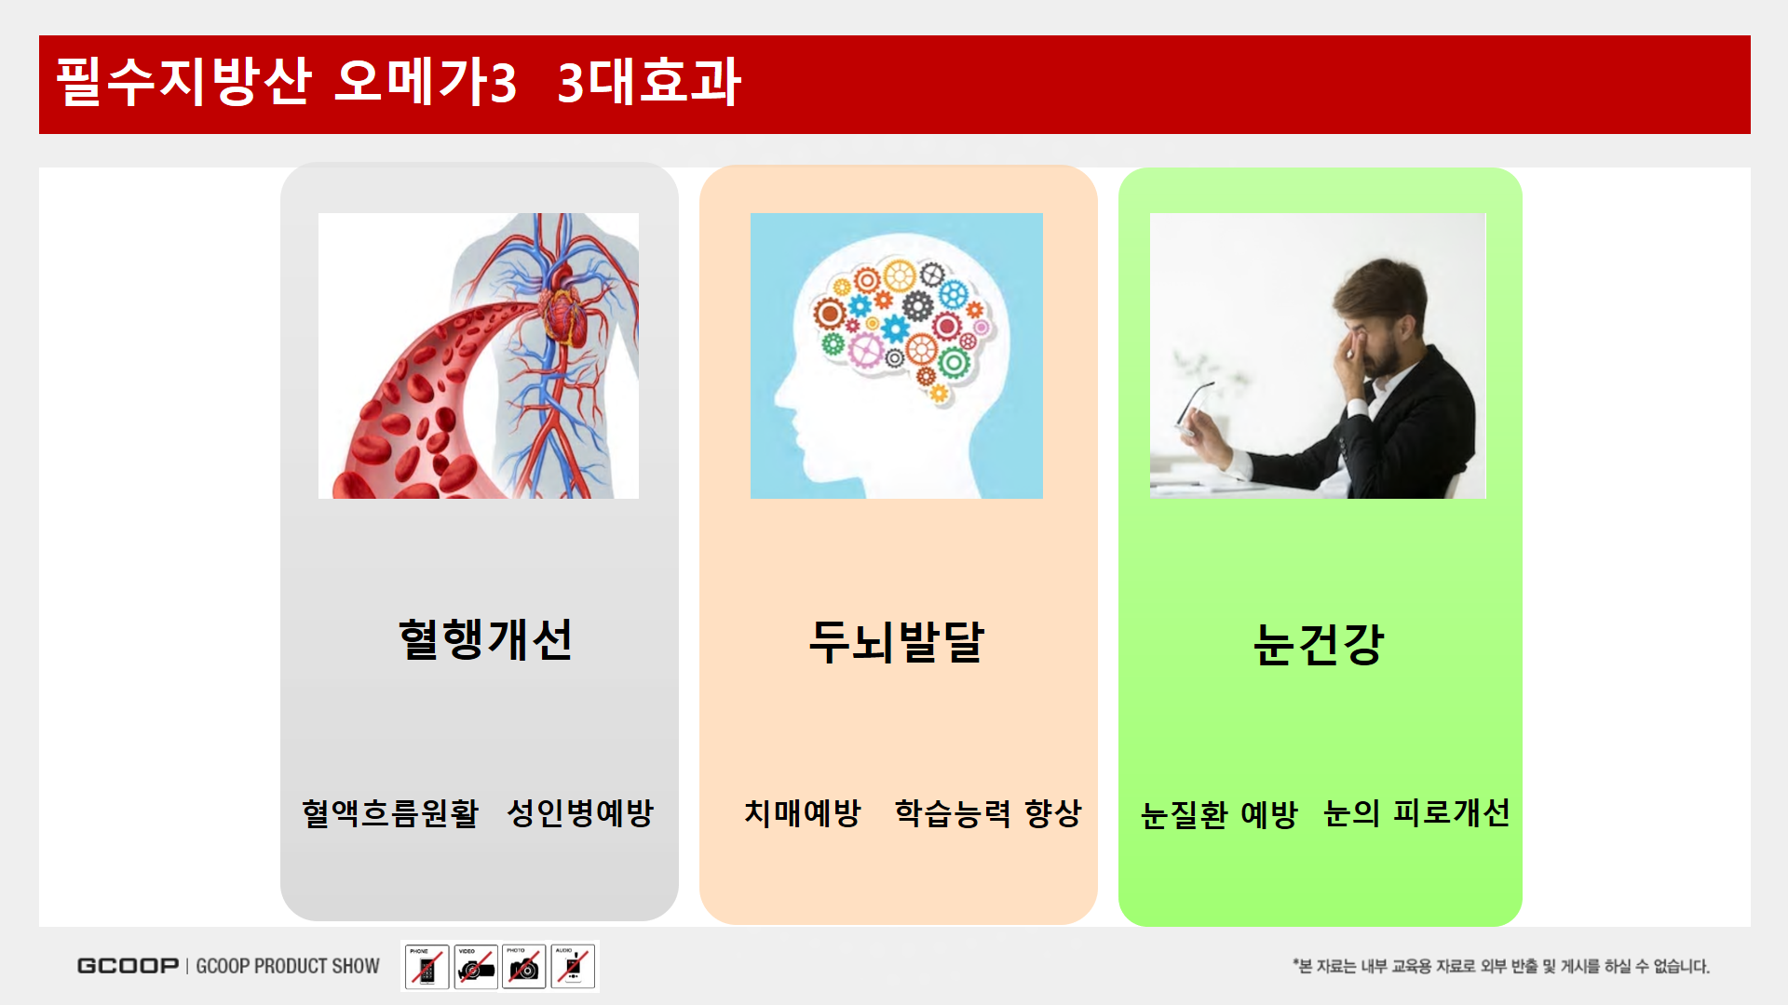

About Circulation
120,000km(3 times around the earth)
1 minute for full body circulation
Aging begins in the 20’s
As aging progresses circulation may not be as smooth
* The information above is based on outsourced studies and may not be directly related to the products of our company.

Slide 8
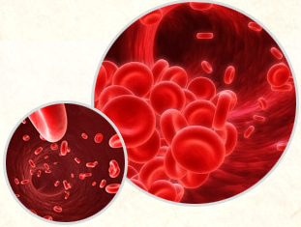
Vascular Health
Blood is an indicator of health
It helps to deliver nutrients, oxygens and hormones to various parts of the body.
Eliminates Waste
Helps to Support Immune System(White Blood Cells)
* The information above is based on outsourced studies and may not be directly related to the products of our company.

Slide 9
If Circulation is Difficult
Pins and needles in the hands and feet
Headaches and dizziness
Shoulder pain/tension
Feeling of heaviness
Chest pain/discomfort
Varicose Veins
Decline in memory
Tired, dry eyes
Frequent cramping (legs, hands, etc.)
Dark circles
* The information above is based on outsourced studies and may not be directly related to the products of our company.

Slide 10

Omega 3 = Component of Brain Structure
Over 95% developed at age 8
60% of the brain comprised of fat
10% of fat in the brain is DHA
Omega 3 helps to support brain health
* The information above is based on outsourced studies and may not be directly related to the products of our company.

Slide 11
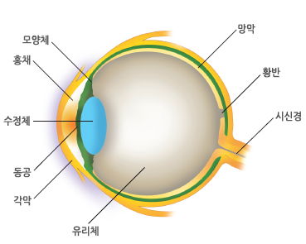
Omega 3 = Helps to Support Eye Health
80% of information taken in visually
Vision fully developed between 7~8 years of age
60% of retinal tissue comprised of DHA
Omega 3 helps to support eye health
* The information above is based on outsourced studies and may not be directly related to the products of our company.

Slide 12
This is why we look for Omega 3

Slide 13
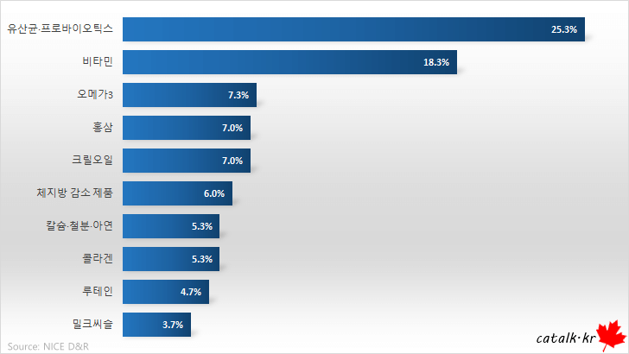
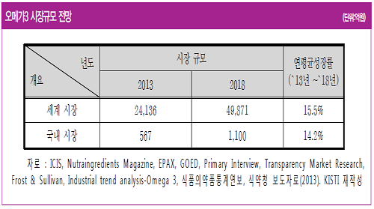
2020 Dietary Supplement Popularity Ranking, 3rd Place
The global omega 3 market has grown rapidly at an annual rate of
15.5%, from 2.4 trillion KRW in 2013 to 4.9 trillion KRW in 2018.
The domestic market also expanded from 57.6 billion KRW in 2013 to 110 billion KRW in 2018, with a double-digit growth rate. This rapid
rate of growth is attributed to changes in consumer perception of
omega 3, high-quality products using highly-concentrated raw
materials, and increased effectiveness and related needs.
According to the results of a survey conducted in South Korea,
by NICE D&R, an agency specializing in marketing and big data
analysis, 'lactic acid bacteria and probiotics' (25.3%) were the most frequently purchased supplements by consumers in the last three months, followed by 'vitamins'( 18.3%), followed by
'Omega 3'(7.3%).
* The information above is based on outsourced studies and may not be directly related to the products of our company.

Slide 14
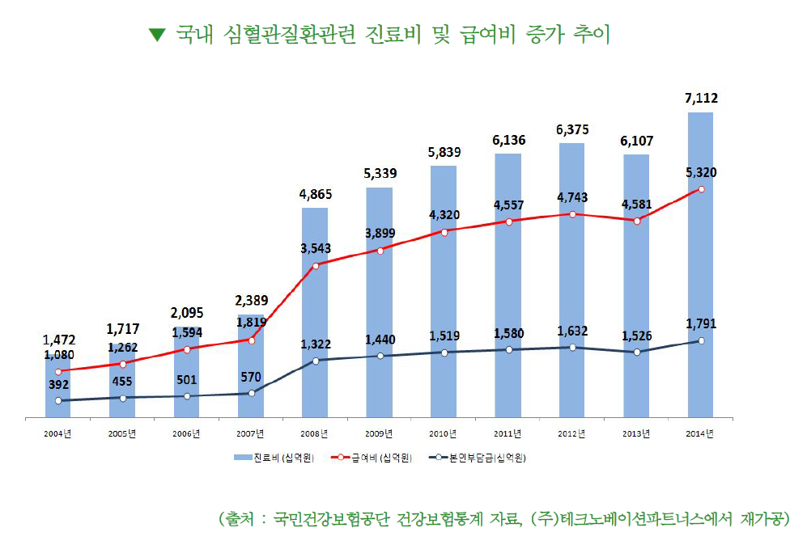
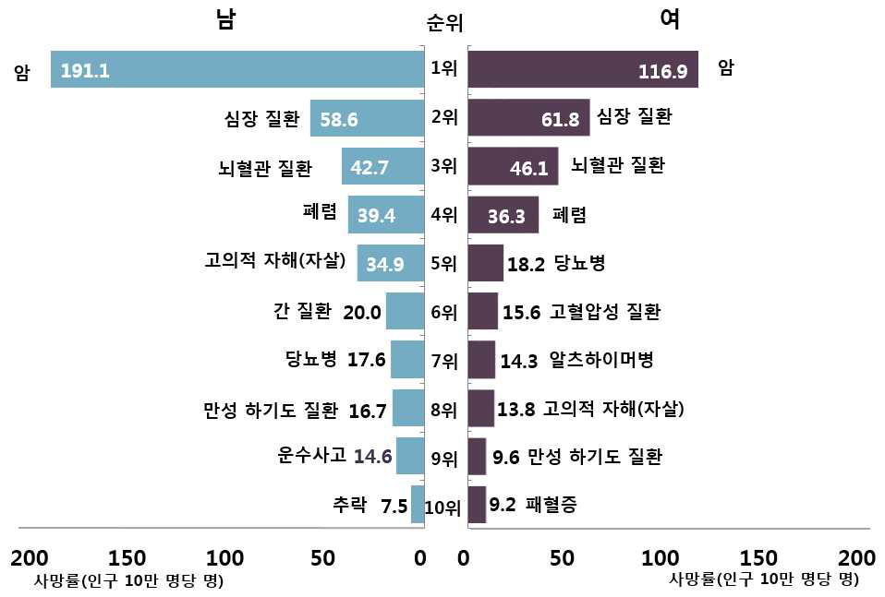
Cause of Death in South Korea, Heart Disease and Vascular Disease
According to health insurance statistics in 2014, the cost of medical insurance
related to cardiovascular disease in Korea was approximately 5.3 trillion KRW,
which is five times higher than the statistics found in 2004 (1.1 trillion KRW).
There was an annual average increase of 17.3% in the medical expenses related
to cardio/cerebrovascular disease, the out-of-pocket expenses increased by an
average of 16.4% per year, which not only increases the financial burden of
health insurance but the financial burden on patients and their families as well.
Source: National Institute of Statistics (South Korea)
The number of deaths caused by heart disease and cerebrovascular disease, which are the second and third
leading causes of death in Koreans respectively, is approximately
50,000 per year.
* The information above is based on outsourced studies and may not be directly related to the products of our company.

Slide 15
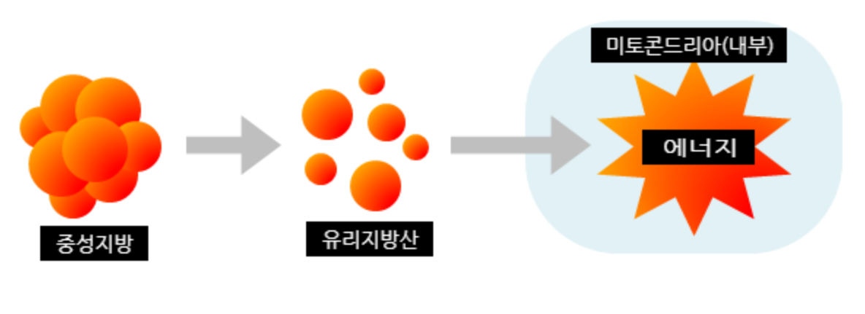
Necessary but if over accumulated…
When animal fats and carbohydrates are consumed, the fat
components are broken down and synthesized in the stomach
and small intestines and further synthesized by the liver into
triglycerides. The synthesized triglycerides are converted into
free fatty acids and are delivered to to various parts of the
body along with the blood and used as energy required for
physical activity.
What are Triglycerides??
Flexible liquid state
Important energy source
May cause health risks when over accumulated,
If triglyceride levels are high, it may present higher risks for obesity.
Fat in the body can be largely divided into two categories. The first are triglycerides and free fatty acids that are used for energy, and the second are cholesterol and phospholipids used to form cells and bodily tissue.
Role of Fats
Control of substances in the body through cell membranes
Stores energy at high density
Large amounts of fat helps to keep warm in colder temperatures and support healing of wounds
Source: Health Chosun/ http://health.chosun.com/site/data/html_dir/2018/02/07/2018020702372.html
* The information above is based on outsourced studies and may not be directly related to the products of our company.

Slide 16
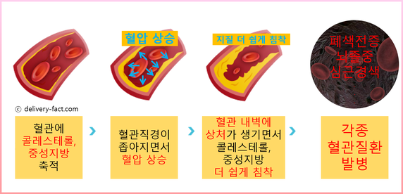
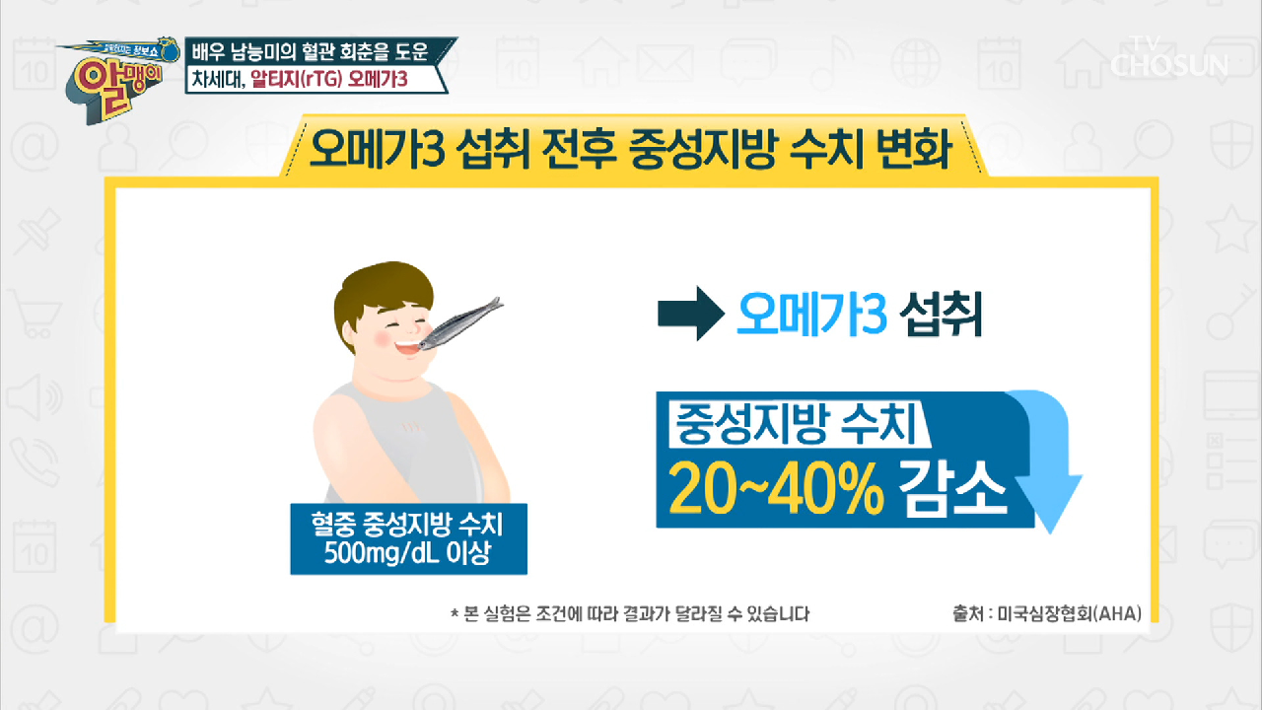
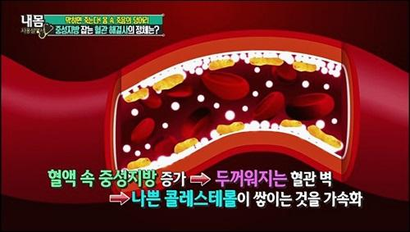
Necessary but if over accumulated…
The American Heart Association recommends “the consumption of Omega-3 because it helps to reduces the risk of cardiovascular disease by lowering triglyceride levels by 20-40%. The key to preventing many cardio/cerebrovascular diseases, ironically, lies in 'fat'. Although they are essential nutrients, omega-3 fatty acids must be consumed as they are not synthesized in the body and hold the key to heart health and vascular health.
Source: Health Chosun / http://health.chosun.com/site/data/html_dir/2018/02/07/2018020702372.html
* The information above is based on outsourced studies and may not be directly related to the products of our company.

Slide 17
Let’s Think About What Kind of Omega 3 Products We Should Choose!

Slide 18
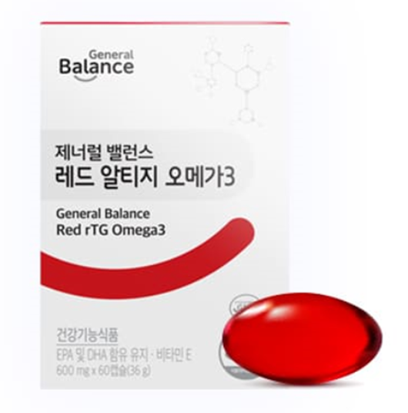
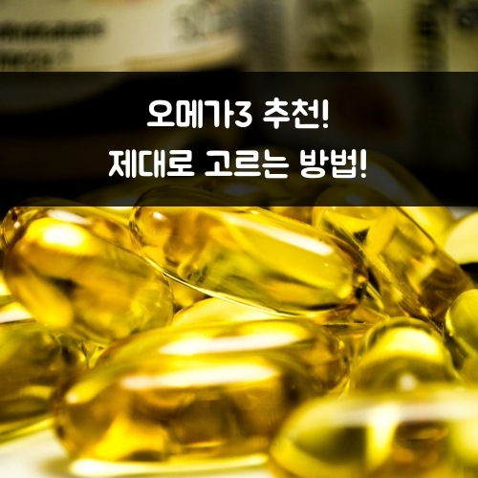
Omega 3 Check List
함유량 확인
It is recommended to choose a product that contains at least 500mg of omega-3 per serving.
오메가3의 원료 형태
It is recommended to choose an rTG omega 3 also known as the ’latest formulation of omega 3’ or
‘3rd generation omega 3’.
작은 생선에서 추출했는지 여부
Omega 3 extracted from smaller fish or bottom feeders may be safer as they may be less
contaminated by heavy metals.
저온 초임계 추출법 적용
Products that employ low temperature supercritical fluid extraction methods have no residual chemicals in the final product and are considered safer.
Serving Size
Formulation
Extracted from Small Fish
Low Temperature SFE Extraction Method
* The information above is based on outsourced studies and may not be directly related to the products of our company.

Slide 19
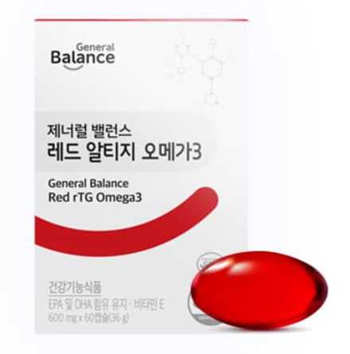
General Balance Red rTG Omega 3
Formulated with rTG omega3 which has a high bioavailability
and contains a variety of nutrients.
General Balance Red rTG Omega3
2 capsules daily help to support heart health and vascular health!
600 mg x 60Capsule(30 servings)
Take 2 capsules once a day.

Slide 20
General Balance Red rTG Omega 3
Contains quality rTG Omega 3 and helps to support circulation, eye health, memory, and heart health.
1. Rich in Nutrients
. Contains 900 mg of EPA and DHA per serving + Vitamin E 3.3 mg α-TE
. Contains Soy Lecithin, Hematococcus Pluvialis Extract, and Grapeseed Oil
2. High Bioavailability
3. Formulated with ingredients developed by KD Pharma
. Certifications from IFOS, GOED, FOS, and HALAL
. Over 80% purity
. Extracted from small fish such as anchovies and sardines
. Exclusive Extraction Methods
- SFE Extraction Method: Extraction method using Carbon Dioxide and low temperatures (no higher than 50 degrees),
Extraction method does not use nucleic acid (no chemical solvents), There is low risk of altering or destroying the heat sensitive molecular structure of Omega 3 and or
residual chemical solvents (nucleic acid)
- SFC Supercritical Fluid Chromatography: EPA and DHA are separated and concentrated, Critical refining process that purifies the fish oil and removes heavy metals and contaminants
4. Vegetarian Capsules: Does not contain gelatin, animal products, artificial flavors, or coloring agents
600 mg x 60Capsule (30 servings)
Take 2 capsules once a day.

Slide 21
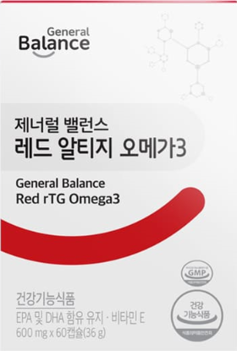
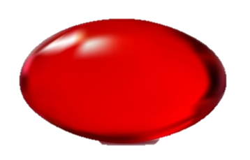
Rich in Nutrients
EPA
Helps to Support Vascular Health
Formulated with rTG omega3 which has a high bioavailability and contains a variety of nutrients.
2 Capsules a Day Helps to Support Heart Health, Vascular Health, Eye Health, and Memory.
DHA
Helps to Support Brain Health and Eye Health
VitaminE
Antioxidants
Supplementary Ingredient
Soy Lecithin
(Phospholipid)
Supplementary Ingredient
Hematococcus Pluvialis
(Astaxanthin)
[Contains EPA and DHA]
Helps to support heart health and vascular health, eye health, and memory.
[Vitamin E]
Helps to protect cells from free radicals

Slide 22
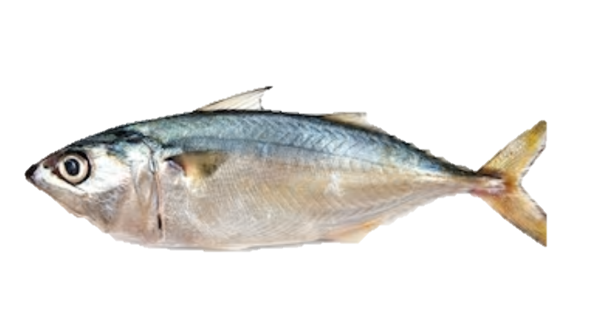
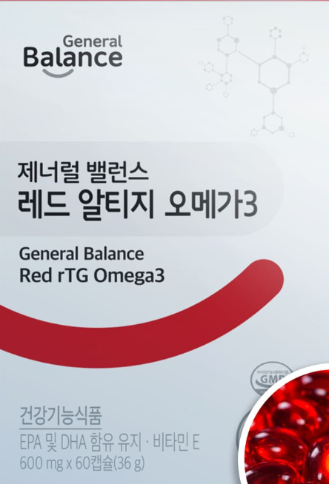
rTG Omega 3, High Bioavailability
Omega 3 is categorized into three different forms (TG, EE, and rTG) according to molecular structure. Of the three, rTG
is the most similar to the natural molecular structure of Omega 3, with less impurities and saturated fatty acids, and more unsaturated fatty acids. The purity of the ingredient is higher because it has less impurities and can be more easily absorbed and utilized by the body.
Unsaturated
Saturated
Glycerol
Ethanol
Glycerol
Unsaturated
Unsaturated
Saturated
Unsaturated
Unsaturated
TG
EE
rTG
* The information above is based on outsourced studies and may not be directly related to the products of our company.

Slide 23
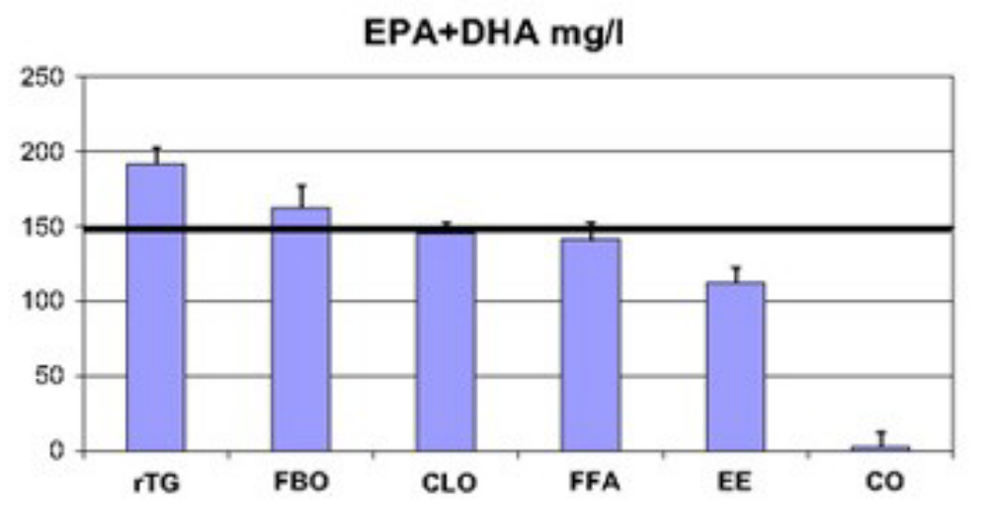
rTG Omega 3, High Bioavailability
Comparison of EPA and DHA Bioavailability
Participants: 72 healthy adults ages 21~56
Conditions: Intake for 14 days
Results: rTG was 1.7 times more bioavailable than EE
Source : Prostaglandins, leukotrienes, and essential fatty acids, September 2010; 83(3):137-141
* The information above is based on outsourced studies and may not be directly related to the products of our company.

Slide 24



General Balance Red rTG Omega 3
Contains 900mg of EPA and DHA combined per serving. Helps to support heart health and vascular health, eye health, and memory.
Helps to support heart
health and vascular health
500~2,000 mg of
EPA and DHA combined
Helps to Support Eye Health
600~1,000 mg of
EPA and DHA combined
Helps to Support Memory
900~2,000 mg of
EPA and DHA combined

Slide 25
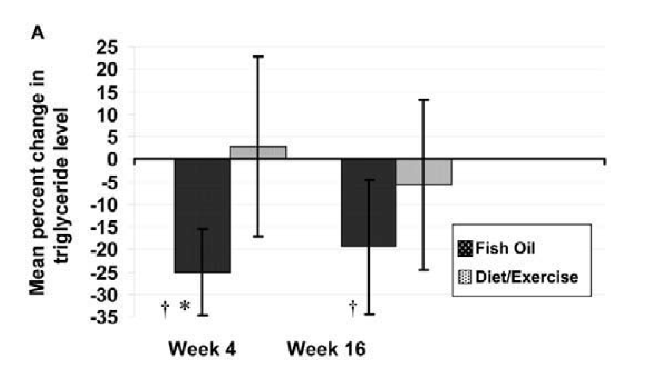
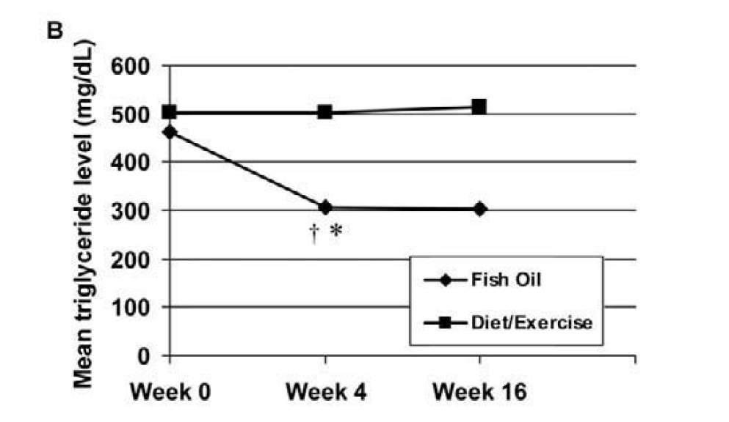
Clinical Test Results of Omega 3_ Decreased Triglyceride Levels
Decreased Triglyceride Levels
. Participants: 52 participants with over 200 mg/dL triglyceride levels (26 participants in the experimental group, participants in the control group)
. Conditions: Experimental group. Participants consume omega 3 for 16 weeks.
Results: Decreased triglyceride levels
중성지방 농도의 평균 변화율
혈중 중성지방 농도
(㎎/㎗)
(%)
Decrease after 4 weeks/ Maintained for 16 weeks
Source : Clinical Infectious Diseases, November 2005; 41(10):1498-504
* The information above is based on outsourced studies and may not be directly related to the products of our company.

Slide 26
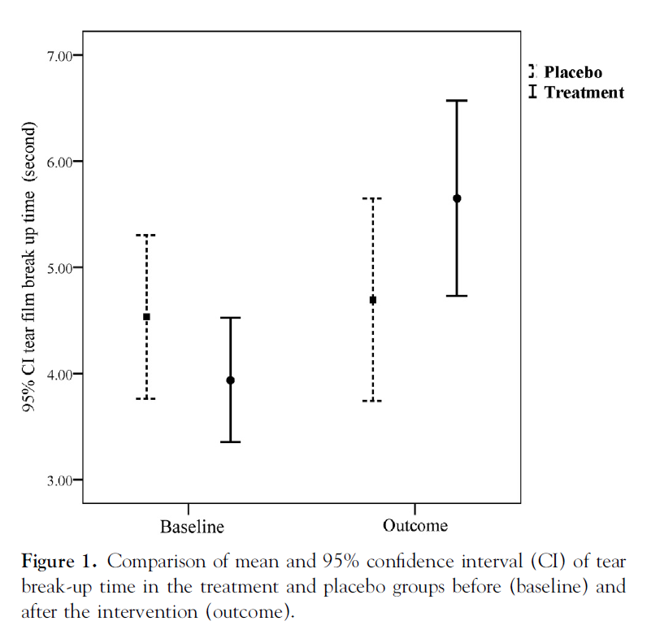
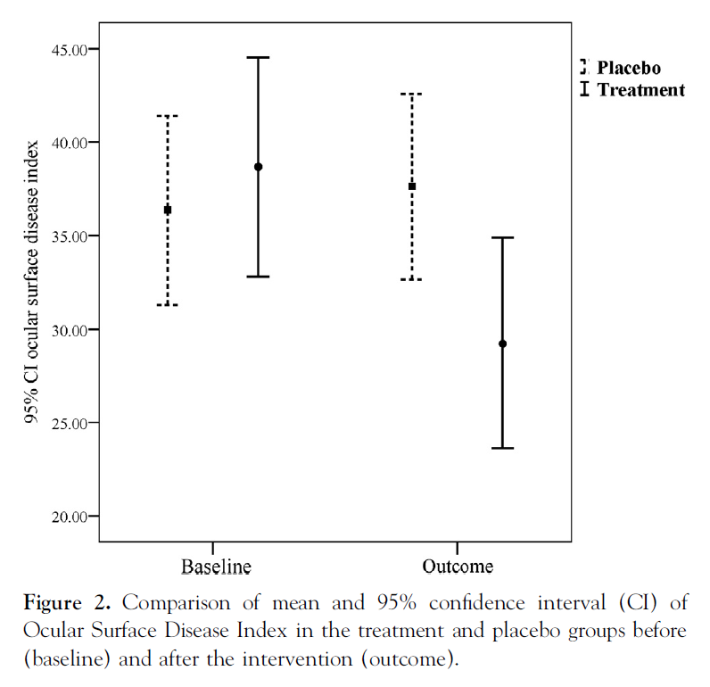
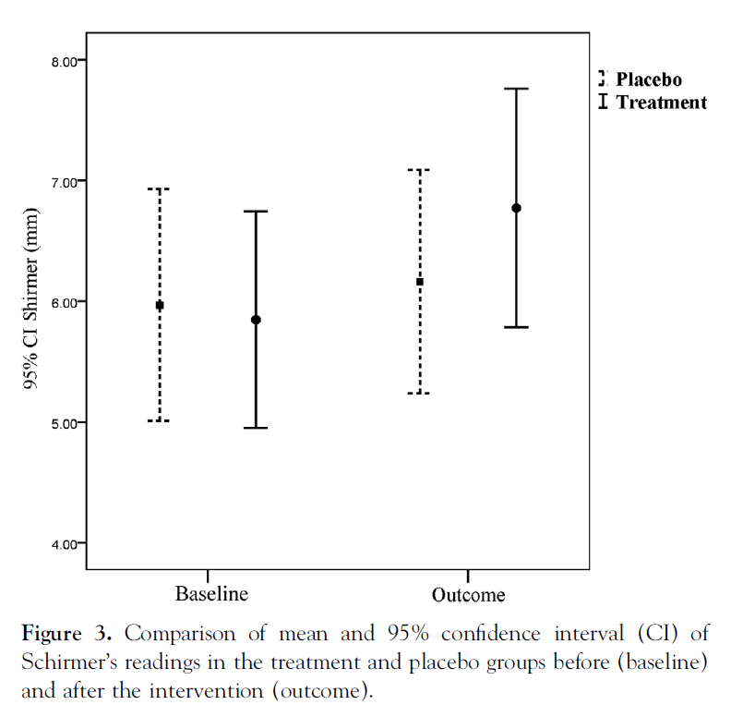
Clinical Test Results of Omega 3_ Helps to Support Eye Health
Helps to Support Eye Health
. Participants: 64 people experiencing dry eye (experimental group: 33, control group: 31)
. Conditions: Consumed 600mg of EPA and DHA for 1 month
. Results: Helped to Support Eye Health
Increased Stability of Tear Film
Improved Ocular Surface Index
Increased Tear Volume
tear break-up time [TBUT]
Ocular Surface Disease Index [OSDI]
Schirmer’s test
Source: Ophthalmology, November 2013; 120(11):2191-6
* The information above is based on outsourced studies and may not be directly related to the products of our company.

Slide 27
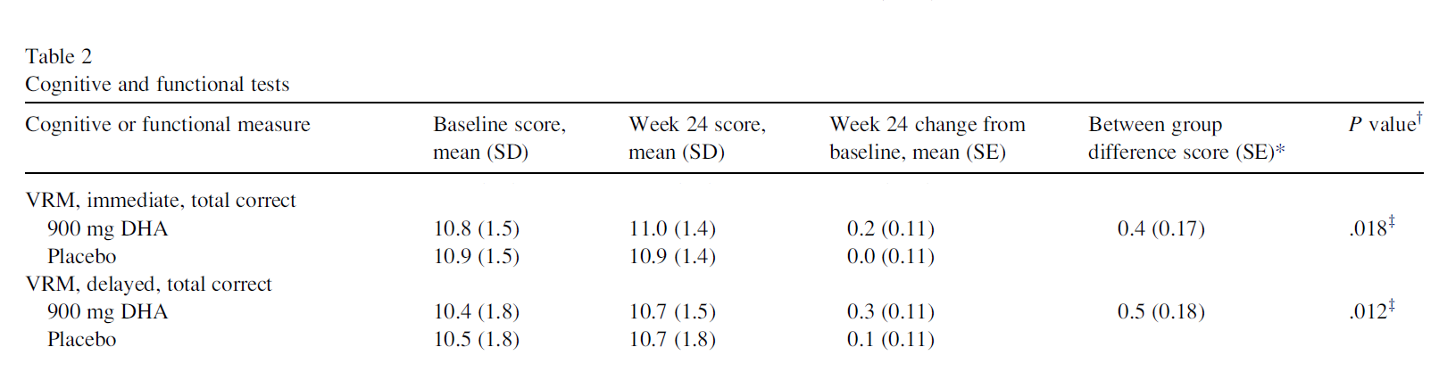
Clinical Test Results of Omega 3_ Helps to Support Memory
Helps to Support Memory
. Participants: 437 people above the age of 55 (experimental group: 219, control group: 218)
. Conditions: Consumed 900 mg/d of DHA for 24 weeks
. Results : Helps to Support Memory
* VRM(Verbal Recognition Memory)
Immediate: Immediately recalled the story presented without delay
Delayed: Recalled the story presented after a certain period of time
Source : Alzheimer’s & Dementia, November 2010; 6(6):456–464
* The information above is based on outsourced studies and may not be directly related to the products of our company.

Slide 28





Formulated with Ingredients Developed by a Renowned German Company
Achieved 5 STARS from IFOS, International Fish Oil Standards.
Certified by GOED, the Global Organization for EPA and DHA Omega-3
International Fish Oil Standards
Global Organization for EPA and DHA Omega-3
General Balance Red rTG Omega 3, is formulated with quality
ingredients developed by, KD Pharma, a renowned German
company that has been recognized for quality through various
international certifications.
Use of ingredients approved by FOS, Friend of the Sea an International Environmental Organization
Certified Halal, which refers to food items that are permissible to consume under Sharia law.
Friend of the Sea
HALAL

Slide 29

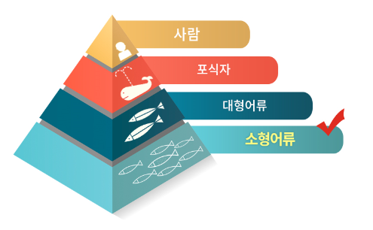
Formulated with Ingredients Developed by a Renowned German Company
Over 80% Purity
Extracted From Small Fish (Anchovies, Sardines)
KD Pharma produces Red rTG Omega3 that has above 80% purity. General Balance Red rTG contains 540mg
of EPA and 360mg of DHA for a total of 900mg per
serving.
Ingredients are extracted from small fish that are on the lowest end of the food chain and fish that have been tested for heavy metals or other contaminants.
EPA
540 mg
Risk of heavy Metal Poisoning
High
DHA
360 mg
Low

Slide 30
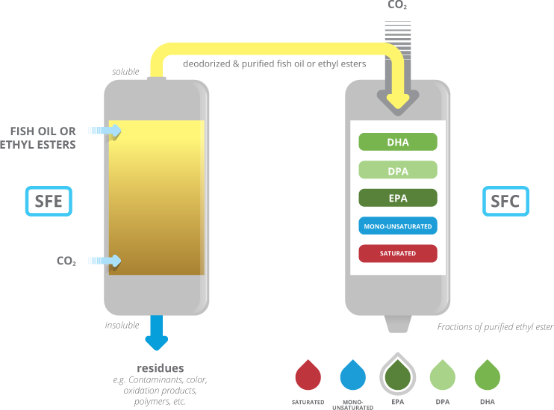
Formulated with Ingredients Developed by a Renowned German Company
Exclusive Extraction Methods
KD Pharma's exclusive, patented extraction methods (SFE, Supercritical Fluid Extraction and SFC, Supercritical Fluid Chromatography) are used for pure, high quality omega 3.
Purified Fish Oil
Extraction
Refinement
SFE (Supercritical Fluid Extraction)
Extraction method using Carbon Dioxide and low temperatures (no
higher than 50 degrees).
Extraction method does not use
nucleic acid (no chemical solvents)
There is low risk of altering or
destroying the heat sensitive
molecular structure of Omega 3
and or residual chemical solvents
(nucleic acid)
SFC(Supercritical Fluid Chromatography)
EPA and DHA are separated and concentrated
Critical refining process that purifies
the fish oil and removes heavy metals
and contaminants

Slide 31
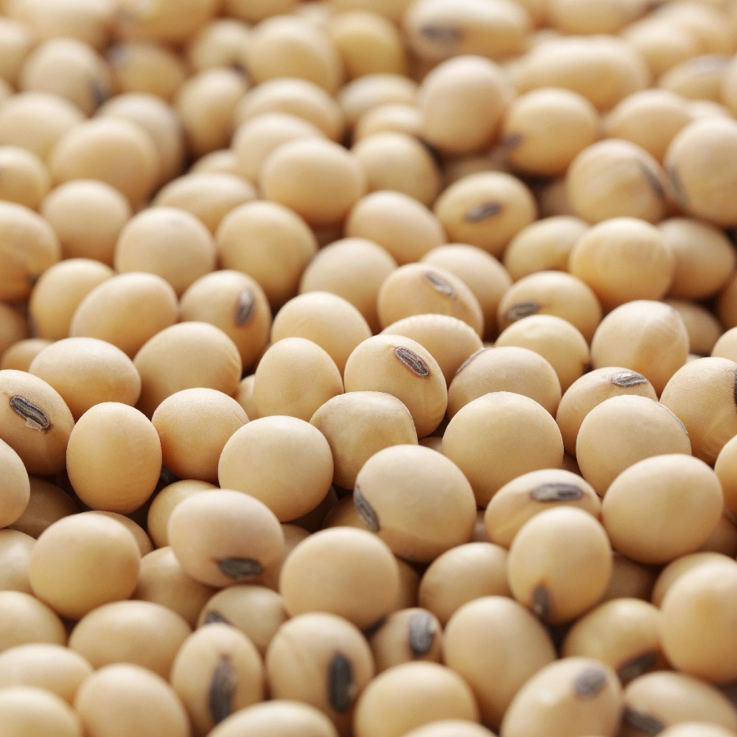
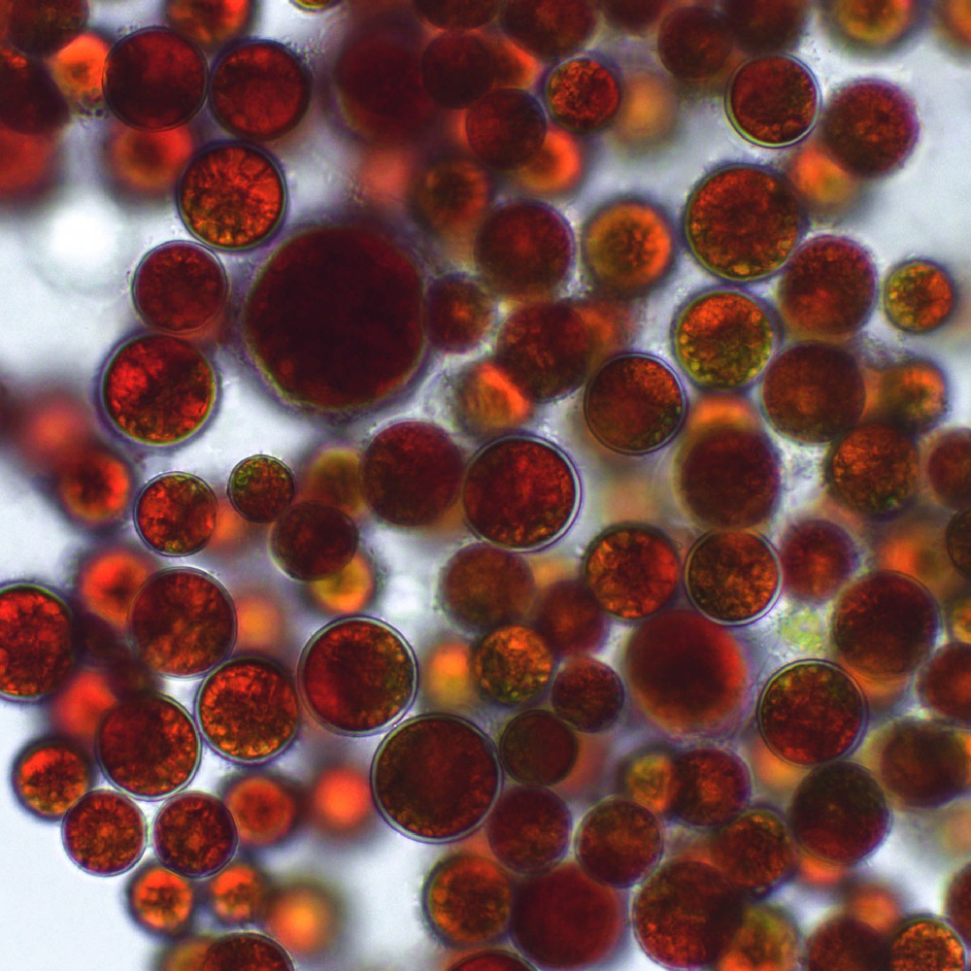
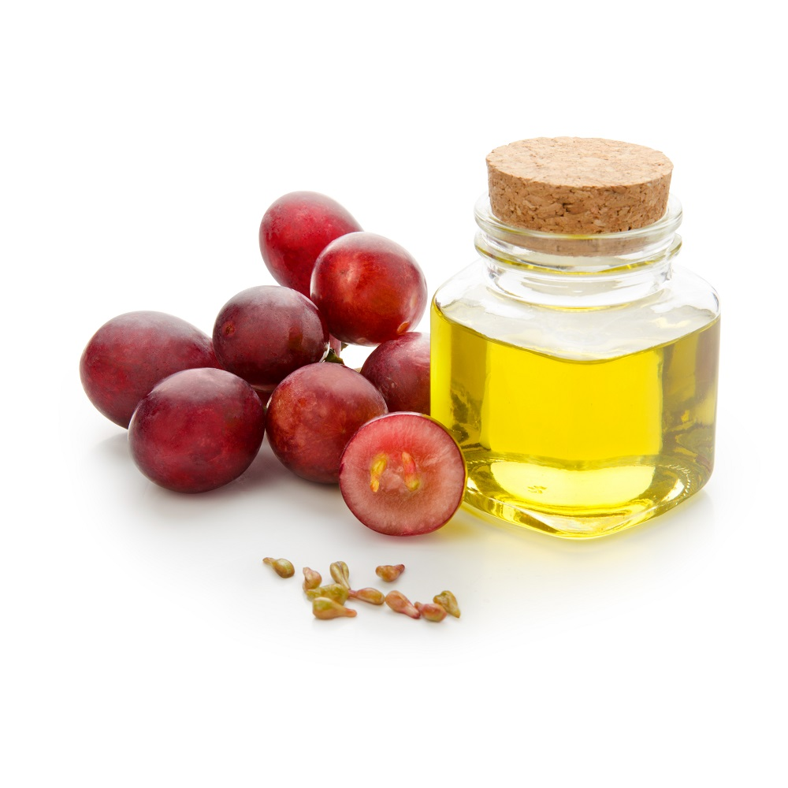
Contains Carefully Selected Supplementary Ingredients
Soy Lecithin
Has a phospholipid structure with strong emulsification properties.
Phospholipids are both hydrophilic and lipophilic, which means they are soluble in water and oil. This helps them absorb quickly and they help to dissolve triglycerides hidden in the blood vessels and eliminate them via urine or sweat.
Hematococcus Pluvialis
Type of micro algae found in seas, lakes and snowy fields in the arctic regions.
Hematococcus is rich in astaxanthin, a powerful antioxidant.
Astaxanthin helps to protect cells from free radicals and oxidation.
Grapeseed Oil
An excellent source of fatty acids such as linolenic acid, oleic acid, stearic acid, and palmitic acid, as well as antioxidant substances such as tocopherol and catechin.
Limited to Ingredient Characteristics
* The information above is based on outsourced studies and may not be directly related to the products of our company.

Slide 32
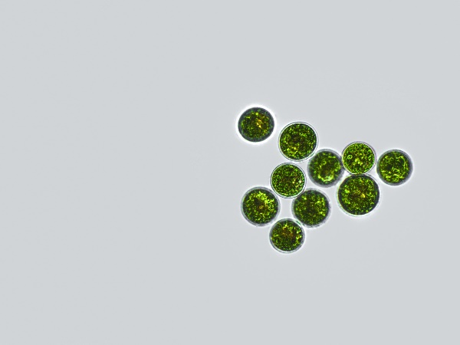
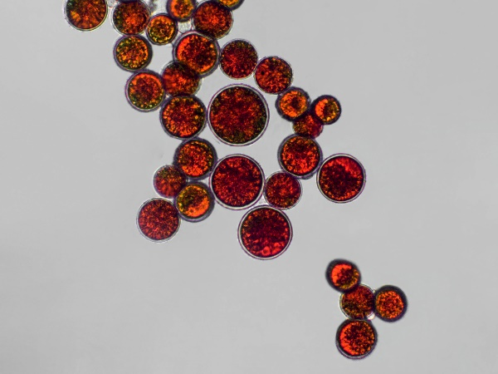
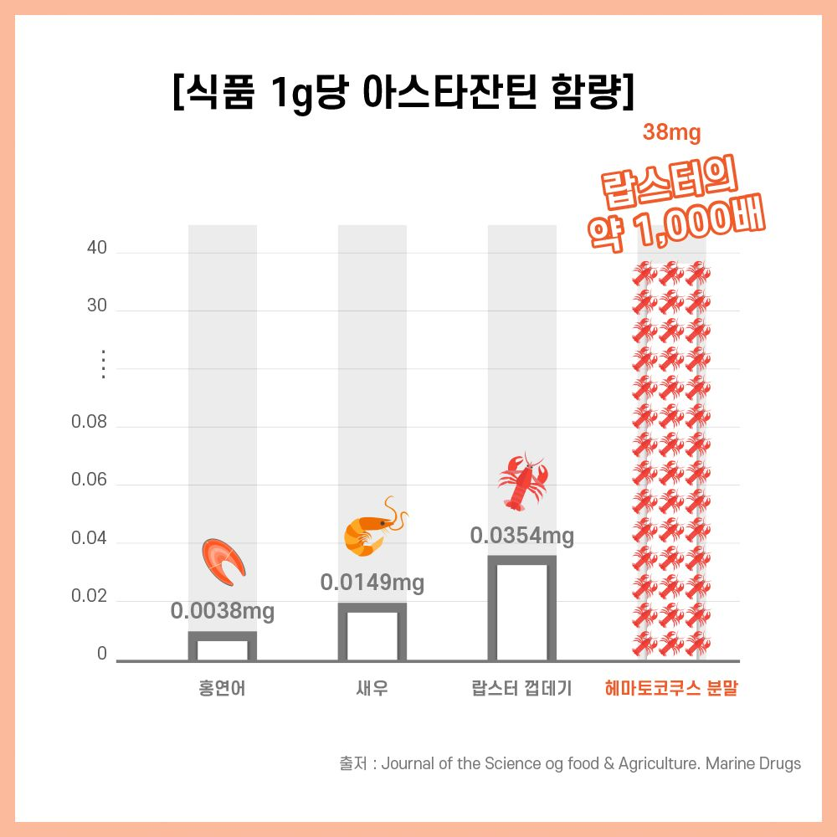
Hematococcus and Astaxanthin
What is Hematococcus?
Hematococcus is a type of micro algae found in seas, lakes and snowy fields in the arctic regions. While it is usually green in color, when it undergoes environmental changes, such as increases in
water temperature, excessive sunlight, increases in salt concentration, or decreases in essential nutrients, it releases astaxanthin which is red.
Astaxanthin content per 1 g
Shrimp, salmon and lobster only contaon 0.003-0.03 mg od astaxanthinper gram, but hematococcus contains 38 mg of astaxanthin per gram. Astaxanthin is an ingredient that is difficult to consume regularly through food, so it is helpful to consume it through supplements.
* The information above is based on outsourced studies and may not be directly related to the products of our company.

Slide 33
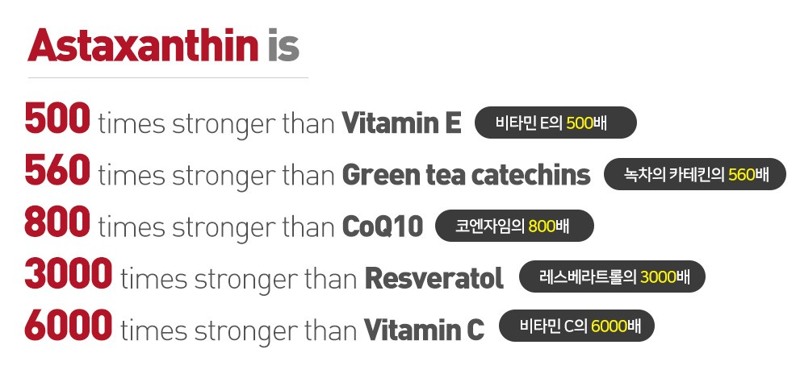
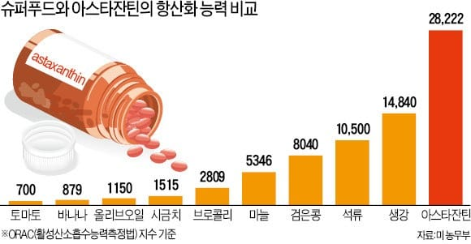
Hematococcus and Astaxanthin
Astaxanthin, a Powerful Antioxidant
Aztaxanthin is a powerful antioxidant that is 550 times more potent than vitamin E. According to the U.S. Department of Agriculture, astaxanthin is 6,000 times more effective as an
antioxidant than vitamin C, 800 times that of coenzyme Q10, and 560 times that of green tea catechins.
자료:미 농무부
* The information above is based on outsourced studies and may not be directly related to the products of our company.

Slide 34
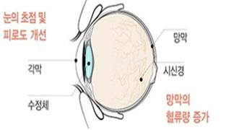
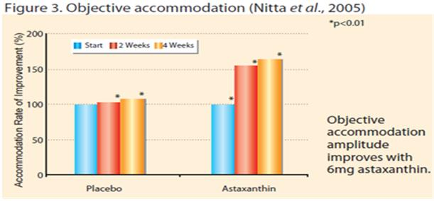
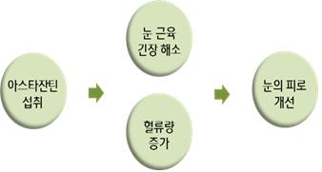
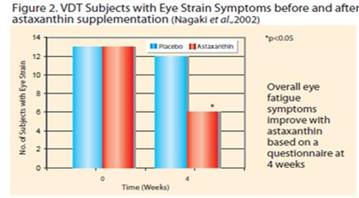
Hematococcus and Astaxanthin
Eye Focus Control
Astaxanthin, Helps to Support Eye Health
Clinical trial results showed that after 2 weeks of astaxanthin consumption, the ‘change rate in eye
focus control,’ an index for improving eye fatigue, increased by 56%.
In addition, a Japanese study, in which 40 subjects with eye fatigue were divided into two groups and only one group consumed 6 mg of astaxanthin per day for 4 weeks, the group that consumed astaxanthin had ``retinal capillary blood flow increased by 9% in the right eye, 10.7% in the left eye”. Based on this scientific data, astaxanthin was recognized by the Ministry of Food and Drug Safety (South Korea) as a “health functional food that helps support eye health”.
Retinal Capillary blood Flow
* The information above is based on outsourced studies and may not be directly related to the products of our company.

Slide 35
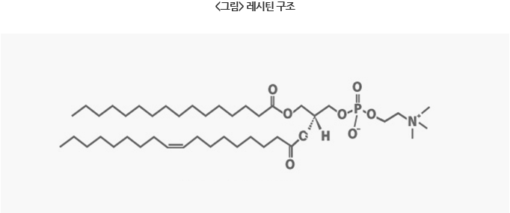
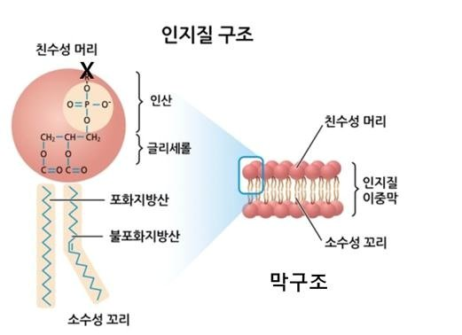
Soy Lecithin and Phospholipids
What are Phospholipids?
Soy lecithin refers to lecithin derived from soybeans.
Soy lecithin contains a variety of phospholipids such as phosphatidylcholine, phosphatidylethanolamine and phosphatidylinositol.
Phospholipids are both hydrophilic and lipophilic, which means they are soluble in water and oil. This helps them absorb quickly and they help to dissolve triglycerides hidden in the blood vessels and eliminate them via urine or sweat.
* The information above is based on outsourced studies and may not be directly related to the products of our company.

Slide 36
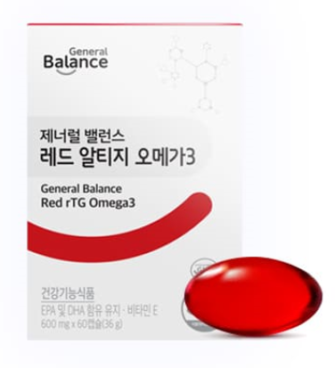
Vegetarian Capsules_
Vegetarian capsules made from red algae and corn. Does not contain gelatin or animal products.
Free of
Beef Gelatin
無
Free of
Artificial Flavors
Free of
Pork Gelatin
無
Free of
Coloring Agents
Free of
無
Fish Gelatin

Slide 37



Directions and Recommended For
Recommended For
Those who want to support heart health
Those who want to support eye health
Those who want to support memory functions
Those who consume meat and or instant foods often
Those who have irregular or unbalanced diets
Those who want a quality Omega3 supplement
Storage
Store in a cool dry
place away from
direct sunlight and
humidity. Keep out of reach of children.
Serving Size
Take two capsules once a day with water.
Directions
Take after lunch
or dinner
※ Please note that if the capsules are exposed to light, red capsule color may change.

Slide 38
Rich in Nutrients
EPA
Helps to Support Vascular Health
Formulated with rTG omega3 which has a high bioavailability and contains a variety of nutrients.
2 Capsules a Day Helps to Support Heart Health, Vascular Health, Eye Health, and Memory.
DHA
Helps to Support Brain Health and Eye Health
VitaminE
Antioxidants
Supplementary Ingredient
Soy Lecithin
(Phospholipid)
Supplementary Ingredient
Hematococcus Pluvialis
(Astaxanthin)
[Contains EPA and DHA]
Helps to support heart health and vascular health, eye health, and memory.
[Vitamin E]
Helps to protect cells from free radicals

Slide 39
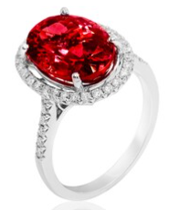
Support Heart Health and Vascular Health with rTG Omega 3!

Slide 40
We are
GCoopers!

Slide 41

Thank You.

