Slide 1

Mega Vitamin C

Slide 2

Mega Vitamin C
1
2
3
Product Details
Product Features
Main Ingredients
4
5
6
Recommended For
Precautions
Why Our Vitamin C is Different
* This document is meant for internal training purposes only. Unauthorized use of this document is strictly prohibited.

Slide 3
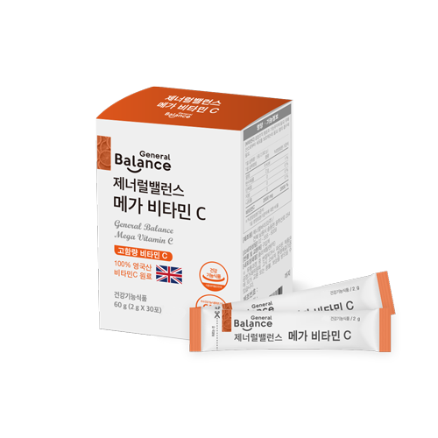
1
Product Details
+ Product Type : Dietary Supplement(High Vitamin C Content)
+ Content : 60g (2g X 30 packets)
+ Ingredients and Content : Vitamin C 99.9%, Ascorbyl palmitate 0.1%
+ Function: Necessary for bodily function
antioxidant properties/ necessary for absorbing iron
+ Daily Dose : Once a day take 1 packet with water.
- We recommend taking this product after a meal.
*Precautions :
Take this product after a meal as it can cause gastric disorders when taken on an empty stomach.
If you have a chronic illness, or are taking prescription medication, consult your doctor before using this product. If you have any allergies, be sure to read the list of ingredients before using this product.

Slide 4
2
Product Features
+ Each packet contains 2000mg of Vitamin C
+ 100% Vitamin C sourced from the UK (DSM)
+ Vitamin C formulated in crystalline powder form to ensure that it is quickly and easily absorbed
+ Does NOT contain additives such as Silicon dioxide, Magnesium stearate , HPMC
+ Dietary Supplement produced by a GMP certified / ISO 22000 certified manufacturing company.

Slide 5
+ Vitamin C : 100% sourced from the UK
3
Main Ingredients
+ 1 packet contains 2,000mg, of high quality Vitamin C
+ Crystalline Powder type formulations
+ A necessary nutrient for bodily function
+ A necessary nutrient to absorb nutrients such as Iron
+ Antioxidant properties
+ Globally, vitamin C ingredients are only available in the UK and China. The General Balance Megavitamin C uses 100% Vitamin C from DSM UK.
+ Pertains to the characteristics of the raw materials

Slide 6
3
+ 100% Vitamin C sourced from the UK
Main Ingredients
* Vitamin C from DSM UK has been sold to the world for over 80 years since it was first produced in 1934 and is an excellent vitamin C ingredient that has been recognized for its reliability and stability.
Vitamin C from natural harvested corn - Vitamin C from DSM UK is sourced from corn through fermentation, concentration and purification processes.
+ Pertains to the characteristics of the raw materials

Slide 7
※ Recommended For
5
1
2
Recommended For
For those who need an extra boost
For those experiencing fatigue
3
For those with a Vitamin C deficiency
5
4
For those who do not incorporate enough fruits and vegetables into their diet
For those who do not have a balanced diet

Slide 8
6
※ Precautions(Must read before using this product)
Precautions
!
Those who have high or excessive amounts of Iron
May cause Kidney Disease for those taking the prescription drug paracetamol
When ingested on an empty stomach, may cause gastric disorders
!
!

Slide 9
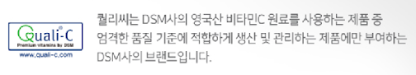
퀄리-씨
7
+ Quali C
Why our Vitamin C is different
DSM, which supplies raw materials from the UK, is a world-class supplier of Vitamin C, which is regarded as superior in terms of stability, by operating a quality certification system (QUALI-C) that meets various quality standards and environmental standards around the world.

