Slide 1
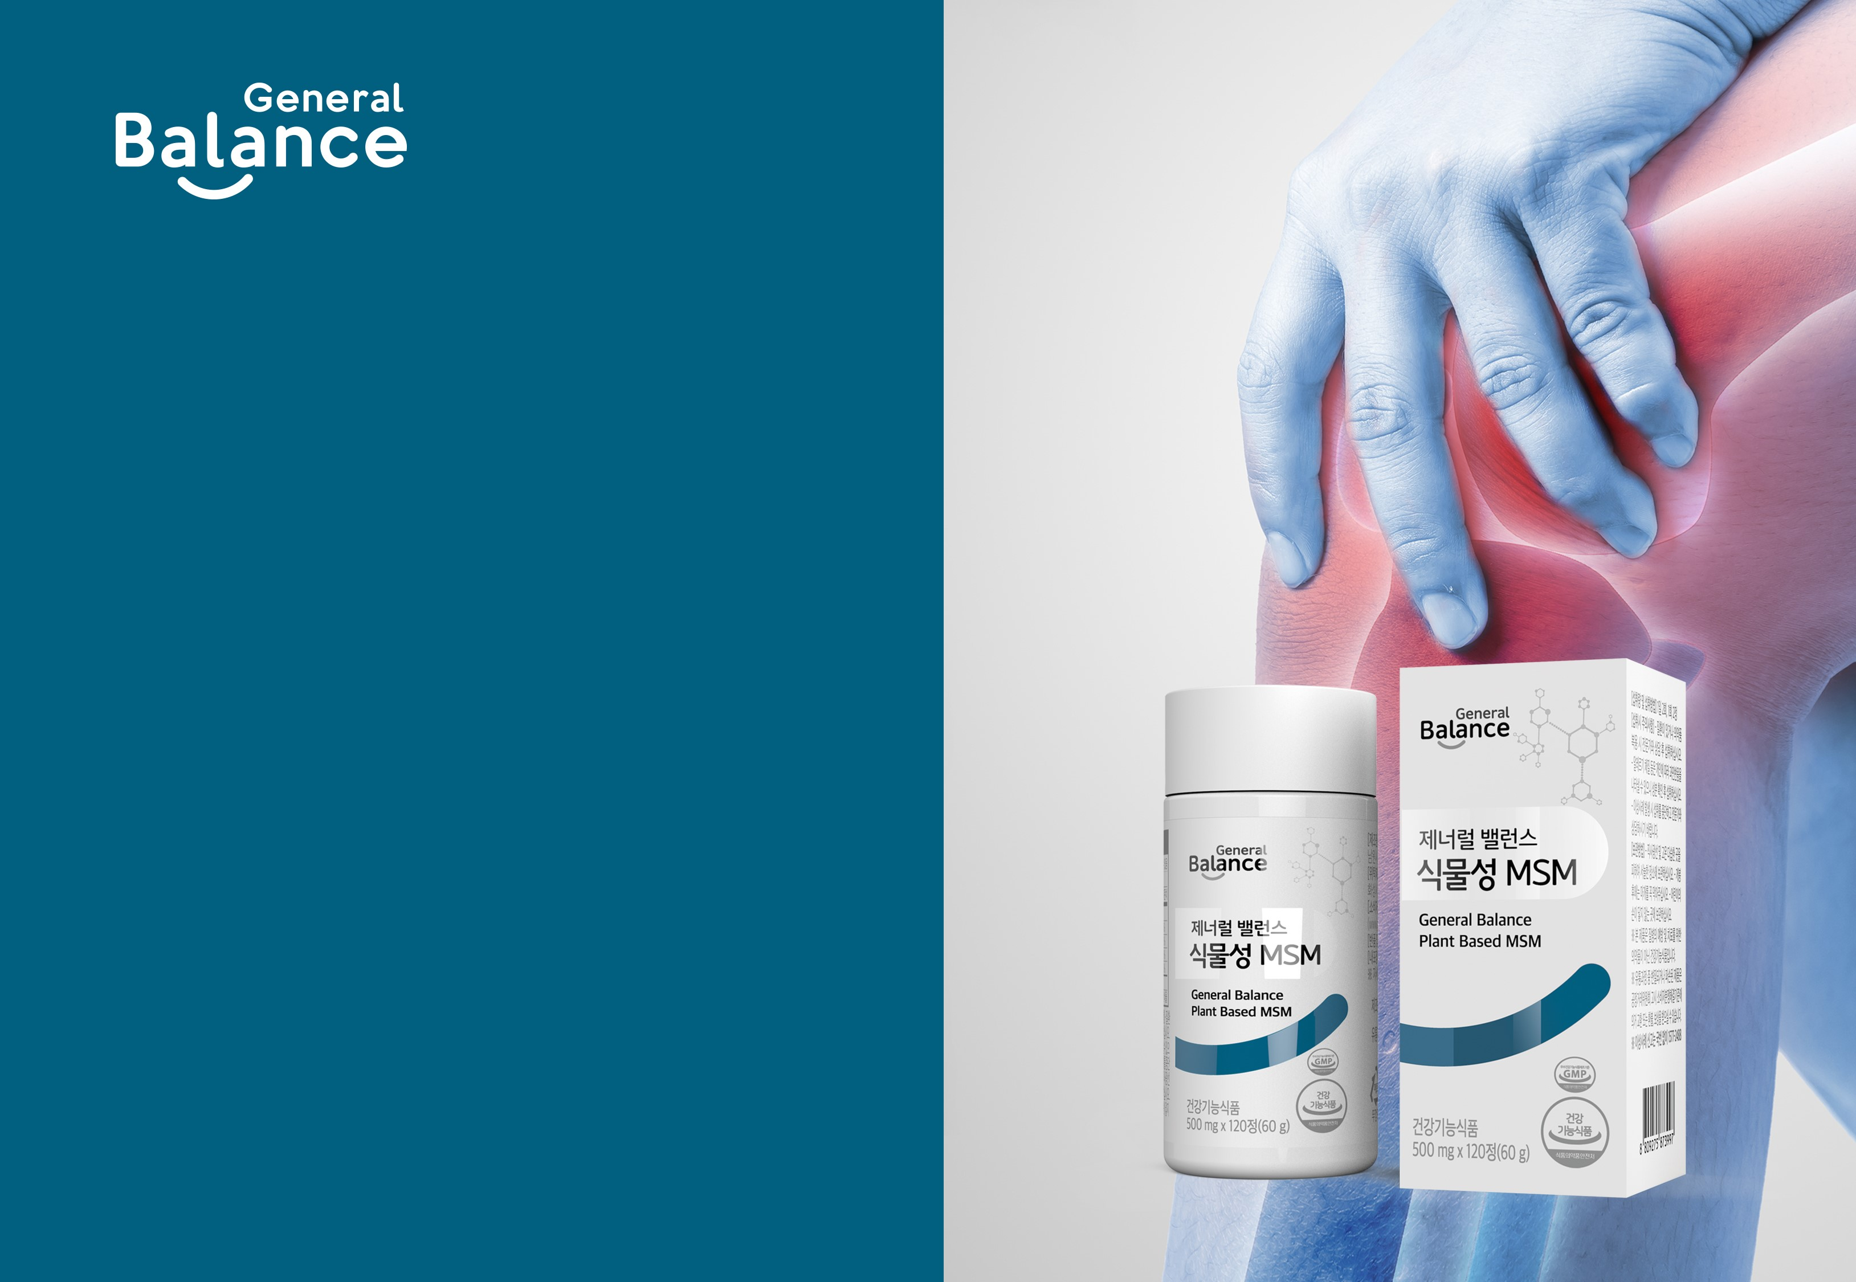
General Balance Plant Based MSM

Slide 2

Advertising Laws Regarding Dietary Supplements
GCOOP strives to ensure that members are not mislead through unlawful or deceptive advertising methods.
We ask for your cooperation in this matter. Please refer to the guidance below to avoid unlawful or deceptive advertising methods.
Labels or advertisements that may be perceived as effective in the prevention or treatment of disease.
Labels or advertisements that may mislead consumers to recognize foods or dietary supplements as drugs.
Labels or advertisements that may mislead consumers to recognize products that are not dietary supplements as dietary supple-ments.
False or exaggerated statements and or signage/markings/logos.
Misleading statements and or signage/markings/logos.
Advertising against other companies or their products.
Unfairly comparing one’s own products against another sales force member or their products without objective factual evidence.
Using unlawful or deceptive representations to encourage and solicit consumers and or using obscene language that significantly infringes public morals or social ethics.
Advertising methods that are noncompliant to or in violation of regulations for business participants (manufacturing facilities, expiration dates, encouraging unethical methods)
[Source] MFDS Policy Info “Food Advertising Guideline”

Slide 3
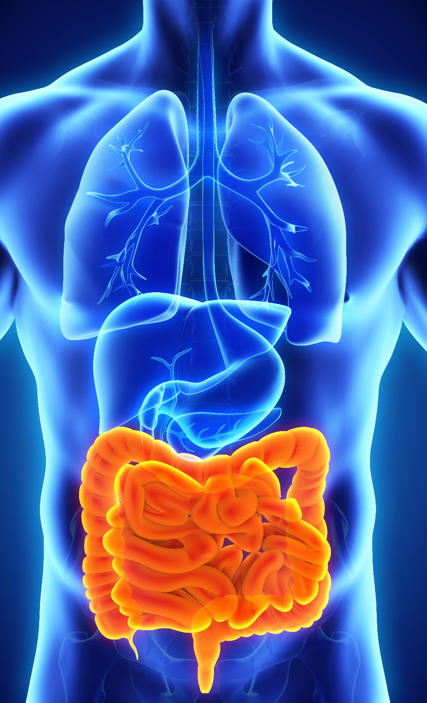
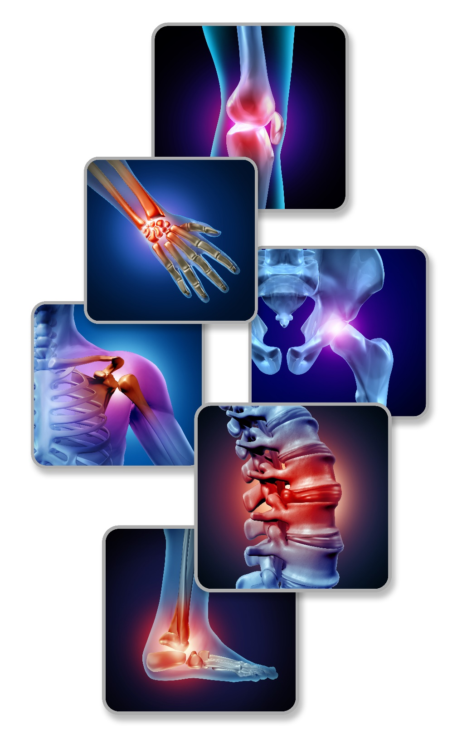
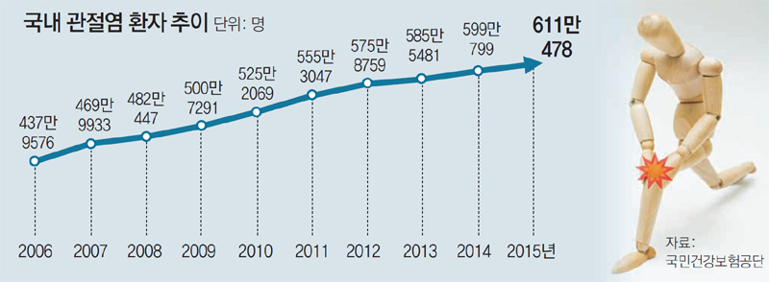
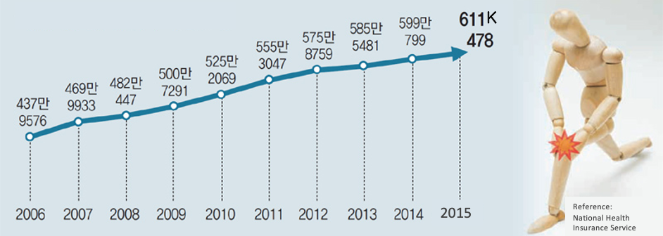
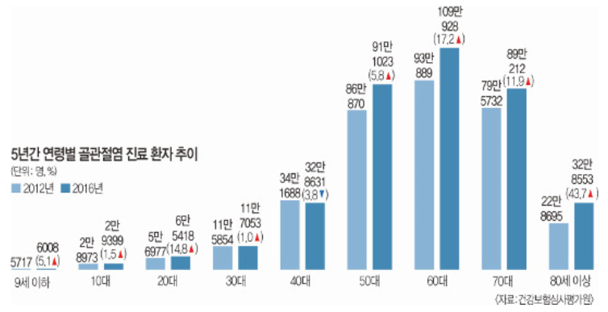
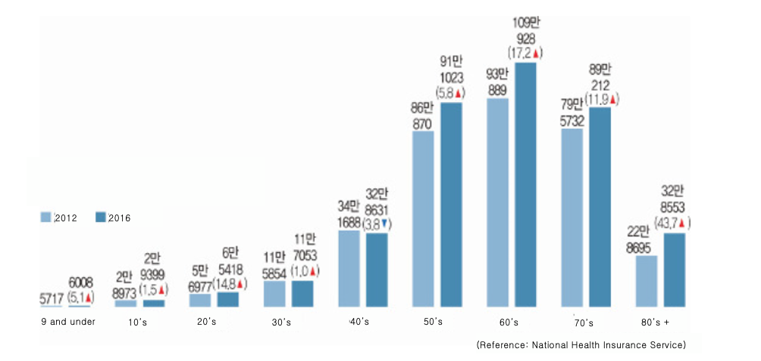
Health Information
[Arthritis Patient Trends in South Korea]
The number of patients with arthritis in South Korea has increased by 40% over 10 years, and in 2015 it reached a total of 611,478 people. Approximately 1 in 8 suffers from arthritis.
[Osteoarthritis Patient Trends by Age for 5 Years]
According to the Health Insurance Review and Assessment Service, patients in their 60s showed the highest distribution among the patients who received osteoarthritis treatment in 2016 with 1.1 million patients. As compared to 2012 the growth rate was 43.7% for those 80 years of age or more, 17.2% for patients in their 60’s and patients in their 20’s increased from 56,977 to 65,418 resulting in an 14.8% increase. These growth rates are much higher than the growth rate of teenage patients (1.5%) as well as patients in their 30’s (1.0%).
* The information above is based on outsourced studies and may not be directly related to the products of our company.

Slide 4
Health Information
1. What are Healthy Joints?
Joints are connections between the bones and are surrounded by cartilage. Healthy joints include healthy undamaged cartilage that surround and protect the joints and have smooth movements.
2. Why Joint Health is Important
As the body ages cartilage becomes worn down, and obesity or excessive movement may affect the joints and lead to problems in the joints or cartilage. In these cases, many experience stiffness, pressure and swelling and cause pain and inconvenience during normal daily activities such as walking or even when there is no movement. Depending on the severity of the condition it may lead to death and therefore it is essential to maintain healthy joints and cartilage.
* The information above is based on outsourced studies and may not be directly related to the products of our company.

Slide 5
Health Information
3. Causes That Damage Joints and Cartilage
Aging
Malnour-ishment
Excessive exercise or obesity
Excessive smoking and drinking
Intense stress and fatigue
4. Ways to Maintain Healthy Joints and Cartilage
In order to maintain healthy joints and cartilage vitamin, minerals, magnesium, and calcium must be sufficiently provided through food or supplements.
Consistent exercise that strengthen the muscles surrounding the joints helps to maintain healthy joint function.
Taking supplements such as MSM that help to support healthy joints and cartilage help to maintain healthy joints and cartilage.
* The information above is based on outsourced studies and may not be directly related to the products of our company.

Slide 6
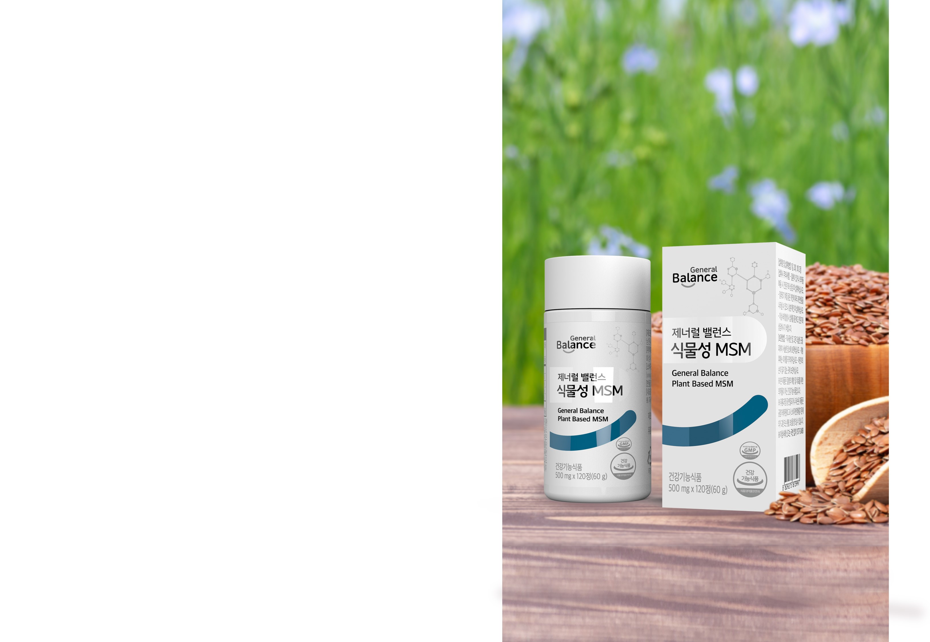
Product Overview
+ Product Name: General Balance Plant Based MSM
+ Product Type: Dietary Supplement
+ Net Quantity : 500 mg x 120 Tablets (60 g)
+ Ingredients: High Quality 100% Pure MSM
(Sourced from Canada)
+ Directions: Take 2 tablets twice a day with water.
Precautions
- Infants, toddlers, children, those pregnant or nursing must take caution when using this product.
- If you have any illness or are taking prescription medication, consult with a physician prior to using this product.
If you have any allergies, please read all ingredients thoroughly prior to using this product.
Stop using this product immediately, if you experience any abnormal reactions and consult with your physician.
- Do not use past expiration date.
- Do not ingest the desiccant.

Slide 7
Product Features
1. Produced using DistilPure MSM sourced in Canada
2. Contains 100% Pure MSM
3. MSM Clinical Test Results
4. No Additives

Slide 8
Featured Ingredients
What is MSM?
MSM (Methyl Sulfonyl Methane) is a source of the essential mineral sulfur. It is a vital substance that is necessary for the creation of cartilage and ligament tissue in joints as well as maintaining normal function and structure of the body.
2. The Role of Sulfur
Sulfur is an essential nutrient for normal bodily function and the third most abundant mineral in the body.
Has an essential role as it helps to form and maintain major bodily structures such as joints, cartilage, skin, hair and nails.
Natural Sulfur
34.0%
Carbon (C)
26%
DistilPure
MSM
Oxygen (O)
34%
TM
Hydrogen (H)
6.0%
* The information above is based on outsourced studies and may not be directly related to the products of our company.

Slide 9
Featured Ingredients
3. Recommended Daily Serving Size
Recommended Daily Serving Size According to Korea Ministry of Food and Drug Safety (MFDS)
1,500 mg or more
Average Daily Intake of Sulfur
Less than 50 mg
Approximately 1,450 mg of sulfur is lacking daily and needs to be supplemented!
4. Causes of Sulfur Deficiency
Sulfur content becomes depleted as it is used to remove harmful substances, such as environmental hormones and heavy metals, that have accumulated in the body.
Sulfur loss occurs during storage, heating and cooking of foods.
Sulfur found in nature has lower absorption rates causing it to be inevitably lacking.
* The information above is based on outsourced studies and may not be directly related to the products of our company.

Slide 10
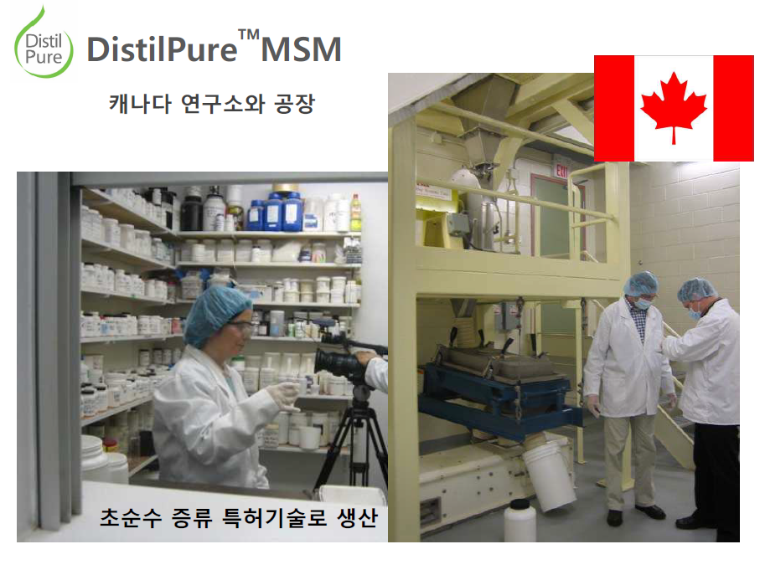
Featured Ingredients
DistilPure MSM Sourced from Canada
DistilPure is a global brand that extracts pure plant-based MSM. DistilPure MSM is extracted from natural plants (corn, flaxseed, soybeans) and is as of yet the first and only plant based MSM recognized by the Korea Ministry of Food and Drug Safety (MFDS).
Research and Manufacturing Facility Located in Canada
Produced using patented ultra pure distillation method.

Slide 11
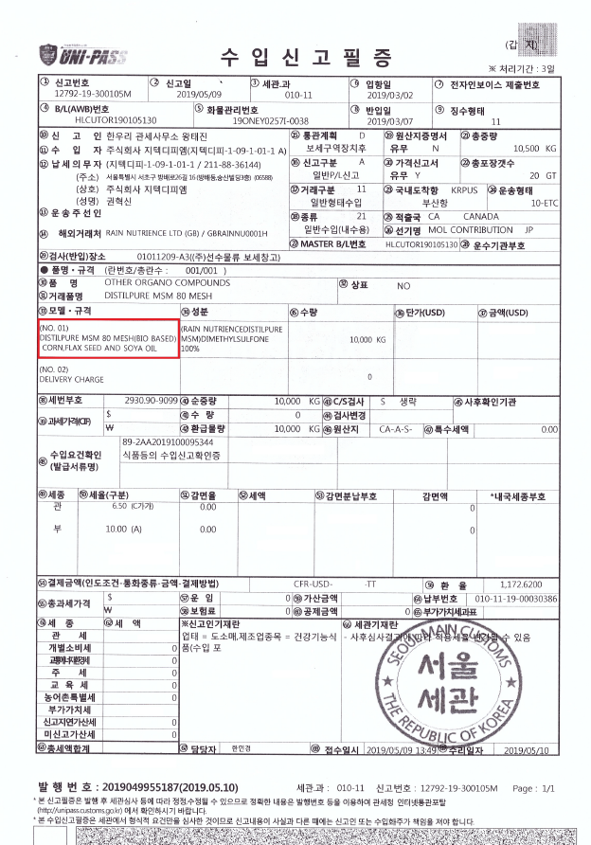
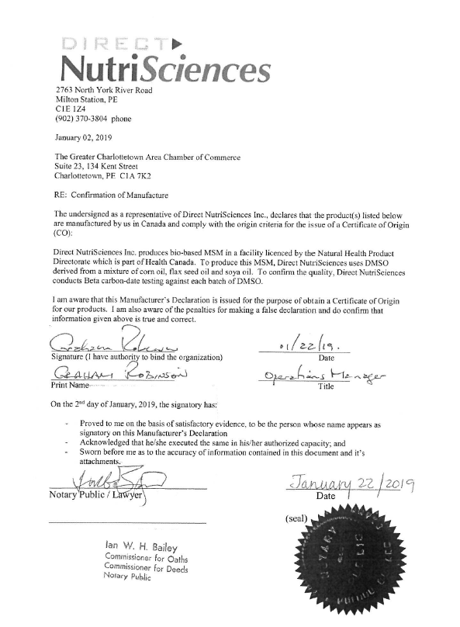
Ingredient Certifications
DistilPure MSM Sourced From Canada
[Import Declaration Certificate]
[Government Certificate]

Slide 12
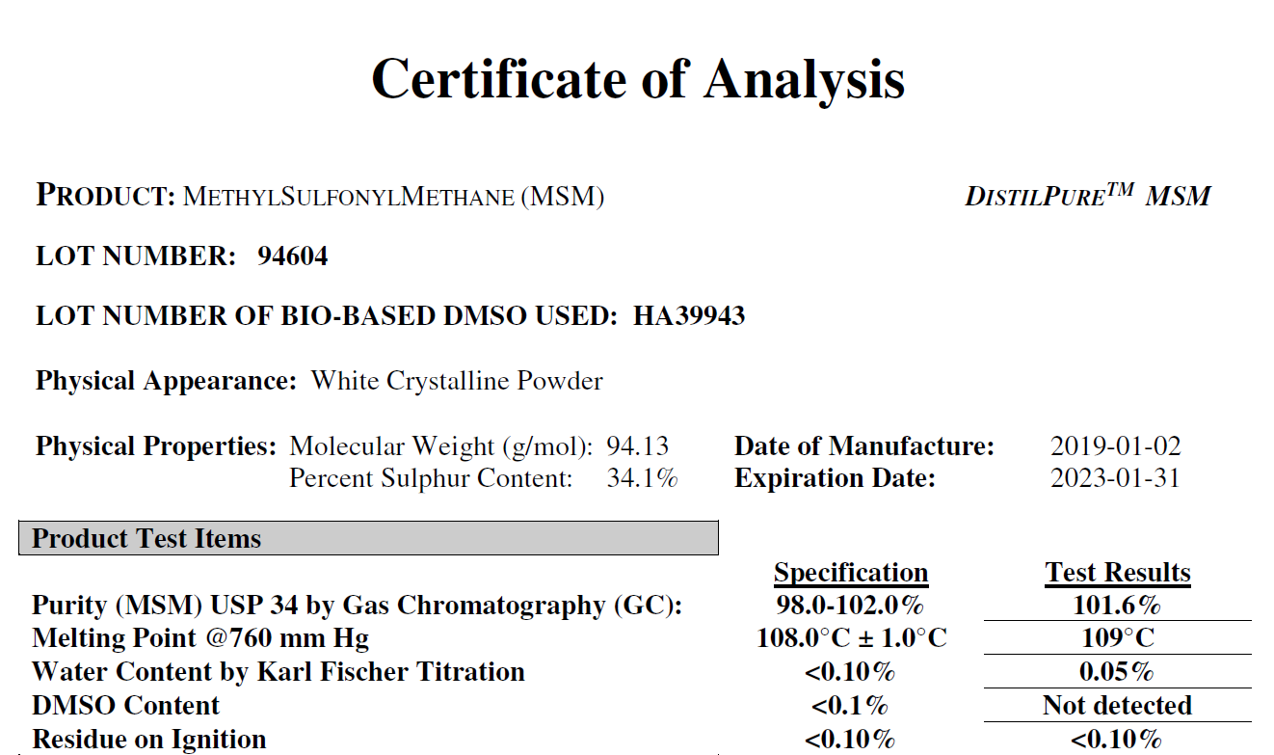
Featured Ingredients
Contains 100% Pure MSM
DistilPure MSM is a premium highly pure ingredient that is extracted using the industry’s most advanced patented distillation technology.

Slide 13
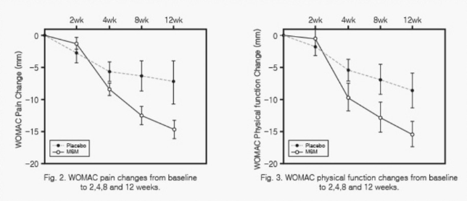
Featured Ingredients
MSM Clinical Testing Results
49 Adult men and women experiencing knee joint discomfort received 3.375g of MSM everyday for 12 weeks resulting in decreased joint pain and discomfort.
WOMAC(Western Ontario and McMaster Osteoarthritis Index): widely used, proprietary set of
standardized questionnaires used by health professionals to evaluate the condition of patients with
osteoarthritis of the knee and hip, including pain, stiffness, and physical functioning of the joints.
Participants: 49 Adult men and women between the ages of 45 and 90 with knee joint discomfort were given, 3.375 g of MSM per day.
Conditions: 25 were placed in a placebo control group, and 25 were placed in the testing group in a randomized, double blind, controlled clinical trial with assessments at baseline, 6 weeks and 12 weeks.
Results: After 6 weeks of ingesting MSM, joint stiffness and motor function were beginning to significantly improve. After 12 weeks, knee discomfort, pain, stiffness and function were improved, as well as quality of life. * Test results do not apply equally to everyone.
[Source] Efficacy of methylsulfonylmethane supplementation on osteoarthritis of the knee: a randomized controlled study
(BMC Complementary and Alternative Medicine 2011, 11:50)
* The information above is based on outsourced studies and may not be directly related to the products of our company.

Slide 14
Featured Ingredients
No Additives
Produced without using chemical excipients (silicon dioxide, magnesium stearate and hydroxypropyl methylcellulose) that are used for production efficiency or product stabilization, as well as artificial flavorings or coloring agents.
Silicon
Dioxide
Magnesium
Stearate
HPMC
Artificial
Flavorings
Coloring
Agents

Slide 15
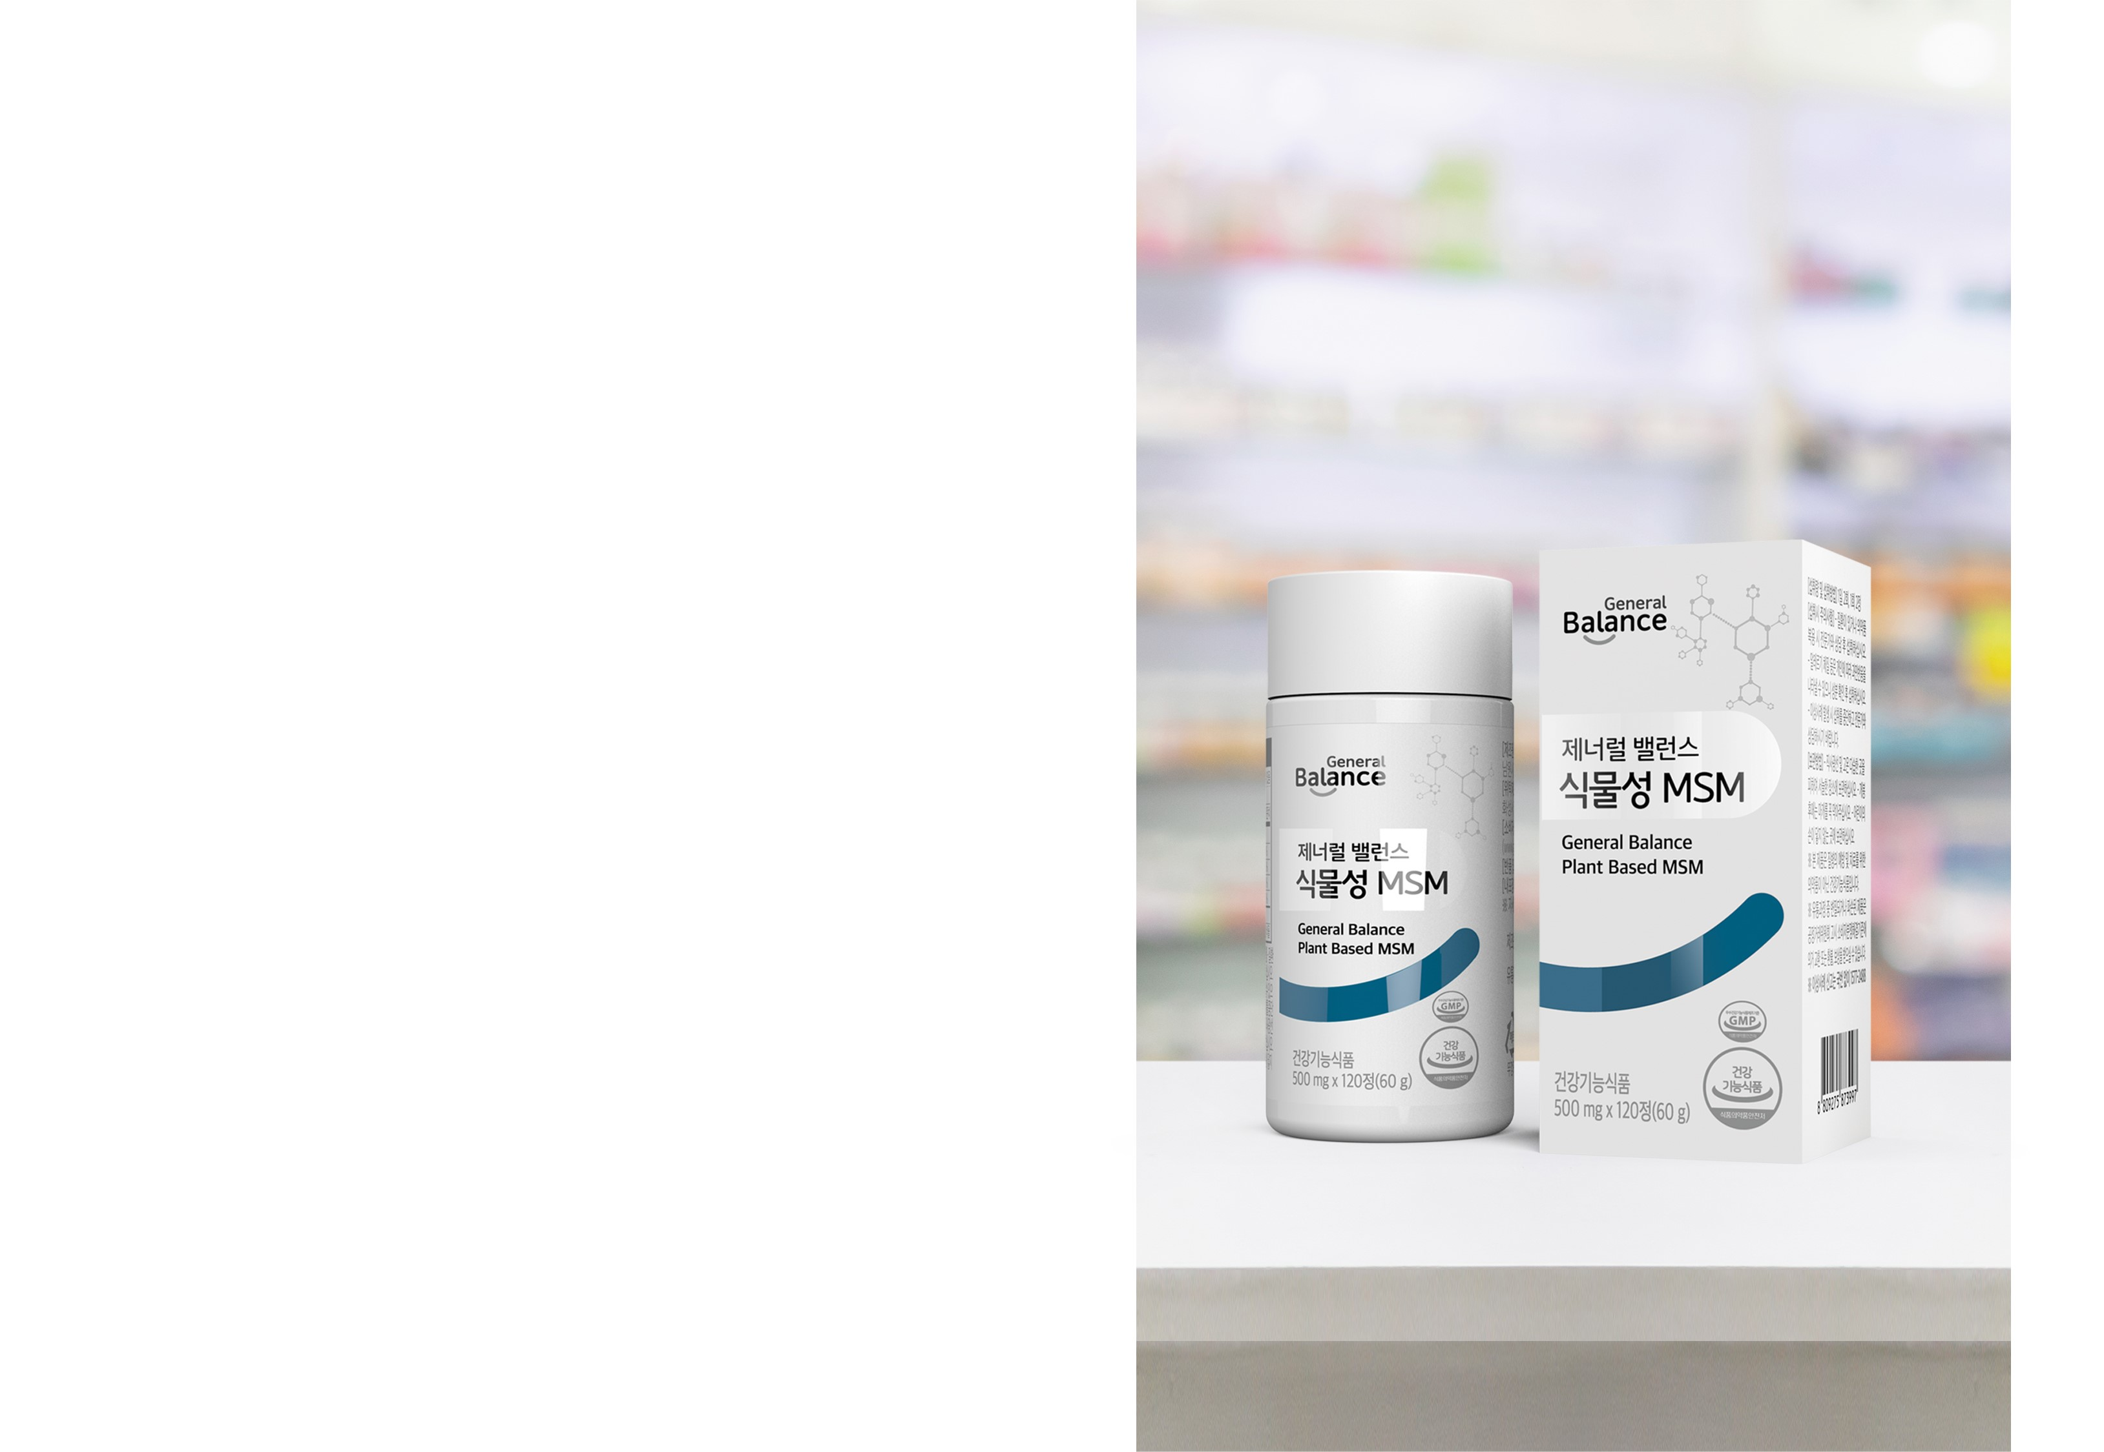

Recommended For
Those who are affected by decreased cartilage and
joint function due to aging.
2. Those who are overweight and are experiencing
discomfort in joints and cartilage.
3. Those who are experiencing discomfort in joints and
cartilage during postpartum.
4. Those who are active or standing for extended
periods of time.
5. Those who excessively use fingers and wrists.
6. Those who wear high heels that cause joint
discomfort.

Slide 16
We are
GCoopers!

Slide 17
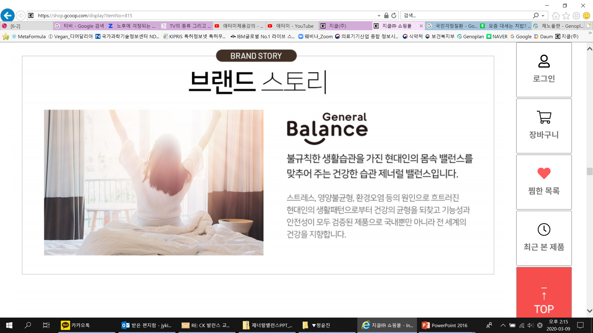
Thank You.
* This document is intended for internal training purposes only. Unauthorized use/sharing of this document is strictly prohibited.

