Slide 1


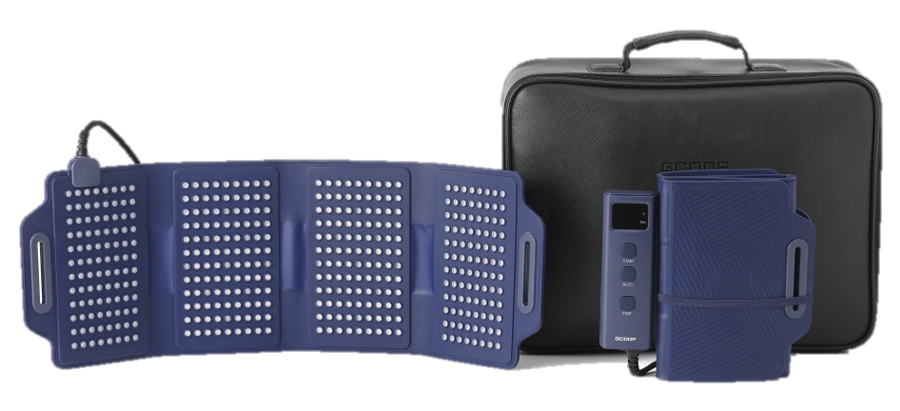
LAPY V
· This material is for internal educational purposes only. Please refrain from external use.

Slide 2


G-Coop Co., Ltd. strives for a healthy advertising culture so that all members are not harmed by hype. Please refer to the relevant laws below and cooperate so as not to lead to false hype.
This material is for internal training purposes and cannot be exported or posted separately.
Laws Against Medical Device Hype
Important Notice
[Excerpt] Article 45 of the Medical Device Law Enforcement Regulations (Scope of Medical Device Advertising, etc.) < Amended July 29, 2015 >

Slide 3
GCOOP LAPY V
CONTENTS
Product Overview
Comparison with Existing Product
Product Features
Product Configuration
How to Use
Storage Method
Environment and Storage Conditions
Recommended for
Product Contents
Precautions and Safety Warnings

Slide 4

Lapy V means…
LAPY is a compound word of LASER +THERAPY meaning “laser treatment.”
“V” is a Roman numeral, meaning the 5th generation, which is an upgrade over the previous 4th generation.
Product Overview
Development Background of GCOOP LAPY V
① Need for next-generation products that compensate for the shortcomings of existing products (low-temperature burns, etc.)
② As our name brand product, it is necessary to secure competitiveness in the market (patent)

Slide 5

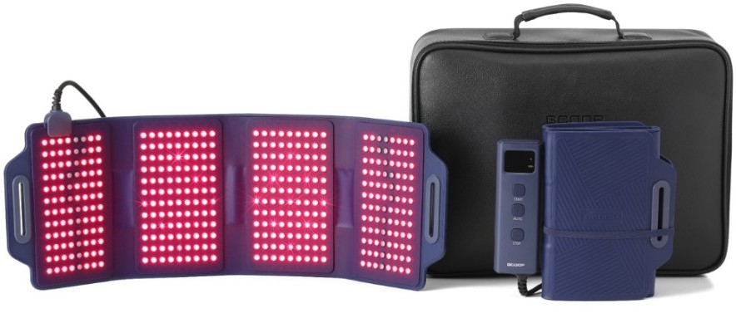

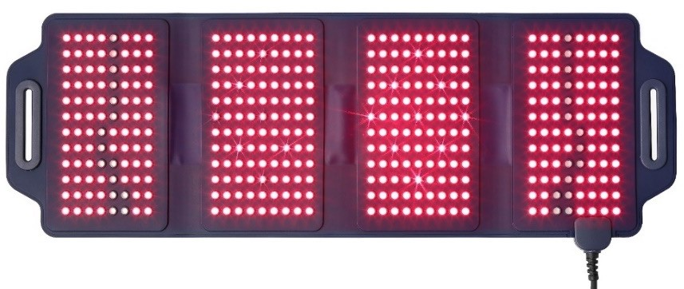
Medical Devices
US FDA Medical Device Level 2
Registered Medical Laser Irradiator Level 3
Efficacy
[1st ] Pain relief
[2nd ] Knee degenerative arthritis pain relief (clinical trial planned)
Manufacturer
General Bio Co., Ltd. (Medical device manufacturing industry GMP acquisition 10.17.2022
Item Name | Infrared Therapeutic Device
Model | GB-WR21001MDR
FDA registration number | D469830
Purpose of Use | A device that uses light energy (laser) radiated to the skin for the purpose of pain relief, etc.
Low-power semiconductor devices | 408 laser beams
Safety control device | Overload cut-off device, temperature control device
Rated voltage | AC 100~240V,50/60Hz
Laser wavelength and power | LED : 12.0mW/cm², 650nm 3.0m W/cm², 870nm Laser diode : 3.0mW, 650nm
Power Consumption | 12VA
Weight / Package Weight | 3.6(1,650g) / 4.1 lb(1,875g)
Mfg number, date of manufacture | See back of product controller
Equipped with 18 high-efficiency lasers
870nm Equipped with 30 infrared wavelengths (invisible)

Slide 6
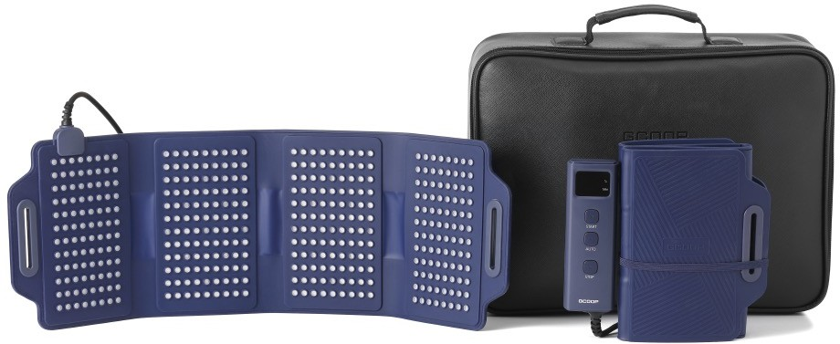
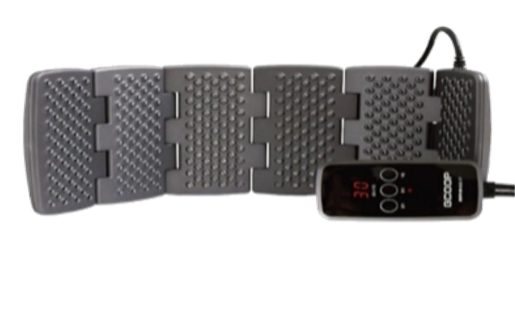
Comparison with Existing Products
Overall Competitiveness Advantage| Design | Free Voltage | Performance | Convenience | Fit | Storage
Category | LAPY V | Existing Product (GCOOP 402 VIP) | Competitiveness
Design |  |  | Predominant
Core Components | 408 light sources (18 high-efficiency lasers + 30 infrared ones) | 402 light sources | Predominant
Fit / Adhesion | Flexible Silicon : Good Adhesion | Hard Plastic : Not good adhesion | Predominant
Storage | Convenient for storing (4-folds) | Inconvenient for storing (6-folds) | Predominant
Portability | Dedicated USB cable (Power bank 20000mAh 12V output) | Not possible | Predominant
Free Voltage | Available: Worldwide Export Share | Not possible: Regional power supply model required | Predominant

Slide 7
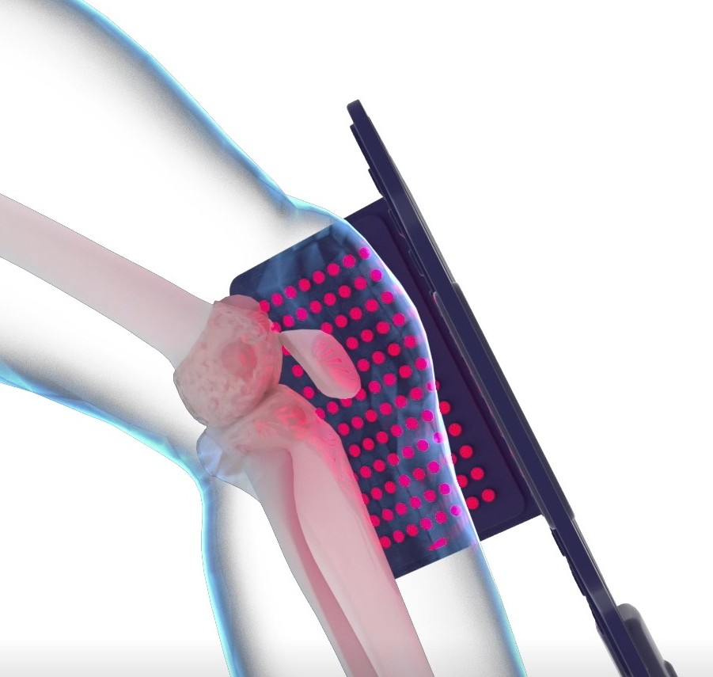
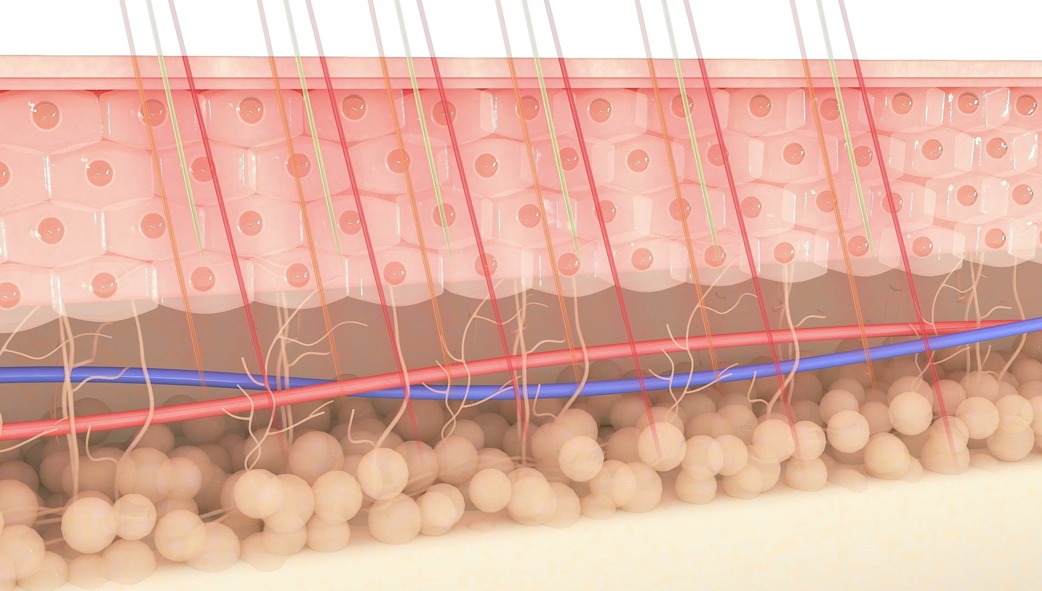
Product Features
Combination of Three Light Sources
18 high-efficiency lasers + 30 infrared + 360 identical to existing product = 408 total applications
High-efficiency laser effectively concentrates on the pain area to provide pain care faster and more effectively than existing products. Complex application of three light sources to quickly and effectively treat various pain causes
Three complex light sources can treat deep muscle and joint pain in skin

Slide 8

18 high-efficiency lasers out of 408 light sources and dual wavelengths (650nm, 870nm)
Eco-friendly silicone material with flexible three-dimensional structure that adheres closely to the skin, effectively applied to painful joint areas
Installation of two temperature sensors for the prevention of low-temperature burns (only 1 in existing 402VIP product)
Convenient use anytime, anywhere with power bank
Free voltage usage (for both domestic & overseas)
Patent registration
[Light survey machine for flexible knee joint
integrated management]
Approved from US FDA as Medical Device Level 2
Equipped with 18 high-efficiency lasers
870nm Equipped with 30 infrared wavelengths (invisible)
Equipped with two temperature sensors for safety such as low-temperature images

Slide 9



THERAPY Application
Accelerates healing of wounds
Shoulder
Forearm
Elbow
Pain relief
Pain-relieving medical device that closely adheres to the painful area and irradiates it intensively
LAPY adheres closely to various parts of the body with pain and directly irradiates the laser, so it improves pain and expect a quick remission.
Knee arthritis
Wrist
Sport Injuries and sprains
Thigh
Soft tissue injuries
Knee
Chronic inflammation
Calf
Ankle

Slide 10
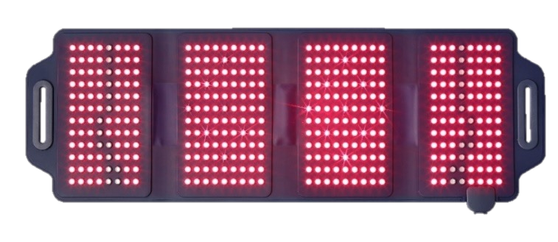
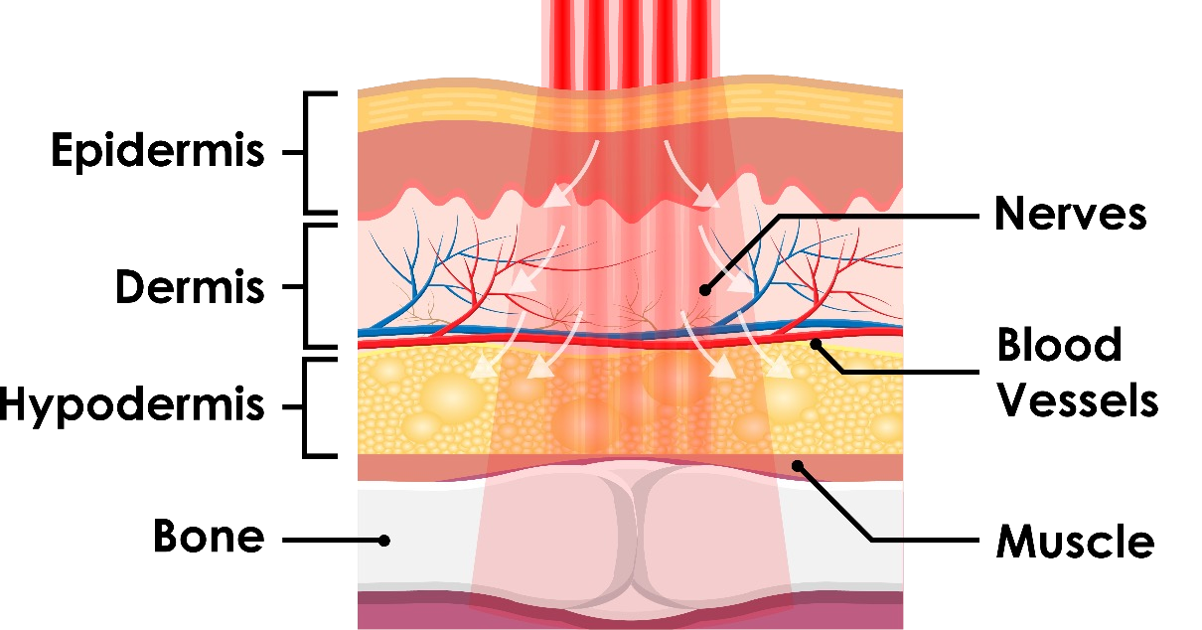
A T P (Adenosine TriPhosphate)
ATP is an organic compound that supplies energy to carry out various vital activities in living cells, such as muscle contraction, conduction of excitation in nerve cells, and synthesis of substances.
In other words, it is also called the energy currency of the cell. It is a monomer necessary for RNA synthesis and is later converted into dATP to become a monomer necessary for DNA synthesis. It also regulates many biochemical pathways.
It also performs important functions outside the cell, which are released from wounded cells to reduce pain and heal.
650nm
650nm Accelerates Surface Healing
If we irradiate 650nm, which is the wavelength at which melanin in our skin is well absorbed, large doses can be administered to the surface area. Wavelengths inhibit bacteria and cells because it can promote growth. Laser treatment has amazing results in wound healing and scar tissue control.
870nm
870nm Increases ATP Production
The enzyme that determines how efficiently cells convert to ATP has the highest absorption rate at 870nm.
This means that regardless of the molecular state of the enzyme, accelerates the absorption process and increases cellular ATP production.

Slide 11

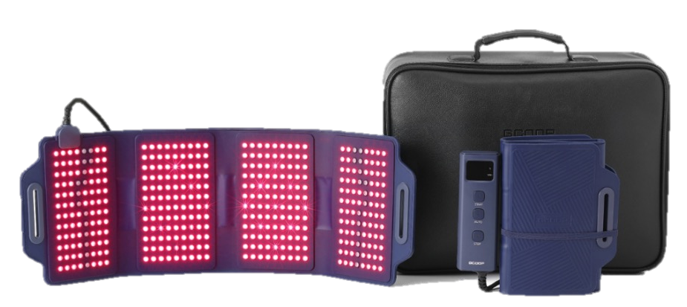
Principles of Inflammation Treatment
Occurrence of inflammation
If you are caught off guard, you can suffer for the rest of your life with…
Chronic Inflammation Management
Treatment of inflammation
Increased blood count
Decrease in amount of blood
Deterioration of blood quality
Cell reduction, increased chronic
inflammation
Muscle weakness
Disease outbreak
Increased blood quality
Cell growth
Reduces chronic inflammation
Strengthen Muscles
Treatment of Disease

Slide 12
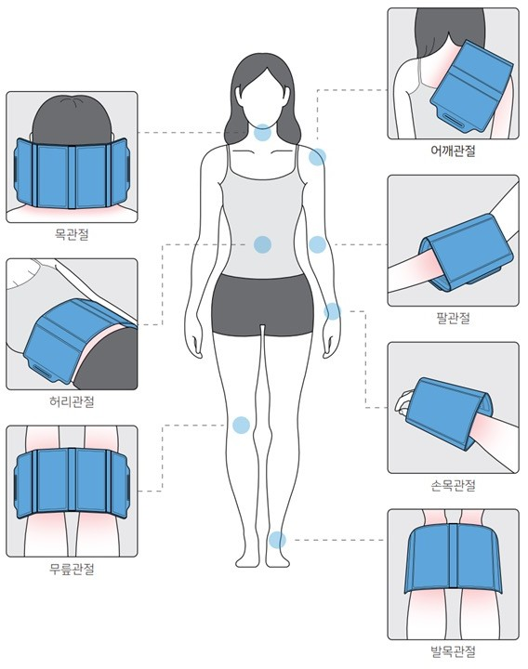
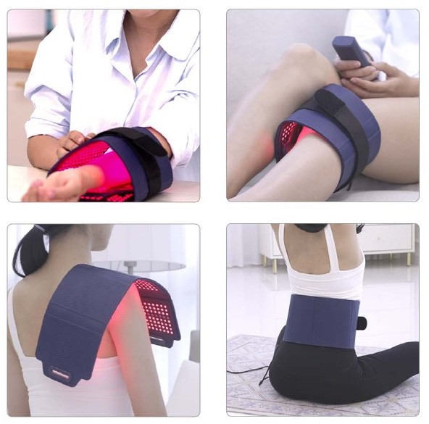
Apply to Various Joints
▶Areas of Inflammation
▶Flexible Silicone and substrate (board) can be applied to treat various painful areas
Shoulder
Neck
Arm
Waist
Wrist
Knee
Ankle

Slide 13
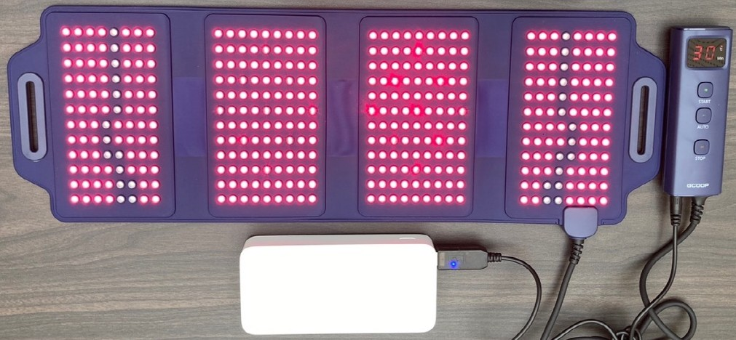
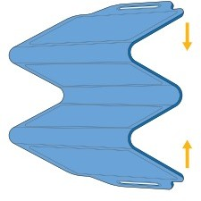
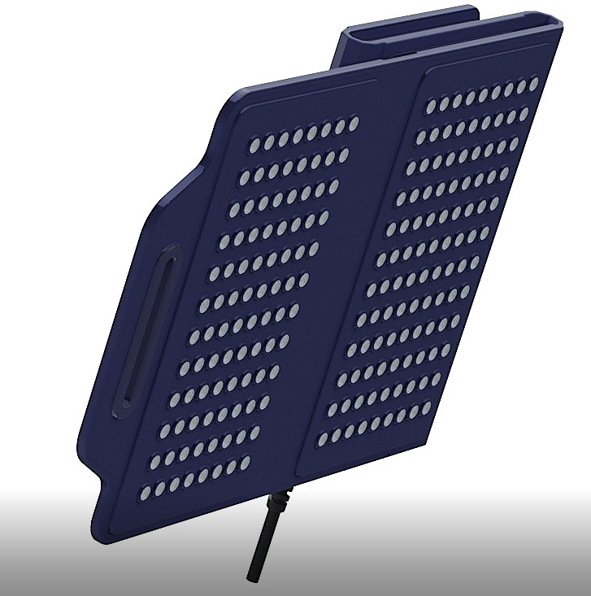
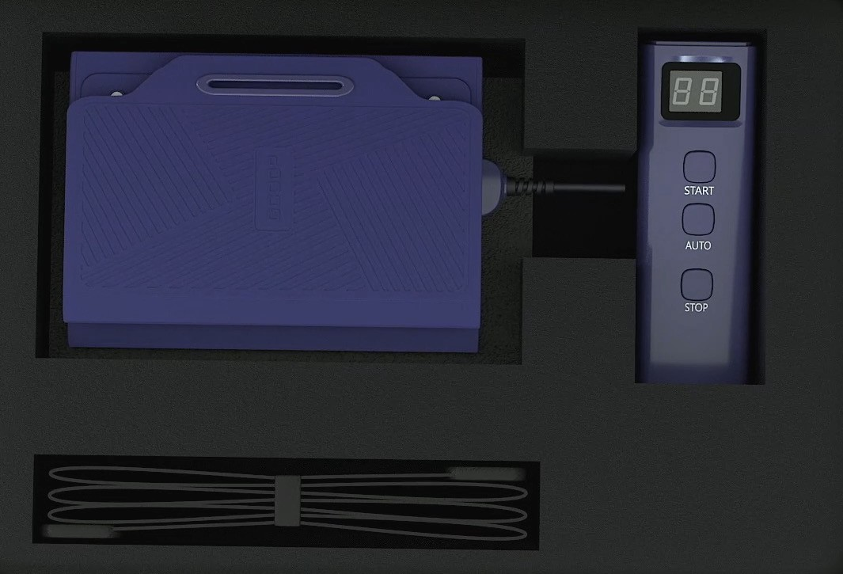
Convenient with High Portability and Storage
4-part fold, convenient for storage due to compact size
Small volume and size, high portability and usage
With a dedicated USB cable and a power bank, it is convenient to use it anytime, anywhere
(Power bank specification 20000mAh DC 12V output 1.5A)

Slide 14
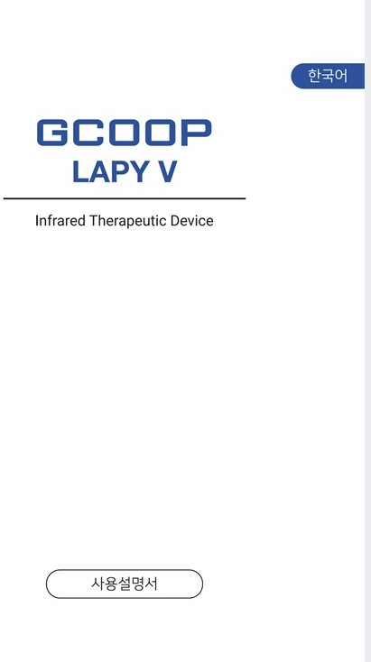
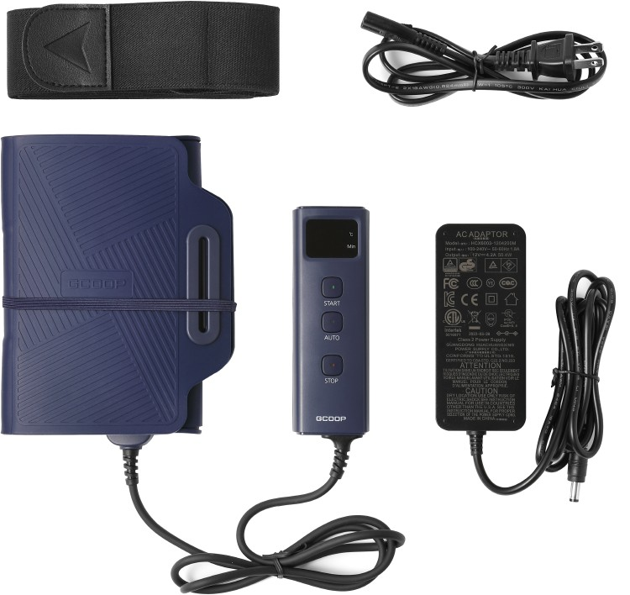
Contents
①
③
⑤
②
④
① Belt
② LAPY V Device and Remote Control
③ Power Cable
④ Adapter
⑤ Product Manual

Slide 15
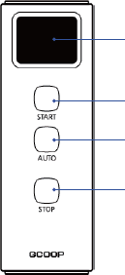
Using the Remote Control
Connect the power adapter plug to a commercial power outlet.
Connect the power adapter connector to the Remote Control.
Apply the device to the area.
Depending on the desired care area, press the Start button or the Automatic button.
Start Button: 30 min. operation, 10 min stop
(If turned off by temperature setting, it is not included in the operating time and there is no melodic sound.)
Auto Button: 30 min. operation and stops automatically afterwards
(If turned off by temperature setting, it is not included in the operating time and there is no melodic sound.)
Press Stop button to stop operation.
When finished, disconnect the power plug from the outlet.
Temperature, Time Display
Start Button
Auto Button
Stop Button
Remote Control
※ Device turns OFF at 45 degrees, so only up to 44 degrees is shown in the display window.
※ Please refer to the Manual: How to Use GCOOP LAPY V for more information.

Slide 16
How to Use LAPY V
Wrap LAPY V around the area you want to care for, secure it lightly with the band supplied with the product, and plug it in (if used over clothing, the effect will be halved). If you tighten the band too much, you may experience pain, so fix it lightly.
When the Start button is pressed, the laser is applied directly to the affected area. Please use it on bare skin as much as possible. However, if you feel hot or sweaty, be sure to use it on top of a white undergarment.
If you only press the Start button, the temperature will be displayed and if it goes up to 45 degrees, it will stop operating temporarily. Once the temperature reaches 41 degrees, it will operate again. (If it is turned off by the temperature setting, it is not included in the operating time, and there will be no melodic sound.) After 30 minutes of operation, it is reapplied after a 10-minute break for the safety of the user.
When Auto button is pressed, the time "30" is displayed which represents 30 minutes of operation. During operation, the temperature setting reaches 45 degrees, which causes a temporary shutdown and does not decrease the time until it is back in operation. (If it is turned off by the temperature setting, it is not included in the operating time, and there will be no melodic sound.) It will automatically turn off after 30 minutes of operation. It will not work unless Start or Auto button is pressed again.
If you want to stop during treatment, just press the Stop button.
At the end of the laser irradiation, the numbers disappear from the display window with a beep.
After completion of use, press the Stop button and remove the power plug.
It is recommended to use 1~2 times a day.

Slide 17
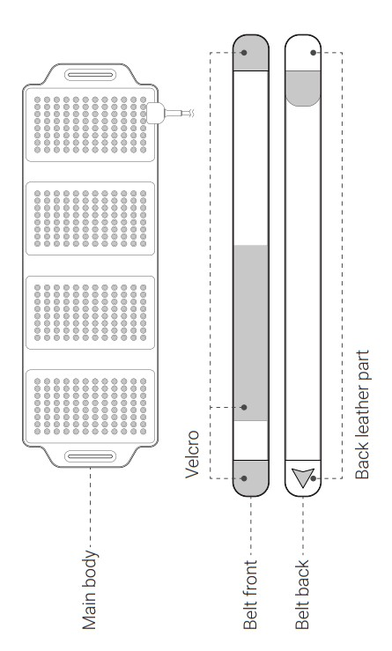
LAPY V Belt Configuration
Main Unit

Slide 18
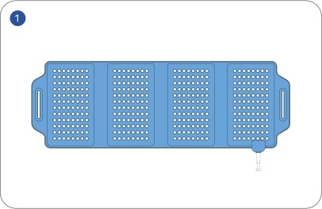
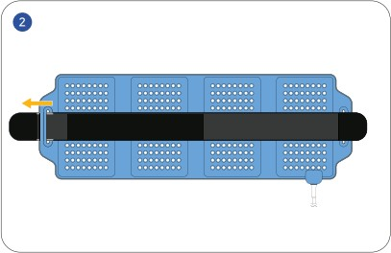
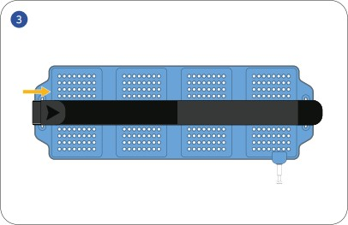
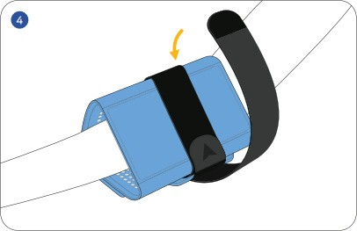
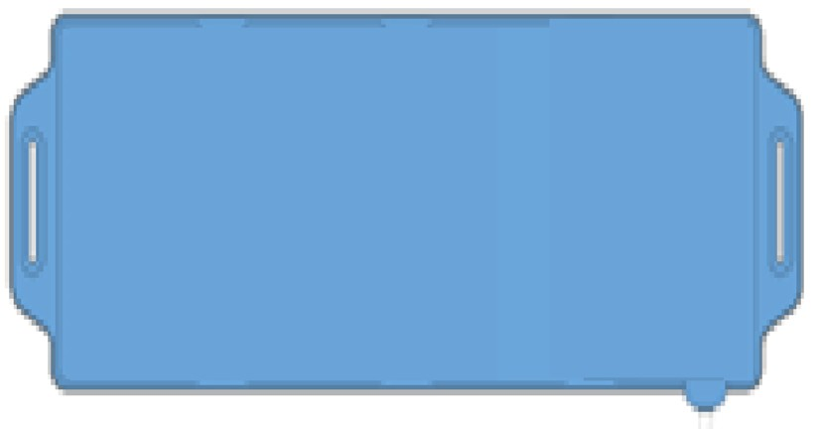


Procedure When Applied to Arm or Knee
Position the light source area of the main device so that it is visible.
Position it so that the front part of the belt is visible.
Insert left part of the front of the belt into the left hole of the main unit and bend it & press against the Velcro.
Attach the body to the area you want to be treated, fix the Velcro around the belt to the body of the device.

Slide 19
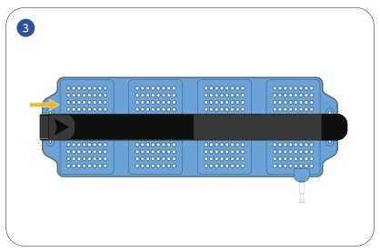
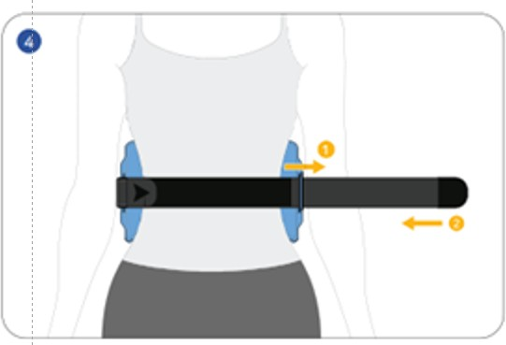
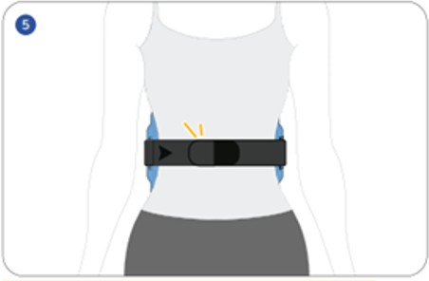
Procedure When Applied to Waist
Position the light source area of the main device so that it is visible.
Position it so that the front part of the belt is visible.
Insert left part of the front of the belt into the left hole of the main unit and bend it & press against the Velcro.
After attaching the device to the tummy or back, insert the unsecured part of the belt into the hole on the right side of the unit and bend it.
Position the curved belt where you want it and fix it with Velcro

Slide 20
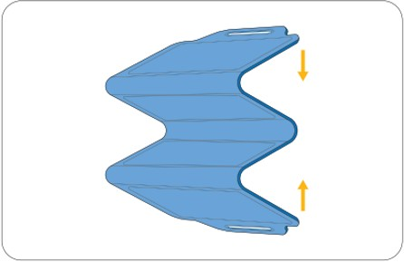
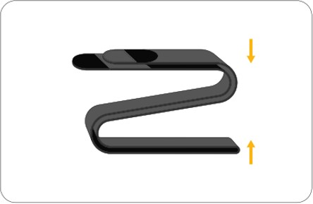
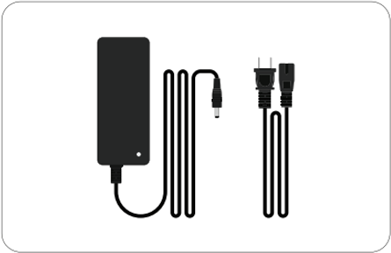
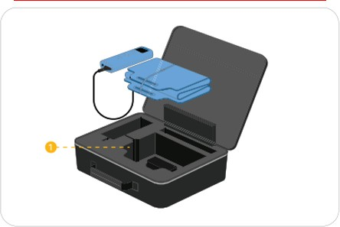
Storage
Fold and store the main unit as shown.
Fold the belt in half first, then in a zigzag shape.
Organize the power adapter and cables
Insert the power adapter and cable into (1) and place on the main unit. Then store controller & wires and lay it in place.

Slide 21
Environment and Storage Conditions
Depending on the environment in which the product is used, if the temperature is low, the operation may stop before reaching 45 degrees during 30 minutes of operation. To effectively feel the heat, use as follows:
Please use in a space where the ambient temperature is not low.
When using the product, wrap it with light clothing, a towel, or a thin blanket to keep it warm.
If the Start Button does not reach 45 degrees and stops after 30 minutes, press the Stop button, and then press the Start Button again. If you start it right away, you can start right from the previous stationary temperature. (Please follow the above as the temperature drops while waiting 10 minutes for re-operation.)
In cold winters or places with low temperatures, wrap them in a heated area with clothes, towels, or thin blankets.
Store in a dry place, at room temperature.
Keep away from chemicals and other products and places where gases are generated.
After use, wipe the front of the main unit (light source) with a dry cloth or the like.
If there is a foreign object on the front of the main unit (light source), gently wipe it off with a cotton swab dipped in alcohol.
Keep out of reach of children.
After use, store in the following order:
① Disconnect the power plug of the power adapter from the outlet.
② Remove the jack on the power adapter connected to the controller.

Slide 22
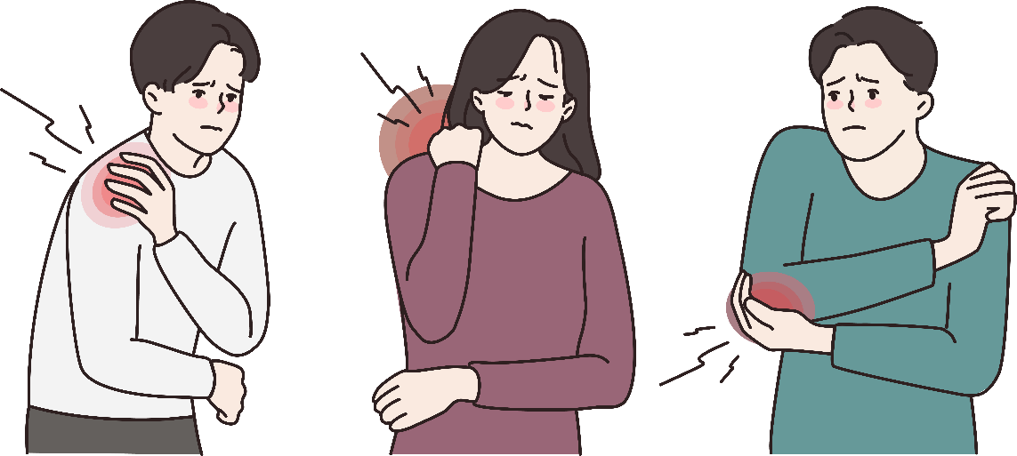
Recommended For….
Those who want to relieve pain in various area
Those who want pain relief from everyday pain
Those who have pain after exercising
Students and office workers who sit for long periods of time
Those who often feel pain after childcare and housework
Those who have joint pains

Slide 23
Product Precautions and Safety Warnings
If you have sensitive or weak skin, or an elderly person, be sure to irradiate with a thin white cotton towel or white undergarment as there may be a risk of low-temperature burns. Also, if it is hot, discontinue use immediately.
When using, if sweating occurs, be sure to irradiate with a white cotton towel or white undergarment underneath. Wipe the product thoroughly with a dry towel and wash the skin thoroughly. (Caution: If the skin is not washed, the skin may turn dark)
Do not use on eyes and face. (Not recommended for use other than in the joint area).
Do not use on high-temperature electric blankets, mats, etc. External heat may alter the surface of the product or be subjected to thermal shock. (In case of malfunction, it will be considered as consumers’ negligence).
When using the device, do not cover it with a thick bedding or blanket. The temperature sensor may malfunction. However, if you unavoidably cover the duvet, place the regulator outside the duvet for accurate temperature sensor operation.
Do not use with joint-related creams or other medications. When used together, it may cause serious failure, deformation and damage to the product. (In case of malfunction, it will be considered as consumers’ negligence).
Never use device below your waist or sit on it. (Therapeutic effect will be difficult. In the event of malfunction, it will be considered as consumers’ negligence.)
Do not use in areas with high humidity.
Do not disassemble arbitrarily in the event of a breakdown. A/S is not possible when disassembling arbitrarily, and we are not responsible for any problems that occur in the future.
Do not drop or subject to excessive shock when handling.
Do not apply excessive force to the wire area connected to the main unit.
(1) In the event of a bad connection (regulator digit malfunction laser light flashing), stop using it immediately and contact
the place of purchase.
(2) Long-term use in the malfunction condition it may cause serious damage to the product.
12. Do not touch the console, outlet, or controller with wet hands.
※ This product is equipped with a light source. Avoid using it directly towards your eyes or towards the eyes of others. Vision impairment may occur.
※ We are not responsible for any problems caused by consumer negligence.

Slide 24
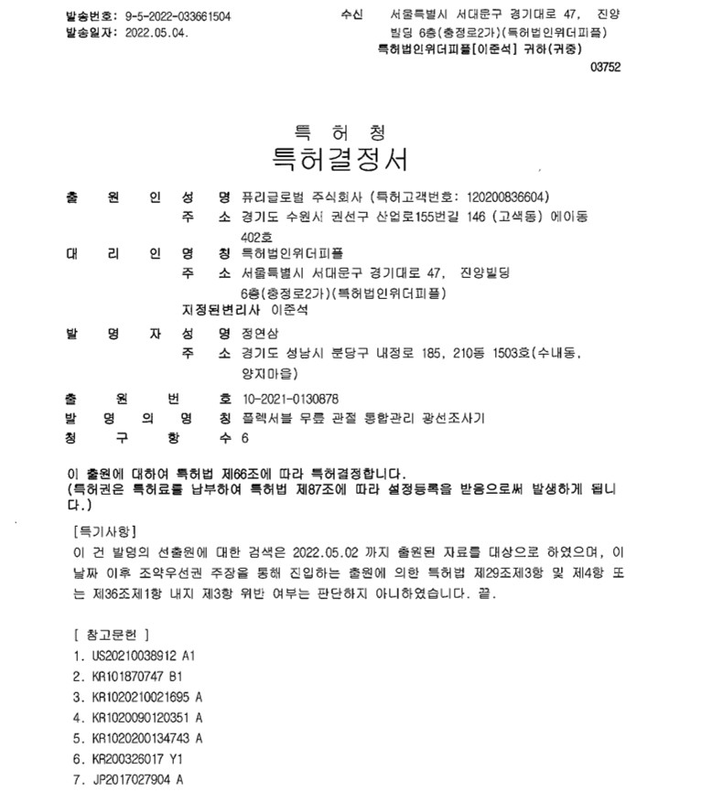
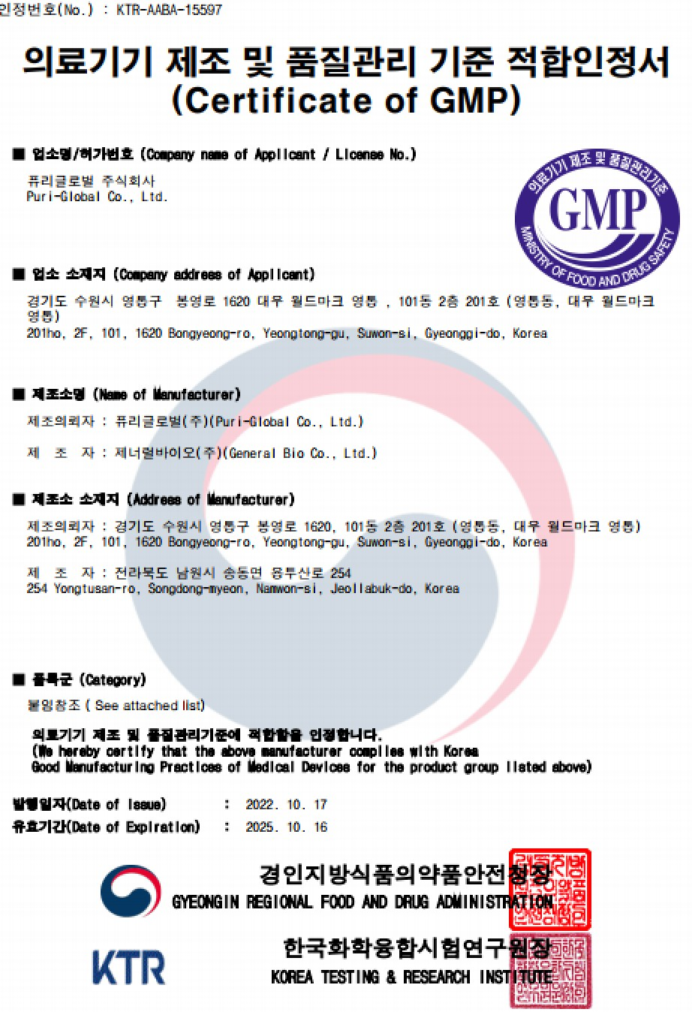
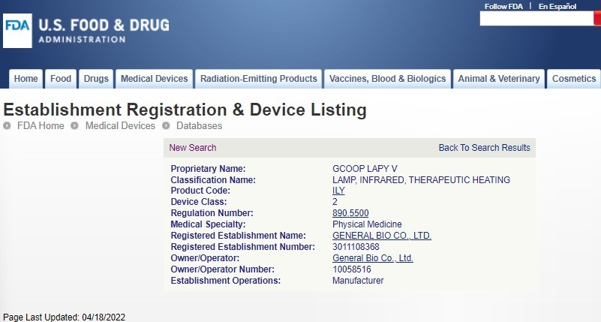



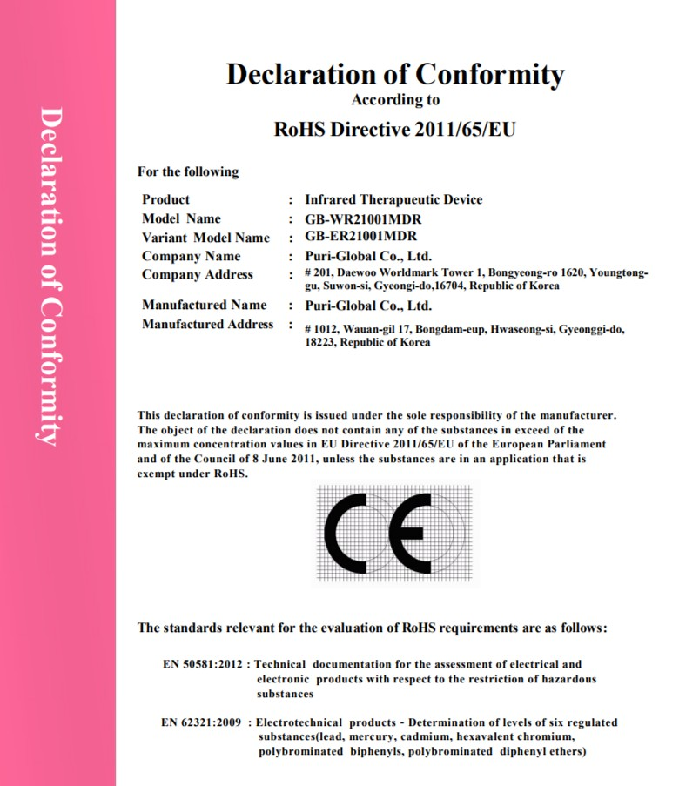
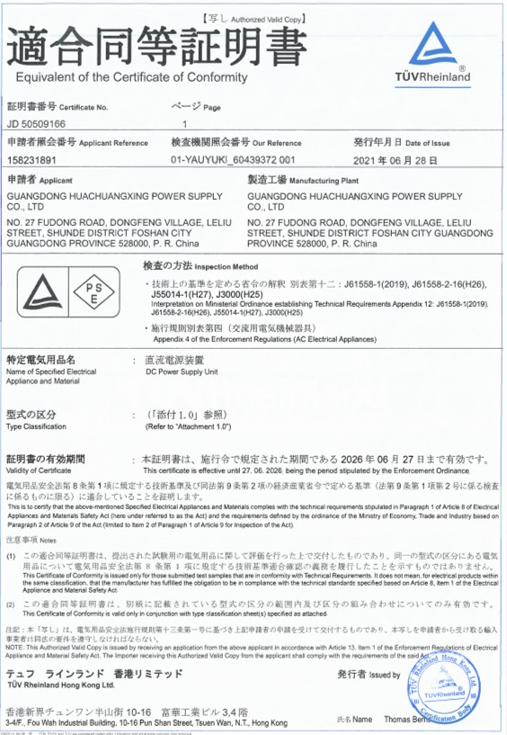


Patents & Certification Materials
Patent Certification
GMP for Korean Medical Devices
CE Certification
Japan PSE Radio Certification

Slide 25
References

Slide 26





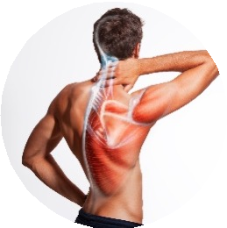
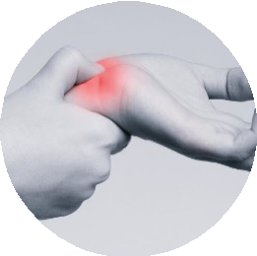
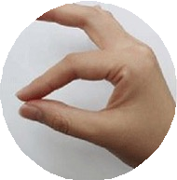
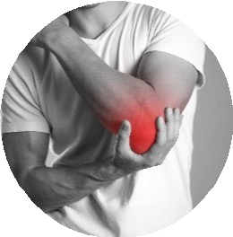
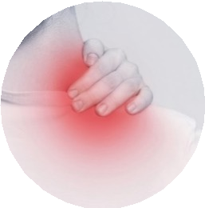
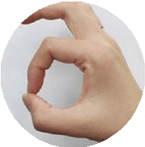

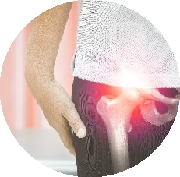
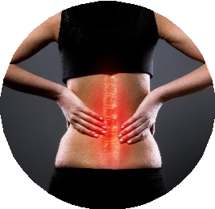
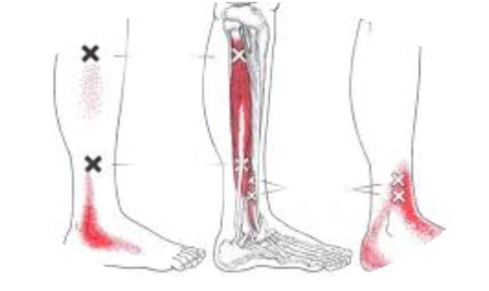
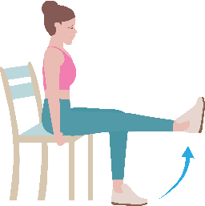
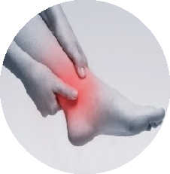
Inflammatory Disorders
Arthritis
Caused by inflammation of the joints due to various causes, and the joints that
surround the joints
Diseases and conditions that invade surrounding tissues.
Carpal Tunnel Syndrome
Caused by pressure on median nerve. Fingers or wrists hurt and tingle. It feels like a fever, a burning sensation.
In severe cases, hand
loss of muscle strength.
Elbow Tunnel Syndrome
Appearance of stiff pain on the inside of the elbow. It causes tingling in the elbows and may extend to the shoulders or neck. Paresthesia of the ring finger & little finger appears.
손목터널증후군
손가락 또는 손목이 아프고 저릿저릿 하다. 열이 오르는 듯한 느낌, 타는듯한 느낌이 난다. 심각한 경우 손의
근력이 떨어진다.
Anterior Interosseous Syndrome
Impaired movement of index and middle finger. Normally, one can make circles with thumb & index finger but weakened fingers cannot.
Frozen Shoulder
A disease in which the joint capsule that surrounds the joint becomes inflamed, causing the surrounding tissues to become harder and stiffer, reducing the range of motion
Disc & Back Pain
Back pain is caused by momentary strain on the lower back, but it can also affect the structure of the spine & inflammation,
When there is a problem with the intervertebral discs or the muscles that support the spine, it manifests itself as ruptured abdominal aorta, urolithiasis, internal diseases, and gynecological diseases.
Leg Nerve Entrapment Syndrome
Tingling pain appears in the thighs, knees and legs. Burning sensation in the knees and calves when standing for a long time, walking, going up and down stairs
symptoms intensify.
Saphenous Capture Syndrome
Numbness in the instep, calves, etc. Feet doesn’t function well and hard to lift toes.
Tenderness may occur on the back of the foot and calf. Sensation in the instep and calf side is difficult or weird.
Ankle Tunnel Syndrome
The soles of feet feel like burning with fever when in fact there’s no heat being generated when touching it. Symptoms intensify at night.
Feels strange, and there is
an aching sensation.
Obstructive Entrapment Syndrome
It can also occur as an aftereffect after a pregnancy/childbirth or car accident. Strong pressure may occur on the lower back. Pain may occur in the inner thigh, inside the groin and in hip joint or in the upper knee joint.

Slide 27
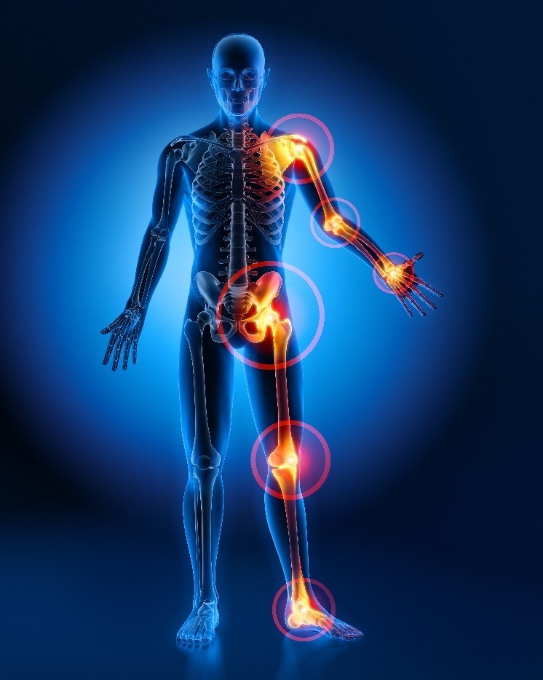
What is Arthritis?
Arthritis is the swelling and tenderness of one or more joints. The main symptoms of arthritis are joint pain and stiffness, which typically worsen with age.
The most common types are degenerative arthritis and rheumatoid arthritis. Degenerative arthritis is a disease in which the bones and ligaments that make up the joints are damaged, inflammation and pain due to damage or degenerative changes in the cartilage that protects the joints.
In the past, it was thought to be simply an “aging” phenomenon cause by old age, and was referred to as degenerative joints, but now degenerative arthritis is increasing due to various cause.
Rheumatoid arthritis is an autoimmune disease and is a chronic inflammatory disease characterized by polyarthritis. Synovitis occurs symmetrically, mainly in small joints such the hands and feet. There is also a violation of the surrounding cartilage and even bones, which leads to the destruction of the joints and the appearance of deformation.

Slide 28





Degenerative Arthritis Progression
Percentage of Patients
with Degenerative Arthritis
Patients from 2015~2019
Cartilage is worn out and the tender part of the joint gradually disappears
To compensate the cartilage, bones at the edges of the joints change irregularly and hurt every time they move
Damaged Kneecap
Patients by Gender in 2019
Ratio of Patients by Age in 2019
As the cartilage wears off, bone-to-bone collide. Knee may swell since a lot of lubricating fluid occurs.
*Source: Health Insurance Review and Evaluation Service Healthcare Big Data

Slide 29


Degenerative Joints (Obesity)
Obesity: Higher the Risk of Developing Arthritis
Odds Ratio of Arthritis of the Knees
Obesity is an important risk factor for developing and exacerbating arthritis.
If you are obese (30kg/m2 or more), the risk of arthritis increases 4 times that of women and 4.8 times that of men than overweight and normal weight.
If an obese person loses about 11 pounds (5 kilograms) of weight, the risk of arthritis is cut into half compared to not losing weight.
Many Activity Disorders for Those with Arthritis & Obese
[Source] Korean Family Medicine Association, Ministry of Health and Welfare, Centers for Disease Control

Slide 30

Degenerative Joints (Smoking)
Smokers are Twice as Higher than Non-smokers to Suffer from Rheumatoid Arthritis
Smokers have twice the risk of developing rheumatoid arthritis than non-smokers.
Smoking exacerbates rheumatoid arthritis.
Only 10 years after quitting smoking, the risk of developing rheumatoid arthritis is reduced to the same extent as non-smokers. Therefore, it is important to quit smoking early!
Odds Ratio of Rheumatoid Arthritis
[Source] Korean Family Medicine Association, Ministry of Health and Welfare, Centers for Disease Control

Slide 31

Degenerative Arthritis
(Joint Damage and Early Diagnosis )
Joint damage is an important risk factor for arthritis.
People who repeatedly strain their joints are at increased risk for arthritis.
Not being in the same position for a long time but distributing the weight to several joints, helps prevent arthritis. For example, when lifting an object, do not just bend your waist, but bend your knees together to use your leg and back strength.
Recently, as more and more people play sports, joint damage is increasing. Warm up well before exercising and wear appropriate protective equipment when exercising.
Damaged Joints Have Higher Risk in Joint Inflammation
Early diagnosis and proper treatment are critical to the management of arthritis.
Osteoarthritis and rheumatoid arthritis are treated and managed differently so it is important to make a differential diagnosis of the two.
Appropriate medication administration and an early diagnosis
along with daily habit correction will not only relief pain but also will improve the course of the disease.
Especially in the case of rheumatoid arthritis, treatment that can slow the progression of the disease can minimize joint damage and deformity.
[Source] Korean Family Medicine Association, Ministry of Health and Welfare, Centers for Disease Control

Slide 32

Degenerative Arthritis
(Laser Treatment)
Consistent Rehabilitation Exercise Can Help
Recovery of Joint Function
Weight control and physical therapy (laser therapy) in arthritis patients can reduce joint strain, reduce pain, and slow the progression of the disease.
Regular exercise and laser treatment reduce pain and improve feelings of depression and anxiety.
Consistent rehabilitation and physical therapy (laser therapy) help preserve remaining joint function, restore lost motor function and relieve pain.
However, excessive rehabilitation exercises can aggravate arthritis. Therefore, depending on the degree of inflammation of the joints and the condition of the muscles, physical therapy (laser treatment) and exercise should be combined to help with treatment.
[Source] Korean Family Medicine Association, Ministry of Health and Welfare, Centers for Disease Control

Slide 33
Thank You

