Slide 1
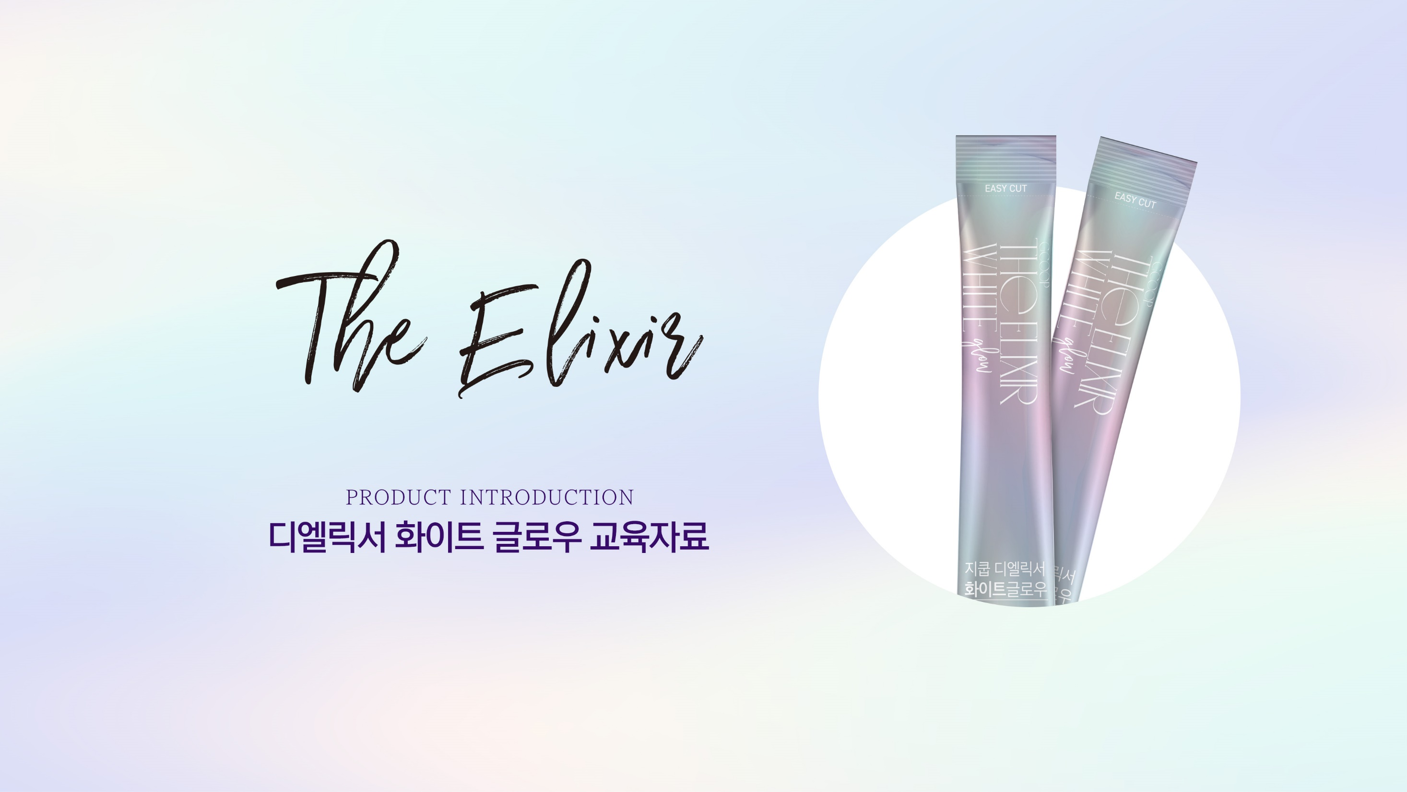
THEELIXIR White Glow

Slide 2
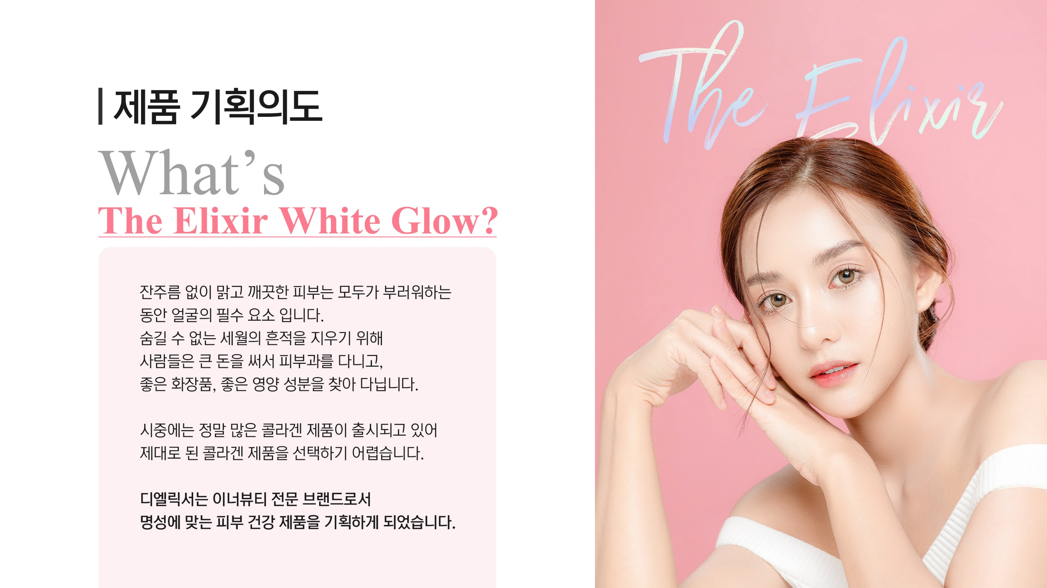
In addition to good nutrition and proper care, collagen is another important part of keeping our skin elastic and healthy.
There are many collagen products and medical treatments available but choosing the right one can be difficult and at times expensive.
As a brand that specializes in inner beauty, we have decided to design a skin health product that lives up to our reputation.

Slide 3

The Elixir
1. Inner Beauty Market
1) What is Inner Beauty?
The Beginning of Healthy Beauty
What is Inner Beauty?
〮 Priority on healthy management of what is underneath our skin, not just the exterior.
〮 Living a ‘Healthy Beauty Lifestyle’ focusing on food intake, lifestyle changes, etc.
Korean Inner Beauty Market
$1 trillion and growing
1.97 trillion KRW
(Unit: KRW/ Source: Shinhan Financial Investment Research Center Report)

Slide 4
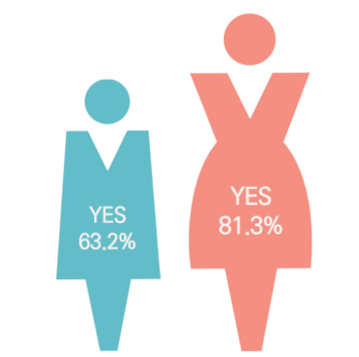
The Elixir
1. Inner Beauty Market
1) What is Inner Beauty?
What do Koreans think about skincare?
Q. Is skincare a priority ?
Q. What are your biggest skincare concerns ?
37.8%
31.7%
28.7%
28.6%
27.7%
25.4%
8.3%
〮 In a survey of 1,200 adult Korean men and women across the country aged 15-59, 72.3% of respondents expressed interest in skincare.
〮 By gender, more women (81.3%) prioritized it than men (63.2%). Adults in their 20s expressed the most interest.
〮 Respondents were most interested in moisturization, removing blemishes and wrinkles, and elasticity.
[Source : Macromill Embrain Trend Monitor]

Slide 5
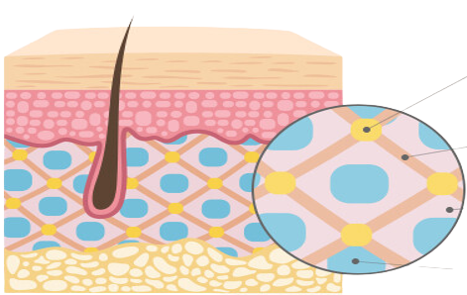
2. Healthy Skin
1) Structure
Understanding Our Skin
Collagen makes up most of the skin tissue. It is rubbery and elastic, making up over 80% of the epidermis. Within the dermis, Elastin binds the collagen and Hyaluronic acid provides moisturization.
Cross Section
Elastin
Epidermis
Collagen
Endodermis
Hyaluronic acid
Fibroblasts

Slide 6
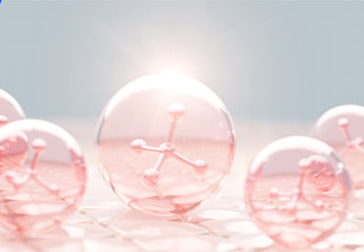
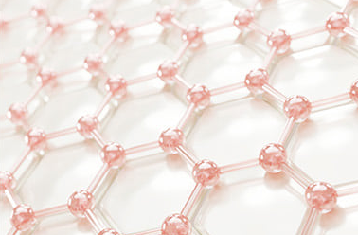
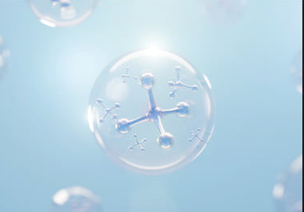
2. Healthy Skin
1) Structure
The 3 Components of the Dermis
Collagen
Provides structural support
Elastin
Binds collagen
Hyaluronic acid
Preserves moisture
Collagen is the protein that gives the skin its mechanical and structural integrity. It comprises about 90% of the dermis.
Elastin is the protein that binds the collagen together, allowing the skin to return to its original shape after stretching or contracting.
Hyaluronic acid is the moisture reservoir of the skin. It can hold more than 1000 times its own weight in water. It fills empty spaces in the skin with water.

Slide 7
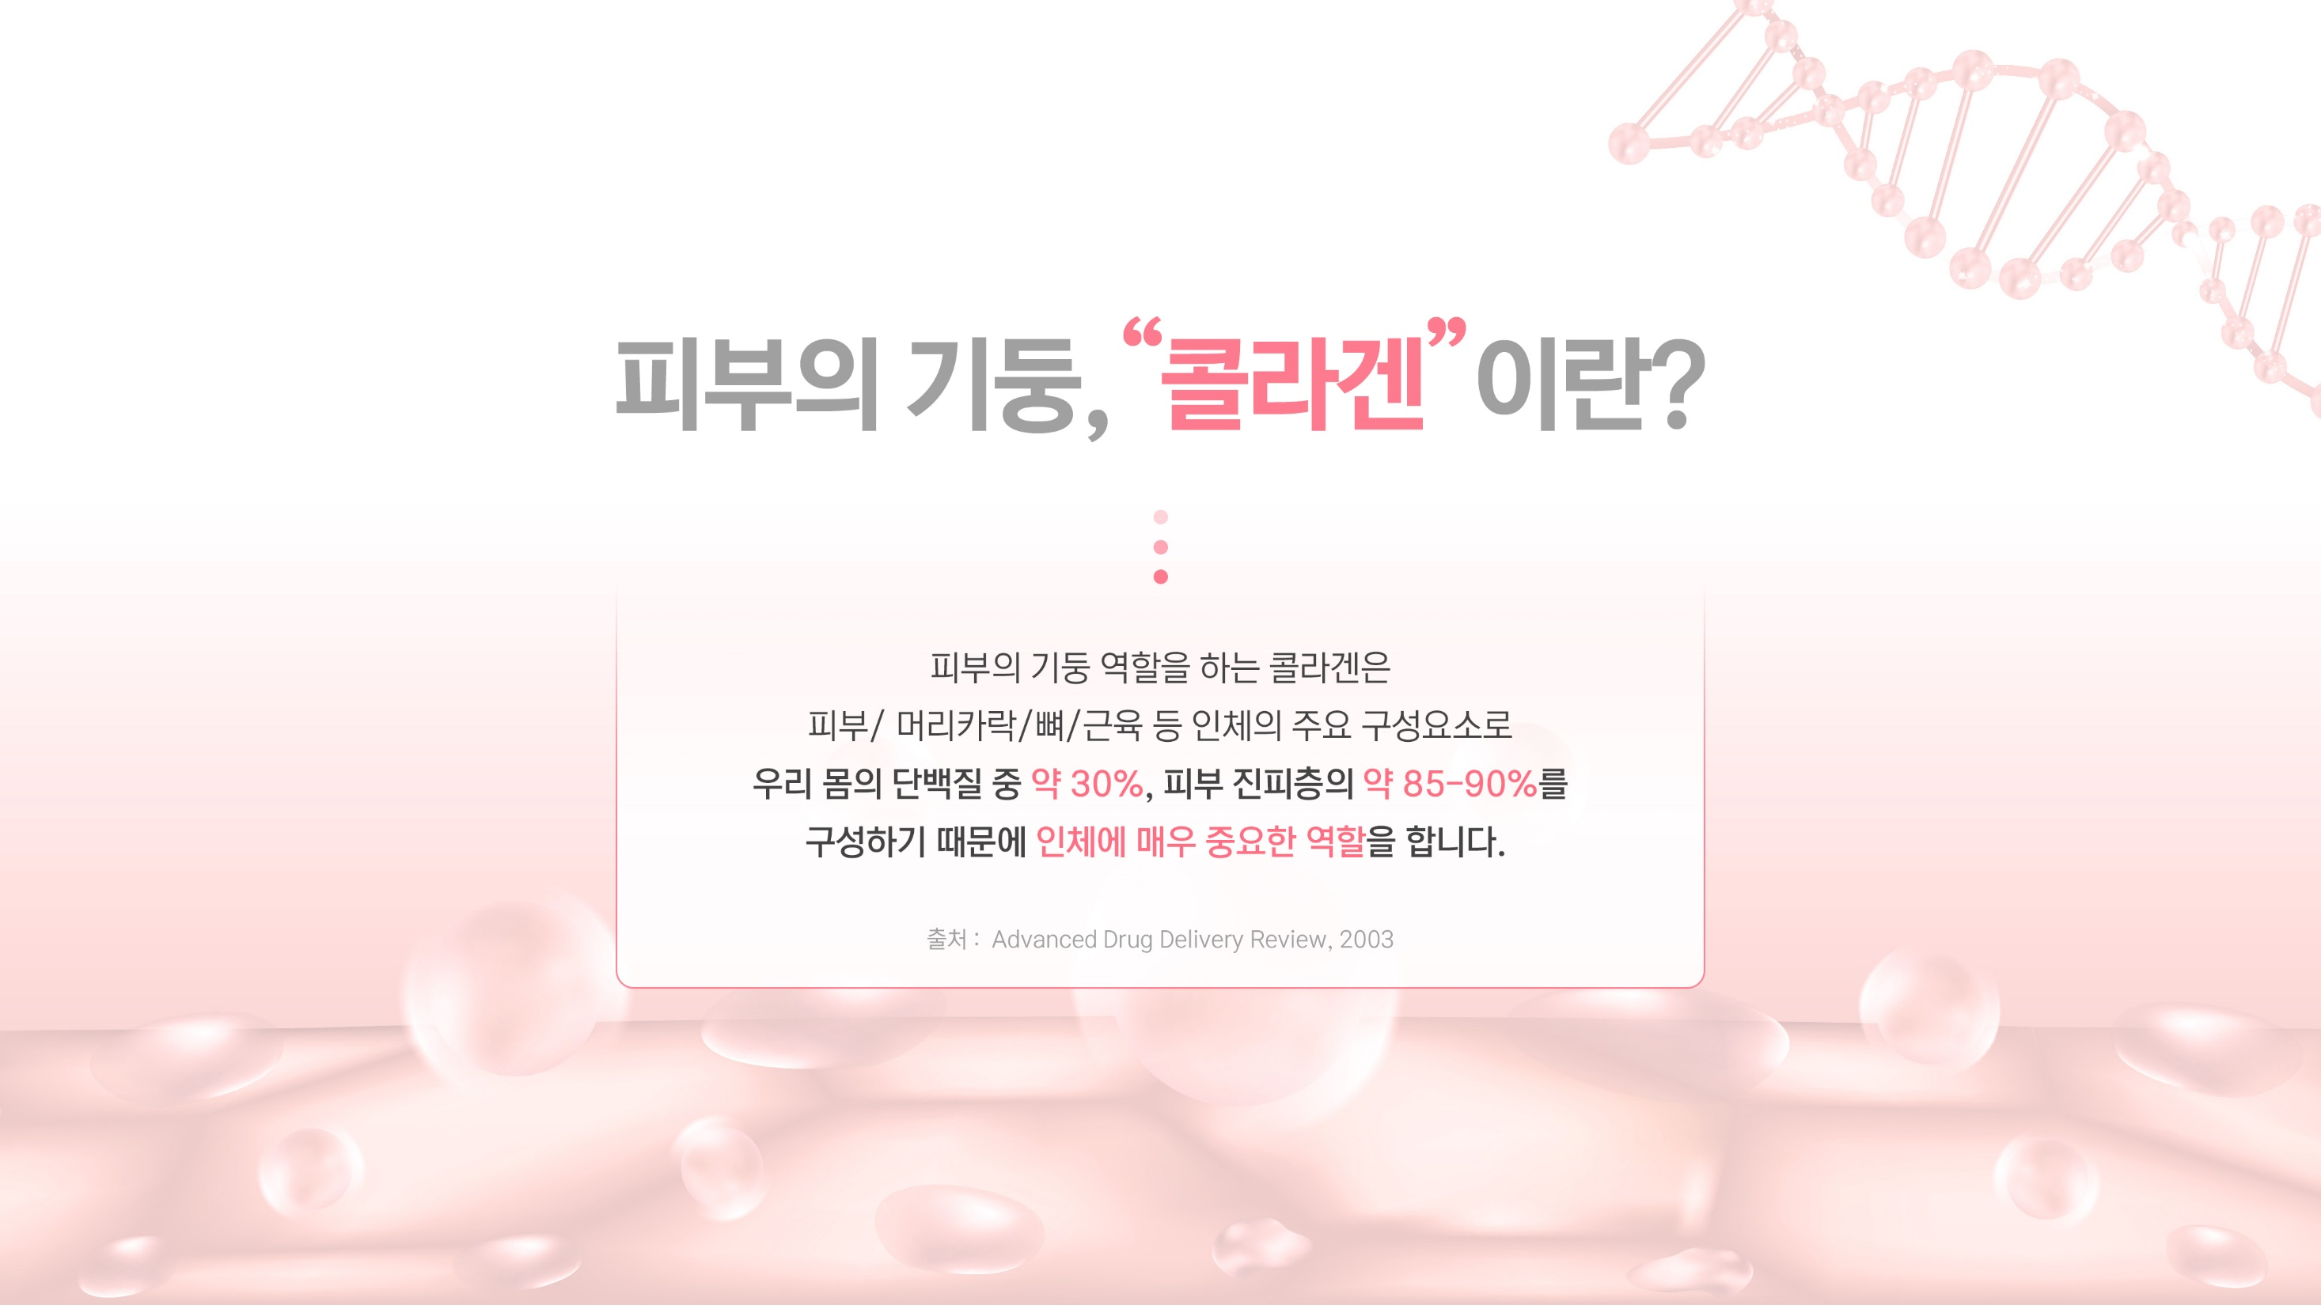
What is Collagen ?
Collagen is a major component of the human body that
makes up about 30% of the proteins in our body and
about 85-90% of the dermal layer of the skin. Collagen is
found in skin, hair, bone, muscle, etc.
Source: Advanced Drug Delivery Review, 2003

Slide 8
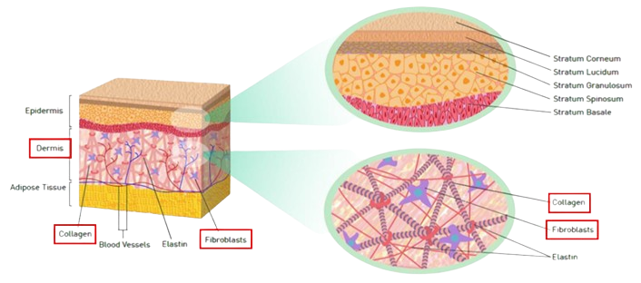
2. Healthy Skin
2) Collagen
An Abundant Protein
About 25-35% of the body’s protein is collagen (skin, hair, bone, muscle, etc.). Although collagen is abundant within the body, it is an oddity among proteins because of its amino acid composition. Collagen has unusually high hydroxyproline (Hyp) content while most other proteins do not contain the amino acid Hyp.
Cross Section

Slide 9
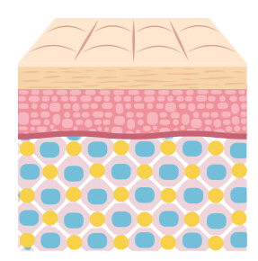
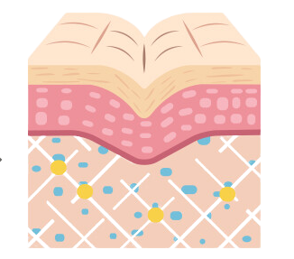
2. Healthy Skin
2) Collagen
Collagen and Skin Elasticity
Our skin loses elasticity as we age because the amount of collagen the body can produce decreases. On average, collagen levels start decreasing after the age of 30 because fibroblasts lose their ability to produce collagen. As the amount of collagen decreases, the skin begins to sag and wrinkle.
What causes wrinkles?
Elasticity maintained
Elasticity gradually lost
Reduction of collagen, elastin, hyaluronic acid

Slide 10
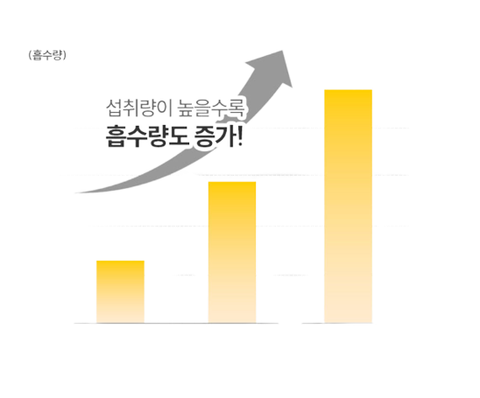
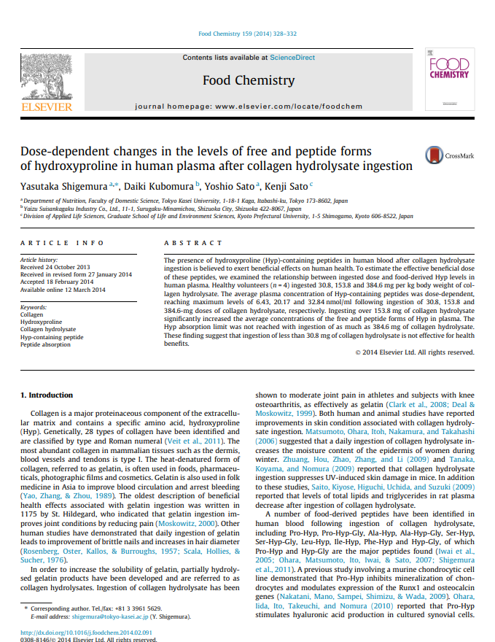
2. Healthy Skin
3) Collagen Intake and Absorption
Collagen Intake vs Absorption Rate
Amount absorbed
Positive Correlation
1,500 mg
8,000 mg
19,000 mg
∙ A study in Food Chemistry, the world’s leading food science journal, found that very high amounts of collagen, 8,000 mg and 19,000 mg per serving, increased absorption compared to 1,500 mg per serving.

Slide 11
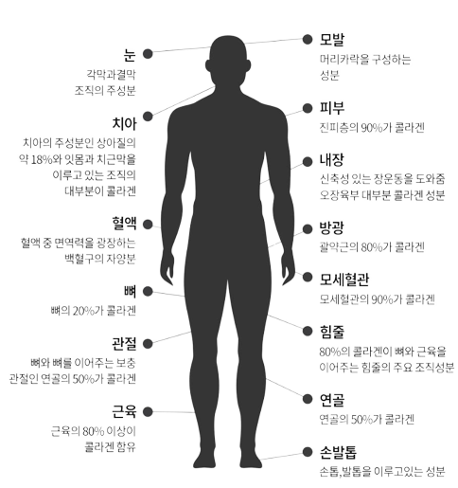
2. Healthy Skin
4) Collagen Within the Body
Collagen in the Body
Eyes
Hair
Main component of corneal
and conjunctival tissue
Main component of hair
Teeth
Skin
Makes up about 18%
of dentin (main
component of teeth)
Main component of gums
and root canals
90% of the dermis is collagen
Intestines
From Head to Toe
Allows for intestinal elasticity
Main component of major organs
Blood
Bladder
Collagen’s biggest role is connecting cells and tissues. Its vast array of threads make numerous connections within the human body.
Collagen is found in all tissues, including skin, muscle, bone, gut, etc.
Nutrients for white blood cells
80% of the sphincter is collagen
Bone
Capillaries
Collagen makes up 20% of bones
90% of capillaries is collagen
Joint
Tendons
Collagen makes up 50% of
joint cartilage
80% of collagen in the body is the
main structural component of tendons
Muscle
Cartilage
Over 80% of a muscle has
collagen within
50% of cartilage is collagen
Nails
Main component of nails (finger, feet)
Source : Hiroshi Hamada, Ph.D., Department of Basic Languages, Faculty of Linguistics, Okayama University of Science, Japan

Slide 12

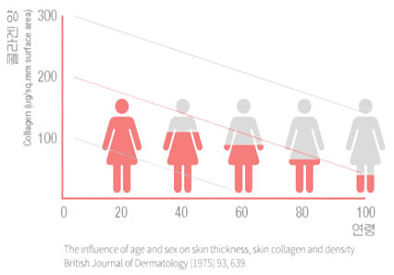
2. Healthy Skin
5) Collagen Loss
What causes collagen loss?
Collagen Production Declines with Age
“The amount of collagen within the body decreases by more than 1% per year in adults. Collagen supplements are necessary to slow skin aging.”
(Source: Korean Journal of Dermatological Surgery, Volume 7, Number 2)
Collagen Amount vs. Age
Decreased skin elasticity is caused by collagen loss
Collagen is worn down and lost daily
The human body synthesizes 1% less collagen every year starting at age 20. By age 40, 30 % less collagen and after 40s, over 30%. This causes a rapid decline in skin elasticity.
Pollution, UV, stress, fatigue, lack of sleep all exacerbate this decline.
Age

Slide 13
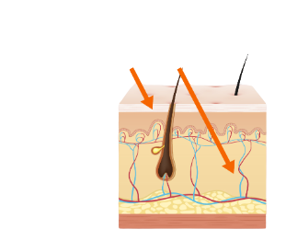
2. Healthy Skin
5) Collagen Loss
What causes collagen loss ?
Skin Damage by UV Causes Collagen Loss
1.3%
Ultraviolet light (UVA) penetrates the dermis, breaking down collagen and decreasing collagen synthesis.
No skincare products used
Collagen loss causes wrinkles and skin aging.
27.6%
41.1%
Unhealthy Lifestyle
UV light
UV B
UV A
29.8%
Natural Aging

Slide 14
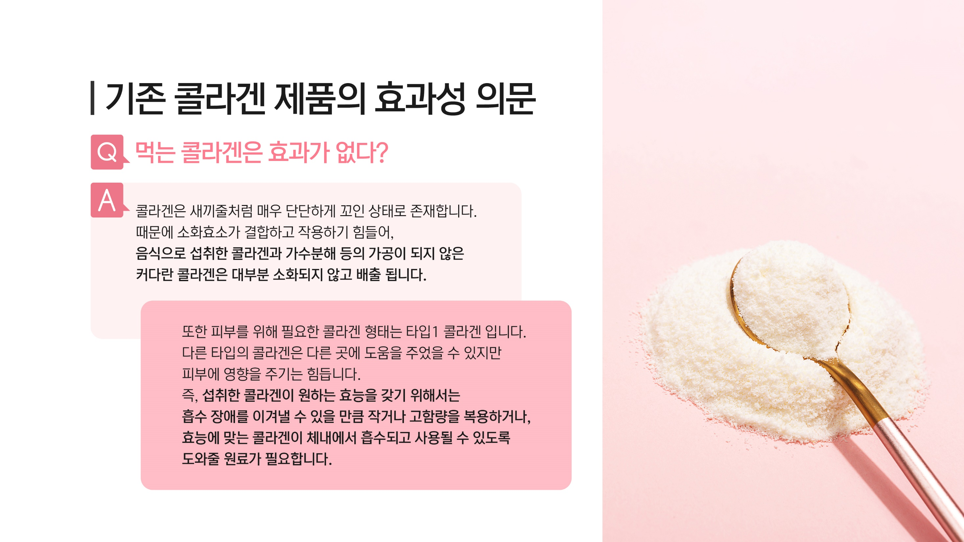
The Effectiveness of Existing Collagen Products
Are collagen supplements effective ?
Collagen exists in a very tightly twisted form, which makes it
difficult for digestive enzymes to bind. Unprocessed collagen
that is ingested is very difficult to hydrolyze and is excreted
without being re-digested.
The collagen necessary for skin health is type 1 collagen.
Other types of collagen that are used in different places
in the body are unlikely to affect the skin. This means that
collagen ingested must be small enough to broken down and absorbed or be in high amounts.

Slide 15
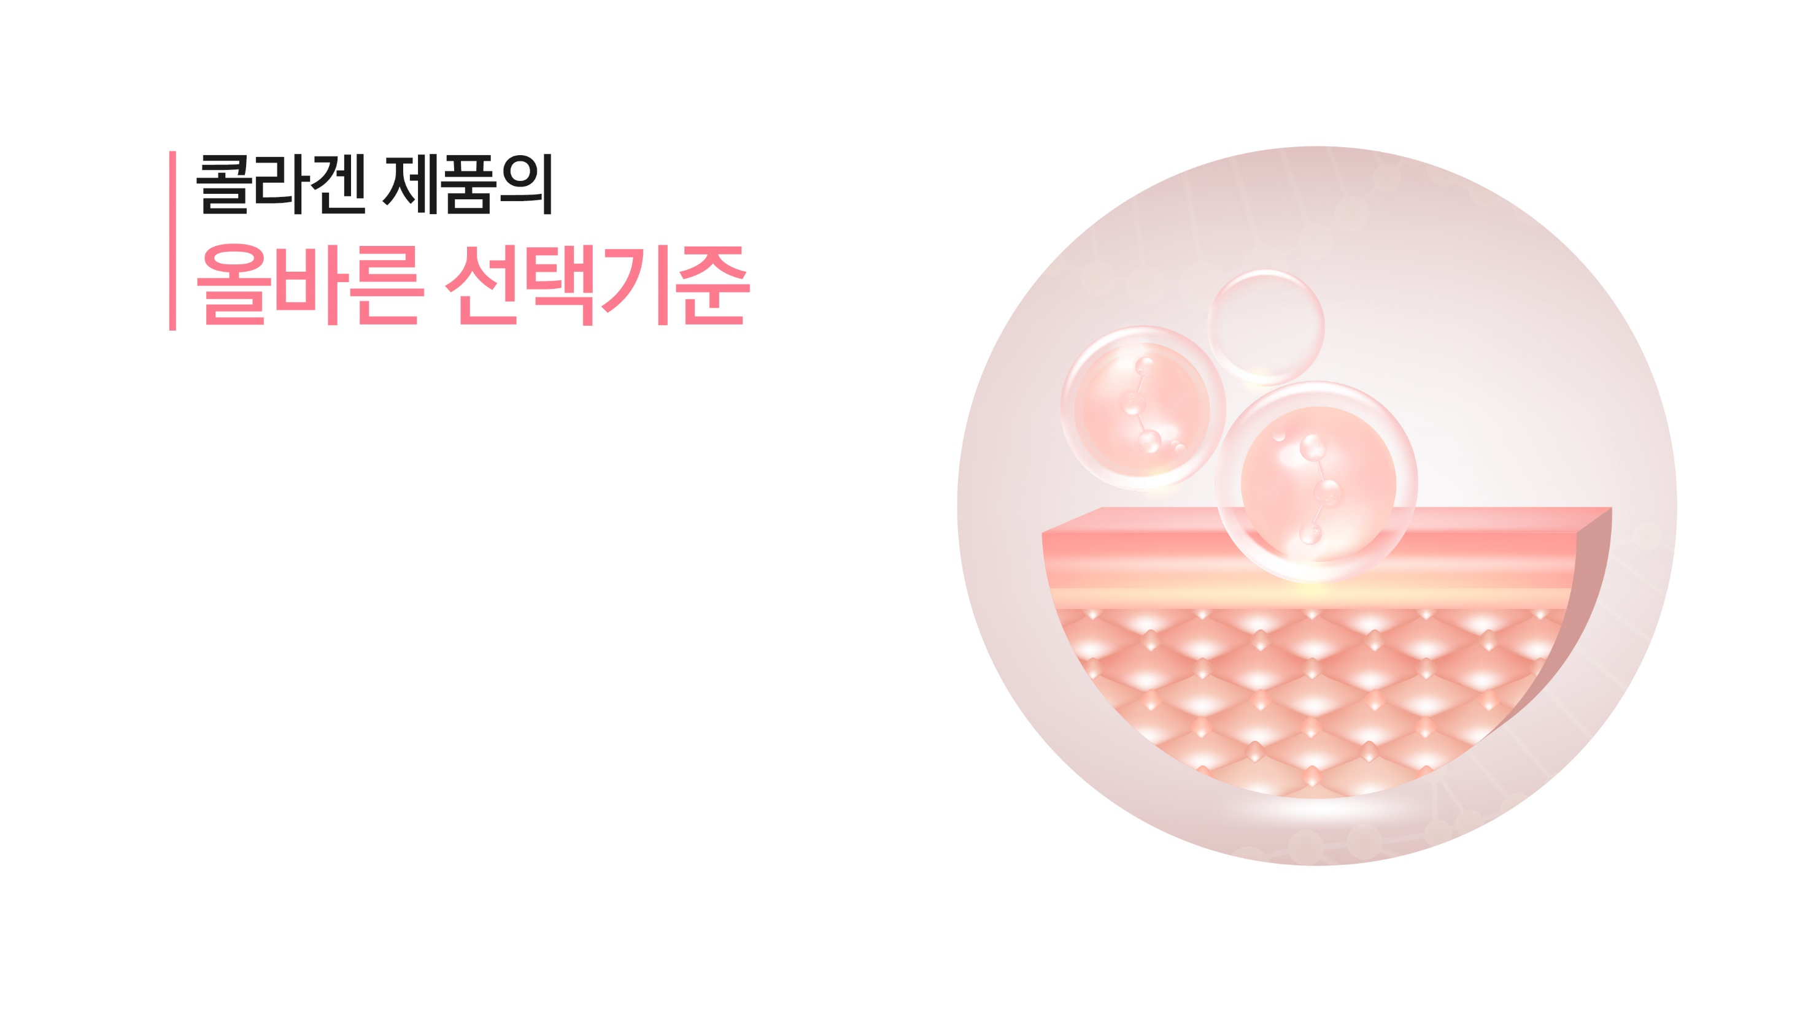
The Features of
Quality Collagen Products

Slide 16
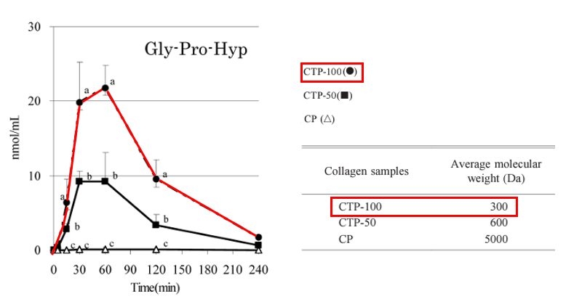
3. What to look for
Quality Collagen
1. Molecule Size
[ Reference ]
Collagen exists in a tightly twisted state, making it difficult for digestive enzymes to bind to it and break it down. Most ingested collagen is undigested and excreted as waste.
The graph shows the difference in absorption amount between a 300 Da and a 5000 Da collagen molecule. The 300 Da molecule is almost 200 times more easily absorbed than the 5000 Da molecule.
Smaller molecules are more easily absorbed!
* Dalton (Da) is a unit measure for molecular weight or mass

Slide 17
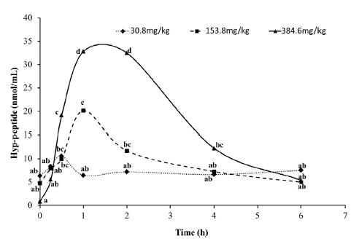
3. What to look for
Quality Collagen
2. Collagen Content
[ Reference ]
Collagen exists in a tightly twisted state, making it difficult for digestive enzymes to bind to it and break it down.
Most ingested collagen is undigested and excreted as waste.
Most studies on the beneficial effects of collagen tested the effects of ingesting 2.5 – 10 grams of collagen per day. Findings from other studies have suggested a daily collagen intake maximum of 20 grams. However, the most important thing is finding the right amount for you.

Slide 18
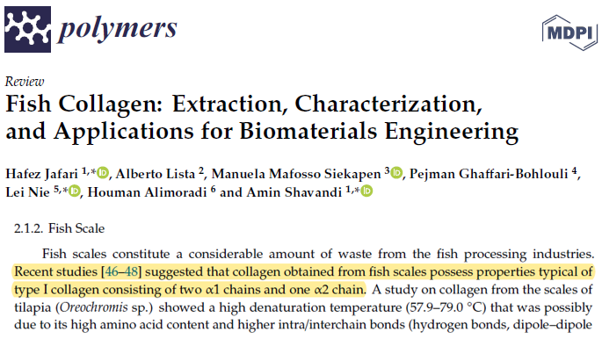
3. What to look for
Quality Collagen
3. Collagen Type
[ Reference ]
When looking for collagen supplements, supplements with type 1 collagen are recommended. Information about the type of collagen may not be provided, but it knowing the source can help.
Collagen derived from fish, not animals is type 1 collagen.
“Recent studies suggest that collagen from fish scales is composed of two alpha1 and alpha 2 chains, which are characteristic of type 1 collagen.”

Slide 19
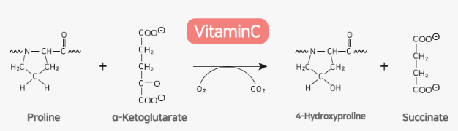
3. What to look for
Quality Collagen
4. Synergetic Ingredients
[ Reference ]
Vitamin C is a coenzyme that is essential for collagen synthesis. The amino acid, hydroxyproline (Hyp), is produced with the help of vitamin C.
▶Vitamin C is essential for collagen synthesis

Slide 20
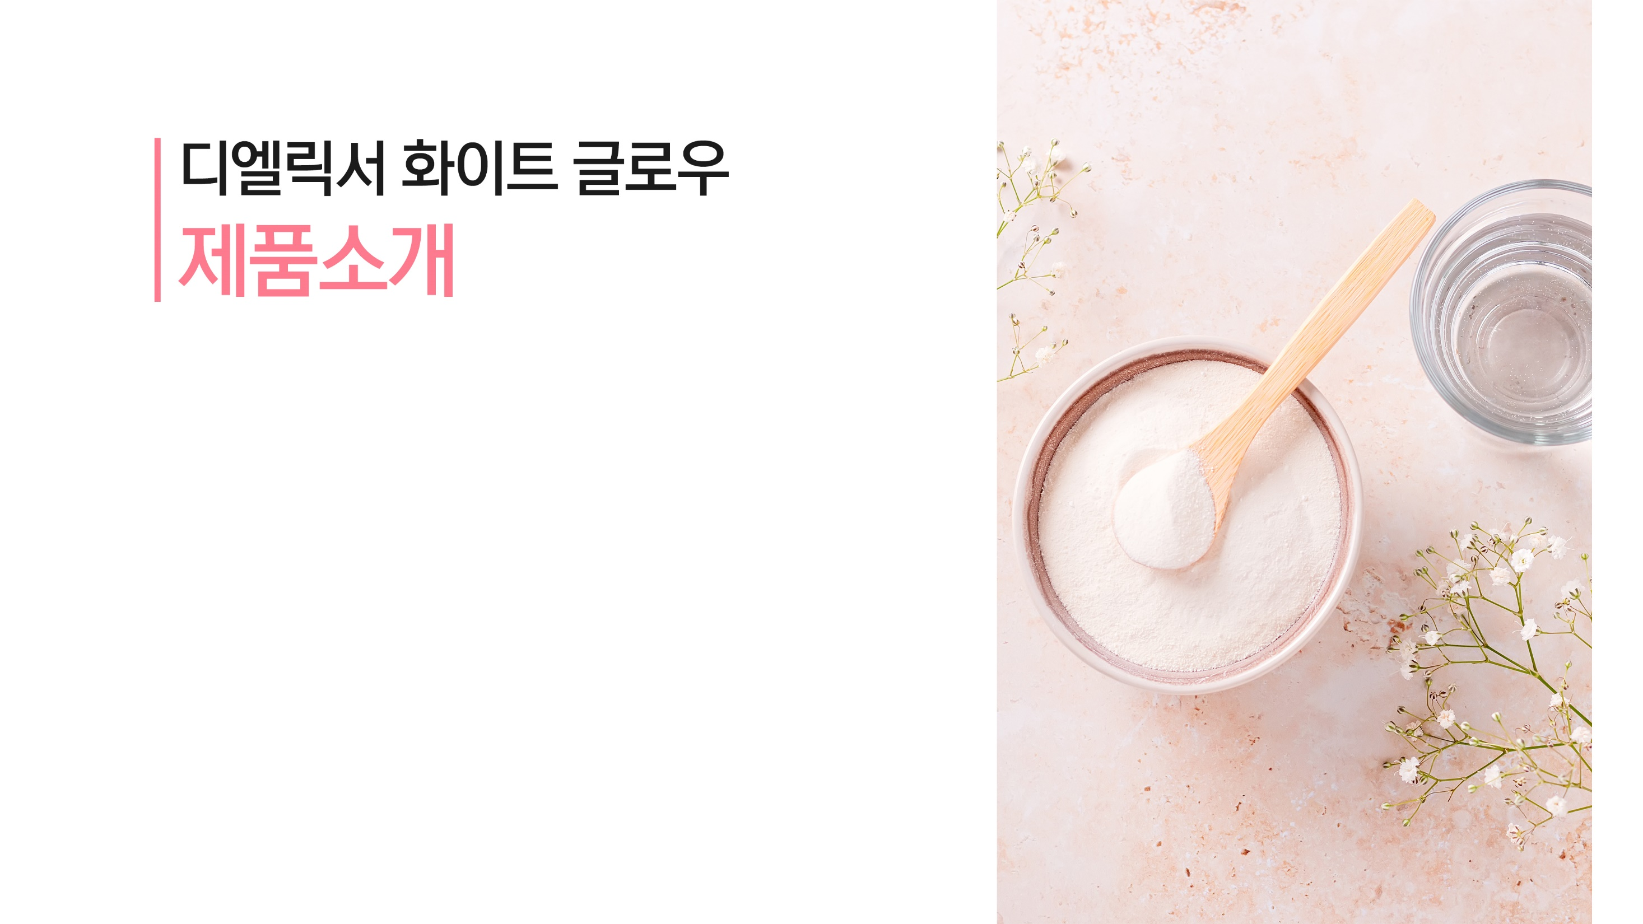
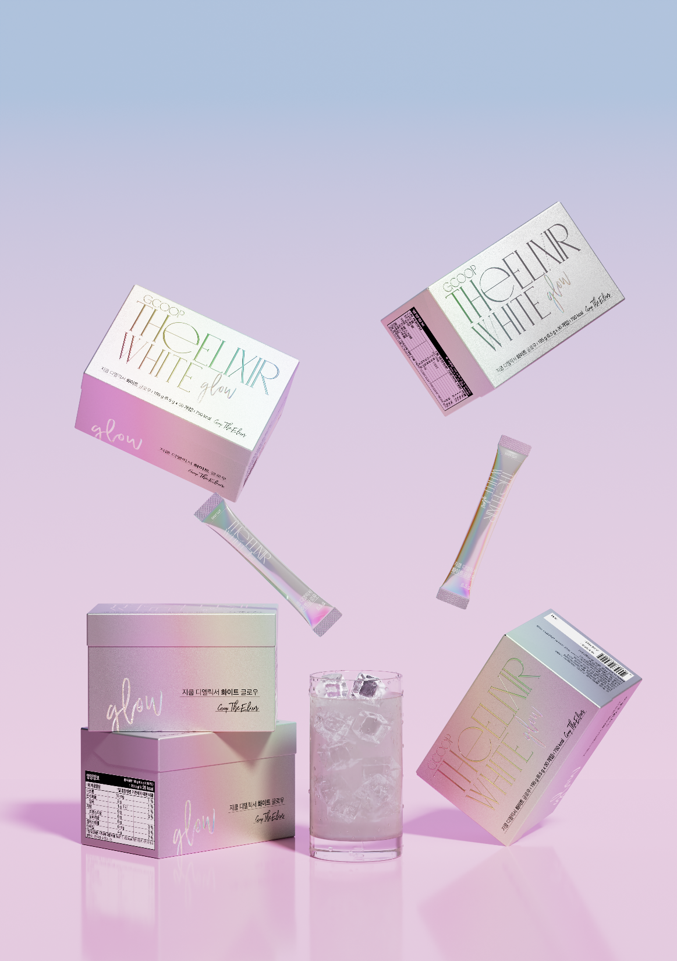
THEELIXIR White Glow
Product Introduction

Slide 21
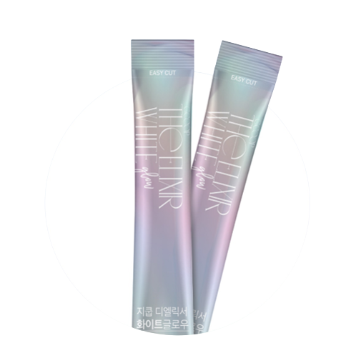
Product Features
01
Wrinkle + Tone + Moisture all-in-one care!
02
Micro molecules for maximum efficiency
03
White tomato extract for synergy
04
Includes glutathione, elastin, vitamin c, biotin
05
Includes organic phytonutrients

Slide 22
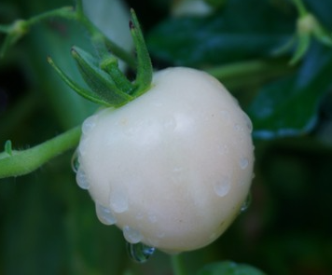
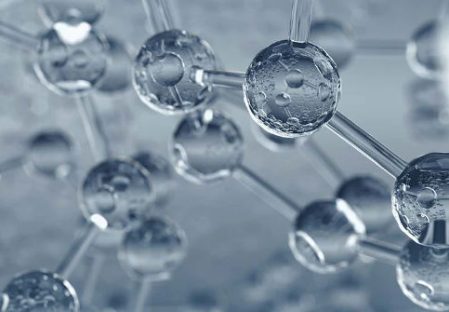
3. What to look for
Quality Collagen
Chapter 01
Wrinkle + Tone + Moisture all-in-one care!
Total inner beauty care with solutions for various skin concerns.
Collagen
White Tomato
Hyaluronic Acid
Wrinkles & Elasticity
Skin Tone
Moisturization
#Skin Rejuvenation
#UV Protection
#Moisture Lock

Slide 23
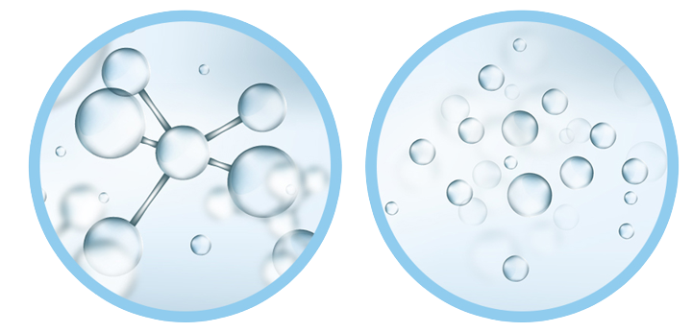
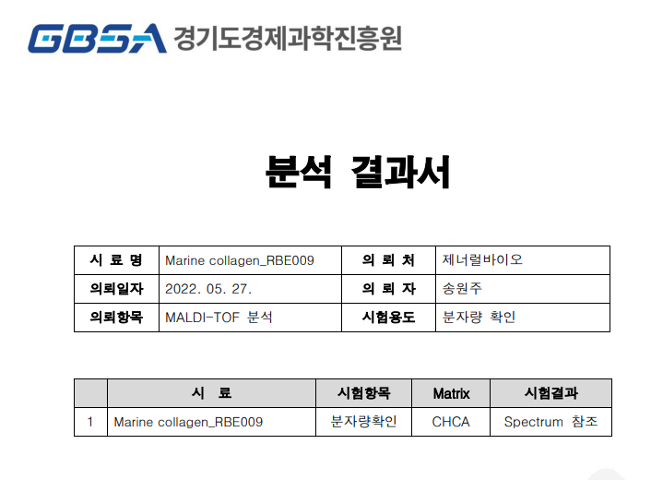
3. What to look for
Quality Collagen
Chapter 02
Micro molecules for maximum efficiency
Smaller and concentrated collagen molecules are better absorbed
Normal collagen
(animal)
Micro molecule collagen
(fish)
[Analysis of Collagen Molecule Size in the Product]
300,000 Da
300 Da
Absorption rate 2%
Absorption rate 84%
Average molecular weight excluding matrix peak: 308.6 Da
The smaller fish collagen molecules are 42 times more absorbable than the much larger animal collagen molecules.

Slide 24
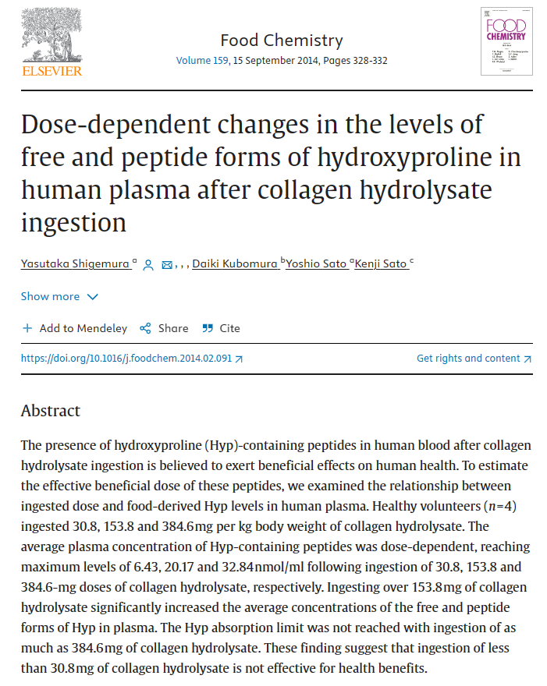
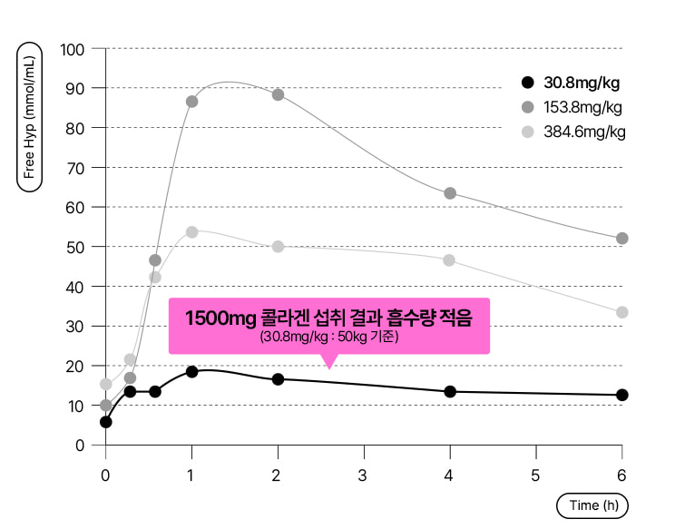
3. What to look for
Quality Collagen
Chapter 02
Micro molecules for maximum efficiency
Smaller and concentrated collagen molecules are better absorbed
Collagen absorption rate is proportional to the amount consumed, making highly concentrated collagen molecules that much more effective.
Results of a study analyzing collagen content and absorption indicate that consuming a low dose of 1500 mg per day has no significant effect in blood collagen levels.

Slide 25
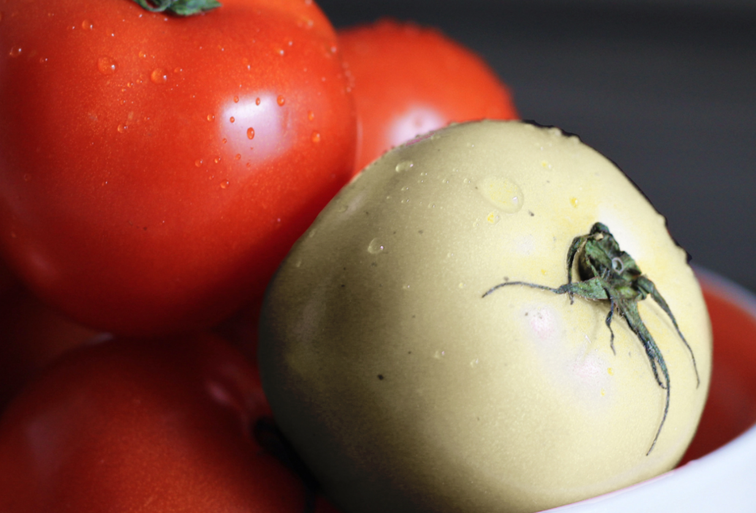
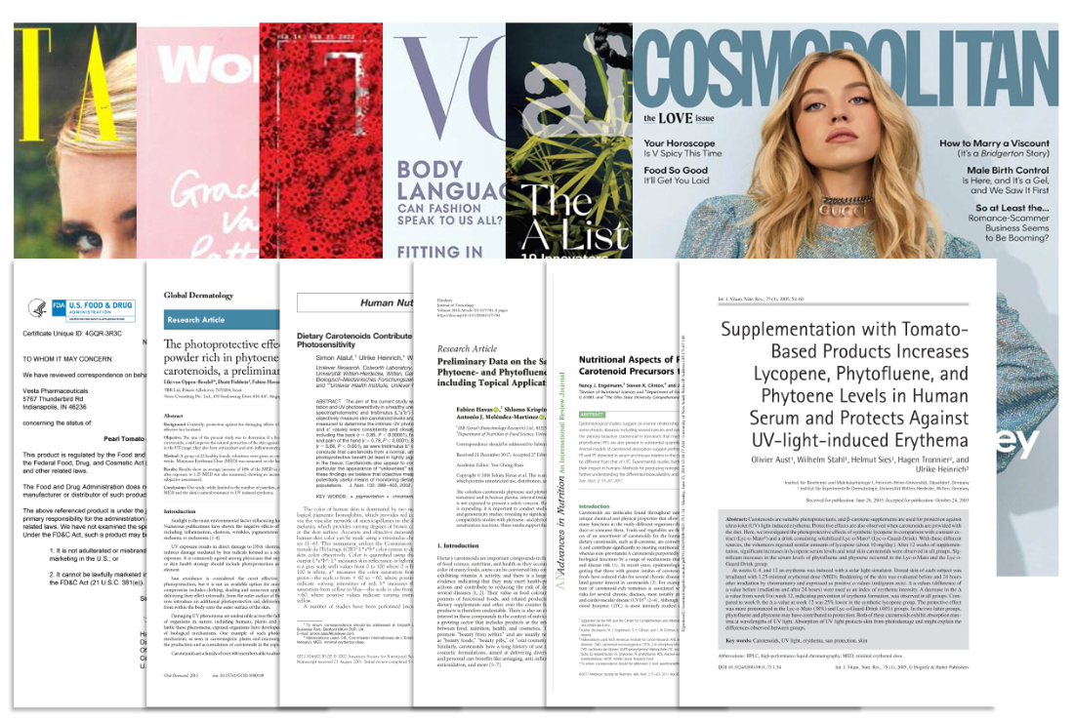
3. What to look for
Quality Collagen
Chapter 03
Organic White Tomato
Brightens and improves skin tone
White Tomato
Rich in colorless carotenoids phytoene & phytofluene*
Reduces melanin in melasma and freckles
The new and upcoming inner beauty food
Phytoene & Phytofluene
Colorless carotenoids in white tomatoes are 400 times more effective than those found in regular tomatoes.
Phyotene and Phytofluene are rare components among carotenoids that protect plants from free radical caused by UV radiation.
Phytoene: Blocks UVB rays, Phytofluene: Blocks UVA rays

Slide 26

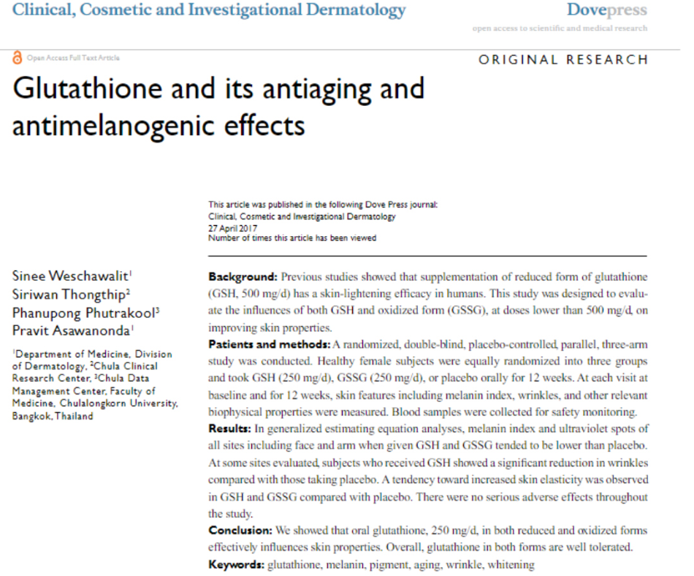
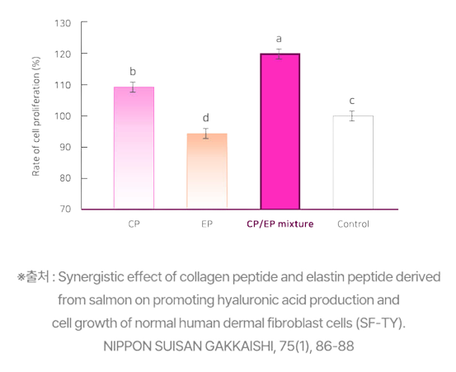
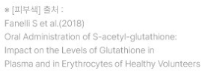
3. What to look for
Quality Collagen
Chapter 04
Synergetic Ingredients
- Glutathione, Hyaluronic acid, Elastin, Vitamin C, Biotin, etc.
1. Glutathione
What is it ?
Glutathione is an amino acid compound made up of 3 amino acids made in the liver. It is an antioxidant that plays an important role in oxidation-reduction reactions in the body.
Use on Skin
〮 As an antioxidant, glutathione protects cells against oxidation. As we age, glutathione levels in the body decrease.
〮 A 2018 study showed that subjects that took glutathione orally had improved skin tone compared to the control group.

Slide 27

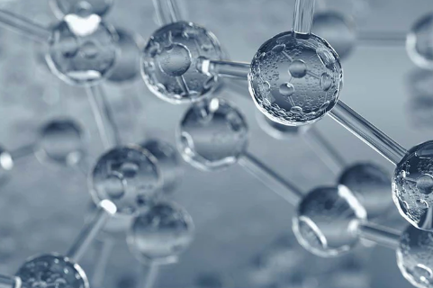
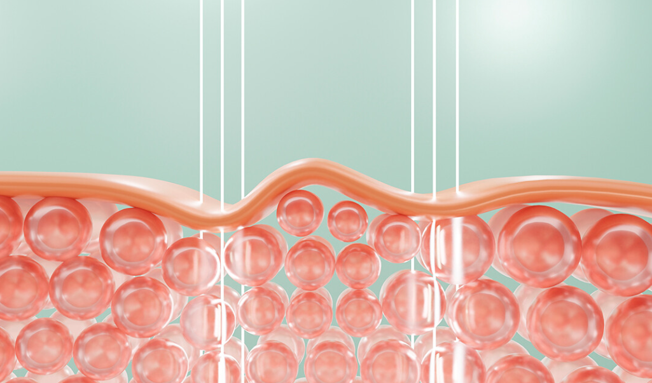
3. What to look for
Quality Collagen
Chapter 04
Synergetic Ingredients
- Glutathione, Hyaluronic acid, Elastin, Vitamin C, Biotin, etc.
2. Hyaluronic Acid
3. Elastin
Hyaluronic acid can attract more than 1,000 times its own weight in water. This property makes it a common ingredient in skincare products for moisturization.
Elastin is one of the three main components of the dermis. It is a stretchy and elastic protein that supports the collagen structure within the skin.

Slide 28
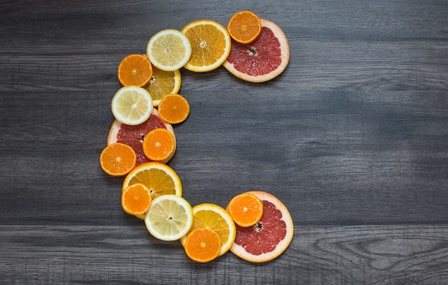
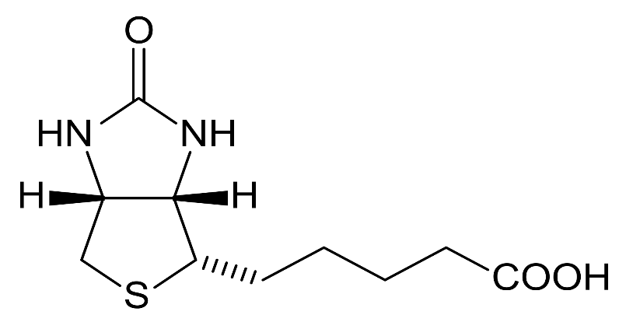
3. What to look for
Quality Collagen
Chapter 04
Synergetic Ingredients
- Glutathione, Hyaluronic acid, Elastin, Vitamin C, Biotin, etc.
4. Vitamin C
5. Biotin
Vitamin C is an important nutrient for the body as it acts as a coenzyme for collagen synthesis and as an antioxidant that protects cells from free radicals.
Biotin is a vitamin that is essential for the metabolism of carbohydrates, fats, and proteins and energy production. It is functional ingredient recognized by the Korean Ministry of Food and Drug Safety.

Slide 29




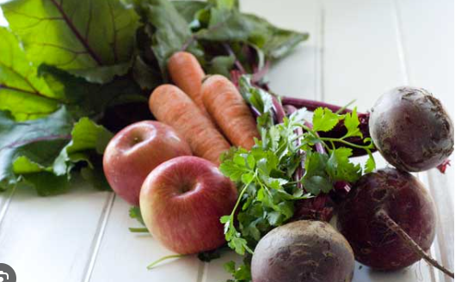
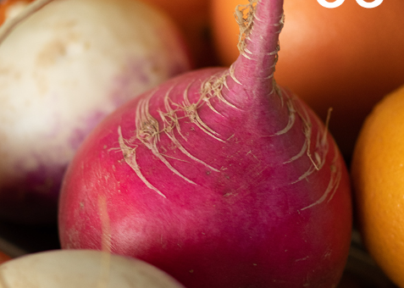
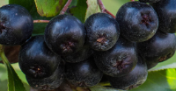

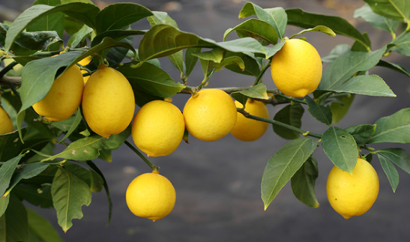
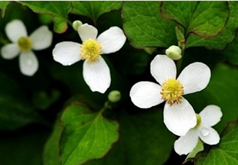
3. What to look for
Quality Collagen
Chapter 05
Organic Phytonutrients
10 supplementary ingredients in every packet
Organic ABC
(Apple, Beet, Carrot)
Organic tangerines
Organic Goji berries
Organic green tea
Organic celery
Organic Beet
Organic Aronia berries
Organic Kohlrabi
Organic lemon
Organic fish mint
A healthy blend of quality phytonutrients that support skin health.

Slide 30
3. What to look for
Quality Collagen
Recommend for
〮 Those who want a quality inner beauty product.
〮 Those who want to improve skin elasticity.
〮 Those that want to improve skin tone.
〮 Those worried about UV damage on the skin.
〮 Those in search of a product that is taken once a day.
〮 Those looking for healthy antioxidants.

Slide 31


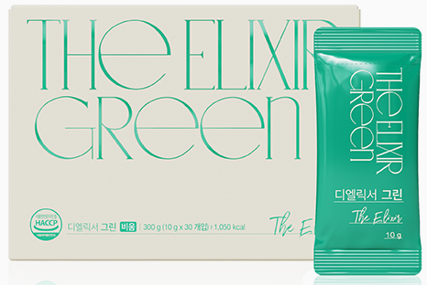
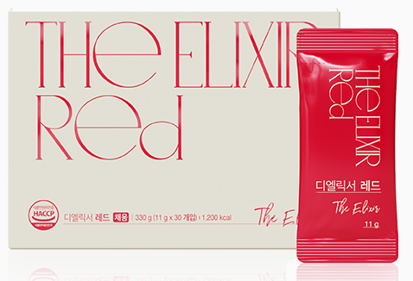
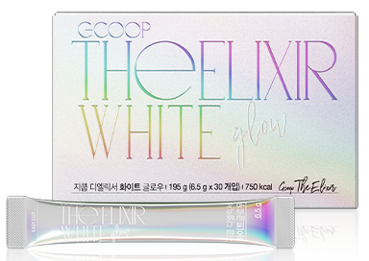
- Find Your True Beauty-
Emptying
Filling
Inner Beauty (Skin)
Cleansing Detox
Healthy Balance
Confidence Within

Slide 32
This document is for internal educational purposes for members and is not intended for advertising/promotional purposes
COPYRIGHT © 2023 GCOOP All Rights Reserved.

