Slide 1
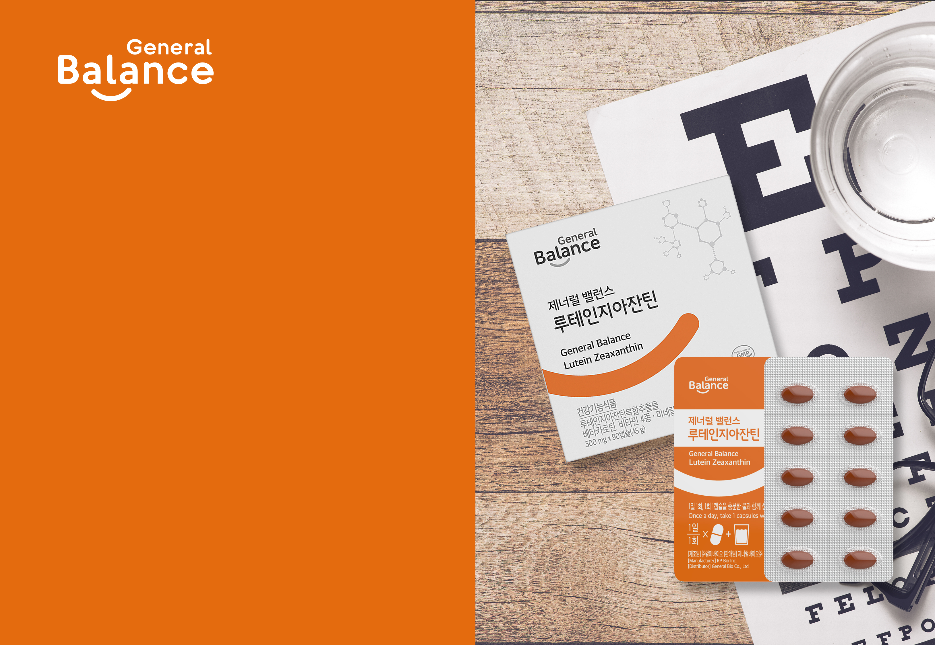

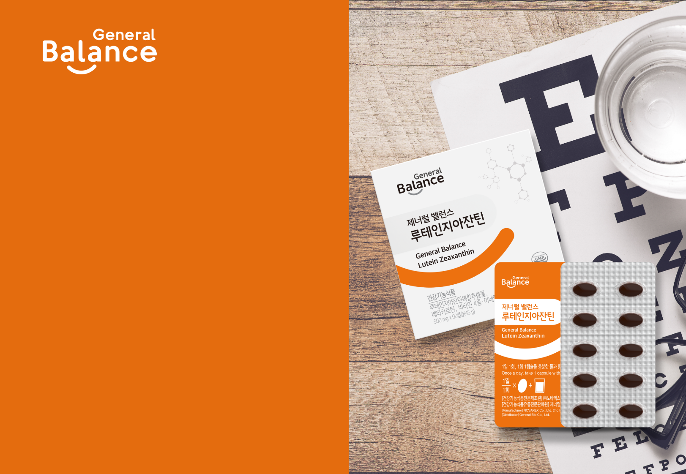
General Balance Lutein Zeaxanthin
This material is not approved by the FDA and it is not intended for the prevention and treatment of disease.

Slide 2
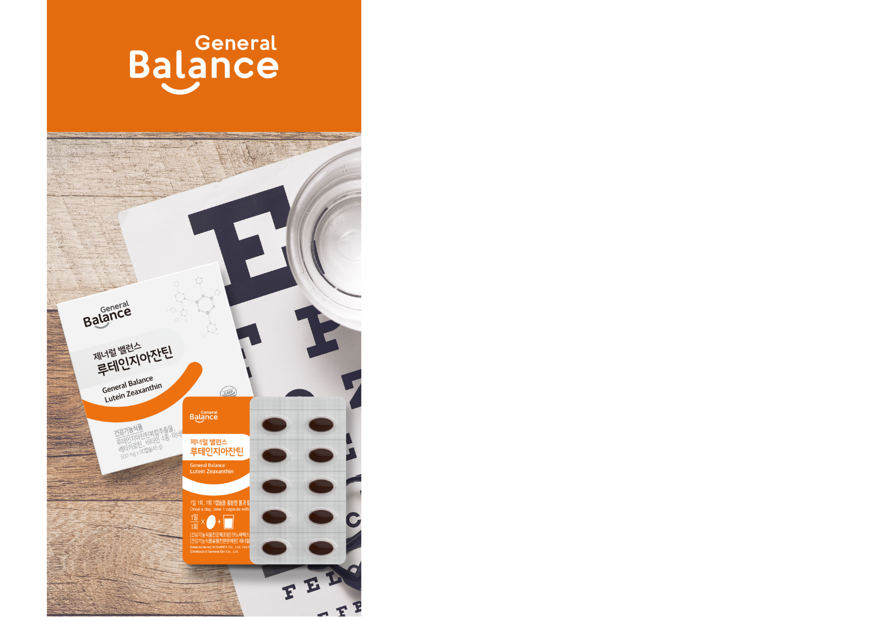
General Balance
Lutein Zeaxanthin
1. General Information
2. Product Features
3. Main Ingredient
4. Recommended for
5. Health Information
* This document is meant only for internal training and
shall be kept confidential. It is prohibited to disclose or post any information included in this document.

Slide 3
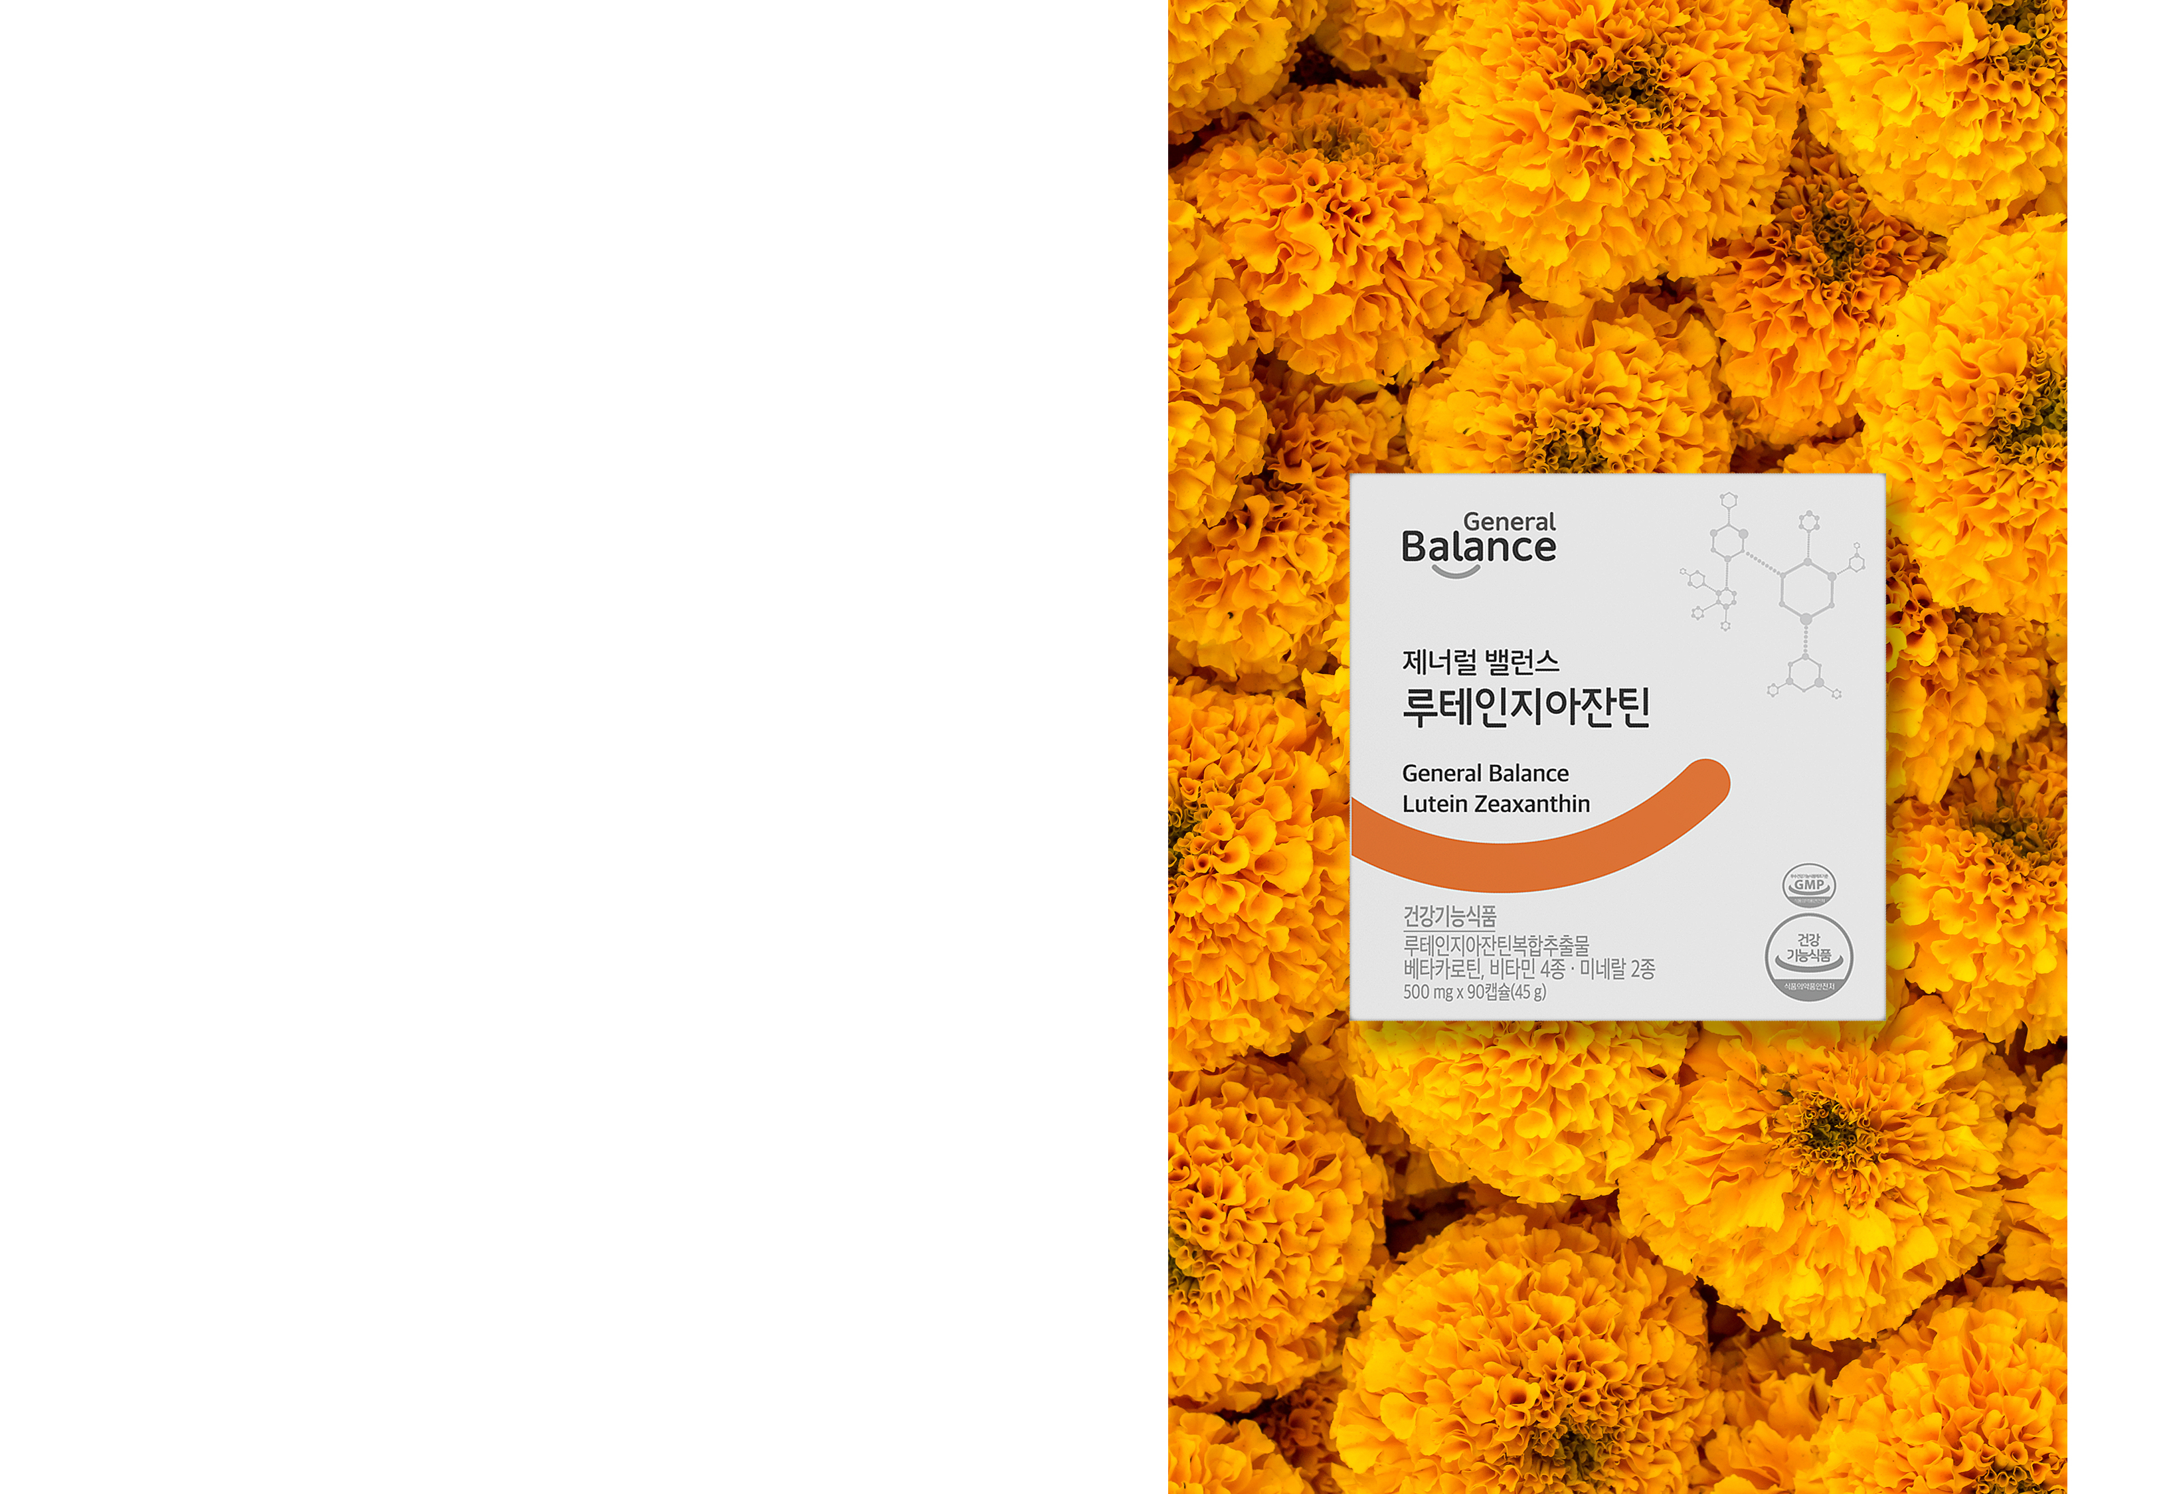
General Information
+ Product Name : General Balance Lutein Zeaxanthin
+ Product Type : Dietary Supplement
+ Net Wt. : 500 mg x 90 capsules (45 g)
+ Ingredients : Lutein Zeaxanthin Complex Extract (No. 2018-4), Beta-Carotene Oil, Vitamins A-B6-C-E, Zinc, Selenium, and more.
+ Suggested Use : Take one capsule once a day.
Precautions
- Infants, toddlers, children, those pregnant or nursing must use this product with caution.
- Excessive consumption may cause skin to temporarily turn yellow.
- Stop use of this product immediately if you experience any allergic reaction or adverse symptoms and seek medical attention.
- Do not consume after expiration date.
- Do not consume the desiccant in the container.

Slide 4
Product Features
1. Lutein + Zeaxanthin
2. Lutein Zeaxanthin Complex Extract (No.2018-4)
3. 8-in-1 capsule for efficiency
4. Additional ingredients for eye health
5. Vegetable capsule with no gelatin or artificial flavors

Slide 5
Main Ingredient :
Lutein Zeaxanthin
1. Lutein
Lutein extracted from Marigold flowers, is a component of the macular pigment that plays an important role in vision. Taking lutein increases macular pigment optical density, improving visual function and protecting against age-related macular degeneration (AMD).
2. Zeaxanthin
Like Lutein, Zeaxanthin is also a component of the macular pigment. However, as it is not naturally produced by the body, it is important to take supplements that contain this.

Slide 6
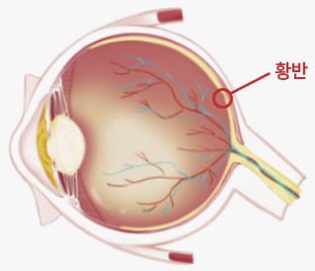
Main Ingredient :
Lutein Zeaxanthin
Macula
The macula is the round area at the center of the retina at the back of the eyeball. It processes your central vision.
Macula
Zeaxanthin
Zeaxanthin concentrated at the center of the macula protects central vision.
Lutein
Lutein is found towards the periphery and protects peripheral vision.

Slide 7
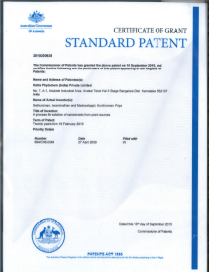
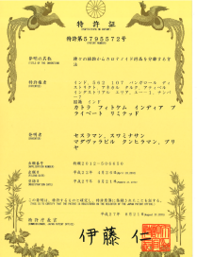
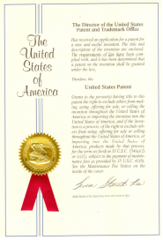
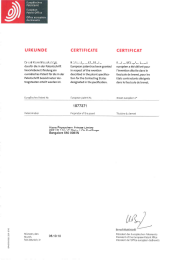
Lutein Zeaxanthin Complex Extract
Lutein-Zeaxanthin Complex Extract (No. 2018-4) is a standardized blend of natural lutein and natural trans-zeaxanthin (3R,3'R-zeaxanthin) extracted from marigold flowers in a 10:1 ratio. The manufacturer, Katra Phytochem Pty Ltd, India, is a pioneer in the field of marigold carotenoids and has been granted patents in Australia, Japan, the United States, and Europe for products containing a blend of lutein and natural zeaxanthin.
[AU 2010200636]
[JP 5,795,572]
[US 8,481,769]
[EU 1877371]

Slide 8
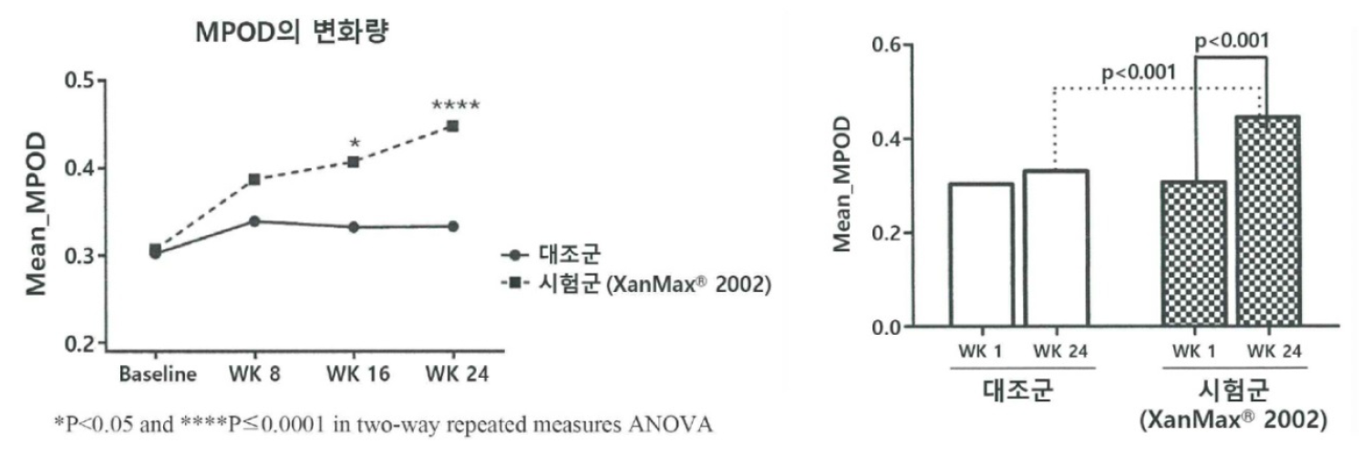
Clinical Trial Result
Male and female subjects aged 45 – 65 years old were given Lutein Zeaxanthin Complex Extract (No. 2018-4) for 24 weeks (180 days). Subjects shows an increase in macular pigment density compared to control group.
Change in MPOD
Control
Exp.
Control
Experimental
* MPOD(Macula Pigment Optical Density) : Macular pigment density in the retina
Institution : Narayana Nethralaya Eye Hospital
Subjects : 60 male and females volunteers aged 45-65 years old with MPOD 0.2-0.4
Conditions : 180 days of intake, 3 measurements at 60-day intervals.
Result : The group taking Lutein Zeaxanthin Complex Extract (No. 2018-4) showed a 44.9% increase in macular pigment density after 180 days with a statistically significant difference (p<0.001) from the control group.
Results may not apply to everyone
[Source] A randomized, double blind, placebo controlled, parallel study to evaluate the comparative 2002 oral soft gel capsule with that of a placebo soft gel capsule efficacy of XanMax improving MPOD levels in elderly volunteers.

Slide 9
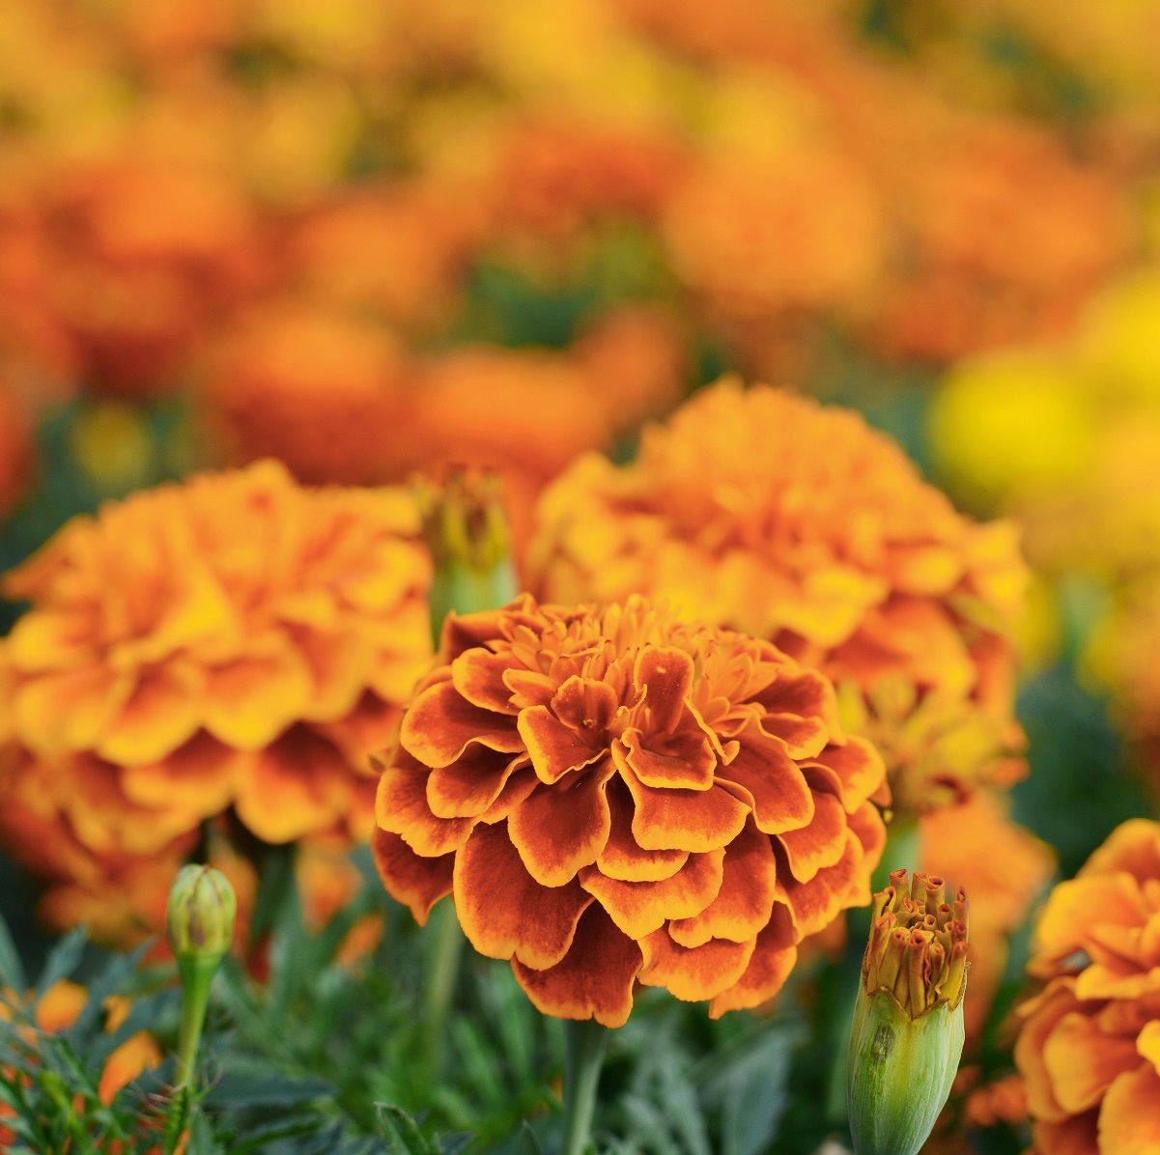
8-in-1 Efficiency
Lutein Zeaxanthin Complex Extract (No.2018-4) contains the maximum 20mg of lutein and zeaxanthin recommended by the Korean Ministry of Food and Drug Safety along with 7 other compounds for eye health.
Beta-Carotene
VitaminA
VitaminB6
Lutein Zeaxanthin 20 mg
(10:1)
[Lutein Zeaxanthin Complex Extract] May support eye health by maintaining macular pigment density, which can decrease with age.
[Beta-Carotene] Needed for visual adaptation in low light and to build and maintain the function of skin and mucous membranes.
[Vitamin A] Needed for visual adaptation in low light and to build and maintain the function of skin and mucous membranes.
[Vitamin B6] Needed to utilize proteins and amino caids. Helps maintain normal blood homocysteine levels.
[Vitamin C] Needed to build and maintain connective tissue. Absorbs iron and protects cells from free radicals.
[Vitamin E] Helps protect cells against free radicals.
[Zinc] Needed for normal immune function and normal cell division.
[Selenium] Helps protect cells from free radicals.
VitaminC
VitaminE
Selenium
Zinc

Slide 10
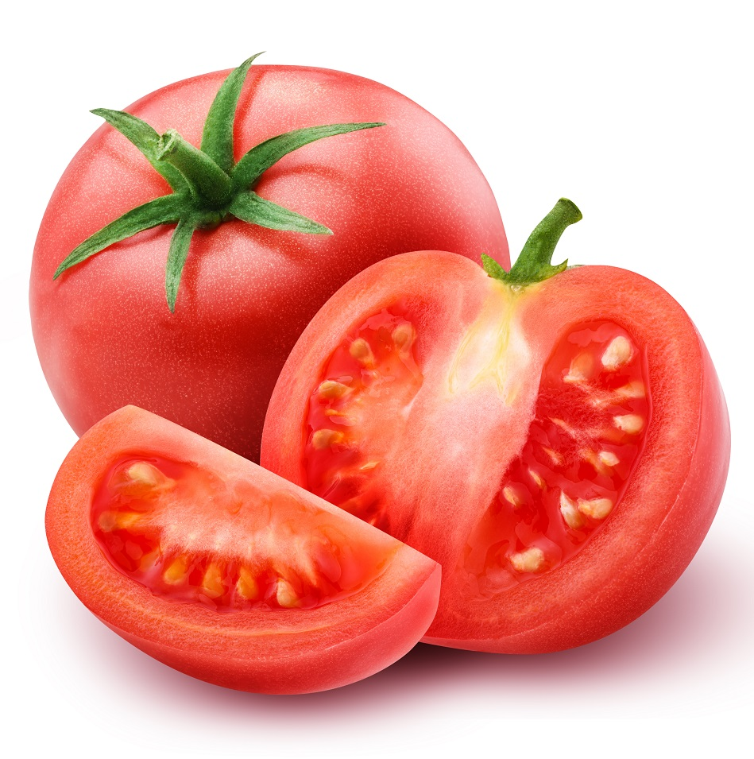
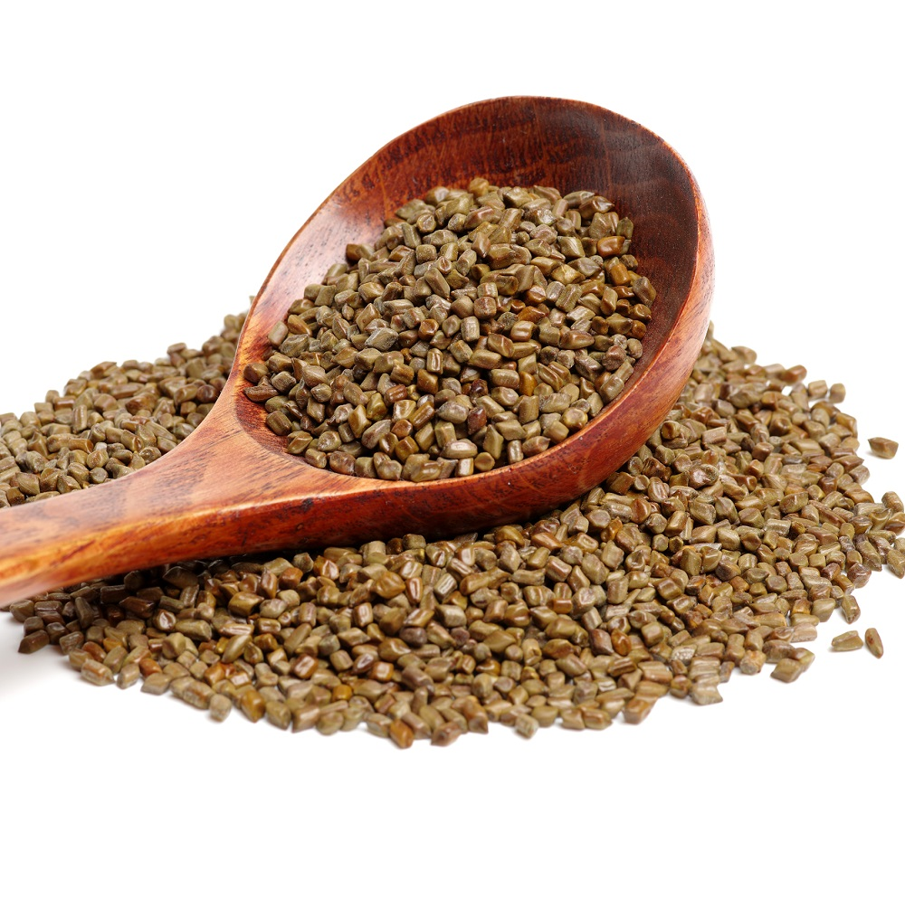
Additional Ingredients
General Balance Lutein Zeaxanthin contains additional ingredients such as tomato, cassia seed, blueberry, and bilberry extract powder that may support eye health.
Tomatoes contain the antioxidant lycopene, which can help prevent dry eyes and night blindness.
Tomato Extract Powder
The carotenes in cassia seeds are a precursor to Vitamin A. Vitamin A can help reduce redness in the eyes, fatigue, and optic nerve diseases.
Cassia Seed Extract Powder
* Description limited to characteristics of raw materials

Slide 11
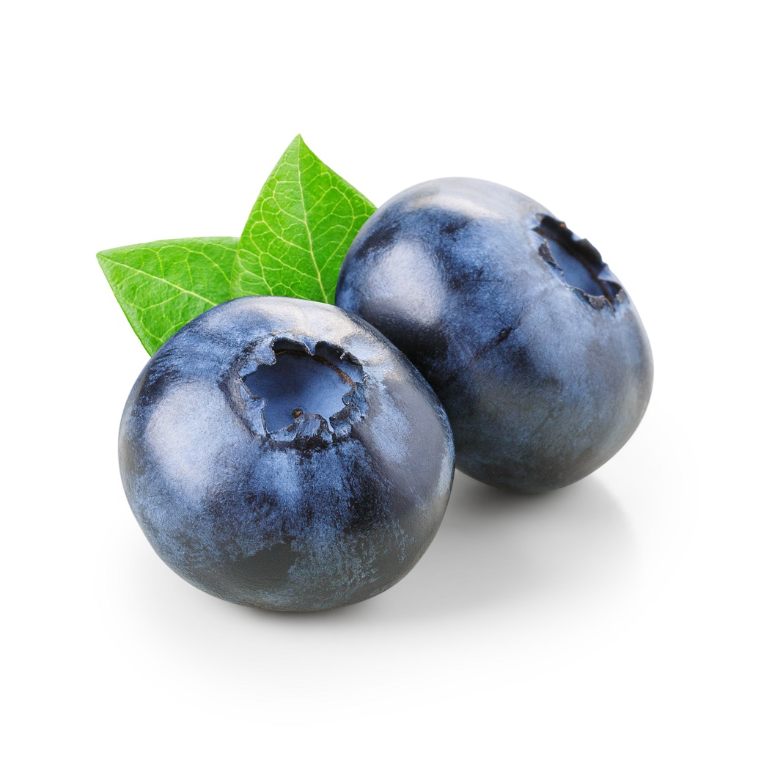
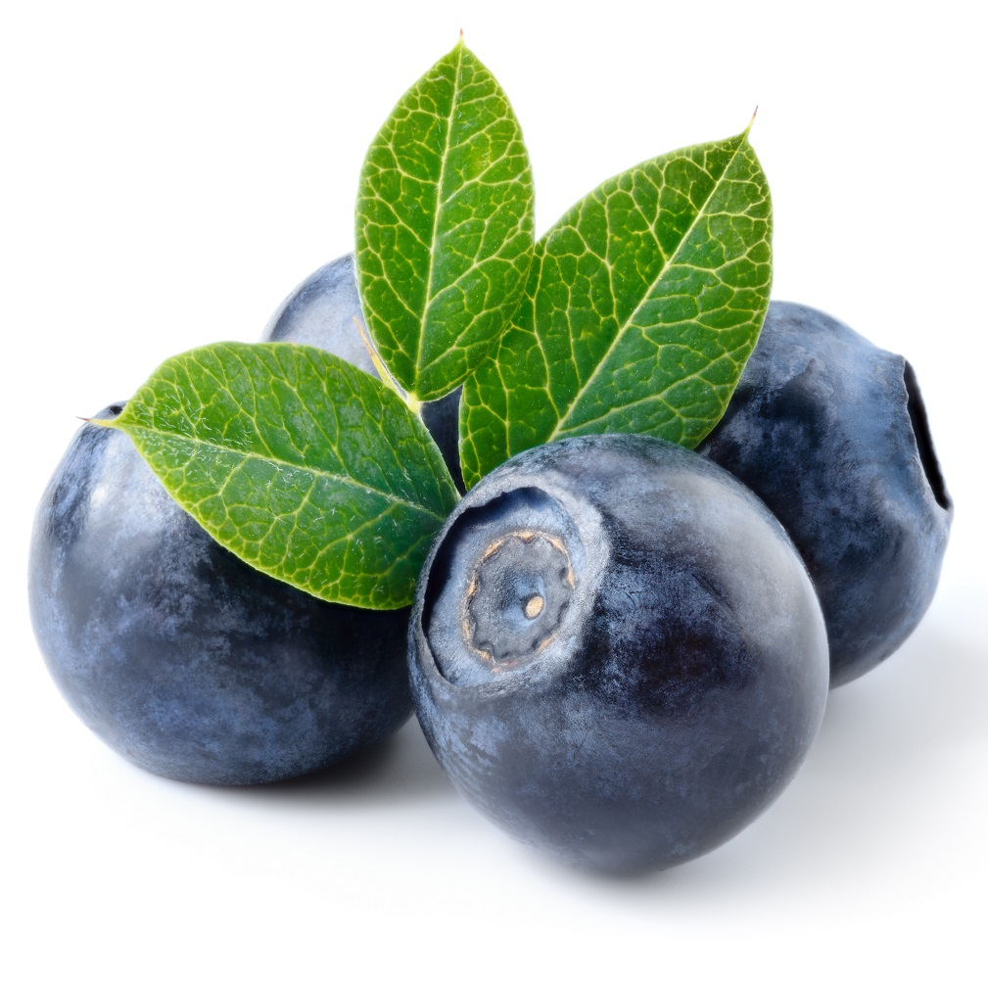
Additional Ingredients
General Balance Lutein Zeaxanthin contains additional ingredients such as tomato, cassia seed, blueberry, and bilberry extract powder that may support eye health.
One of Time magazine’s top 10 “superfoods,” blueberries are rich in anthocyanins and polyphenols, giving them powerful antioxidant and vision-protecting properties.
Blueberry Extract Powder
Similar in appearance to blueberries, bilberries are rich in antioxidants - anthocyanins and polyphenols. They are characterized by their purple color, outside and inside.
Bilberry Extract Powder
* Description limited to characteristics of raw materials
[Source] Fruits and Vegetables for Eye Health BEST 8..“Food to Look for” | BreakNews
4 Foods for Eye Health | Health Chosun

Slide 12
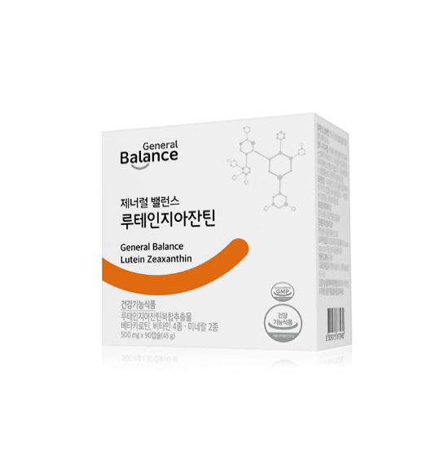
Plant-based Capsules
General Balance Lutein Zeaxanthin capsules are not made with animal products. The capsules are vegetarian soft gel capsules made with carrageen, starch, and red algae.
Plant-Based
Carrageen, Starch
Gelatin
Animal product
Synthetic
flavors

Slide 13
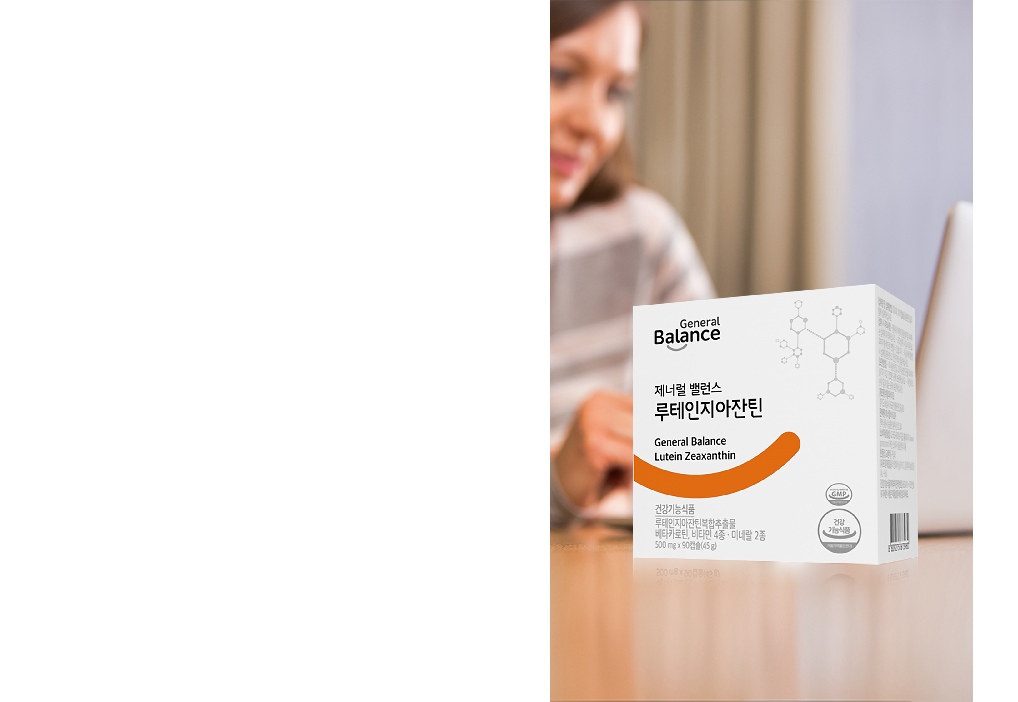

Recommended for
1. Those who want Lutein and Zeaxanthin
2. Those concerned about AMD
3. Those who spend all day in front of a computer
4. Teens and young adults studying
5. Those who are outside a lot and are exposed to UV rays
6. Those who work late or drive long distances

Slide 14

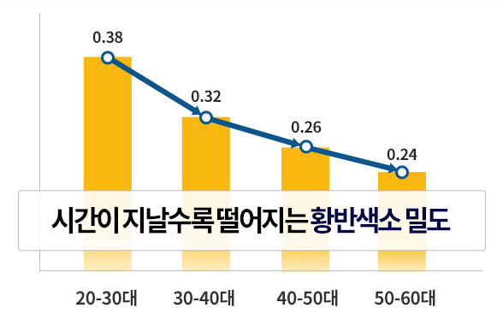
Health Information
As we age, the macula becomes more important as it plays an important role in maintaining vision.
Macular pigment density decreases with age, leading to condition called macular degeneration that can significantly reduce vision. Studies have shown that people in their 50s and 60s have half the macular pigment density of those in their 20s.
Macular pigment density decreases with time
Ages
[Source] Risk factors for age-related maculopathy are associated with a relative lack of macular pigment (Experimental Eye Research 2007 Jan;84(1):61-74)

Slide 15
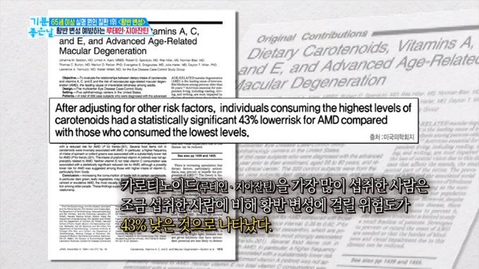
Health Information
Take Lutein and Zeaxanthin
together for Maximum Benefit
The American Medical Association found that “people who consumed lutein and zeaxanthin daily have 43% lower risk of macular degeneration than those who did not.”
The American Academy of Clinical Nutrition found that “consistent intake of lutein and zeaxanthin can lower the risk of cataracts by 22%.”
[Source] Dietary Carotenoids, Vitamins A, C, and E, and Advanced Age-Related Macular Degeneration (JAMA. 1994 Nov 9;272(18):1413-20)

Slide 16
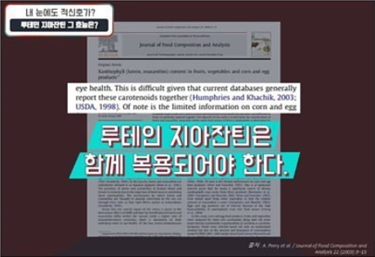
Health Information
Take Lutein and Zeaxanthin together
for Maximum Benefit (continued)
8.9% improvement in visual acuity with lutein alone. 12.1% with zeaxanthin.
22% lower risk of cataracts when lutein and zeaxanthin are taken together
People with higher blood zeaxanthin levels have 93% reduced risk of developing AMD.
[Source] Xanthophyll (lutein, zeaxanthin) content in fruits, vegetables and corn and egg products (Journal of Food Composition and Analysis 2009 Feb;22(1):9-15)

