Slide 1
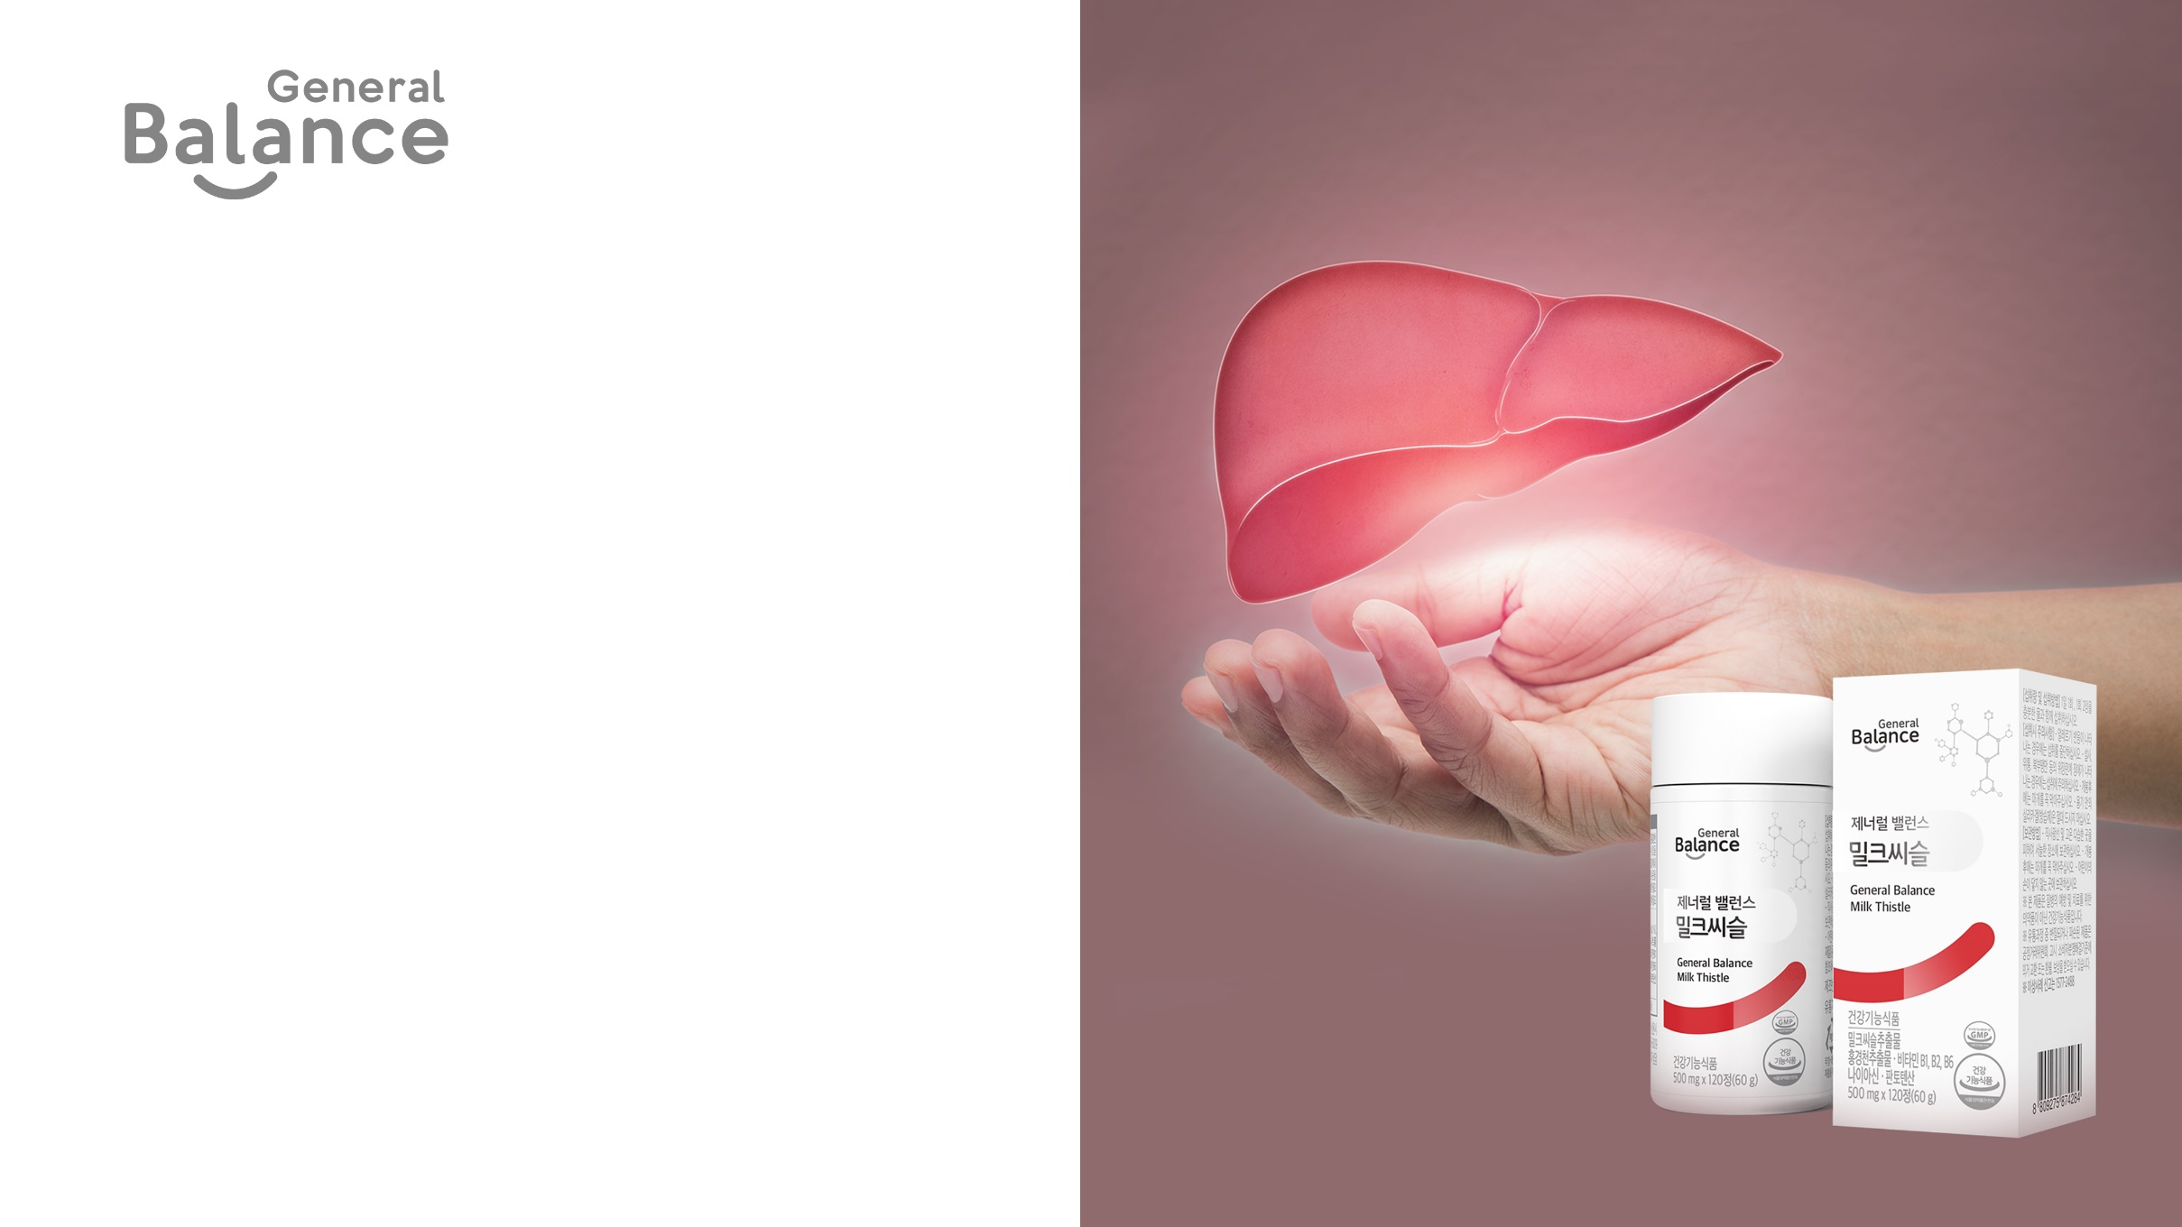
General Balance
Milk Thistle
This material is not approved by the FDA and this product
is not intended for the prevention and treatment of disease.

Slide 2
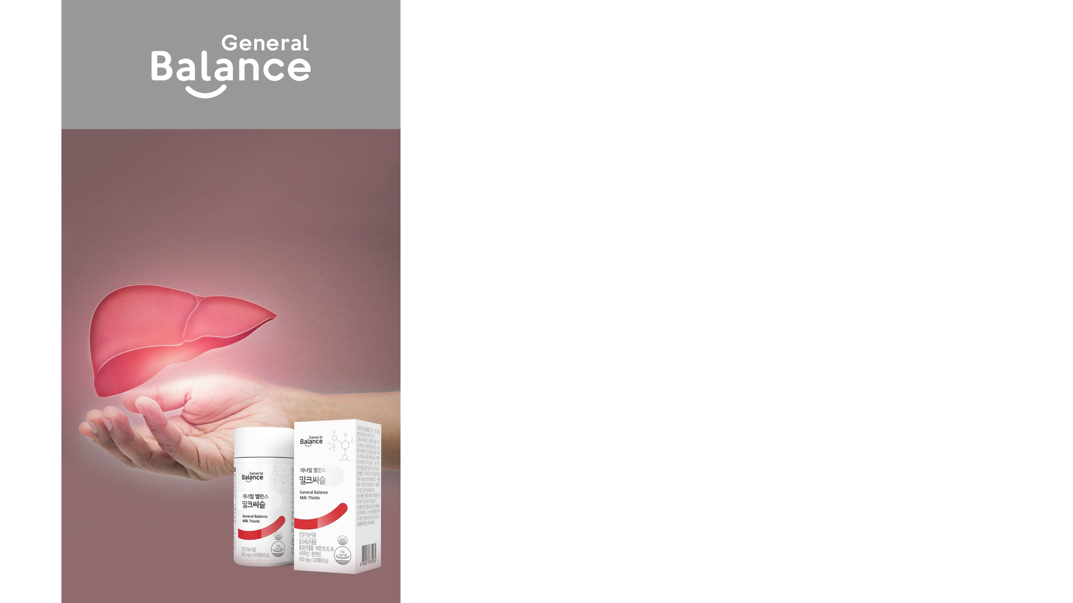
General Balance Milk Thistle
1. General Balance Milk Thistle Key Points
2. Product Introduction
3. Product Features
4. Recommended for
5. Synergetic Supplements
6. General Information
7. FAQ

Slide 3
General Balance Milk Thistle Key Points
1
New 7-in-1 Efficiency
Milk Thistle, Rhodiola Rosea, Vitamin B1 (100%), Vitamin B2 (100%), Vitamin B6 (100%), Niacin (100%), Pantothenic Acid (100%)
2
Niacin (100%) added as a sub-ingredient
3
Liver health (milk thistle), fatigue recovery (Rhodiola rosea), energy metabolism (B vitamins)
4
20 hand-picked quality sub-ingredients
5
Smaller tablets for easier intake
6
No additives

Slide 4
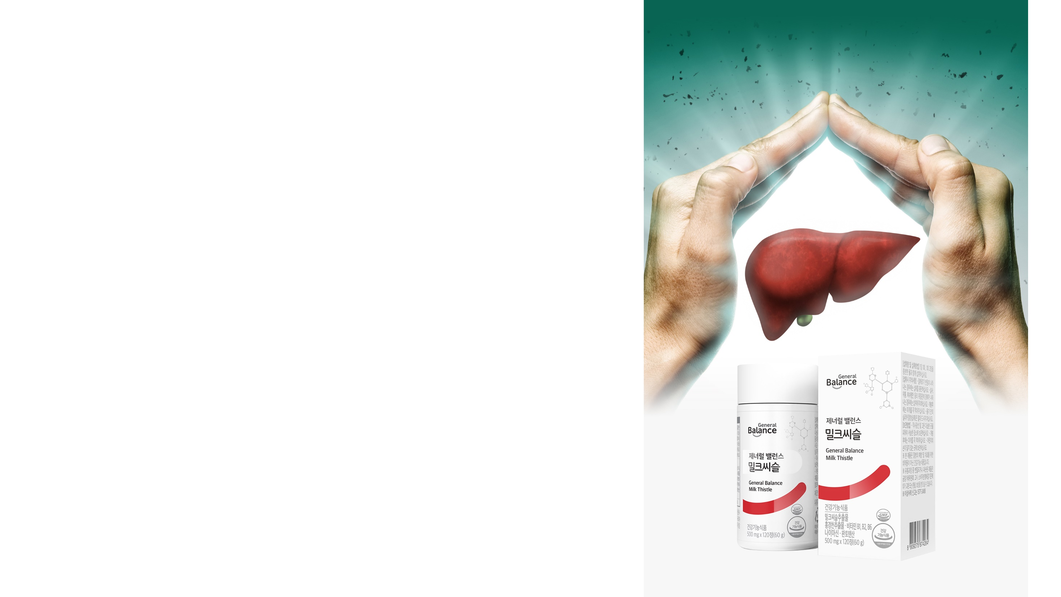
Product Introduction
+ Product Name : General Balance Milk Thistle
+ Product Type : Dietary Supplement
+ Net Wt. : 500mg x 120 tablets (604g)
+ Ingredients : Milk Thistle Extract Powder (USA), Rhodiola Rosea Extract (Spain/Rhodiola Rosea, Maltodextrin), Nicotinamide, Calcium Pantothenate, Vitamin B6 Hydrochloride, Vitamin B1 Hydrochloride, Vitamin B2, Corn Starch [Corn (foreign countries/Russia, Hungary, Serbia, etc.)], Powdered Crystalline Dextrose, 16 Fruit Vegetable Blend (Pomegranate Concentrate, Calamansi Juice Powder, Blueberry Concentrate, Cranberry Concentrate, Apple Concentrate, Green Tea Extract, Orange Concentrate, Tart Cherry Concentrate, Bilberry Concentrate, Red Grape Concentrate, Radish Extract, Black Garlic Concentrate, Broccoli Concentrate, Sprouted Oat Extract, Carrot Juice Extract, Spinach Extract), Taurine, Rapeseed Oil Powder, Corn Protein Extract, Glycerin, Ginseng Fermented Extract
+ Suggested Use : Take one tablet twice a day with water.
Precautions
Please take as directed and check the expiration date before consuming.
If you have any medical conditions or are taking medication, consult a healthcare professional before use.
If you experience diarrhea, stomach pain, bloating, or other gastrointestinal symptoms, take caution when using this product.
If you experience any adverse events, stop use and consult a healthcare professional.
For individuals with allergies, please check all ingredients before use.
Do not consume the silica gel (desiccant) in the container.
* Tablet does not contain chemical excipients and may break easily. Product is safe to consume.

Slide 5

Product Features
1. Milk Thistle
2. Rhodiola rosea
3. Five B Vitamins
4. 7-in-1 Efficiency
5. General Balance Milk Thistle Upgrade
6. 20 hand-picked quality sub- ingredients for liver health

Slide 6
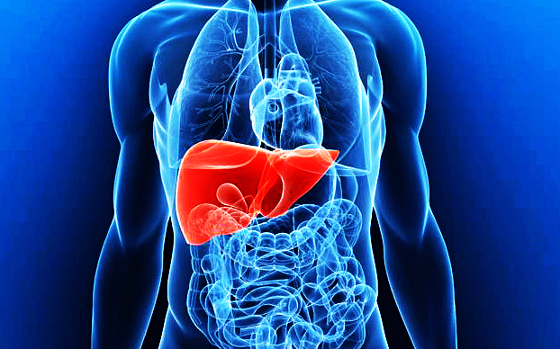
Product Features
Milk Thistle
The Silent Organ
The liver is a vital organ that makes and cleanses nutrients, detoxifying harmful substances. It is called the silent organ as 70% of it can deteriorate without any adverse symptoms. Therefore, it is highly recommended to take preemptively measures to maintain liver health.
Sterilization / Detoxification / Hormone and enzyme synthesis / Bile production and fat digestion / Alcohol breakdown / Antibody production
Major Causes of Liver Damage
Excessive alcohol use
Fatigue
Stress

Slide 7
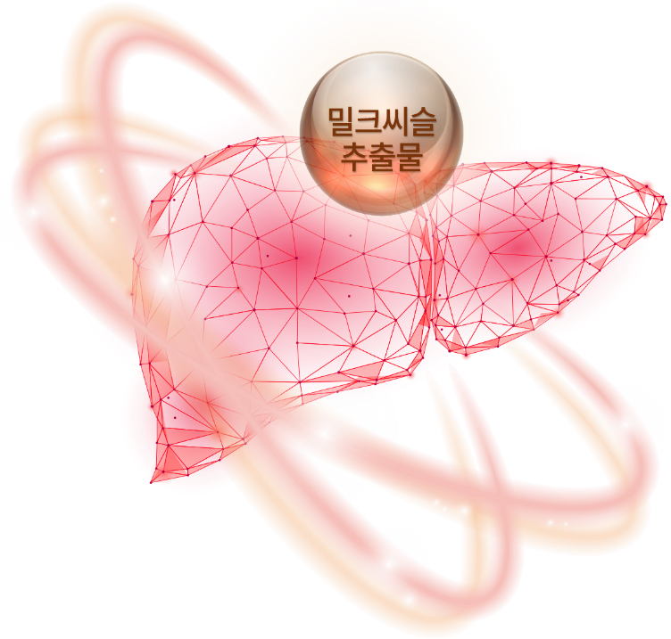
Product Features
Milk Thistle
Silymarin
Milk thistle, also known as "thistle," is an Asteraceae plant known for its silymarin content that can help support liver health. It has been used by humans for millennia, with over 2,000 years of history. There are records of milk thistle being used for liver health by botanists in the 16th and 17th centuries.
A Key Ingredient for Liver Health
Milk Thistle Extract

Slide 8
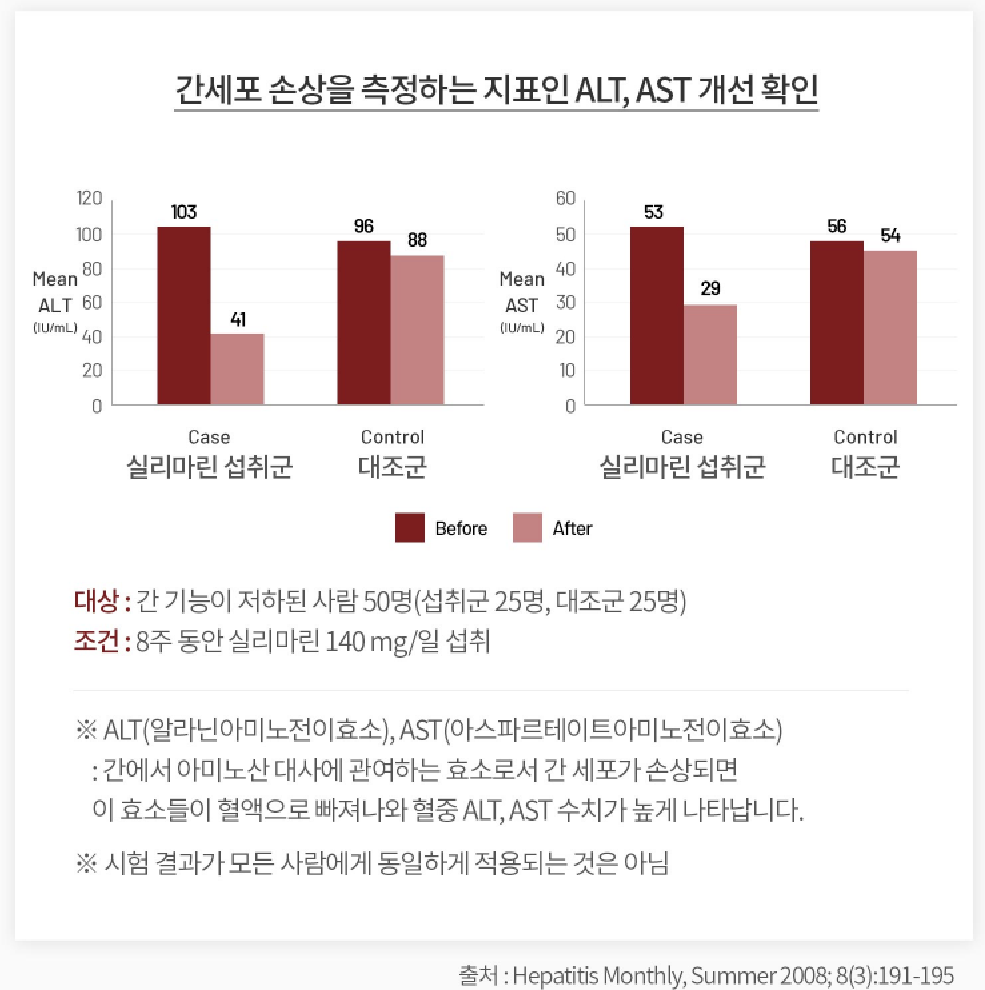
Product Features
Milk Thistle – Results from Clinical Trials
Decrease in ALT and AST, Markers of Liver Cell Damage
Subjects: 50 people with reduce liver function (25 intervention group, 25 control group)
Trial: Daily intake of 140mg of silymarin for 8 weeks
ALT (Alanine aminotransferase), AST (Aspartate aminotransferase)
ALT and AST are enzymes involved in metabolizing amino acids in the liver. When liver cells are damaged, these enzymes enter the bloodstream,
resulting in high levels of ALT and AST in the blood.
*Test results may not apply for everyone
Source: Hepatitis Monthly, Summer 2008;8(3):191-195

Slide 9
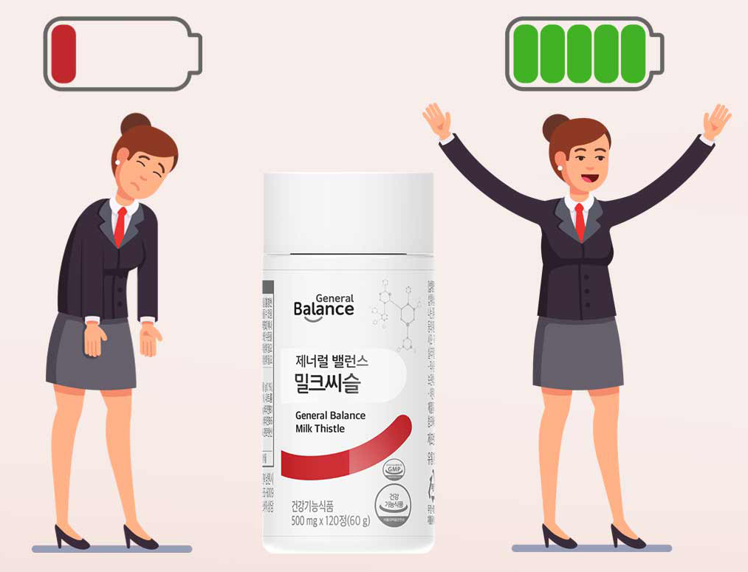
Product Features
2. Rhodiola rosea
Effective Stress and Fatigue Relief
Rhodiola rosea grows in the rocky crevices of the alpine mountains in a barren land. It is rich in the ingredient rosavin, which has been recognized by the Korean Ministry of Food and Drug Safety as an ingredient that can "help improve fatigue caused by stress."

Slide 10
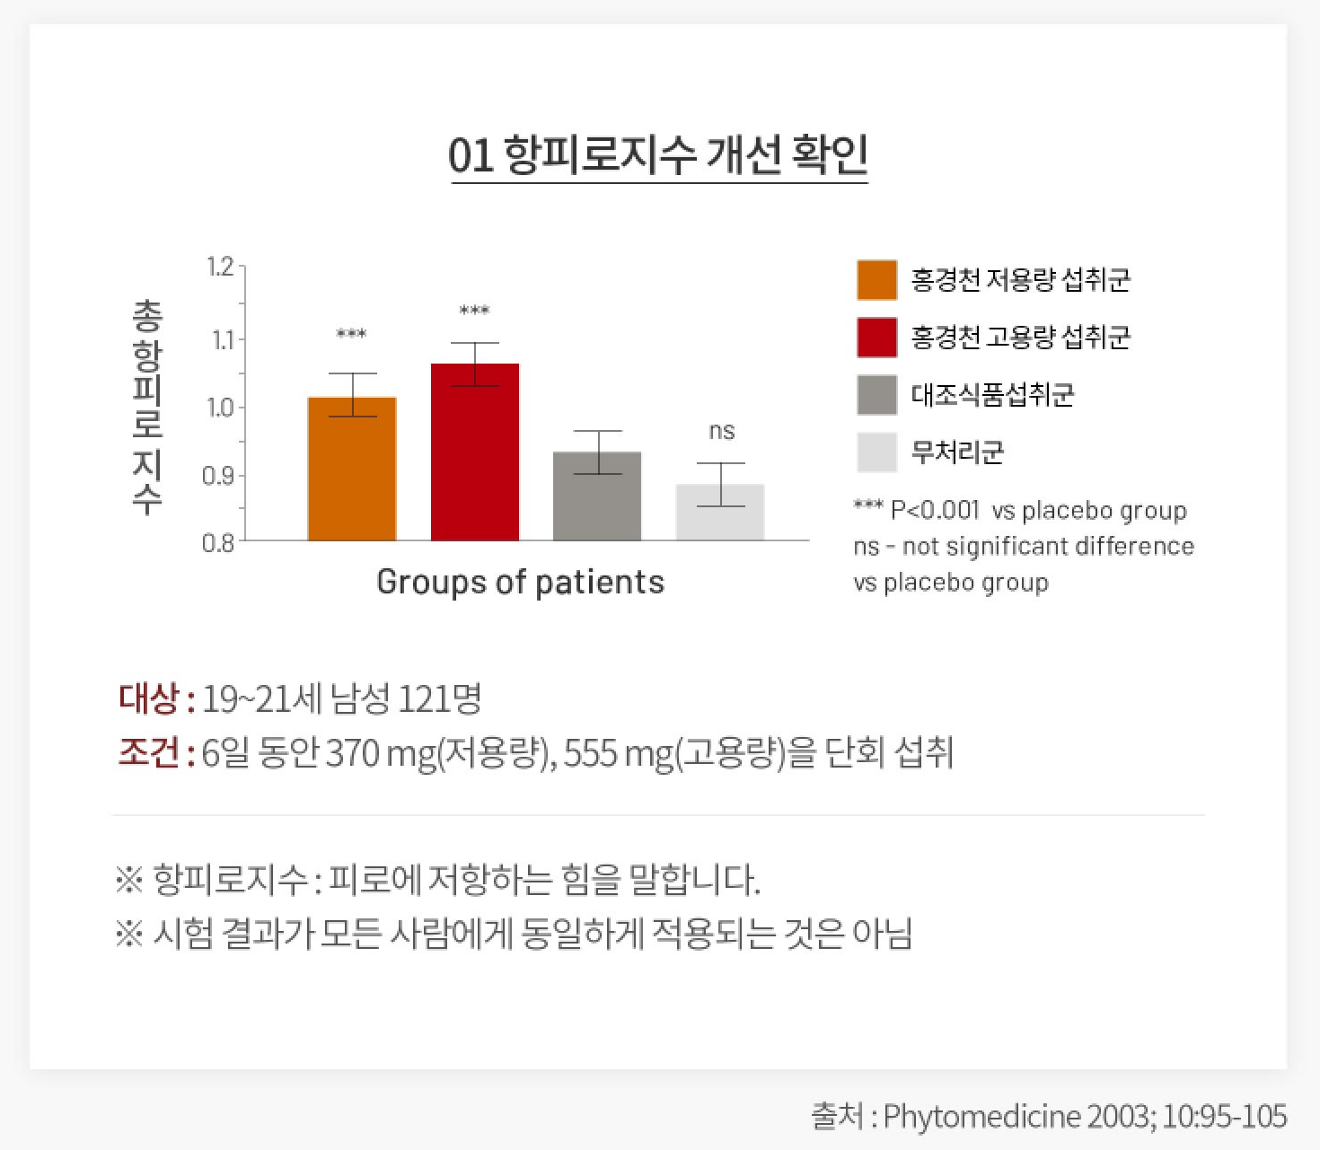
Product Features
2. Rhodiola rosea – Results from Clinical Trials
01 Confirmed Increased Fatigue-Resistance
Anti-Fatigue Index
Low Dose (370mg)
High Dose (555mg)
Other Supplement
Control
Subjects: 121 males ages 19-21
Trial: Daily intake of 370mg (low dose), 555mg (high dose) for 6 days
Anti-Fatigue Index: Fatigue-resistance level
*Test results may not apply for everyone
Source: Phytomedicine 2003;10:95-105

Slide 11
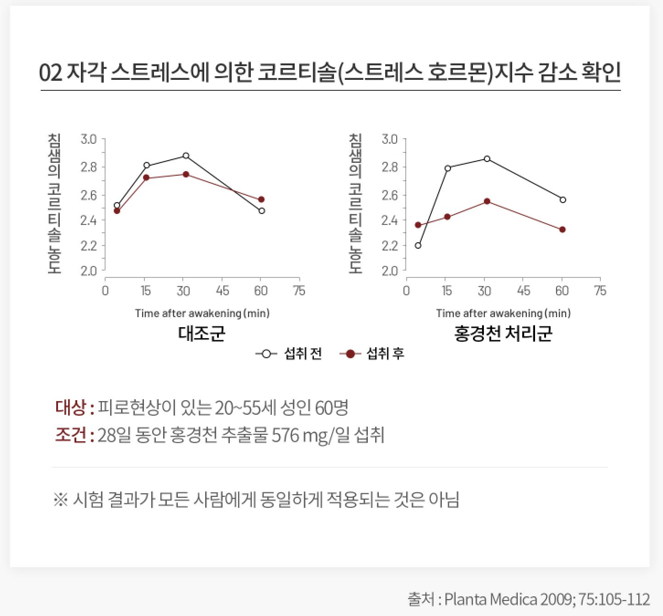
Product Features
2. Rhodiola rosea – Results from Clinical Trials
02 Confirmed Decrease in Cortisol Levels From Perceived Stress
Salivary cortisol conc.
Salivary cortisol conc.
Control
Intervention
Before
After
Subjects: 60 females from ages 20-55 showing fatigue
Trial: Daily intake of 576mg Rhodiola rosea extract for 28 days
*Test results may not apply to everyone
Source: Planta medica 2009;75:105-112

Slide 12
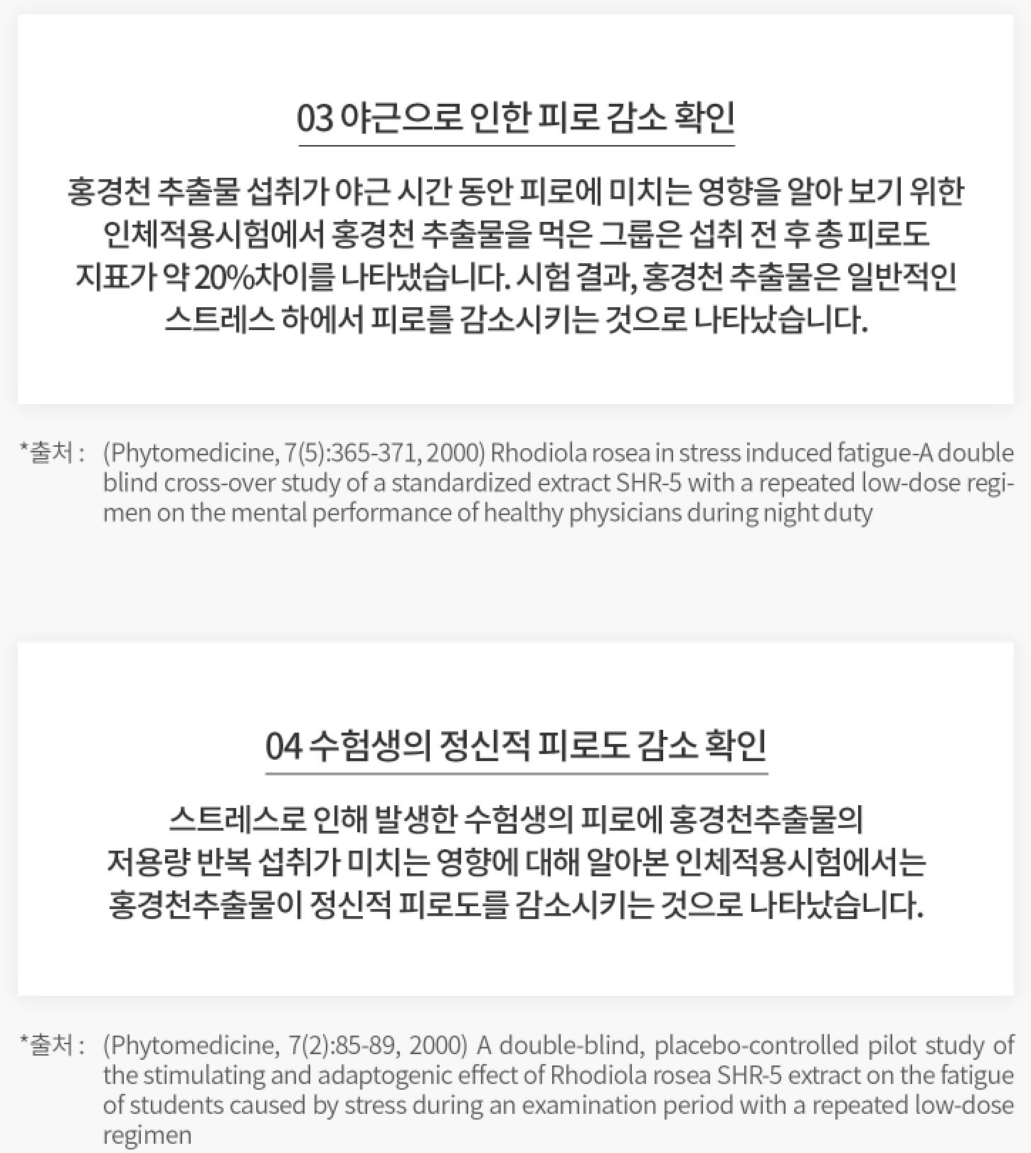
Product Features
2. Rhodiola rosea – Results from Clinical Trials
03 Confirmed Decrease in Fatigue
from Working Overtime
To observe the effects of Rhodiola rosea extract on the fatigue levels
of those working overtime, an intervention group was given Rhodiola
rosea extract. The intervention group showed an approximate 20%
decrease in fatigue levels after intake of the Rhodiola rosea extract.
The results show that Rhodiola rosea extract reduces fatigue from
general stress.
Source
04 Confirmed Decrease in Students’
Mental Fatigue
To observe the effects of low doses of Rhodiola rosea extract on the
mental fatigue levels of students, an intervention group was given low
doses of Rhodiola rosea extract. The results show that continuous intake of low doses of Rhodiola rosea extract reduces mental fatigue.
Source

Slide 13
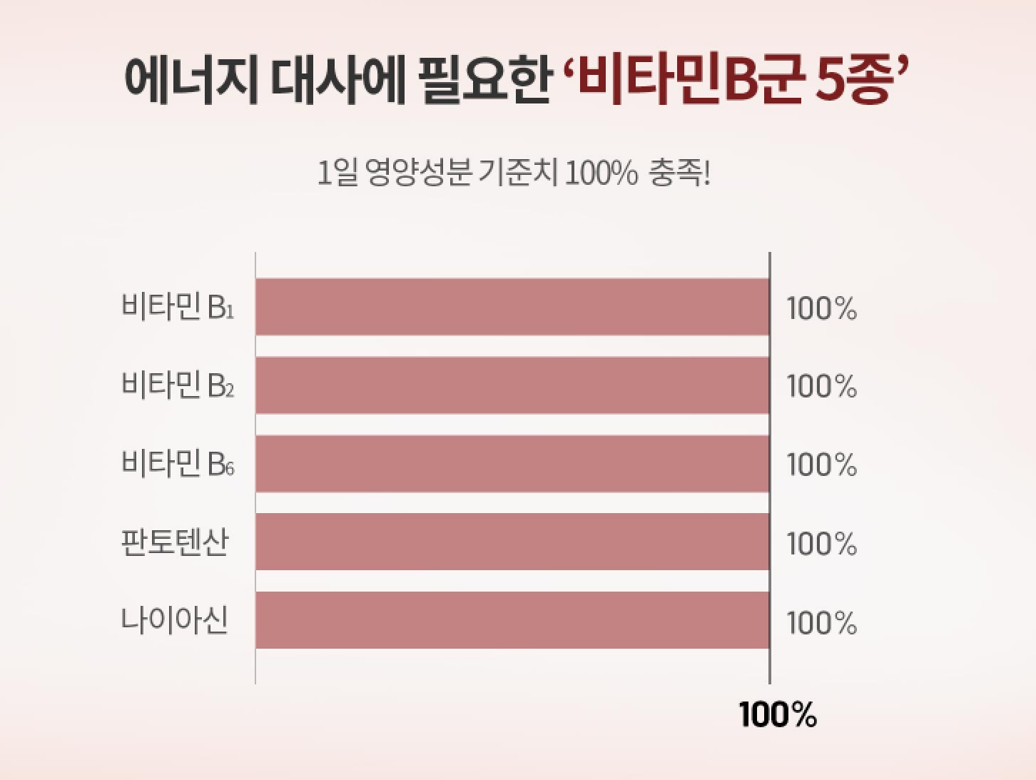
Product Features
3. B Vitamins
Five B Vitamins for Energy Metabolism
Vitamin B₁
Vitamin B₂
Vitamin B₆
Pantothenic Acid
Niacin

Slide 14
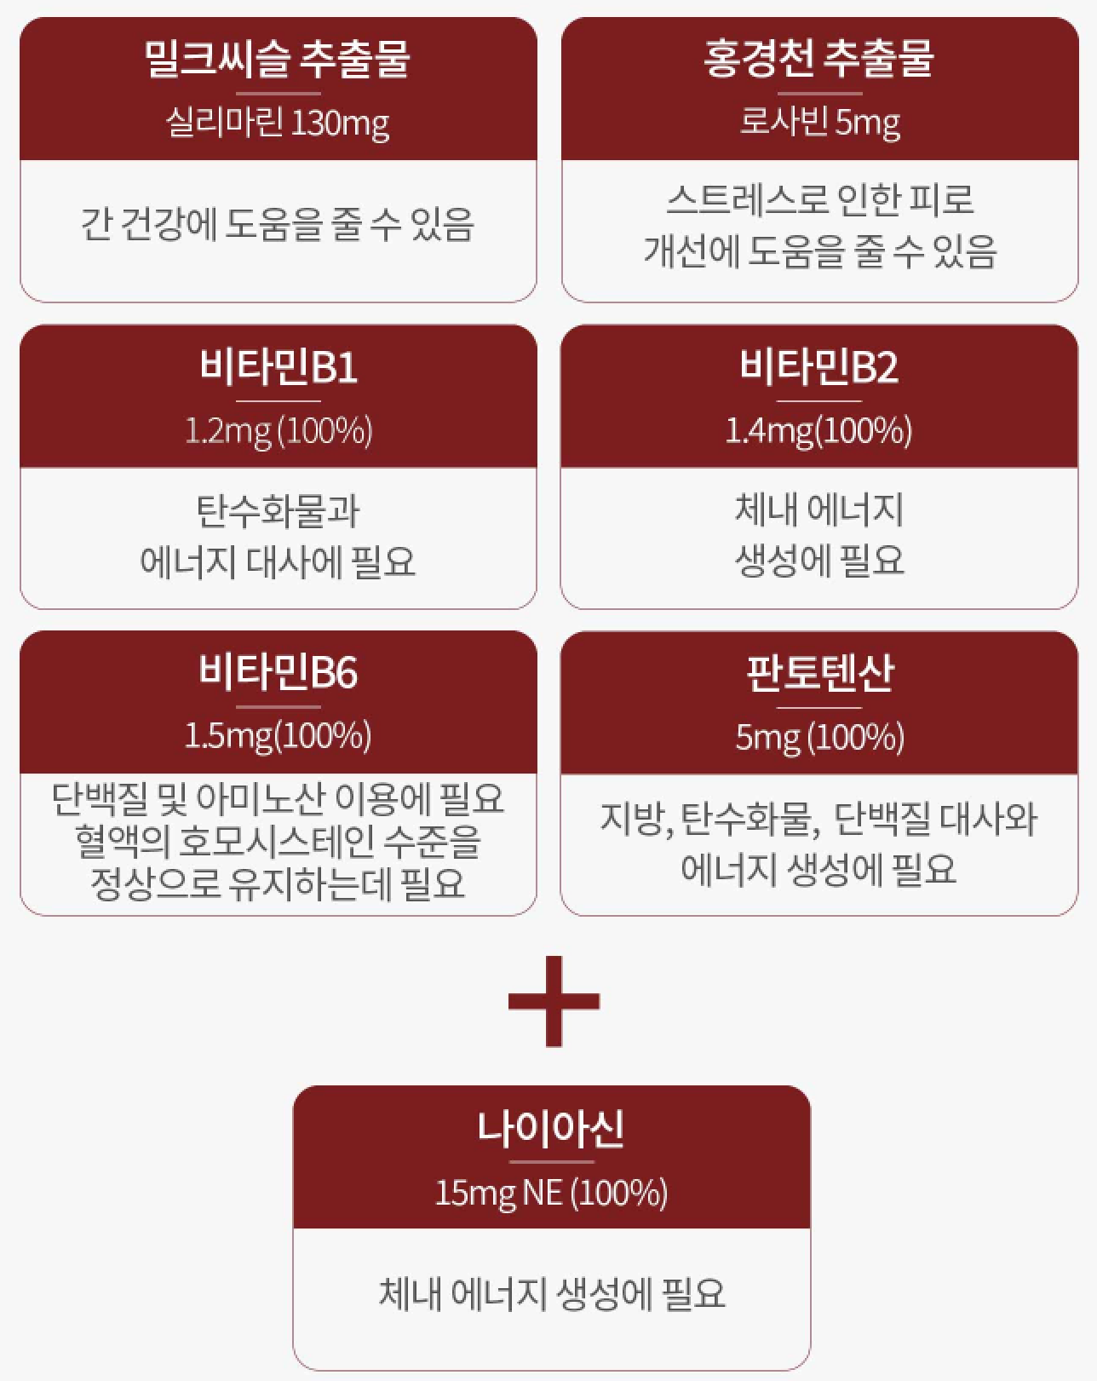
Product Features
4. New 7-in-1 Efficiency
Milk Thistle Extract
Silymarin 130mg
Rhodiola Rosea Extract
Rosavin 5mg
May improve liver health
May relieve fatigue
Vitamin B₁
1.2mg(100%)
Vitamin B₂
1.4mg(100%)
Required for carbohydrate
and energy metabolism
Required for energy
production in the body
Vitamin B₆
1.5mg(100%)
Pantothenic Acid
5mg(100%)
Required to utilize proteins and
amino acids and maintain
optimal homocysteine levels in
the blood
Required for carbohydrate, lipid, amino acid
metabolism and energy production within
the body.
Niacin
15mg NE(100%)
Required for energy production
in the body

Slide 15
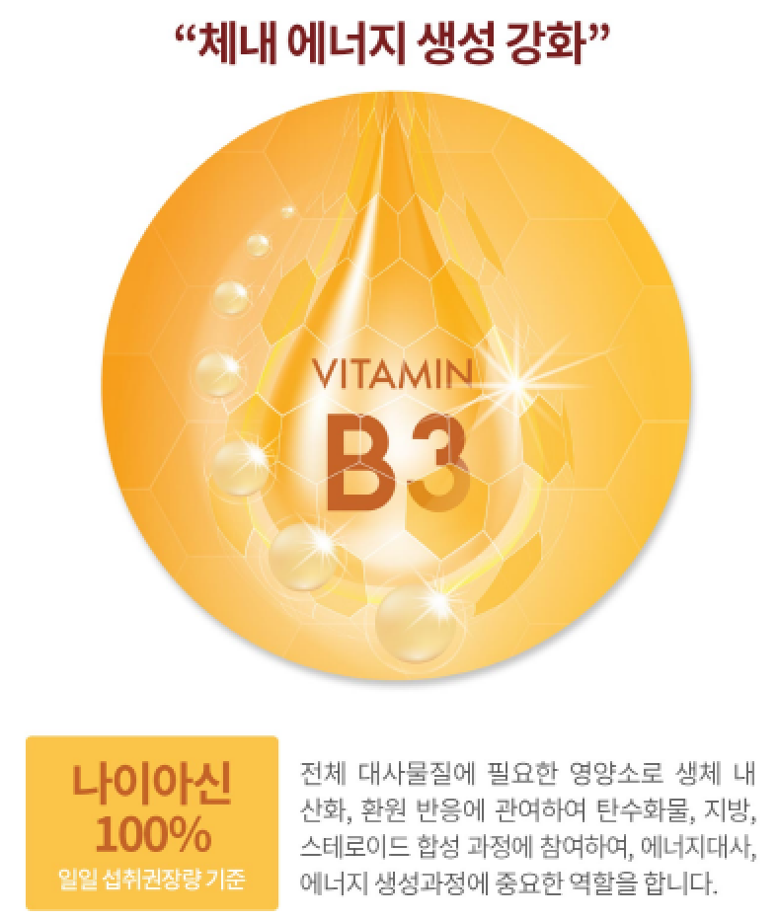
Product Features
5. General Balance Milk Thistle – Upgraded
Now contains more niacin (100%) for increased liver protection and energy.
Energy Production Booster
Vitamin B3 is a nutrient required for all metabolites as it plays an important role in energy metabolism and energy production. It participates in oxidation and reduction reactions in the body to synthesize carbohydrates, fats, and steroids.
Niacin
(100%)

Slide 16

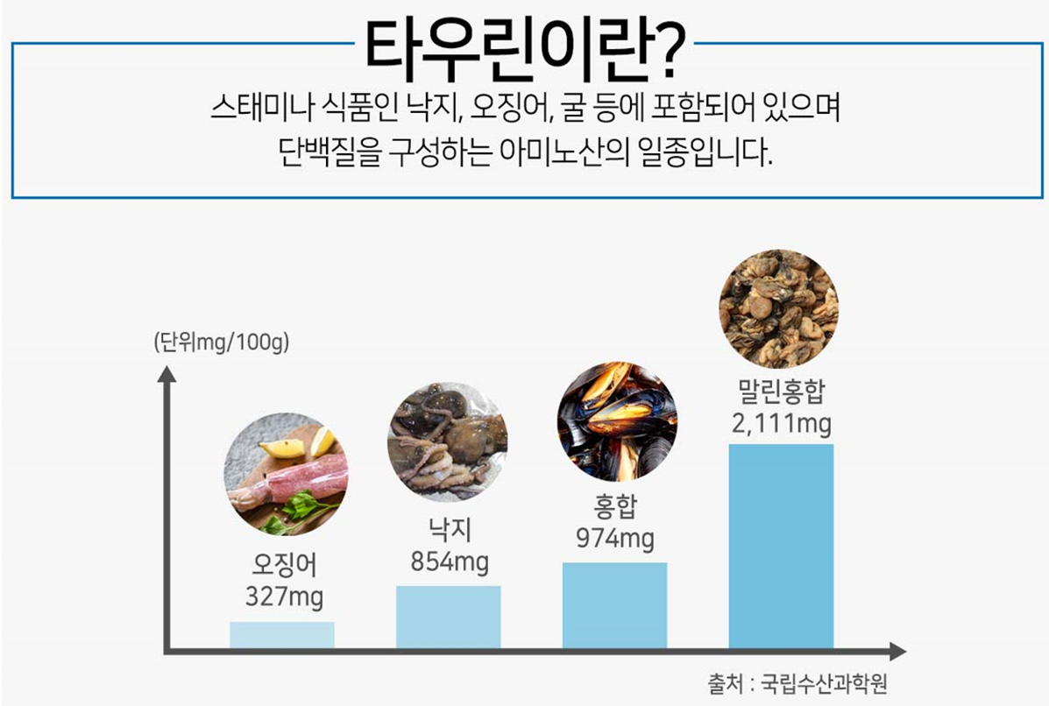
Product Features
6. 20 Sub-Ingredients for Liver Health - Taurine
Energize Your Body with Taurine
Taurine
Taurine is a type of amino acid found in high-protein foods like octopus, squid, and oysters.
mg/100g
Dried mussel
Octopus
Mussel
Squid
Korean National Institute of Fisheries Science

Slide 17
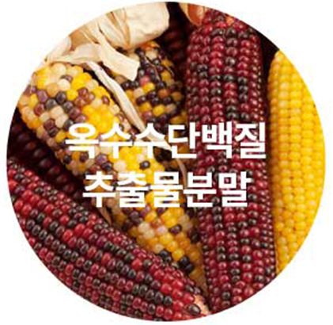


Product Features
6. 20 Sub-Ingredients for Liver Health
Corn is a good source of antioxidants that contains nutrients like dietary fiber, vitamin A, vitamin E, niacin linoleic acid, and calcium beta-sitosterol.
Rapeseed is rich in beta-carotene, an antioxidant that helps boost the immune system. It also contains vitamin A and vitamin C which are beneficial for eye and skin health.
Ginseng extract can help boost the immune system, enhance memory, relieve stress, improve alcohol induced liver conditions, and prevent osteoporosis, eczema, and wrinkles.
[Source] 7 Benefits of 'Ginseng', a Timeless Medicine
[Source] Korea Policy Briefing

Slide 18
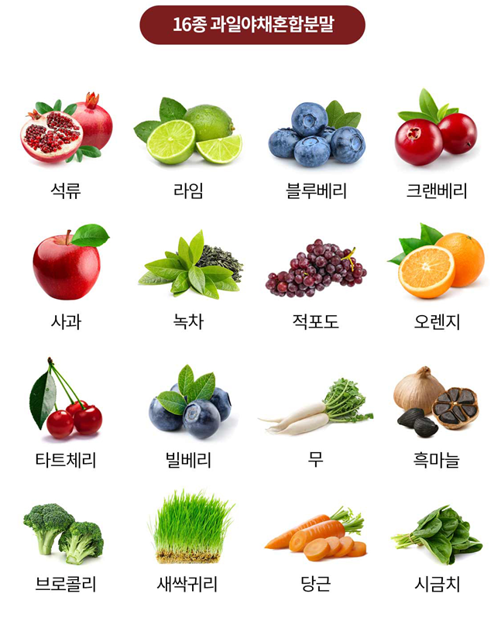
Product Features
6. 20 Sub-Ingredients for Liver Health
16 Ingredient Blend
Pomegranate Lime Blueberry Cranberry
Apple Green Tea Grape Orange
Cherry Bilberry Radish Black Garlic
Broccoli Sprouted Oats Carrots Spinach

Slide 19
Product Features
No Additives
Made without chemical excipients (silicon dioxide, magnesium stearate, hydroxypropyl methylcellulose (HPMC)) used for production efficiency or product stabilization, and synthetic additives for flavor, color, or taste (synthetic flavors, colors, and sweeteners).
스테아린산
마그네슘
Silicon Dioxide
Magnesium
Stearate
이산화규소
HPMC
HPMC
합성향료
착색료
감리료
Synthetic Flavors
Synthetic Colors
Synthetic Sweeteners

Slide 20
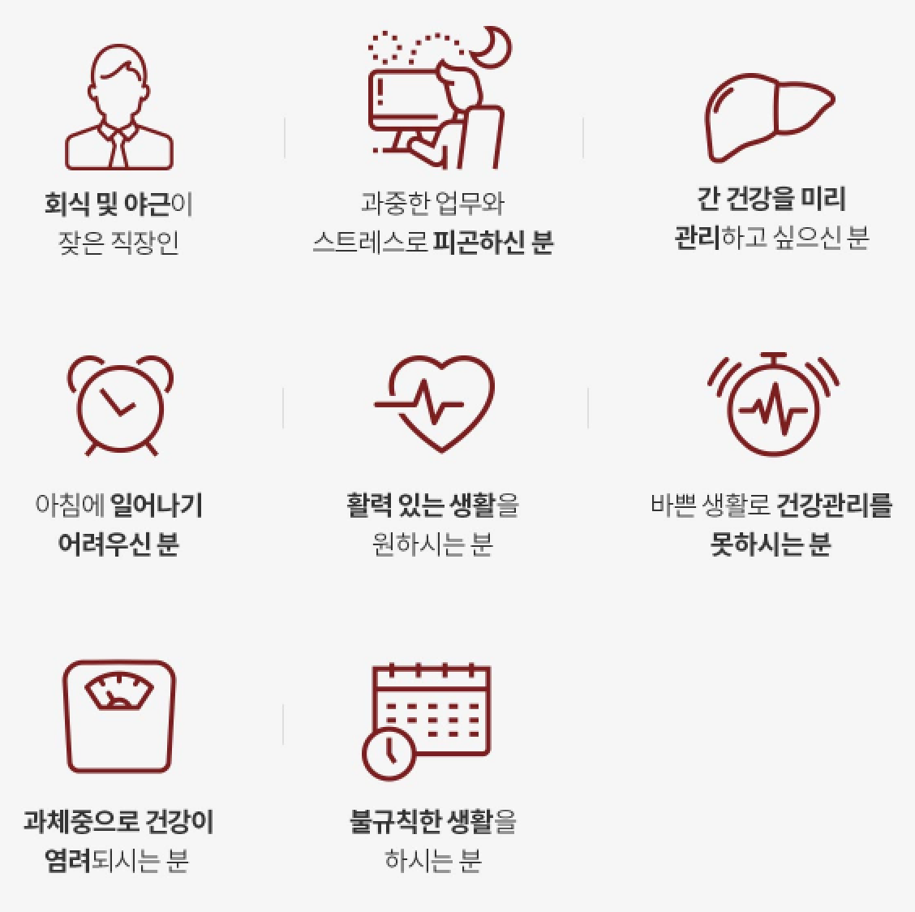
Recommended for
Those who are fatigued
Those who frequently work late
Those who want preemptive
liver care
Those who struggle to
wake up in the morning
Those looking for a healthy
energy booster
Those who want an
efficient supplement
Those concerned about
weight
Those with irregular lifestyles

Slide 21
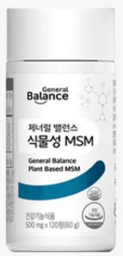
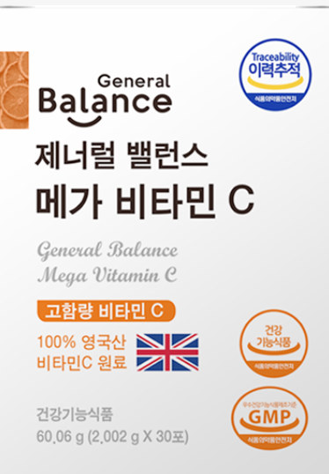
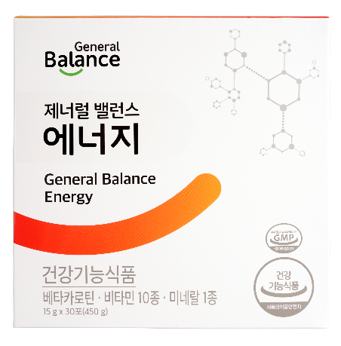
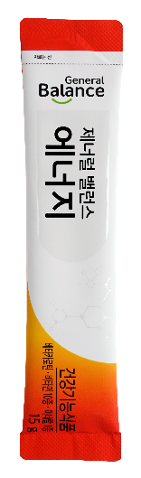
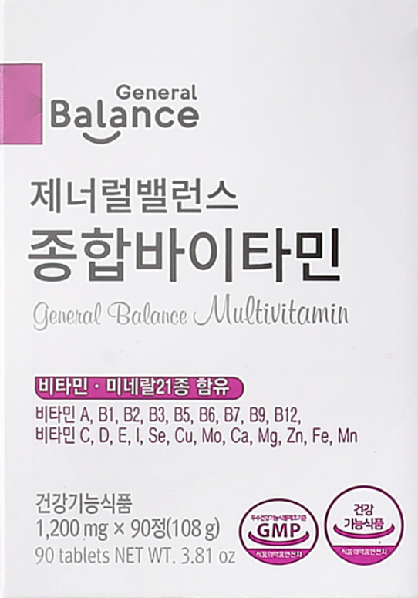
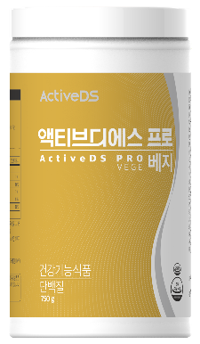
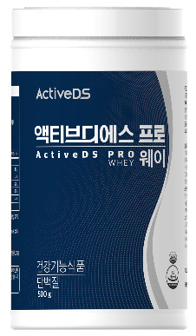
Synergetic Supplements
General Balance
Plant-Based MSM
General Balance
Mega Vitamin C
General Balance Energy
General Balance
Multivitamin
Active DS
Pro Whey / Veggie

Slide 22
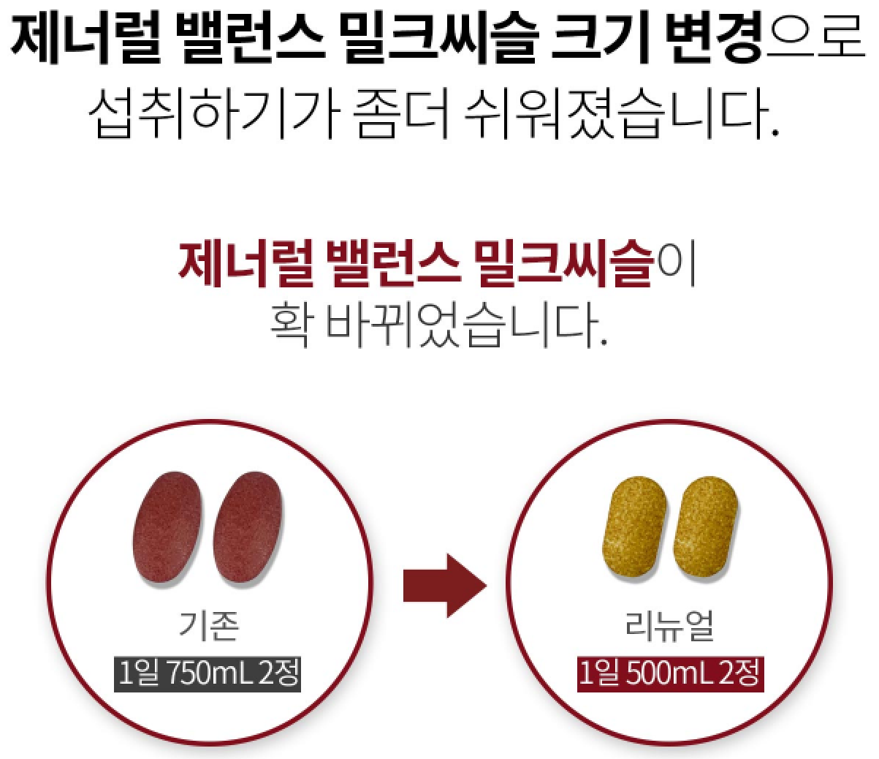
General Information
Smaller Tablets for Easier Intake
Original
New
2 tablets w/ 750 mL
of water a day
2 tablets w/ 500mL
of water a day

Slide 23
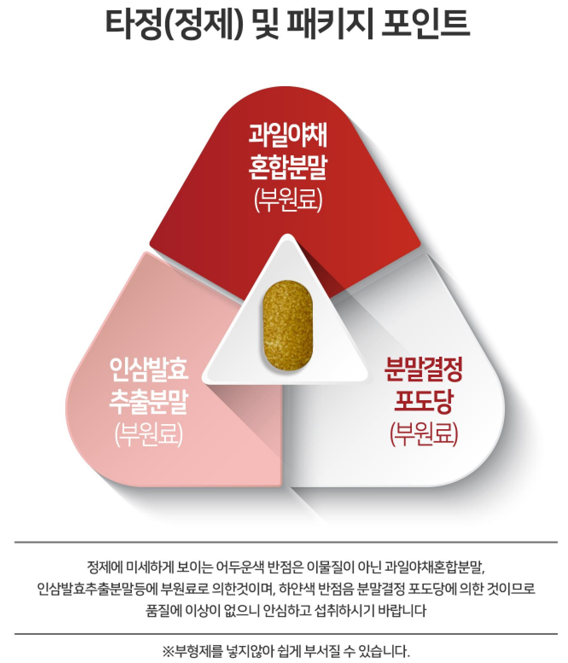
General Information
Tablet & Package Point
Fruit &
Vegetable
Extract
Ginseng
Extract
Powdered
Crystalline
Glucose
The tiny dark spots in the tablet are the fruit & vegetable and ginseng extract and the white spots are powdered glucose.
*Tablet contains no excipients, may break easily

Slide 24
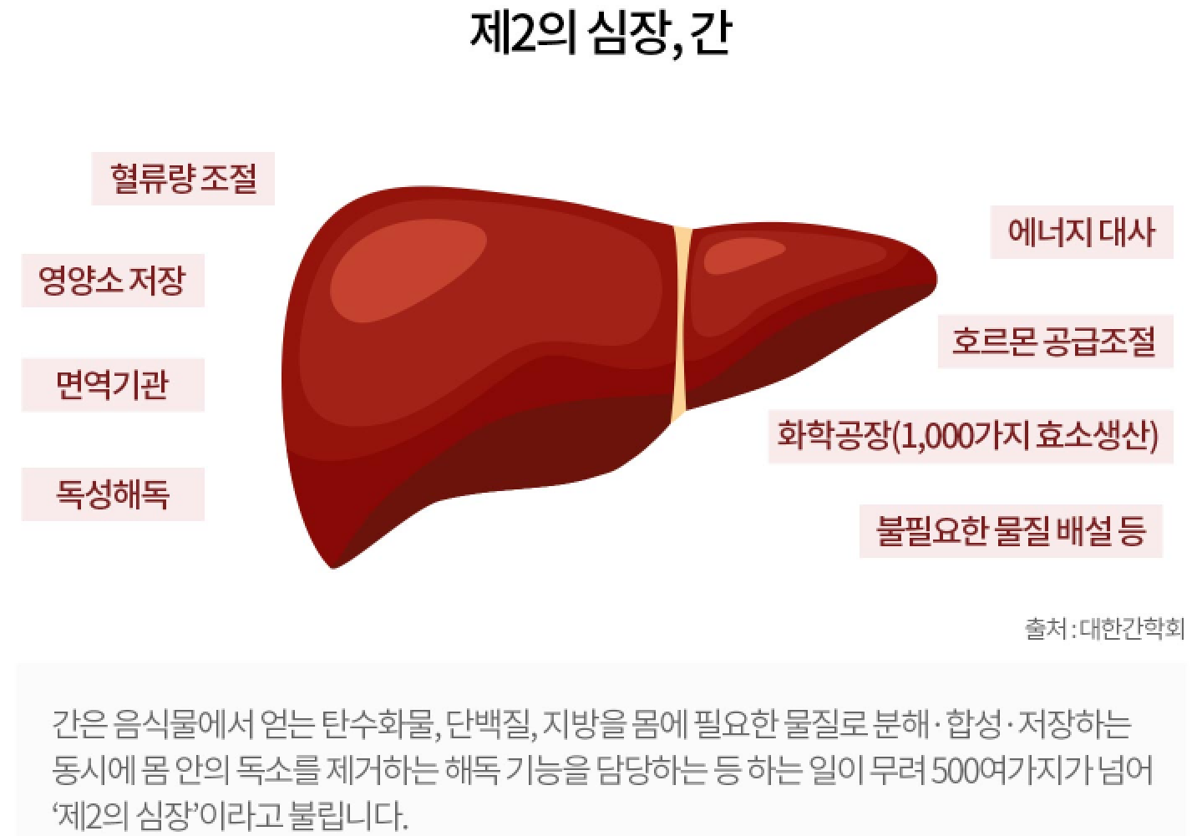
General Information
The Importance of the Liver
Liver, The Second Heart
The liver is responsible for many processes including metabolism, detoxification, immune system support, and bile formation.
Decreased liver function can lead to hepatitis, cirrhosis, fatty liver, and alcoholic liver disease.
More than half of the liver can become non-functional before the body shows symptoms of liver damage.
Blood Flow Regulation
Energy Metabolism
Nutrient Storage
Enzyme Synthesis
Immune System Support
Hormone Supply Regulation
Detoxification
Excretion
Source: Korean Society of Hepatology
The liver is called the second heart because it is involved in more than 500 processes including metabolism, detoxification, immune system support, and bile formation.

Slide 25
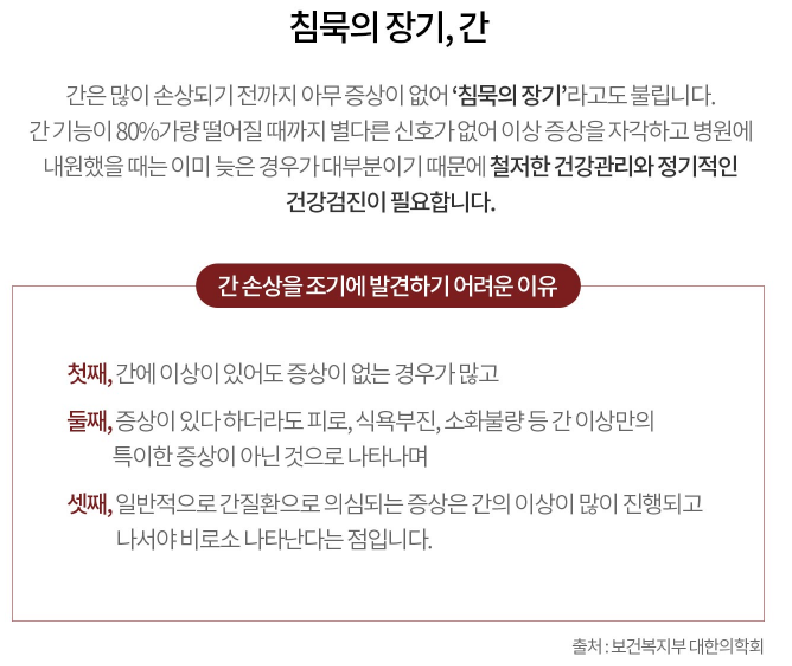
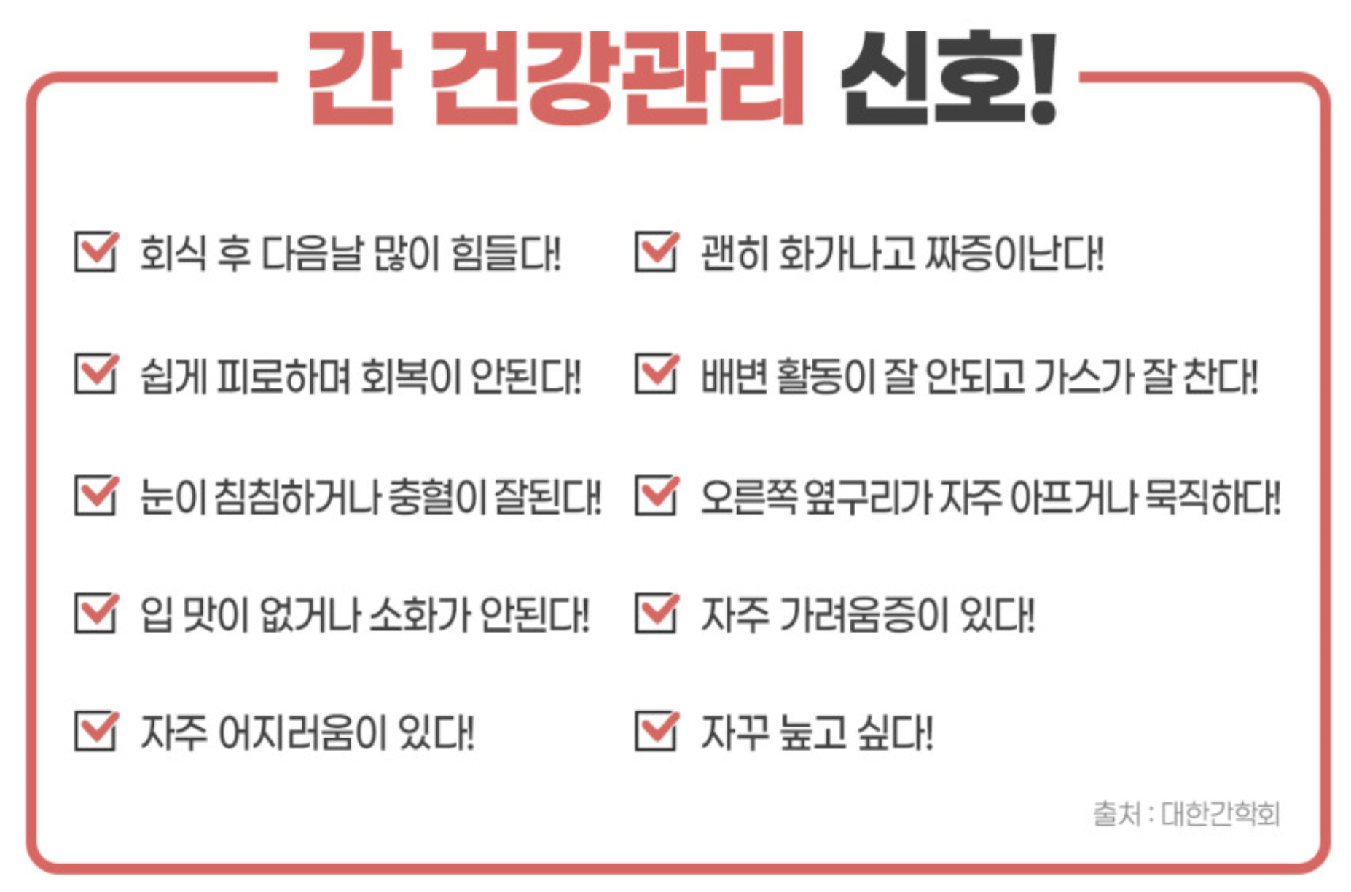
General Information
Liver, The Silent Organ
The liver is called the silent organ because it may not
show symptoms of damage until it has lost up to 80% of its function. By the time medical attention is sought, the liver is often heavily damaged. For this reason, it is
particularly important to preemptively care for the liver.
Early Signs of Liver Damage
Tired and blurry eyes
Body does not handle alcohol well
Detecting Liver Damage
Loss of appetite
Extreme irritability
Early signs of liver damage are difficult to detect because
There are often no symptoms of liver damage
The symptoms (fatigue, loss of appetite, indigestion, etc.)
are often no indicative of liver damage
The symptoms indicative of liver damage often appear when
the liver is already heavily damaged.
Indigestion
Frequently nauseous
Easily fatigued
Pain or heaviness on the right side
Frequent itching
Frequent desire to lie down
Source: Korean Society of Hepatology
Source: Korean Ministry of Health and Welfare, Korean Academy of Medical Sciences

Slide 26
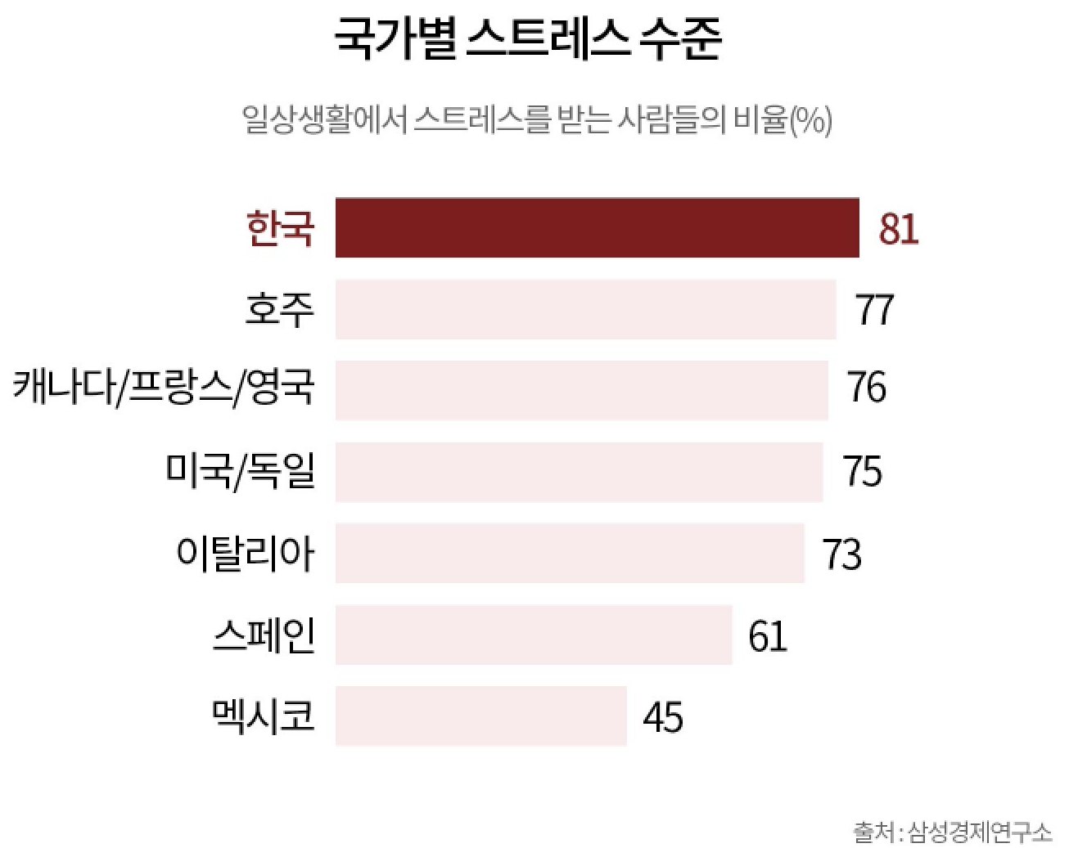
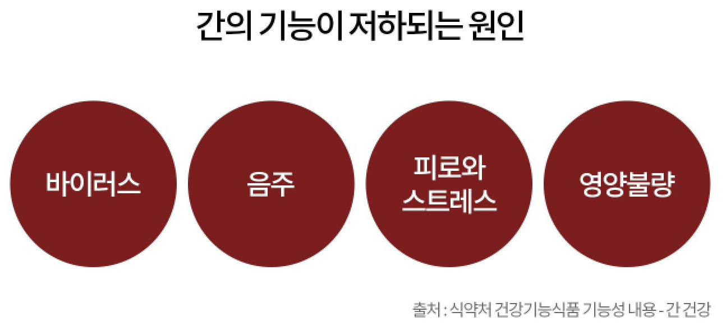
General Information
Stress Level by Country
% of people experiencing stress in daily life
Causes for Liver Damage
South Korea
Australia
Canada/France/UK
US/Germany
Italy
Spain
Mexico
Virus Alcohol Stress Malnutrition

Slide 27
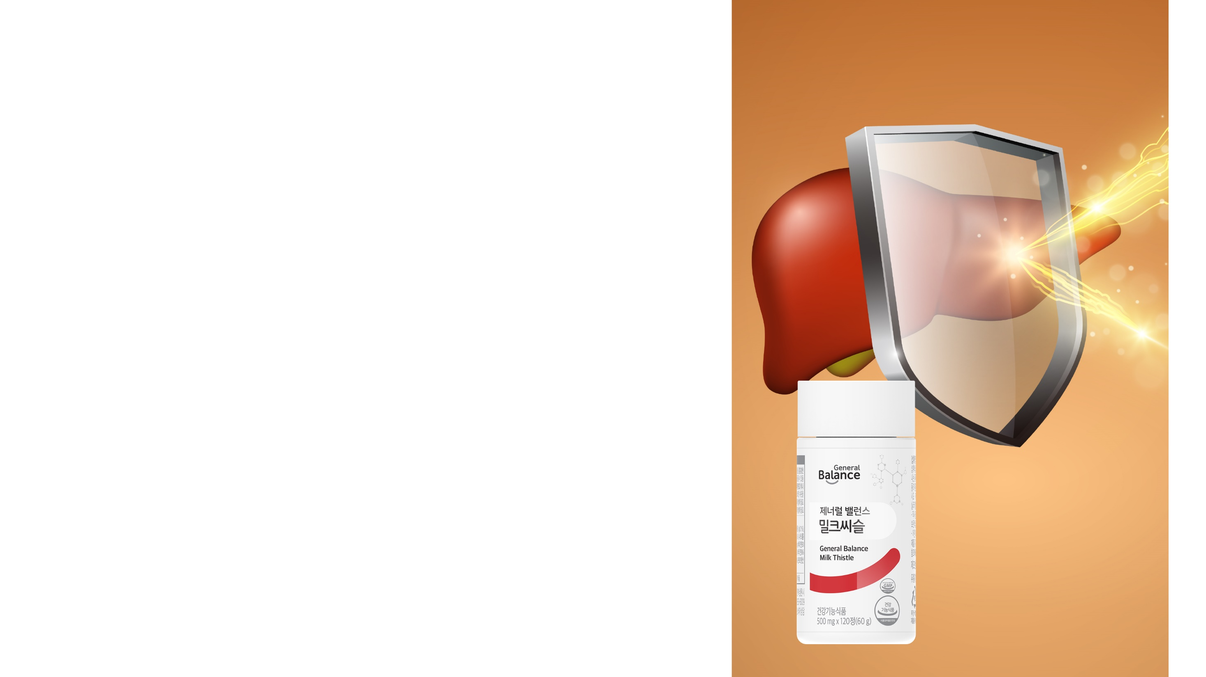
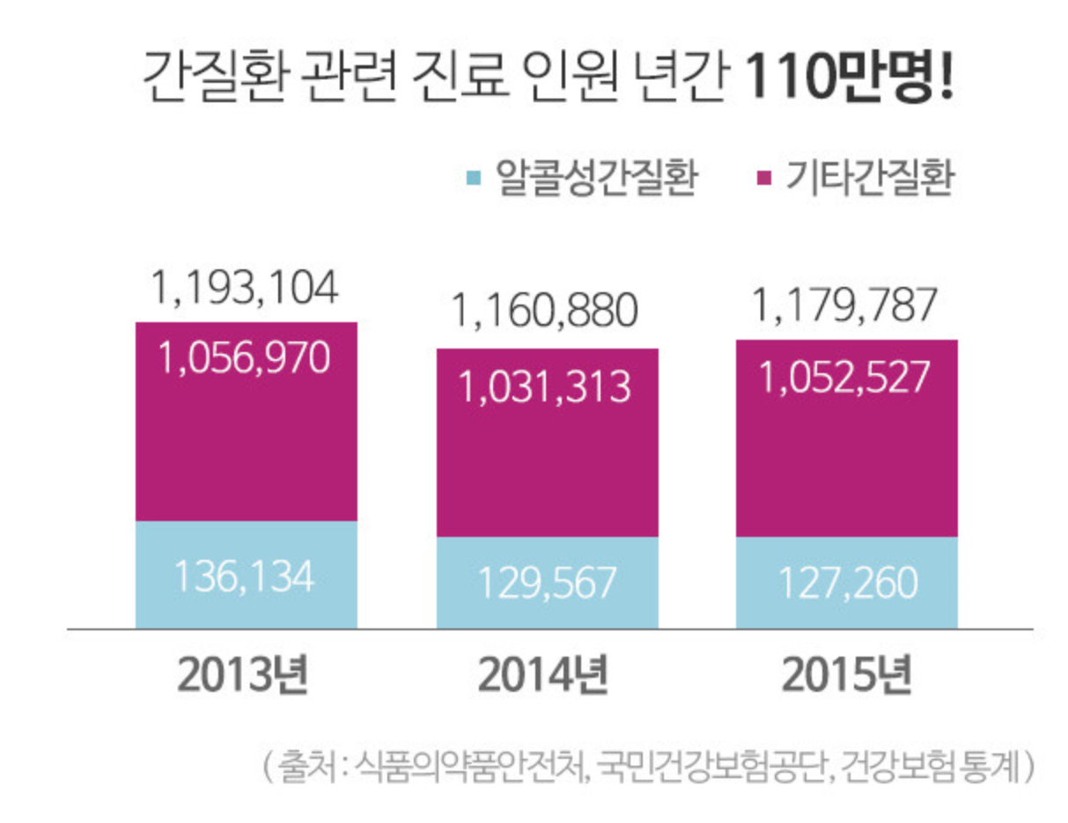
General Information
In South Korea, there are over 1.1million liver disease cases every year
Alcohol related
Non-alcohol related
Cases
Year
Source: Korean Ministry of Food and Drug Safety, National Health Insurance Service, Health Insurance Statistics

Slide 28
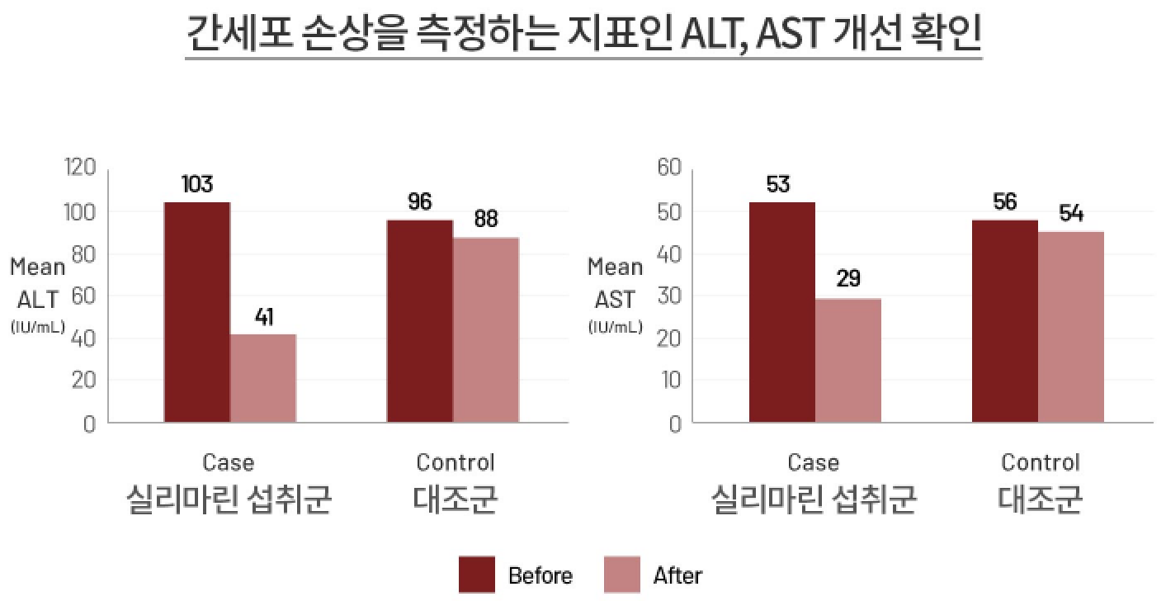
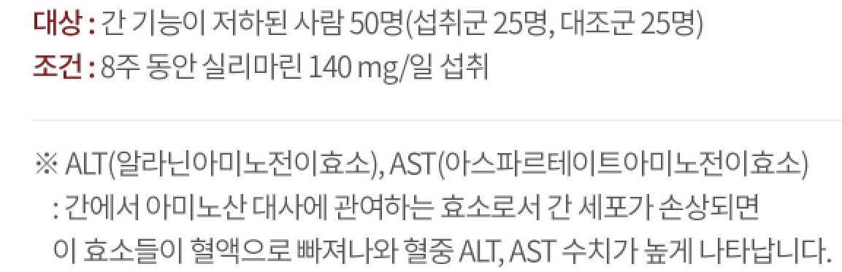
General Information
Detox Treatment
Taking vitamin C and silymarin together detoxifies lead in the liver, improving liver function of those with liver diseases.
It cleanses the body and treats the damage done by heavy metals, allowing for essential nutrients to stay within the body and boosting the immune system.
Journal of Herbmed Pharmacology
Heavy metals detoxification: A review of herbal compounds for chelation therapy in heavy metals toxicity
Reza Mehrandish1, Aliasghar Rahimian2, Alireza Shahriary1* I
Decrease in ALT and AST, Markers of Liver Cell Damage
Subjects: 50 people with reduce liver function (25 intervention group, 25 control group)
Trial: Daily intake of 140mg of silymarin for 8 weeks
ALT (Alanine aminotransferase), AST (Aspartate aminotransferase)
ALT and AST are enzymes involved in metabolizing amino acids in the liver.
When liver cells are damaged, these enzymes enter the bloodstream, resulting
in high levels of ALT and AST in the blood.
Source: Hepatitis Monthly, Summer 2008;8(3):191-195

Slide 29
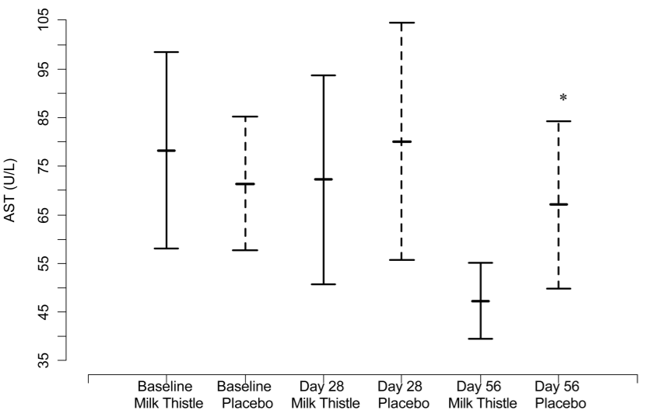
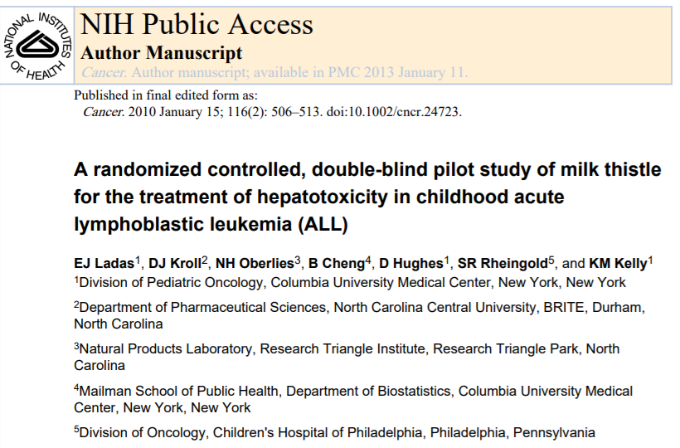
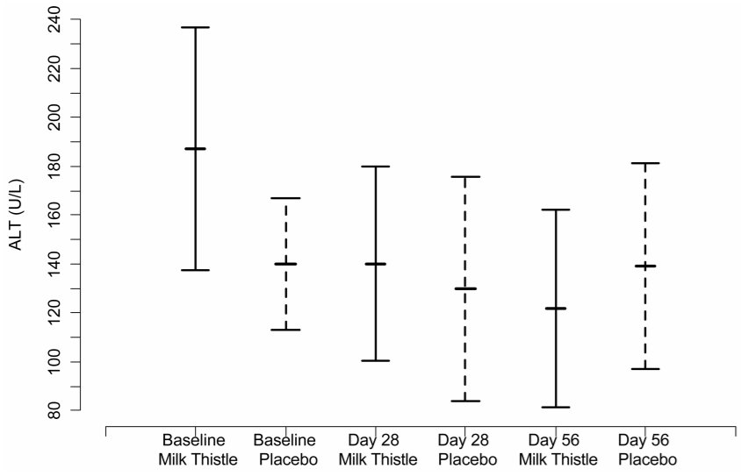
General Information
Treatment of Hepatotoxicity
Confirmed Decrease in (AST, ALT)
24 pediatric patients with acute lymphocytic leukemia were treated orally with 6mg of milk thistle to confirm hepatotoxicity.
- Patients treated with milk thistle showed lower levels of blood AST and ALT compared to that of the control group.
[Source: Cancer. 2010 January 15; 116(2): 506–513. A randomized controlled, double-blind pilot study of milk thistle for the treatment of hepatotoxicity in childhood acute lymphoblastic leukemia (ALL) EJ Ladas, DJ Kroll, NH Oberlies, B Cheng, D Hughes, SR Rheingold, and KM Kelly.]

Slide 30
General Information
Anti-Inflammatory & Anti-Bacterial Effect
Milk thistle ethanolic seed extract showed antimicrobial activity against Gram-positive (Staphylococcus aureus) and Gram-negative (Salmonella entirica) bacteria.
Reduced the production of nitric oxide (NO) and inflammatory cytokines (TNF-α, IL-1β, IL-6).
Milk thistle see extract showed anticancer properties as it inhibits the growth of cancer cells
Silibinin, a flavonoid extracted from milk thistle seeds, inhibited renal cell carcinoma metastasis by inhibiting the Wnt/β-catenin signaling pathway.
Silymarin dose-dependently inhibited the proliferation of HSC-4 oral cancer cells and induces caspase-dependent apoptosis.
Journal of Biotechnology Research · May 2020.
Effect of Milk Thistle (Silybum marianum (L.) Gaertn) Seed Extract on Bacterial Activities and Growth of Human Liver Cancer Cells.
Basma S. M. Ali, Abdelaleim I. ElSayed, Mahmoud A. Doheem, Ahmed M. Abo Eita, Ahmad A. Omar.
INTERNATIONAL JOURNAL OF MOle cular me dicine 45: 1341-1350, 2020.
Silibinin inhibits epithelial‑mesenchymal transition of renal cell carcinoma through autophagy‑dependent Wnt/β‑catenin signaling.
YIZENG FAN, TAO HOU, WEICHAO DAN, TIANJIE LIU, JIAXIN LUAN, BO LIU, LEI LI and JIN ZENG.
Tumor Biology May 2018: 1–11, 2018.
In vitro and in vivo anti-cancer activity of silymarin on oral cancer.
Dong-HoonWon, Lee-Han Kim, Boonsil Jang, In-Hyoung Yang, Hye-Jeong Kwon, Bohwan Jin, Seung Hyun Oh, Ju-Hee Kang, Seong-Doo Hong, Ji-Ae Shin and Sung-Dae Cho.

Slide 31
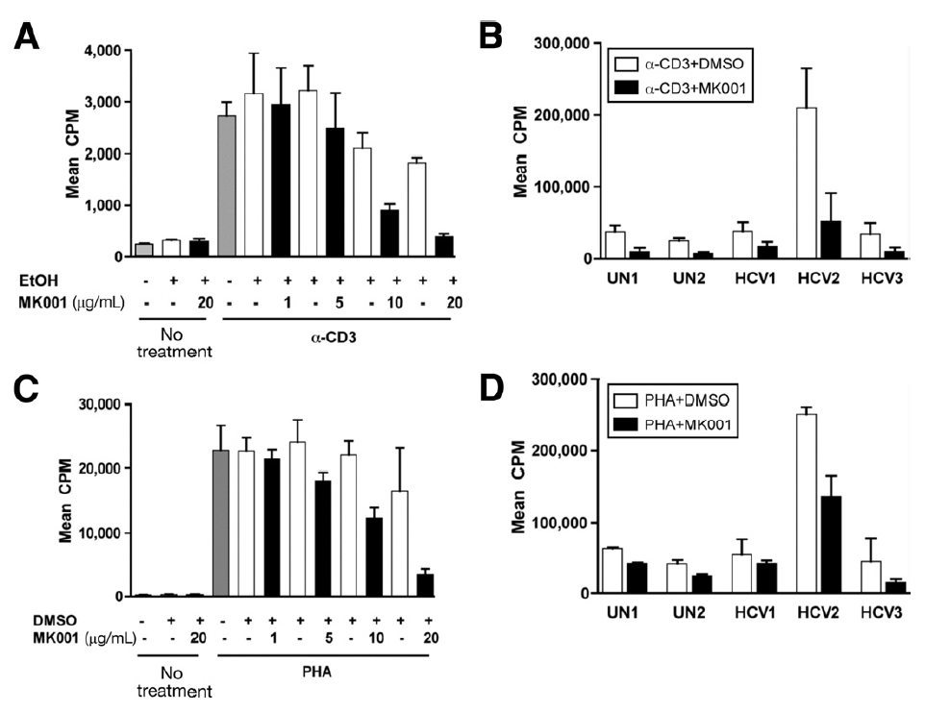
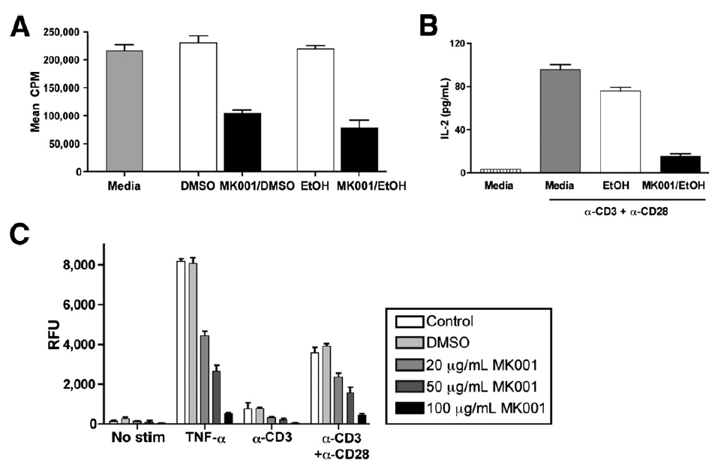
General Information
Immunomodulatory Effect
Inhibits proliferation of peripheral blood mononuclear cells
Inhibits Jurkat T cell proliferation and cytokine production
* Jurkat T cell line: a peripheral blood-derived T cell line from human acute lymphoblastic leukemia patients.
An evaluation of the immunofunctional effects of silymarin on liver disease induced by hepatitis C virus.
- Silymarin(MK001) inhibited the proinflammatory cytokines TNF-α, IFN-γ and IL-2 (produced by peripheral blood mononuclear cells) activated by anti-CD3 in a concentration-dependent manner.
- Inhibited transcriptional activation of NF-κB and was associated with inhibition of Jurkat T cell line proliferation and suppression of IL-2 secretion.
[Source: Gastroenterology, 2010, 138: 671-681. Silymarin inhibits in vitro T-cell proliferation and cytokine production in hepatitis C virus infection. Morishima C, Shuhart MC, Wang CC, Paschal DM, Apodaca MC, Liu Y, Sloan DD, Graf TN, Oberlies NH, Lee DYW, Jerome KR, Polyak SJ.]

Slide 32
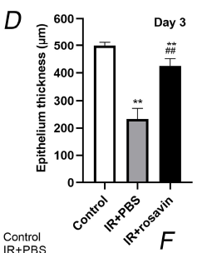
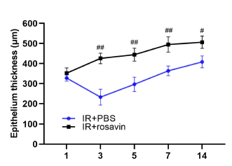
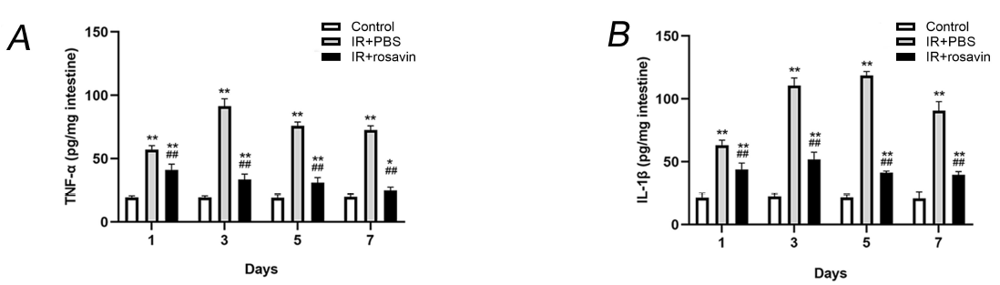
General Information
Radioprotective Effect
Restoration of Intestinal Epithelial Thickness
Reduction of Inflammatory Cytokines
To investigate the protective effect of Rhodiola rosea against radiation-induced intestinal damage, rats were divided into three groups: control group, irradiated group, and post-irradiation treatment group, and randomly assigned to each group.
- The intestinal epithelial thickness was checked after rhodiola administration and it was found that the intestinal damage caused by radiation thinning was improved after 3 days.
- Inflammatory cytokines (TNF-α, IL-1β) were significantly reduced in the rhodiola treatment group compared to the control group.
[Source: Chemistry & Biodiversity, 22 October 2020. The Protective Effect of Rosavin from Rhodiola rosea on Radiation-Induced Intestinal Injury. Weijie Zhou, Kequan Chen, Quan Lu, Yujun Luo, Chen Zhang, Yue Zheng, Zewei Zhuo, Kehang Guo, Jinghua Wang, Hao Chen, Weihong Sha.]

Slide 33
General Information
Anti-Inflammatory Effect
Rhodiola rosea components inhibited expression of proinflammatory cytokines (TNF-α, IL-1β, IL-6) in BV2 cells in a concentration-dependent manner
Treatment of inflammation-induced raw 264.7 cells with Rhodiola rosea showed anti-inflammatory effects of kaempferol and antioxidant effects of herbacetin.
Oral administration of methanol-extracted rhodiola rosea in inflammation-induced rats confirmed its effectiveness in reducing inflammation and analgesia.
Evidence-Based Complementary and Alternative Medicine Volume 2013, Article ID 514049.
Anti-Inflammatory and Neuroprotective Effects of Constituents Isolated from Rhodiola rosea.
Yeonju Lee, Jae-Chul Jung, Soyong Jang, Jieun Kim, Zulfiqar Ali, Ikhlas A. Khan, and Seikwan Oh.
Molecules 2012, 17(10), 11484-11494
The Antioxidant and Anti-inflammatory Effects of Phenolic Compounds Isolated from the Root of Rhodiola sachalinensis A. BOR
Kang In Choe, Joo Hee Kwon, Kwan Hee Park, Myeong Hwan Oh, Manh Heun Kim, Han Hyuk Kim, Su Hyun Cho, Eun Kyung Chung, Sung Yi Ha and Min Won Lee.
International Journal of Pharma Research & Review, Feb 2015; 4(2):1-8.
Anti-inflammatory and Analgesic Activity of Methanolic Extract of Medicinal Plant Rhodiola rosea l. Rhizomes
Avijit Chatterjee, Biswarup Sen, Sumanta Das, Tapan Kumar Chatterjee.

Slide 34
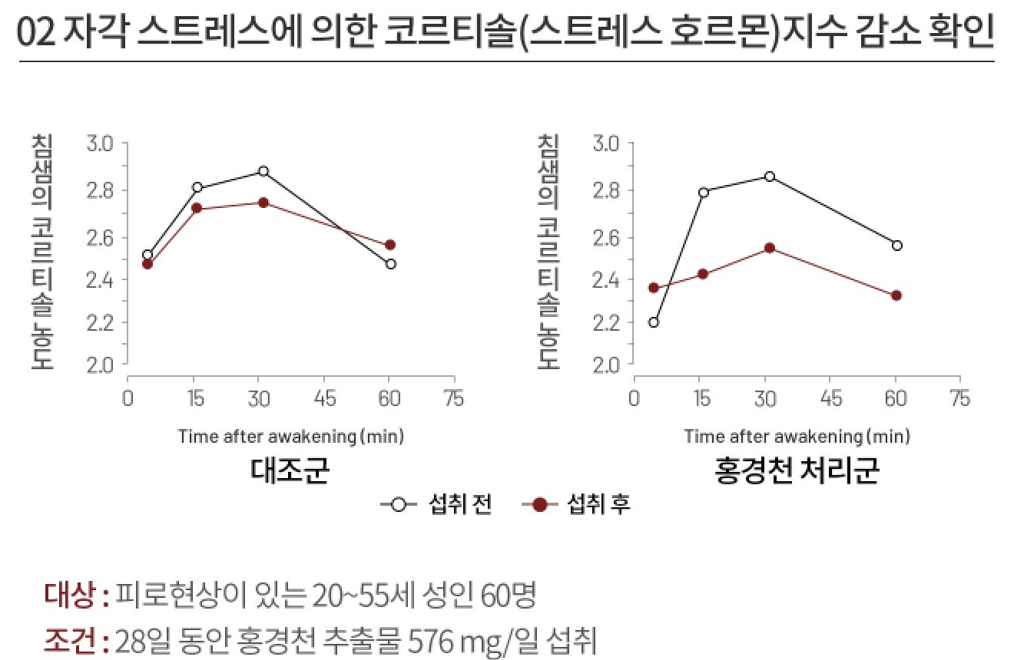
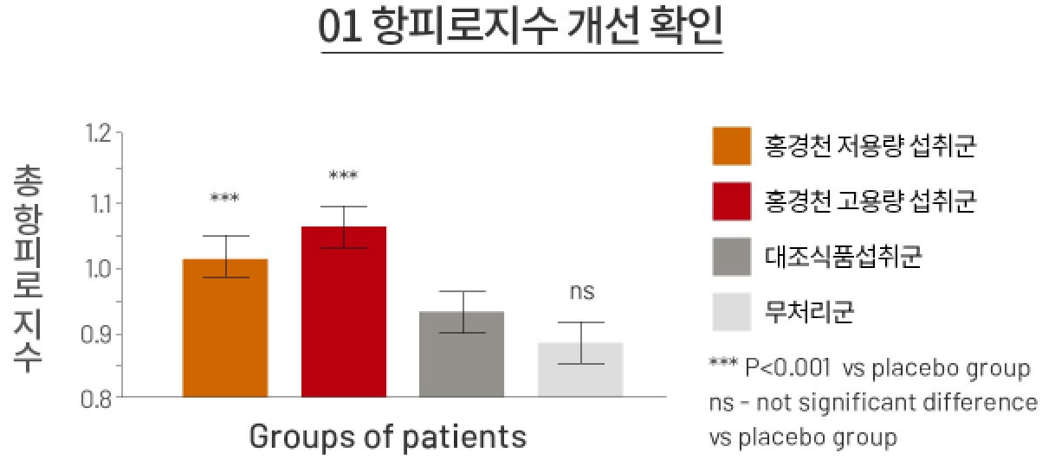


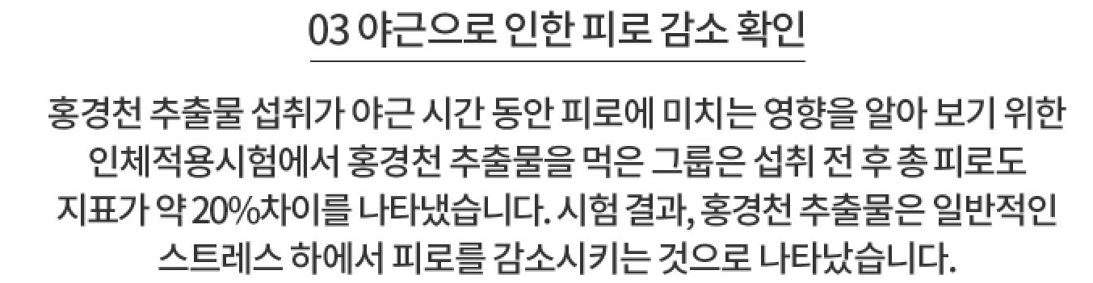
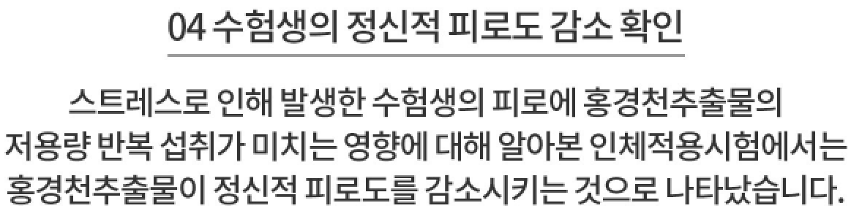
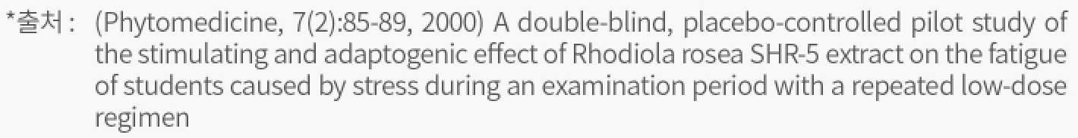

General Information
Immunomodulatory Effect
01 Confirmed Increased Fatigue-Resistance
02 Confirmed Decrease in Cortisol Levels From Perceived Stress
Anti-Fatigue Index
Low Dose (370mg)
High Dose (555mg)
Salivary cortisol conc.
Salivary cortisol conc.
Other Supplement
Control
Control
Intervention
Subjects: 121 males ages 19-21
Trial: Daily intake of 370mg (low dose), 555mg (high dose) for 6 days
Before
After
Subjects: 60 females from ages 20-55 showing fatigue
Trial: Daily intake of 576mg Rhodiola rosea extract for 28 days
Anti-Fatigue Index: Fatigue-resistance level
Source: Phytomedicine 2003;10:95-105
Source: Planta medica 2009;75:105-112
03 Confirmed Decrease in Fatigue
from Working Overtime
04 Confirmed Decrease in Students’
Mental Fatigue
To observe the effects of Rhodiola rosea extract on the fatigue levels
of those working overtime, an intervention group was given Rhodiola
rosea extract. The intervention group showed an approximate 20%
decrease in fatigue levels after intake of the Rhodiola rosea extract.
The results show that Rhodiola rosea extract reduces fatigue from
general stress.
To observe the effects of low does of Rhodiola rosea extract on the
mental fatigue levels of students, an intervention group was given low
doses of Rhodiola rosea extract. The results show that continuous intake of
low doses of Rhodiola rosea extract reduces mental fatigue.
Source
Source

Slide 35
FAQ
1. What are the benefits?
Infectious viruses and excessive alcohol consumption are the most common causes of poor liver function, but other causes include stress, other medication, poor nutrition, metabolic disorder, and obesity. Milk thistle can improve liver function as it can help counteract some of the above-mentioned factors that can harm the liver. It can also be beneficial as an energy booster that can restore vitality.
2. Why is the liver so important?
The liver has many functions such as metabolism, detoxification, immune system management, bile production, and compound synthesis. When liver function declines, there is an increased risk of liver diseases such as hepatitis, cirrhosis, hepatic encephalopathy, fatty liver, alcoholic liver disease, etc.
3. Why are there spots or cracks on the tablet?
The dark spots on the tablet are fruit and vegetable powder and ginseng extract powder. The white spots are powdered crystalline glucose. These are all sub-ingredients of the tablet. The tablet may have cracks as no chemical excipients were used during production.
4. Can pregnant/nursing women take it?
Children, pregnant women, and nursing mothers should avoid consumption. Anyone experiencing gastrointestinal disturbances such as diarrhea or allergic reactions should immediately discontinue use and consult a healthcare professional.
5. Are there any additives?
The tablets contain no chemical excipients, synthetic flavors, or synthetic colors.

