Slide 1
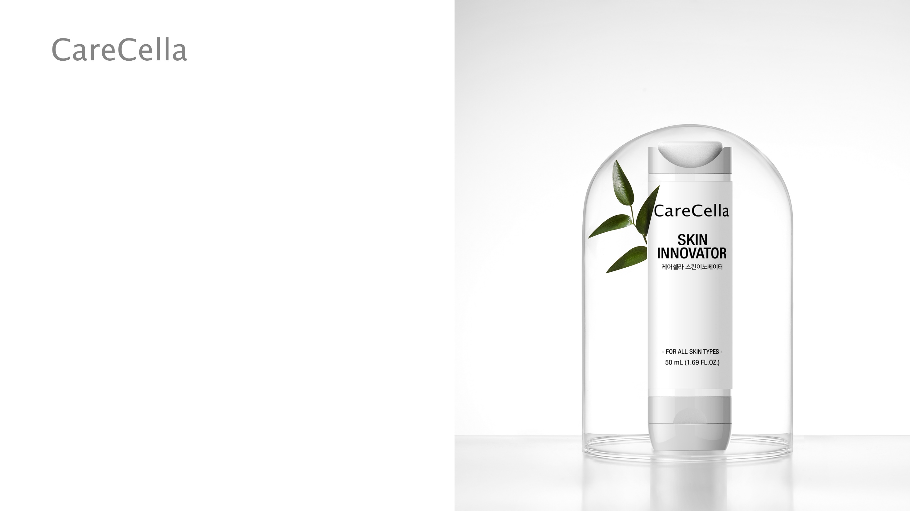
CareCella
Skin Innovator
* This document is meant only for internal training and shall be kept confidential. It is prohibited to disclose or post any information included in this document

Slide 2
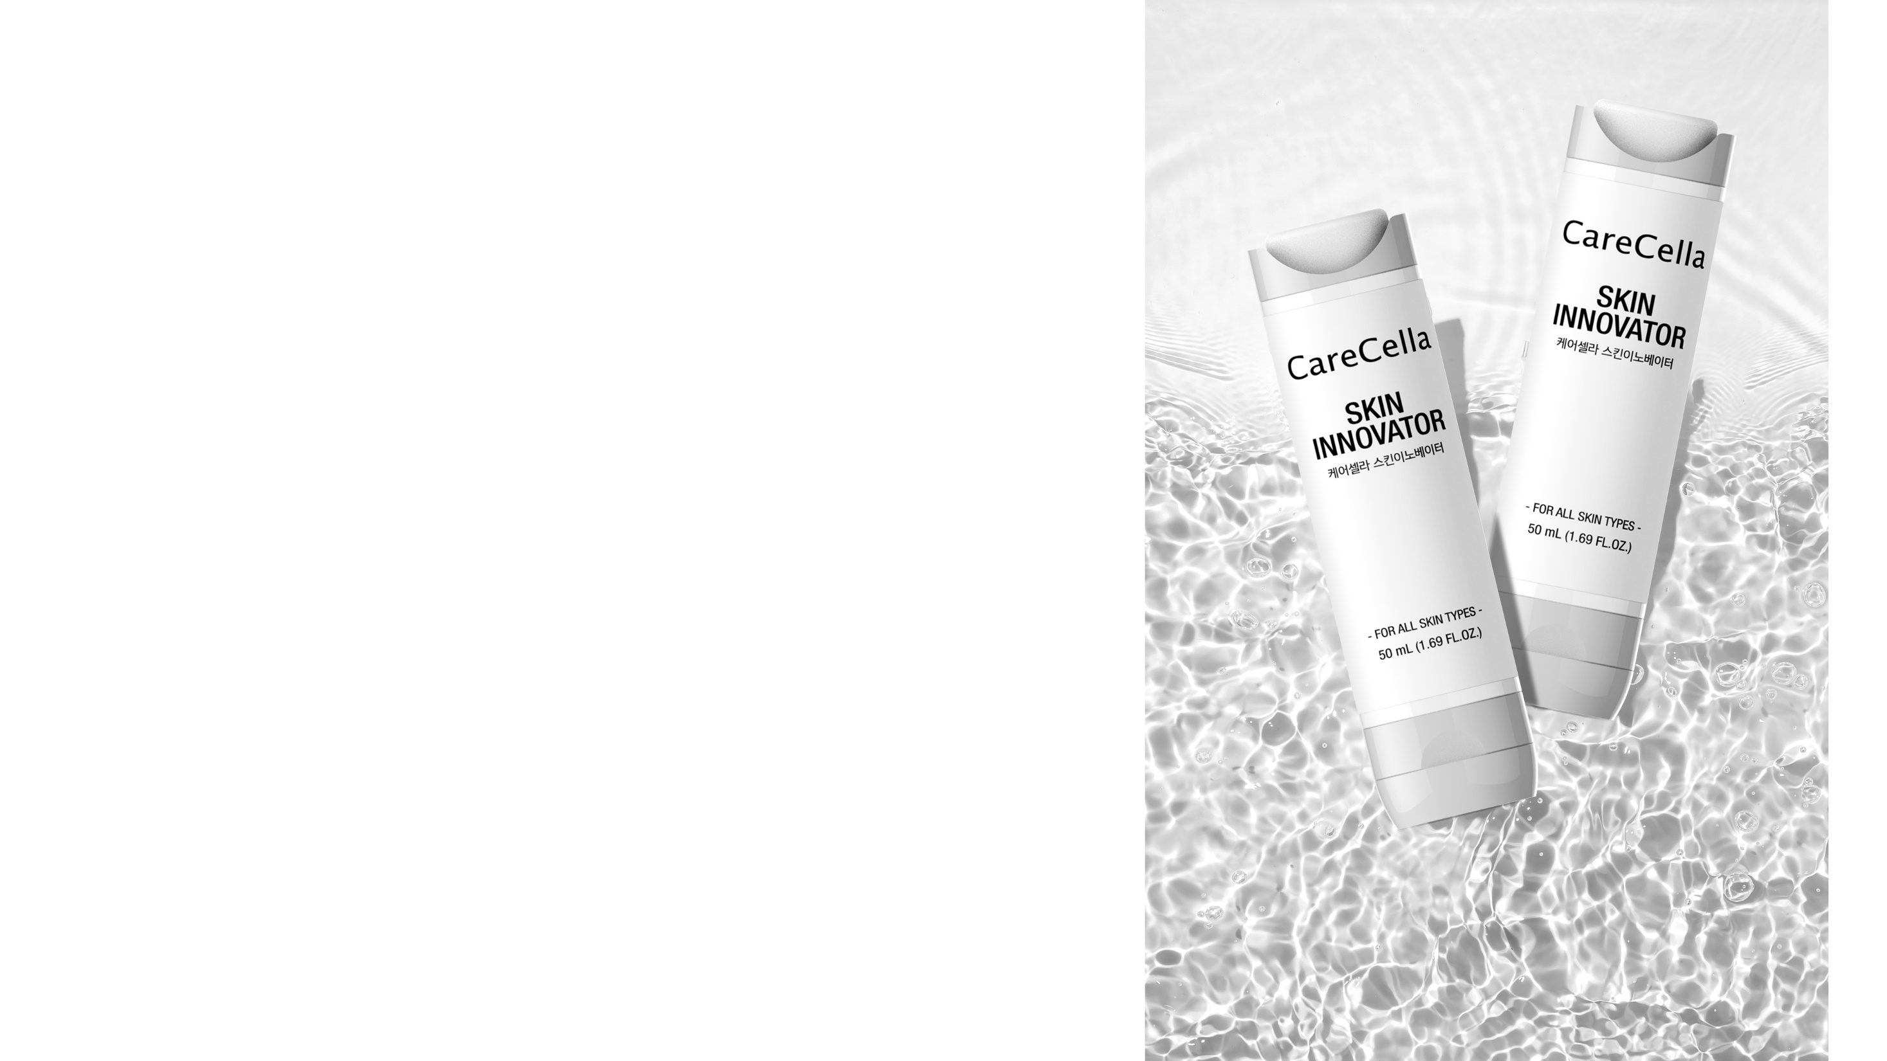
CareCella Skin Innovator
케어셀라 스킨이노베이터
Product Details
Product Features
Highly Elastic Film-forming Mechanism
Main Ingredients
How to Use
Before & After
Recommended for
* This material is for internal educational purposes and cannot be taken out or posted externally.

Slide 3
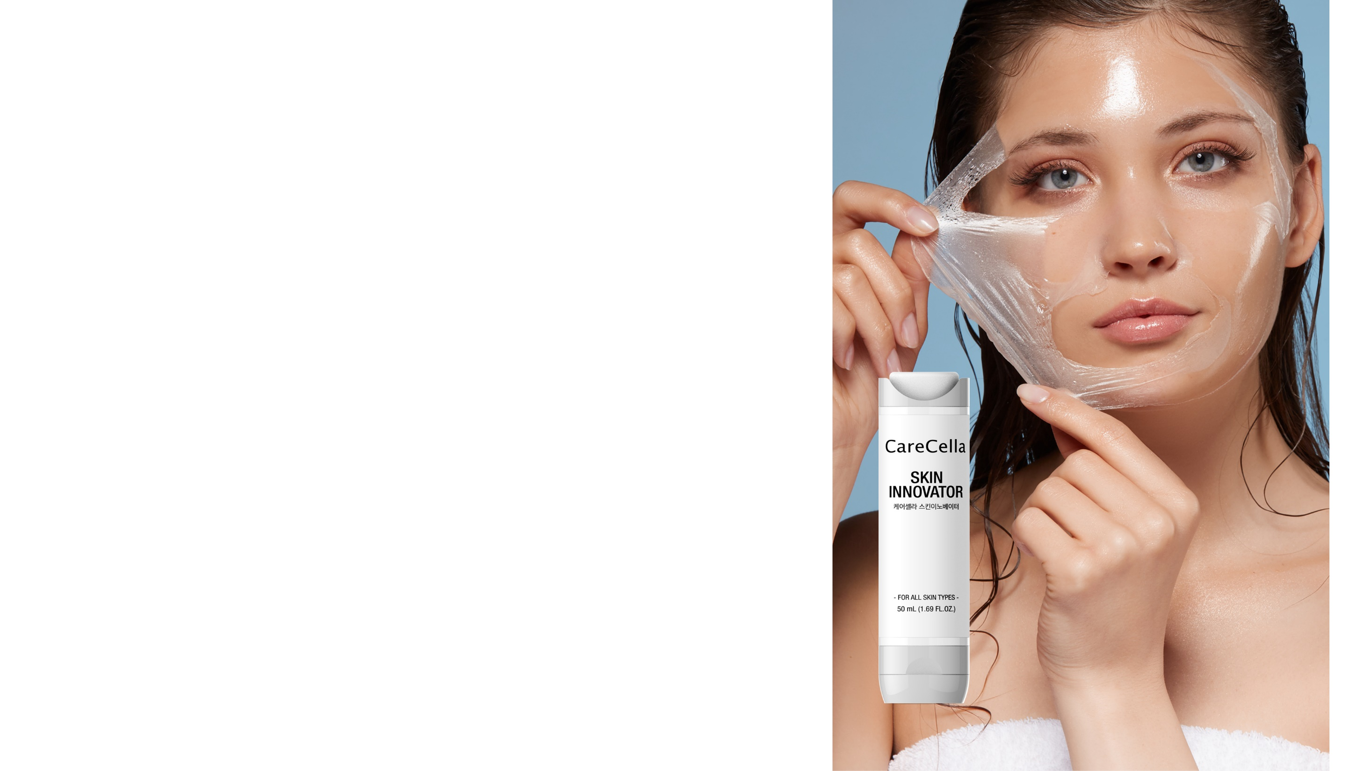

1. Product Details
+ Effects: Relief from dry skin-induced itching, skin protection, and moisturizing.
+ Passed the skin irritation test, DERMATEST, in Germany.
+ Main Ingredients: Beta-glucan, Propolis wax, Ginsenoside, Allantoin, Centella Asiatica, 9 Types of Plant Extracts
+ Volume: 50mL
+ Frequency: Once or twice a day, applicable time to time
+ Area: Face(reddish and itchy areas due to dry skin, spots requiring moisturization),
Body

Slide 4
2. Product Features
+ Fast-Acting
Fast Relief of itching caused by dry skin.
+ Applies formula to form elastic, flexible and fine Water-soluble film.
Washable in water and allows free skin movement.
+ Peel-off-type pack with rich mask
Significant effects for anti-aging and exfoliation as a peel-off-type pack.
+ Film formed (moisturizing band) to provide a moist environment that protects the skin.
Nurtures skin rapidly to return to normal condition.
+ Film contains no acetone or antiseptics
Only skin-deep ingredients proven to be safe are used (tested for skin irritation).
+ Applicable Part
Can be used on face and body
**For sensitive skin, do not peel off, but gently rinse with water.

Slide 5

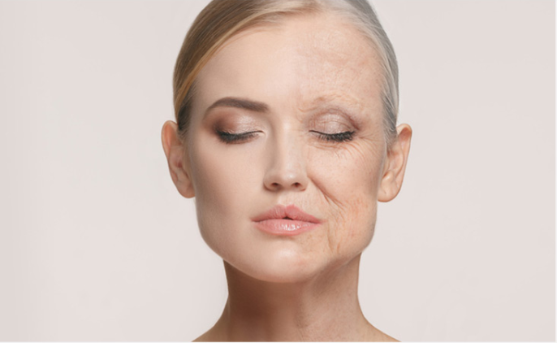
2. Product Features
+ Maximized Skin Protection with an Outstanding Film-Forming Formula
Forms a flexible layer that protects the skin from harmful environments while creating a moist environment that enhances skin flexibility and smoothness. The superior film-forming formula allows for natural skin movement, making it suitable for use on both the face and body.
+ Anti-Wrinkle Improvement
Contains adenosine, a wrinkle-improving ingredient, which helps reduce the appearance of wrinkles.

Slide 6


2. Product Features
+ Maintain optimal skin condition
Contains Beta-glucan, Propolis wax, Ginsenoside Rg2, Allantoin, Centella Asiatica and 9 Types of Plant Extracts which maintain optimal skin condition.
+ This product has passed the skin irritation test, DERMATEST, in Germany.

Slide 7
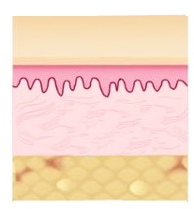
3. High Elastic Film-forming Mechanism
+ Water-solube Film
+ Protection induced by formation of film
Establishes a moist environment through formation of water-soluble film
+ Relieves itching caused by dry skin
Includes beta-glucan, allantoin, Asiatic pennywort and 9 other plant extracts
+ Enhancement of skin barrier
Includes Ginsenoside, RG2 and other compounds.
+ Active Ingredient
+ Skin

Slide 8
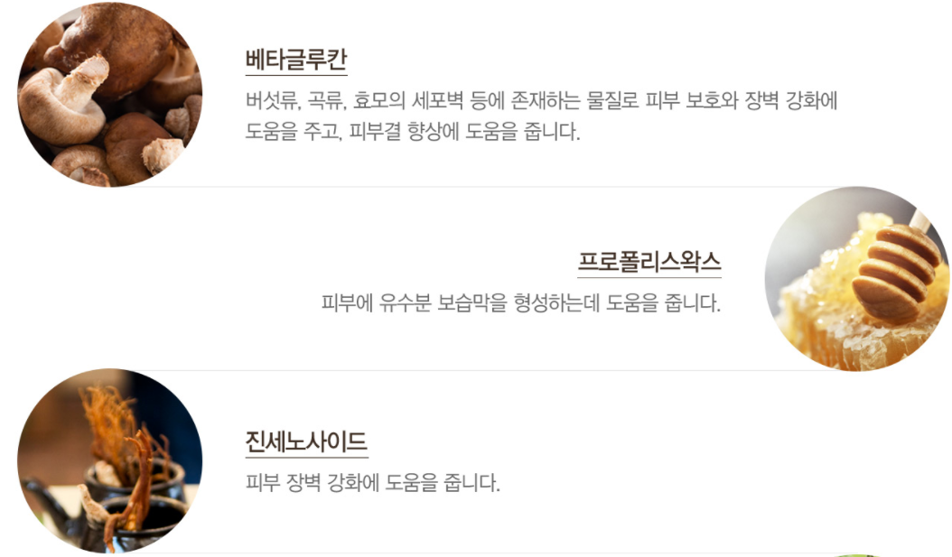

4. Main Ingredients
원료적 특성에 한함

Slide 9
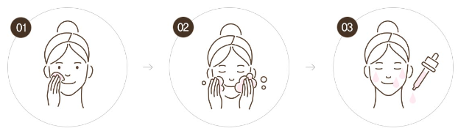
5. How to Use - Face
Evenly apply a suitable amount of product to your skin.
After 30 to 60 minutes, wipe off product with tepid water.
Apply hydration toner and serum.
* When using as a sleeping mask:
After generously applying a moisturizing serum and nourishing cream, apply the mask. Wash it off the next morning after waking up.

Slide 10
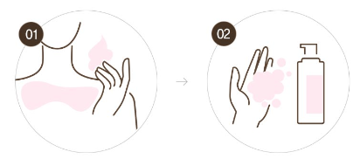
5. How to Use - Body
Evenly apply a suitable amount of product to your skin.
Gently remove with tepid water.
*Removing Film
Gently peel of the film next morning.
If you have sensitive skin, rinse after removing.

Slide 11
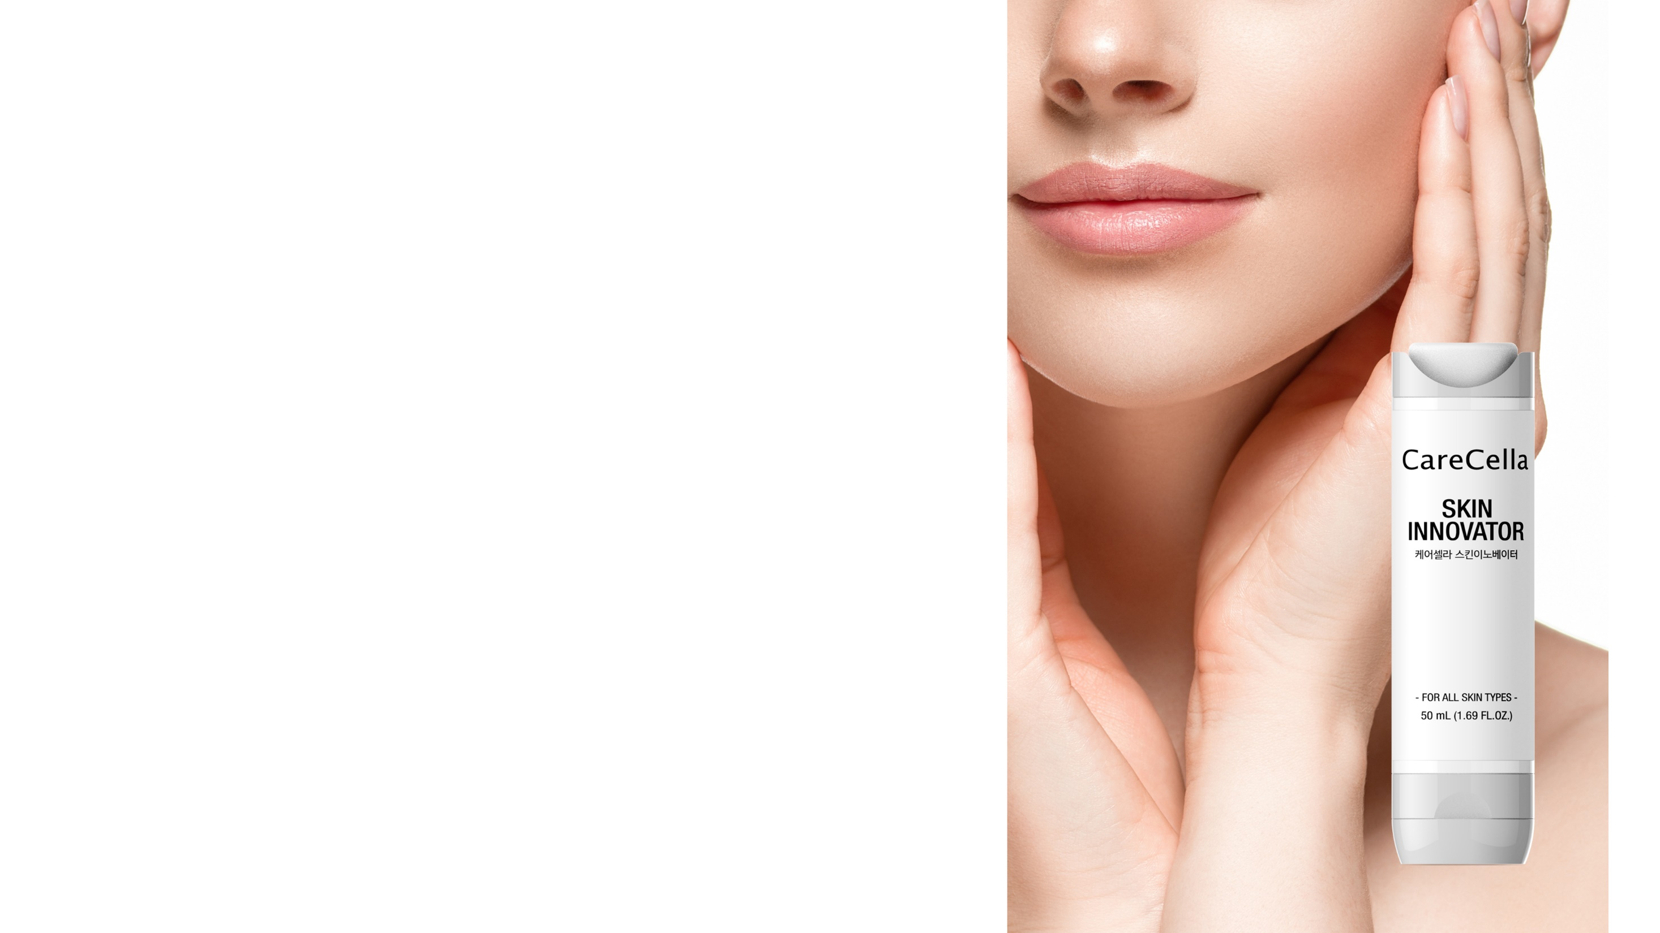
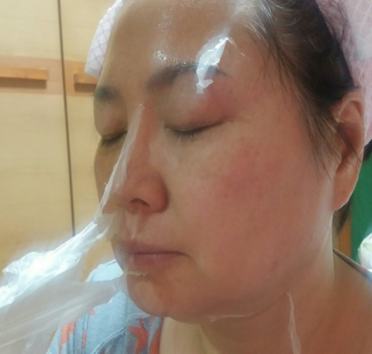
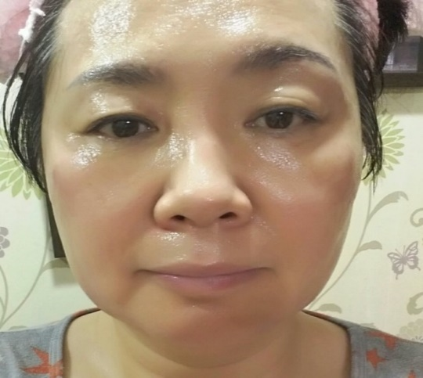
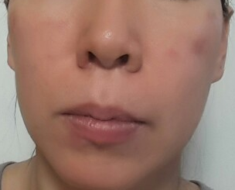
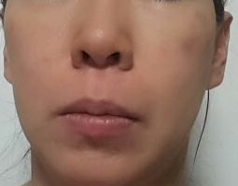
6. Before & After (Face)
+ Applied as a facial Peel-off pack
1회차 적용 후
Before use
After use

Slide 12
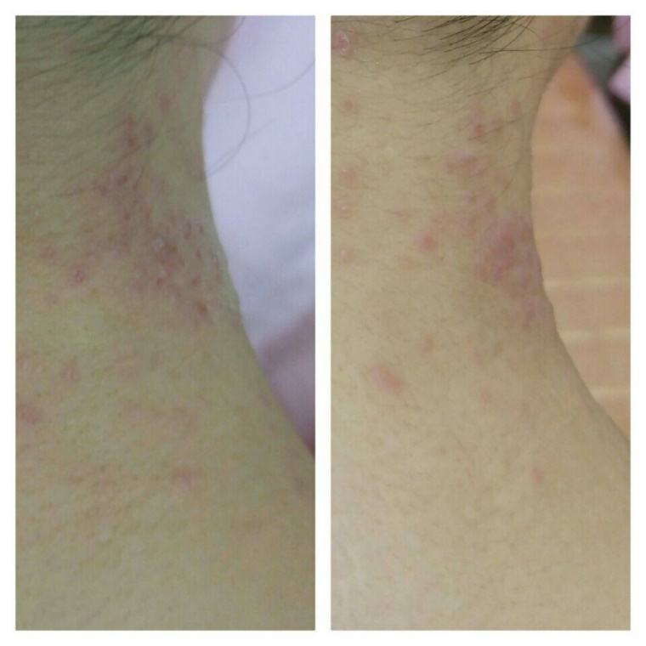
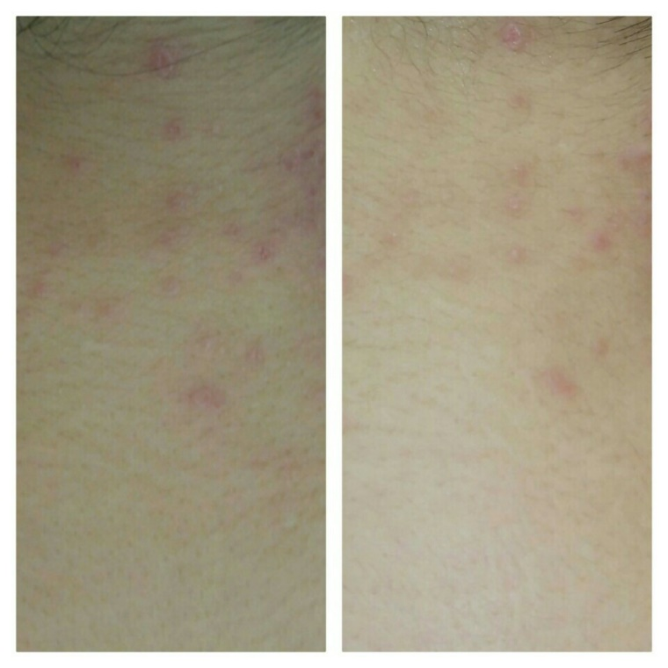
6. Before & After (Neck)
+ Body Application_Back of Neck
Before use
After use

Slide 13
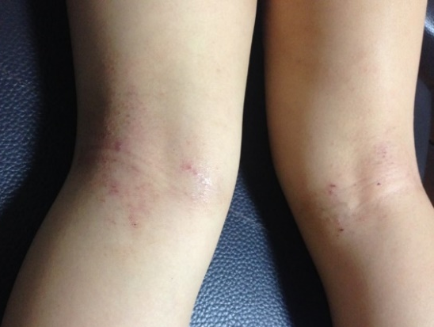
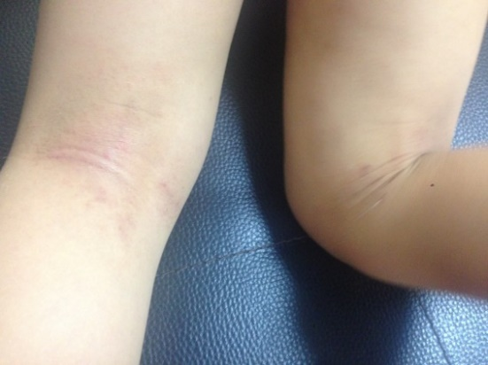
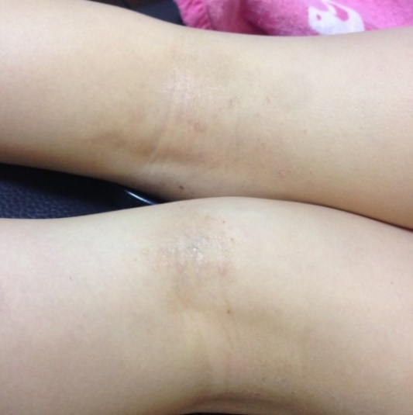
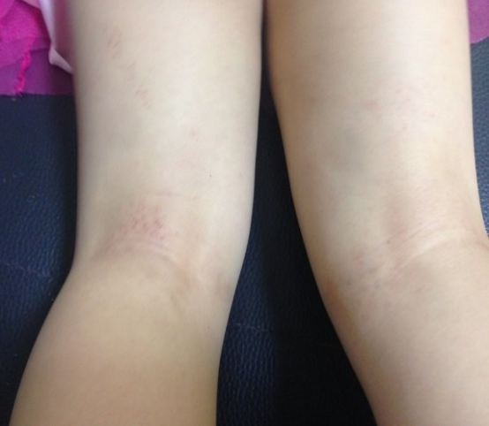
6. Before & After (Body)
+ Body Application_Back of Knee
Before use
After 1st Application (15 min.)
After 2nd Application (15 min.)
After 3rd Application (15 min.)

Slide 14
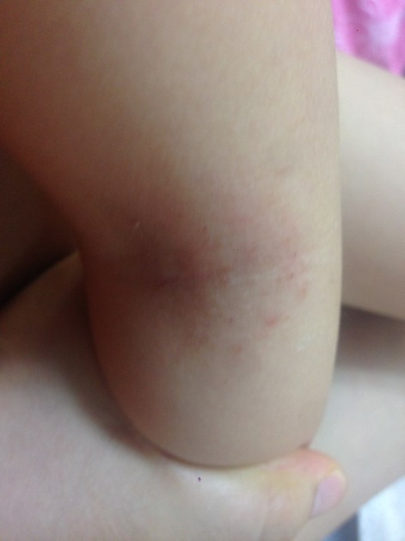
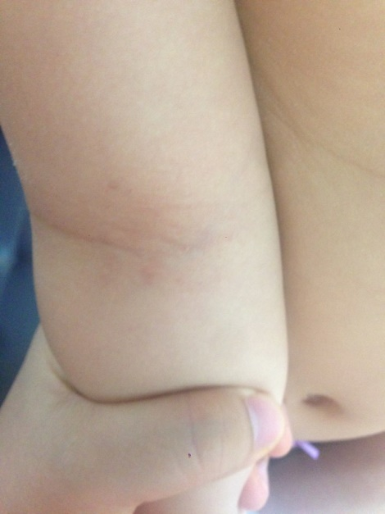
6. Before & After (Body)
+ Body Application_Chelidon (Inside of Elbow)
Before use
After 1st Application (15 min.)

Slide 15
7. Recommended for
For those who want to protect their skin from harmful environments
For those concerned about skin wrinkles
For those who want to care for their skin with soothing products overnight
For those looking to use one product in multiple ways
For those seeking a sleeping mask

