Slide 1



Slide 2
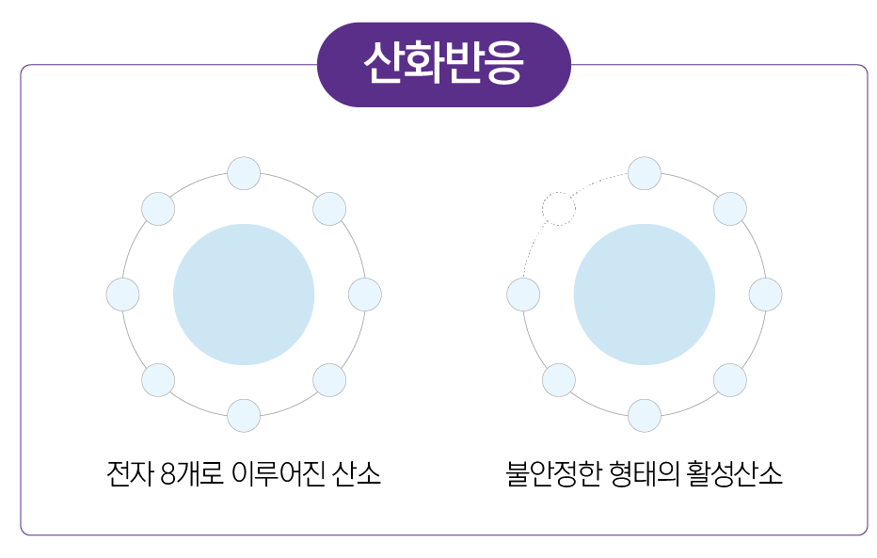
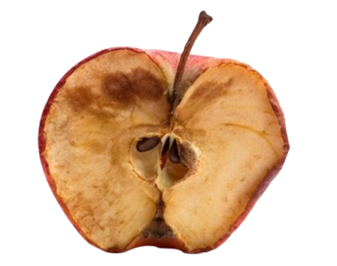
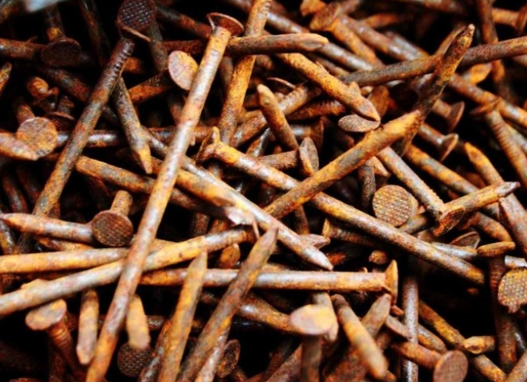
2. Reactive Oxygen Species
1) What is Oxidation?
What is Oxidation?
Oxidation
A reaction where a substance combines with oxygen
Oxidation refers to the process where an atom or ion gains oxygen or loses hydrogen or electrons.
All molecules need their electrons to be paired to achieve stability. Activated oxygen that has undergone oxidation is in an unstable state because its electrons are not paired.
Unstable activated oxygen will steal electrons from its surroundings, and this reaction is called oxidation.
8-electron oxygen
Unstable oxygen
◈ Common Oxidation Reactions
[Apple browning]
[Rust on nails]

Slide 3
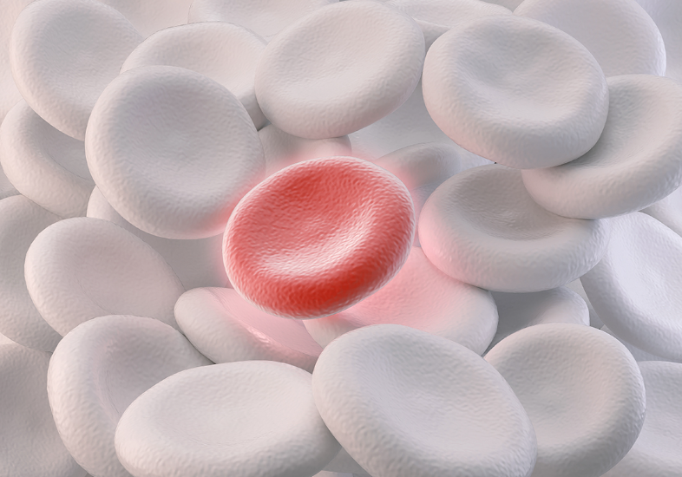
2. Reactive Oxygen Species
2) What are Reactive Oxygen Species?
(Reactive Oxygen Species, ROS)
Inevitable byproducts of respiration
The leftover residues after oxygen is used in respiration and metabolic processes
About 5% of oxygen will inevitably be converted into reactive oxygen species during respiration
In appropriate amounts, reactive oxygen species play a role in protecting the body from bacteria and viruses

Slide 4
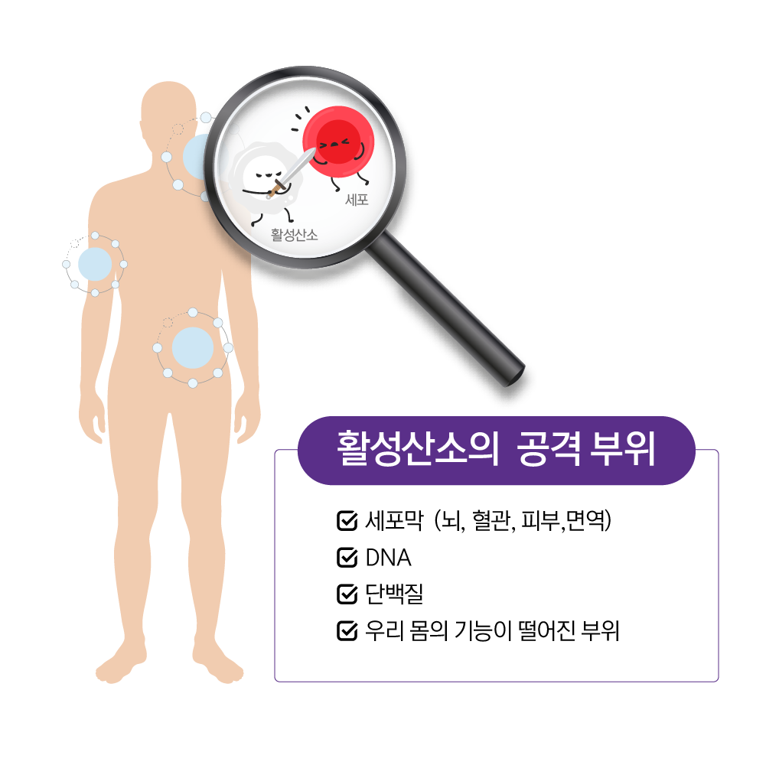

2. Reactive Oxygen Species
2) What are Reactive Oxygen Species?
The Importance of Removing Reactive Oxygen Species from the Body
Reactive oxygen species become highly reactive and attack cell membranes.
With cells under attack, normal functions of our body cannot be maintained.
Brain, vascular, and skin cells are easily damaged
Attacks on cell DNA can lead to various conditions including cancer.
Targets of Reactive Oxygen
Cell membrane (brain, blood vessels, skin)
DNA
Proteins
Areas where body functions are impaired

Slide 5

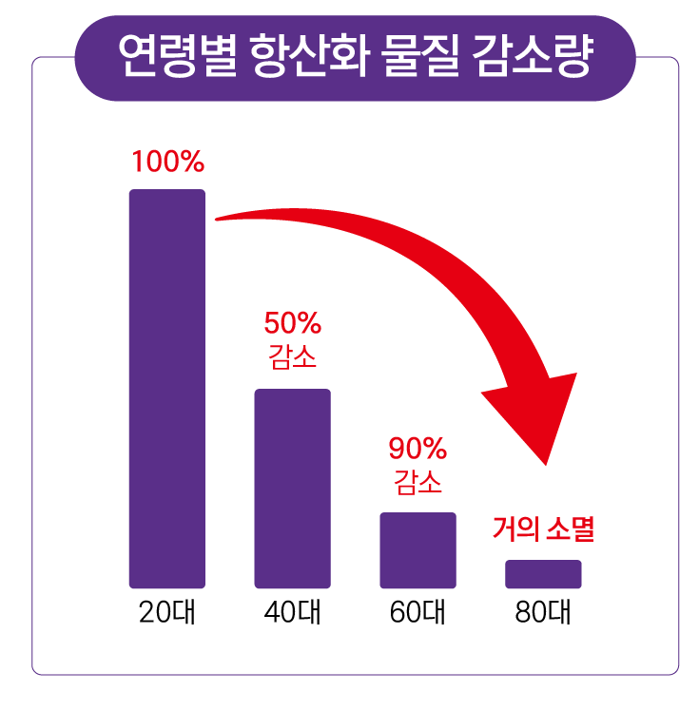
2. Reactive Oxygen Species
2) What are Reactive Oxygen Species?
The Dangers of Reactive Oxygen Species
“There are approximately 36,000 diseases in humans, and reactive oxygen species is the cause of 90% of them”
Source: Johns Hopkins University School of Medicine (1991)
연령별 항산화 물질 감소량
Reduction in Antioxidant Capacity of Cells by Age
Capacity Reduction
▶ Antioxidant capacity of cells significantly decreases with age.
▶ By 60s, antioxidant capacity of cells is reduced by 90%.
Almost gone
20s 40s 60s 80s

Slide 6


2. Reactive Oxygen Species
3) How is it Created?
Creation of Reactive Oxygen Species
Overeating
Excessive Consumption of
Fast / Processed Food
Pollution
Stress
Smoking

Slide 7

2. Reactive Oxygen Species
3) How is it Created?
Habits that Create Reactive Oxygen Species
Excessive exposure to UV rays
Frequent overeating and heavy drinking
Lack of proper sleep
Smoking
Prolonged periods of stress
Exposure to chemicals (pesticides, cleaning agents, etc.)
Long-term use of certain medications

Slide 8


2. Reactive Oxygen Species
3) How is it Created?
Exercise and Reactive Oxygen Species
∙ x10-15 increase in body oxygen levels
∙ x100 increase in oxygen levels in stimulated muscles
Exercise (High Intensity Aerobic Exercises ex: Marathon)
Excessive oxygen intake
Excessive energy creation
Increase in reactive oxygen species

Slide 9
2. Reactive Oxygen Species
4) Reactive Oxygen Species and Diseases
Diseases Caused by Excessive Reactive Oxygen Species
Aging
∙ Reactive oxygen species (ROS) are generated by ultraviolet (UV) radiation
∙ Continuous oxidative stress leads to protein oxidation, lipid peroxidation, and the activation of protein-
degrading enzymes that destroy intercellular lipid components
∙ Reactive oxygen species damage fibrous proteins such as collagen and elastin, which are crucial for skin elasticity
∙ This process not only acidifies the skin and causes the accumulation of waste products beneath the skin but also impairs blood circulation
∙ The negative effects include dehydration, dryness, wrinkles, and reduced elasticity.

Slide 10
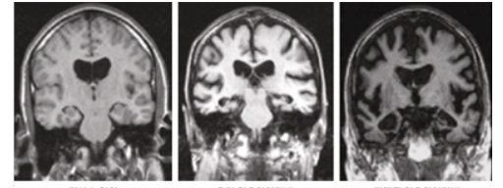
2. Reactive Oxygen Species
4) Reactive Oxygen Species and Diseases
Diseases Caused by Excessive Reactive Oxygen Species
Dementia
∙ The brain is the organ with highest oxygen usage
∙ Brain cells are the body sensitive to attacks by reactive oxygen species
∙ When brain cells damaged by reactive species, brain vascular function is impaired.
∙ Treatments to manage symptoms are available, but there is currently no cure for dementia.

Slide 11
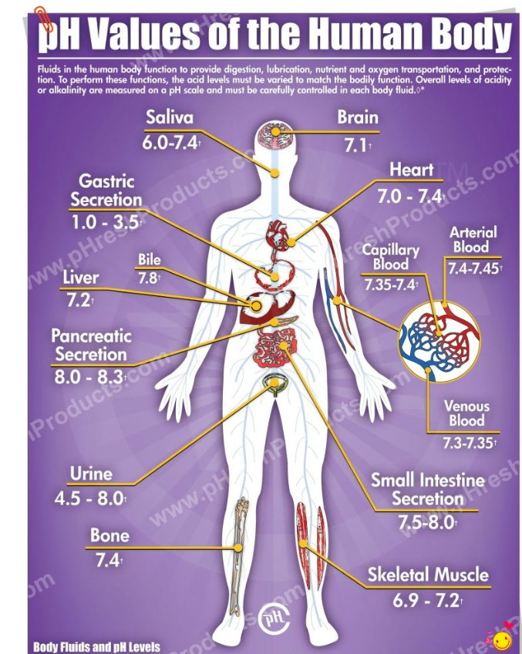
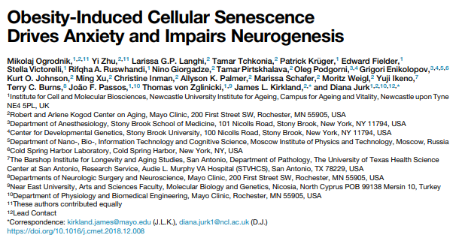
2. Reactive Oxygen Species
4) Reactive Oxygen Species and Diseases
Diseases Caused by Excessive Reactive Oxygen Species
Vascular Health
Blood plays a crucial role in transporting oxygen and nutrients throughout the body.
When there is an excess of reactive oxygen species, the body becomes oxidized, causing the movement of red blood cells to slow down.
With up to 25 trillion red blood cells not moving properly and clumping together, there is great risk of blood becoming acidic.
The risk of stroke increases fourfold, the risk of death from cardiovascular disease triples, and the risk of premature death rises by 80%.
When cells affected by reactive oxygen species accumulate in the blood vessels, they can cause cardiovascular diseases such as stroke, angina, and myocardial infarction. Additionally,
such cells can inhibit the normal function of surrounding cells,
leading to mutations that can potentially cause cancer.

Slide 12
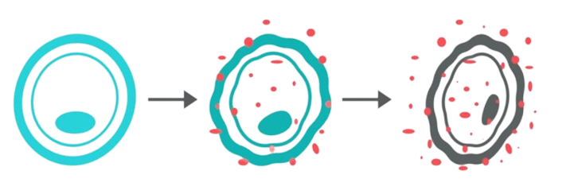
2. Reactive Oxygen Species
4) Reactive Oxygen Species and Diseases
Diseases Caused by Excessive Reactive Oxygen Species
Increases Risk of Cancer Development
Reactive Oxygen Species → Oxidation of intracellular proteins, lipids, and nucleic acids → Promotion of cellular aging and apoptosis → Mutant genes caused by DNA damage → Proliferation of cancer cells
Normal Cells
Attack on normal cells by
reactive oxygen species
Proliferation of cancer cells due to cellular damage

Slide 13
2. Reactive Oxygen Species
4) Reactive Oxygen Species and Diseases
Accumulation of Reactive Oxygen Species
Antioxidant Enzymes (SOD Enzymes): Decrease by 50% by age 40 compared to
age 25; decrease by 90% after age 60, and almost none after age 80.
Middle-aged Individuals (Over 40)
Occurs when body fluids become acidic. Reactive oxygen species damage pancreatic cells, reducing pancreatic function and increasing risk of diabetes. When blood vessels are damaged, peroxidized lipids are produced, causing arteriosclerosis and coronary artery disease, and increasing the risk of stroke and cardiovascular diseases.
Obesity and Metabolic Disorders
Unpleasant body odor is related to the breakdown of peroxidized lipids into a component called
nonenal. Excessive oxidation of fats due to high levels of reactive oxygen species in the body can result
in more noticeable odors from the scalp or body. If there is an increase in body odor compared to usual,
it may be a sign of excessive oxidative stress.
Unpleasant Body Odor

Slide 14

3. Antioxidation
1) What is Antioxidation
What is Antioxidation
∙ Preventing oxidation/Inhibition of Oxidation
∙ A natural defense system to protect cells from reactive oxygen species and to respond to oxidative stress.
∙ The principle involves lending an electron to unstable reactive oxygen species to stabilize them into a stable
oxygen molecule.
Antioxidant
Reactive Oxygen Species
Normal Oxygen
Effects
∙ Removal of ROS helps prevent aging and protects the body
∙ Helps prevent diseases caused by ROS

Slide 15
3. Antioxidation
2) Types of Antioxidants
Types of Antioxidants
 | Antioxidants | Characteristics
Enzymatic Antioxidants | SOD (Superoxide Dismutase) | ∙ One of the first reactors among the body’s antioxidant defense system that directs lower-level antioxidants ∙ Acts as the first enzyme to respond to O₂⁻, converting it to O₂ and thus reducing the concentration of reactive oxygen species.
 | CAT (Catalase) | ∙ H₂O₂를 O₂와 2H₂O로 분해
 | GPX (Glutathione Peroxidase) | ∙ Provides strong antioxidant activity against a broad range of peroxides, including H₂O₂ and OH⁻
Non-enzymatic Antioxidants | Vitamin | ∙ Vitamin A (Beta carotene) ∙ Vitamin C (Ascorbic acid) ∙ Vitamin E (Tocopherol)
 | Mineral | ∙ Selenium ∙ Zinc
 | Antioxidant foods | ∙ Super foods, Plant-based phytochemicals, various natural substances
∙ Enzymatic antioxidants (endogenous) : Antioxidants that are naturally produced within the body.
∙ Non-enzymatic antioxidants (exogenous) : Antioxidants that enter the body from external sources and react with reactive oxygen species without being processed by the enzyme-based

Slide 16
3. Antioxidation
3) Antioxidant Test
Antioxidant Test
▶ Antioxidant testing is one of the processes used to evaluate the stability of various products such as food and cosmetics.
  1. DPPH (Free Radical Scavenging Activity) Analysis
DPPH is an unstable free radical used to measure antioxidant activity. This test measures the extent to which antioxidants react with DPPH to stabilize it.
  2. ABTS Analysis
ABTS is a chemical substance containing unstable protons used to measure antioxidant
activity. This test measures the extent to which antioxidants react with ABTS to convert it from a proton-containing form.
  3. ORAC Test
The ORAC (Oxygen Radical Absorbance Capacity) test objectively measures how well a food
can handle reactive oxygen species in the body. Studies have shown that individuals who
consumed at least 6000 ORAC units daily lived longer.

Slide 17
Your Start to ‘Well-Aging’
THEELIXIR Purple

Slide 18
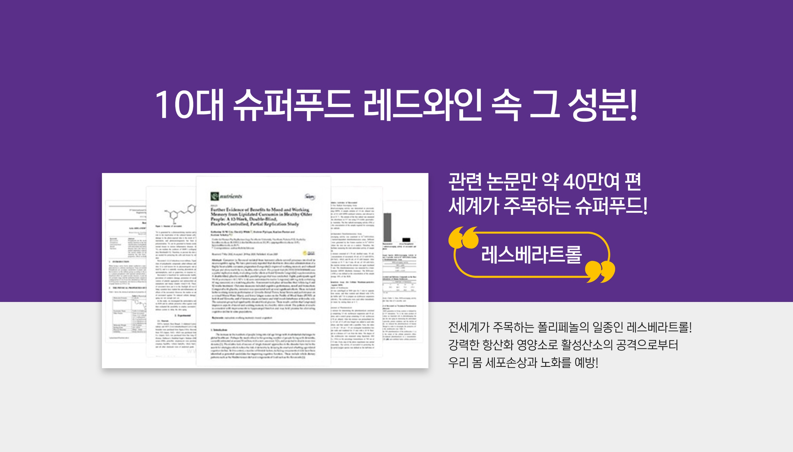

An Antioxidant within Red Wine
Approximately 400,000 related research papers
An antioxidant gaining global attention
Resveratrol
Resveratrol, a type of polyphenol that is gaining
worldwide attention, is a powerful antioxidant
that can help prevent cellular damage and aging
caused by oxidative stress.
COPYRIGHT © 2022 GCOOP All Rights Reserved.

Slide 19

THEELIXIR Purple
Benefits of Resveratrol
Potent Antioxidative Effect
May help reduce oxidative stress
May help reduce cell damage and aging
May improve menopausal symptoms
COPYRIGHT © 2022 GCOOP All Rights Reserved.

Slide 20

THEELIXIR Purple
Product Features
Antioxidant formula with resveratrol
Includes anticarcinogen, trans-resveratrol
The perfect combination of Reynoutria japonica,
grape seed, and pomegranate
Easy and Convenient – Anywhere, Anytime
Quality ingredients for well-aging

Slide 21

A Potent Antioxidant: Resveratrol
An antioxidant gaining attention
Found in plants such as peanuts, mulberries, raspberries, cranberries
1.68million liters of red win needed to obtain 1kg
of resveratrol
According to a 2003 paper published in Nature, "Resveratrol activates the SIRT1 gene, which extends lifespan."
Plants thickening their skins for protection against
bacteria, insects, etc. triggers a chemical reaction that
produces resveratrol and other compounds
May help prevent
cardiovascular diseases
Antioxidant and
anti-cancer properties
May help prevent
metabolic syndrome
May help prevent
dementia
May help prevent
cancer
Well-being and
well-aging
Note: These benefits are attributed to the intrinsic properties of the ingredients or functional components, not the product itself.
(제품에 의한 특징이 아닌 원료적 또는 기능성분의 특성에 한함)

Slide 22
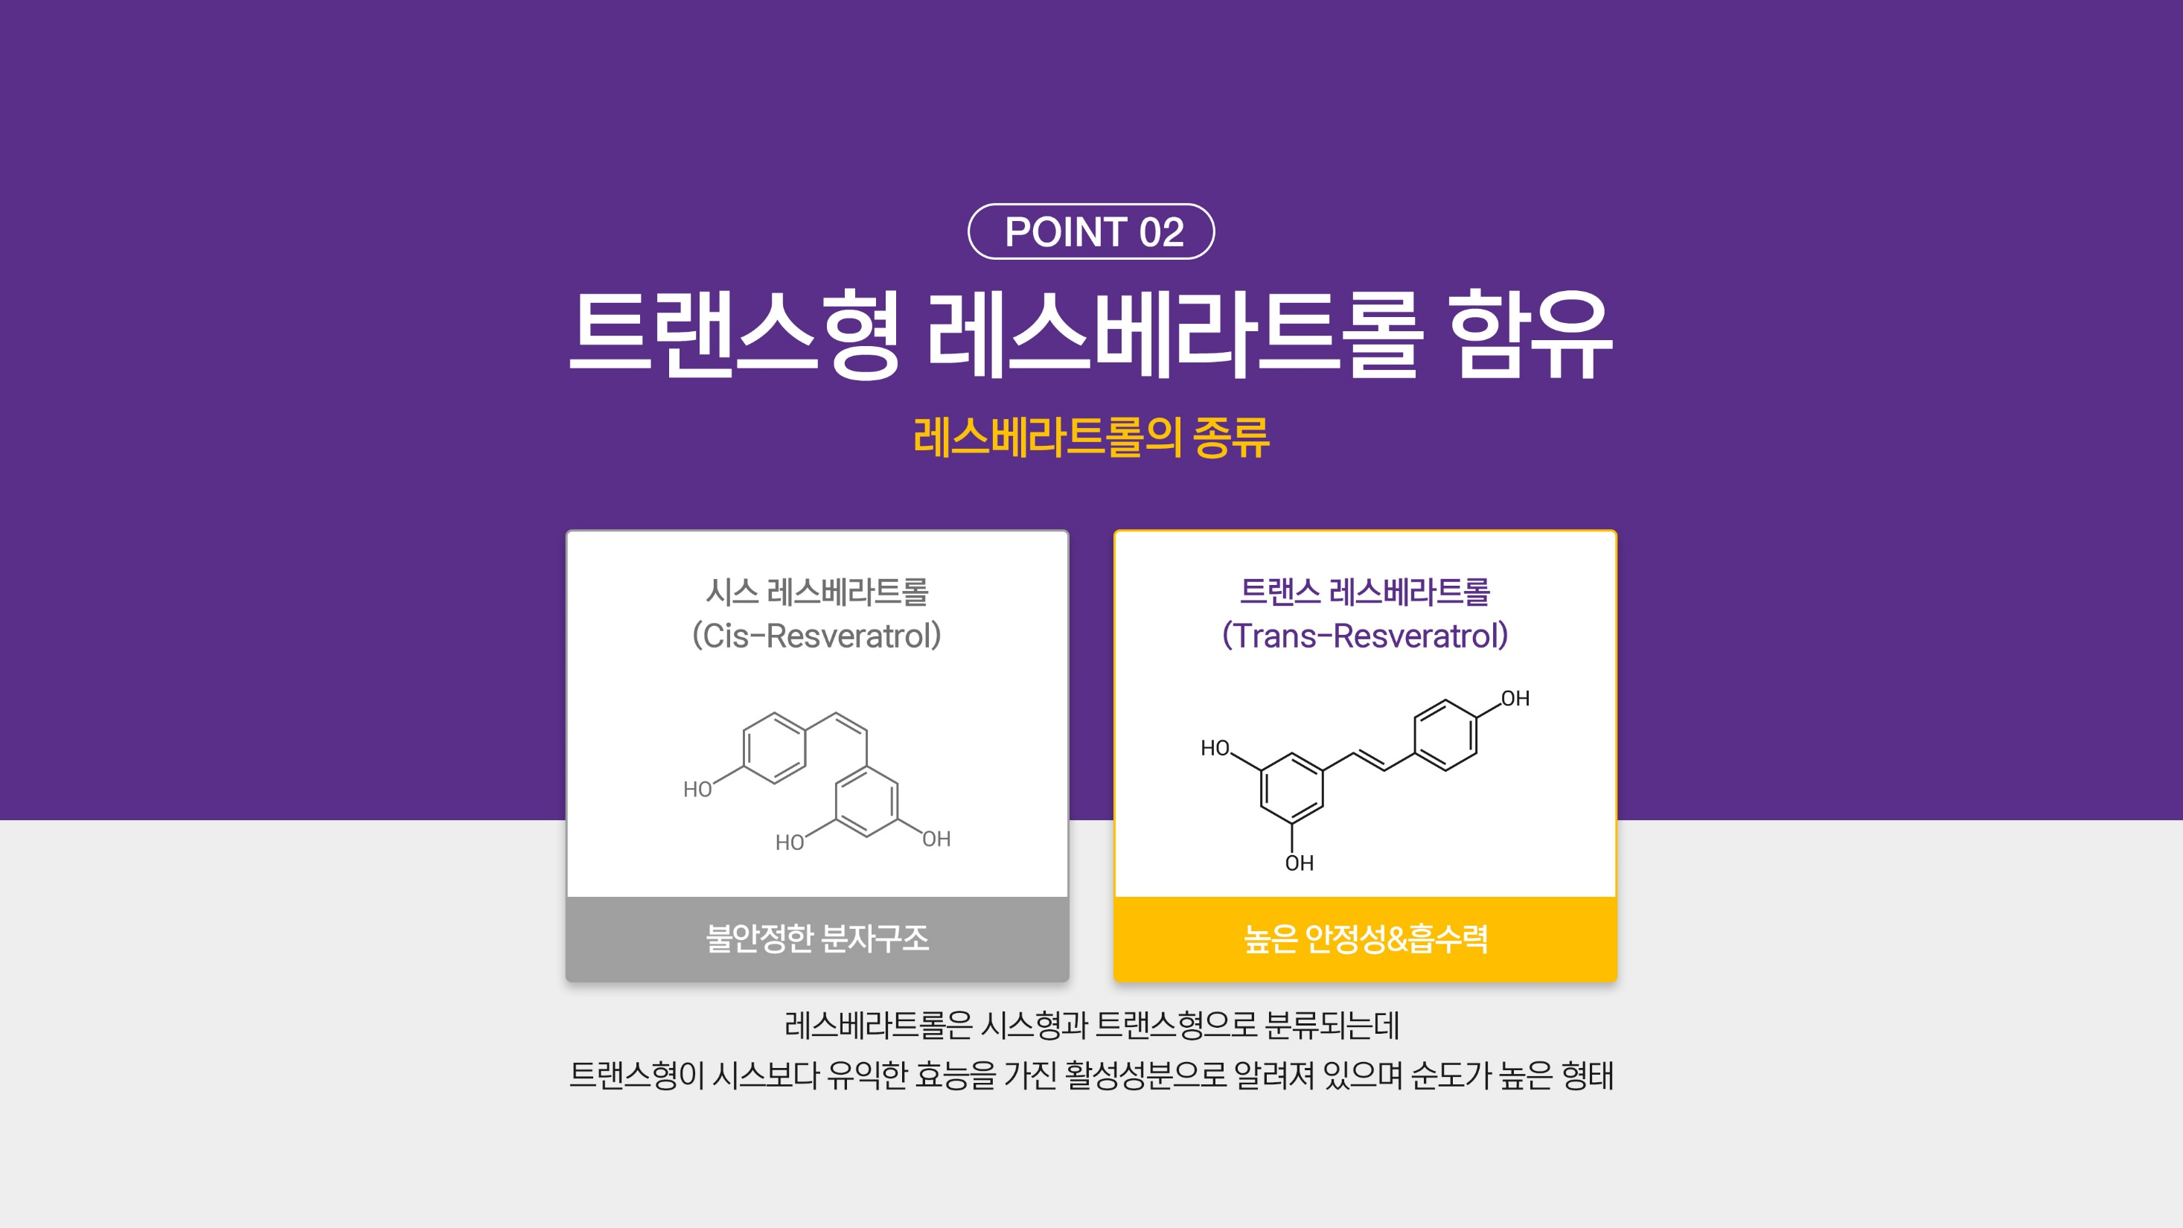
Trans-Resveratrol
Types of Resveratrol
Unstable molecular structure
Highly stable and absorbable
Resveratrol has a cis and a trans configuration. Trans-resveratrol is known
to be more beneficial as it is purer in form and more effective.

Slide 23
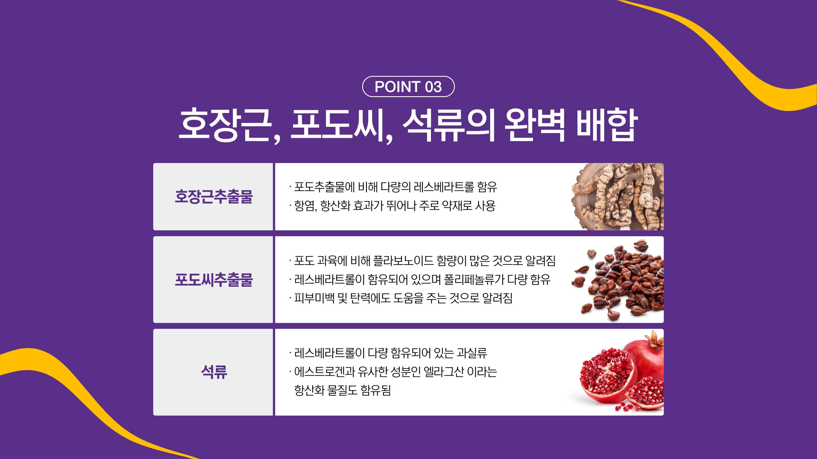
The Perfect Combination of Reynoutria japonica, Grape Seed, and Pomegranate
Reynoutria japonica
extract
Contains more resveratrol than grape extract
Has excellent anti-inflammatory and antioxidant properties
and is mainly used as a medicinal ingredient.
Contains more resveratrol than the fruit
Contains high amounts of polyphenol
Known to help improve skin tone and elasticity
Grape Seed
extract
Contains high levels of resveratrol
Also contains ellagic acid, an antioxidant compound
similar to estrogen
Pomegranate
Note: These benefits are attributed to the intrinsic properties of the ingredients or functional components, not the product itself.
(제품에 의한 특징이 아닌 원료적 또는 기능성분의 특성에 한함)

Slide 24
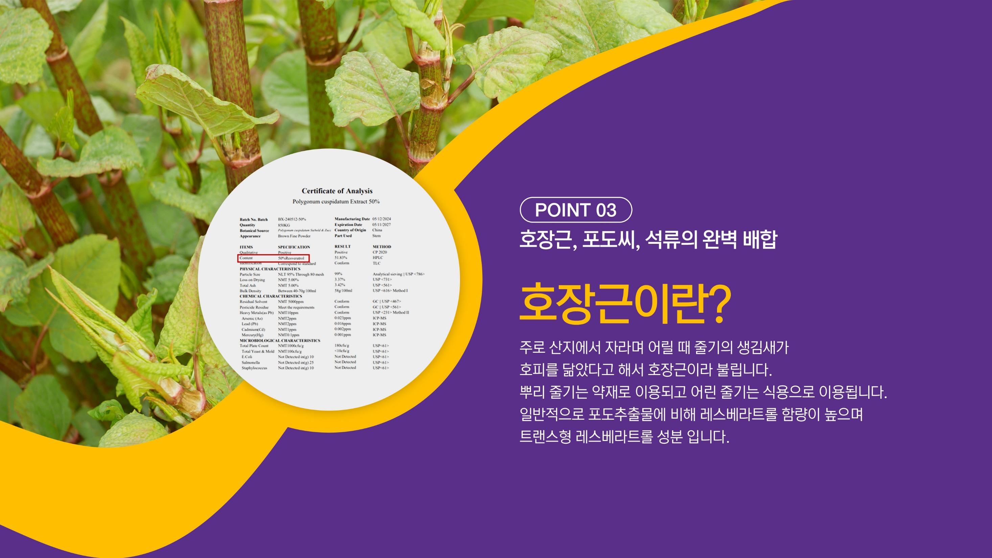
The Perfect Combination of Reynoutria japonica, Grape Seed, and Pomegranate
Reynoutria japonica
Reynoutria japonica mainly grows in the highland and is native to China,
Japan, and Korea. The root stalk is used as a medicinal ingredient, while the
young stems are eaten as food. Its extract is trans-resveratrol and on average
has more resveratrol than grape extract.

Slide 25

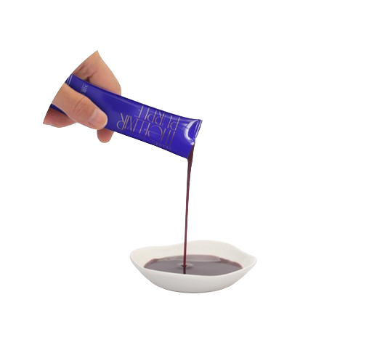
Easy and Convenient - Anywhere, Anytime

Slide 26

Antioxidant Formula
Quality Ingredients for Maximum Effect
Cypress Tree
Extract
Blueberry
7-Berry Mix
Maca
Arginine
Vitamin C

Slide 27

Recommended for Those Who
Are interested
in well-aging
Want
an antioxidant
supplement
Exercise frequently
Have been
eating poorly
Want
menopausal symptom
relief
Want to alleviate
stress

Slide 28

THEELIXIR Purple
How to Enjoy
As is for the original taste
With other THEELIXIR products
With sparkling water
Chill in the fridge for freshness

Slide 29

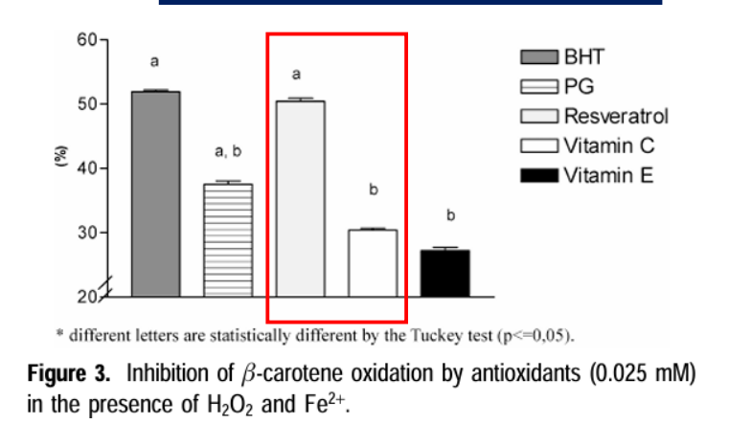
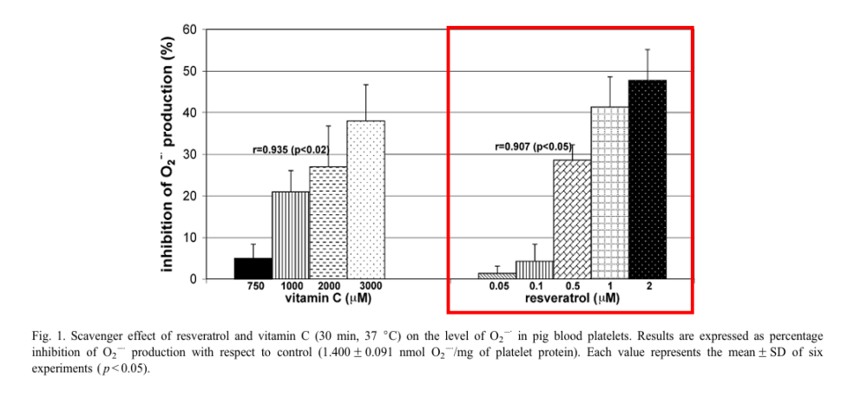
Reference
Functionality of Resveratrol
레스베라트롤의 기능성
Antioxidative effect confirmed
ROS inhibition confirmed
[산화적 효과 확인]
[활성산소 억제 효과]
Study shows resveratrol is a potent antioxidant
even among other antioxidants.
Study shows resveratrol is more effective than vitamin C
in inhibiting ROS even at lower concentrations
▶ 레스베라트롤의 기능성을 검토한 결과
항산화물질들 사이에서 강력한 산화적 효과를 확인함
▶ 활성산소 억제 효과에서도 비타민C에 비해 낮은 농도로도
더 강력한 억제 효과가 있었음을 확인함
* Source : 1. Sequestering Ability of Butylated Hydroxytoluene, Propyl Gallate, Resveratrol and Vitamin C and E against ABTS,DPPH and Hydroxyl Free Radicals in Chemical and Biological System(2003)
2. Resveratrol and Vitamin C as antioxidants in blood platelets(2003)

Slide 30
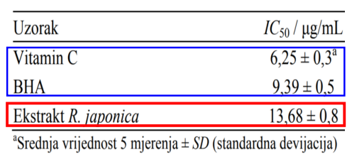
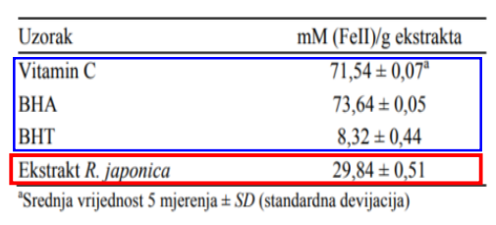
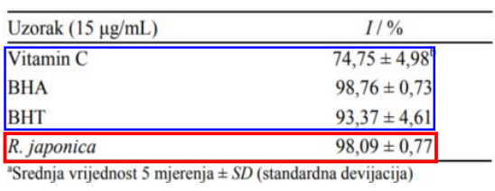
Reference
호장근추출물의 항산화 활성
Antioxidative Property of Reynoutria japonica
Electron Donating Ability
ADTS Radical Scavenging Ability
DPPH Radical Scavenging Ability
[전자공여능]
[DPPH 라디칼 소거능]
[ABTS 라디칼 소거능]
▶ DPPH 라디칼 소거능은 비타민C 보다 약2배,
BHT보다 약 1.5배 농도 차이를 보임
Electron donating ability is about three times higher
than that of BHT, but approximately 2.4 times lower
than that of vitamin C and BHA.
ABTS radical scavenging ability is comparable to BHA
and BHT, and was higher than that of vitamin C.
DPPH radical scavenging ability is approximately
twice that of vitamin C and about
1.5 times that of BHT.
▶ 호장근추출물의 전자공여능은 BHT보다 약 3배
높았으며 비타민C, BHA보다 약 2.4배 낮았음
▶ 호장근추출물의 ABTS라디칼 소거능은 BHA,BHT에 준하는 활성을 보였으며 비타민C 보다높았음
* Source : Antioksidativna i antimikrobna aktivnost ekstrakta Reynoutria japonica

