Slide 1
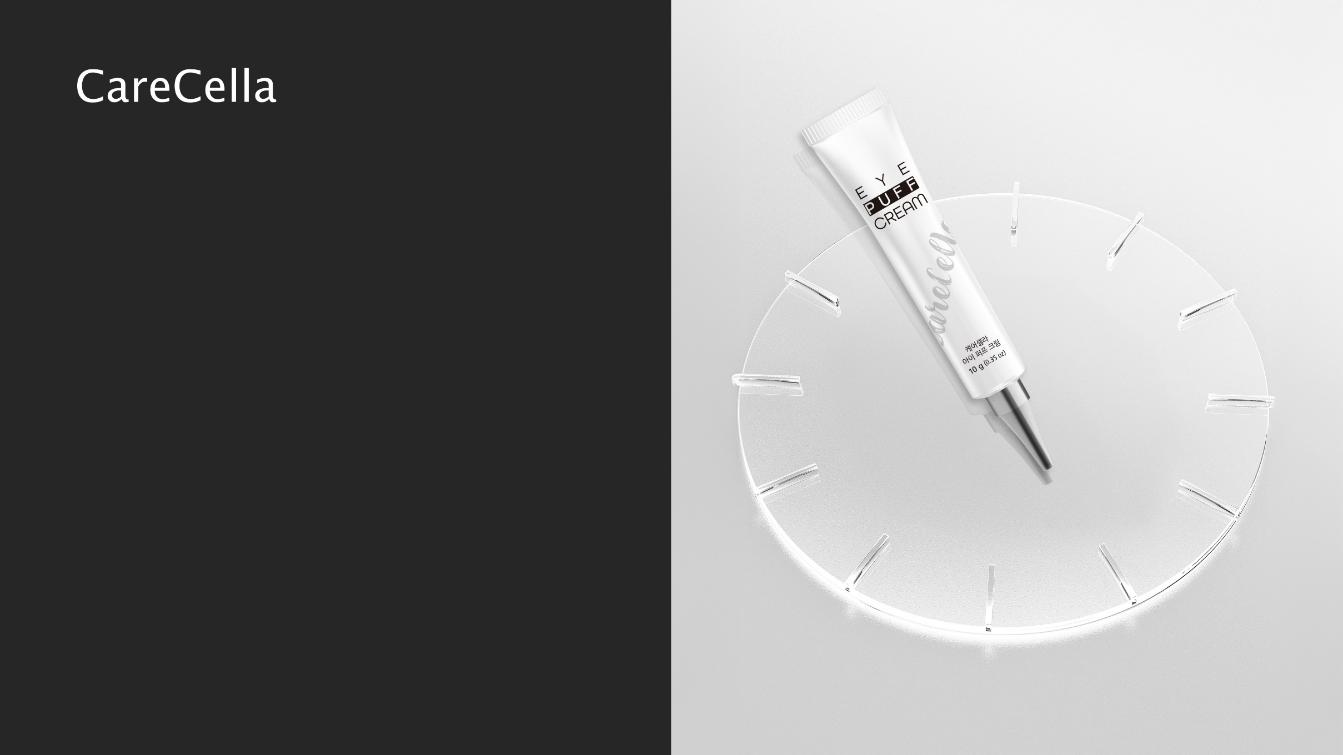
CareCella
EYE PUFF CREAM

Slide 2

Laws on Exaggerated Advertising of Cosmetics
General Bio Co., Ltd. is committed to fostering a responsible advertising culture to prevent any harm caused by exaggerated advertisements.
Please refer to the relevant laws below and cooperate to ensure that false or exaggerated advertising does not occur.
Do not include any descriptions, product names, or advertisements that may be mistaken for pharmaceutical products or that misrepresent the product’s efficacy and effects.
When comparing with competing products, clearly specify the comparison target and criteria, and only include verifiable, objective information in advertisements. Avoid using exclusive and absolute expressions such as "best" or "top.“
Do not use advertisements that are false or, even if partially true, may mislead consumers when viewed as a whole. Additionally, avoid any advertisements that deceive or have the potential to deceive consumers.
Do not advertise claims about quality or efficacy that cannot be objectively verified or have not been confirmed. Additionally, avoid any advertisements that exceed the scope of cosmetics as defined in Article 2, Paragraph 1 of the law.
Do not use advertisements that contain vulgar expressions, offensive imagery, designs, or photos.
Do not include any advertisements that state or imply that the cosmetics contain processed materials from internationally endangered species.
Do not include advertisements that disparage other products or could be suspected of doing so, regardless of whether the claims are true.
[Excerpt] Enforcement Rules of the Cosmetics Act, Article 22 (Scope of Labeling and Advertising, etc.)[Effective July 9, 2024] [Prime Ministerial Decree No. 1970, Partial Amendment on July 9, 2024][Annex 5] <Amended on July 9, 2024> Scope and Compliance Requirements for Cosmetics Labeling and Advertising (Related to Article 22)

Slide 3
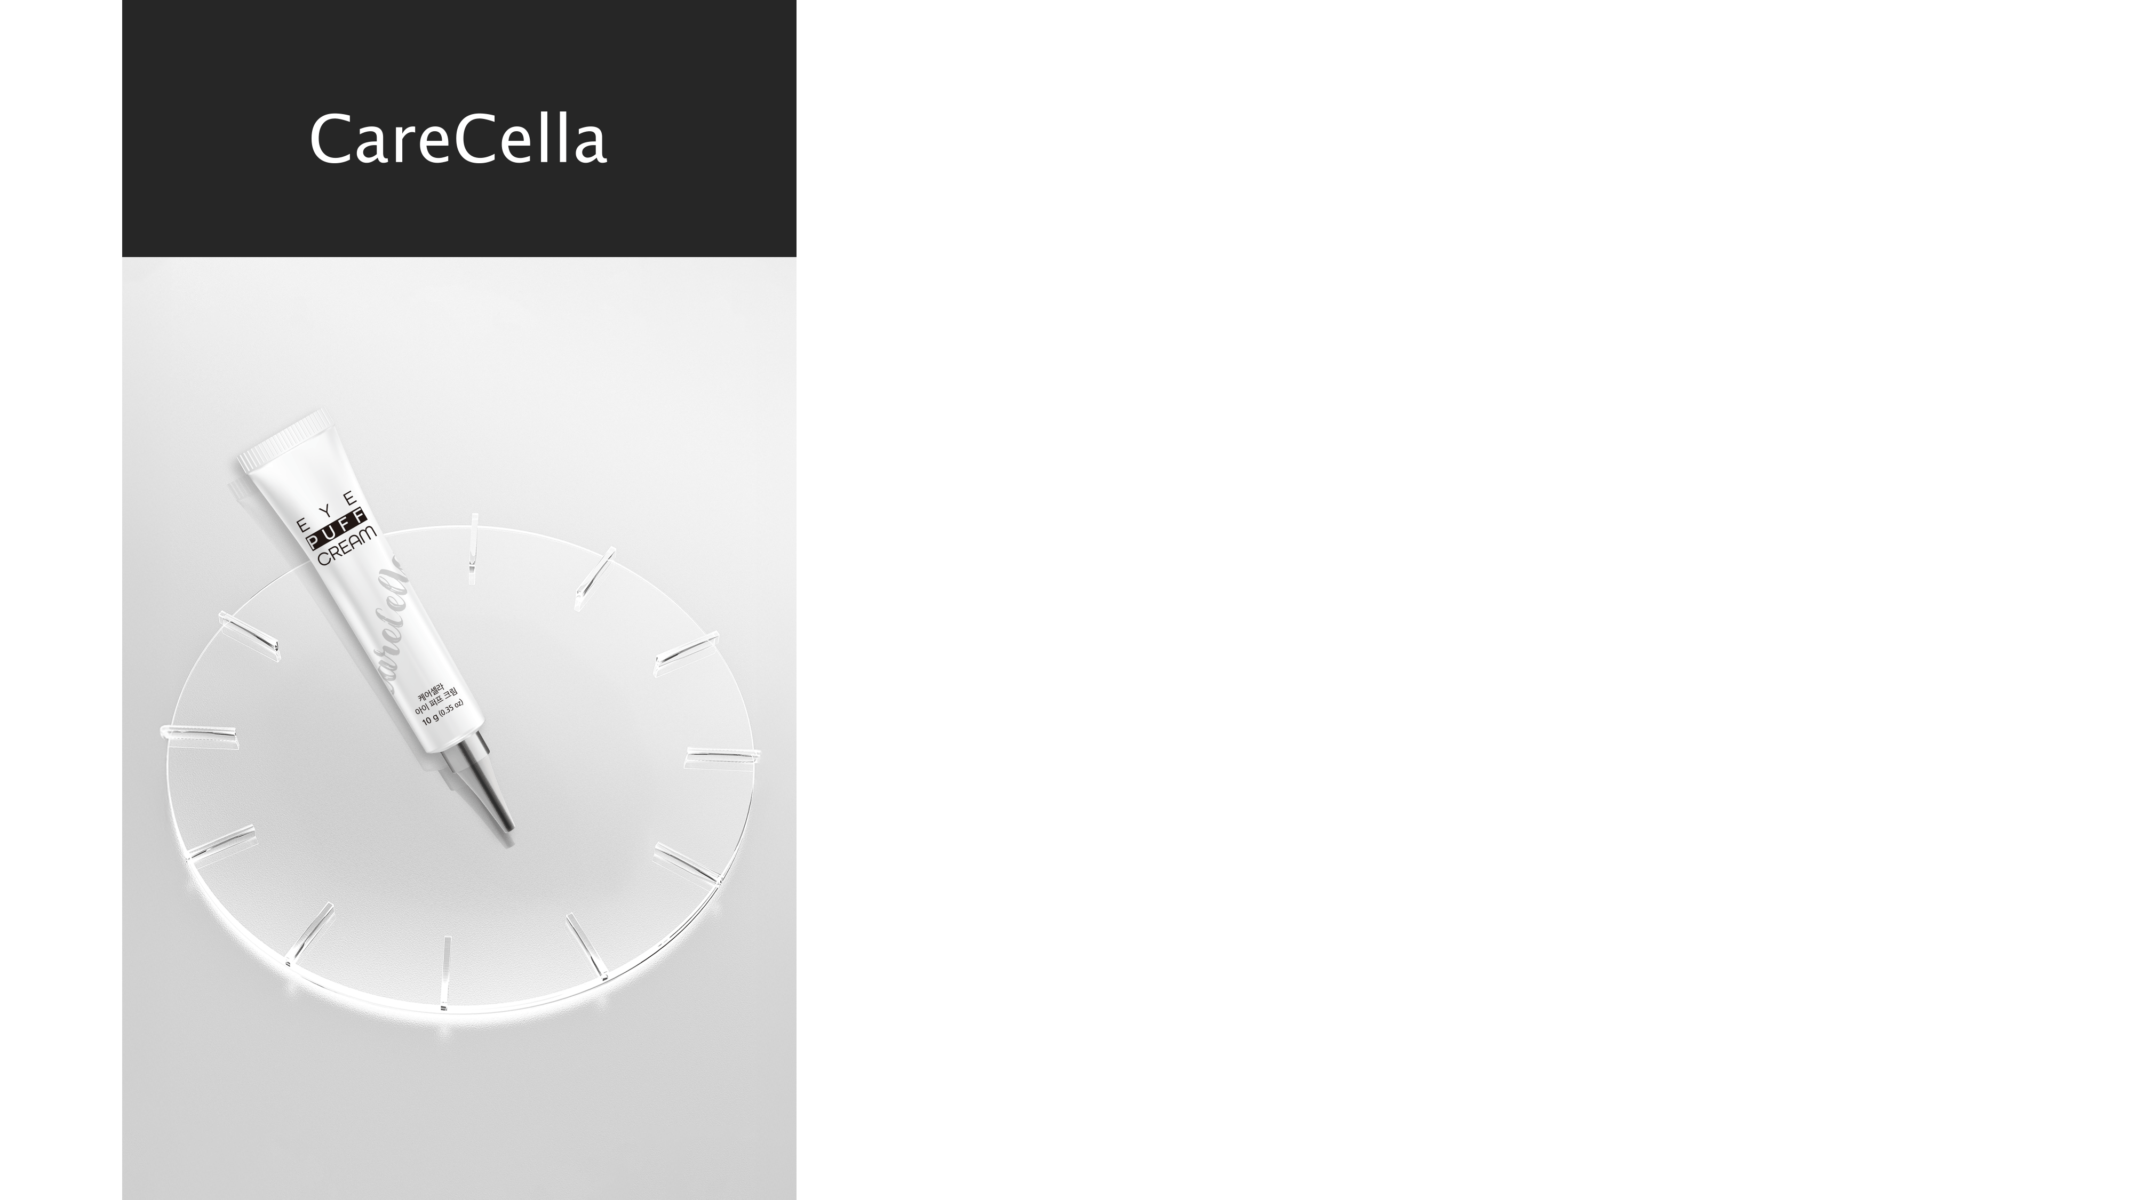
CareCella EYE PUFF CREAM
Development story
Product composition
Product Specifications
Product Features
Product Information
How to use & Precautions
Recommended For
*This material is for internal training purposes only and cannot be distributed or posted externally.

Slide 4


1. Development story
The beginning of aging starts with eye bags.
The eye area is a highly specialized part of the skin that is vulnerable to various changes affecting appearance and different biological systems. Since the skin around the eyes is thinner and more sensitive than other facial areas, it is more prone to irritation. Additionally, the eye area naturally has fewer sebaceous glands, making it more susceptible to moisture loss.
Moreover, because this area is frequently in motion, wrinkles tend to form easily. These changes in the eye area are inevitable as we age.
Using an eye-specific cream, such as CareCella EYE PUFF CREAM, can provide the following benefits:
Designed as a gentle, non-irritating formula specifically for the delicate eye area.
Delivers a lifting effect in a short time, enhancing skin elasticity and improving sagging around the eyes.
Specifically formulated as a lifting cream for the eye area, CareCella EYE PUFF CREAM helps reduce puffiness in eye bags and effectively addresses age-related festoons, providing targeted care for aging concerns.
All EYE BAG
care
Can use all day long
Reduce white cast
Minimizes skin irritation
(Non-irritating)
*Festoons refer to pouch-like swelling that forms under the eyes. This condition occurs when excessive skin or tissue accumulates in specific areas around the eyes, or when lymphatic fluid builds up. It can worsen due to sun exposure or aging.
Festoons typically develop from under the eyes to the surrounding eye area, causing skin sagging and making the face appear tired and aged.

Slide 5

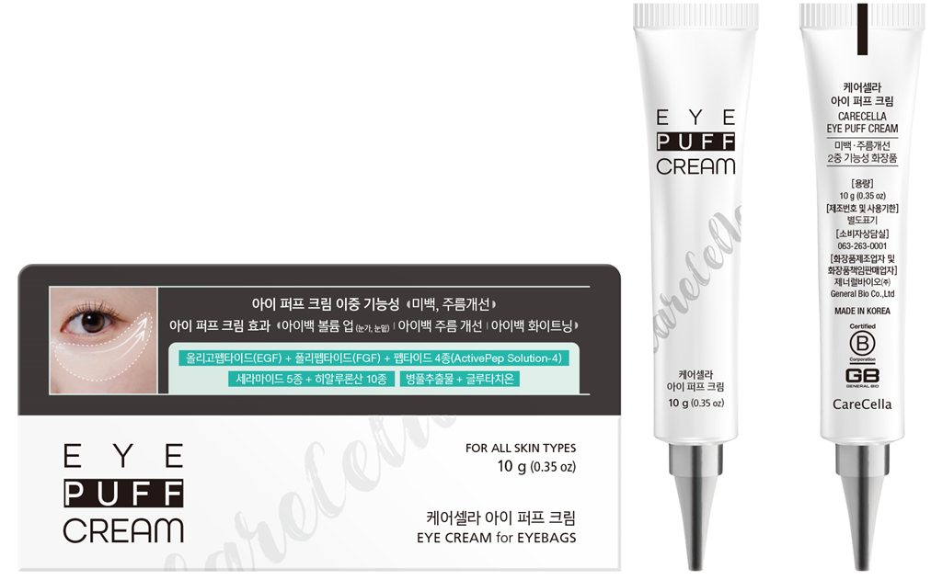
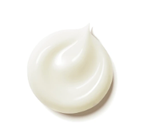
2. Product composition
Spatula
Formulation

Slide 6

3. Product Specifications
+ Product Name : CareCella EYE PUFF CREAM
+ Contents : 10g x 1ea (Includes spatula)
+ Functionality : Dual-Function Whitening & Anti-Wrinkle Cosmetic (Contains Niacinamide & Adenosine)
+ Certifications : Skin Irritation Test Completed (Non-irritating)
Human Application Test Completed (Improves Eye Area Volume, Reduces Under-Eye Puffiness, Diminishes Wrinkles Around the Eyes)
+ Key Ingredients : Magnesium Aluminum Silicate
Aqua Cera5 (Ceramide-based formula with 5 types of ceramides, NO PEG)
Growth Factor Peptide Solution (EGF, FGF) + 4 Peptides (ActivePep Solution-4)
10-Complex Hyaluronic Acid (High, Medium, and Low Molecular Weights)
Centella Asiatica Extract, Glutathione

Slide 7
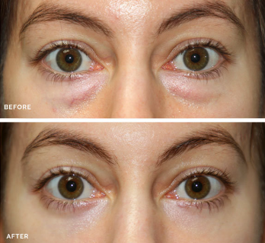
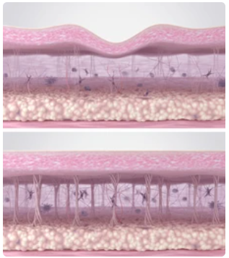

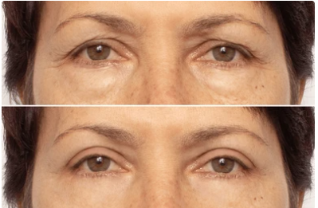
4. Product Features
1. EYE Volume Lifting – 1-Minute Upgrade
1-Minute Upgrade Effect to Restore Sagging EYE BAGS
2 HGH-Like Ingredients (EGF, FGF) + 4 Peptides (ActivePep Solution-4)
+ 5 types of ceramide + 10 complex hyaluronic acid+ Centella Asiatica extract
Boosts collagen and elastin production within the skin with growth factor peptides and key active ingredients
# Instant Lifting Effect & EYE BAG Layer-Up
*Limited to the characteristics of the raw ingredients.

Slide 8
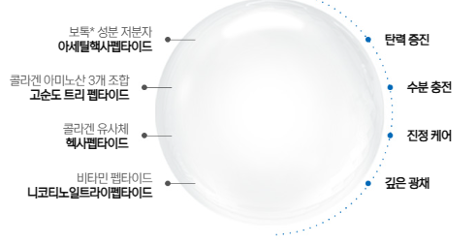
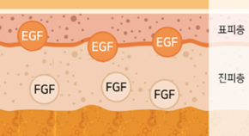
4. Product Features
2. EYE Regeneration Lifting
1-Minute Upgrade Effect for EYE BAG Regeneration
2 HGH-Like Ingredients (EGF, FGF) + 4 Peptides (ActivePep Solution-4)
Through HGH-like ingredients, EGF (epidermal regeneration) + FGF (dermal regeneration) + Four Peptides (ActivePep Solution-4) help restore elasticity and rejuvenate EYE BAGS
#Instant Firming Effect #Elasticity Lifting #Regeneration Lifting #Deep Hydration #Soothing Care
4 Peptides (ActivePep Solution-4) – Ingredients for Plump and Firm Skin
A botox-like ingredient with
low molecular weight
Acetyl Hexapeptide
Enhances Elasticity
Epidermal
layer
A combination of three collagen amino acids
High-Purity Tripeptide
Deep Hydration
Dermis
layer
A collagen-mimicking
peptide
Hexapeptide
Soothing Care
A vitamin peptide
Nicotinoyl Tripeptide
Radiant Glow
*Limited to the characteristics of the raw ingredients

Slide 9
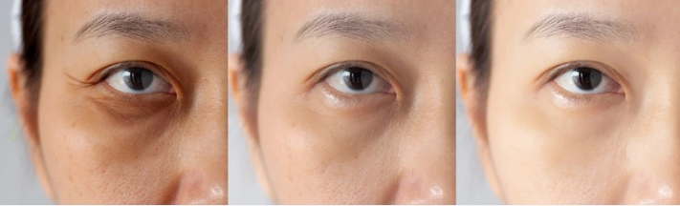
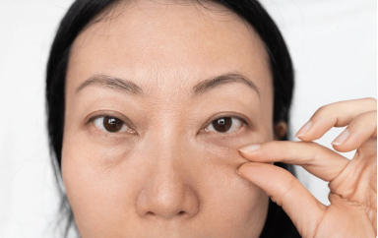
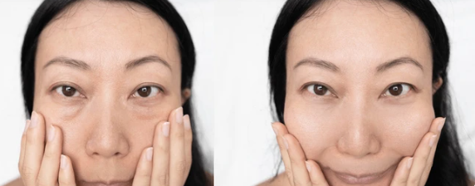
4. Product Features
3. Dark Circle Care (Brightening Solution)
Niacinamide + Glutathione
Whitening functional ingredient Niacinamide + Powerful antioxidant Glutathione
Intensive care for dark circles and dull eye areas caused by various factors
#Whitening Brightening Solution #Whitening Function #Antioxidant #Prevents Pigmentation #Dark Circle Care
*Limited to the characteristics of the raw ingredients

Slide 10
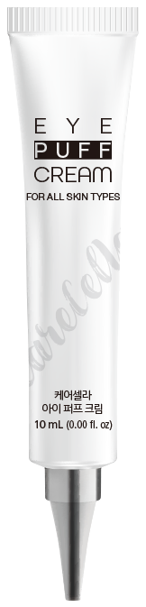
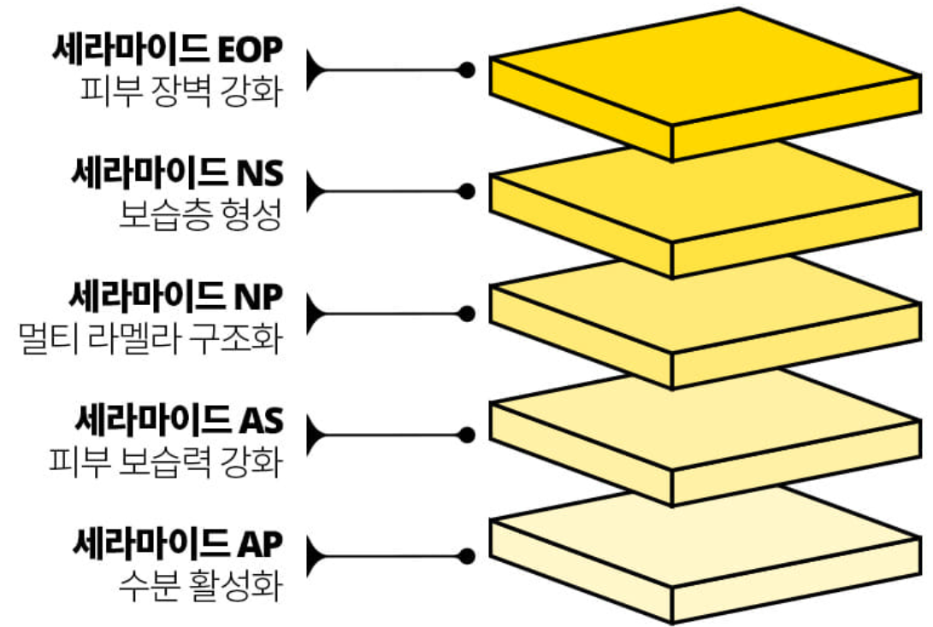
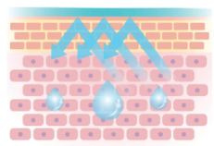
4. Product Features
4. EYE BAG Skin Moisture Barrier Care
Ceramide Complex Ceracare AC-1 (EOP, NS, NP, AS, AP) + Aqua Cera5 (NP)
Powerful hydration and skin barrier restoration through the complementary action of five ceramide types
#Strengthens Inner Skin Moisture Barrier, Enhanced Absorption with NP Complex ＃Intensive Hydration Care
External Irritation
Ceramide EOP
Enhances skin barrier
Ceramide NS
Forms a moisture layer
Ceramide
Ceramide NP
Multi-lamellar structure formation
Ceramide AS
Strengthens skin moisture retention
Ｈ２Ｏ
Ceramide AP
Activates hydration
A Strong Skin Barrier Coated with Ceramide
*Limited to the characteristics of the raw ingredients

Slide 11
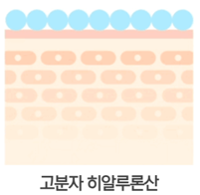
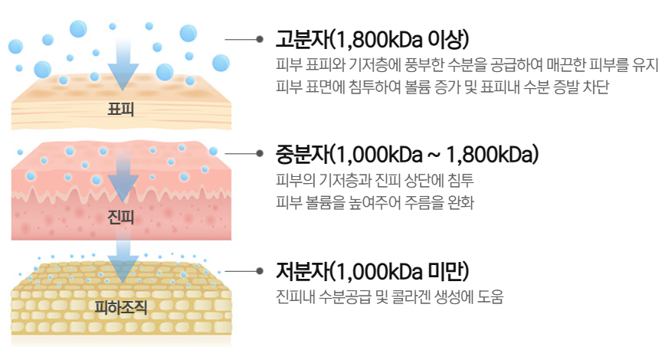
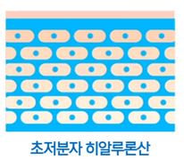
4. Product Features
5. 10-Complex Hyaluronic Acid
10-Complex Hyaluronic Acid (High, Medium, and Low Molecular Weights)
A three-tiered 10-complex hyaluronic acid system that deeply hydrates from the outer to inner layers of the skin, creating a radiant, dewy glow.
# EYE BAG Skin Hydration Solution
High Molecular Weight (≥ 1,800 kDa)
Supplies abundant moisture to the skin surface and stratum corneum, maintaining smooth skin.
Forms a protective layer to increase volume and prevent moisture loss on the skin's surface.
Epidermal layer
Medium Molecular Weight (1,000 kDa – 1,800 kDa)
Penetrates the epidermis and upper dermis.Enhances skin volume and helps reduce wrinkles.
High molecular hyaluronic acid
Derrmis layer
Low Molecular Weight (< 1,000 kDa)
Provides deep hydration within the dermis.
Supports collagen production for firmer skin.
Subcutaneous tissue
Ultra-Low Molecular Hyaluronic Acid
*Limited to the characteristics of the raw ingredients

Slide 12
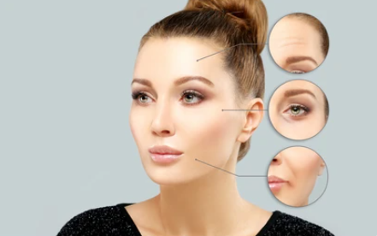
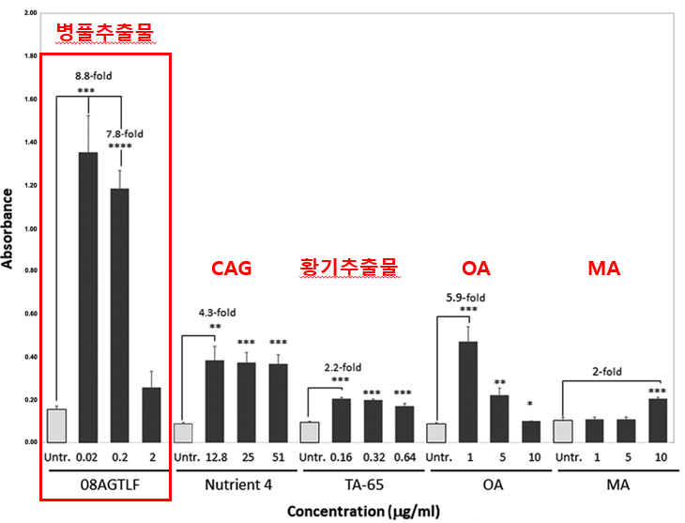
4. Product Features
6. Contains Centella Asiatica Extract
Telomerase Anti-Aging Effect Found in Centella Asiatica
Centella Asiatica Extract (08AGTLF) increases telomerase activity by 8.8 times compared to the control group.
# Prevents Skin Aging Even for Sensitive Skin
Centella Asiatica Extract
Anti-Aging Ingredient Content Ratio
Astragalus Extract
Telomerase Activation
The Nobel Prize-winning secret to longevity – "Telomeres“
"Telomeres govern human lifespan."
Increasing anti-aging compounds such as NMN, NR, and NAD+ helps counteract aging caused by cell division.
Genetic variation in human telomerase is associated with telomere length in Ashkenazi centenarians
- November 13, 2009 | 107 (suppl_1) | https://doi.org/10.1073/pnas.0906191106
*Limited to the characteristics of the raw ingredients

Slide 13

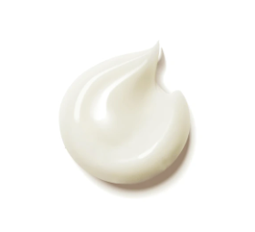

4. Product Features
7. Dual-Function Whitening & Anti-Wrinkle Cosmetic
Niacinamide (Whitening) + Adenosine (Anti-Wrinkle)
KFDA-approved ingredients for a brighter, firmer EYE BAG
#Enhances Deep Wrinkles with Firmness & Brightness
Anti-Wrinkle Functionality
Whitening Functionality
*Limited to the characteristics of the raw ingredients

Slide 14
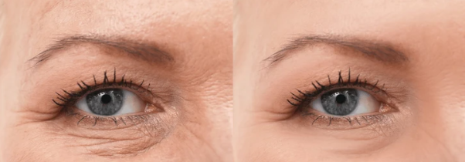
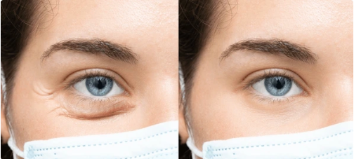
4. Product Features
8. Boosted Effects in 1 Minute, Lasting ALL DAY – Non-Irritating
1-Minute Effect (White Cast Reduction + Non-Irritating = ALL DAY)
Safer for Your Skin – Free from Fragrance, Mineral Oil, and Artificial Coloring
Less Irritation Compared to Our Previous Products (Non-Irritating)
No White Cast, No Eye Stinging, No Irritation
＃Non-Irritating ＃1-Minute Effect ＃White Cast Reduction
00:01:00
*Limited to the characteristics of the raw ingredients

Slide 15
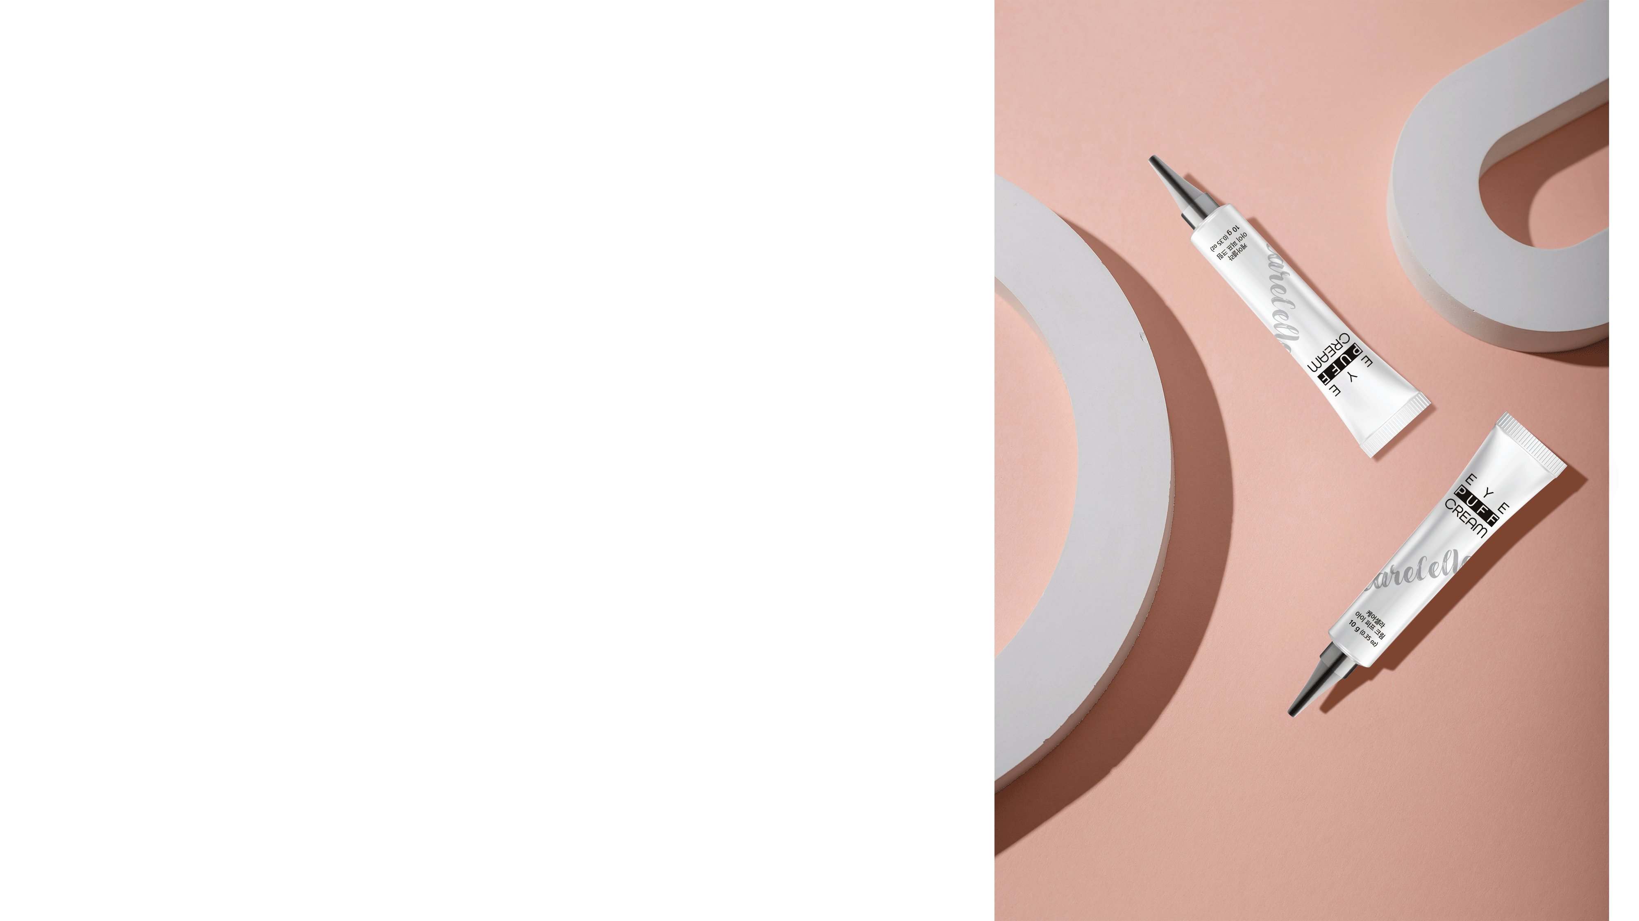
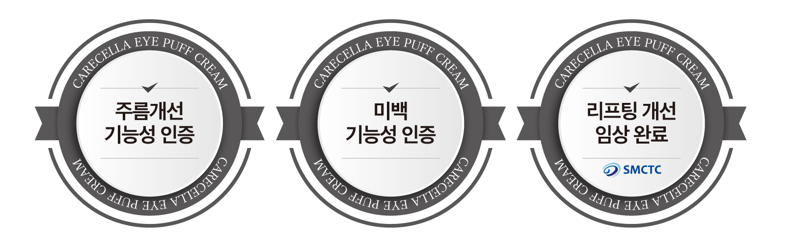

5. Product Information
Clinical Trials & Certifications
Certified for
Anti-Wrinkle Functionality
Certified for
Whitening Functionality
Clinical Trial for Lifting Improvement Completed
Skin
Irritation Test Completed

Slide 16
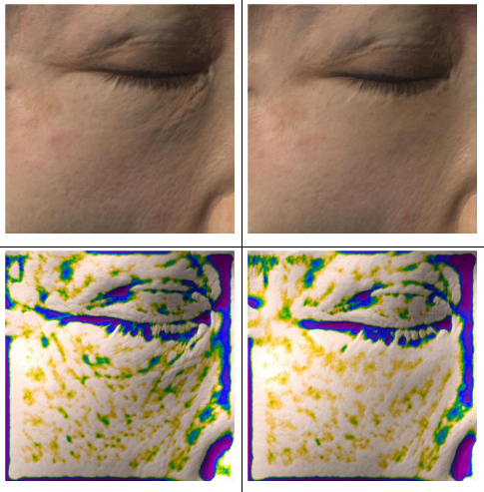
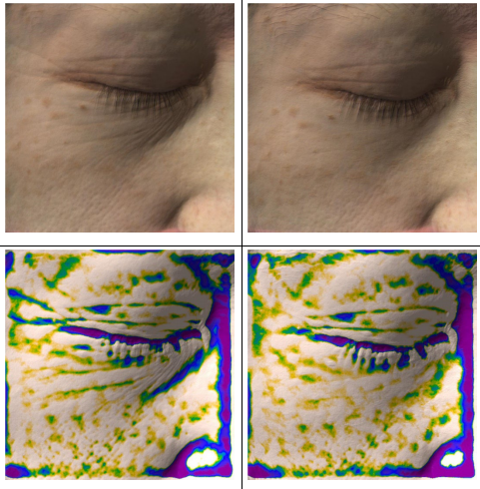
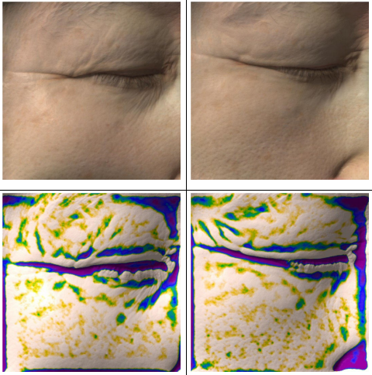
5. Product Information
Clinical Trials & Certifications- Under-Eye Volume (Immediate Effect)
Immediate Effect
Max 194.6% Improvement
Improves Under-Eye Volume with Just One Use of Eye Puff Cream
Before
After
Before
After
Before
After
Under eye volume
194.6%
Improved
Under eye volume
177.2%
Improved
Under eye volume
174.3%
Improved
"Clinical Study on the Effects of CareCella Eye Puff Cream for Under-Eye Volume, Eye Area Volume, and Wrinkle Improvement“ Conducted by: SMCTC (Semyung University Skin & Cosmetic Clinical Center)
Study Period: November 25, 2024 – December 20, 2024 Participants: 20 adult women Evaluation Points: Before use, immediately after use Note: Results may vary by individual Baseline Measurement: (%) Before Use

Slide 17
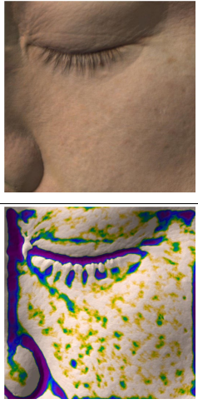
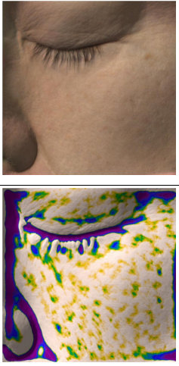
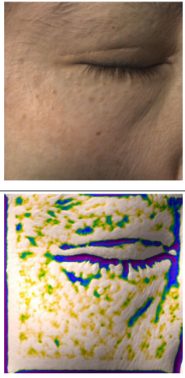
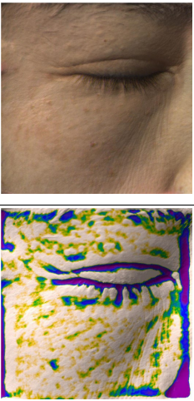
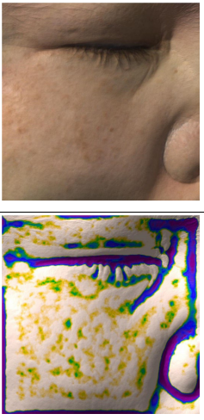
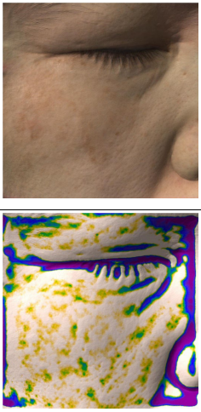
5. Product Information
Clinical Trials & Certifications- Under-Eye Volume (Effect After 4 Weeks)
Improves Under-Eye Volume with Just One Use of Eye Puff Cream
4 Weeks Effect
Max 151.8% Improvement
Before
After
Before
After
Before
After
Under eye volume
151.8%
Improved
Under eye volume
150.0%
Improved
Under eye volume
144.6%
Improved
"Clinical Study on the Effects of CareCella Eye Puff Cream for Under-Eye Volume, Eye Area Volume, and Wrinkle Improvement“ Conducted by: SMCTC (Semyung University Skin & Cosmetic Clinical Center)
Study Period: November 25, 2024 – December 20, 2024 Participants: 20 adult women Evaluation Points: Before use, immediately after use Note: Results may vary by individual Baseline Measurement: (%) Before Use

Slide 18
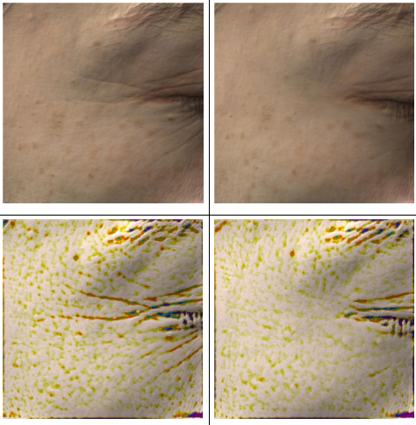
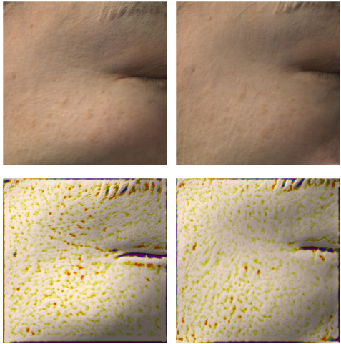
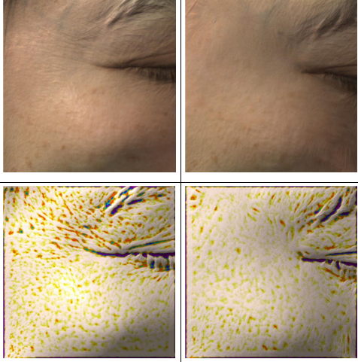
5. Product Information
Clinical Trials & Certifications- Under-Eye Volume (Immediate Effect)
Improves Under-Eye Volume with Just One Use of Eye Puff Cream
Immediate Effect
Max 189.0% Improvement
Before
After
Before
After
Before
After
Under eye volume
189.0%
Improved
Under eye volume
185.4%
Improved
Under eye volume
183.0%
Improved
"Clinical Study on the Effects of CareCella Eye Puff Cream for Under-Eye Volume, Eye Area Volume, and Wrinkle Improvement“ Conducted by: SMCTC (Semyung University Skin & Cosmetic Clinical Center)
Study Period: November 25, 2024 – December 20, 2024 Participants: 20 adult women Evaluation Points: Before use, immediately after use Note: Results may vary by individual Baseline Measurement: (%) Before Use

Slide 19
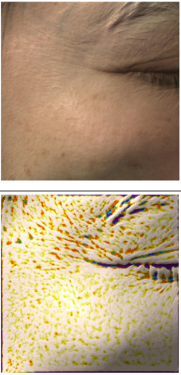
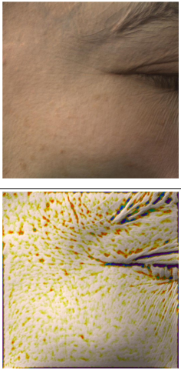
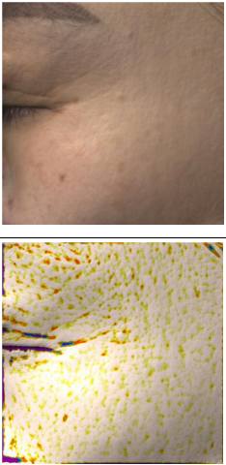
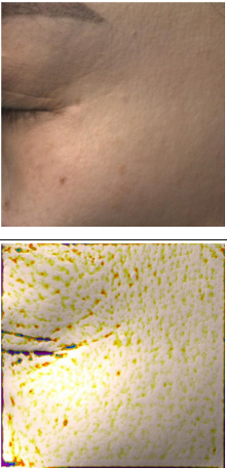
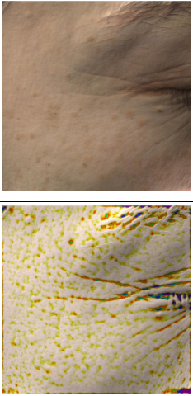
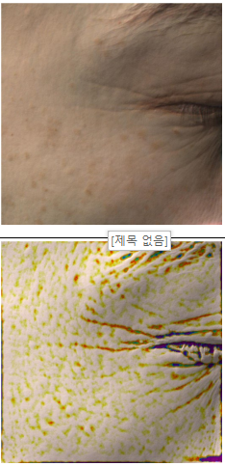
5. Product Information
Clinical Trials & Certifications- Under-Eye Volume (Effect After 4 Weeks)
Improves Under-Eye Volume with Just One Use of Eye Puff Cream
4 Weeks Effect
Max 154.1% Improvement
Before
After
Before
After
Before
After
Under eye volume
154.1%
Improved
Under eye volume
147.5%
Improved
Under eye volume
129.6%
Improved
"Clinical Study on the Effects of CareCella Eye Puff Cream for Under-Eye Volume, Eye Area Volume, and Wrinkle Improvement“ Conducted by: SMCTC (Semyung University Skin & Cosmetic Clinical Center)
Study Period: November 25, 2024 – December 20, 2024 Participants: 20 adult women Evaluation Points: Before use, immediately after use Note: Results may vary by individual Baseline Measurement: (%) Before Use

Slide 20
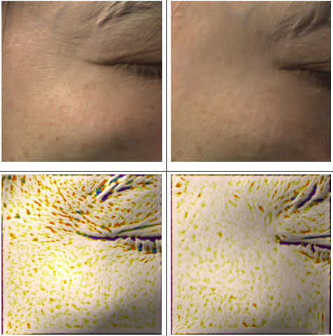
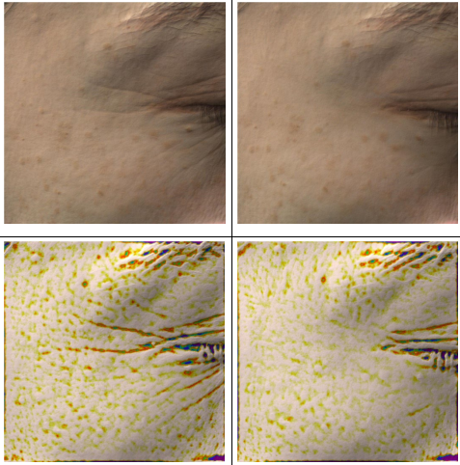
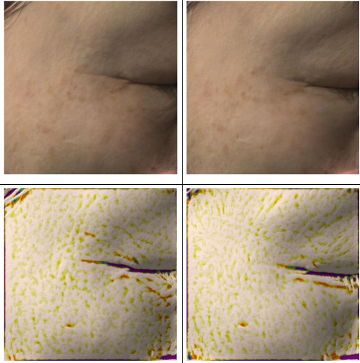
5. Product Information
Clinical Trials & Certifications- Under-Eye Volume (Immediate Effect)
Improves Under-Eye Volume with Just One Use of Eye Puff Cream
Immediate Effect
Max 182.6% Improvement
Before
After
Before
After
Before
After
Under eye volume
182.6%
Improved
Under eye volume
165.0%
Improved
Under eye volume
161.2%
Improved
"Clinical Study on the Effects of CareCella Eye Puff Cream for Under-Eye Volume, Eye Area Volume, and Wrinkle Improvement“ Conducted by: SMCTC (Semyung University Skin & Cosmetic Clinical Center)
Study Period: November 25, 2024 – December 20, 2024 Participants: 20 adult women Evaluation Points: Before use, immediately after use Note: Results may vary by individual Baseline Measurement: (%) Before Use

Slide 21
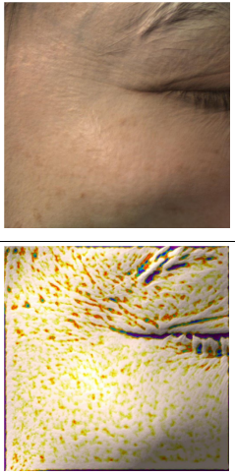
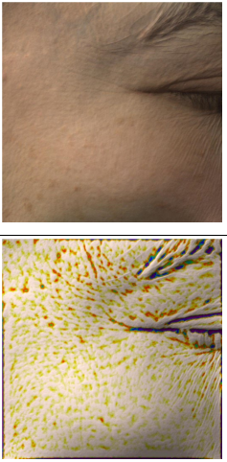
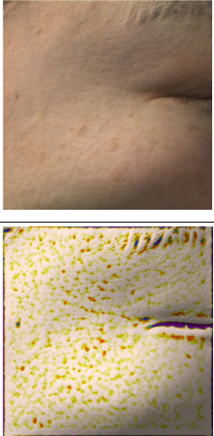
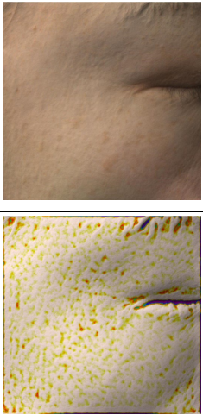


5. Product Information
Clinical Trials & Certifications- Under-Eye Volume (Effect After 4 Weeks)
Improves Under-Eye Volume with Just One Use of Eye Puff Cream
4 Weeks Effect
Max 132.1% Improvement
Before
After
Before
After
Before
After
Under eye volume
132.1%
Improved
Under eye volume
130.4%
Improved
Under eye volume
129.7%
Improved
"Clinical Study on the Effects of CareCella Eye Puff Cream for Under-Eye Volume, Eye Area Volume, and Wrinkle Improvement“ Conducted by: SMCTC (Semyung University Skin & Cosmetic Clinical Center)
Study Period: November 25, 2024 – December 20, 2024 Participants: 20 adult women Evaluation Points: Before use, immediately after use Note: Results may vary by individual Baseline Measurement: (%) Before Use

Slide 22


5. Product Information
Clinical Trials
&
Certifications
General Bio Co., Ltd.
Report on the Clinical Test Results for the Effects of "CareCella Eye Puff Cream" on Under-Eye Volume, Eye Area Volume, and Wrinkle Improvement
General Bio Co., Ltd.
Report on the Clinical Test Results for the Skin Irritation Safety Assessment of "CareCella Eye Puff Cream“
"Clinical Study on the Effects of CareCella Eye Puff Cream for Under-Eye Volume, Eye Area Volume, and Wrinkle Improvement“
Conducted by: SMCTC (Semyung University Skin & Cosmetic Clinical Center)
2024.11.25~2024.12.20 / 20 adult women / Before use, immediately after use / Results may vary by individual
Skin Irritation Test (Non-Irritating)Conducted by: SMCTC (Semyung University Skin & Cosmetic Clinical Center)

Slide 23

6. How to use & Precautions
How to use & Precautions
TIP
It is recommended to use the cream once a day as part of your night care routine.
For day care, apply according to the usage instructions, and after the cream has fully absorbed, apply makeup or other products.
Squeeze an appropriate amount of cream, about the size of a grain of rice, onto the spatula.
Apply smoothly from the inner to the outer under-eye area.
If too much cream is used or if the skin does not fully absorb the product, or if the skin is too dry, white residue may appear. Be sure to apply only the appropriate amount, roughly the size of a grain of rice.
After applying, you can feel a tightening effect around the eye area after about 2 minutes. (Be careful not to frown or move your face at this time.)
Avoid rubbing too hard with your hands, as this may cause the product to peel.
Avoid using products with oil content. (If you apply oil products to the eye bag area, gently tap the area with your fingers.)

Slide 24

7. Recommended For
Recommended For
If you're concerned about wrinkles around the eyes
If fine lines or deeper wrinkles have appeared around the eyes, Eye Puff Cream, known for its excellent wrinkle improvement effects, will help.
If you have severe dark circles
If your under-eye area is darkened or pigmented due to fatigue or stress, Eye Puff Cream, which contains brightening ingredients, will help lighten the area.
If your eye area is dry
Dry skin around the eyes can cause more fine lines, so a highly moisturizing product like Eye Puff Cream is necessary.
If you've lost elasticity
If the skin around the eyes is thin and sagging due to a loss of elasticity, Eye Puff Cream with collagen-boosting ingredients will help.
If you experience frequent puffiness
Eye Puff Cream containing ingredients that reduce puffiness will be beneficial.
If you're worried about skin aging
To prevent eye aging, which typically begins in the mid-30s, Eye Puff Cream with anti-aging effects will help.

