Slide 1
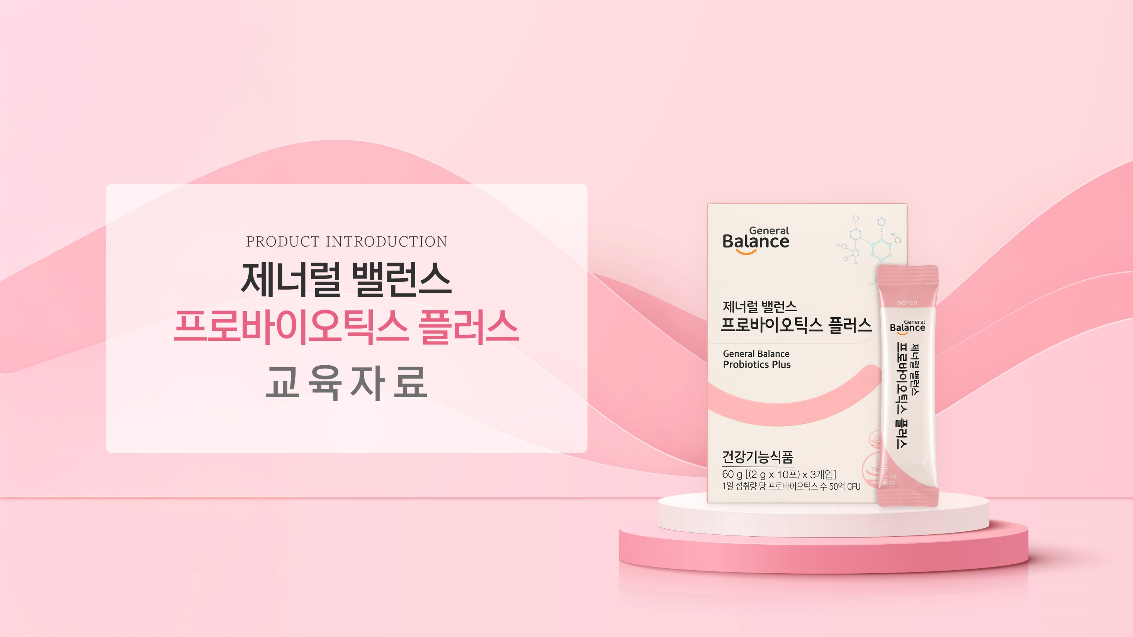
PRODUCT INTRODUCTION
GENERAL BALANCE
PROBIOTICS PLUS
EDUCATIONAL RESOURCE

Slide 2
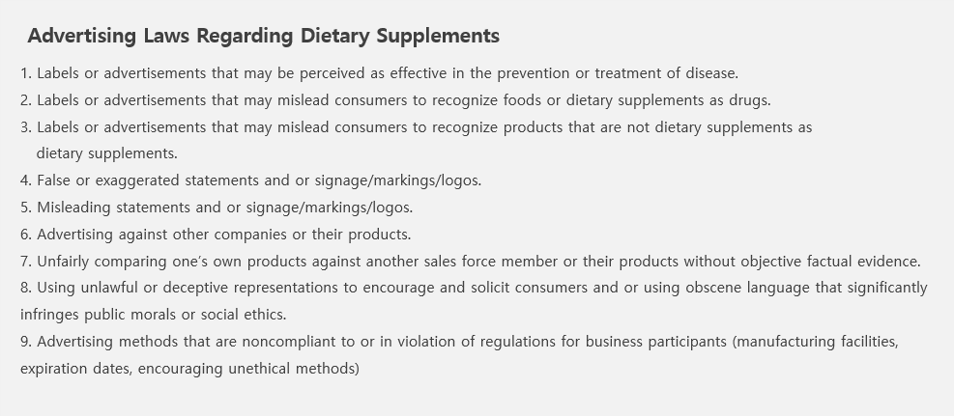
GCOOP is committed to maintaining a unique and responsible advertising culture, strictly avoiding exaggerated claims in all member recruitment efforts. We kindly ask for your cooperation in ensuring that promotional content complies with regulations on health supplement advertising and does not lead to false or misleading claims.
Please note that this material is intended solely for internal training purposes and must not be shared externally or posted elsewhere.

Slide 3

1. COEXISTENCE WITH
MICROORGANISMS
1) Microbial Shower (Lactic Acid Shower)
MICROBIAL SHOWER
The process in which beneficial microorganisms enter the body as the fetus passes through the mother's birth canal
At this time, microorganisms become the resident flora in the newborn's intestines, which determines the person's initial immunity.

Slide 4
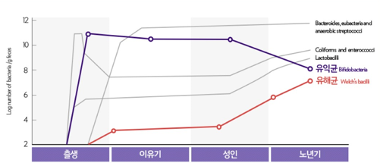
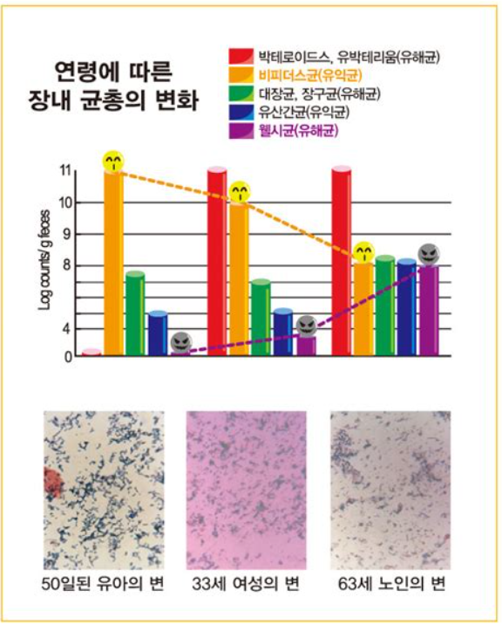
1. COEXISTENCE
WITH MICROORGANISM
2) Age-related Changes in Microbiota
CHANGES IN GUT MICROBIOTA WITH AGE
GUT HEALTH INDICATORS BY AGE
A 50-day-old
infant’s stool
33 year old woman's stool
63 year old woman's stool
If you look into the intestines of young babies, more than 90% of the intestinal bacteria are composed of bifidobacteria, which help suppress the growth of harmful bacteria and improve the intestinal environment. As they age, the secretion of gastric acid increases, digestive enzymes decrease, and the use of antibiotics and drugs increases, which reduces the diversity of microorganisms and decreases the number of beneficial intestinal bacteria.

Slide 5
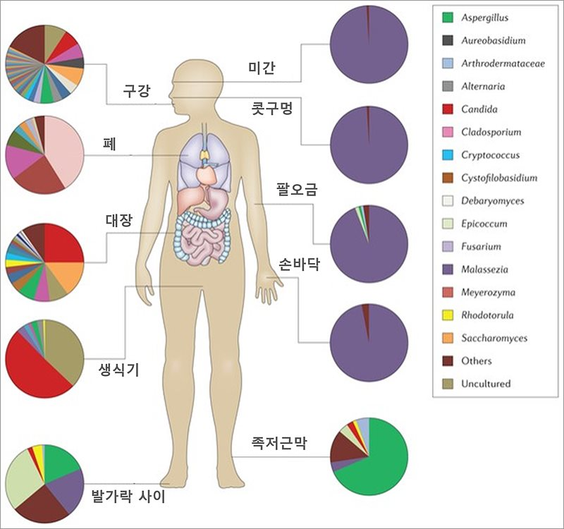
2. MICROORGANISMS
IN OUR BODIES
1) The Microbial Ecosystem
THE MICROBIAL ECOSYSTEM
THAT MAKES UP OUR BODY
ㅣINTESTINAL MICROORGANISMS ㅣ
Between the Eyebrows
Oral
95% of all microorganisms exist in the large intestine
Short-chain fatty acid production
Interacts with immune cells to maintain balance
Lung
Nostrils
Lung
Colon
Palm of the Hand
ㅣ SKIN MICROBIOME ㅣ
There are billions of microorganisms on the skin, and the composition of the microorganisms varies depending on the area.
Protects skin by suppressing harmful bacteria
Acne, dermatitis, and skin diseases when imbalanced
Reproductive
organs
Plantar Fascia
Between the Toes
▲ MICROORGANISMS THAT EXIST EVERYWHERE IN OUR BODY
ㅣ ORAL MICROORGANISMS ㅣ
If microorganisms on the skin are not properly managed, skin infections can occur, problems in the mouth can lead to tooth decay and periodontitis, and in the digestive tract, diarrhea and constipation, colitis, liver damage, and autoimmunity can occur.
There are about 700 species in the oral cavity and they are distributed on the surface of the teeth, tongue, gums, etc.
Involved in tooth decay and gum disease, etc.

Slide 6
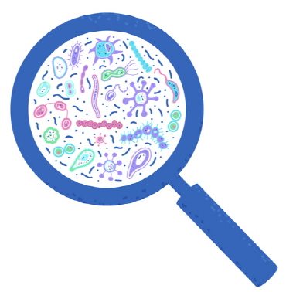

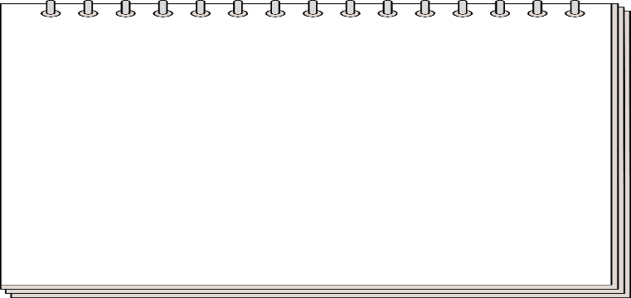
2. MICROORGANISMS
IN OUR BODIES
2) Beneficial Bacteria VS Harmful Bacteria
TYPES OF MICROORGANISMS
HARMFUL BACTERIA
BENEFICIAL BACTERIA
〮 The main culprit of all diseases that
produce harmful toxins and carcinogens
to the human body and destroy
the immune balance
〮 Produces large amounts of carcinogens
in the body, causing various cancers and
inflammatory diseases, and weakening
immune function
〮 Beneficial bacteria that play a role in
preventing the growth of harmful bacteria
and helping to establish desirable intestinal
flora.
〮 Strengthening the barrier, regulating
the immune system
INTERMEDIATE BACTERIA
(OPPORTUNISTIC BACTERIA)
〮 The fungus varies depending on
the situation
〮 When beneficial bacteria are dominant,
it changes into beneficial bacteria,
and when harmful bacteria are dominant,
it changes into harmful bacteria.

Slide 7
2. MICROORGANISMS
IN OUR BODIES
2) Beneficial Bacteria VS Harmful Bacteria
IDEAL BALANCE OF GUT MICROBES
BENEFICIAL
BACTERIA
INTERMEDIATE
BACTERIA
30 %
60 - 65%
HARMFUL
BACTERIA
5-10 %
An ideal balance of gut microbes affects a variety of bodily functions, including digestion, immunity, mental health, and weight management.
When the ideal ratio is disrupted, it can cause problems for the overall health of the body.
In academic circles, the most ideal final intestinal state is considered to be a ratio of beneficial bacteria to harmful bacteria of approximately 85%:15%!

Slide 8
2. MICROORGANISMS
IN OUR BODIES
4) Changing perception of microbes
CHANGES IN PERCEPTION REGARDING MICROBES
GERMS ARE ALWAYS BAD THE BALANCE BETWEEN GOOD AND
BAD BACTERIA IS IMPORTANT.
ERADICATION OF GERMS BACTERIAL COEXISTENCE

Slide 9
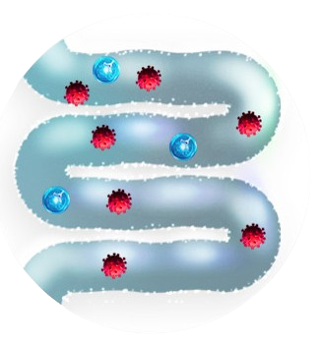
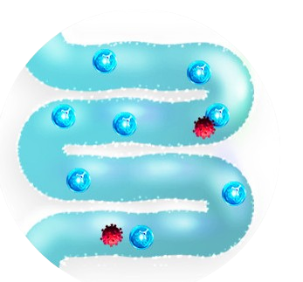

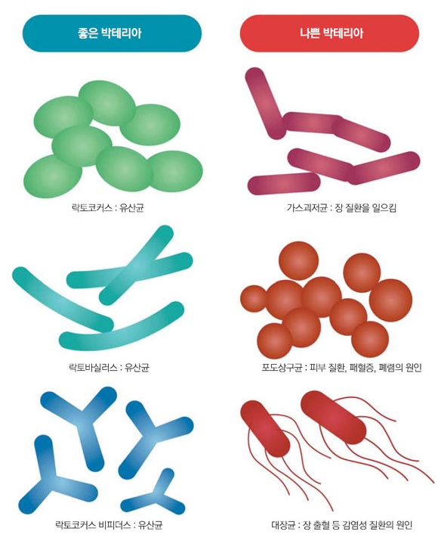

2. MICROORGANISMS
IN OUR BODIES
5) What is Dysbiosis?
DYSBIOSIS
Gut Microbial Imbalance
NORMAL ECOSYSTEM
DYSBIOSIS
Harmful bacteria > Beneficial bacteria
Beneficial bacteria > Harmful bacteria
A state where the balance of the intestinal microflora ecosystem is disrupted,
the opposite of normal.

Slide 10
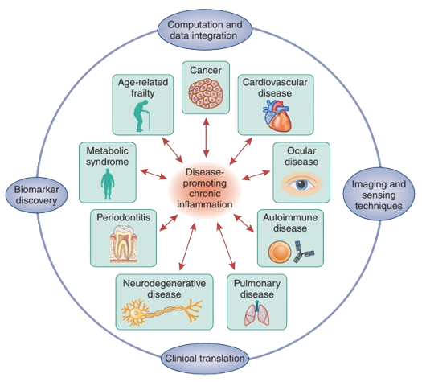
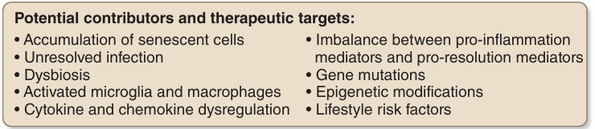
2. MICROORGANISMS
IN OUR BODIES
5) What is Dysbiosis?
DYSBIOSIS AND RELATED DISEASES
Dysbiosis can lead to chronic inflammation and expose you to various diseases/depression/chronic fatigue.
Source : Nature Immunology volume 18, page 1175-1180 (2017)

Slide 11
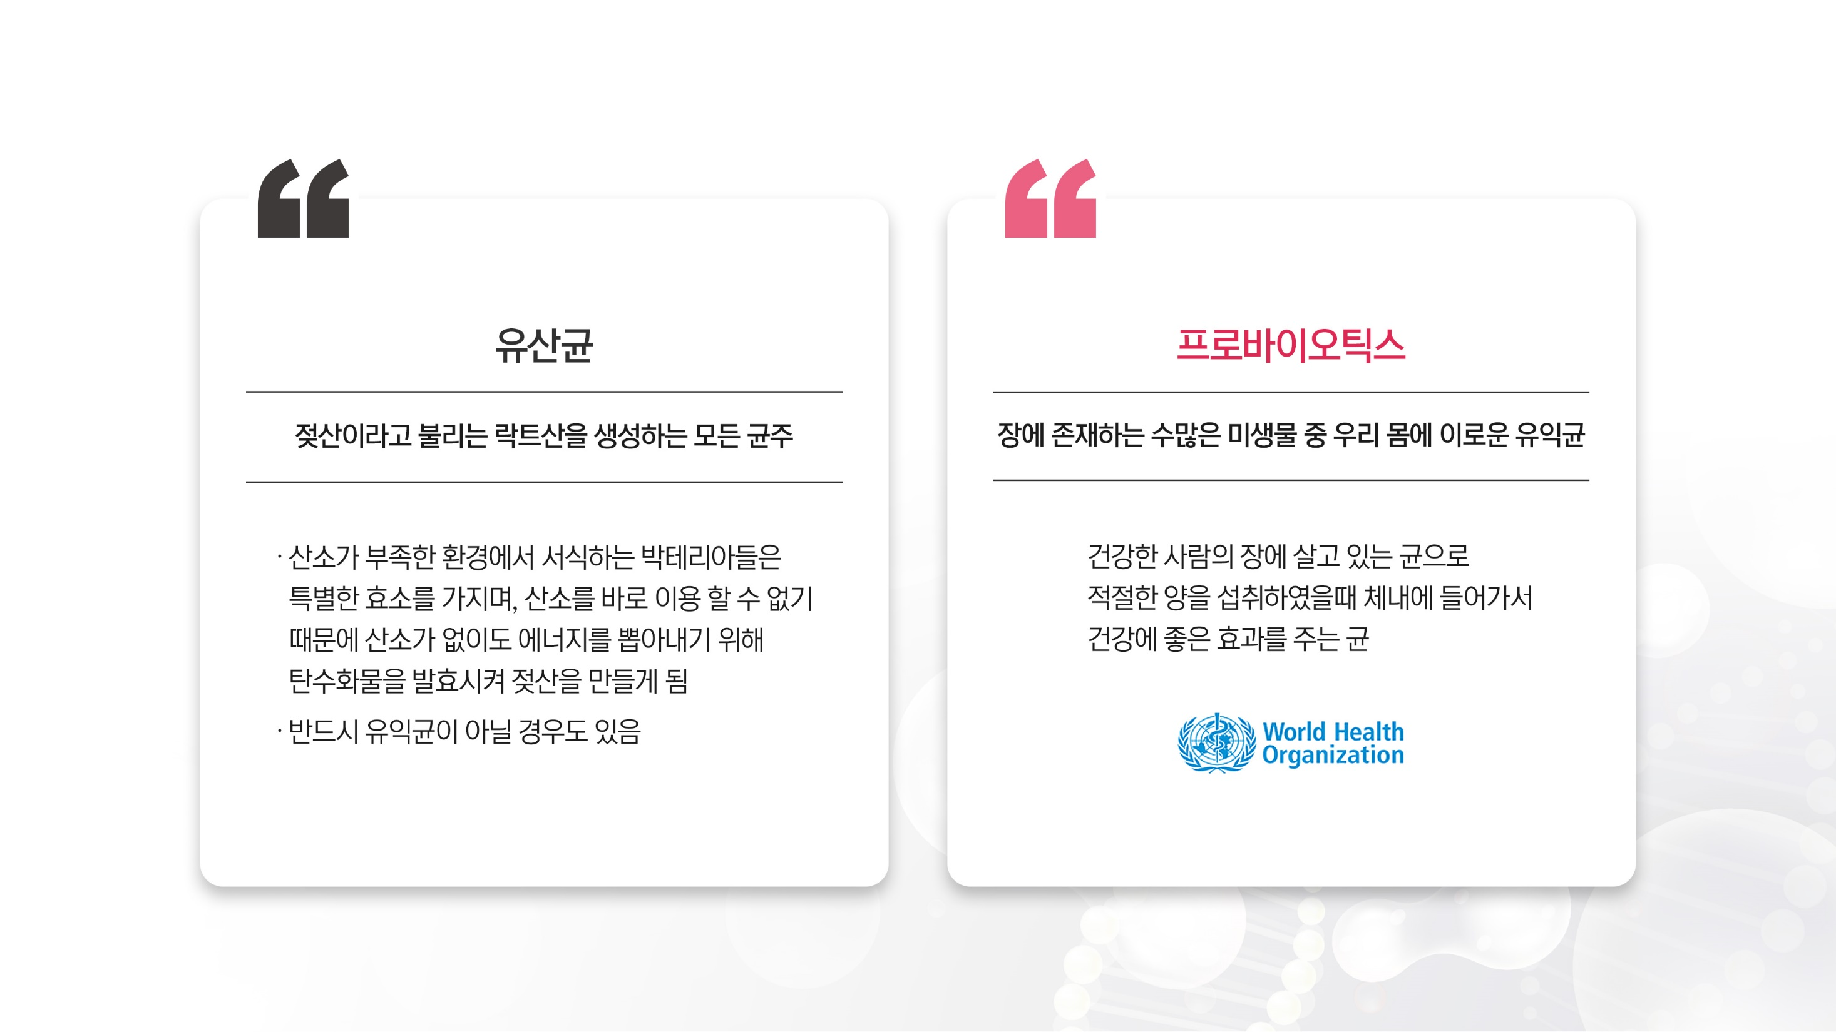

3. PROBIOTICS
1) What is Lactobacillus?
LACTOBACILLUS
PROBIOTICS
ANY STRAIN THAT PRODUCES LACTIC ACID,
ALSO KNOWN AS LACTIC ACID
BENEFICIAL BACTERIA AMONG THE NUMEROUS MICROORGANISMS
PRESENT IN THE GUT THAT ARE GOOD FOR OUR BODY
Bacteria that live in low-oxygen environments possess
special enzymes, and because they cannot directly
use oxygen, they ferment carbohydrates to produce
lactic acid in order to generate energy without oxygen.
Bacteria that live in the gut of a healthy person and,
when consumed in appropriate amounts, enter the body
and provide beneficial effects on health.
Not necessarily beneficial bacteria.

Slide 12
3. PROBIOTICS
2) DEFINITION OF PROBIOTICS
PROBIOTIC STRAINS APPROVED BY THE MINISTRY OF FOOD AND DRUG SAFETY
DIVISION | TYPE
Lactobacillus | L.acidophilus, L.casei, L.bulgaricus, L.helveticus, L.fermenteum, L.paracasei, L.Plantaarum, L.reuteri, L.rhamnosus, L.salivarius
Lactococcus | L. lactis
Enterocuccus | E.faecium, E.faecalis
Streptococcus | S. Thermophilus
Bifidobacterium | B. bifidum, B.breve, B.longum, B.animalis ssp. lactis
FUNCTIONAL CONTENT OF PROBIOTICS
∙ Promotion of lactic acid bacteria growth
and suppression of harmful bacteria
∙ Smooth bowel movements
∙ Helps with gut health

Slide 13
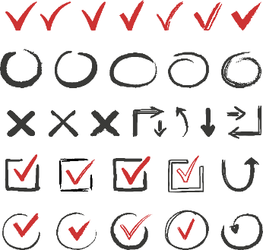
3. PROBIOTICS
3) STANDARDS FOR PROBIOTICS PRODUCTS
EVOLUTION OF PROBIOTIC PRODUCTS
4 Generation
3 Generation
POSTBIOTICS
2 Generation
SYNBIOTICS
(Beneficial Bacteria + Food + Metabolites)
1 Generation
PREBIOTICS
(Probiotics + Food)
PROBIOTICS
(Food for Beneficial Bacteria)
(Beneficial Bacteria)
Probiotic products are constantly evolving, moving beyond simply providing probiotics
to optimizing gut health.

Slide 14
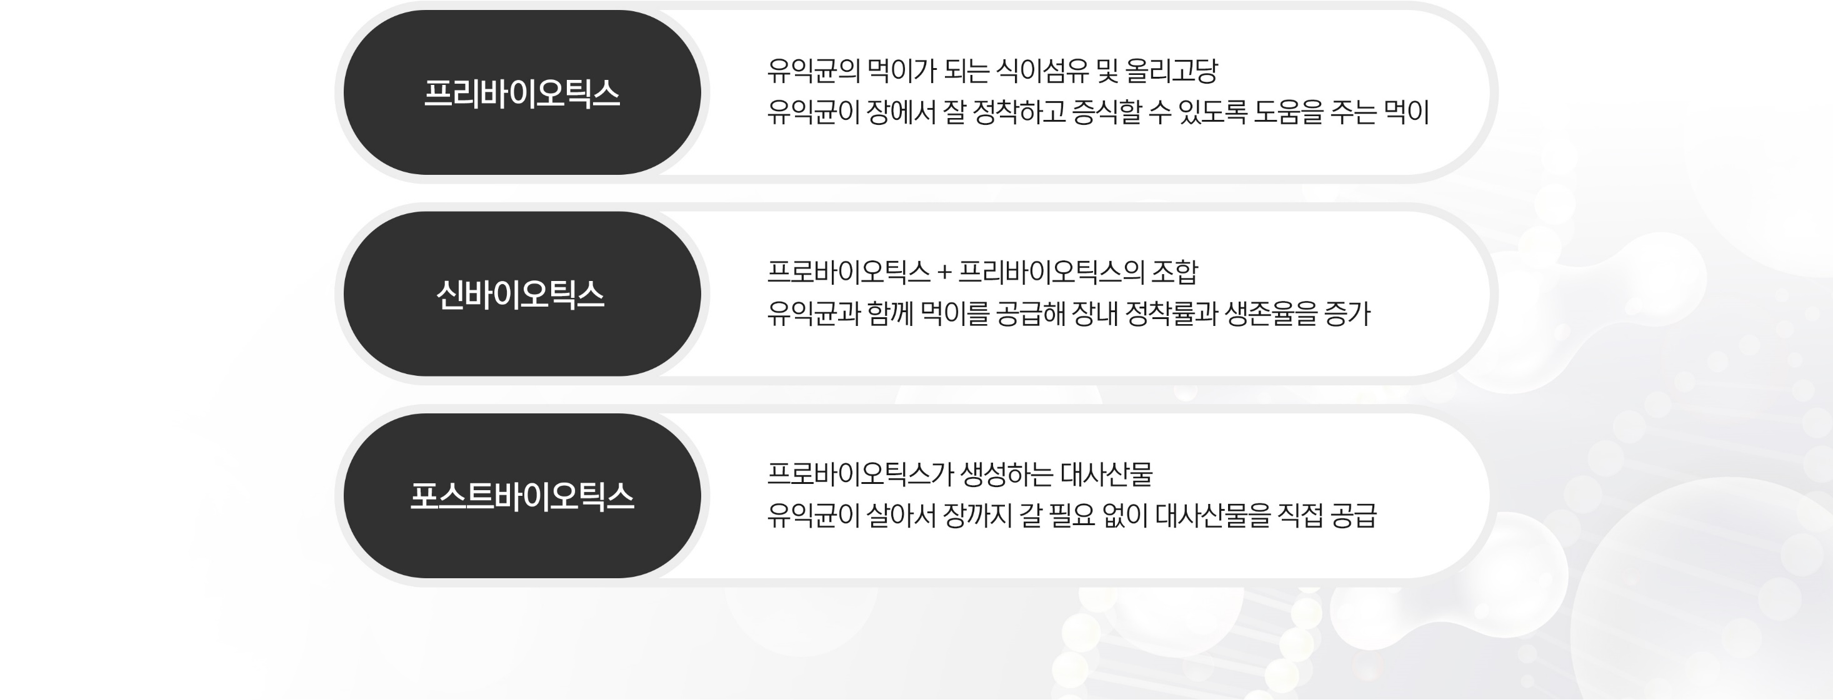
3. PROBIOTICS
3) STANDARDS FOR PROBIOTICS PRODUCTS
EXPLANATION OF PROBIOTICS TERMS
PREBIOTICS
Dietary fiber and oligosaccharides that serve as food for beneficial bacteria.
Food that helps beneficial bacteria settle and proliferate in the intestines.
Combination of probiotics and prebiotics.
SYNBIOTICS
Increase intestinal colonization and survival rate by providing food with
beneficial bacteria.
Metabolites produced by probiotics.
POSTBIOTICS
Beneficial bacteria supply metabolites directly without having
to travel to the intestines alive.

Slide 15
3. PROBIOTICS
4) THE REASON YOU SHOULD TAKE PROBIOTICS
THE REASON YOU SHOULD TAKE PROBIOTICS
① GUT HEALTH
HELPS INTESTINAL HEALTH DIRECTLY BY ALLOWING BENEFICIAL BACTERIA TO REACH THE INTESTINES.
Probiotics, as beneficial bacteria, produce organic acids that acidify the gut, helping to inhibit the growth of harmful bacteria that are sensitive to acidic environments, thereby supporting the establishment of a healthy gut microbiota.
They also help reduce toxins produced by harmful bacteria and synthesize vitamins to supplement nutrients.
IT CAN HELP INTESTINAL HEALTH BY INCREASING BENEFICIAL BACTERIA IN THE INTESTINES.
When a favorable environment for beneficial gut bacteria is formed, their growth is promoted while the growth of harmful bacteria is inhibited, leading to an overall improvement in the gut environment.
MAY HELP IMPROVE BOWEL MOVEMENTS AND PROMOTE GUT HEALTH
In conclusion, when the gut microbiota is normalized, intestinal motility and bowel movements improve, which can contribute to better gut health.

Slide 16
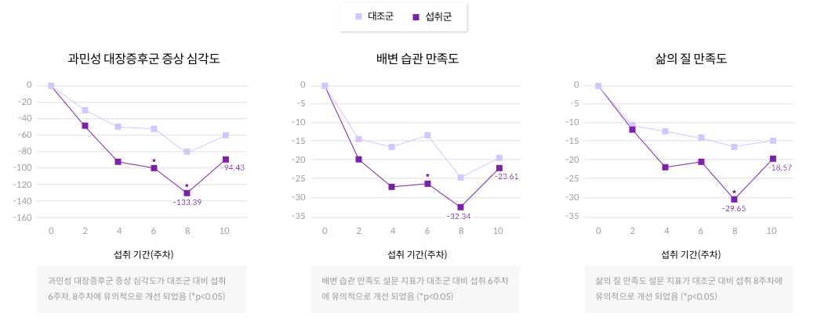
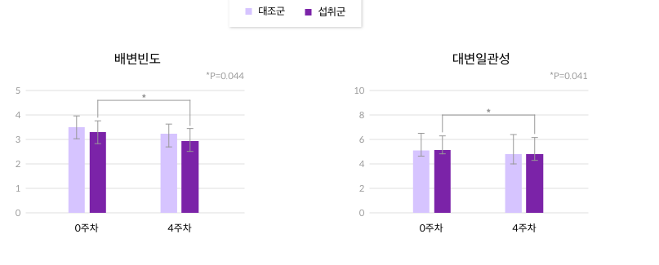
3. PROBIOTICS
4) THE REASON YOU SHOULD TAKE PROBIOTICS
THE REASON YOU SHOULD TAKE PROBIOTICS
◈ HUMAN CLINICAL TRIAL RELATED TO GUT HEALTH
CONTROL GROUP
FEEDING GROUP
IRRITABLE BOWEL SYNDROME SYMPTOM SEVERITY
SATISFACTION WITH BOWEL HABITS
QUALITY OF
LIFE SATISFACTION
BOWEL MOVEMENT FREQUENCY
STOOL CONSISTENCY
CONSUMPTION PERIOD (WEEKS)
CONSUMPTION PERIOD (WEEKS)
CONSUMPTION PERIOD (WEEKS)
The severity of irritable bowel syndrome
symptoms showed significant improvement at weeks 6 and 8 of intake compared to
the control group.(*p<0.05)
The bowel habit satisfaction questionnaire
index significantly improved in the 6th week of intake compared to the control group.
(*p<0.05)
The quality-of-life satisfaction questionnaire index significantly improved in the 8th week of intake compared to the control group.
(*p<0.05)
WEEK 0
WEEK 4
WEEK 0
WEEK 4
In one study, 90 adults (ages 18–65) with diarrhea symptoms consumed Lactobacillus plantarum CCFM1143 (3.52 × 10⁹ CFU/day) for 30 days (a total of 4 weeks).
After 4 weeks of probiotic intake, bowel movement frequency and stool consistency showed significant improvement in the test group compared to before intake.
In a study involving 52 adult men and women (average age 39) with irritable bowel syndrome, participants consumed a combination of four probiotic strains at 2.5 × 10¹⁰ CFU/day for 8 weeks, resulting in significant improvements.

Slide 17
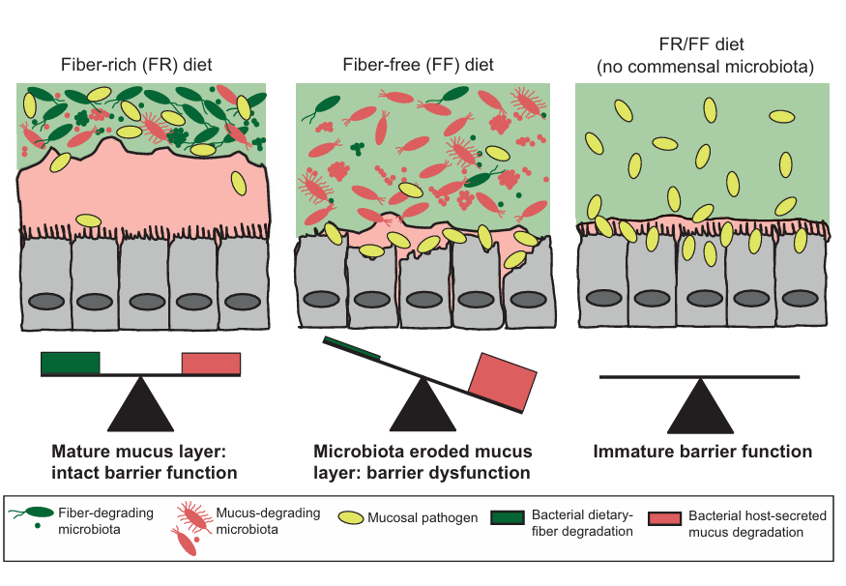
3. PROBIOTICS
4) THE REASON YOU SHOULD TAKE PROBIOTICS
THE REASON YOU SHOULD TAKE PROBIOTICS
◈ MECHANISMS RELATED TO GUT HEALTH
3 STEPS TO MAINTAINING
GUT HEALTH WITH PROBIOTICS
1
Prevents pathogens from establishing
in the intestinal mucosa.
2
Protects intestinal cells by activating
mucus secretion.
3
Intestinal cells produce good substances
to maintain the intestinal system.
Gut microbiota imbalance > Damage to the intestinal lining > Toxins and harmful bacteria enter the bloodstream > Cause direct damage or are detected as antigens, triggering
inflammation > Leads to various gut-related diseases (such as leaky gut syndrome)
* Mucus: It coats the intestinal cells like clothing and protects them.
Source : A dietary fiber-Deprived gut microbiota degrades the colonic muscus barrier and enhance pathogen susceptibility, Cell, 2016

Slide 18
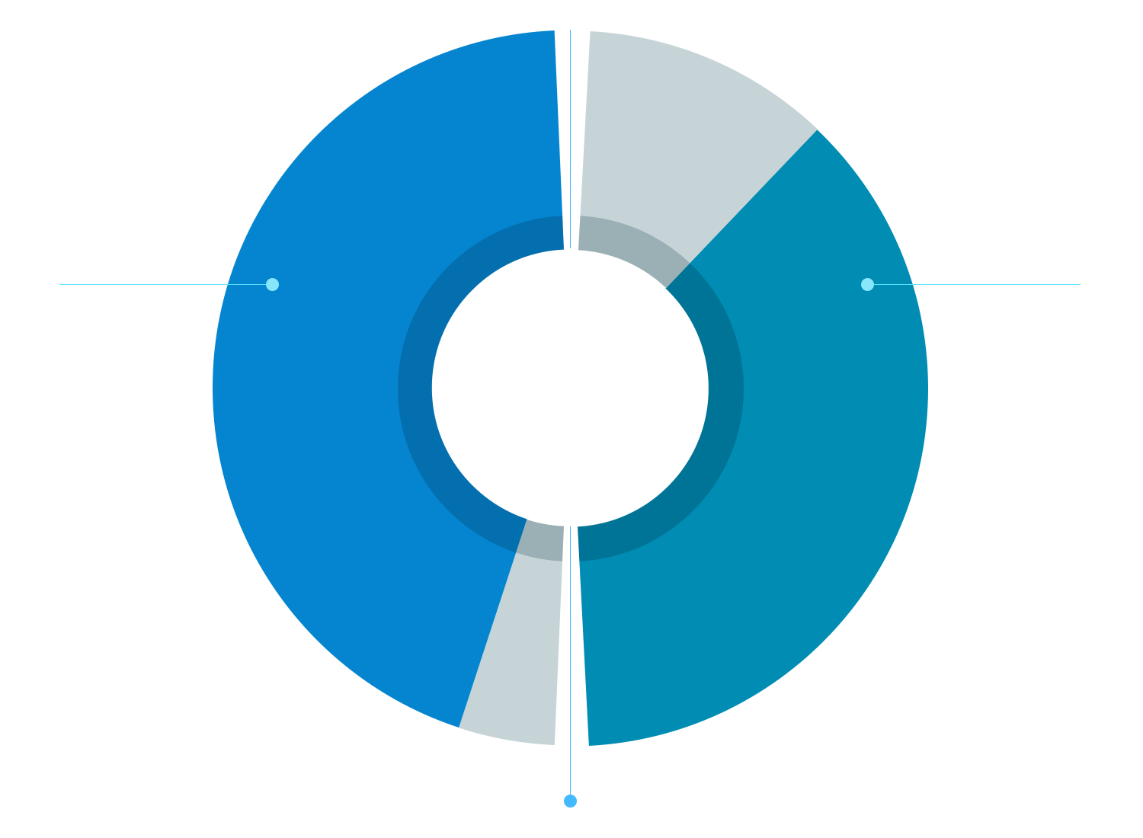
3. PROBIOTICS
4) THE REASON YOU SHOULD TAKE PROBIOTICS
THE REASON YOU SHOULD TAKE PROBIOTICS
② IMMUNITY AND MENTAL HEALTH
Another function of the intestines, immunity
The intestines are the largest immune organs, and 70% of the body's immune cells are concentrated there. Among them, the small intestine, which is about 7 meters long, absorbs nutrients from food and prevents the invasion of pathogens. The command center is the Pfeiffer plate distributed in the mucosa of the small intestine, where lymphocytes are densely concentrated. When a foreign substance such as a pathogen is found, some of the lymphocytes recognize the foreign substance and create immune antibodies that prevent the reaction. This is the intestinal immune system. Also, if the intestines are not healthy, nutrient absorption is not smooth, and immunity is weakened.
THE INTESTINE:
THE LARGEST IMMUNE ORGAN
HAPPY HORMONE
70% OF IMMUNE CELLS PRESENT
POOR INTESTINAL
HEALTH CAN CAUSE
VARIOUS DISEASES.
90% SEROTONIN PRESENT
The intestines, The second brain
More than 90% of the happiness hormone serotonin is secreted in the stomach. Serotonin is a neurotransmitter that exists in the medial hypothalamus and has a calming effect in the brain. Therefore, if there is a lack of serotonin, depression, anxiety, etc. occur, and American neurophysiologist Michael Gerson discovered that 90% of serotonin is produced in the intestines and named the intestines the second brain.
CONSTIPATION, DIARRHEA, IRRITABLE BOWEL SYNDROME, ATOPY, RHINITIS, OBESITY, ETC.

Slide 19
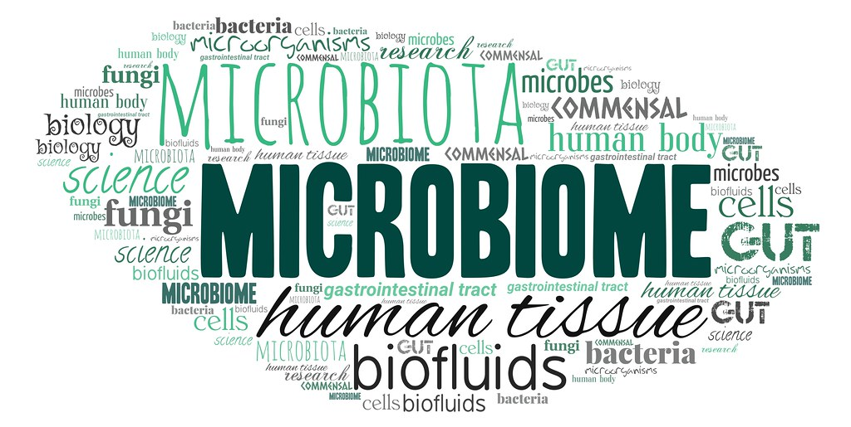
3. PROBIOTICS
4) THE REASON YOU SHOULD TAKE PROBIOTICS
THE REASON YOU SHOULD TAKE PROBIOTICS
③ HEALTHY MICROBIOME
Microbiome = Micro + Biome
Microbe : microorganism, Biome : Ecosystem
The microbiome is an ecosystem of microorganisms that coexist in various parts of the human body.

Slide 20
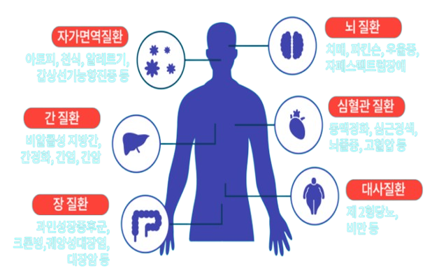
3. PROBIOTICS
4) THE REASON YOU SHOULD TAKE PROBIOTICS
THE REASON YOU SHOULD TAKE PROBIOTICS
DISEASES AFFECTED BY THE MICROBIOME
BRAIN DISEASE
AUTOIMMUNE DISEASE
치매, 파킨슨, 우울증
자페스펙트럼 장애
아토피, 천식, 알레르기,
갑상선항진증 등
Dementia, Parkinson's, depression, autism spectrum disorders
Atopy, asthma, allergies, hyperthyroidism, etc.
CARDIOVASCULAR
DISEASE
LIVER DISEASE
동맥경화, 심근경색,
뇌졸중, 고혈압
Arteriosclerosis, myocardial infarction, stroke,
hypertension
Nonalcoholic fatty liver disease, cirrhosis, hepatitis, liver cancer
비알콜성 지방간,
간경화, 간염, 간암
METABOLIC DISEASE
INTESTINAL DISEASE
제2형 당뇨, 비만 등
Type 2 diabetes, obesity, etc.
과민성장증후군,
크론병, 궤양성대장염, 대장암 등
Irritable bowel syndrome, Crohn's disease, ulcerative colitis, colon cancer, etc.

Slide 21
3. PROBIOTICS
4) THE REASON YOU SHOULD TAKE PROBIOTICS
WHY CONTINUOUS INTAKE OF PROBIOTICS IS IMPORTANT!
〮 Probiotics are temporary visitors in the body and are different from the native bacteria in the gut.
〮 Most are excreted within about two weeks after consumption. → Does not settle in the intestines.
〮 However, they help support gut health and fight off harmful bacteria.
〮 The gut environment is constantly changing due to diet, stress, medications, and other factors.
CONSISTENT PROBIOTIC INTAKE IS ESSENTIAL FOR MAINTAINING A HEALTHY GUT!

Slide 22
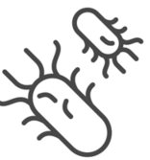

4. UNDERSTANDING
THE MICROBIOME
1) WHAT IS A MICROBIOME?
DEFINITION OF MICROBIOME
MICROBIOME-RELATED DISEASES
OBESITY DIABETES
INFLAMMATORY BOWEL DISEASE
AUTOIMMUNE
BRAIN DISEASE (DEMENTIA, PARKINSON'S, AUTISM)
CANCER
〮 A state where beneficial and harmful bacteria form an ecosystem
〮 It changes easily Unlike the human genome.
〮 It acts on the immune, nervous, and endocrine systems
and is associated with various diseases.

Slide 23
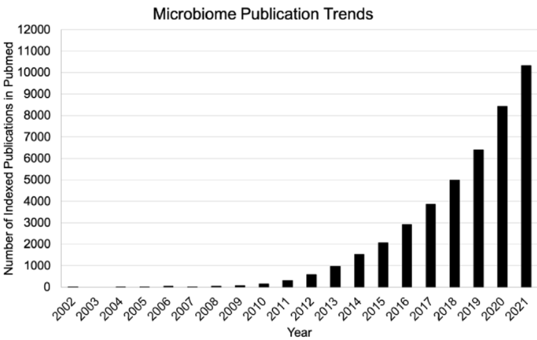
4. UNDERSTANDING
THE MICROBIOME
2) DIRECTION OF MICROBIOME RESEARCH
THE MICROBIOME: THE KEY TO DISEASE
CURRENT RESEARCH INSIGHTS AND FINDINGS.
The number of microbiome research papers continues to grow, and interest in the correlation between health and disease is growing.

Slide 24
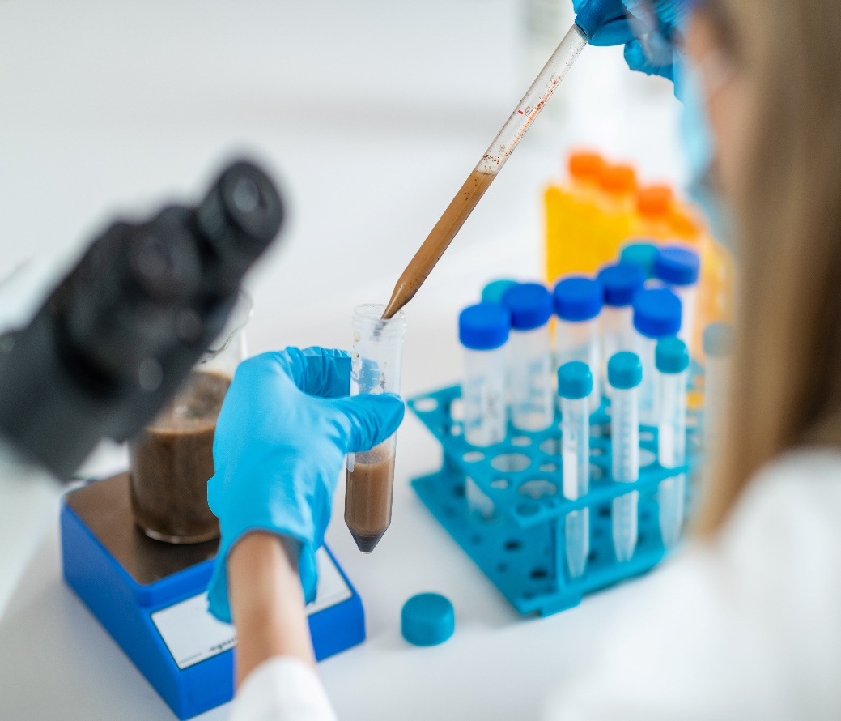
4. UNDERSTANDING
THE MICROBIOME
2) DIRECTION OF MICROBIOME RESEARCH
HISTORY AND DEVELOPMENT OF MICROBIOME RESEARCH
■ BEFORE 2000: CONSIDERED A SIMPLE ASSISTANT
- Research on gut microbes was once rare
- Mainly recognized as mere aids for digestion
- Little awareness of their direct connection to overall health
■ Early 2000s: NEW TECHNOLOGIES AND DISCOVERIES
- The emergence of NGS (Next-Generation Sequencing) technology
revolutionized microbial gene analysis.
- Completion of the human genome project (2003) revealed
the limitations of explaining disease through genes alone.

Slide 25
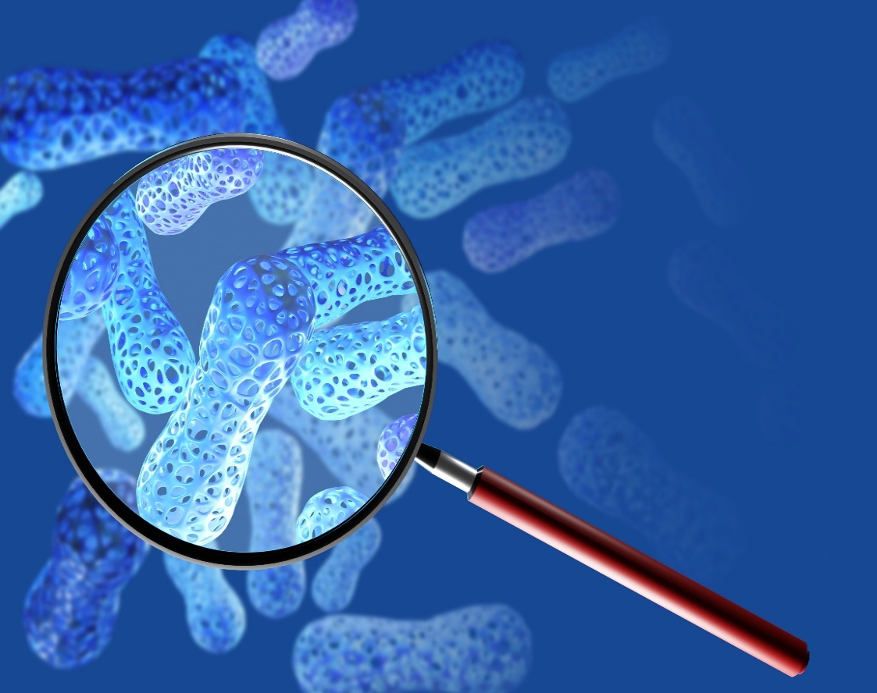
4. UNDERSTANDING
THE MICROBIOME
2) DIRECTION OF MICROBIOME RESEARCH
THE HISTORY AND DEVELOPMENT OF MICROBIOME RESEARCH
■ ADVANCEMENTS IN MICROBIOME RESEARCH
- Dr. Jeffrey Gordon: Unveiling the Link Between Gut Microbes and Human Health
- First to demonstrate the link between gut microbiota and obesity.
→ Discovery of differences in gut microbiota composition in individuals
with obesity.
■ EARLY 2000S: NEW TECHNOLOGIES AND DISCOVERIES
- The emergence of NGS (Next Generation Sequencing) technology
→ Innovation in microbial genetic analysis
- Completion of the Human Genome Project (2003)
→ Recognition of the limitations of explaining diseases using genes alone

Slide 26
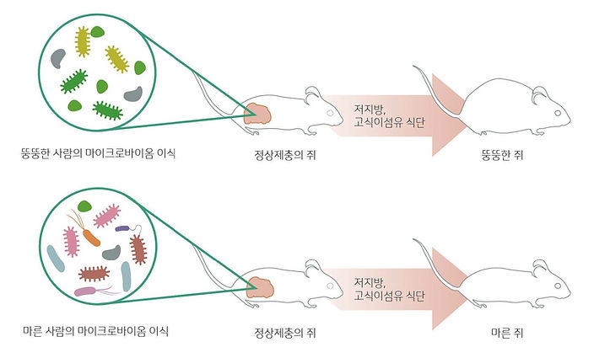
4. UNDERSTANDING
THE MICROBIOME
3) MICROBIOME RELATED PAPERS
DISCOVERING THE MICROBIOME THAT CAUSES OBESITY
ㅣ EXPERIMENTS ON LEAN VS OBESE MICEㅣ
∙ When fecal matter from obese and lean mice was transplanted
into germ-free mice, those that received the obese mouse
feces gained weight more quickly.
∙ A study revealed that the gut microbiome composition differs
between obese and lean individuals.
∙ Later, fecal transplants from obese and lean human twins into
germ-free mice showed that mice receiving the obese twin’s
microbiota gained fat more rapidly.
∙ Since then, extensive research has explored the correlation
between the microbiome and various diseases.
LOW-FAT,
HIGH-FIBER DIET
Transplanting
the Microbiome of an Obese Person
NORMAL MICE
OBESE MICE
LOW-FAT,
HIGH-FIBER DIET
Transplanting
the Microbiome of a Lean Person
NORMAL MICE
LEAN MICE
Source Ridaura et al. (2013), Science

Slide 27
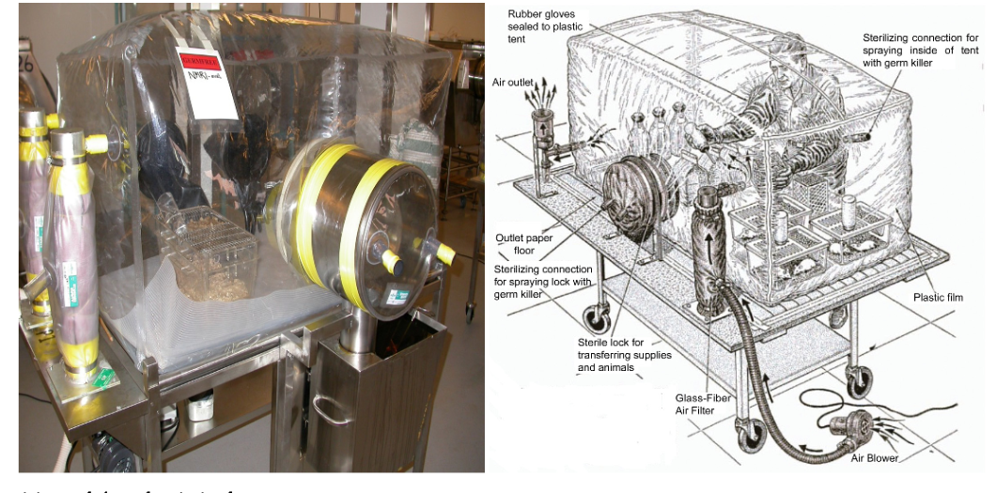
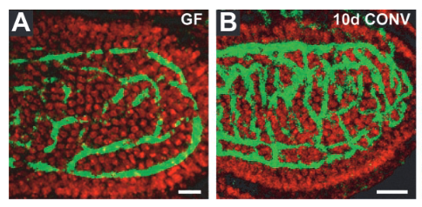
4. UNDERSTANDING
THE MICROBIOME
3) MICROBIOME RELATED PAPERS
RESEARCH RELATED TO GERM-FREE MICE ①
GERM-FREE MOUSE BLOOD VESSELS
NORMAL MOUSE BLOOD VESSELS
EQUIPMENT FOR CONDUCTING EXPERIMENTS ON MICE IN STERILE CONDITIONS
Mice with microbes in their gut had well-formed blood vessels, while germ-free mice had poorly formed blood vessels.
Source : Al-Asmakh & Fahad Zadjali(2015), Stappenbeck et al.(2002)

Slide 28
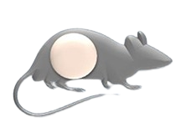
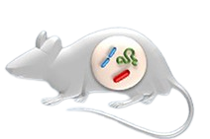
4. UNDERSTANDING
THE MICROBIOME
3) MICROBIOME RELATED SOCIETIES
RESEARCH RELATED TO GERM-FREE MICE ②
NORMAL MOUSE
GERM-FREE MICE
∙ Low body weight (nutritional deficiency)
∙ Liver and spleen underdeveloped
∙ Underdeveloped and underdeveloped
∙ Immunity (low antibody production)
∙ Underdeveloped brain
∙ Stress found (depression)
Source : Gabay et al. (2002)

Slide 29
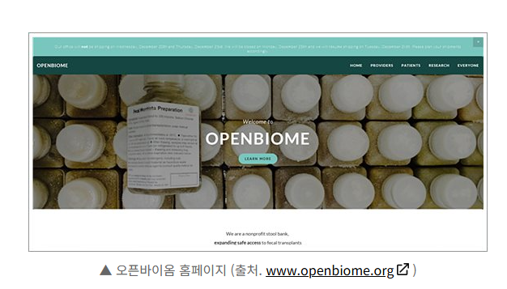
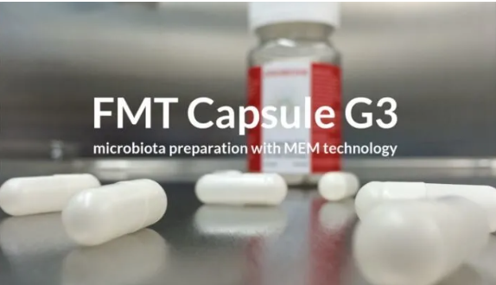
4. UNDERSTANDING
THE MICROBIOME
4) MICROBIOME RELATED INDUSTRIES
THE AGE OF TURNING STOOL AND MICROBES INTO MONEY
[ U.S. STOOL BANK, OPENBIOME ]
‘Donate Your Stool — Earn Money and Save Lives’
Founded in 2012 in Boston, the nonprofit organization OpenBiome offers $40 per donation of healthy stool. If you donate regularly, about three to four times a week, you could earn over 10 million KRW (roughly $7,500 USD) in a year.

Slide 30
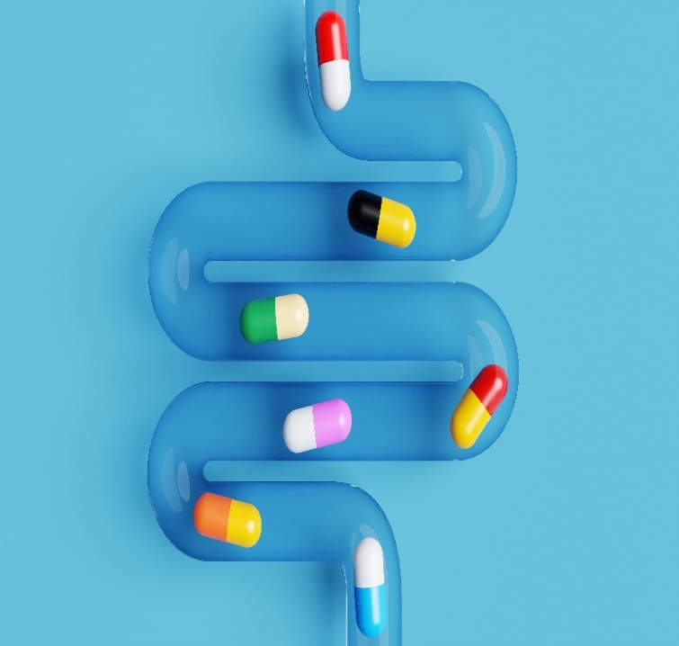
4. UNDERSTANDING
THE MICROBIOME
5) THE CHANGEABLE MICROBIOME
GENES ARE INHERITED — BUT YOUR MICROBIOME CAN BE CHANGED!
Comparing the microbiomes of healthy people and those with disease shows that they are different.
The microbiome can change or be changed after a two-week intervention!

Slide 31
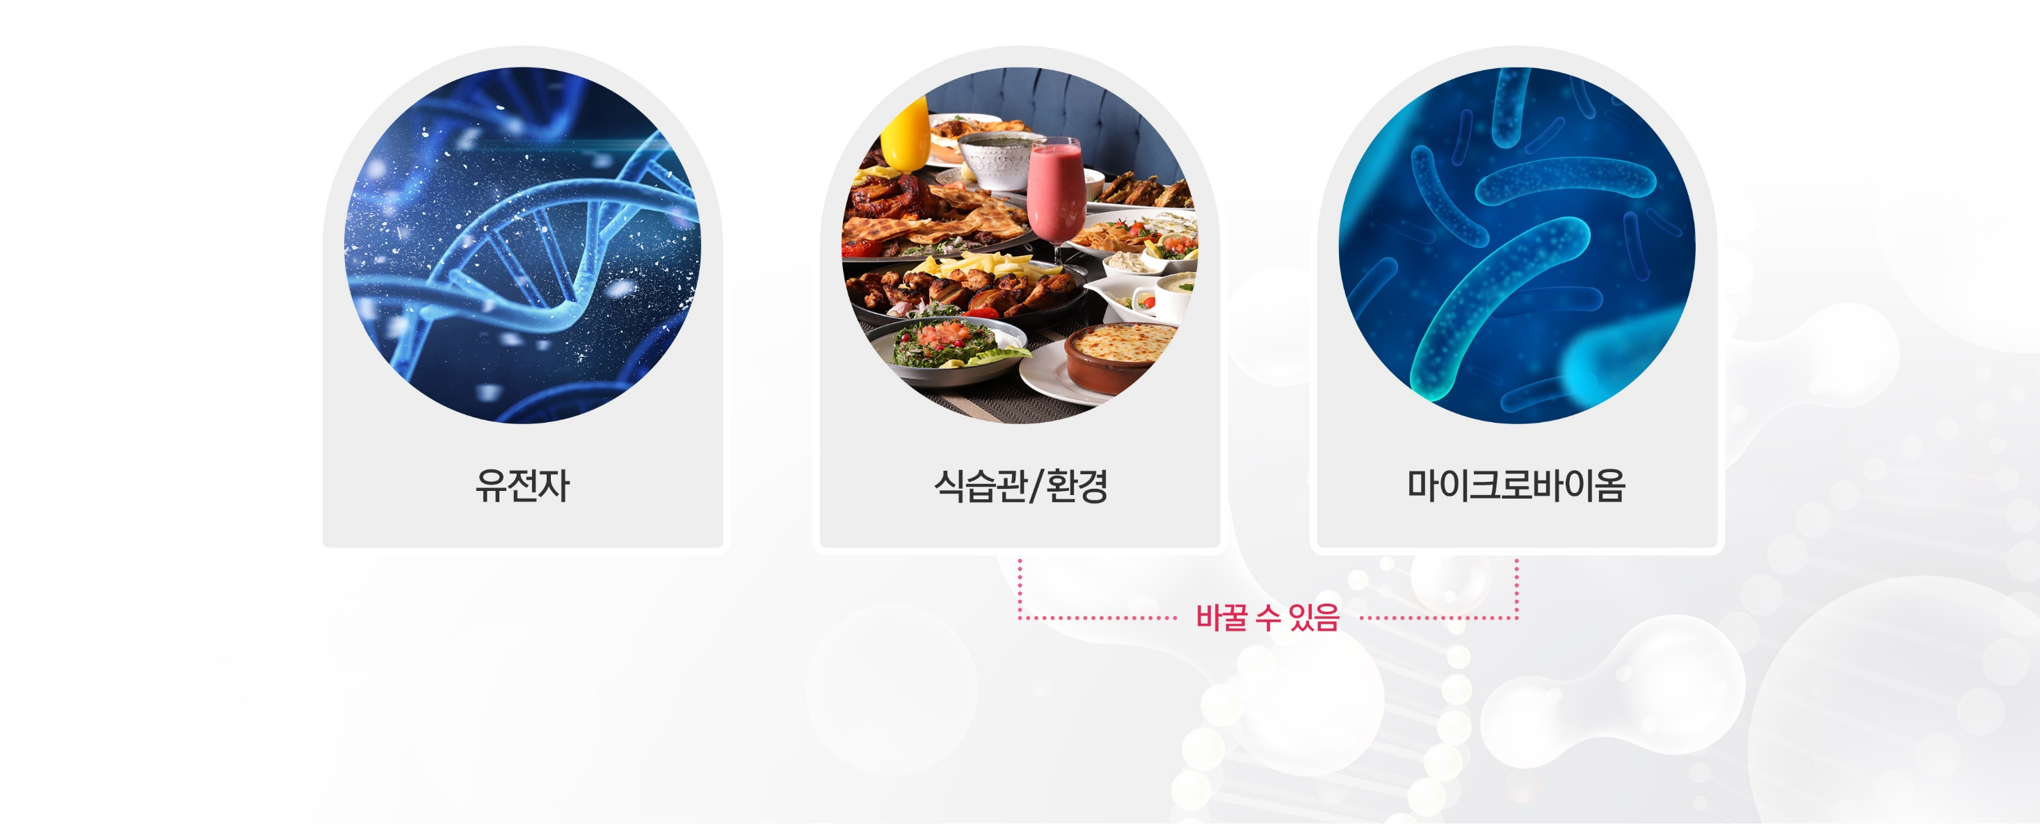
4. UNDERSTANDING
THE MICROBIOME
5) THE CHANGEABLE MICROBIOME
NOW THERE ARE 3 CAUSES OF DISEASE!
GENE
EATING HABITS/
ENVIRONMENT
MICROBIOME
Changable

Slide 32
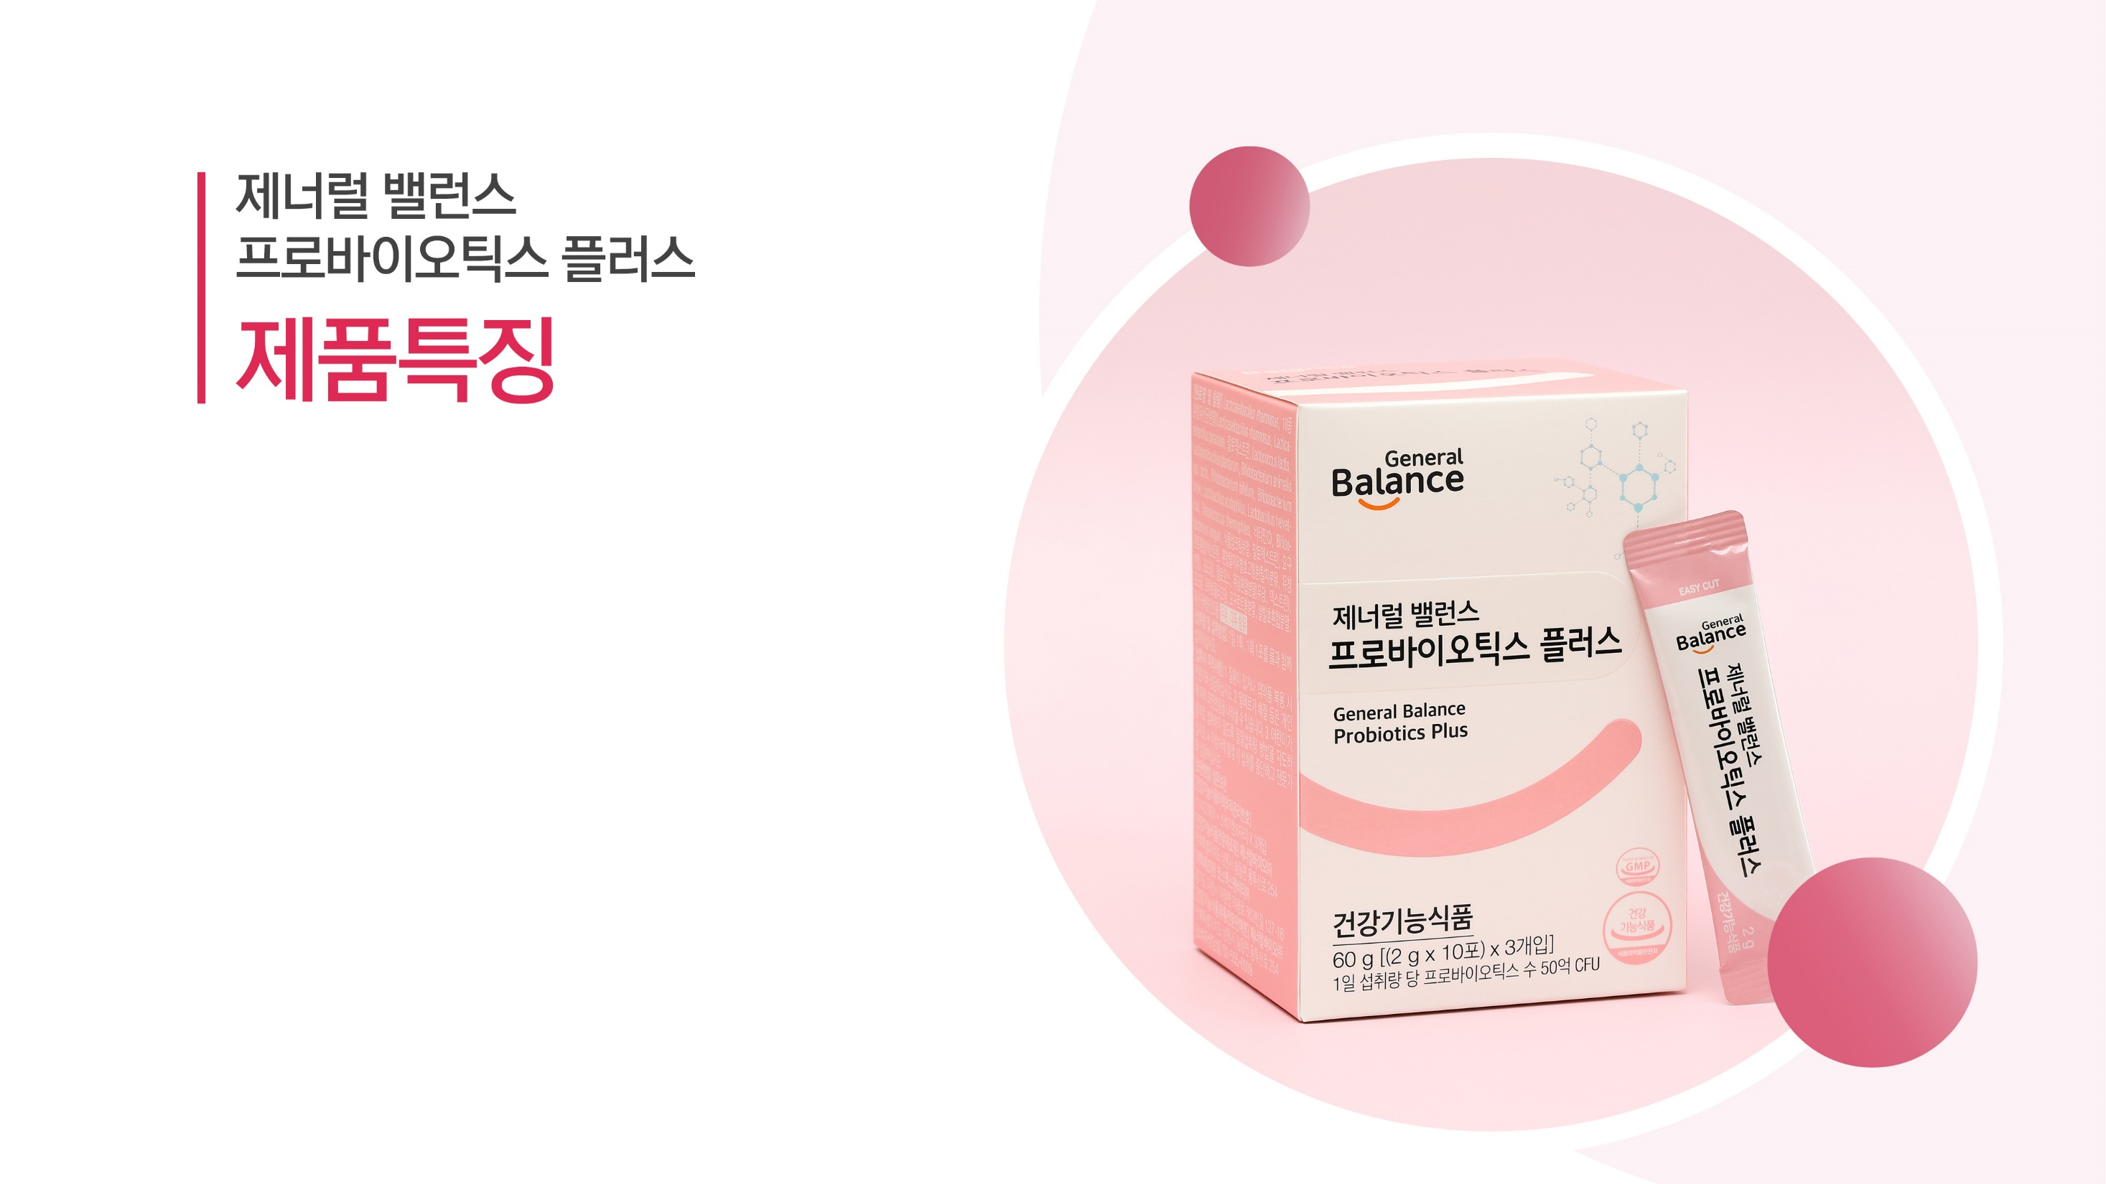
GENERAL BALANCE
PROBIOTICS PLUS
PRODUCT FEATURES

Slide 33
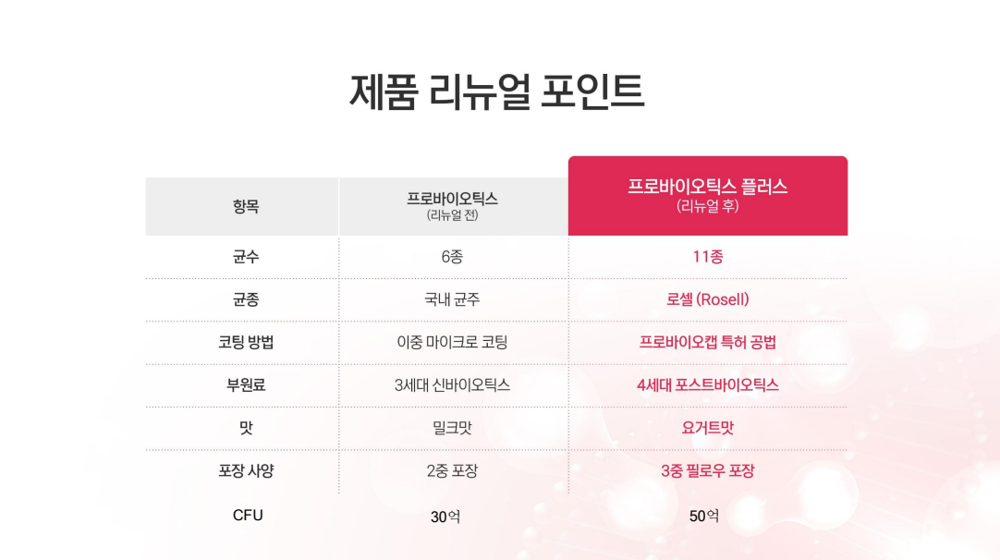
PRODUCT RENEWAL POINT
PROBIOTICS
(Before Renewal)
PROBIOTICS PLUS
(Renewal Ver.)
ITEM
NUMBER OF BACTERIA
6
11
TYPES OF
BACTERIA
Domestic strains
Rosell
COATING
METHOD
Double Micro Coating
Probiocap patented method
SUBSIDIARY
INGREDIENTS
3rd Generation Synbiotics
4th Gen. Post Biotics
FLAVOR
Milk
Yogurt
PACKAGING
Double Packing
Triple pillow packaging
CFU
3 billion
5 billion

Slide 34
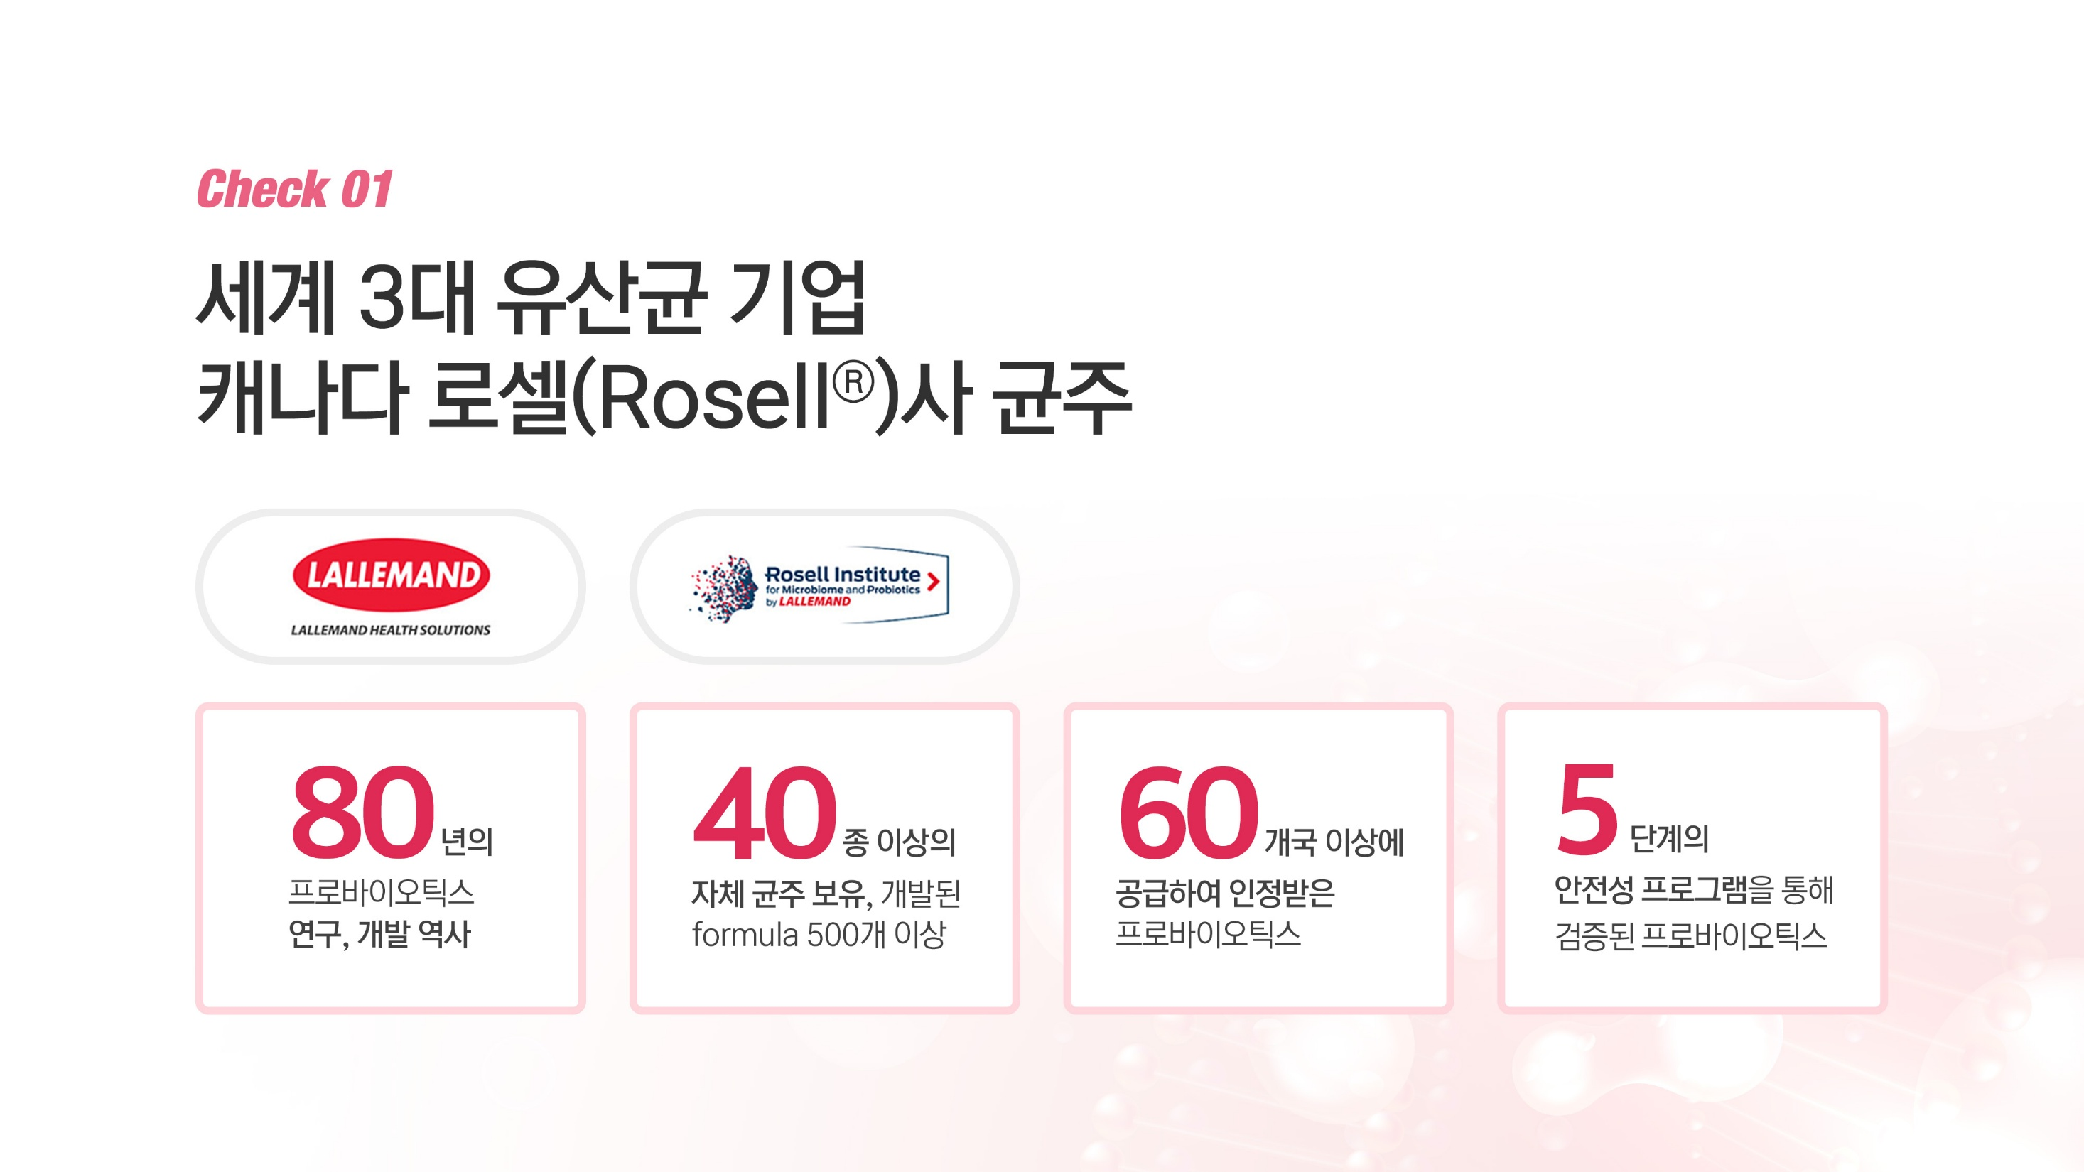
STRAIN FROM ROSELL,
ONE OF THE WORLD'S TOP THREE
LACTIC ACID BACTERIA COMPANIES, CANADA
80
40
Probiotics recognized and
supplied to over
countries.
Probiotics verified through
A step safety program
years of
probiotics research and
development history
We have over types of our own strains and over 500 developed formulas.
60
5

Slide 35
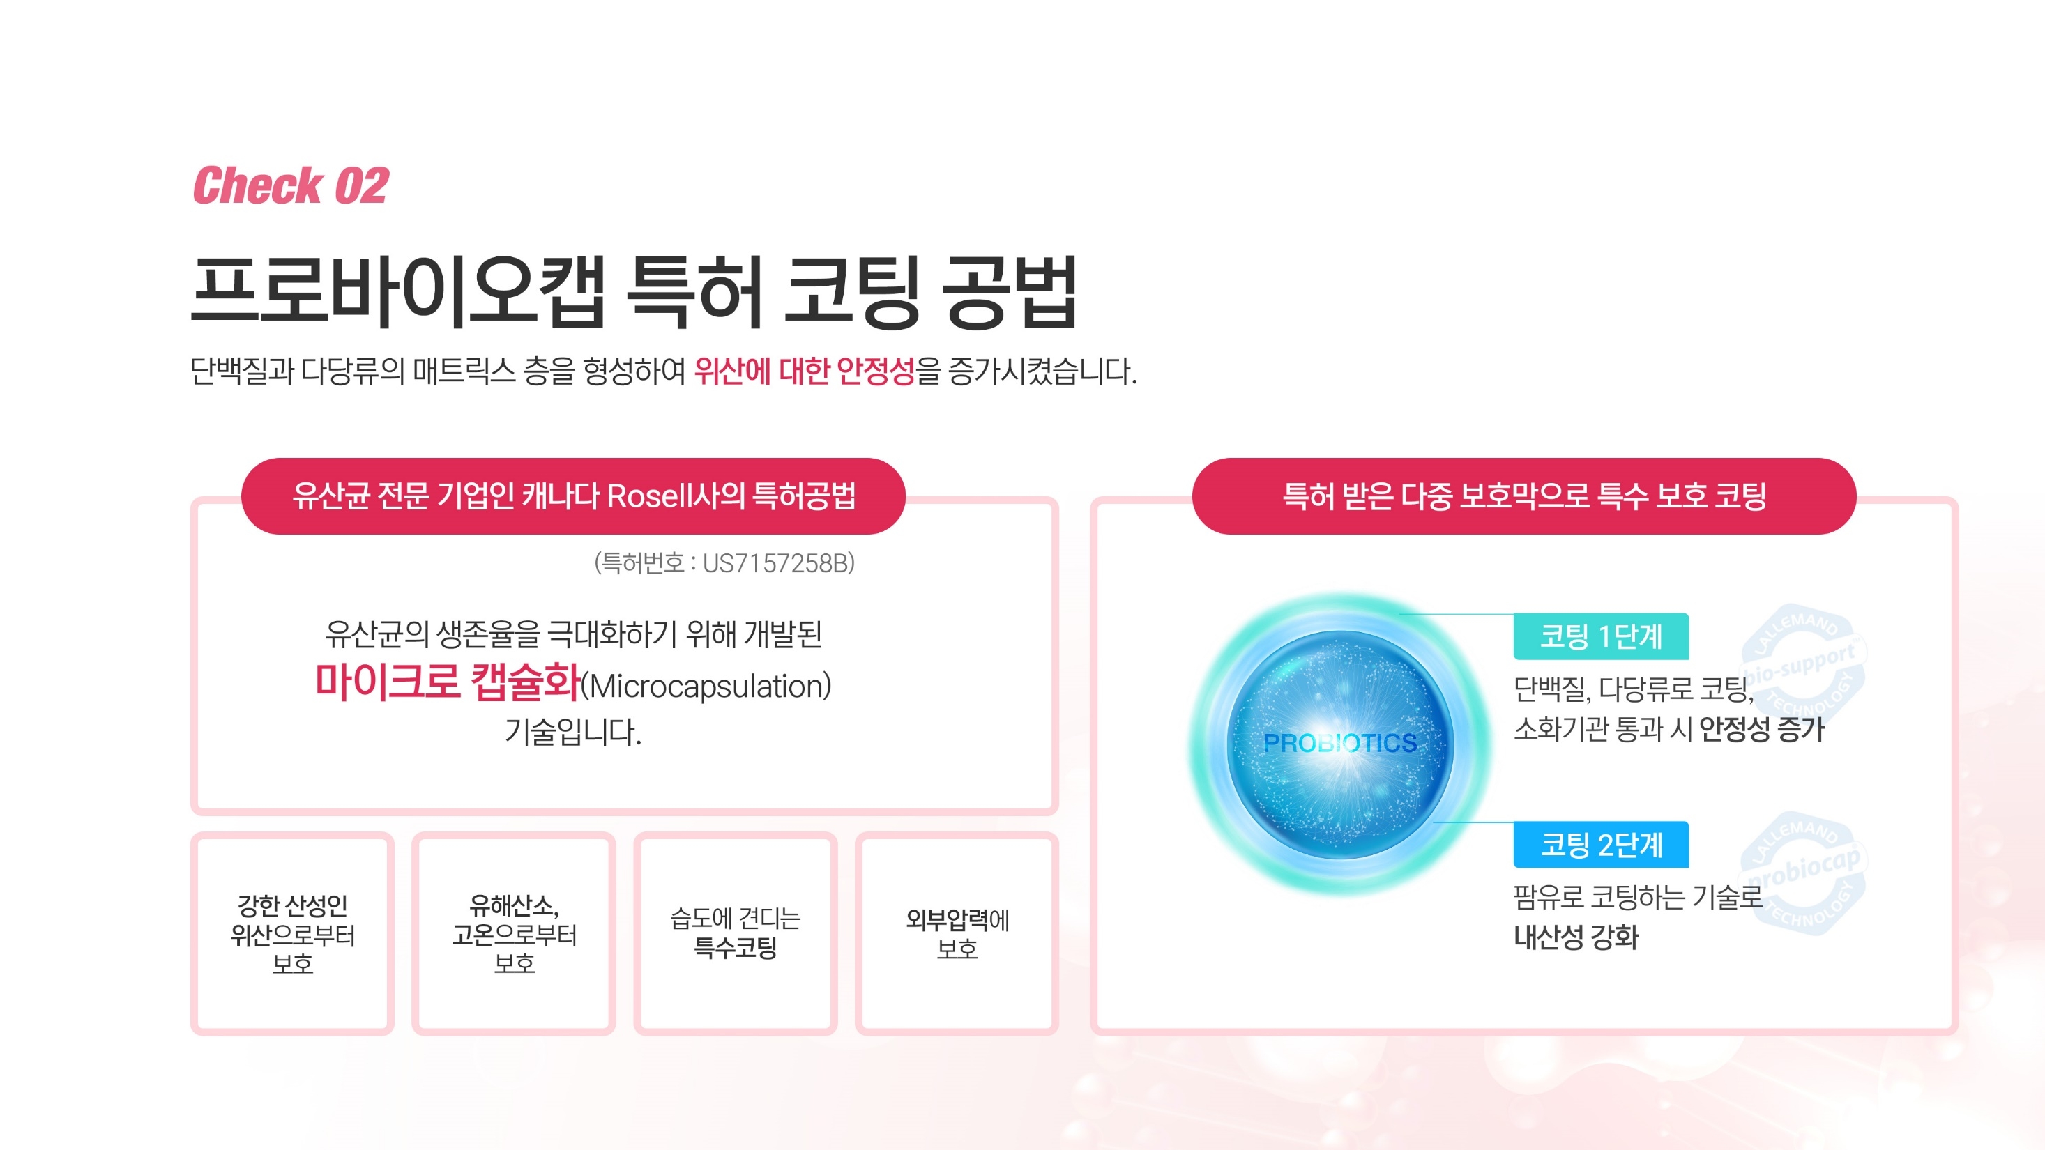
PROBIOCAP PATENTE COATING METHOD
It forms a matrix layer of proteins and polysaccharides to increase stability against gastric acid.
PATENTED METHOD OF ROSELL,
A CANADIAN COMPANY SPECIALIZING IN LACTIC ACID BACTERIA
SPECIAL PROTECTIVE COATING
WITH PATENTED MUSPECIAL PROTECTIVE COATING WITH PATENTED MULTI-LAYER PROTECTIONLTI-LAYER PROTECTION
PATENT
NO.
THIS IS A MICROENCAPSULATION TECHNOLOGY DEVELOPED TO MAXIMIZE THE SURVIVAL RATE OF LACTIC ACID BACTERIA.2.
COATING LEVEL 1.
COATING Coated with proteins and polysaccharides, increasing stability when passing through the digestive tract 2.
COATING LEVEL 2.
Protection from strong acidic
stomach acid
Protection from
harmful oxygen
and high
temperatures
Special coating to withstand humidity
Protection against external pressure
Enhanced acid resistance through palm oil coating technology
Notes:
ㅌ

Slide 36
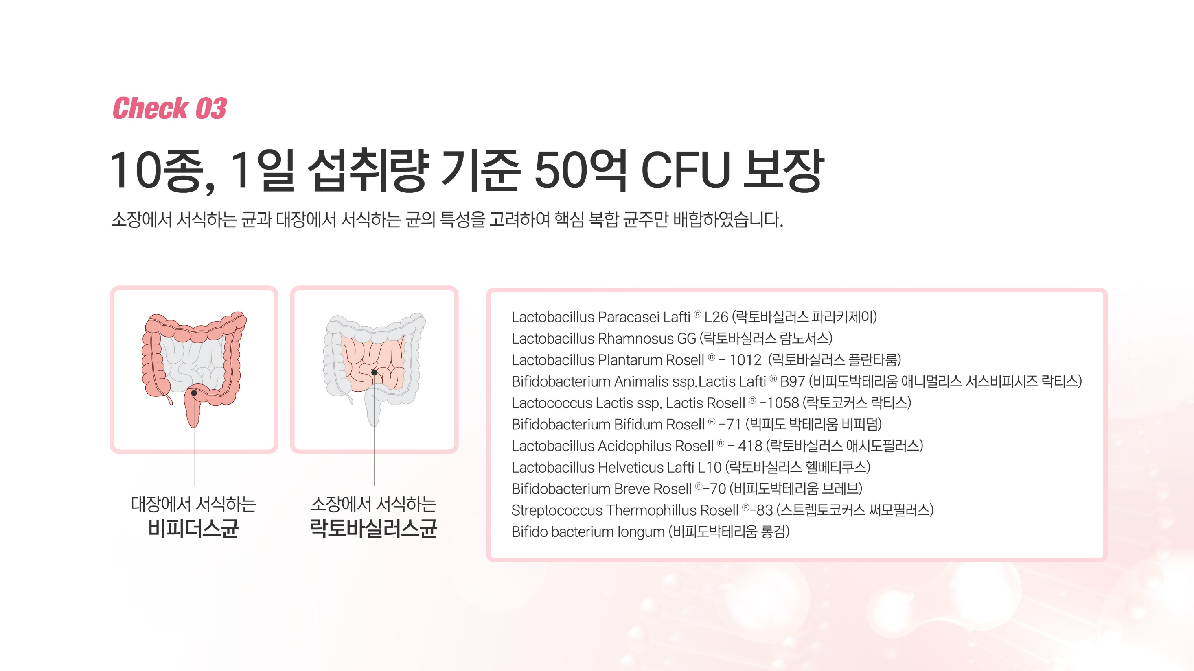


GUARANTEED 5 BILLION CFU PER DAY
We’ve carefully selected and combined only the key probiotic strains, taking into account the unique characteristics of those that reside in the small and large intestines.
BIFIDOBACTERIUM LIVING
IN THE LARGE INTESTINE
LACTOBACILLUS BACTERIA LIVING IN THE SMALL INTESTINE

Slide 37
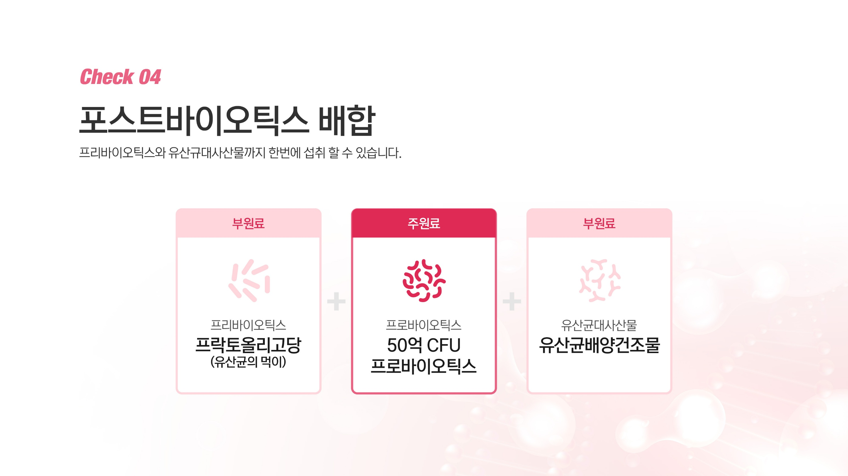
POSTBIOTICS FORMULATION
You can consume both prebiotics and lactic acid bacteria metabolites at the same time.
SECONDARY INGREDIENT
MAIN INGREDIENT
SECONDARY INGREDIENT
PREBIOTICS
FRUCTOOLIGOSACCHARIDES
(Food for
Lactic Acid Bacteria)
PROBIOTICS
5 billion CFU
PROBIOTICS
Lactic Acid Bacteria Metabolites
Lactic acid bacteria
culture dried product

Slide 38
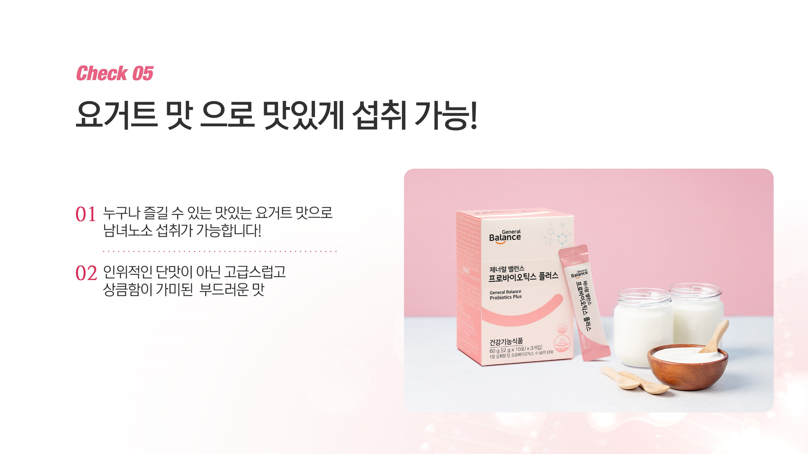
YOU CAN ENJOY IT DELICIOUSLY WITH YOGURT FLAVOR!
It has a delicious yogurt flavor that anyone can enjoy, so it can be consumed by people of all ages!
A soft taste with a luxurious and refreshing flavor, not an artificial dot flavor.

Slide 39
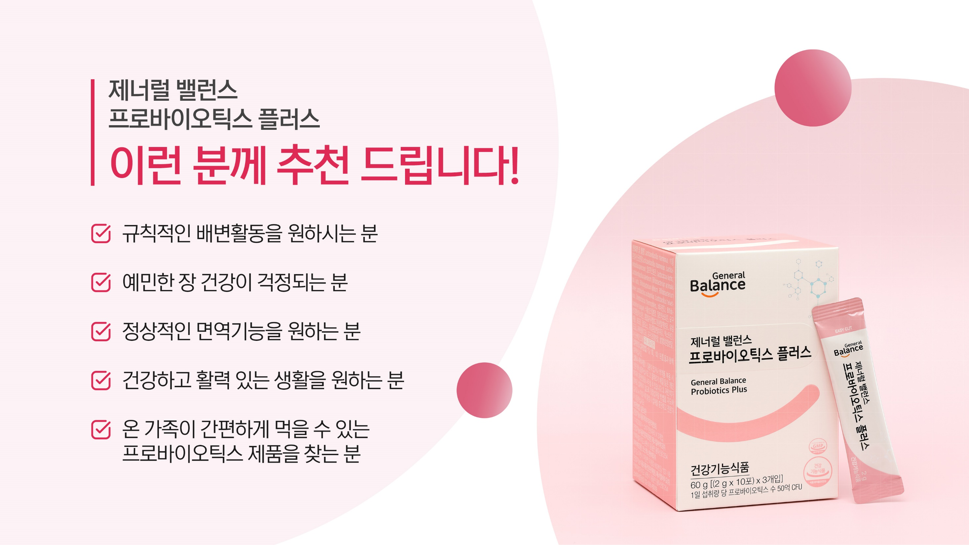
GENERAL BALANCE
PROBIOTICS PLUS
I recommend this to these people!
Those who want regular bowel movements
Those concerned about sensitive gut health
Those who want normal immune function
Those who want a healthy and energetic life
Those looking for a probiotic product
that the whole family can easily consume

Slide 40
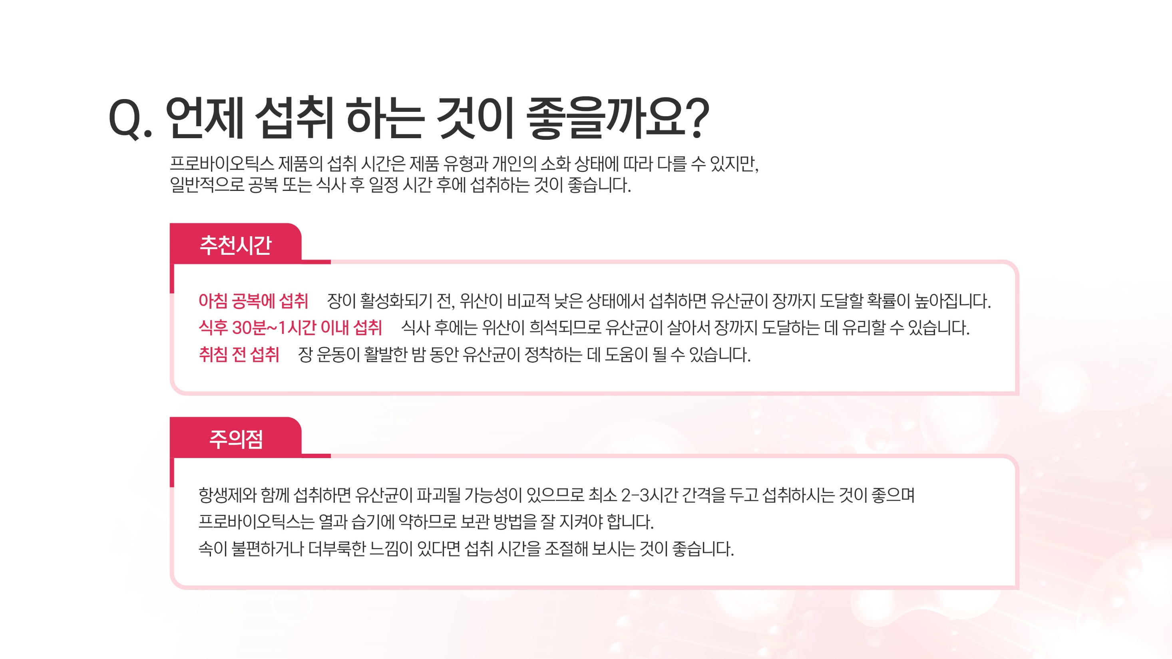
WHEN IS THE BEST TIME TO TAKE IT?
THE TIME OF INTAKE OF PROBIOTIC PRODUCTS MAY VARY DEPENDING ON THE TYPE OF PRODUCT AND THE INDIVIDUAL'S DIGESTIVE CONDITION, BUT IT IS GENERALLY RECOMMENDED
TO TAKE THEM ON AN EMPTY STOMACH OR A CERTAIN AMOUNT OF TIME AFTER A MEAL.
RECOMMENDED TIME
TAKE ON AN EMPTY STOMACH IN THE MORNING
Taking it before digestion starts helps more probiotics reach your gut.
TAKE WITHIN 30 MINUTES TO 1 HOUR AFTER A MEAL
After eating, diluted acid may help probiotics survive to reach the gut.
TAKE BEFORE BEDTIME
At night, active bowels may help probiotics settle.
NOTE
To protect probiotics, take them 2–3 hours apart from lactic acid bacteria, store them properly away from heat and moisture, and adjust intake time if you feel discomfort or bloating.

