Slide 1

TERA Patch
Standard Education

Slide 2
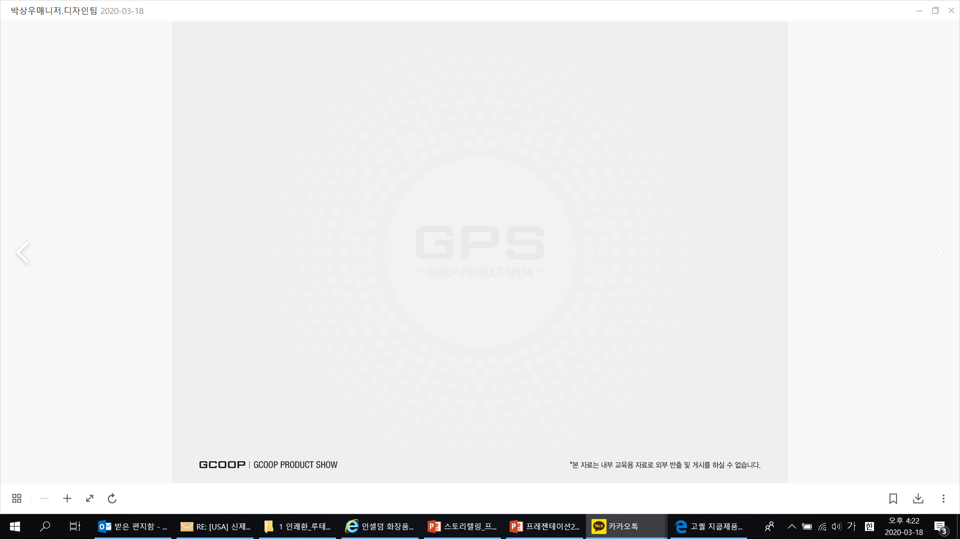
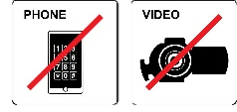
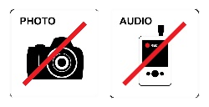
Laws on Exaggerated Advertising
탄력
In accordance with advertising laws, we strive to foster a sound advertising culture and prevent consumer harm caused by exaggerated claims. Please refer to the related laws below and cooperate to avoid any false or misleading advertising
1. False or exaggerated claims about product name, manufacturing method, performance, efficacy, or principles of operation.
2. Advertising unapproved or unregistered products under Article 6(2) or Article 15(2) of the Medical Device Act.
3. Denying all side effects or overly emphasizing safety.
4. Citing false clinical results, test data, academic papers, or claiming unverified patent certifications.
5. Implying that doctors, dentists, oriental medicine doctors, or veterinarians guarantee the product’s effects.
6. Misleading claims that medical professionals or professors recommend, approve, or use the product (except in cases officially designated by the government for public health).
7. Advertising that could mislead consumers into thinking a domestic product is foreign or vice versa.
8. Using user testimonials, appreciation letters, or phrases suggesting a rush of purchases.
9. Using absolute terms such as “guaranteed,” “best,” or “top.”
10. Creating confusion that the product is something other than a medical device.
11. Mentioning specific medical institutions, departments, or contact details to imply endorsement.
12. Using images, articles, or designs that imply performance or efficacy.
13. Displaying before-and-after comparisons that imply specific results.
14. Disparaging or implying criticism of other products.
15. Using content that suggests abortion or contains obscene materials.
16. Depicting threatening symptoms or surgical scenes related to the product’s use or claimed benefits.
[Excerpts from Relevant Laws] Medical Device Enforcement Regulations, Article 45 (Scope of Advertising) *Amended July 29, 2015*
This material is for internal training purposes only and cannot be taken out or posted externally.

Slide 3
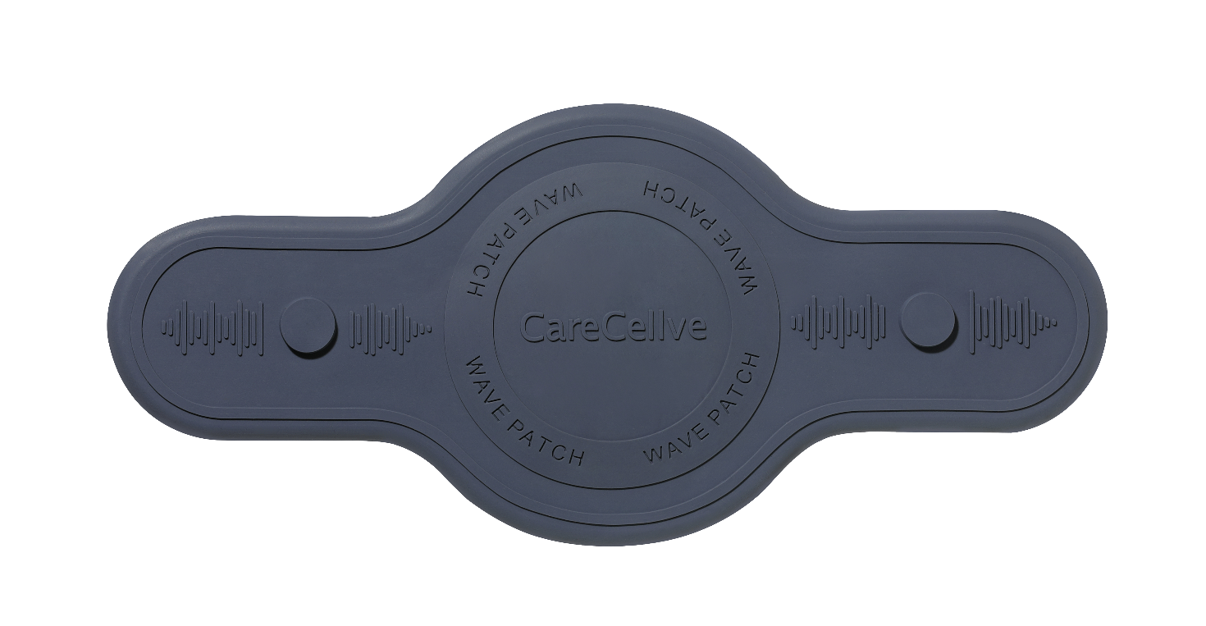
CareCellve TERA Patch
Development Background
Product Information
Product Points
Recommended Target
How to Use and Manage
Precautions (Usage Restrictions)
This material is for internal training purposes only and cannot be taken out or posted externally.

Slide 4
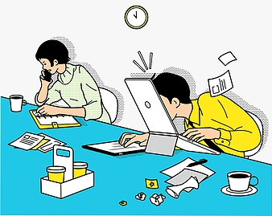
Development Background
In the age of the <every-second-counts> modern lifestyle, physical stillness prevails, and circulation declines
Modern people spend long hours sitting.
Physical activity decreases while stress and fatigue build up.
However, there is a lack of time and effective methods to relieve this.
Consequences of insufficient exercise and poor posture include:
Reduced blood flow,,Muscle stiffness, Cold sensations,
Pain that disrupts systemic flow.
The body feels heavy and cold, negatively affecting immunity and vitality.
Can lead to VDT (Visual Display Terminal) syndrome.
*This content is for scientific reference and informational purposes only. It does not guarantee the product's efficacy or effects.
This material is for internal training purposes only and cannot be taken out or posted externally.

Slide 5
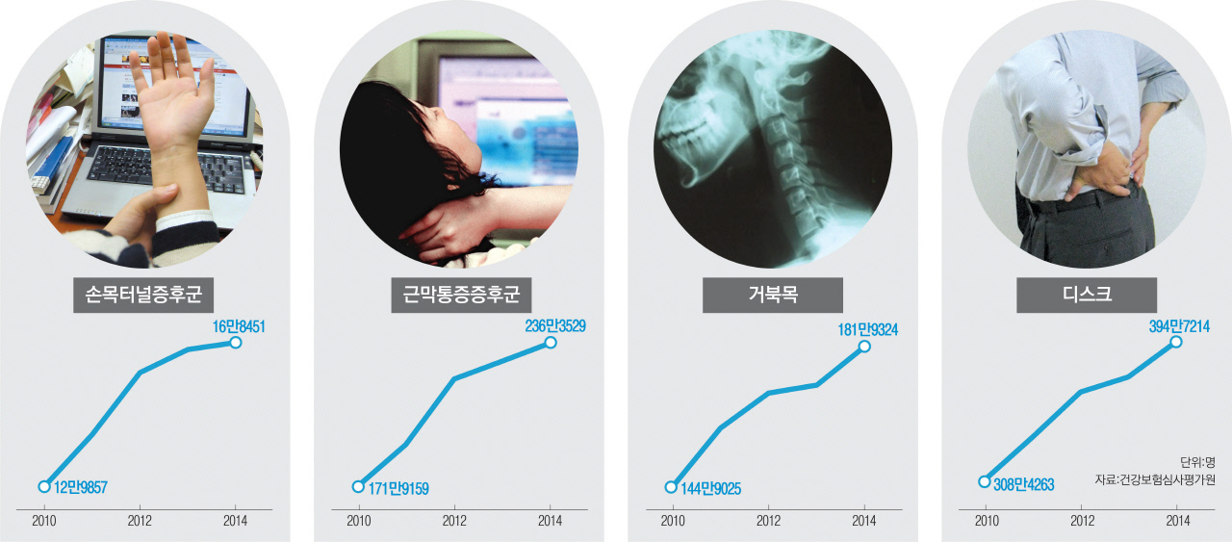
Development Background
What is VDT Syndrome Commonly Experienced by Office Workers and Middle-aged Adults?
*VDT (Visual Display Terminal) Syndrome refers to a series of symptoms caused by prolonged use of computers, smartphones, and other smart devices.
<VDT Syndrome Patients Surge by 48 Million in 5 Years, Medical Expenses Exceed 7 Trillion Won>
Rep. In Jae-geun (New Politics Alliance for Democracy) of the National Assembly Health and Welfare Committee analyzed data submitted by the Health Insurance Review and Assessment Service on the 6th, and revealed that 47.86 million patients were treated for diseases related to VDT syndrome, such as myofascial pain syndrome, carpal tunnel syndrome, disc, turtle neck, and dry eye syndrome, between 2010 and 2014, and the medical expenses amounted to 7.6 trillion won.
Patients with carpal tunnel syndrome, which is particularly related to computer use, increased by 29.7% from 129,857 in 2010 to 168,451 in 2014. Patients with turtle neck, which causes the cervical spine to deform due to long-term head bending, also increased by 25.6% from 1,449,025 to 1,819,324 during this period.
Medical expenses are also skyrocketing along with the increase in patients. The cost of turtle neck treatment increased by 42% from approximately KRW 196 billion in 2010 to KRW 278 billion last year, the cost of disc herniation increased by 30.7% from KRW 959 billion to KRW 1.253 trillion, and the cost of carpal tunnel syndrome increased by nearly three times from approximately KRW 13 billion to KRW 38 billion. The tendency of computer and smartphone use to cause diseases is also confirmed in other statistics. According to statistics from the National Health Insurance Corporation, the number of patients with cervical disc herniation in their 20s increased by 14.5% in 2011 compared to 2010, while the number of patients with cervical disc herniation in their teens increased by 13.3% and the number of patients with cervical disc herniation in their 30s increased by 12.7%. It is interpreted that the number of patients with cervical disc herniation increased in 2010 as smartphones became popular and the number of users increased rapidly.
*출처: 경향신문
→ Stagnation of body circulation, muscle tension, and decreased heat circulation lead to a decline in overall body vitality and condition.
*해당 내용은 과학적 연구 및 일반적인 정보 전달을 위한 것이며 제품의 효능이나 효과를 단정짓는 것은 아닙니다.
*This content is for scientific reference and informational purposes only. It does not guarantee the product's efficacy or effects.
This material is for internal training purposes only and cannot be taken out or posted externally.

Slide 6

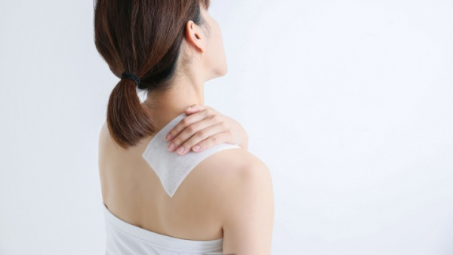
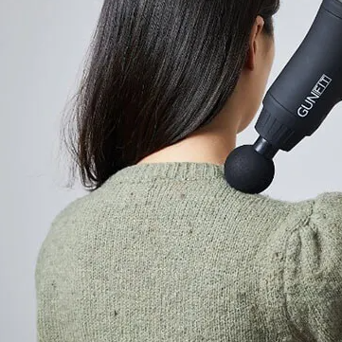
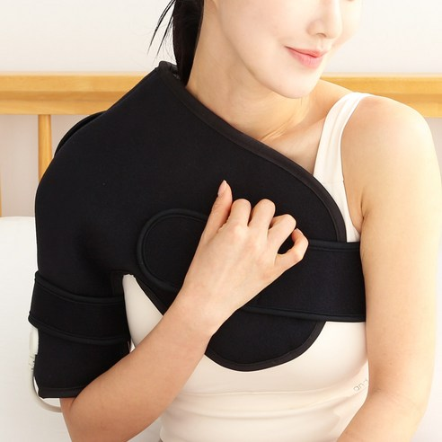
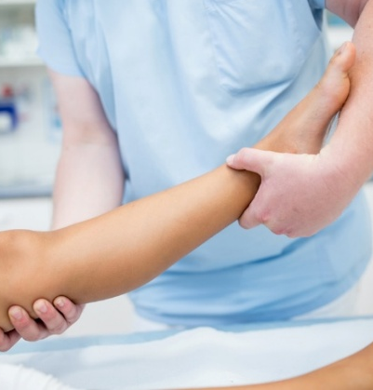
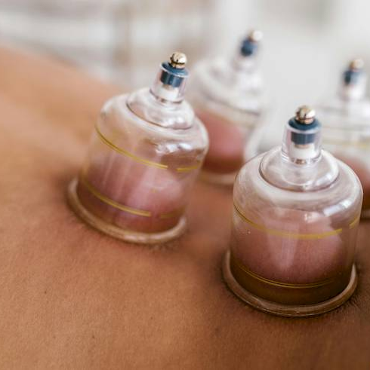
Development Background
When the body feels heavy or congested, people try various solutions.
Various choices modern people make to restore circulation.
Stretching
Paste, Hot pack
Massage gun
Steamer
Physical therapy, manual therapy
Oriental medicine (moxibustion, cupping)
However, most options are temporary or difficult to repeat regularly.
Sustainable self-care remains a challenge for many.
*해당 내용은 과학적 연구 및 일반적인 정보 전달을 위한 것이며 제품의 효능이나 효과를 단정짓는 것은 아닙니다.
*This content is for scientific reference and informational purposes only. It does not guarantee the product's efficacy or effects.
This material is for internal training purposes only and cannot be taken out or posted externally.

Slide 7
Feels like it's not a one-time thing, but can be used repeatedly, and has a non-irritating feel.
Wellness care that starts the moment you attach it without complicated explanations
CareCellve TERA Patch
Product Introduction

Slide 8
Product Information
  Product Name: CareCellve TERA Patch
  Manufacturer name : Generalbio Co.,LTD.
  FDA : Class 1
  * Korean medical device class 2 (25-4476)
  Medical Magnetic Generator
  4. Purpose of use: A device used to relieve muscle pain by using the magnetic field of a permanent magnet.
  5. Country of Origin: Republic of Korea
*해당 내용은 과학적 연구 및 일반적인 정보 전달을 위한 것이며 제품의 효능이나 효과를 단정짓는 것은 아닙니다.
*This content is for scientific reference and informational purposes only. It does not guarantee the product's efficacy or effects.
This material is for internal training purposes only and cannot be taken out or posted externally.

Slide 9

Product Points
A New Solution for Pain Relief
True wellness care begins the moment you apply it.
Point 1
‘Recovery routine’ created by science Bio Terra energy works deep into the body
Point 2
Can be used consistently for a semi-permanent period (approximately 200 times for 30 minutes each time)
*There may be individual differences. Avoid using for more than 30 minutes.
Point 3
Medical Device Class 1 Silicone Patch to Help Alleviate Pain and Circulation Related Symptoms
*해당 내용은 과학적 연구 및 일반적인 정보 전달을 위한 것이며 제품의 효능이나 효과를 단정짓는 것은 아닙니다.
*This content is for scientific reference and informational purposes only. It does not guarantee the product's efficacy or effects.
This material is for internal training purposes only and cannot be taken out or posted externally.

Slide 10


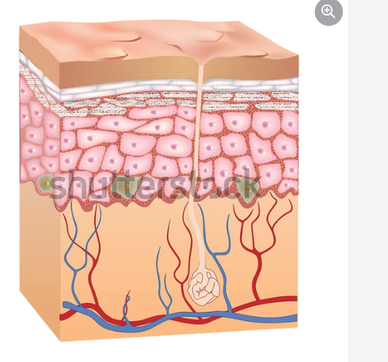
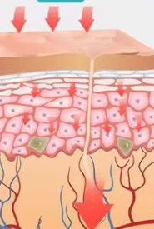
Product Points
Point 1
‘Recovery routine’ created by science Bio Terra Energy works deep into the body
Magnetic fields reach deep into the tissues to reduce inflammation and swelling, and gently stimulate tight muscles to relieve pain.
Terahertz waves penetrate deep into the body's tissues and help regulate the flow of energy in the body.
[Epidermis]
Heat Penetration
[Dermis]
Deep penetration
The fusion of Herbal extracts and cutting-edge technology generates a strong magnetic force of 1800 Gauss of neodymium (permanent magnet) to help relieve muscle pain quickly.
[Subcutaneous tissue]
Targeted pain relief
*해당 내용은 과학적 연구 및 일반적인 정보 전달을 위한 것이며 제품의 효능이나 효과를 단정짓는 것은 아닙니다.
*This content is for scientific reference and informational purposes only. It does not guarantee the product's efficacy or effects.
This material is for internal training purposes only and cannot be taken out or posted externally.

Slide 11
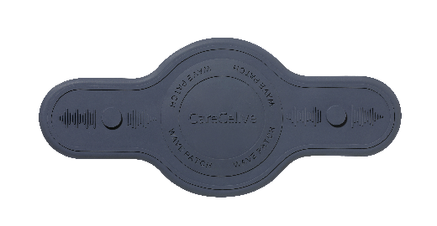

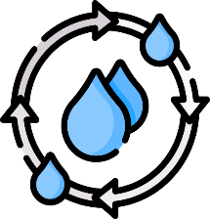

Product Points
Point 2
Semi-permanent use (Approximately 200 uses within 30 minutes per use) enables long-term application.
①
Attach TeraPatch
Can be washed and reused after each use, making it economical and supporting a consistent wellness routine.
Soft and elastic silicone material adheres gently to the skin
Comfortable fit that adheres without lifting even when moving
Even sensitive skin can use it safely without worrying about skin allergies
Economical because it can be hygienically reused after washing (approximately 200 times)
②
Use within 30 minutes per use
③
Wash with water, use with wet tissue
*There may be individual differences. Avoid using for more than 30 minutes.
*해당 내용은 과학적 연구 및 일반적인 정보 전달을 위한 것이며 제품의 효능이나 효과를 단정짓는 것은 아닙니다.
*This content is for scientific reference and informational purposes only. It does not guarantee the product's efficacy or effects.
This material is for internal training purposes only and cannot be taken out or posted externally.

Slide 12
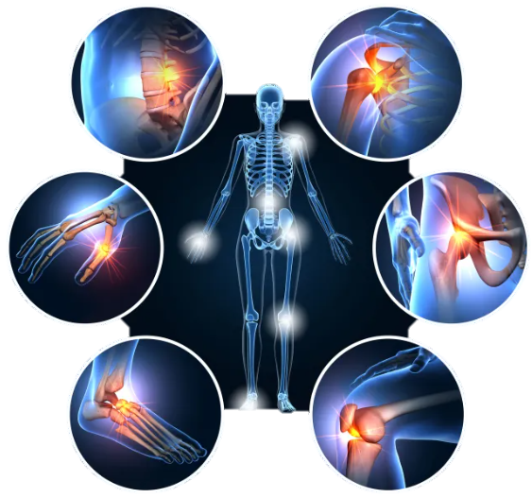
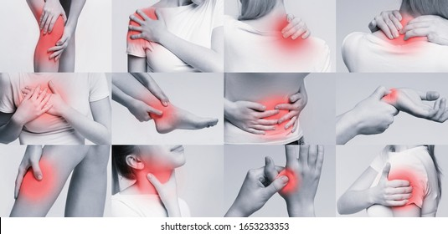
Product Points
Point 3
Medical Device Class 1 Silicone Patch to Help Alleviate Pain and Circulation Related Symptoms
A warm feeling that occurs immediately just by attaching it, providing scientific safety and natural care
TeraPatch is not a product that simply transmits heat, but has obtained a Korean Class 2 medical device certification for the purpose of ‘pain relief and improved blood circulation.’
It is not intended to cure disease, but is suitable for safe and sustained relief of pain and circulation problems that occur in everyday life.
A new wellness care method that gently stimulates the body's flow by simply attaching it without any chemical or electricity, combining terahertz energy and Herbal extracts ingredients.
*해당 내용은 과학적 연구 및 일반적인 정보 전달을 위한 것이며 제품의 효능이나 효과를 단정짓는 것은 아닙니다.
*This content is for scientific reference and informational purposes only. It does not guarantee the product's efficacy or effects.
This material is for internal training purposes only and cannot be taken out or posted externally.

Slide 13
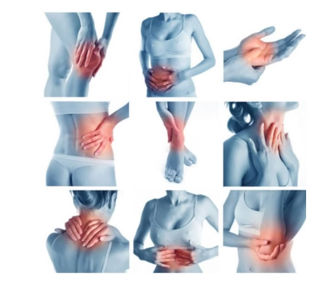
Recommended Target
People who are concerned about chronic muscle pain (back, shoulders, neck, etc.).
People who experience muscle pain and stiffness after exercise.
People who are concerned about swelling
People who experience tingling or redness and itchiness after applying the patch.
People who are looking for a safe silicone thermal patch product that does not fall off even when moving.
*This content is for scientific reference and informational purposes only. It does not guarantee the product's efficacy or effects.
This material is for internal training purposes only and cannot be taken out or posted externally.

Slide 14






How to Use and Manage
How to use
1
2
3
4
5
6
Please read the user manual thoroughly before use.
Please check if there is any foreign matter on the patch and remove it.
Clean and dry the attachment area.
Please attach the patch so that the center of the patch is on the painful area.
Press the adhesive
part to secure it firmly.
It is recommended to use it for about
30 minutes at a time. (Up to 3 times a day)
*There may be individual differences. Avoid using for more than 30 minutes.
Storage method
※ When storing the product before use, do not store it together with magnetic products or electronic products.
※ Store at room temperature, avoiding moisture and direct sunlight
※This product is a consumable product.
*This content is for scientific reference and informational purposes only. It does not guarantee the product's efficacy or effects.
This material is for internal training purposes only and cannot be taken out or posted externally.

Slide 15

Precautions (Usage Restrictions)
Precautions
for use
▶ The period of use of the patch may vary depending on the skin condition, so it is recommended to use it according to the individual.
▶ People with implantable medical electronic devices, especially pacemakers (e.g., pacemakers), are prohibited from using it.
▶ Keep watches, magnetic cards, etc. that are affected by magnetism away from the product.
▶ In the following cases, be sure to consult a doctor before using the product.(patients with acute diseases, patients with malignant tumors, patients with a fever of 38 degrees or higher, patients with abnormal blood pressure, etc.)
▶ If allergic symptoms such as rash, hives, or itchiness appear when attaching the product, stop using it immediately and consult a doctor.
▶ Pregnant or lactating women are not recommended to use it.
▶ Be sure to wash your hands after applying the patch.
Never touch your eyes with unwashed hands or with hands that have touched the patch surface after applying the patch.
*This content is for scientific reference and informational purposes only. It does not guarantee the product's efficacy or effects.
This material is for internal training purposes only and cannot be taken out or posted externally.

